Slide 1
SLA-guided data integration on cloud environments
N. Benani, C. Ghedira, M. Musicante, G. Vargas-Solar
Univ. Lyon, CNRS INSA-Lyon, LIRIS, France
Magellan, IAE, Univ. J-Moulin Lyon 3, France
DiMAP, UFRN, Brazil
CNRS, LIG-LAFMIA, France

Slide 2



Self sustainable Smart CitY
Preferences:
<proximity, TaF, av, max $-h/watt>
Energy
Producer
Energy
Consumer
< av, TaF,
<$/Kwatt, [t1,t2]>
>
Energy “stock” exchange
Guide energy stock exchange mechanism that enables a timely and costly provision of energy from consumers and producers located in a given region (e.g., the same city)
Choose producers according to their agreed SLA
Determine whether found providers fulfil energy requirements according to given consumer preferences

Slide 3
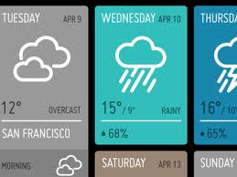



Self sustainable Smart CitY
List of providers that can provision 1000 Kwatts/h, in the next 10 seconds, that are close to my city with a cost of 0,50 euros/Kwatt?
Which are the providers with the highest energy availability in the next three hours with 1-TaF, 10 Km from my location ?
Energy
Producer
Energy
Consumer
Data services
Energy “stock” exchange
Which are the rooms of my house with the highest average consumption when the external temperature is lower than -5 degrees or greater than 30 degrees?
Meteorology
Location
Maps

Slide 4
objectives
Propose an SLA guided continuous data integration and provision system as a DaaS
Integrated SLA computation out of the Data agreed SLA
Optimized and adaptable data collection, query rewriting and integration according to user preferences
Learning based data integration mechanisms
Notes:
Objetivo general
Proponer una herramienta de ayuda a la toma de decisiones para componer servicios de procesamiento de datos adaptados a contratos de preferencias (Service Level Agreement).
Aplicar la solución al contexto de Smart Grid en particular al tratamiento de datos asociados a la optimización del consumo de energía en las casas habitación.
Objetivos específicos:
Estudiar los diferentes modelos map reduce y probar sus implementaciones en particular Hadoop y Dryad;
Hacer un estado del arte de operadores de procesamiento de datos definidos usando modelos map-reduce
Implementación de operadores bajo modelos map-reduce en una plataforma cloud
Proponer estrategias de evaluación de consumo de recursos de los operadores analizados dentro del marco de un escenario Smart Grid

Slide 5
Roadmap
New challenges of data integration in the era of the clouds
SLA guided data integration as a service
SLA model
Continuous query evaluation process
Conclusions and perspectives

Slide 6




Sla guided data integration service
Agreed
SLA
Data
providers
Cached Data
Meta
Agreed SLA
Metadata
Decision Making
Integrated SLA
IaaS
Agreed
SLA
SaaS
Agreed
SLA
PaaS
Monitoring (Data + Conditions)
Service
providers
Rewriting
SLA
Rewriting
Integration

Slide 7
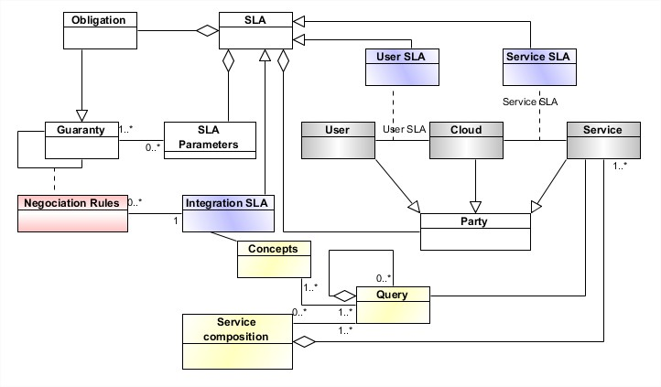

Deriving SLA

Slide 8
Query rewriting
We begin with an abstract query, (to services / databases) and including non-functional (Quality?, SLA?) conditions.
Which are the providers with the highest energy availability in the next three hours with 1-TaF, 10 Km from my location ?
Need to transform this query into several concrete queries (eventually, adding new SLA).
Lookup and iterate over local hubs:
- Check energy availability from energy providers reporting to this hub.
|| including cached data.
- Sumarise the results.
Using information about each available hub node. Lookup must verify agreed conditions. Iteration stops once results are satisfactory.
Notes:
The metering dashboard service is invoked with data of the specific node (nodeId) that sets the location and can be of type inHouseMasterNode, BlockNode, quarterNode or cityCentralNode. It also receives a) the user role type, which according to their profile will determine the aggregation level; and b) the selected graphic type. The output of this service is the GraphicFlowFunction, which is a data stream to graphically represent the aggregated energy consumption during a specified time window.

Slide 9
Roadmap
New challenges of data integration in the era of the clouds
SLA guided data integration as a service
SLA model
Continuous query evaluation process
Conclusions and perspectives

