Slide 1
Smart city scenario
Nadia benani, Chirine ghedira, genoveva vargas-Solar
Martin musicante, david sol

Slide 2
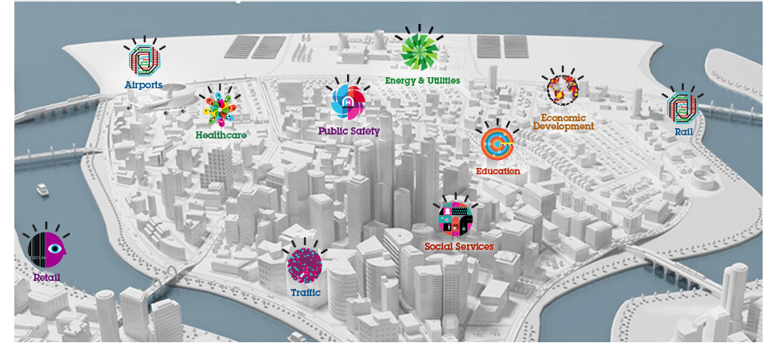


Self sustainable Smart CitY
Challenge: determine adapted and efficient energy consumption and provisioning models
Preferences:
<proximity, TaF, av, max $-h/watt>
Energy
Producer
Energy
Consumer
< av, TaF,
<$/Kwatt, [t1,t2]>
>
Energy “stock” exchange
Guide energy stock exchange mechanism that enables a timely and costly provision of energy from consumers and producers located in a given region (e.g., the same city)
Choose producers according to their agreed SLA
Determine whether found providers fulfil energy requirements according to given consumer preferences

Slide 3
Self sustainable Smart CitY
Challenge: determine adapted and efficient energy consumption and provisioning models
Preferences:
<proximity, TaF, av, max $-h/watt>
Energy
Producer
Energy
Consumer
< av, TaF,
<$/Kwatt, [t1,t2]>
>
Energy “stock” exchange
Processing big data implied in the energy consumption observation
Computing energy consumption behavior models
Analyse and optimize energy consumption versus respecting the confort requirement of inhabitants
Need of efficient data processing solutions

Slide 4
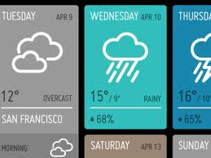



Self sustainable Smart CitY
List of providers that can provision 1000 Kwatts/h, in the next 10 seconds, that are close to my city with a cost of 0,50 euros/Kwatt?
Which are the providers with the highest energy availability in the next three hours with 1-TaF, 10 Km from my location ?
Energy
Producer
Energy
Consumer
Data services
Energy “stock” exchange
Which are the rooms of my house with the highest average consumption when the external temperature is lower than -5 degrees or greater than 30 degrees?
Meteorology
Location
Maps

Slide 5
objectives
Propose an SLA guided continuous data integration and provision system as a DaaS
Integrated SLA computation out of the Data agreed SLA
Optimized and adaptable data collection, query rewriting and integration according to user preferences
Learning based data integration mechanisms
Notes:
Objetivo general
Proponer una herramienta de ayuda a la toma de decisiones para componer servicios de procesamiento de datos adaptados a contratos de preferencias (Service Level Agreement).
Aplicar la solución al contexto de Smart Grid en particular al tratamiento de datos asociados a la optimización del consumo de energía en las casas habitación.
Objetivos específicos:
Estudiar los diferentes modelos map reduce y probar sus implementaciones en particular Hadoop y Dryad;
Hacer un estado del arte de operadores de procesamiento de datos definidos usando modelos map-reduce
Implementación de operadores bajo modelos map-reduce en una plataforma cloud
Proponer estrategias de evaluación de consumo de recursos de los operadores analizados dentro del marco de un escenario Smart Grid

Slide 6

Cloud Data Services / Data Providers
Cached Data
Meta
Metadata
Agreed SLA
Decision Making
Integrated SLA
Monitoring (Data + Conditions)
Query
Rewriting
SLA
Rewriting
SLA integration
N. Benani
C. Ghedira
PCD-RW
U. Costa,
et al.
Integration
Query workflow
G. Vargas-Solar
et. al

Slide 7
Sla guided data integration service

Slide 8
SLA Guided data integration on cloud
Notion of service as design, data access and processing unit
Map-reduce for executing costly data processing operations;
Association of service level agreements (SLA) to quality of service measures (QoS) describing the cloud and its services for guiding data processing and analysis

Slide 9
Services
Data service: can produce data on demand or as streams according to their exported interfaces
A data service is described by it API and its SLA
Data is gathered from on-demand data services by invoking their methods with the appropriate parameters, producing tuples as output.
Stream services export subscription methods that after invocation, will produce a stream. For example, a location service is a streaming service that exports: subscribe() → ⌈location:⟨id, coor⟩⌉
Computing service
Simple its execution is performed by a single service method invocation. For example, a distance computation service relies on a geo-distance service
Composite its execution involves multiple method invocations, possibly also to different services
The method invocations and additional operations are organized in a (sub)workflow that specifies a service coordination that we refer to as data processing service coordination
perform common tasks associated with data management (e.g. indexation or storage) or particular calculations (e.g. mathematical functions)

Slide 10
Query
List of providers that can provision 1000 kWh, in the next 10 seconds, that are close to my city with a cost of 0,15 USD/kWh?
Energy provision
service
< Availability= 10 secs,
Cost <= 0,15 USD/kWh,
Proximity <= 50 Km >
Location
service
< av, TaF,
<$/Kwatt, [t1,t2]>
>
Transformation of global SLA using agreed SLA
Hub1
Hub2
<ID, Region, kW/rate,cost>
<ID, Region, kW/rate,cost>
< av, TaF,
<$/Kwatt, [t1,t2]>
>
< av, TaF,
<$/Kwatt, [t1,t2]>
>
Agreed SLA
Smart meters
<ID, Loc, kW/rate, cost>
< av, TaF,
<$/Kwatt, [t1,t2]>
>
Notes:
The metering dashboard service is invoked with data of the specific node (nodeId) that sets the location and can be of type inHouseMasterNode, BlockNode, quarterNode or cityCentralNode. It also receives a) the user role type, which according to their profile will determine the aggregation level; and b) the selected graphic type. The output of this service is the GraphicFlowFunction, which is a data stream to graphically represent the aggregated energy consumption during a specified time window.

Slide 11
Query
List of providers that can provision 1000 kWh, in the next 10 seconds, that are close to my city with a cost of 0,15 USD/kWh?
Location
service
Energy provision
service
< av, TaF,
<$/Kwatt, [t1,t2]>
>
Look up Hubs
Locate
KNN
Sum
1000KWh, 0,15USD
Hub
<ID, Region, kW/rate,cost>
< av, TaF,
<$/Kwatt, [t1,t2]>
>
Smart meters
<ID, Loc, kW/rate, cost>
< av, TaF,
<$/Kwatt, [t1,t2]>
>
Notes:
The metering dashboard service is invoked with data of the specific node (nodeId) that sets the location and can be of type inHouseMasterNode, BlockNode, quarterNode or cityCentralNode. It also receives a) the user role type, which according to their profile will determine the aggregation level; and b) the selected graphic type. The output of this service is the GraphicFlowFunction, which is a data stream to graphically represent the aggregated energy consumption during a specified time window.

Slide 12
Query rewriting
We begin with an abstract query, (to services / databases) and including non-functional (Quality?, SLA?) conditions.
Which are the providers with the highest energy availability in the next three hours with 1-TaF, 10 Km from my location ?
Need to transform this query into several concrete queries (eventually, adding new SLA).
Lookup and iterate over local hubs:
- Check energy availability from energy providers reporting to this hub.
|| including cached data.
- Sumarise the results.
Using information about each available hub node. Lookup must verify agreed conditions. Iteration stops once results are satisfactory.
Notes:
The metering dashboard service is invoked with data of the specific node (nodeId) that sets the location and can be of type inHouseMasterNode, BlockNode, quarterNode or cityCentralNode. It also receives a) the user role type, which according to their profile will determine the aggregation level; and b) the selected graphic type. The output of this service is the GraphicFlowFunction, which is a data stream to graphically represent the aggregated energy consumption during a specified time window.

