Slide 1
SLA-guided data integration on cloud environments
N. Bennani, C. Ghedira, M. Musicante, G. Vargas-Solar
Contact: Nadia.Bennani@insa-lyon.fr
Univ. Lyon, CNRS INSA-Lyon, LIRIS, France
Magellan, IAE, Univ. J-Moulin Lyon 3, France
DiMAP, UFRN, Brazil
CNRS, LIG-LAFMIA, France

Slide 2
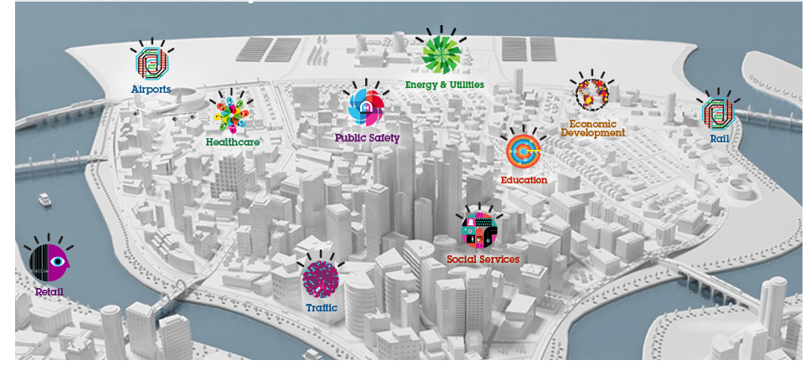


Self sustainable Smart CitY
Preferences:
<proximity, TaF, av, max $-h/watt>
Energy
Producer
Energy
Consumer
< av, TaF,
<$/Kwatt, [t1,t2]>
>
Energy “stock” exchange
Guide energy stock exchange mechanism that enables a timely and costly provision of energy from consumers and producers located in a given region (e.g., the same city)
Choose producers according to their SLA
Determine whether providers fulfil energy requirements according to given consumer preferences

Slide 3
List of green energy providers that can provision 1000 kWh, in the next 10 seconds, that are close to my city with a cost of 0,15 USD/kWh?
Challenge:
Query rewritting such that it matches the services that can provide data to build final results
Existing works:
MiniCon algorithm (Pottinger and Halevy, 2001) for query rewriting
Query rewriting techniques adapted to service composition
Look up Hubs
Locate
KNN
Sum
1000KWh, 0,15USD
[1] Pottinger, R. and Halevy, A. Y. (2001). Minicon: A scalable algorithm for answering queries using views. VLDB J., 10(2-3):182–198.
Energy provision Hub
Energy provision
services
<ID, Region, kW/rate,cost>
< av, TaF,
<$/Kwatt, [t1,t2]>
>
[2] Barhamgi, M., Benslimane, D., and Medjahed, B. (2010). A query rewriting approach for web service composi- tion. IEEE T. Services Computing, 3(3):206–222.
[3] da Costa, U. S., Alves, M. H. F., Musicante, M. A., and Robert, S. (2013). Automatic refinement of service compositions. In Daniel, F., Dolog, P., and Li, Q., editors, ICWE, volume 7977 of Lecture Notes in Com- puter Science, pages 400–407. Springer.
[4] Zhao, W., Liu, C., and Chen, J. (2011). Automatic compo- sition of information-providing web services based on query rewriting. Science China Information Sciences, pages 1–17.
< av, TaF,
<$/Kwatt, [t1,t2]>
>
Location
services
< av, TaF,
<$/Kwatt, [t1,t2]>
>
< av, TaF,
<$/Kwatt, [t1,t2]>
>
Smart meters
<ID, Loc, kW/rate, cost>

Slide 4

List of green energy providers that can provision 1000 kWh, in the next 10 seconds, that are close to my city with a cost of 0,15 USD/kWh?
Maximum of $5 as total query cost
Only green energy providers (provenance)
At least 85% of precision of provided data, ^{even if they are not fresh}
Availability rate of at least 90%
^{Response time of 0,01 sec.}
Challenge:
Integrate the agreed SLAs with the QoS requirements expressed by the user → Derived SLA
Existing works:
Negotiation of use conditions, which are statically agreed between the parts [1]–[3]
Monitoring of use conditions as cloud resources are used, to detect SLA contracts violation [4], [5]
Look up Hubs
Locate
KNN
Sum
1000KWh, 0,15USD
Agreed
SLA
Energy provision Hub
Agreed
SLA
Energy provision
services
<ID, Region, kW/rate,cost>
[1] V. Emeakaroha, I. Brandic, M. Maurer, and S. Dustdar, “Low level metrics to high level slas - lom2his framework: Bridging the gap between monitored metrics and sla parameters in cloud environments,” in HPCS 2010, 2010, pp. 48–54.
[2] A. V. Dastjerdi, S. G. H. Tabatabaei, and R. Buyya, “A dependency-aware ontology-based approach for deploying ser- vice level agreement monitoring services in cloud,” Softw. Pract. Exper., vol. 42, no. 4, pp. 501–518, Apr. 2012.
[3] J. Ortiz, V. T. de Almeida, and M. Balazinska, “A vision for personalized service level agreements in the cloud,” in Proc.2nd Workshop on Data Analytics in the Cloud. pp. 21–25.
< av, TaF,
<$/Kwatt, [t1,t2]>
>
< av, TaF,
<$/Kwatt, [t1,t2]>
>
Location
services
[4] M. Hale and R. Gamble, “Secagreement: Advancing security risk calculations in cloud services,” in IEEE SERVICES, 2012, pp. 133–140.
[5] I. Brandic, V. Emeakaroha, M. Maurer, S. Dustdar, S. Acs, A. Kertesz, and G. Kecskemeti, “Laysi: A layered approach for sla-violation propagation in self-manageable cloud infras- tructures,” in IEEE COMPSACW, 2010, pp. 365–370.
< av, TaF,
<$/Kwatt, [t1,t2]>
>
< av, TaF,
<$/Kwatt, [t1,t2]>
>
Smart meters
<ID, Loc, kW/rate, cost>

Slide 5
Problem statement
How can the user efficiently obtain results for her queries such that they meet her QoS requirements
they respect her subscribed contracts with the involved cloud provider(s)
they do not neglect services contracts
Particularly, for queries that call several services deployed on different clouds

Slide 6




CHallenges
Energy provision
Hub
Requirements
Agreed
SLA₁
Service Agreed
SLA
Service Agreed
SLA
Service Agreed
SLA
How to be sure that all the agreed SLAs are respected while satisfying the user?

Slide 7

Challenges
Agreed
SLA₁
Energy provision
Hub
Service Agreed
SLA
Agreed
SLA₂
Service Agreed
SLA
Service Agreed
SLA
Can my constraints be satisfyed? Which services shall I ask for?
How can ressources be saved for next query?
7

Slide 8
objectives
Propose an SLA guided continuous data integration and provision system as a DaaS
Integrated SLA computation out of the Data agreed SLA
Optimized and adaptable data collection, query rewriting and integration according to user preferences
Learning based data integration mechanisms
Notes:
Objetivo general
Proponer una herramienta de ayuda a la toma de decisiones para componer servicios de procesamiento de datos adaptados a contratos de preferencias (Service Level Agreement).
Aplicar la solución al contexto de Smart Grid en particular al tratamiento de datos asociados a la optimización del consumo de energía en las casas habitación.
Objetivos específicos:
Estudiar los diferentes modelos map reduce y probar sus implementaciones en particular Hadoop y Dryad;
Hacer un estado del arte de operadores de procesamiento de datos definidos usando modelos map-reduce
Implementación de operadores bajo modelos map-reduce en una plataforma cloud
Proponer estrategias de evaluación de consumo de recursos de los operadores analizados dentro del marco de un escenario Smart Grid

Slide 9
Roadmap
New challenges of data integration in the era of the clouds
SLA guided data integration as a service
SLA model
Query rewriting
Conclusions and perspectives

Slide 10
General approach
Query rewriting
SLA derivation
Service composition
Query evaluation
Lookup
prederived SLA
Rewrite query with SLA constraints
SLA guided
optimization
OR
SEQ
SEQ
Integrate
SLA
Store rewriten queries
Execution
SLA
management
Monitoring

Slide 11
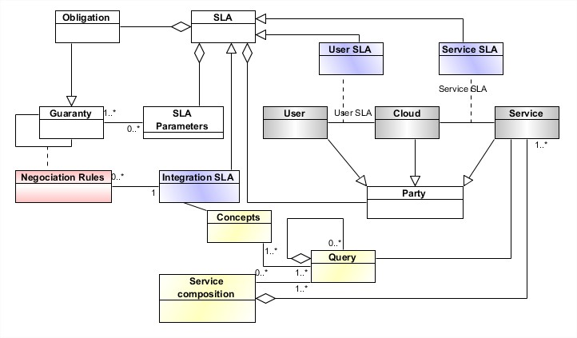


SLA Integration
^{Cost of $0,05 cents per call}
^{8 GB of I/O volume/month}
Free data transfer cost within the same region
^{1 GB of storage}
Q total cost:Σ_{i=1…n} cost(s_{i}) + data transfer ≦ $5
Total response time: Σ_{i=1…n} respTime(s_{i}) + data transfer ≦ $5 0,01 sec.
Availability: (of services involved) ≦ 90%
Freshness: non
Precision: avg precision of services involved ≦ 85%
Provenance: green services
Storage: partial results size ≦ 1 Giga
Maximum of $5 as total query cost
Only green energy providers (provenance)
At least 85% of precision of provided data, ^{even if they are not fresh}
Availability rate of at least 90%
^{Response time of 0,01 sec.}

Slide 12
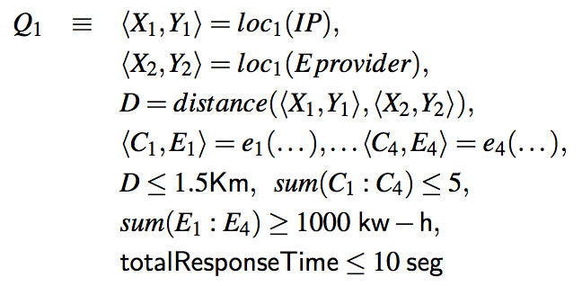
Query rewritting
Given a list of possible services filtered according to the integrated SLA, produce k compositions:
Compute my location using location service Loc₁
Compute Eprovider location using location service Loc₁
Compute the distance between me and the provider
Retrieve the energy and cost KW of each Eprovider
Filter according to QoS requirements

Slide 13

Sla guided data integration service
Agreed
SLA
Data
providers
Cached Data
Meta
Agreed SLA
Metadata
Decision Making
Integrated SLA
IaaS
Agreed
SLA
SaaS
Agreed
SLA
PaaS
Monitoring (Data + Conditions)
Service
providers
Deriving
SLA
Query
Rewriting
Evaluation
Integration

Slide 14
Roadmap
New challenges of data integration in the era of the clouds
SLA guided data integration as a service
SLA integration
Query rewritting
Conclusions and perspectives

Slide 15
Conclusions and current work
Current big data settings impose to consider SLA and different data delivery models
The complexity of query evaluation includes steps that imply greedy computations
combine and revisit well-known solutions in parallel cloud distributed settings
Develop strategies and algorithms applied to energy consumption applications
Hints: SLA modeling and integration, automatic learning for reducing overhead, business model for delivering query results

Slide 16
Thanks
Merci
N. Bennani, C. Ghedira, M. Musicante, G. Vargas-Solar
Contact: Nadia.Bennani@insa-lyon.fr

