Slide 1
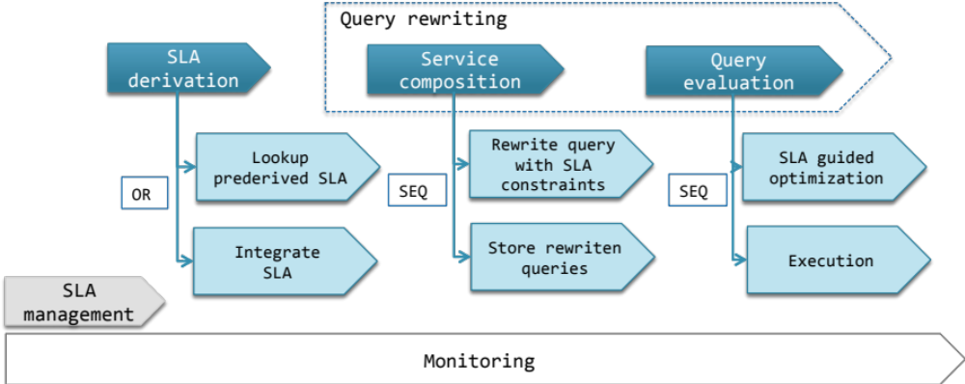
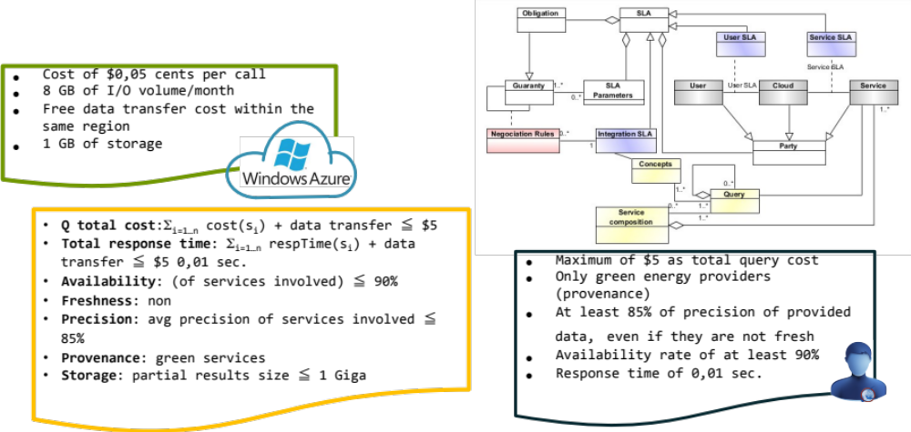




SLA-Guided Data Integration on
Cloud Environments
C. Ghedira, N. Bennani,
M. Musicante, G. Vargas-Solar
General approach
Problem statement
How can the user efficiently obtain results for her queries such that they meet her QoS requirements
  they respect her subscribed contracts with the involved cloud provider(s)
  they do not neglect services contracts
Particularly, for queries that call several services deployed on different clouds
List of green energy providers that can provision 1000 kWh, in the next 10 seconds, that are close to my city with a cost of 0,15 USD/kWh?
C. Ghedira Guegan
chirine.ghedira-guegan@univ-lyon3.fr
Magellan, IAE, Univ. J-Moulin Lyon 3, France

