Slide 1
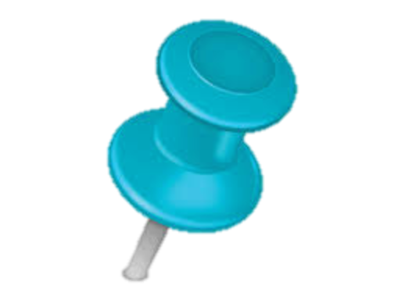



Sla guided data integration service
Agreed
SLA
Data
providers
Cached Data
Meta
Agreed SLA
Metadata
Decision Making
Integrated SLA
IaaS
Agreed
SLA
SaaS
2
4
PaaS
Agreed
SLA
Monitoring (Data + Conditions)
Service
providers
3
5
1
Deriving
SLA
Query
Rewriting
Evaluation
Integration

Slide 2
4
Evaluation
Integration
Agreed
SLA
Integrated
SLA
Cloud¹
Agreed SLA
(user subscription)
Data
providers
s3
3
Query
Rewriting
s1
s2
Query + QoS preferences
s2
IaaS
2
Choosing services
Cloud²
Agreed SLA
(user subscription)
SaaS
PaaS
Derived
SLA
Cloud³
Agreed SLA
(user subscription)
s1
s5
s2
1
Deriving
SLA
Service
providers
SLA-Service
directory
Abstract
intercloud layer

