Slide 1

Introduction to Apache Hadoop-Pig
Prashant Kommireddi
Hadoop Infrastructure, Salesforce.com
pkommireddi@salesforce.com

Slide 2
Agenda
Hadoop Overview
Hadoop at Salesforce
MapReduce and HDFS
What is Pig
Introduction to Pig Latin
Getting Started with Pig
Examples

Slide 3
Hadoop Overview

Slide 4

What Can Hadoop Do For You
Handle large data volume
Run queries spanning days/months
GB/TB/PBs
Structured, Semi and
Unstructured data
Computationally intensive
Deep analytics
Machine learning algorithms

Slide 5
What Hadoop Can NOT Do
Real-time/near-real-time processing
Some lag involved
Hadoop is batch-oriented (full dataset scans)
For real-time queries consider Hbase - built on top of HDFS
Example
Give me log lines with url containing “login” in the last 30 secs : difficult to achieve with hadoop (MapReduce), not really suitable for it

Slide 6
Why Hadoop?

Slide 7
Why Hadoop?
Data is growing, we need to be able to scale-out computation
Uses cheap(er) hardware to grow horizontally
Tolerates a few machines going down
Happens all the time
Store all your data from all systems
Don’t throw it away!

Slide 8
Who’s using it…

Slide 9










Slide 10
Agenda
Hadoop Overview
Hadoop at Salesforce
MapReduce and HDFS
What is Pig
Introduction to Pig Latin
Getting Started with Pig
Examples

Slide 11
Hadoop at Salesforce
Several clusters in production and internal environments
Driving search relevancy and recommendations on Salesforce.com/Chatter
Data ingest from app servers (logs), Oracle and other sources
Several internal use cases – product intelligence, security, performance, UX, TechOps….

Slide 12
A few use-cases at Salesforce ….

Slide 13
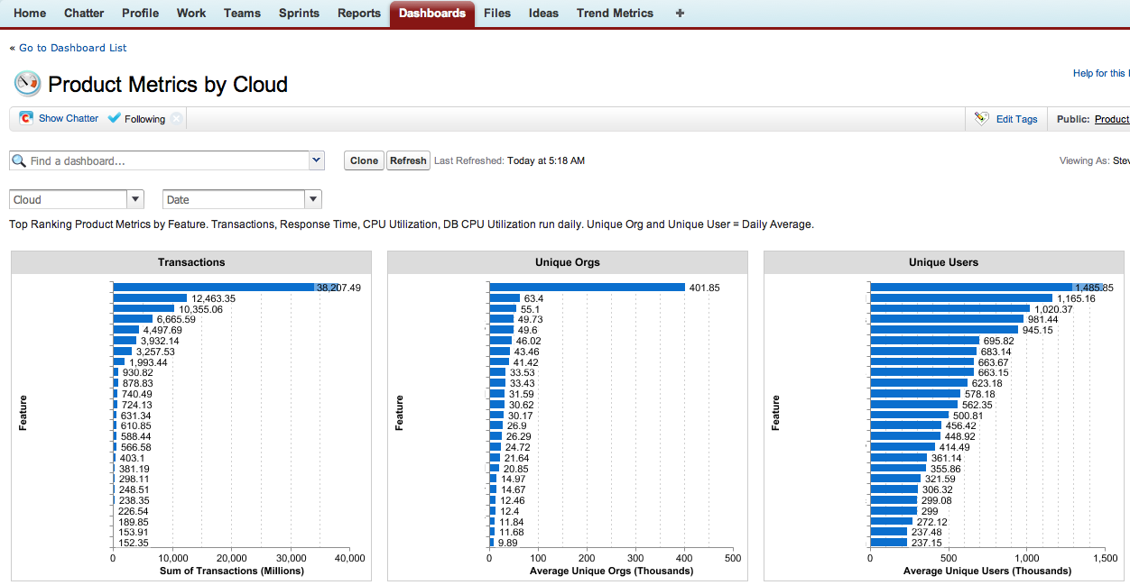
Product Metrics

Slide 14
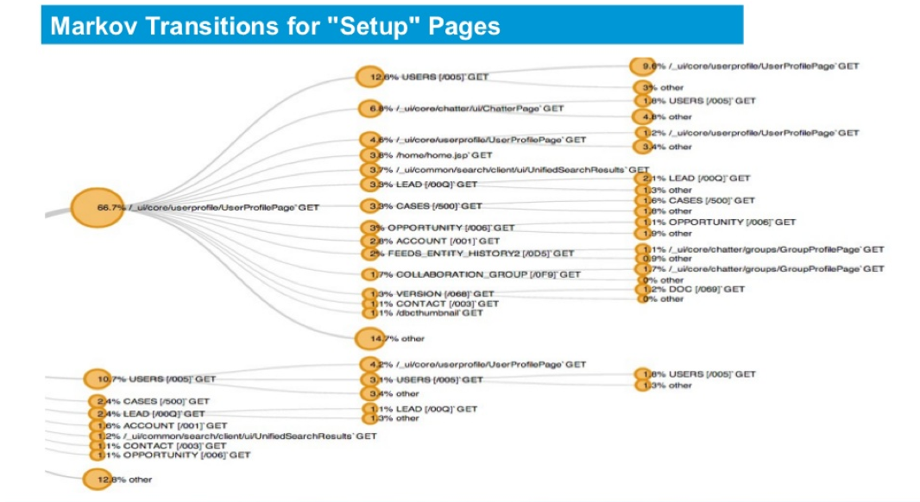
Click-through analysis

Slide 15

What is Hadoop?

Slide 16
System for
Processing
Large (Giga, Tera, Peta)
Amounts of
Data

Slide 17
MapReduce
+
HDFS

Slide 18
MapReduce (Computation)
+
HDFS (Storage)

Slide 19
What is HDFS?

Slide 20
What is HDFS?
Hadoop Distributed File System
Provides common File System functionality such as create, delete, write, read, copy, move, list …
pkommireddi@pkommireddi-wsl:$ hadoop fs -ls /user/pkommireddi
Found 2 items
drwxr-xr-x - pkommireddi supergroup 0 2012-03-27 19:02 /user/pkommireddi/dir1
drwxr-xr-x - pkommireddi supergroup 0 2012-03-28 15:37 /user/pkommireddi/dir2
pkommireddi@pkommireddi-wsl:~$ hadoop fs -mkdir /user/pkommireddi/dir3
pkommireddi@pkommireddi-wsl:~$ hadoop fs -ls /user/pkommireddi
Found 3 items
drwxr-xr-x - pkommireddi supergroup 0 2012-03-29 13:33 /user/pkommireddi/dir1
drwxr-xr-x - pkommireddi supergroup 0 2012-03-27 19:02 /user/pkommireddi/dir2
drwxr-xr-x - pkommireddi supergroup 0 2012-03-28 15:37 /user/pkommireddi/dir3
pkommireddi@pkommireddi-wsl:~$ hadoop fs –rmr dir3
Moved to trash: hdfs://gforce1-nn1-1-sfm.ops.sfdc.net:54310/user/pkommireddi/dir3

Slide 21
How does HDFS work?

Slide 22
We’re raising the question because no one else wants to, because no one else wants to say what needs to be said.
And let’s be real, it’s the two-ton elephant in the room with nearly every other star’s name on the trade rumor radar these days.
We’ve read over and over again about Nash refusing to ask for a trade, refusing to play the game that so many others have late in their careers.
A file we want to store on HDFS …
600 MB

Slide 23
We’re raising the question because no one else wants to, because no one else wants to say what needs to be said.
256 MB
HDFS Splits file into blocks …
And let’s be real, it’s the two-ton elephant in the room with nearly every other star’s name on the trade rumor radar these days.
256 MB
We’ve read over and over again about Nash refusing to play the game that so many others have late in their careers.
88 MB

Slide 24
We’re raising the question because no one else wants to, because no one else wants to say what needs to be said.
We’re raising the question because no one else wants to, because no one else wants to say what needs to be said.
We’re raising the question because no one else wants to, because no one else wants to say what needs to be said.
3 copies
HDFS will create 3 replicas of each block …
And let’s be real, it’s the two-ton elephant in the room with nearly every other star’s name on the trade rumor radar these days.
And let’s be real, it’s the two-ton elephant in the room with nearly every other star’s name on the trade rumor radar these days.
And let’s be real, it’s the two-ton elephant in the room with nearly every other star’s name on the trade rumor radar these days.
3 copies
We’ve read over and over again about Nash refusing to play the game that so many others have late in their careers.
We’ve read over and over again about Nash refusing to play the game that so many others have late in their careers.
We’ve read over and over again about Nash refusing to play the game that so many others have late in their careers.
3 copies

Slide 25
HDFS distributes these replicas across the cluster …
And let’s be real, it’s the two-ton elephant in the room with nearly every other star’s name on the trade rumor radar these days.
And let’s be real, it’s the two-ton elephant in the room with nearly every other star’s name on the trade rumor radar these days.
We’re raising the question because no one else wants to, because no one else wants to say what needs to be said.
We’ve read over and over again about Nash refusing to play the game that so many others have late in their careers.
Node 1
Node 2
We’re raising the question because no one else wants to, because no one else wants to say what needs to be said.
We’ve read over and over again about Nash refusing to play the game that so many others have late in their careers.
And let’s be real, it’s the two-ton elephant in the room with nearly every other star’s name on the trade rumor radar these days.
We’ve read over and over again about Nash refusing to play the game that so many others have late in their careers.
We’re raising the question because no one else wants to, because no one else wants to say what needs to be said.
Node 3
Node 4

Slide 26
If a node goes down, we have copies elsewhere
And let’s be real, it’s the two-ton elephant in the room with nearly every other star’s name on the trade rumor radar these days.
And let’s be real, it’s the two-ton elephant in the room with nearly every other star’s name on the trade rumor radar these days.
We’re raising the question because no one else wants to, because no one else wants to say what needs to be said.
We’ve read over and over again about Nash refusing to play the game that so many others have late in their careers.
Node 1
Node 2
We’re raising the question because no one else wants to, because no one else wants to say what needs to be said.
We’ve read over and over again about Nash refusing to play the game that so many others have late in their careers.
And let’s be real, it’s the two-ton elephant in the room with nearly every other star’s name on the trade rumor radar these days.
We’ve read over and over again about Nash refusing to play the game that so many others have late in their careers.
We’re raising the question because no one else wants to, because no one else wants to say what needs to be said.
Node 3
Node 4

Slide 27
What is MapReduce?

Slide 28
MapReduce: High-Level Overview
Consists of two phases: Map and Reduce
Between M and R is a stage known as the shuffle and sort!
Each Map task operates on a certain portion of the overall dataset
Typically 1 HDFS block of data!

Slide 29
It’s all Keys & Values
Map: extract data you care about.
map(K,V) -> <K`,V`>*
Note the original input key (K) and output key from map (K`) could be different
Shuffle: distribute sorted Map output to Reducers
Reduce: aggregate, summarize, output results
reduce(K`,List<V`>) -> <K``,V``>*
All V` with same K` are reduced together
Again, input key (K`) could be different from
reducer output key (K``)

Slide 30

But, writing MapReduce
jobs in Java is painful. Let’s see why …

Slide 31
Pig Job
Generate COUNT of ‘U’ log events for each (OrgId, UserId)
A = load ’/app_logs/2012/01/*/' using PigStorage(); uLogs = FILTER A BY $0 == ’U'; uLogFields = FOREACH uLogs GENERATE $1 as orgId, $2 as userId, orgUserGroup = GROUP uLogFields BY (orgId, userId); uCount = FOREACH orgUserGroup GENERATE group, COUNT(uLogFields); STORE uCount INTO ‘output’;

Slide 32
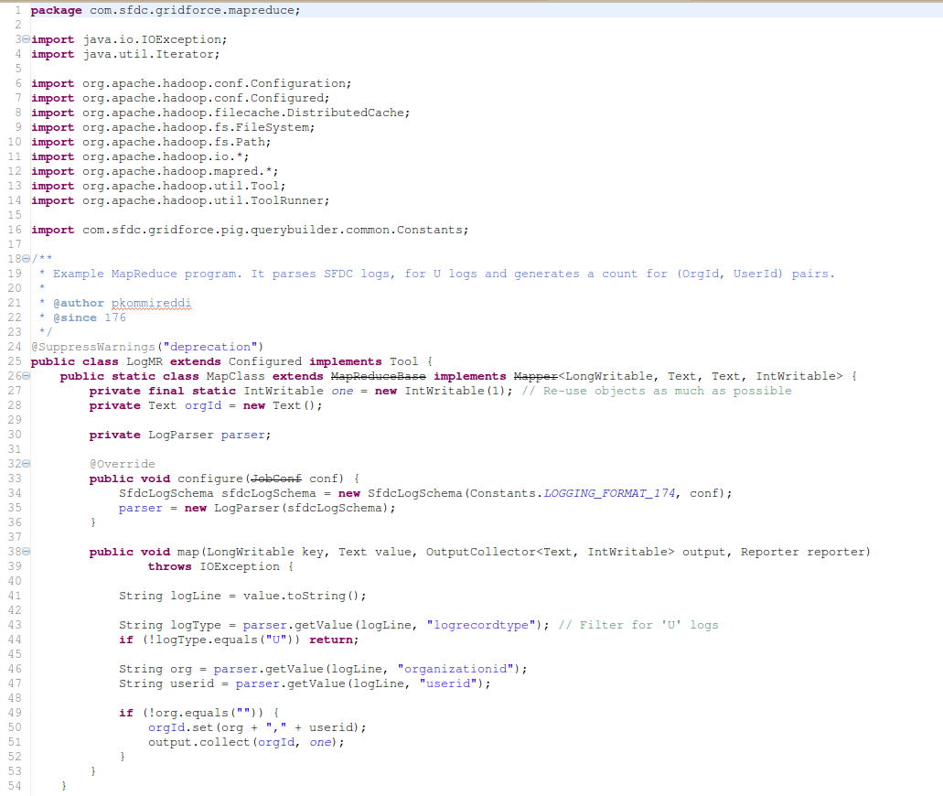
Same job in Java MR ..

Slide 33
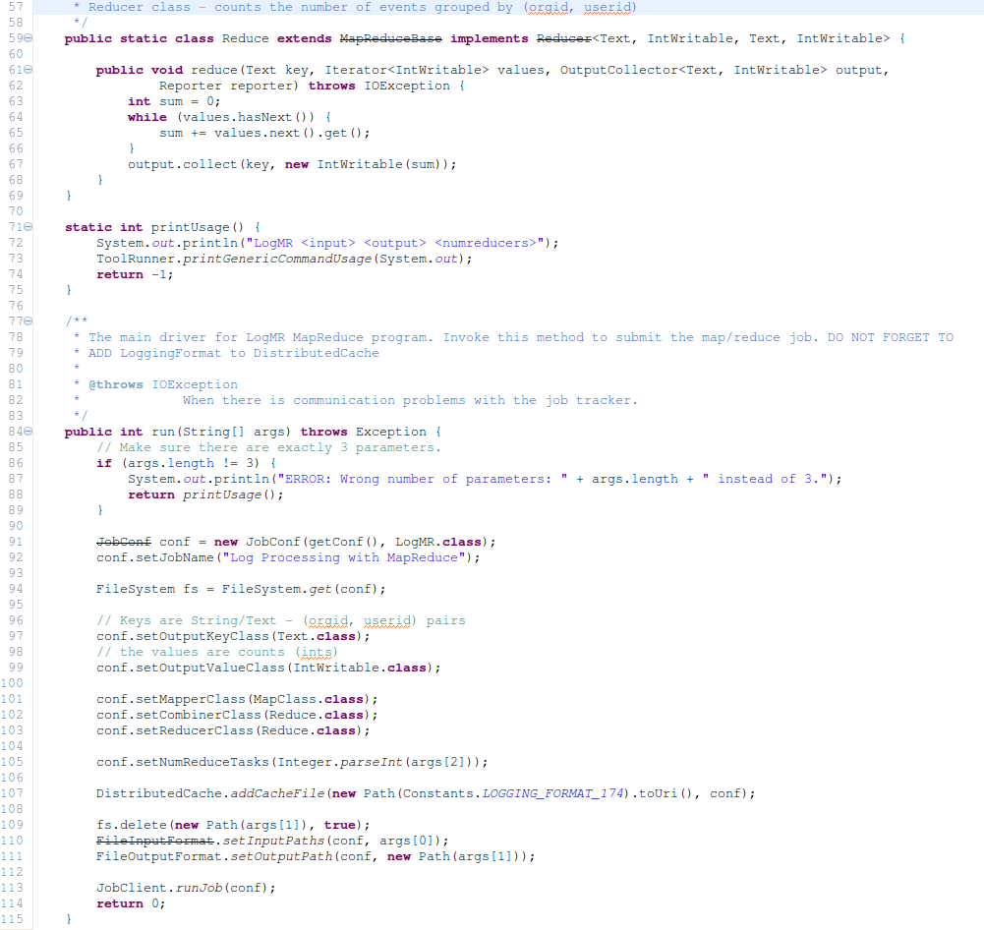
And …

Slide 34
Let’s talk about Pig!

Slide 35
Agenda
Hadoop Overview
Hadoop at Salesforce
MapReduce and HDFS
What is Pig
Introduction to Pig Latin
Getting Started with Pig
Examples

Slide 36
What is Pig?
Sub-project of Apache Hadoop
Platform for analyzing large data sets
Includes a data-flow language Pig Latin
Built for Hadoop
Translates script to MapReduce program under the hood
Originally developed at Yahoo!
Huge contributions from Hortonworks, Twitter

Slide 37


Pig Execution Stages
Client machine
Hadoop Cluster
Pig Script
Pig Execution Engine
MapReduce
Hadoop Job

Slide 38
Why Pig?
Makes writing hadoop jobs a lot simpler
5% of the code, 5% of time
You don’t have to be a programmer to write Pig scripts
Provides major functionality required for DW and Analytics
Load, Filter, Join, Group By, Order, Transform, UDFs, Store
User can write custom UDFs (User Defined Function)

Slide 39
Hive
Hive has the advantage that its syntax is similar to SQL.
Requires Schema (some sort of)
Difficult to define schema for semi-structured data, i.e. app logs
Writing data-flow queries gets complex
Sub queries
Temporary tables
Integration with Spark
Integration with Hbase in the works
Heavily used at Facebook
We at Salesforce adopted Pig more widely
Pig is easier for variable schema

Slide 40
Agenda
Hadoop Overview
Hadoop at SFDC
MapReduce and HDFS
What is Pig
Introduction to Pig Latin
Getting Started with Pig
Examples

Slide 41
PigLatin – the dataflow language
PigLatin statements work with relations
A relation (analogous to database table) is a bag
A bag is a collection of tuples
A tuple (analogous to database row) is an ordered set of fields
A field is a piece of data
Example, A = LOAD ‘input.dat’;
Here ‘A’ is a relation
All records in ‘A’ (from the file ‘input.dat’) collectively form a bag
Each record in ‘A’ is a tuple
A field is a single cell in each tuple
To remember : A Pig relation is a bag of
tuples

Slide 42
Getting started
Download a recent stable release from one of the Apache Download Mirrors (see Pig Releases).
Unpack the downloaded Pig distribution
Add pig-x.y.z/bin to your path.
Use export (bash,sh,ksh) or setenv (tcsh,csh).
For example: $ export PATH=/<my-path-to-pig>/pig-x.y.z/bin:$PATH
Test the Pig installation with this simple command: $ pig –help

Slide 43
Local mode
All files are installed and run using your local host and file system
Does not involve a real hadoop cluster
Great for starting off, debugging
Specify local mode using the -x flag
$ pig –x local
$ grunt> a = load ‘foo’; -- here the file ‘foo’ resides on local filesystem

Slide 44
Mapreduce mode
Default mode
Access to a Hadoop cluster and HDFS installation
Point Pig to remote cluster by placing HADOOP_CONF_DIR on PIG_CLASSPATH
HADOOP_CONF_DIR is the directory containing your hadoop-site.xml, hdfs-site.xml, mapred-site.xml files
Example: $ export PIG_CLASSPATH=<path_to_hadoop_conf_dir>
$ pig
grunt> a = load ‘foo’; -- here ‘foo’ refers to a file on HDFS

Slide 45
Data types
int, long
float, double
chararray – Java String
bytearray
default type of all fields if schema not specified
Complex data types
tuple, eg (abc,def)
bag, eg {(19,2), (18,1)}
map, eg [sfdc#logs]

Slide 46
Loading data
LOAD
Reads data from the file system
Syntax
LOAD ‘input’ [USING function] [AS schema];
Eg, A = LOAD ‘input’ USING PigStorage(‘\t’) AS (name:chararray, age:int, gpa:float);

Slide 47
Schema
Use schemas to assign types to fields
A = LOAD 'data' AS (name, age, gpa);
name, age, gpa default to bytearrays
A = LOAD 'data' AS (name:chararray, age:int, gpa:float);
name is now a String (chararray), age is integer and gpa is float

Slide 48
Describing Schema
Describe
Provides the schema of a relation
Syntax
DESCRIBE [alias];
If schema is not provided, describe will say “Schema for alias unknown”
grunt> A = load 'data' as (a:int, b: long, c: float); grunt> describe A; A: {a: int, b: long, c: float} grunt> B = load 'somemoredata'; grunt> describe B; Schema for B unknown.

Slide 49
Dump and Store
Dump writes the output to console
grunt> A = load ‘data’;
grunt> DUMP A; //This will print contents of A on Console
Store writes output to a HDFS location
grunt> A = load ‘data’;
grunt> STORE A INTO ‘/user/username/output’; //This will write contents of A to HDFS
Pig starts a job only when a DUMP or STORE is encountered

Slide 50
Referencing Fields
Fields are referred to by positional notation OR by name (alias)
Positional notation is generated by the system
Starts with $0
Names are assigned by you using schemas. Eg, A = load ‘data’ as (name:chararray, age:int);
With positional notation, fields can be accessed as
A = load ‘data’;
B = foreach A generate $0, $1; //1st & 2nd column

Slide 51
Limit
Limits the number of output tuples
Syntax
alias = LIMIT alias n;
grunt> A = load 'data'; grunt> B = LIMIT A 10; grunt> DUMP B; --Prints only 10 rows

Slide 52
Foreach.. Generate
Used for data transformations and projections
Syntax
alias = FOREACH { block | nested_block };
nested_block usage later in the deck
grunt> A = load ‘data’ as (a1,a2,a3); grunt> B = FOREACH A GENERATE *, grunt> DUMP B; (1,2,3) (4,2,1) grunt> C = FOREACH A GENERATE a1, a3; grunt> DUMP C; (1,3) (4,1)

Slide 53
Filter
Selects tuples from a relation based on some condition
Syntax
alias = FILTER alias BY expression;
Example, to filter for ‘marcbenioff’
A = LOAD ‘sfdcemployees’ USING PigStorage(‘,’) as (name:chararray,employeesince:int,age:int);
B = FILTER A BY name == ‘marcbenioff’;
You can use boolean operators (AND, OR, NOT)
B = FILTER A BY (employeesince < 2005) AND
(NOT(name == ‘marcbenioff’));

Slide 54
Group By
Groups data in one or more relations (similar to SQL GROUP BY)
Syntax:
alias = GROUP alias { ALL | BY expression} [, alias ALL | BY expression …] [PARALLEL n];
Eg, to group by (employee start year at Salesforce)
A = LOAD ‘sfdcemployees’ USING PigStorage(‘,’) as (name:chararray, employeesince:int, age:int);
B = GROUP A BY (employeesince);
You can also group by all fields together
B = GROUP B BY ALL;
Or Group by multiple fields
B = GROUP A BY (age, employeesince);

Slide 55
Using Grouped Results
FOREACH works for grouped data
Let’s see an example to count the number of rows grouped by employee start year
‘group’ is an implicit field name given to group key
Use the alias grouped, within an aggregation function - COUNT(A)
grunt> A = load ’data’ as (name, employeesince, age); grunt> B = GROUP A by employeesince; grunt> C = FOREACH B GENERATE group, COUNT(A);

Slide 56
Aggregation
Pig provides a bunch of aggregation functions
AVG
COUNT
COUNT_STAR
SUM
MAX
MIN

Slide 57
Define
Assigns an alias to a UDF
Syntax
DEFINE alias {function}
Use DEFINE to specify a UDF function when:
UDF has a long package name
UDF constructor takes string parameters.
grunt> DEFINE LEN org.apache.pig.piggybank.evaluation.string.LENGTH(); grunt> A = load ‘data’ as (name:string, age:int); grunt> B = Foreach A Generate LEN(name) as namelength;

Slide 58
Case Sensitivity
names (aliases) of relations and fields are case sensitive
A = load ‘input’; B = foreach a generate $0; --Won’t work
UDF names are case sensitive
‘LENGTH’ is not the same as ‘length’
PigLatin keywords are case insensitive
Load, dump, Group by, foreach..generate, join

Slide 59
And we’re done
Goal of this presentation was to only get you started
There’s a lot more to Hadoop and Pig, and this only serves as a starting ground ☺

Slide 60
Good Stuff
Pig Latin basics - http://pig.apache.org/docs/r0.10.0/basic.html
Programming Pig - http://ofps.oreilly.com/titles/9781449302641/
Pig Mailing List - http://pig.apache.org/mailing_lists.html#Users
How Salesforce.com uses Hadoop - http://www.youtube.com/watch?v=BT8WvQMMaV0
New features in Pig 0.11 - http://www.slideshare.net/hortonworks/new-features-in-pig-011

Slide 61
We are hiring ☺
http://www.salesforce.com/careers/tech/

