Slide 1


Tracker Hit Resolution Measurements in 2009 CRAFT Data
LPC Physics Forum Oct. 15th, 2009
Keith Ulmer
University of Colorado

Slide 2
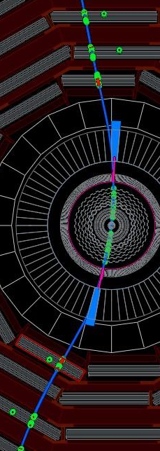
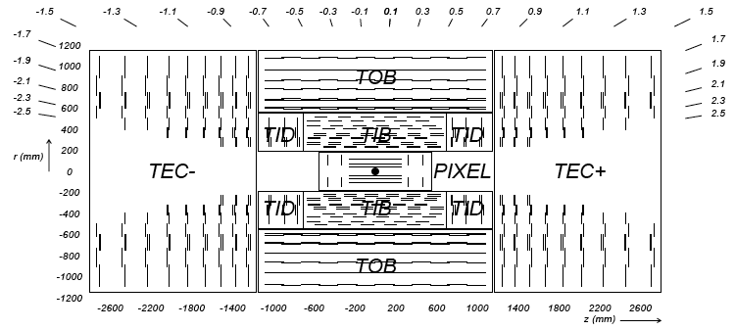
The CMS tracker and CRAFT
All silicon tracker
  66M pixels: 100x150μm
  9M strips: pitch varies from 80-183μm
CRAFT = CosmicRaysAtFourTesla
  July 23 to Sept. 1 collected 480M triggers
  3.6M quality tracker tracks with B field on
  64k tracks with pixels hits
Silicon Strips
Silicon Pixels

Slide 3
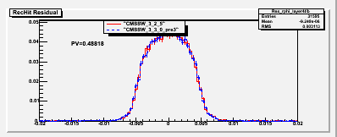
Measuring hit resolution
Want to measure the inherent silicon sensor resolution using tracks from CRAFT data
The natural tool is the track residual
  Not sensitive enough
  Dominated by uncertainty from the tracking
TIB layer4 residual [cm]
Example TIB layer 4
  σ(residual)≈50μm
  pitch = 120μm: expected resolution 15-35μm
Need to do something more creative…

Slide 4
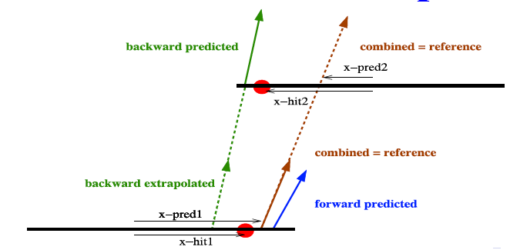
The overlap technique
Use tracks passing through two sensors in the same layer
  Overlap layers typically spaced ~1-4cm from each other
Combine all tracker information without the hits from the layer understudy to obtain the best track prediction
Compare differences in hit and predicted positions on the two overlap modules: Δx_{hit}=x_{hit1}-x_{hit2}, Δx_{pred}=x_{pred1}-x_{pred2}

Slide 5
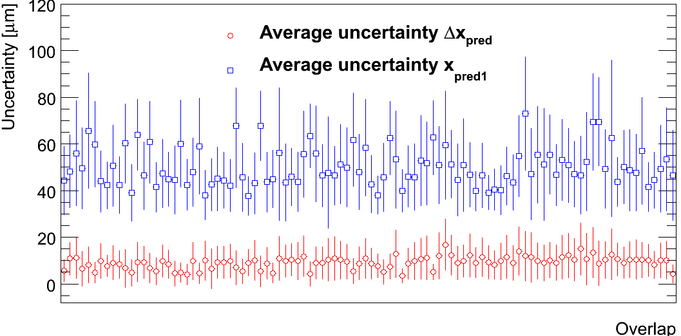
Advantages of using overlaps
σ(Δx_{pred}) << σ(x_{pred1})
  Correlations in track positions reduce uncertainty on Δx_{pred}
  Allows for sensitivity to hit resolution
X_{hit1}
X_{pred1}
X_{hit2}
misalignment
Translational misalignment shifts the mean of Δx_{hit}-Δx_{pred}, the double difference (dd)
Fit for the width of dd, which is independent of translational misalignment
X_{pred2}
ΔX_{hit}-ΔX_{pred}

Slide 6
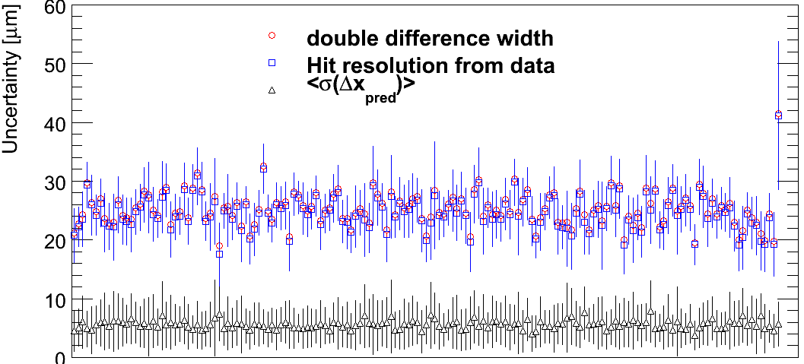
Extraction of hit resolution
Double difference width is a combination of uncertainty from the track predicted position and the hit resolution
  width(double difference)²=σ(Δx_{pred})²+σ(Δx_{hit})²
Assume the resolution for both overlap hits is equal
  σ(Δx_{hit})² = σ(x_{hit1})² + σ(x_{hit2})² = 2σ(x_{hit})²
Calculate the resolution for each pair of overlapping sensors
TIB layer 1-2, 0°-10°

Slide 7
Event selection
Use CRAFT09 data from all runs with “field on”
Require > 5 hits on track
Track χ² probability > 10⁻³
<σΔx_{pred}> < 25 μm, <σΔy_{pred}> < 25 μm
Use all overlap tracks from TIB and TOB with extrapolation distance < 7 cm
Pixel overlaps with extrapolation < 2 cm
Track momentum > 15 GeV for Strips
Momentum > 5 GeV for Pixels
Misalignment uncertainty < 5 μm
Remove clusters at the edge of sensors

Slide 8
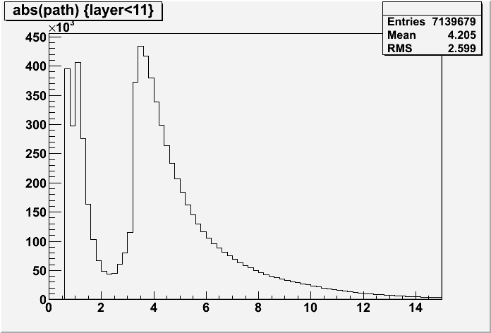
Uncertainty from MS
Multiple scattering has a significant effect
Can limit the effect by
  Extrapolating track over short distances (path length)
  Requiring high momentum tracks
  θ_{RMS}=(13.6MeV/p)*√(x/X₀), with x/X0=2.5%/layer
  θ_{RMS}≈linear_{RMS}/path length
Path length varies with geometry and trajectory
Cut away false overlaps
Cut
Path length strip overlaps [cm]

Slide 9
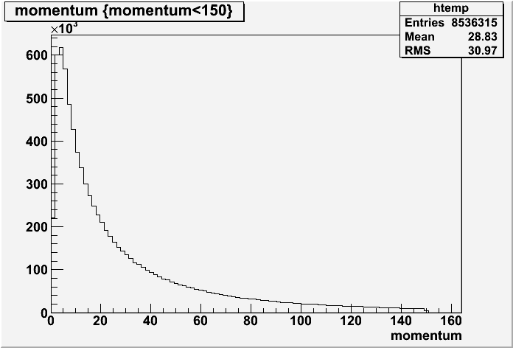
Uncertainty from MS
Keep momentum > 15 GeV to limit MS
For peak path length = 4 cm and minimum momentum = 15 GeV, uncertainty = 5.7 μm on dd, or 4.0 μm per strip sensor
Cut
Less of an issue for pixels with shorter path length
  For peak path length = 1 cm and minimum momentum = 5 GeV, uncertainty = 4.3 μm on dd, or 3.0 μm per pixel sensor
Apply this as an uncertainty to the measurement

Slide 10
Uncertainty from misalignment
Translational misalignment isn’t a problem
Rotational misalignment can be a problem
ΔX can change as a function of y position of track
  x1-x2 < x1-x2
  Apparent as a slope in dd vs y position
y₂
x₁
x₂
Other rotations show non-zero slopes in dd vs x position and track angle

Slide 11
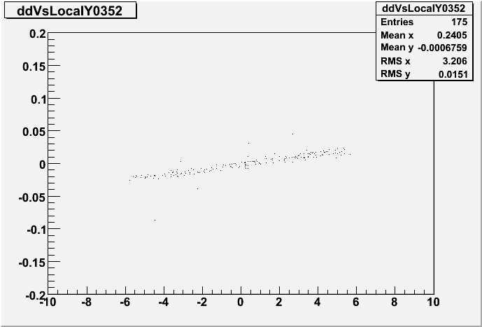
Uncertainty from misalignment
Rotational misalignment
causes artificially wide
dd widths
Measure effect on dd width as slope*range
Remove misaligned overlap pairs when
d(dd)/d(X)*RMS(X) > 7 μm
  “X” can be x or y position, or track angles dx/dz or dy/dz
double difference [cm]
Local Y [cm]
Apply rotational misalignment measurement as an uncertainty on the dd width
  Up to 7/√2 = 4.9 μm per sensor (7 μm for pixels)
Overlaps information also currently being used for alignment studies (Thomas Speer, Brown University)

Slide 12
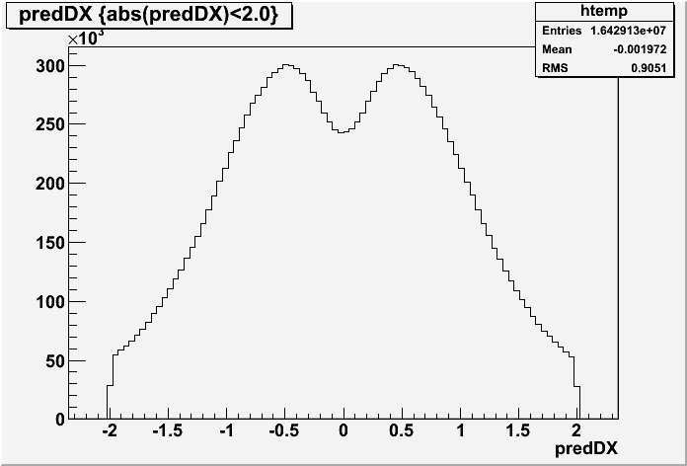
What to expect for hit resolution
The resolution should depend on the pitch and thickness of the sensors, track angle and cluster size
  Single strip clusters limited to pitch/√(12) by geometry
  Multiple strip clusters can be more precise
The pitch is different for different layers
  TIB layer 1, 2 = 80 μm
  TIB layer 3, 4 = 120 μm
  TOB layer 1-4 = 183 μm
  TOB layer 5, 6 = 122 μm
  Pixels 100x150 μm
Track angles vary greatly for
cosmic tracks
  Large angles are more likely
  to cross multiple strips
Other effects can worsen resolution
  Crosstalk, delta rays, dead channels, calibration…
pitch
Track dx/dz

Slide 13
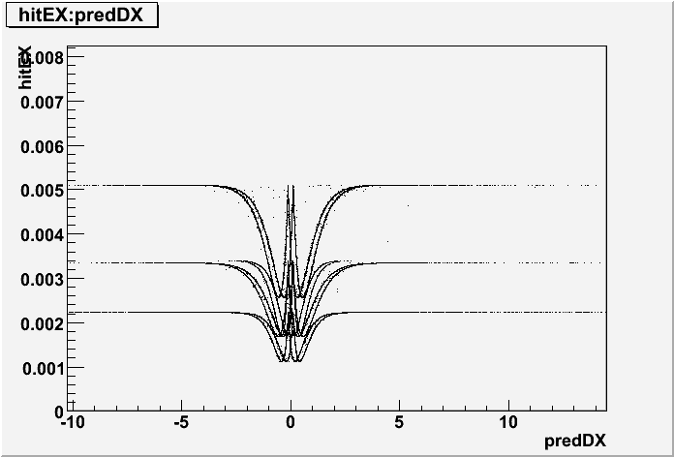
Hit resolution estimates
An estimate of σ(x_{hit}) is used in the track reconstruction called Cluster Parameter Estimator (CPE) error
CPE error [cm]
dx/dz
CPEs are calculated as a function of the pitch, thickness, cluster size, charge and track angle
Resolution measurements from CRAFT data can be compared to the estimated resolutions

Slide 14
Binning the results
CRAFT provides sufficient statistics to group tracks with similar expected resolutions
  Bin in pitch (pixels, TIB12, TIB34, TOB1234, TOB56)
  Can bin by track angle (0°-10°, 10°-20°, 20°-30°, 30°+)
  Can bin by cluster width
    With two clusters in each overlap,
    must require both clusters of same
    width to avoid averaging effects
    Cluster width results possible only for
    widths of 2 and 3 strips
cluster 1
cluster 2

Slide 15
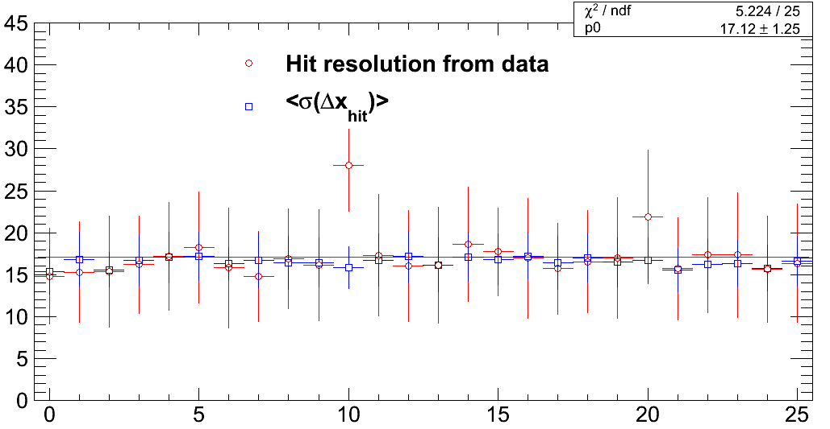
Hit resolution results
Sample bin: TIB layer 1&2, track angles 0-10°
26 sites of overlapping modules with at least 30 tracks passing the cuts plotted
Very good agreement between the measurement and CPE’s
Mean resolution of 17±1 μm
(CPE)

Slide 16
Results summary by track angle
Track Angle | 0-10 | 10-20 | 20-30 | 30+
TIB 12 resolution (μm) | 17.1±1.2 | 14.6±1.0 | 14.7±1.5 | 22.6±2.2
TIB 12 ratio | 1.03±0.08 | 1.21±0.08 | 1.17±0.12 | 1.28±0.13
TIB 34 resolution (μm) | 25.4±1.8 | 17.5±1.1 | 17.3±1.1 | 25.0±1.8
TIB 34 ratio | 0.96±0.08 | 0.89±0.06 | 1.00±0.06 | 1.13±0.09
TOB 1-4 resolution (μm) | 38.1±2.3 | 29.0±1.5 | 25.0±1.8 | 35.6±1.5
TOB 1-4 ratio | 0.94±0.08 | 0.97±0.06 | 0.94±0.07 | 1.05±0.05
TOB 56 resolution (μm) | 23.8±2.4 | 18.1±4.0 | 16.9±4.2 | ----
TOB 56 ratio | 0.99±0.13 | 0.95±0.22 | 0.87±0.21 | ----
Ratio = measured resolution/CPE
Results generally consistent between the measurements and the APE’s
Typical resolutions 15-30 μm
  Best resolution for intermediate track angles
For large angle TIB tracks, APE’s underestimate the resolution

Slide 17
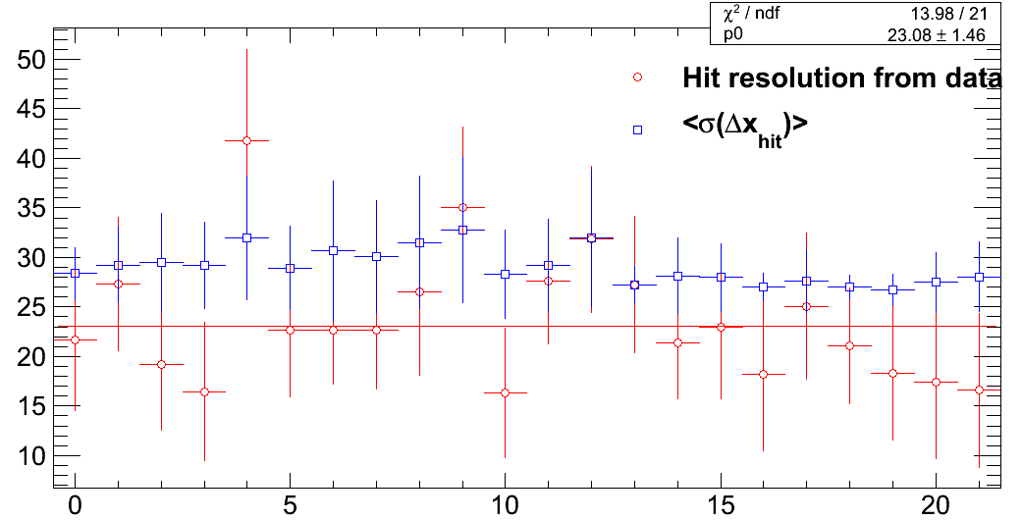
Results by cluster size
Sufficient statistics exist to measure the resolution for clusters of width 2 and 3 strips individually
  All track angles integrated
Sample results TOB 1234, both clusters width=2
Measured resolution is better than CPE’s, and better than any single track angle bin

Slide 18
Results by cluster size
Cluster size | 2 | 3
TIB 12 resolution (μm) | 13.0±0.9 | 16.6±1.7
TIB 12 ratio | 1.00±0.07 | 1.22±0.14
TIB 34 resolution (μm) | 17.3±0.8 | 16.2±3.9
TIB 34 ratio | 0.89±0.05 | 0.81±0.20
TOB 1-4 resolution (μm) | 23.1±1.5 | 25.5±0.9
TOB 1-4 ratio | 0.79±0.06 | 0.84±0.03
TOB 56 resolution (μm) | --- | 16.0±1.7
TOB 56 ratio | --- | 0.78±0.09
Achieve better resolution by cluster size in all layers than any single track angle bin
  Clusters of size 2 and 3 strips are well measured with good resolution
CPE’s consistently over estimate the resolution for width 2 and 3 clusters for most tracker layers
Track angle bin data shows good agreement, so width ≥4 CPE’s must be under estimated
  Work now ongoing to improve the predicted resolution to achieve better agreement

Slide 19
Pixel resolution
The same technique can be applied to pixel sensors
  Pixel resolution can be measured in both sensitive directions, x and y
Statistics is a problem
  Many fewer tracks with pixels hits from CRAFT
  Insufficient tracks to bin results by track angle
    Keep all tracks within 30° of normal incidence
  Must loosen the momentum cut
  Require fewer tracks through overlap pairs
A measurement is still possible!

Slide 20
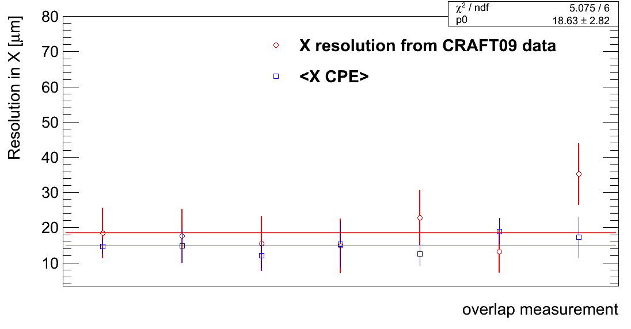
Pixel resolution results in X
7 sites of overlapping modules with at least 10 tracks passing the cuts for X plotted
Mean resolution of 19±3 μm, average CPE = 15±1 μm
CRAFT08 resolution is 19±2 μm

Slide 21
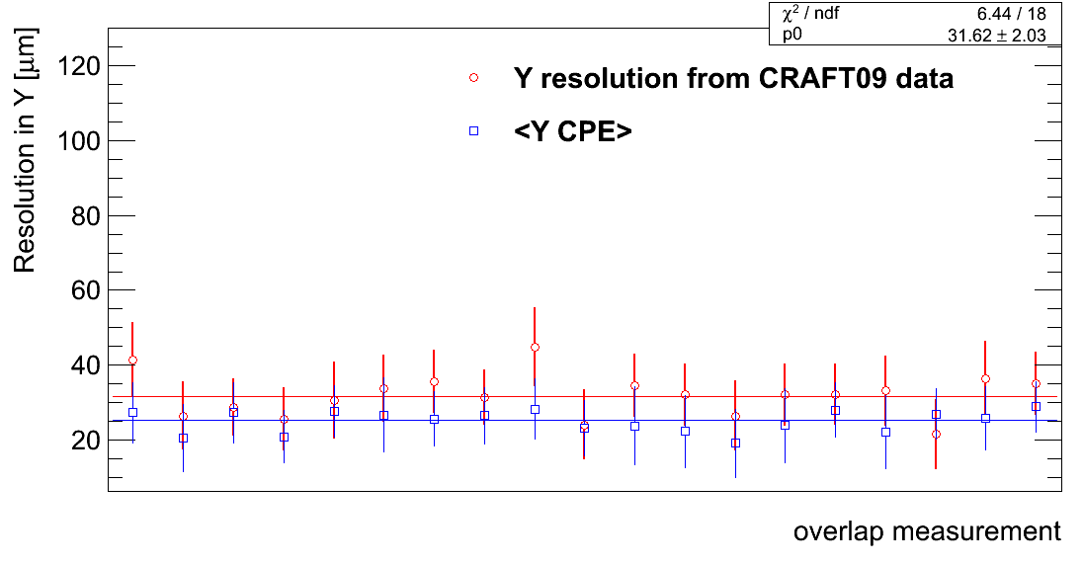
Pixel resolution results in Y
19 sites of overlapping modules with at least 15 tracks passing the cuts for Y plotted
Mean resolution of 32±2 μm, average CPE = 25±2 μm
CRAFT08 resolution is 31±3 μm

Slide 22
Conclusions
The technique of using tracks passing through overlapping sensors allows for the extraction of the resolution of the silicon pixels and strips
The strip tracker achieves resolutions as low as 13 μm and up to 38 μm in good agreement with predictions
Pixel resolution is measured to be 19 and 32 μm in the two sensitive directions including a large range of track angles
These measurements are now being used to help refine the predictions used in simulation and track reconstruction

