Slide 1
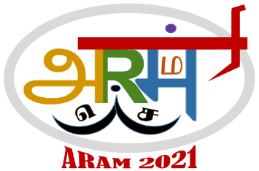
ARAM173
INTERNET OF THINGS BASED WATER MONITORING
Team Members
Varshinee M M - Department of CSE, SSN, Chennai-603110
S.V.Jansi Rani - Department of CSE, SSN, Chennai-603110

Slide 2
Outline
Introduction
Motivation
Literature Survey
Problem definition
Objective of the project
Feasibility Study
Solution Methodology
Prototype
Conclusion/Summary
Bibliography/Reference

Slide 3
Introduction
Groundwater plays a very important role in meeting the water demand of Indian cities.
The recent report of NITI Aayog on groundwater level said that 21 Indian cities including Chennai will run out of groundwater by 2020. It also said that 40 per cent of India's population will have no access to drinking water by 2030.
Even though available water resource the major concern of people is they cant keep track and control their water usage.

Slide 4
Motivation
Water usage must be minimized and the acknowledgement of the water usage to be known to the user.
No proper method for water monitoring in Household applications
Problem is being faced in most part of India.

Slide 5
Literature Survey
Water Scarcity in Chennai:Institutions, Entitlements and Aspects of Inequality in Access ,P. B. Anand, WIDER Discussion Paper, No. 2001/140
Motivation to provide water usage graph analysis.
To control the water usage in industrial and other sectors.

Slide 6
Objective of the project
The objective of the product is
To monitor the water usage in various places like Kitchen, washing clothes, hostels etc.,
To analyze the flow of water and daily usage in every field.
To detect water leakage.
To control the flow of water by using IoT and Android App.

Slide 7
Feasibility Study
4
EFFICIENCY OF THE SYSTEM?
The water can be saved drastically to 40-60%
WHERE THIS CAN BE INCORPORATED?
In all house
CAN THIS BE USED BY LAYMAN?
Ofcourse Yes
ECONOMICALLY FEASIBLE
TECHNICALLY FEASIBLE
OPERATIONALLY FEASIBLE
IS IT EASY TO IDEALIZE WITH ENGINNERING TECHNIQUES?
YES…

Slide 8
Solution Methodology
When the process is switched ON, by the IOT server called thinger.io
Which is used for control the DC motor and monitor the Flow of water is indicated in the laptop or mobile
The internet connection is needed for both Nodemcu module and controlling device.
By using IOT software the flow rate will be determined in graph diagram. The motor opening and closing will be determined in percentage such as 25, 50, 75 and 100.

Slide 9
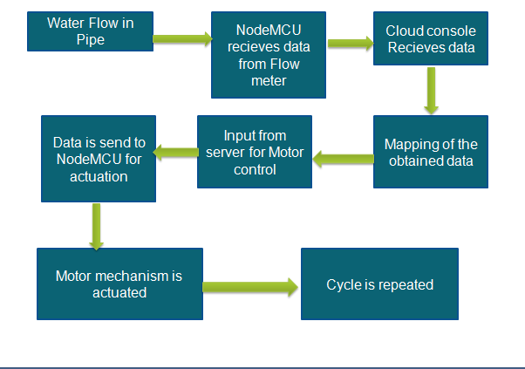
Conceptual Mapping

Slide 10
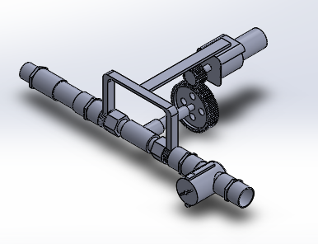
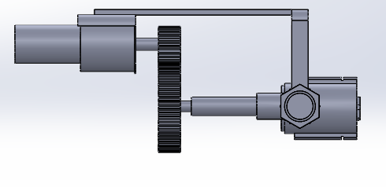
3D Prototype Model

Slide 11
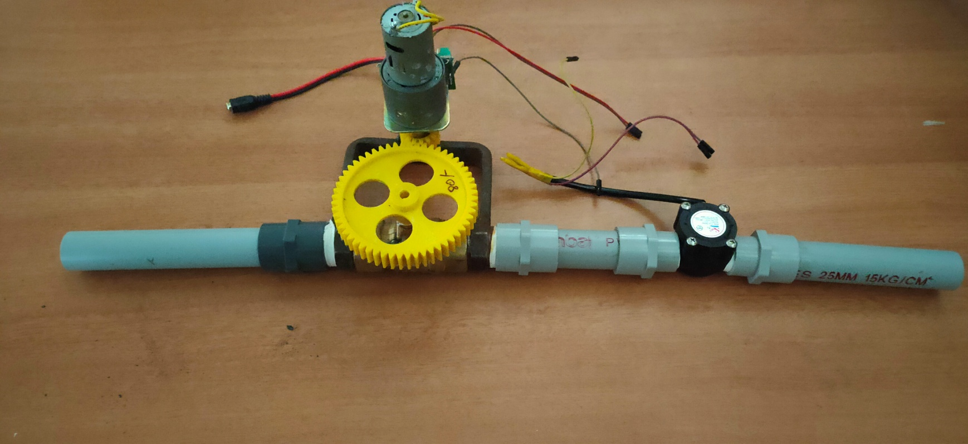
Fabrication Setup
12
Gear setup motor
Motor driver
Flow sensor

Slide 12
Conclusion
This machine is completely alternate for the existing manually operating system. By automating the flow rate process, high accuracy in flow is obtained.
The risk of manual operation is reduced and wastage rate is decreased.
The automation system is implemented by replacing the manual operation Gate valve system.

Slide 13
Future Scope
All the Household and industries are benefited by implementing the automation process for flow regulating operation through IOT based system. The new system is easy to access and far more efficient than the existing system

Slide 14
References
[1] The Second Machine Age: Work, Progress and Prosperity in a Time of Brilliant Technologies by Erik Brynjolfsson and Andrew McAfee
[2] Internet of Things (IoT): A vision, architectural elements, and future directions , JayavardhanaGubbi,RajkumarBuyya,SlavenMarusic,Marimuthu Palaniswami, Future Generation Computer Systems,Volume 29, Issue 7, September 2013, Pages 1645-1660

