Slide 1


모델 = 아기
데이터

Slide 2


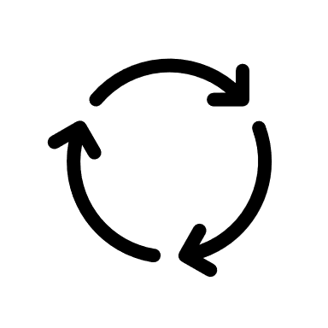




Slide 3
Data Preprocessing
Test / Train Data
Data shape control .. etc

Slide 4
 | Train |  |  |  |  |  |  |  | Test
Features | 1 | 2 | 3 | 4 | 5 | 6 | 7 | 8 | 8 | 9 | 0
Label | 1 | 2 | 3 | 4 | 5 | 6 | 7 | 8 | - | - | -

Slide 5
Model Define
Layer
Activation function
Loss function
Optimizer

Slide 6
운동 시간 (x) | 체중 감소량 (y)
1 | 0.5
3 | 1
5 | 2
6 | 1.8
10 | 3

Slide 8
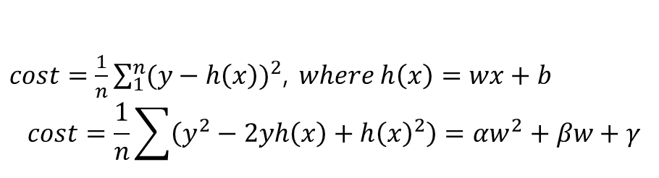

h(x)=wx+b
$$h\left(z\right)=\frac{1}{1+e^{−z}} , where z=wx+b$$
$$w^{′}=w−αf^{′}(w)$$
$cost=\frac{1}{n}\sum_{1}^{n}{{(y−h\left(x\right))}^{2}}$, $where h\left(x\right)=wx+b$
$$cost=\frac{1}{n}\sum{\left(y^{2}−2yh\left(x\right)+{h\left(x\right)}^{2}\right)=αw^{2}+βw+γ}$$

Slide 9
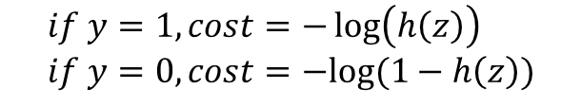


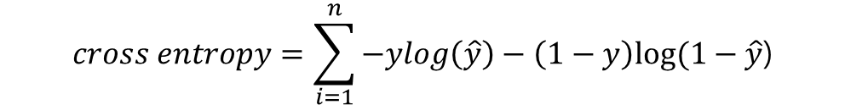
$$cost=\frac{1}{n}\sum_{j=1}^{n}{\sum_{i=1}^{k}{−y_{i}^{j}log\left({{\hat{y}}^{j}}_{i}\right)} }$$
$$if y=1, cost=−\log\left(h\left(z\right)\right) \\ if y=0, cost=−log⁡(1−h\left(z\right))$$
$cross entropy=−ylog\left(\hat{y}\right)−\left(1−y\right)log⁡(1−\hat{y}$)
$$cross entropy=\sum_{i=1}^{n}{−ylog\left(\hat{y}\right)−\left(1−y\right)log⁡(1−\hat{y}\text{)}}$$
$$cost=\frac{1}{n}\sum_{i=1}^{n}{−ylog\left(\hat{y}\right)−\left(1−y\right)log⁡(1−\hat{y}\text{)}}$$

Slide 10
 | 1
1 | 1 | 1
 | 1
마지막엔 일렬로 펼쳐서..
4 | 2 | 1 | 0
2 | 2 | 0 | 0
1 | 0 | 0 | 0
0 | 0 | 0 | 0
 | 1
1 | 1 | 1
 | 1
…
…
필터
(3x3)
풀링(2x2)
피쳐맵
(4x4)
(풀링을 통한)
피쳐맵
(2x2)
입력 이미지
(6x6)
밀집층으로 보낸다

