Slide 1
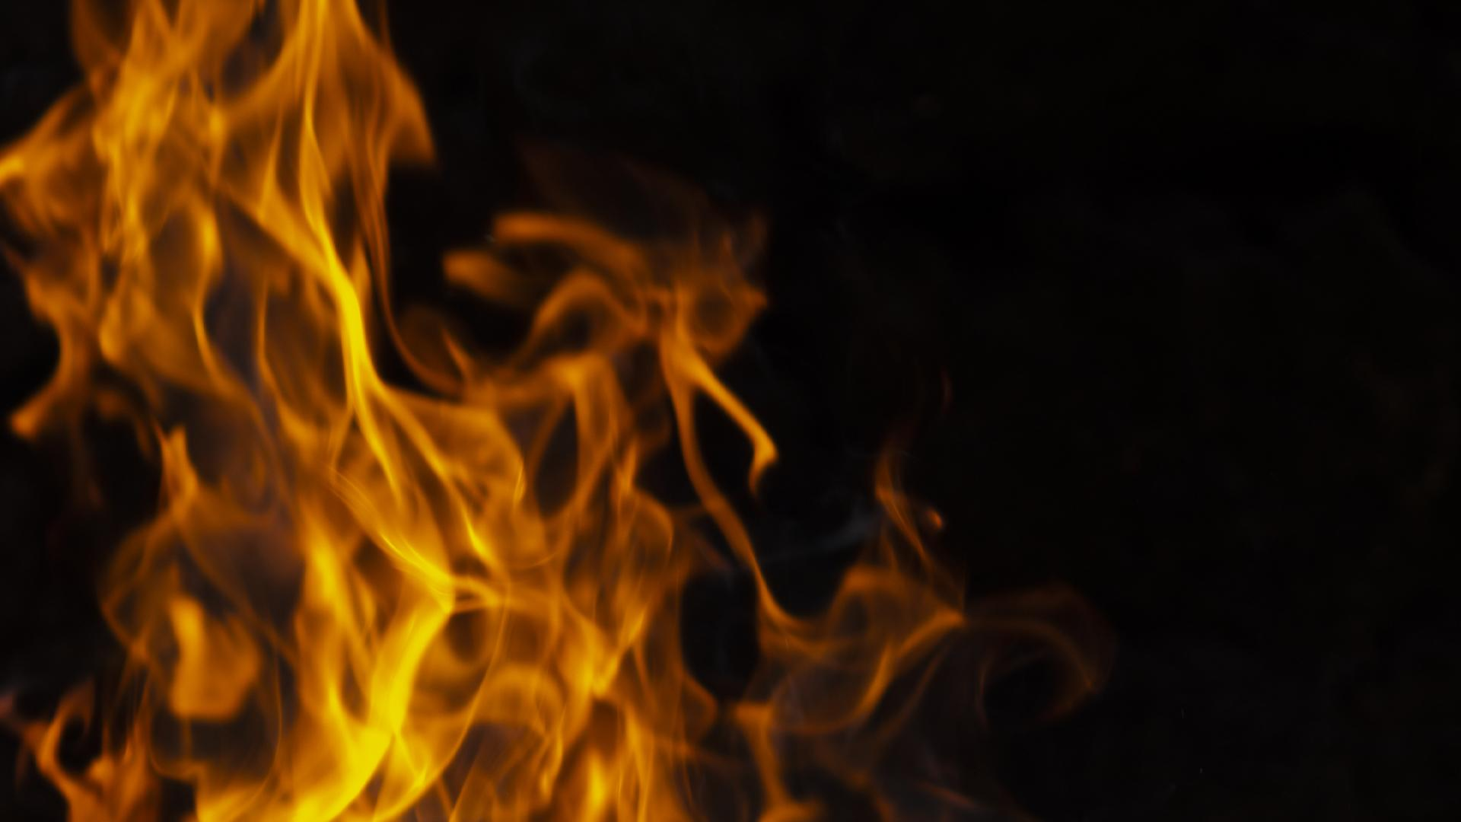
Wildfire
Oregon Department of Forestry
2002 - 2023
Myriah Hodgson

Slide 2
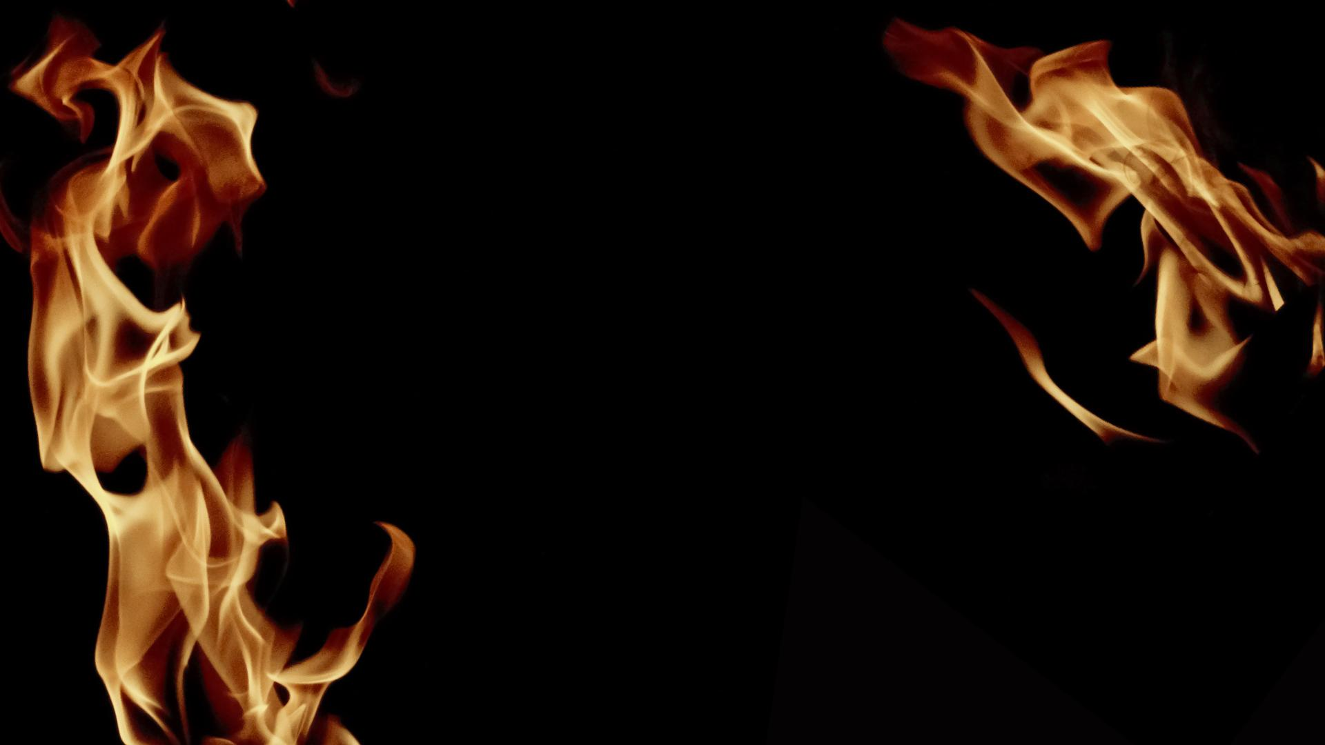
Human Or Lightning?
The two primary causes of Oregon wildfires
How many acres have these fires burned?
Where, on average, do these fires occur?

Slide 3
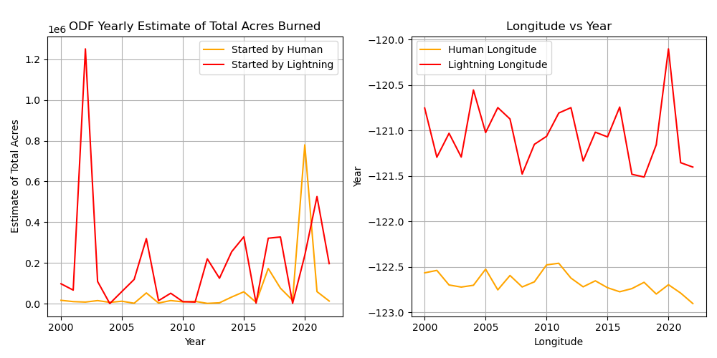


Slide 4
Let’s take another, more locationally visual, approach at sonifying human and lightning started Oregon wildfires…

Slide 5
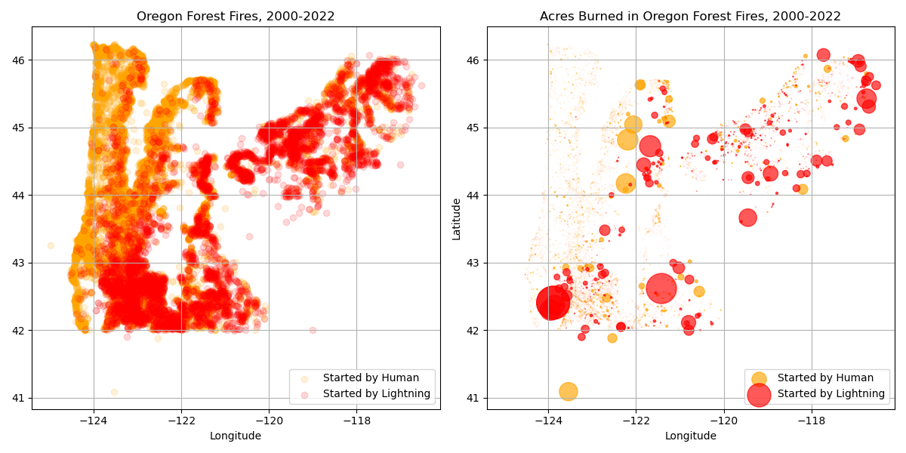

Slide 6
What types of land do these fires occur on?
Depending on the type of land, does the duration of time it typically takes to control the fire change?

Slide 7
