Slide 1

KING FAHD UNIVERSITY OF PETROLEUM & MINERALS
BUSINESS SCHOOL
DEPARTMENT OF INFORMATION SYSTEM & OPERATIONS MANAGEMENT
MANAGEMENT SCIENCE OM 511
03 – Sensitivity Analysis
Dr. Igor Barahona
DHAHRAN, SAUDI ARABIA

Slide 2
Sensitivity analysis (SA)
SA is about how the changes on objective function or constrains affect the optimal solution. Two questions emerge from above
1. How a change in the coefficients of the objective function will affect the optimal
solution? (reduced cost)
2. How a change in the right-hand-side value for a constraint will affect the optimal solution? (shadow price)

Slide 3
Sensitivity analysis
Why Sensitivity Analysis is important?
Prices of raw materials change
Product demand changes
Companies purchase new machinery,
Storage prices fluctuate
Employee turnover occurs

Slide 4
Sensitivity analysis
The range of optimality comprises the domain on which coefficient values (both: objective function and constrains) throw an optimal solution
Attention should be focused on coefficients that
Have a narrow range of optimality
Near to end points of the range

Slide 5
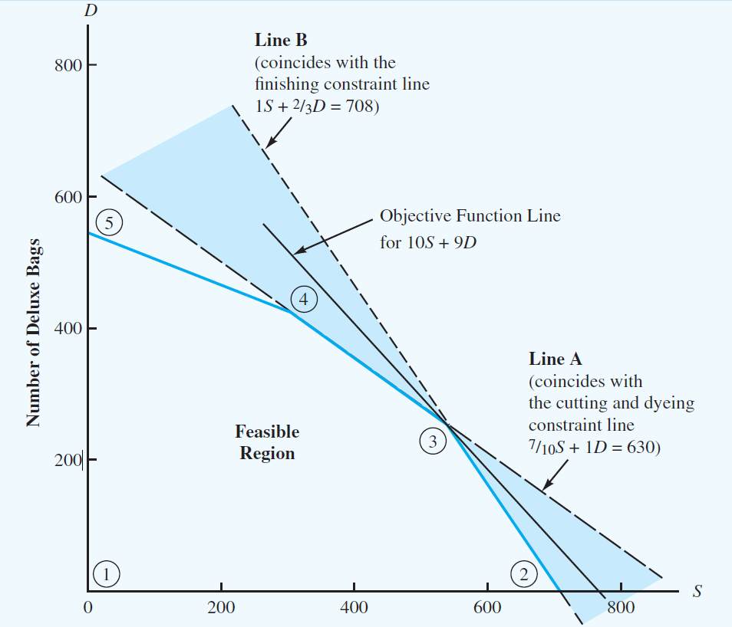
Sensitivity analysis

Slide 6
Sensitivity analysis
As long as the slope of the Objective Function (OF) is between the slope of lines A and B point 3 will be optimal (S=540 and D=252)
Changing an OF coefficients will cause the slope change
Rotating the OF clockwise causes the slope to become more negative
Slope of Line A provides an upper limit for the slope of the OF

Slide 7
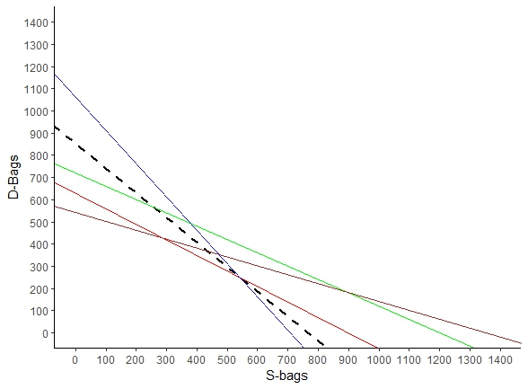
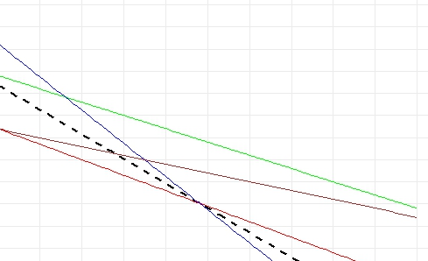

Sensitivity analysis
Line A
Line A
Line B
Line B

Slide 8
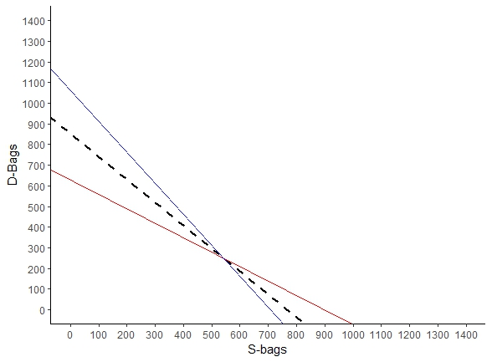
Sensitivity analysis
Line A
O.Func
Line B
Figure 3.1, page 98, chapter 3, Anderson’s book

Slide 9
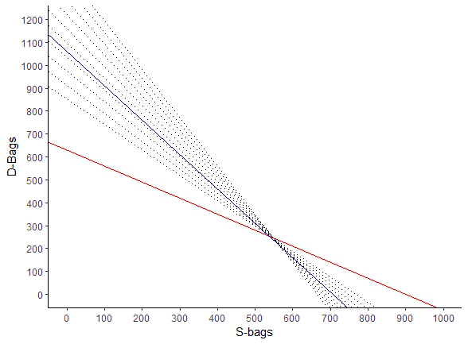
Rotating the OF clockwise causes the slope to become more negative
Slope of Line B provides an upper limit for the slope of the OF
Line A
Line B
Figure 3.1, page 98, chapter 3, Anderson’s book

Slide 10
Rotating the OF clockwise causes the slope to become more negative
Slope of Line B provides an upper limit for the slope of the OF
Line A
Line B
Figure 3.1, page 98, chapter 3, Anderson’s book

Slide 11
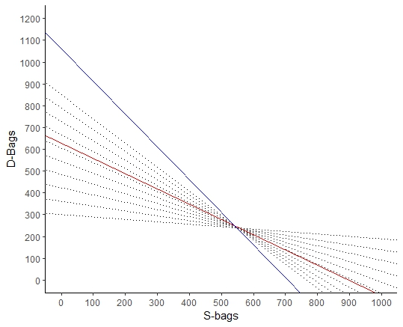
Rotating the OF counter clockwise causes the slope to become less negative
Slope of Line A provides an lower limit for the slope of the OF
Line A
Line B
Figure 3.1, page 98, chapter 3, Anderson’s book

Slide 12
Rotating the OF counter clockwise causes the slope to become less negative
Slope of Line A provides an upper limit for the slope of the OF
Line A
Line B
Figure 3.1, page 98, chapter 3, Anderson’s book

Slide 13
Sensitivity analysis
From previous charts we conclude that :
Slope of Line A <= Slope Objective function <= Slope of Line B
As long as O.Func is between Line A and Line B the optimal solution remains the same.
When final value is equal to RH constrains, then there is not slack. All available resources are being used completely
Shadow price: How objective function changes while units in constrains are added or removed ¿How optimal solution changes by adding / removing recourses?

Slide 14
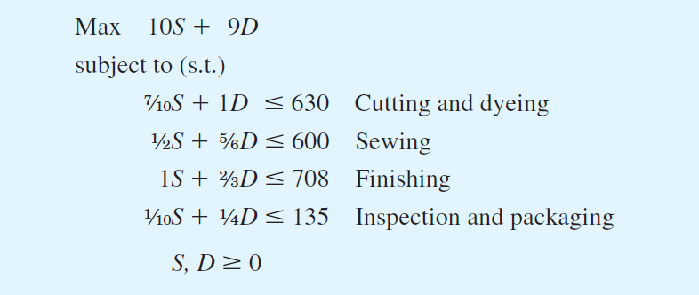
Practical example

Slide 15
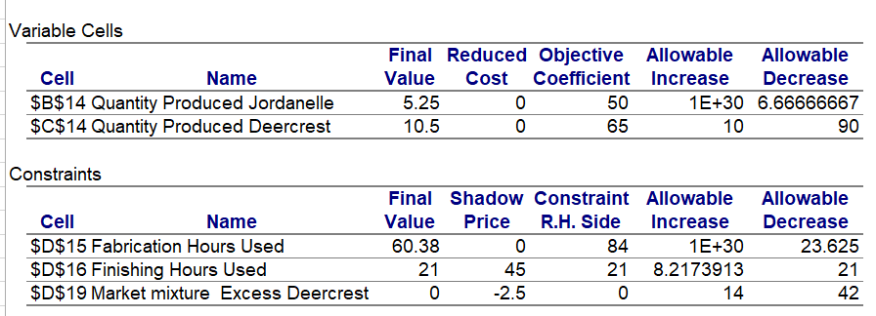
Sensitivity analysis Excel Solver
SA report consist into two parts
Cell Variables
Constraints section

Slide 16
Sensitivity analysis Excel Solver
The reduced cost value indicates on what extend optimal value (Z) is changing for a unit increase in that decision variables
Positive reduced-cost shows that a unit increase on decision variables will result in a increase on the optimal value (Z).
A negative reduced-cost indicates that a unit increase in decision variables will result in a decrease on the optimal value (Z).

Slide 17
Sensitivity analysis Excel Solver
Allowable increase and allowable decrease refers to the intervals inside of which changes on Coefficients (Objective Function) don’t affect the Optimal Solution.
When changes on Coefficients (Objective Function) are either higher or lower than allowable intervals, then Optimal Solution is not valid.

Slide 18
Sensitivity analysis Excel Solver
Shadow prices refers to what extent the optimal value (Z) will change as result of adding or removing resources on constrains.
Shadow price equal to zero indicates that one additional unit of that constrain will not affect the optimal value (Z) (e.g. no additional profits)
Negative shadow prices indicate that changing the constrain value in one unit, will decrease the optimal value (Z)
A negative shadow price indicates that loosening (or increasing the right-hand side) of a constraint will decrease the objective function value. Tightening (or decreasing the right-hand side) will increase the objective function value.

Slide 19
Sensitivity analysis Excel Solver
If the objective is to maximize profit and a resource constraint has a shadow price of $10, it means that increasing the availability of that resource by one unit would increase the profit by $10.
If the objective is to minimize cost and a constraint has a shadow price of $5, relaxing the constraint by one unit would reduce the cost by $5.

Slide 20
Sensitivity analysis Excel Solver
Allowable increase and allowable decrease values refers to the extend the Right Side Constrain can change before the optimal value (Z) in not further valid.
If RS constraint increases by an amount greater than the allowable increase the shadow price will not be valid any more.
On the other hand, If RS constrain decreases by an amount more than the allowable, the shadow price changes will not be valid any more.

Slide 21
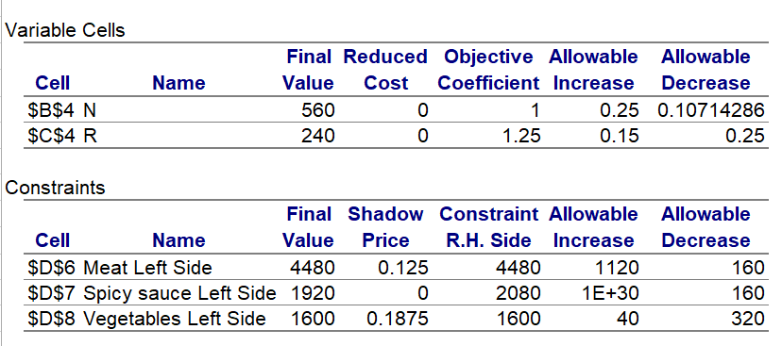
SA report consist into two parts
Cell Variables
Constraints section

Slide 22
Refer to the Kelson Sporting Equipment problem (Chapter 2, Problem 24). Letting
R= number of regular gloves
C= number of catcher’s mitts
Objective Function
5R + 8C >> MAX
s.t.
R + 3/2*C <= 900
½*R + 1/3*C <= 300
1/8*R + ¼*C <= 100
R,C => 0
Find the optimal solution
Which constraints are binding?
What are the dual values for the resources? Interpret each.
If overtime can be scheduled in one of the departments, where would you recommend doing so?
Prepare your solution either using Excel Solver or Pulp python

Slide 23
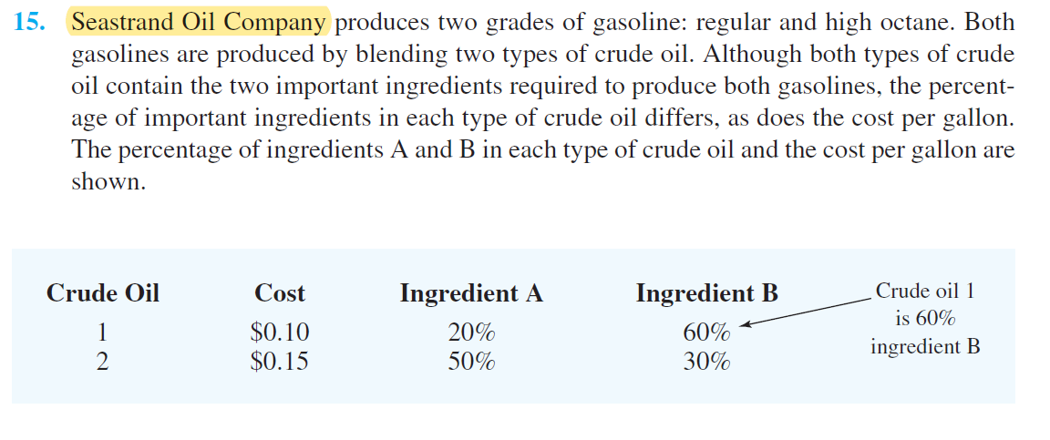
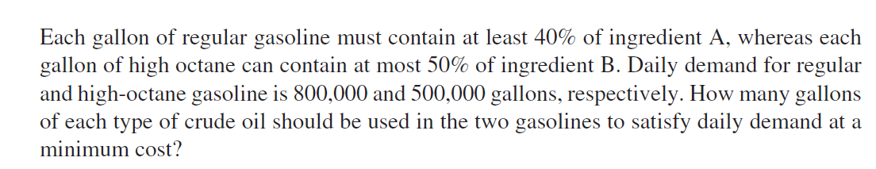

Slide 24
Exercise in class
Arrange teams up to 5 participants
Based on the SeaStrand case of study, your team will find the following
2.1 Settle the linear programming model
2.2 Write the mathematical formulation
2.3 Calculate how many gallons of each type of crude satisfy the minimal cost by using Excel Solver

Slide 25

Exercise in class
KFUPM Investment Club is working on designing a strategy for allocating founds among six possible alternatives, as it is illustrated on the Table.
Decision makers have collected information about return rate and risk associated to each alternative. The risk is measured in an index between 0 and 1, on which the higher the index, the higher the volatility and therefore more uncertainty.
Alternative | Annual Return Rate | Price / Stock | Risk
NVIDIA | 168.3% | $120.30 | 0.17
Apple Inc | 34.1% | $256.16 | 0.32
Amazon | 45.3% | $183.55 | 0.41
Tesla | 3.9% | $256.23 | 0.48
Google (Alphabet Inc Class A) | 23.8% | $166.23 | 0.22
Cash / Savings | 2.0% | ---- | 0.0

Slide 26
Exercise in class
A conservative strategy implies the average risk for the overall portfolio is lower or equal to 0.25.
A moderate strategy comprises that the average risk for the overall portfolio should be between 0.26 and 0.39
An aggressive strategy comprises an average risk higher or equal to 0.40
The considerations for the Club members are:
No more than 50% of the total investment may be in Google (Alphabet Inc Class A)
The amount invested on Apple should be at least the amount invested on Amazon.
At least the 5% of the investments, should be kept on cash
The plan comprises to allocate 100,000 USD based on the proposed model.
What is the optimal portfolio allocation for a conservative, moderate and aggressive strategy given the previous considerations?

Slide 27
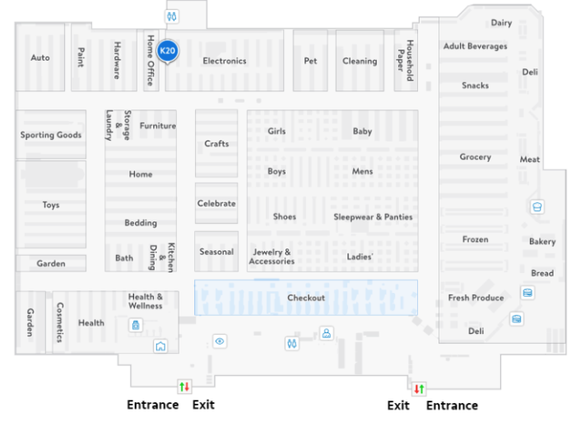
Jarir Book store is planning to open a new store in Damman. The architects calculated that the store has 100,000 square meters of area. Besides the business analytics department made the following projections based on the current demand.

Slide 28
Department | Investments sf | Risk (% of invested) | Minimum sf | Maximum st | Expected profit per st
Video games X1 | 100 | 24 | 7,000 | 30,000 | 13.0
Office supplies X2 | 50 | 12 | 11,000 | 30,000 | 7.0
Arabic books X3 | 30 | 5 | 3,000 | 5,000 | 3.0
Smart TVs x4 | 600 | 10 | 2,000 | 42,000 | 30.0
Laptops X5 | 900 | 14 | 1,000 | 11,000 | 20.0
School X6 | 50 | 2 | 1,000 | 7,000 | 2.0
Smart phones X7 | 400 | 3 | 12,000 | 40,000 | 14.0

Slide 29
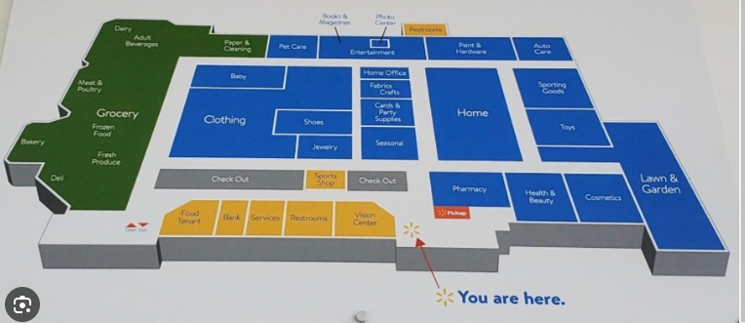
Jarir Book store is planning to allocate 200 million SAR for the new store. The risk column refers to the associated risk for investing on the floor based on historical data. The amount of risk should be no more than 10% of the total investment.
a. Develop a linear optimization model to maximize profit.
b. If the chain obtains another $1 million of investment capital for stock, what would the new solution be?

Slide 30
Exercise in class
Arrange teams up to 5 participants
Based on the Jarir Bookstore case of study, your team will find the following
2.1. Configure the linear programming model
2.2. Write the mathematical formulation this this model.
2.3. Calculate how many cost by using Excel Solver

Slide 31
