Slide 1
Chapter 1
Differing Perspectives on Quality

Slide 2
Have you ever thought?
Why Does One iPhone Cost $800 and Another 'Smartphone' Cost $200? Both have screens, cameras, processors, and can make phone calls.
So why is one worth 4x the price?
Is it performance? Features? Reliability? Brand? How does it feel in your hand?
Today, we'll discover that quality is NOT one-dimensional—different people, functions, and cultures see it very differently. By understanding these differences, you'll see why organizations often struggle internally when different departments pursue conflicting quality goals.

Slide 3
Chapter Objectives
Recognize that different dimensions of quality exist.
Be able to discuss the quality dimensions.
Communicate the seven different functional perspectives on quality.
Understand why it is important to know that different perspectives exist.
Define a quality system using the three spheres.
Understand how the three spheres complement each other.
Understand the value-added perspective on quality.
Discuss differing cultural perspectives on quality.

Slide 4
Product Quality Dimensions
Performance – Efficiency with which a product achieves its intended purpose
Features – Attributes of a product that supplement the product’s basic performance
Reliability – The tendency for a product to perform consistently over its useful design life
Conformance – Adherence to certain numeric dimensions for the product’s performance
Garvin, D., “What Does ‘Product Quality’ Really Mean?” Sloan Management Review (Fall 1984): 25-43.
Notes:
Performance: This might be the return on a mutual fund investment, the fuel efficiency of an automobile, or the acoustic range of a pair of stereo speakers. Better performance is usually synonymous with better quality.
Features: They include many of the “bells and whistles” contained in products. A visit to any television or computer retail store will reveal that features such as surround sound, HDTV capability, 3-D, and size are powerful marketing tools for which customers will pay a premium.
Reliability: A subfield in quality management has emerged, called reliability management, based on the application of probability theory to quality. A product is considered reliable if the chance that it will fail during its designed life is very low. For example, if a refrigerator has a 2% chance of failure in a useful life of 10 years, we say that it is 98% reliable.
Conformance is perhaps the most traditional dimension of quality. When a product is designed, certain numeric dimensions for the product’s performance are established, such as capacity, speed, size, durability, or the like. These numeric product dimensions are referred to as specifications.

Slide 5
Product Quality Dimensions
Durability – The degree to which a product tolerates stress or trauma without failing
Serviceability – The ease of repair for a product (easily and cheaply)
Aesthetics – The degree to which product attributes are matched to consumer preferences
Perceived quality – A customer’s understanding of the goodness of a product
Garvin, D., “What Does ‘Product Quality’ Really Mean?” Sloan Management Review (Fall 1984): 25-43.
Notes:
Durability: An example of a product that is not very durable is a lightbulb. Lightbulbs are damaged easily and cannot be repaired. In contrast, a trash can is a very durable product that can be subjected to much wear and tear.
Serviceability: A product is very serviceable if it can be repaired easily and cheaply. Many products require service by a technician, such as the technician who repairs your personal computer. If this service is rapid, courteous, easy to acquire, and competent, the product generally is considered to have good serviceability.
Aesthetics: Although vinyl interiors in automobiles require less maintenance, are less expensive, and are more durable, leather interiors are usually considered more aesthetically pleasing. We measure aesthetic quality as the degree to which product attributes are matched to consumer preferences.
Perceived quality: We can witness an example of the effect of perceived quality every year in college football polls that rank teams. In many cases, the rankings are based on past records, team recognition, university tradition, and other factors that are generally poor indicators of team quality on a given Saturday. In the same way that these factors affect sportswriters’ perceptions, factors such as brand image, brand recognition, amount of advertising, and word of mouth can affect consumers’ perceptions of quality.

Slide 6
Open Discussion
Think of a product you own and love—a laptop, car, watch, or coffee maker. Why do you think it's high quality? What matters most to you—performance, how it looks, reliability, price, or something else?

Slide 7
Service Quality Dimensions
Tangibles – The physical appearance of the service facility, the equipment, the personnel, and the communication materials
Service reliability – The ability of the service provider to perform the promised service dependably and accurately
Responsiveness – The willingness of the service provider to be helpful and prompt in providing service
Assurance – The knowledge and courtesy of employees and their ability to inspire trust and confidence
Empathy – Caring, individualized attention from the service firm
Notes:
Tangibles: For example, a hotel with yellowed linens will be rated low for quality. Hair salons catering to an elite clientele might invest in ambient lighting and employ only well-dressed hairstylists. That the hairstylist is dressed well does not affect the service being provided; however, clients believe that their hair will be better styled by someone who is dressed stylishly.
Service reliability: For example, a firm might hire a consultant based on reputation alone. If the consultant delivers what the customer wants, the customer will be satisfied and pay the consultancy fee. If the consultant delivers something other than what the customer expects, the customer will not pay the consultancy fee.
Responsiveness: When you last called your bank for service, how long did it take for a response? Were your problems taken care of quickly, or did you have to wait while you listened to “elevator music” for an hour? Does your service provider always respond to you within three rings of the phone—without forwarding your call to another location?
Assurance: If you needed heart surgery, you probably would not opt for a doctor who appeared forgetful and disorganized during an office consultation. Rather, you would want assurance that the doctor is competent.
Empathy: A maxim in the restaurant industry is that “if you are in it for the money, you probably won’t survive.” A restaurant in which the employees are constantly focused on efficiency will not give the customers the feeling that their needs are important. Therefore, no empathy will be shared, and restaurant employees will not adequately provide service that will make customers want to return again and again.

Slide 8
Open Discussion
Have you ever returned a product or been unhappy with a service?
Why?
Was it because it didn't work, or because of something else, like slow customer service, poor appearance, or unfulfilled promises?

Slide 9
Functional Perspective on Quality
The functional perspective on quality views the organization like a body—each function (operations, marketing, finance, HR, engineering, supply chain) has its own definition and priorities for quality, and overall quality depends on how well these parts work together rather than in isolation.
Notes:
Just as the body is subject to breakdown when different parts do not perform properly, so are organizations.
Unfortunately, firms do not have the magnificent communication network (i.e., the central nervous system) to coordinate activities that human bodies have.
For this reason, firms must constantly improve their communication. Recognizing fundamental differences between how different functions view quality is an important first step in understanding and resolving problems associated with mismatches of quality perceptions within organizations.

Slide 10
A Supply Chain Perspective
Global supply chain model:
  Upstream processes (supply management) – All activities involving interaction with suppliers
  Core processes (operations management) – Traditional process improvement
  Downstream processes (customer relationship management) – All activities involving interaction with customers
Notes:
In recent years, supply chain management has moved to the forefront in importance. This is largely due to the opportunity for cost savings, along with quality and service improvement. There are many important quality-related activities that are part of supply chain management. We discuss these separately as upstream activities, core processes, and downstream activities.

Slide 11
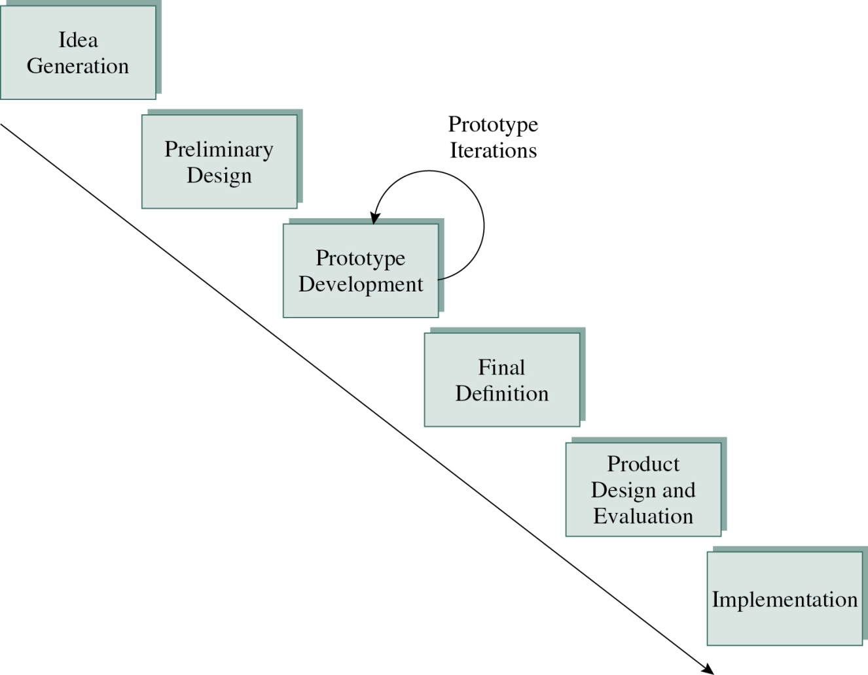
An Engineering Perspective
Engineering:
Applying mathematical problem-solving skills and models to the problems of business and industry
Figure 1-2
Notes:
Product design engineering involves all those activities associated with developing a product, from concept development to final design and implementation.
Product and process design are fields of engineering that have experienced major changes in recent years. Whereas traditionally they were considered separate and in most cases sequential activities, concurrent engineering has resulted in the simultaneous performance of these activities.
Reliability engineers use probability theory to determine the rate of failure that a product will experience over its useful life. Life testing is a facet of reliability engineering that determines whether a product will fail under controlled conditions during a specified life.
If a component has a relatively high probability for failure that will affect the overall function of a product, redundancy is applied so that a backup system can take over for the failed primary system. Many redundant systems are used on the NASA space shuttle in case of primary system breakdown. After all, if a hard drive crashes in space, it is not easy to find a replacement close by.

Slide 12
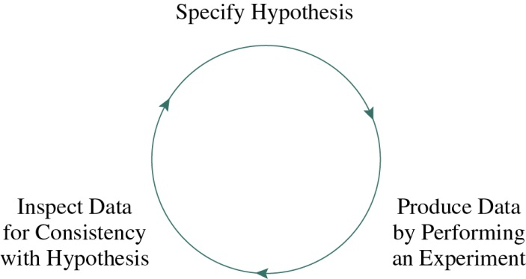
An Engineering Perspective
Shewart’s control process:
The process underlying Statistical Process Control (SPC)
Figure 1-3
Notes:
Statistical process control (SPC), is concerned with monitoring process capability and process stability. If a process is capable, it will consistently produce products that meet specifications.
If a process is stable, it will only exhibit random or common cause variation instead of nonrandom special cause variation. This type of variation is often acceptable, if kept within limits.
The control process, as specified by Walter Shewhart in his book Statistical Method from the Viewpoint of Quality Control (1939), is shown in Figure 1-3. This is the process underlying SPC. A hypothesis is specified that the process meets a given specification, data about the process are gathered, and a hypothesis test is performed to see if the process is stable.

Slide 13
An Operations Perspective
Systems view:
Understanding that product quality results from the interactions among several variables, such as machines, labor, procedures, planning, and management.
Focuses management on the system as the cause of quality problems.
Notes:
The historically internally-focused view of operations managers has become externalized. Still, the customer needs to become more central in the thinking of many operations managers who still tend to be too product focused. This will occur as operations management becomes more service oriented.

Slide 14
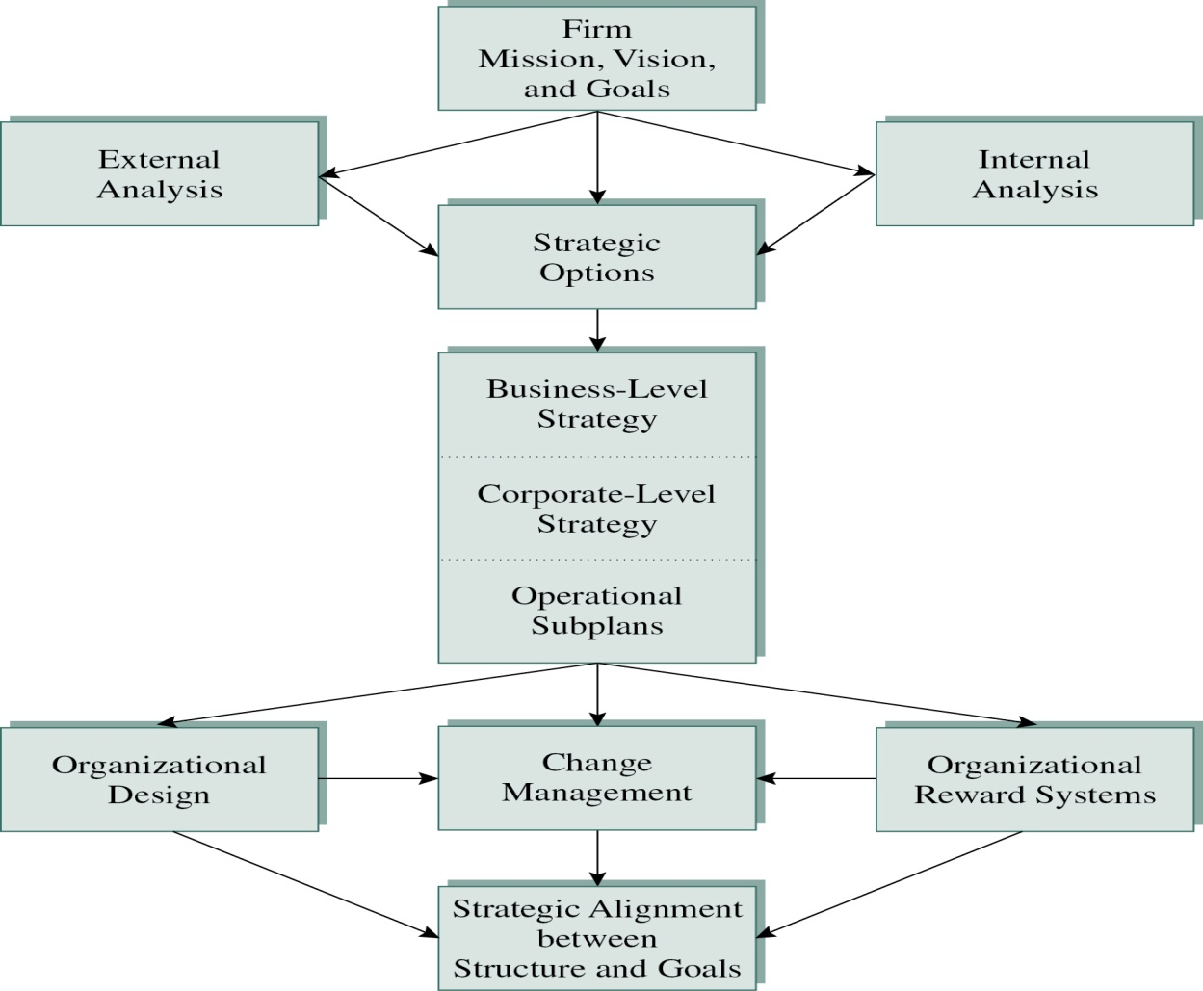
A Strategic Management Perspective
Strategy
The planning process used by an organization to achieve a set of long-term goals
Mission
Why the organization exists
Core values
Guiding principles that simplify decision-making in that organization
Figure 1-4
Notes:
Figure 1-4 shows a generic strategic planning process and its components. Based on the analysis of mission, vision, and goals, strategic options and business-level and functional-level strategies are developed.

Slide 15
A Marketing Perspective
Marketing
Activities involved with directing the flows of products and services from the producer to the consumer
Customer relationship management
Satisfying the customer and delivering value to the customer
Perceived quality
The customer’s view of quality
Notes:
If all customers are satisfied, sales increase exponentially! Therefore, more firms are focusing on relationship management, which increases the importance of high levels of customer service and after-sales support.

Slide 16
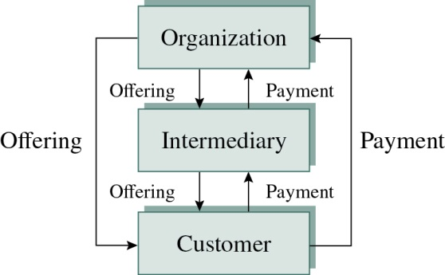
A Marketing Perspective
Primary marketing tools for influencing customer perceptions of quality are price and advertising.
The customer is the focus of marketing-related quality improvement.
Figure 1-5
Notes:
The marketing perspective on quality is unique because the customer is the focus of marketing-related quality improvement. In trying to satisfy customer needs, marketing often wants to develop specialized products for different customers to perfectly satisfy customer needs. This can make life more difficult for producers because operations wants to standardize products to reduce processing complexity. Often, quality strategies result in a compromise between these two polar positions.

Slide 17
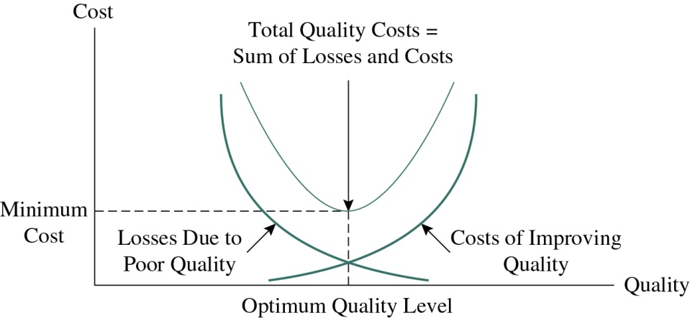
A Financial Perspective
The law of diminishing marginal returns:
There is a point at which investment in quality improvement will become uneconomical.
The pursuit of higher levels of quality will result in higher expenditures.
Investing beyond the minimum cost level will result in non-economic decisions
Figure 1-6
Notes:
One of the most commonly-asked questions about quality management is “Will it pay us financial benefits?” The answer to this question is an unqualified “maybe.” When implemented correctly, improved quality reduces waste and can lead to reduced cost and improved profitability. However, these returns tend to be long term rather than short term.

Slide 18
The Human Resources Perspective
Employee empowerment
Moving decision-making to the lowest level possible in the organization.
Organizational design
Design of reward systems, pay systems, organizational structure, compensation, training mechanisms, and employee grievance arbitration.
Job analysis
Collecting detailed information about a particular job.
Notes:
Human resources (HR) managers are involved in enabling the workforce to develop and use its full potential to meet the company’s objectives. Understanding the HR perspective on quality is essential because it is impossible to implement quality without the commitment and action of employees. Although leadership is an important antecedent to successful quality efforts, the involvement and participation of employees is just as key. After all, it is the rank and file that implements quality throughout the organization.

Slide 19
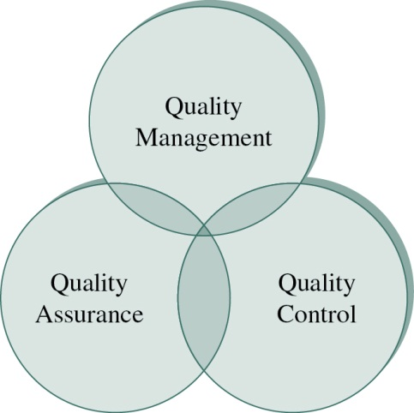
The Three Spheres of Quality
Quality control
Based on the Scientific Method
Quality assurance
Activities associated with guaranteeing the quality of a product or service
Quality management
Ties together the control and assurance activities
Figure 1-7
Notes:
One way to conceptualize the field of quality management is known as the three spheres of quality. These spheres are quality control, quality assurance, and quality management, and their functions overlap, as seen in Figure 1-7.

Slide 20
Other Perspectives on Quality
Value-added perspective
A subjective assessment of the efficacy of every step of the process for the customer
Cultural perspectives
Differences in tastes and preferences among different cultures
Contingency theory perspective
There is no theory or method for operating a business that can be applied in all instances
Notes:
Value-added perspective on quality: A value-added activity can be pinpointed by asking, “Would this activity matter to the customer?” In other words, in most cases, a value-added activity will have economic value to the customer.
Cultural perspectives on quality: American firms are more likely to favor empowerment approaches that reward creativity and individualism. Certainly, cultures that are more class conscious or command-and-control-oriented might have trouble delegating decision making to lower levels of employees.
Contingency theory perspective on quality: The contingency approach to quality also helps settle the different perceptions concerning the definition of quality. By adopting a contingency philosophy, we find that the definitions and dimensions of quality applied within organizations will (and should) vary.

Slide 21
Conclusive Remarks
Today, we learned that quality is not one thing. It is:
Eight product dimensions (Performance, Features, Reliability, Conformance, Durability, Serviceability, Aesthetics, Perceived Quality)
Five service dimensions (Tangibles, Reliability, Responsiveness, Assurance, Empathy)
Seven functional perspectives (Supply Chain, Engineering, Statistical Control, Operations, Strategy, Marketing, Finance, and HR)
Different cultural values–What is 'good quality' in Germany is not the same as in Japan or Saudi Arabia.

Slide 22
If your organization does not align these perspectives
“Then you will have internal conflict.”
Engineering will design for reliability; Marketing will promise features engineering can't deliver. Operations will want standardization; Sales will want customization, Finance will say 'spend less’, HR will say 'invest in employees’, Operations will say ‘improve quality.'
Your job as a supply chain and procurement professional is to understand these different lenses so that you can:
Communicate quality in language that each function understands.
Find the balance—compromise, not conflict.
Make strategic sourcing decisions that serve the whole organization, not just one department.

