Slide 1




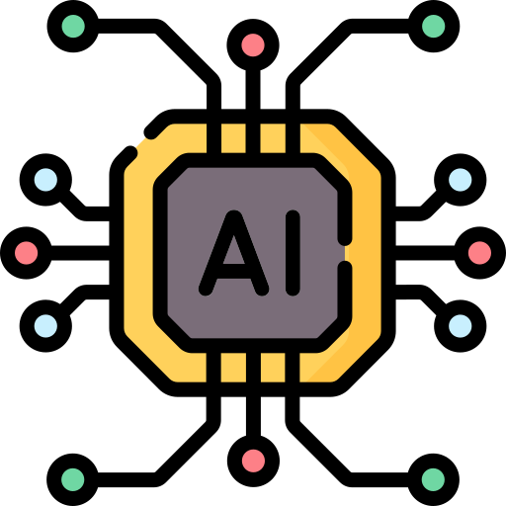

MIS 393 Digital Transformation in Business

Slide 2
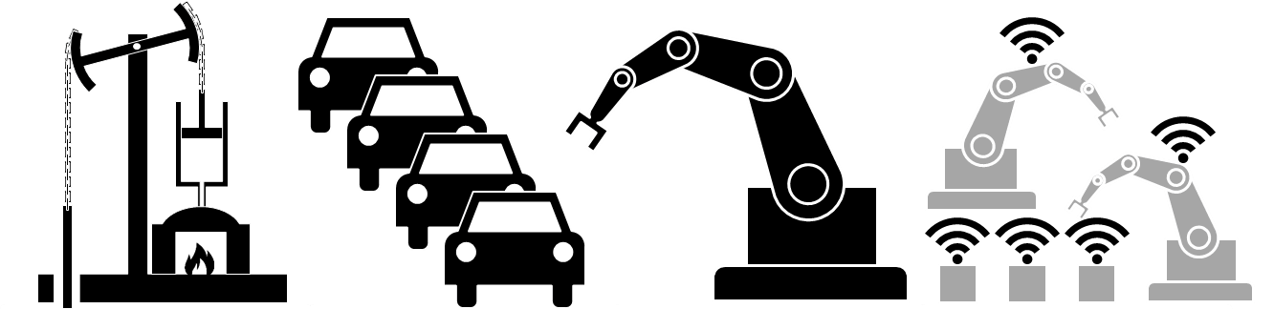
History of Technological Revolution: The Four Industrial Revolutions

Slide 3
Objectives
Understand the Historical Context of Technological Evolution.
Analyze the Impact of Revolutions on Society and Economy.
Differentiate Between Information Technology and Digital Technology.
Understand the Levels of Artificial Intelligence.

Slide 4
Technological Evolution
To know the present and future, you must learn the past.
Why a Revolution?
The word “revolution” denotes abrupt and radical change.
Revolutions have occurred throughout history when new technologies and novel ways of perceiving the world trigger a profound change in:
Economic systems
Social structures.
فِيهِ لنفسِ العاقِلِ اعْتِبَارُ
كيف آتَى القوْمُ وكيف صاروا
فَيُثْبِتُ الحق بِسَهْمٍ صائِبٍ
ويَتْرُكُ الجهل لِأَهْل الجهلِ
وبعدُ فالتاريخُ والأخبارُ
وفِيهِ للمُسْتَبْصِرِ اسْتِبْصَارُ
يُمْضِي على الحاضِرِ حُكْمَ الغائِبِ
ويَنْظُرُ الدنيا بعين النُبْلِ
لسان الدين ابن الخطيب

Slide 5


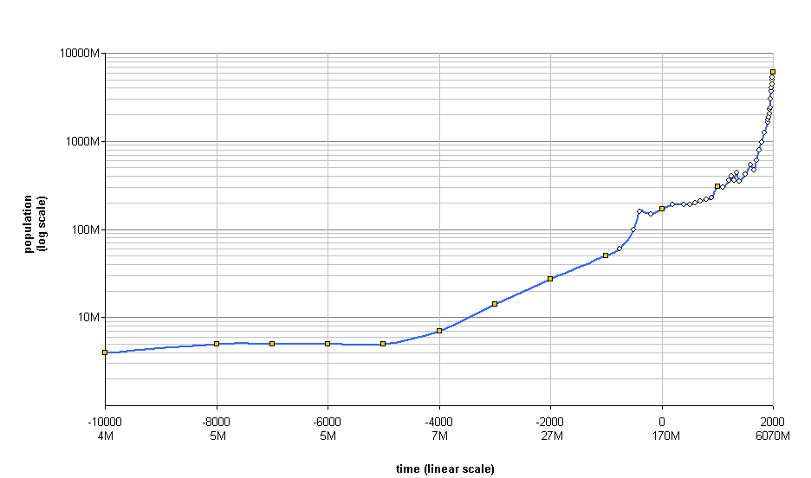
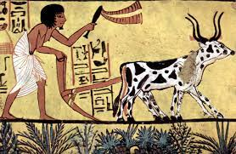
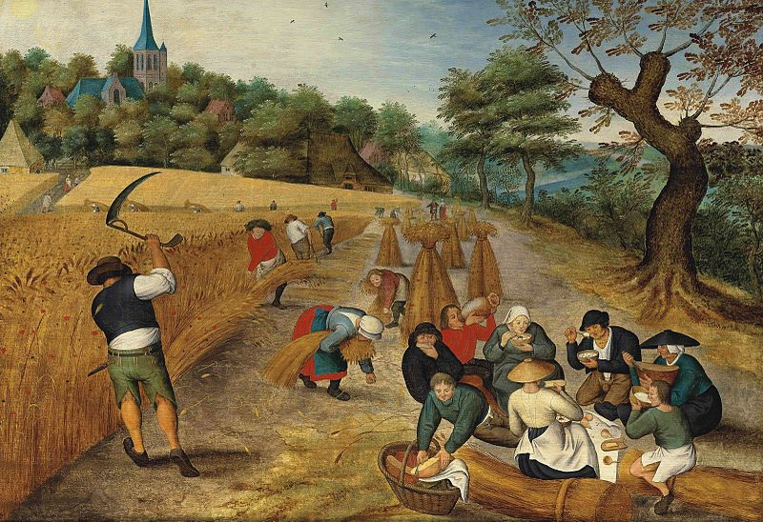
Technological Evolution
~ 10,000 years ago → Agricultural revolution.
From hunting and gathering to one of agriculture and settlement.
Domestication of animals.
Production, transportation and communication.
Results:
Food production improved.
population growth.
Development of large societies.

Slide 6
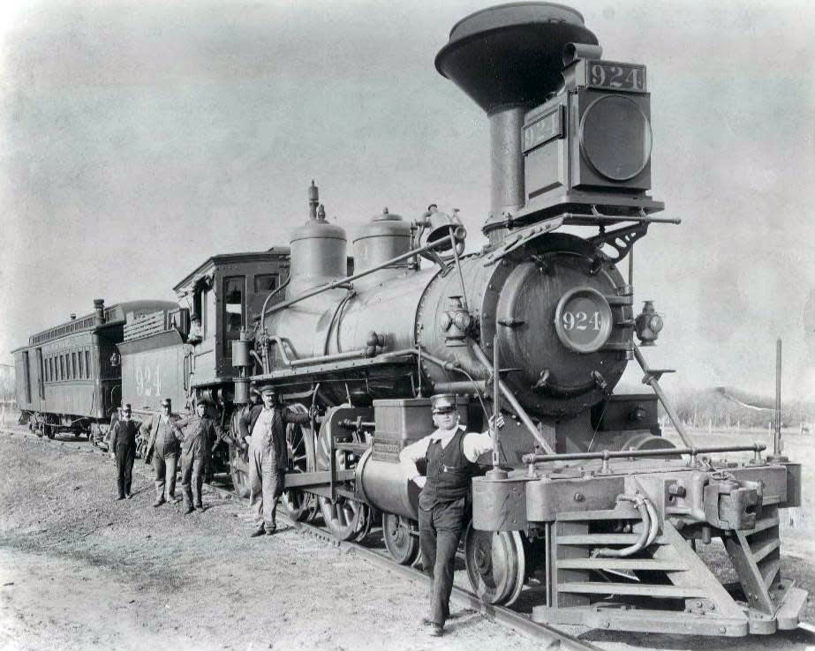
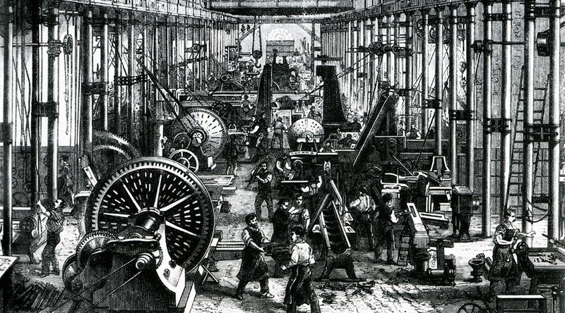
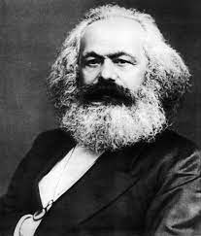
Technological Evolution
First Industrial Revolution:
~ From 1760 to 1840.
From muscle power to mechanical power.
Technologies:
Construction of railroads.
Invention of the steam engine.
Factory System.
Changes:
Mid-class .
Population growth.
Capitalism.

Slide 7
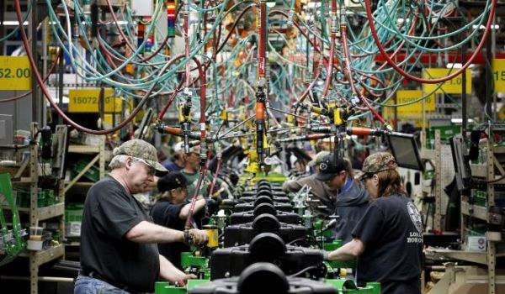
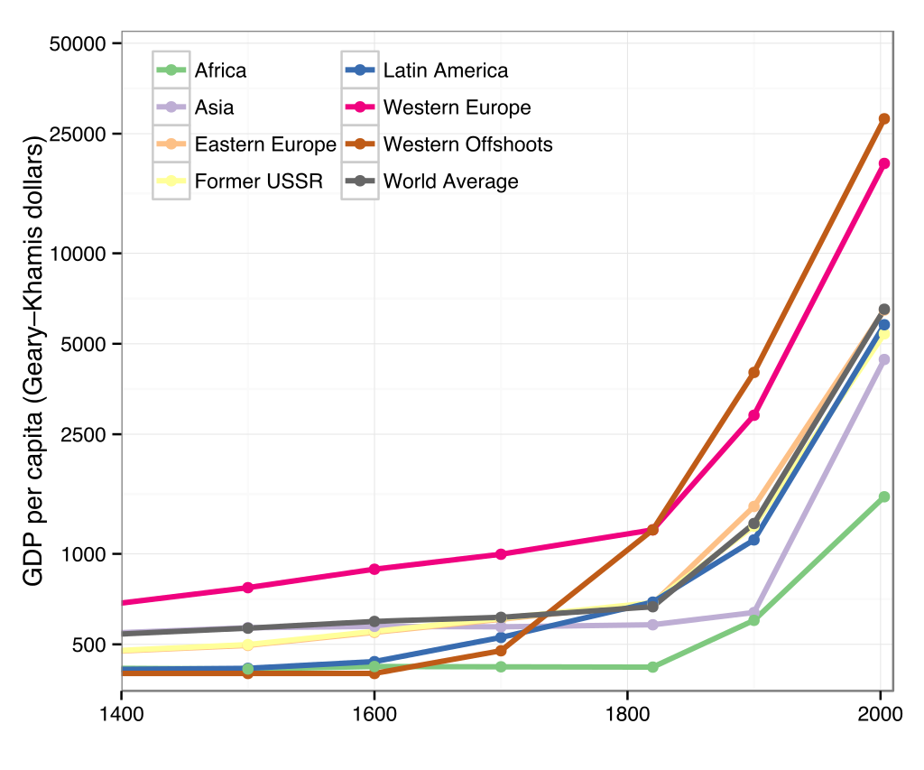
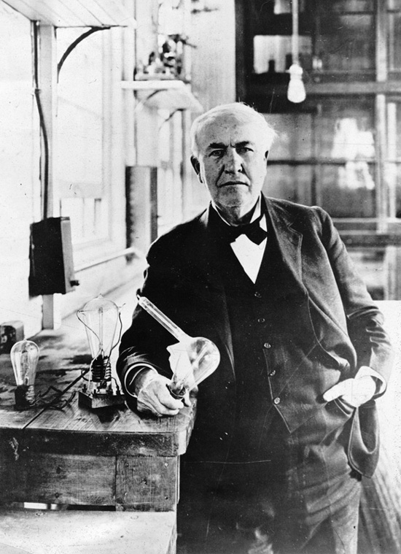
Technological Evolution
Second Industrial Revolution:
~ From Late 19th century to early 20th century.
Industrial mass-production
Technologies:
Electrical power.
Telephone.
Assembly line.
Changes:
Economic growth.
Machines replacing humans.
Improvements in public health.

Slide 8
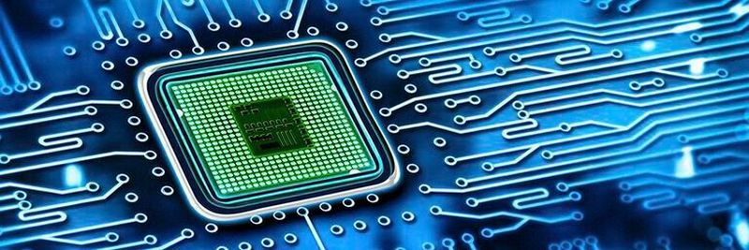
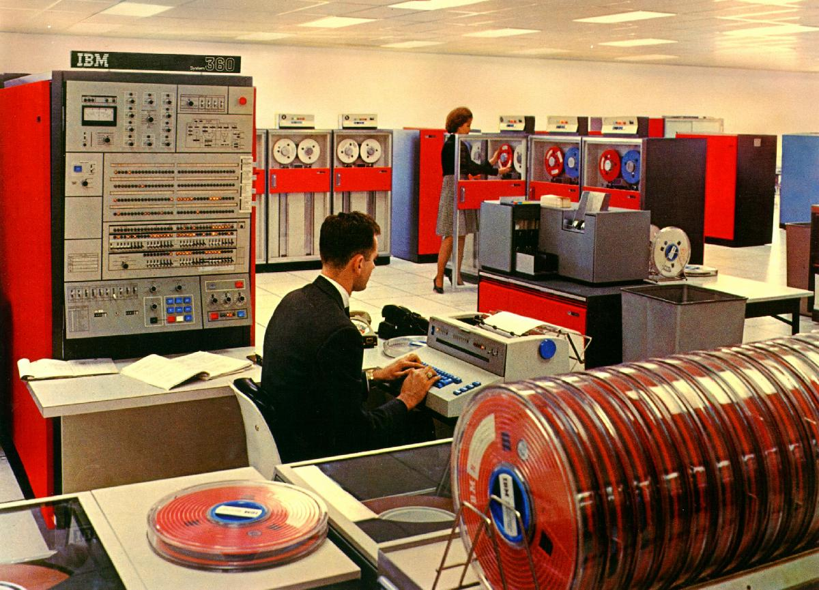

Technological Evolution
Third Industrial Revolution
~ From 1960s – After WW2.
From mechanical and analogue electronic technology
to digital electronics
Technologies:
Semiconductors & Mainframe computing (1960s).
Personal computing (1970s and 80s).
Internet (1990s).
Changes:
Globalization.
IT productivity paradox.
New business models:
Sharing economy – digital platforms – outsourcing.
Data… Data… Data.

Slide 9
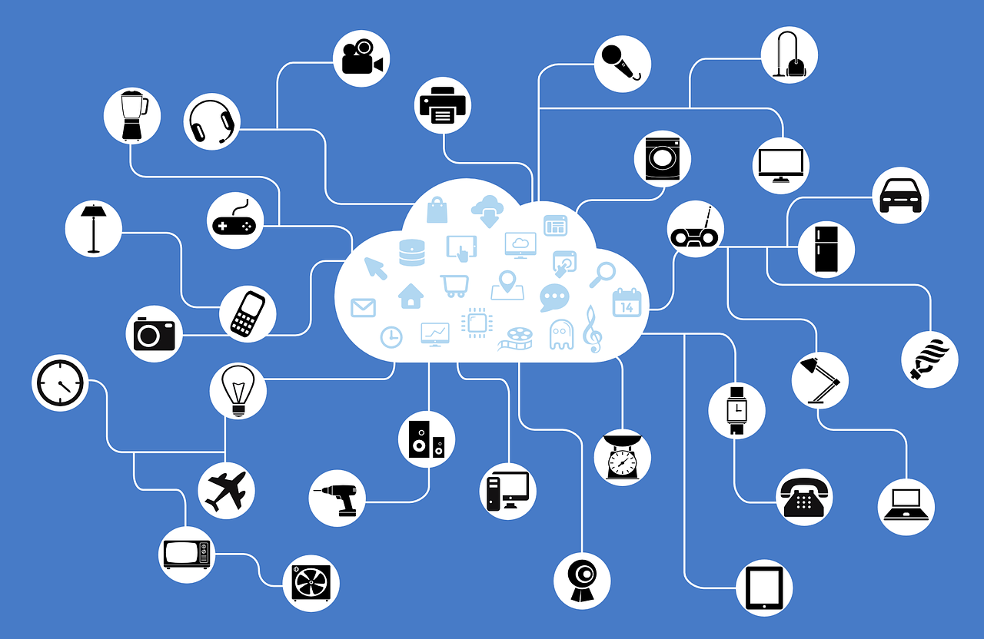
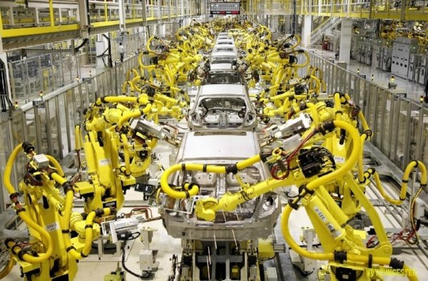
Technological Evolution
Fourth Industrial Revolution:
~ From 2000s.
Connectedness, Machine Intelligence, Digitization.
Technologies:
Artificial intelligence & Machine learning.
Internet of Things (IoT).
Blockchain.
5G.
Robotics.
Big data & Analytics.
Cloud computing.
AR & VR.

Slide 10
Discussion:
Will AI Kill Jobs?
AI has been widely employed by many industries, from banking, to education, to marketing, to healthcare, to perform a wide range of repetitive tasks, including customer service, technical support, facial recognition, online search, online ad targeting, and limited medical diagnoses. Despite its limitations, AI in the form of machine learning can be used to increase the efficiency of business operations and management decision making. Supplemented with other technologies, such as robots, big data, and cloud computing, AI is expected to be the next big thing that helps enterprises create value and reduce costs.
While AI is beneficial to businesses, some worry that the technology threatens job stability. In a survey of 2,092 people in Switzerland by the Swiss Broadcasting Corporation, two-thirds of the respondents believed that the emergence of AI would render many jobs obsolete. Among the respondents, only 9 percent of the farmers and a quarter of the senior management were confident that their jobs would not be affected by AI. As noted by the European Commission in a comprehensive study on the changing nature of work and skills in the digital age, it is difficult to estimate the number of jobs that may be impacted by AI in the future, with estimates varying widely. In one study conducted in 32 countries, the Organization for Economic Co-operation and Development (OECD) estimated that only about 14 percent of jobs are at high risk (that is, they have more than 70 percent probability) of being automated. That said, the number of job losses forecast by the OECD—around 66 million—is still significant.

Slide 11
There are three views on what AI will do to jobs:
Job killer (Automation): AI applications will become smart enough to perform most tasks, will never get tired, and will never talk back. They will be ideal employees, which is why they will gradually replace human employees completely and leave everyone out of a job.
Job changer: There will be a division of labor between human workers and AI. AI applications will do simple, trivial, and boring tasks involving large amounts of data, freeing their human colleagues to focus on complex and challenging assignments. People and machines will complement each other.
Job creator: Just like how the rise of the Internet has generated a huge demand for expertise in web programming, website design, e-marketing, and so on, AI will create new jobs. For example, AI initiatives needs teams of experts to work out algorithms, write computer programs, feed materials for training, fine-tune models, and fix them when they are out of order.
Job augmenter (Augmentation): AI will not only perform tasks but also enhance the capabilities of human workers, allowing them to achieve more with less effort. By augmenting human intelligence, AI systems can assist in decision-making, provide insights from vast datasets, and automate routine aspects of complex tasks. This partnership between humans and AI means that workers can focus on higher-level strategic activities while leveraging AI to handle detailed analysis, routine monitoring, and other supportive functions. This collaboration will lead to more efficient workflows, enabling human workers to be more productive and innovative, ultimately enhancing job satisfaction and effectiveness rather than replacing jobs.

Slide 12
Information Technology vs. Digital Technology
Information Technology vs. Digital Technology
What is the difference between Information Technologies and Digital Technologies?
Establishing such difference will allow us to decide whether we need new approaches to govern and invest in digital technologies and assess their contribution and organizational impact.
Information Technology | Digital Technology
Internal… Back office… | External
They are internal because they initiate inside the organization and mainly are under the control and governance of the IT department. | Autonomy: Contemporary forms of AI have an increasing capacity to act on their own, without human intervention
Automation & efficiency. | Learning: The ability to inductively improve automatically through data and experience

Slide 13
Information Technology vs. Digital Technology
Digital Technology as a Conceptual Shift
Infrastructural Shift → Shifts focus from stable, central IT systems to dynamic, interconnected digital systems:
Decentralized, scalable, and flexible.
Deferred and temporary binding → Flexibility and adaptability in how digital and physical elements are combined and used.
From monolithic, organization-specific IT systems to more modular, cloud-based, and interconnected digital ecosystems.
Agential Shift → Technology as an active participant or "agent" in organizational processes rather than just a passive tool.
Economic Shift → Digital technologies enable new business models, such as platform economies, sharing economies, and digital marketplaces, which can disrupt entire industries.
Semiotic Shift:
The evolving meaning and interpretation of digital artifacts.
Digital artifacts are more dynamic and open to interpretation.
For example, digital platforms and social media allow for continuous reconfiguration and reinterpretation of content, leading to new meanings and uses that were not originally intended by their creators.

Slide 14
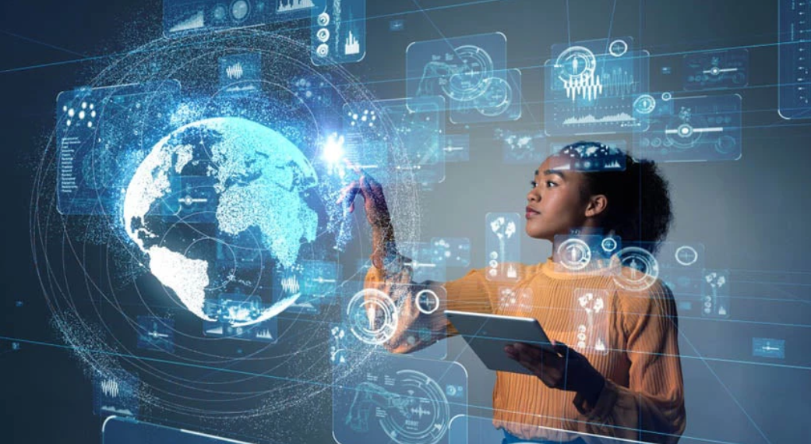
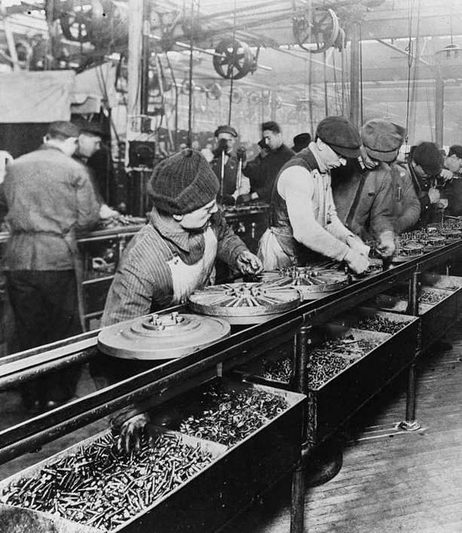
Information Technology vs. Digital Technology
Root Metaphor Shift
Industrial Age: Rooted in physical production, efficiency, and central IT artifacts.
Digital Age: Focus on software development, user-centered design, and iterative processes.
Digital technology emphasizes agility, responsiveness, and innovation over physical production.
Scaling in the Digital Age
Scaling digital ventures is faster and less resource-intensive (e.g., Asset-light organizations).
Relies on digital infrastructure rather than physical resources (e.g., Cloud Computing Services).
Marks a significant departure from traditional scaling processes in industrial firms (e.g., building more factories).

Slide 15
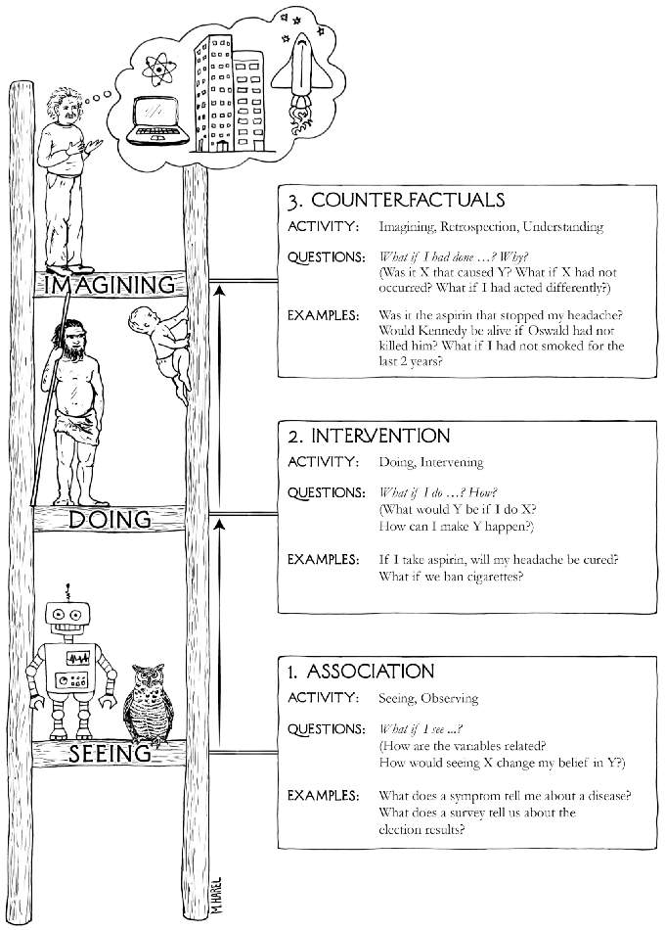

Information Technology vs. Digital Technology

Slide 16
Information Technology vs. Digital Technology
Association (Seeing)
Activity: Observing and recognizing patterns in data.
Questions: "What if I see...?" (e.g., How are variables related? What does seeing one thing tell us about another?)
Examples: What does a symptom tell me about a disease? What does a survey tell us about customer satisfaction?
Implications for AI: Most AI systems today operate at this level. They use large datasets to identify patterns and make predictions based on correlations. For example, predict outcomes like customer churn or disease diagnosis based on observed data patterns.

Slide 17
Information Technology vs. Digital Technology
2. Intervention (Doing)
Activity: Intervening in the world to see the effect of actions.
Questions: "What if I do...?" (e.g., What would happen if I do X? How can I make Y happen?)
Examples: If I take aspirin, will my headache be cured? What if we ban cigarettes?
Implications for AI: This level involves understanding causality—knowing not just that two variables are related, but how one can influence the other. AI systems that operate at this level are capable of making decisions based on potential outcomes of different actions. This is more complex than simple pattern recognition and requires understanding the cause-and-effect relationships in data.

Slide 18
Information Technology vs. Digital Technology
3. Counterfactuals (Imagining)
Activity: Imagining alternate realities or understanding what could have been.
Questions: "What if I had done...?" (e.g., What if X had not occurred? What if I had acted differently?)
Examples: Was it the aspirin that stopped my headache? Would Kennedy be alive if Oswald had not killed him?
Implications for AI: This is the highest level of causal reasoning and involves deep understanding and reasoning about possible worlds that differ from the actual one. AI systems capable of counterfactual reasoning could simulate and analyze alternate scenarios, allowing them to explain decisions, explore hypothetical outcomes, and provide more robust decision-making capabilities.

Slide 19
Information Technology vs. Digital Technology
What It Tells Us About AI?
Current AI Systems: Most AI today operates primarily at the association level, where models predict outcomes based on observed correlations without understanding the underlying causal mechanisms.
Advancing AI: To reach the intervention and counterfactual levels, AI systems need to be able to reason about causality, not just correlation. This would enable them to understand the impact of their actions and reason about hypothetical scenarios, making them more powerful, explainable, and capable of generalizing across different contexts.
The Future of AI: As AI progresses, the goal is to develop systems that can operate at all three levels, moving from mere pattern recognition to deeper causal reasoning and decision-making. This would allow AI to not only predict outcomes but also understand and manipulate the causes behind them, ultimately making AI more aligned with human reasoning and better suited for complex real-world tasks.

