Slide 1
Node.js Training
Event Loop and Control Flow

Slide 2
Event Loop
What is Event Loop?
Notes:
Какво е Event-loop? Преди да отговорим на този въпрос ще разгледаме как работи javascript и в частност node.js?

Slide 3
Node.js
What are you?
Notes:
Защо е важно да знаем как работи даден език за програмиране? Ами всъщност е важно но не е задължително. Но javascript е странен език и много неща в него не изглеждат логични. И за да не търсим излишно логика е по добре да знаем какво в действителност се случва. Нека да разгледаме какво представлява node.js.

Slide 4
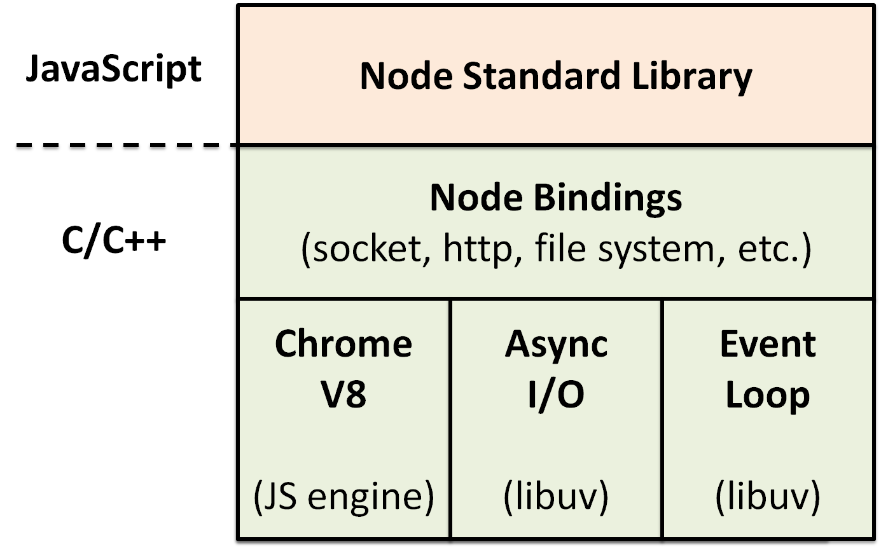
A single-threaded event-driven server-side JavaScript environment based on V8.
call stack
event loop
callback queues
C++ apis
and other stuff…
Hit reset layout so all text goes to default color.
Notes:
Едно от определенията какво представлява node.js е: ”A single-threaded event-driven server-side JavaScript environment based on V8”. Node.js обединява stack, event loop, callbacks queues, C++ apis и други неща. Event-loop-а изиграва много важна роля в екосистемата на node.js и както ще видим по нататък без event-loop нямаме асинхронен модел. Също така node.js използва v8 за runtime-engine.
A call stack is used for several related purposes, but the main reason for having one is to keep track of the point to which each active subroutine should return control when it finishes executing.
V8 translates JavaScript code into more efficient machine code instead of using an interpreter.

Slide 5
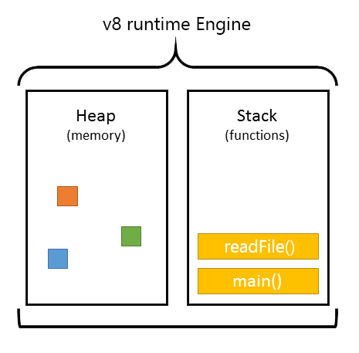
v8 has a call stack and a heap.
Heap
“Chaotic” listing of objects
Memory allocation happens here
Stack
Functions to run and available variables
More added as code is run
Stuff guaranteed to run in order
Hit reset layout so all text goes to default color.
Notes:
V8 има call-stack и heap. Обектите са разпределени в heap-a(купчина), който е просто име за означаване най-вече на голяма неструктурирана област на паметта. Стекът от друга страна е мястото където се държат временни данни с кратък живот. Heap-а няма да го разглеждаме в конкретната лекция, като ще обърнем голямо внимание на стекът.

Slide 6
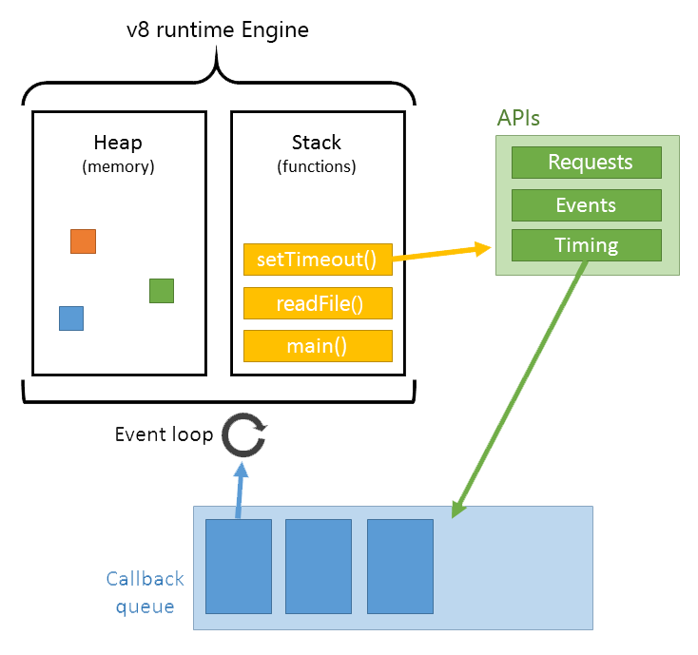
Node.js
Technical implementation
Heap
Stack
Queue
Gets added to stack when the stack is empty
Notes:
Ето една друга диаграма където освен стекът и heap-ът, които са част от v8 можем да видим как са свързани с C++ api-тата, с event-loop-a и с callback queue-то. Имайте в предвид, че node.js има повече от едно callback queue, но за момента, ще разгледаме само това, което също го има в web-browser-ите и което се използва по същият начин.

Slide 7
Processing model
- one thread == one call stack == one thing at a time
- everything runs in parallel except your code
- The C++ threads are the libuv ones which do the asynchronous I/O (disk or network). The main event loop continues to execute after the dispatching the request to thread pool. It can accept more requests as it does not wait or sleep. SQL queries/HTTP requests/file system reads all happen this way.
- What about child_process and cluster modules?
Notes:
1. Така, JavaScript is a single threaded programming language, single threaded Runtime, it has a single call stack. And it can do one thing at a time, that's what a single thread means, the program can run one piece of code at a time.
2. Node.js uses a single thread any time it is running the JavaScript in your application. Tasks that are asynchronous (network, filesystem, etc.) are all handled on separate threads automatically for you. This means that you get much of the usefulness of a multithreaded application without having to worry about all of the trouble that comes with locking resources and what not.
3. The reason Node is often quoted as being faster than servers like Apache is that it doesn't create a thread and all of the resources with it to handling requests. In Apache, most of the time, that thread handling requests is waiting on network or filesystem data. While it does this, it is wasting resources. With Node, only one thread processes those requests (in your application).
4. This is great for some things, but if you have a lot of processing to do, Node would not be effective as it can really only handle a single request at a time in these situations. A single instance of Node.js runs in a single thread. To take advantage of multi-core systems the user will sometimes want to launch an additional process of Node.js processes to handle the load. The child_process and cluster modules allows you to easily create child processes that all share server ports.
В днешната лекция обаче няма да говорим за scaling node.js. Просто ги споменавам, че ги има и че съществуват като варианти.

Slide 8
Call Stack
function multiply(a, b) {
return a * b;
}
function square(n) {
return multiply(n, n);
}
function printSquare(n) {
var squared = square(n);
console.log(squared);
}
printSquare(4);
stack
multiply(n, n)
console.log(squared)
square(n)
printSquare(4)
main()
Notes:
Така, нека се опитаме да визуализираме, какво представлява един процес и как работи той в този конкретен пример:
I have some code like this on your left, we've got a few functions, a function multiplier which multiplies two numbers, square which calls multiply with the same number twice, a function which prints the square of a number of calling square and then calling console.log and then at the bottom of our file we actually run print square, this code all good? Make sense? Cool. So, if we run this, well, I should back up a step, so the call stack is basically ‑‑ it's a data structure which records basically where in the program we are, if we step into a function, we put something on to the stack, if we return from a function, we pop off the top of the stack that's all the stack can do, ‑‑ so if you run this file, there's kind of a main function, right, like the file itself, so, we push that on to the stack. Then we have some function definitions, they're just like defining the state of the world, and finally we got to print square, right, so print square is a function call, so we push that on to the stack, and immediately inside print square, push on to the stack, which calls multiply, now we have a return statement, we multiply A and B and we return, when we return we pop something off the stack, so, pop, multiplier of the stack, returning to square, return to print square, console.log, there's no return, it's implicit, because we got to the end of the function, and we're done so that's like a visualization of the call stalk, does that make sense?

Slide 9
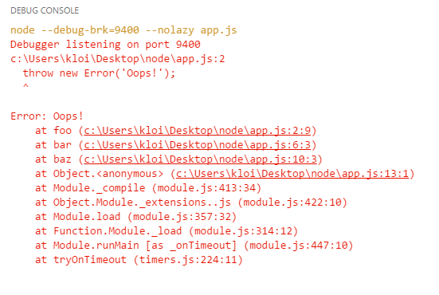
Call Stack
function foo() {
throw new Error(‘Oops!’);
}
function bar() {
foo();
}
function baz() {
bar();
}
baz();
Notes:
Даже и да не сте виждали стек преди най-вероятно ще видите нещо подобно в node.js като гръмне някоя грешка. В Chrome изгледът би бил подобен. Така, в случая baz извиква bar, която извиква foo, която хвърля грешка. Снимката е snapshot на конзолата.

Slide 10
Call Stack
foo()
foo()
foo()
foo()
function foo() {
return foo();
}
foo();
foo()
stack
foo()
foo()
foo()
foo()
foo()
main()
Notes:
Ако се чували терминът препълване на стекът следващото е пример на това. Имаме функция foo, която извиква foo, т.е. рекурсивно – себе си. И в случая node.js ти казва – едва ли наистина си искъл да викнеш foo 16000 пъти.

Slide 11
blocking
What happens when things are slow?
Notes:
Така, големият въпрос който следва е - какво се случва когато нещата са бавни. В случая говорим за blocking и blocking behavior, но под blocking няма точна дефиниция какво в същност е или не е blocking и в повечето пъти се има в предвид, че нещата всъщност са доста бавни. Например извикването на console.log еднократно не е бавно, но while цикъл от 1 до 10 милиарда е бавно, network request са бавни, Image requests са бавни. Нещата които забавят много и са вътре в стека, това се има в предвид под bocking.

Slide 12
Call Stack
var syncRequest = require(‘sync-request’);
var foo = syncRequest(‘GET’, ‘//foo.com’);
var bar = syncRequest(‘GET’, ‘//bar.com’);
var qux = syncRequest(‘GET’, ‘//qux.com’);
console.log(foo.getBody());
console.log(bar.getBody());
console.log(qux.getBody());
stack
syncRequest(‘GET’, ‘//foo.com’)
console.log(foo.getBody())
console.log(qux.getBody())
console.log(bar.getBody())
syncRequest(‘GET’, ‘//bar.com’)
syncRequest(‘GET’, ‘//qux.com’)
main()
Notes:
Ето малък пример. Let's say we have, this is like a fake bit of code, getSynchronous, right, like http request is like, AJAX request. What would happen if those were synchronous requests, forget what we know about async callbacks they're synchronous. If we go through it like we have, we call getSync and then we wait, because then we're doing network request, network is relative to computers, are slow, hopefully that network requests completes, we can move on, wait, move on. Wait, and, I mean, this network request might never finish, so ... yeah, I guess I'll go home. Finally those three, you know blocking behaviors complete and we can clear the stack, right. So in a programming language is single threaded you're not using threads like say Ruby, that's what happens, right, we make a network request, we have to just wait till it's done, because we have no way of handling that.

Slide 13
Why is this a problem?
because, the I/O.
(in most cases)
Notes:
Why is this actually a problem? Проблемът е защото ние трябва да обработваме множество клиентски заявки едва ли не едновременно.

Slide 14
Demo
Notes:
I'm faking this out with a big while loop, because it's synchronous, I basically while loop for five seconds before continuing, so if I open up the console here. We can see what happens, so with request foo.com, why this is happening, I can't do anything, right, even the run button hasn't finished rerendering the fact that I clicked it. The browser is blocked, it's stuck, it can't do anything until those requests complete. And then all hell breaks loose because I did some stuff,it figured that out I'd done it, it couldn't actually render it. Couldn't do anything. That's because if that call stack has things on it, and here it's got these yeah, it's still going. We've got the synchronous request, the browser can't do anything else. It can't render, it can't run any other code, it's stuck. Not ideal, right if we want people to have nice fluid UIs, we can't block the stack.

Slide 15
The solution?
Asynchronous callbacks
By synchronous we mean a function that calls its callback on the same tick in the javascript event loop and asynchronous is called in a different tick.
Asynchronous events are those occurring independently of the main program flow. Asynchronous actions are actions executed in a non-blocking scheme, allowing the main program flow to continue processing.
Notes:
So, how do we handle this? Well the simplest solution we're provided with is asynchronous callbacks, there's almost no blocking functions in the browser, equally in node, they're all made asynchronous, which basically means we run some code, give it a callback, and run that later, if you've seen JavaScript you've seen asynchronous callbacks, what does this actually look like.

Slide 16
Asynchronous code functions
The asynchronous code node.js functions are setTimeout, setInterval, setImmediate and process.nextTick.
setTimeout is a native JavaScript function, which calls a function or executes a code snippet after a specified delay (in milliseconds).

Slide 17
Async Callbacks & The Call Stack?
console.log(‘hi’);
setTimeout(function () {
console.log(‘there’);
}, 5000);
console.log(‘Node.js course’);
stack
console.log(‘Node.js course’)
console.log(‘hi’)
setTimeout(cb, 5000);
console.log(‘there’)
main()
Notes:
et's run the code. Console.log hi. setTimeout. We know it doesn't run immediately, we know it's going to run in five seconds time, we can't push it on to the stack, somehow it just disappears, we don't have like a way of describing this yet, but we'll come to it. We log JSConfEU, clear, five seconds later somehow magically "there" appears on the stack. How does that happen? And that's ‑‑ this is basically where the event loop comes in on concurrency.

Slide 18
Concurrency & the Event Loop
One thing at a time,
except not really.
Notes:
Right, so I've been kind of partially lying do you and telling you that JavaScript can only do one thing at one time. That's true the JavaScript Runtime can only do one thing at one time. It can't make an AJAX request while you're doing other code. It can't do a setTimeout while you're doing another code. The reason we can do things concurrently is that the browser is more than just the Runtime. So, remember this diagram, the JavaScript Runtime can do one thing at a time, but the browser gives us these other things, gives us these we shall APIs, these are effectively threads, you can just make calls to, and those pieces of the browser are aware of this concurrency kicks in. If you're back end person this diagram looks basically identical for node, instead of web APIs we have C++ APIs and the threading is being hidden from you by C++.

Slide 19


console.log(‘hi’);
setTimeout(function () {
console.log(‘there’);
}, 5000);
console.log(‘Node.js course’);
console.log(‘hi’);
setTimeout(function () {
console.log(‘there’);
}, 5000);
console.log(‘Node.js course’);
stack
apis
timer ( )
cb
log(‘hi’)
log(‘there’)
setTimeout cb
log(‘Node.js course’)
main()
Changing the Full-Width Photo:
Ideally new photo is 10” wide x 5” high (this will fill the entire slide, minus bar)
Double click on photo
Right click on photo
Select “Change Picture” from menu
Console
event loop
hi
Node.js course
there
task
queue
cb
Notes:
Now we have this picture let's see how this code runs in a more full picture of what a browser looks like. So, same as before, run code, console log hi, logs hi to the console, simple. now we can see what happens when we call setTimeout. We are ‑‑ we pass this callback function and a delay to the setTimeout call. Now setTimeout is an API provided to us by the browser, it doesn't live in the V8 source, it's extra stuff we get in that we're running the JavaScript run time in. The browser kicks off a timer for you. And now it's going to handle the count down for you, right, so that means our setTimeout call, itself is now complete, so we can pop off the stack. “JSConfEU”, clear, so, now we've got this timer in the web API, which five seconds later is going to complete. Now the web API can't just start modifying your code, it can't chuck stuff onto the stack when it's ready if it did it would appear randomly in the middle of your code so this is where the task queue or callback queue kicks in. Any of the web APIs pushes the callback on to the task queue when it's done. Finally we get to the event loop, title of the talk, what the heck is the event loop is like the simplest little piece in this whole equation, and it has one very simple job. The event loop's job is to look at the stack and look at the task queue. If the stack is empty it takes the first thing on the queue and pushes it on to the stack which effectively run it. So here we can see that now the stack is clear, there's a callback on the task queue, the event loop runs, it says, oh, I get to do something, pushes the callback on to the stack. Remember it's the stack is like JavaScript land, back inside V8, the callback appears on the stack, run, console.log “there”, and we're done.

Slide 20
console.log(‘hi’);
setTimeout(function () {
console.log(‘there’);
}, 0);
console.log(‘Node.js course’);
console.log(‘hi’);
setTimeout(function () {
console.log(‘there’);
}, 0);
console.log(‘Node.js course’);
stack
apis
timer ( )
cb
log(‘hi’)
log(‘there’)
setTimeout cb
log(‘Node.js course’)
main()
Changing the Full-Width Photo:
Ideally new photo is 10” wide x 5” high (this will fill the entire slide, minus bar)
Double click on photo
Right click on photo
Select “Change Picture” from menu
Console
event loop
hi
Node.js course
there
task
queue
cb
Notes:
So, now we can see how this works with probably one of the first encounters you would have had with Async stuff which for some weird reason someone says says you have to call setTimeout zero, ‑‑ okay, you want me to run the function in zero time? Why would I wrap it in a setTimeout? Like the first time you run across this, if you're like me,i see it doing something, but I don't know why. The reason is, generally, if you're trying to defer something until the stack is clear. So we know looking at this, if you've written JavaScript, that we're going to see the same result, we're going to see “hi” “JSConf”, and “there” is going to appear at the end. We can see how that happens. The setTimeout zero, now it's going to complete immediately and push it on to the queue, remember what I said about the event loop, it has to wait till the stack is clear before it can push the callback on to the stack, so your stack is going to continue to run, console.log “hi”, “JSConfEU” and clear, now the event loop can kick in and call your callback. That's like an example of setTimeout zero, is deferring that execution of code, for whatever reason to the end of the stack. Or until stack is clear.

Slide 21

var express = require('express');
var app = express();
app.get(‘/’, function () {
res.send(‘Hi there’);
});
app.listen(3000);
stack
apis
Var express = require(‘express’);
app.get(‘/’, function () {
res.send(‘Hi there’);
});
App.listen(3000);
req ( )
cb
cb
app.get /
send(‘Hi there’)
main()
Changing the Full-Width Photo:
Ideally new photo is 10” wide x 5” high (this will fill the entire slide, minus bar)
Double click on photo
Right click on photo
Select “Change Picture” from menu
Response
event loop
Hi there
task
queue
cb
Notes:
So, all these web APIs work the same way, if we have AJAX request, we make an AJAX request to the URL with a callback, works the same way, oops sorry, console log, “hi”, make an AJAX request, the code for running that AJAX request does not live in JavaScript Runtime but in the browser as a web API, so we spin it up with a callback in the URL, your code can continue to run. Until that XHR request completes, or it may never complete, it's okay, the stack can continue to run, assuming it completes, gets pushed to the queue,picked up by the event loop and it's run. That's all that happens when an Async call happens.

Slide 22
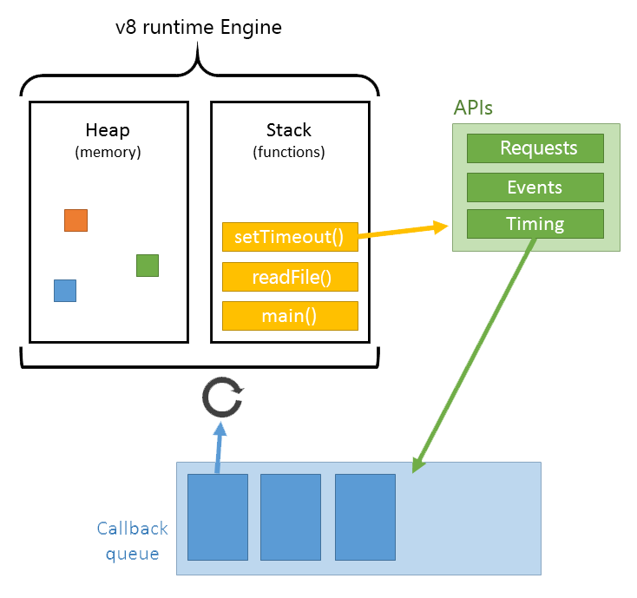
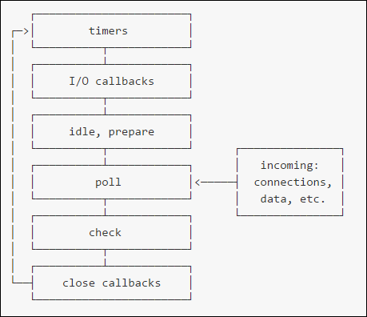
Changing the Full-Width Photo:
Ideally new photo is 10” wide x 5” high (this will fill the entire slide, minus bar)
Double click on photo
Right click on photo
Select “Change Picture” from menu
event loop

Slide 23
Node.js Event loop
Timers:
setTimeout - Added in: v0.0.1
setInterval - Added in: v0.0.1
setImmediate - Added in: v0.9.1
Process:
process.nextTick - Added in: v0.1.26, changed in v0.10
Changing the Full-Width Photo:
Ideally new photo is 10” wide x 5” high (this will fill the entire slide, minus bar)
Double click on photo
Right click on photo
Select “Change Picture” from menu

Slide 24
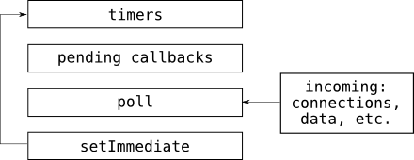
Internal implementation
Running async tasks one at a time
Limitations
Intensive operations
Sync variant of all the I/O methods

Slide 25
var express = require('express');
var app = express();
app.get(‘/’, function () {
res.send(‘Hi there’);
});
app.listen(3000);
stack
apis
nextTick
setImmediate
Changing the Full-Width Photo:
Ideally new photo is 10” wide x 5” high (this will fill the entire slide, minus bar)
Double click on photo
Right click on photo
Select “Change Picture” from menu
Response
event loop
task
queue
Notes:
nextTick handlers are run right after each call from C++ into JavaScript. That means that, if your JavaScript code calls process.nextTick, then the callback will fire as soon as the code runs to completion, but before going back to the event loop. The race is over, and all is good.
However, there are programs out in the wild that use recursive calls to process.nextTick to avoid pre-empting the I/O event loop for long-running jobs. In order to avoid breaking horribly right away, you have to use setImmediate for these kinds of tasks instead.

Slide 26
setImmediate() vs process.nextTick()
setImmediate
setImmediate(function A() {
setImmediate(function B() {
log(1);
setImmediate(function D() { log(2); });
setImmediate(function E() { log(3); });
});
setImmediate(function C() {
log(4);
setImmediate(function F() { log(5); });
setImmediate(function G() { log(6); });
});
});
setTimeout(function timeout() {
console.log('TIMEOUT FIRED');
}, 0)
// 'TIMEOUT FIRED' 1 4 2 3 5 6
// OR
// 1 'TIMEOUT FIRED' 4 2 3 5 6
nextTick
process.nextTick(function A() {
process.nextTick(function B() {
log(1);
process.nextTick(function D() { log(2); });
process.nextTick(function E() { log(3); });
});
process.nextTick(function C() {
log(4);
process.nextTick(function F() { log(5); });
process.nextTick(function G() { log(6); });
});
});
setTimeout(function timeout() {
console.log('TIMEOUT FIRED');
}, 0)
// 1 4 2 3 5 6 'TIMEOUT FIRED‘
vs
Changing the Full-Width Photo:
Ideally new photo is 10” wide x 5” high (this will fill the entire slide, minus bar)
Double click on photo
Right click on photo
Select “Change Picture” from menu
- setImmediate's callback is queued after I/O callbacks – one callback per iteration, while nextTick's callbacks are queued to execute before I/O callbacks in the order that they were queued.
- the nextTickQueue will be processed after the current operation completes, regardless of the current phase of the event loop
- the event loop maintain multiple queues and check queue is just one of them, the node will decide which queue to use based on some rules with process.nextTick however, it is sort of bypassing all the rule and execute the callback in nextTick immediately.

Slide 27
Use case: process.nextTick()
const EventEmitter = require('events');
const util = require('util');
function MyEmitter() {
EventEmitter.call(this);
// use nextTick to emit the event once a handler is assigned
process.nextTick(function () {
this.emit('event');
}.bind(this));
}
util.inherits(MyEmitter, EventEmitter);
const myEmitter = new MyEmitter();
myEmitter.on('event', function() {
console.log('an event occurred!');
});
Changing the Full-Width Photo:
Ideally new photo is 10” wide x 5” high (this will fill the entire slide, minus bar)
Double click on photo
Right click on photo
Select “Change Picture” from menu

Slide 28
Use case: process.nextTick()
var remote = require(‘./remote’),
cache = {};
function getValue(key, callback) {
if (key in cache) {
process.nextTick(function() {
callback(key, cache[key]);
});
} else {
remote.fetch(key, function(value) {
cache[key] = value;
callback(key, cache[key]);
});
}
}
Changing the Full-Width Photo:
Ideally new photo is 10” wide x 5” high (this will fill the entire slide, minus bar)
Double click on photo
Right click on photo
Select “Change Picture” from menu

Slide 29
Use case: process.nextTick()
(Part of node’s design philosophy is that API should always be asynchronous even where it doesn't have to be.)
function apiCall (arg, callback) {
if (typeof arg !== 'string') {
return process.nextTick(callback,
new TypeError('argument should be string'));
}
}
- apiCall() always runs its callback after the rest of the user's code and before the event loop is allowed to proceed.
Changing the Full-Width Photo:
Ideally new photo is 10” wide x 5” high (this will fill the entire slide, minus bar)
Double click on photo
Right click on photo
Select “Change Picture” from menu

Slide 30
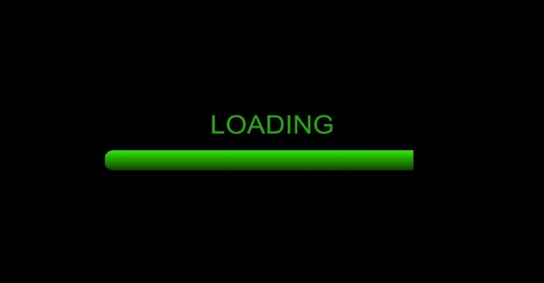
Use process.nextTick() when
Use setImmediate() for
Partitioning Long-running Tasks
Changing the Full-Width Photo:
Ideally new photo is 10” wide x 5” high (this will fill the entire slide, minus bar)
Double click on photo
Right click on photo
Select “Change Picture” from menu

Slide 31
Control Flow
Sometimes the past and present live side by side.
After, all
Notes:
Node is know for its ability to handle events and async methods etc. but there are plenty of use-cases where might need to get some flow control in place. So not matter what order the callbacks return in, you would like them to be executed in the right order.

Slide 32
Control flow
callbacks
streams(next time)
async.js
promises
generators (ES6)
async/await (ES7)
…

Slide 33
Before we start
Node.js, being an asynchronous platform, doesn't wait around for things like file I/O to finish.
Node.js uses callbacks. A callback is a function called at the completion of a given task; this prevents any blocking, and allows other code to be run in the meantime.

Slide 34
Callbacks
Non-blocking functions take callbacks (last argument) of two forms:
// Error-first callbacks
function (err, result) {
// …
}
// Callbacks
function (result) {
// …
}

Slide 35
CALLBACKS
// Nested callbacks
var http = require('http'),
url = require('url'),
userService = require(‘/components/user’).service,
accountService = require(‘/components/account’).service,
accountUtils = require(‘/utils/account.js’);
http.createServer(function (req, res) {
var queryObject = url.parse(req.url, true).query;
// inline callback function ...
userService.getUser(queryObject.id, function (err, user) {
if(err) { res.writeHead(500).end(); }
// another inline callback function ...
accountService.getAccount(user.accountId, function (err, account) {
if(err) { return res.writeHead(500).end(); }
// one more inline callback function ...
accountUtils.calcExpences(account, function (result) {
res.writeHead(200);
res.end(result);
});
});
});
});
// Flattened nested callbacks
var http = require('http'),
url = require('url'),
userService = require(‘/components/user’).service,
accountService = require(‘/components/account’).service,
accountUtils = require(‘/utils/account.js’);
http.createServer(handleRequest);
function handleRequest (req, res) {
var queryObject = url.parse(req.url, true).query;
userService.getUser(queryObject.id, function (err, user) {
if(err) { res.writeHead(500).end(); }
calcAccExpences(user.id, res);
});
}
function calcAccExpences (id, res) {
accountService.getAccount(id, function (err, account) {
if(err) { res.writeHead(500).end(); }
accountUtils.calcExpences(account, sendResults(res));
});
}
function sendResults (res) {
return function(result) {
res.writeHead(200);
res.end(result);
}
}
vs
Changing the Full-Width Photo:
Ideally new photo is 10” wide x 5” high (this will fill the entire slide, minus bar)
Double click on photo
Right click on photo
Select “Change Picture” from menu

Slide 36
Pros
Cons
Easy to create.
Keep code simple, not nested and split up into small modules.
Somewhat more efficient, because fewer objects are created and garbage collected.
It’s recommended to using callbacks, for code which will be run many times per second.
Less readable.
Conflates the input with the output.
Confusing error handling.
Executed within the same scope.
Changing the Full-Width Photo:
Ideally new photo is 10” wide x 5” high (this will fill the entire slide, minus bar)
Double click on photo
Right click on photo
Select “Change Picture” from menu

Slide 37
Callback hell
Error handling downsides
step1(function (value1) {
step2(function (err, value2) {
step3(function (err, value3) {
step4(function (err, value4) {
step5(function (err, value5) {
step6(function (err, value6) {
// Do something with value6
});
});
});
});
});
});
function readJSON(filename, callback){
fs.readFile(filename, 'utf8', function (err, res){
if (err) {
return callback(err);
}
try {
res = JSON.parse(res);
} catch (ex) {
return callback(ex);
}
callback(null, res);
});
}
Changing the Full-Width Photo:
Ideally new photo is 10” wide x 5” high (this will fill the entire slide, minus bar)
Double click on photo
Right click on photo
Select “Change Picture” from menu

Slide 38
Alternatives
streams(next time)
async.js
promises
generators (ES6)
async/await (ES7)
…

Slide 39
Async.js
http://caolan.github.io/async/docs.html
Async is a utility module which provides straight-forward, powerful functions for working with asynchronous JavaScript.
Async provides around 70 functions that include the usual 'functional' suspects (map, reduce,filter, each…) as well as some common patterns for asynchronous control flow (parallel,series, waterfall…). All these functions assume you follow the Node.js convention of providing a single callback as the last argument of your asynchronous function -- a callback which expects an Error as its first argument -- and calling the callback once.

Slide 40
Async.js
async.map(['file1','file2','file3'], fs.stat, function(err, results){
// results is now an array of stats for each file
});
async.filter(['file1','file2','file3'], function(filePath, callback) {
fs.access(filePath, function(err) {
callback(null, !err)
});
}, function(err, results){
// results now equals an array of the existing files
});
async.parallel([
function(callback){ ... },
function(callback){ ... }
],
function(err, results) { // optional callback
};
async.series([
function(callback){ ... },
function(callback){ ... }
]);

Slide 41
Pros
Cons
Provides around 70 functions that include the usual 'functional' suspects.
Works with control flow primitives.
Conflates the input with the output.
Code overhead.
Changing the Full-Width Photo:
Ideally new photo is 10” wide x 5” high (this will fill the entire slide, minus bar)
Double click on photo
Right click on photo
Select “Change Picture” from menu

Slide 42
Promises
A promise is a special kind of javascript object which contains another object. I could have a promise for the integer 17, or the string “hello world”, or some arbitrary object, or anything else you could normally store in a javascript variable.
The core idea behind promises is that a promise represents the result of an asynchronous operation. A promise is in one of three different states:
pending - The initial state of a promise.
fulfilled - The state of a promise representing a successful operation.
rejected - The state of a promise representing a failed operation.
Once a promise is fulfilled or rejected, it is immutable (i.e. it can never change again).

Slide 43
Promises
Callbacks are imperative, promises are functional.
The nature of promises is that they remain immune to changing circumstances.
Frank Underwood, ‘House of Cards’
The biggest design mistake committed by Node.js: the decision, made quite early in its life, to prefer callback-based APIs to promise-based ones.
Everybody uses [callbacks]. If you publish a module that returns promises, nobody’s going to care. Nobody’s ever going to use that module.
I don't think it's a matter of if promises will be implemented I think it's a matter of when.

Slide 44
“Let's imagine for a moment that Node core was initially designed with a promise based API, almost all the same arguments could be made about supporting an errback API. Let's try:
First, promises are not as bad as you think and there are some simple, effective ways to organize callback driven code to avoid common complaints.
Second, callbacks have costs and benefits like anything, and while the benefits are well-advertised, the costs can be hidden and frustrating.
Third, the callback is the fundamental unit of asynchronous programming in JavaScript and Promises are just callbacks with added semantics (a specific type of callback if you will). There is no single abstraction that's perfect for all use cases.
Fourth, promises aren't a silver bulllet. There are whole classes of use cases where promises aren't the right abstraction [...].
Well, I don't have to alter that one. There are some places where promises are indeed not a good abstraction, like event and stream APIs.
Fifth, the design philosophy of node core is to encourage maximum compatibility and discourage decisions that lead to incompatibility. While it is trivial to turn a promise based API into a callback one, the opposite is not always true.
Sixth, integrating with c++ bindings/libuv has only been possible using callbacks. The core team is committed to keeping node lightweight and fast by providing APIs that are as "close to the action" as possible, so they're not going to be introducing a new abstraction to asynchronous programming in core anytime soon: http://blog.trevnorris.com/2014/02/nodejs-es6-and-me.html”
There are a lot of resources about the discussion – should we use promises instead of callbacks like:
Introducing Promises to node core? - https://github.com/nodejs/node/issues/4596
Changing the Full-Width Photo:
Ideally new photo is 10” wide x 5” high (this will fill the entire slide, minus bar)
Double click on photo
Right click on photo
Select “Change Picture” from menu

Slide 45
Promises
function getMoreData (res) {
return new Promise(function (resolve, reject) {
…
});
}
function doSomethingElse (res) {
return new Promise(function (resolve, reject) {
…
});
}
function handleError (err) {
console.log(err);
}
function getData () {
return new Promise(function(resolve, reject) {
// do a thing, possibly async, then…
if (/* everything turned out fine */) {
resolve("Stuff worked!");
}
else {
reject(Error("It broke"));
}
});
}
getData()
.then(getMoreData)
.then(doSomethingElse)
.catch(handleError);

Slide 46
Pros
Cons
They are like a standard asynchronous interface.
Native support from node v4.0.0.
Making error handling simpler(in some cases).
Slower than callbacks.
Compatibility issues.
Sometimes they are not a good abstraction, like event and stream APIs.
Changing the Full-Width Photo:
Ideally new photo is 10” wide x 5” high (this will fill the entire slide, minus bar)
Double click on photo
Right click on photo
Select “Change Picture” from menu

Slide 47
Async.js
Promises
function sendEmail (options) {
…
}
async.auto({
getData: function (callback){
…
callback(null, 'data', 'converted to array');
},
makeFolder: function (callback){
…
callback(null, 'folder');
},
writeFile: ['getData', 'makeFolder', function (callback, results){
callback(null, 'filename');
}],
emailLink: ['writeFile', function (callback, results) {
allback(null, {'file':results.write_file,
'email':'user@example.com'});
}]
}, function (err, results) {
if(err) {
return console.log(err);
}
sendEmail(results);
});
function getData () {
return new Promise(function (resolve, reject) {
...
}
}
function makeFolder () {
return new Promise(function (resolve, reject) {
...
}
}
function sendEmail (options) {
return new Promise(function (resolve, reject) {
...
}
}
Promise
.all([getData, makeFolder])
.spread(function writeFile (data, folder) {
return new Promise(function(resolve, reject) {
...
}
})
.then(function emailLink (filename) {
return sendEmail({file: filename, 'email':'user@example.com'});
})
.catch(function (err) {
console.log(err);
});
vs
Changing the Full-Width Photo:
Ideally new photo is 10” wide x 5” high (this will fill the entire slide, minus bar)
Double click on photo
Right click on photo
Select “Change Picture” from menu

Slide 48
Generators – mysterious and powerful
A function that returns multiple values at different times at the function execution.
function* bears () {
yield 'grizzly';
yield 'polar';
return 'done';
}
var bear = bears();
console.log(bear.next().value);
console.log(bear.next().value);

Slide 49
Generators – a new feature of ECMAScript 6
Implementing iterables.
Blocking on asynchronous function calls.

Slide 50
Generator function is simply the function with star in its head and (optional) yield in its body.
function *generator() {
console.log('Start!');
var i = 0;
while (true) {
if (i < 3) {
yield i++;
}
}
}
var gen = generator();
// nothing happens here!!
Changing the Full-Width Photo:
Ideally new photo is 10” wide x 5” high (this will fill the entire slide, minus bar)
Double click on photo
Right click on photo
Select “Change Picture” from menu
var ret = gen.next();
// Start!
console.log(ret);
// {value: 0, done: false}
console.log(gen.next());
// {value: 1, done: false}
console.log(gen.next());
// {value: 2, done: false}
console.log(gen.next());
// {value: undefined, done: true}
Notes:
1. Generator function itself does not do anything but return a generator, in the case above, gen. No console output here because only after the returned
generator's next method is called the body of generator function will run. Generator has several methods, of which the most important one is next.
next runs the code and returns the generator result.
2. ret above is generator result. It has two property: value, the value you yield in generator function, and done, a flag indicating
whether the generator function return.
3. Generator has two features:
one can choose to jump out of a function and let outer code to determine when to jump back into the function.
the control of asynchronous call can be done outside of your code
In code, yield jumps outside of function, and next(val) jumps back to the function and pass value back into the function.
Outside code can handle asynchronous call and decide proper time to switch to your own code.

Slide 51
HOW IT WORKS - FULFILLING
yield 10 is an expression.
A generator can be manually operated via .next(value).
function* demo() {
var res = yield 10;
assert(res === 32);
return 42;
}
var d = demo();
var resA = d.next();
// => {value: 10, done: false}
var resB = d.next(32);
// => {value: 42, done: true}
// d.next() - THROWS!!!
Changing the Full-Width Photo:
Ideally new photo is 10” wide x 5” high (this will fill the entire slide, minus bar)
Double click on photo
Right click on photo
Select “Change Picture” from menu

Slide 52
HOW IT WORKS - REJECTING
A generator can be sent an exception via .throw(error)
var sentinel = new Error('foo');
function* demo() {
try {
yield 10;
} catch (ex) {
assert(ex === sentinel);
}
}
var d = demo();
d.next();
// => {value: 10, done: false}
d.throw(sentinel);
Changing the Full-Width Photo:
Ideally new photo is 10” wide x 5” high (this will fill the entire slide, minus bar)
Double click on photo
Right click on photo
Select “Change Picture” from menu

Slide 53
Generators
A SEQUENCE OF OPERATIONS
FOR
var get = gen(function *(){
var left = yield readJSON('left.json');
var right = yield readJSON('right.json');
return {left: left, right: right};
});
var uploadDocuments = gen(function *(documents){
for (var document of documents) {
yield upload(document);
}
});
PARALLEL OPERATIONS
var uploadDocumentsParallel = gen(function *(documents){
var operations = [];
for (var document of documents) {
operations.push(upload(document));
}
for (var operation of operations) {
yield operation;
}
});
var get = gen(function *(){
var left = readJSON('left.json');
var right = readJSON('right.json');
return {left: yield left, right: yield right};
});
Changing the Full-Width Photo:
Ideally new photo is 10” wide x 5” high (this will fill the entire slide, minus bar)
Double click on photo
Right click on photo
Select “Change Picture” from menu
TRY/CATCH
var tryGet = gen(function *(key, defaultValue){
var result;
try {
result = yield get(key);
} catch (ex) {
result = defaultValue;
}
return result;
});

Slide 54
Generator helper
function gen(makeGenerator){
return function (){
var generator = makeGenerator.apply(this, arguments);
function handle(result){ // { done: [Boolean], value: [Object] }
if (result.done) return result.value;
return result.value.then(function (res){
return handle(generator.next(res));
}, function (err){
return handle(generator.throw(err));
});
}
return handle(generator.next());
}
}
Changing the Full-Width Photo:
Ideally new photo is 10” wide x 5” high (this will fill the entire slide, minus bar)
Double click on photo
Right click on photo
Select “Change Picture” from menu

Slide 55
Generator based control flow libraries
Suspend - Generator-based control-flow for Node enabling asynchronous code without callbacks, transpiling, or selling your soul.
Works with control flow primitives
Handles errors
Conflates input with output
Isn’t doing what it looks like
Can’t do parallel operation
CO - co@4.0.0 has been released, which now relies on promises. It is a stepping stone towards the async/await proposal.
Works with control flow primitives
Handles errors
Can’t do parallel operation
Can’t share and cache async operations
var suspend = require('suspend');
suspend(function*() {
var user = yield UserModel.find({ username: 'jmar777' });
console.log(user.favoriteColor);
})();
co(function* () {
var result = yield Promise.resolve(true);
return result;
}).then(function (value) {
console.log(value);
}, function (err) {
console.error(err.stack);
});

Slide 56
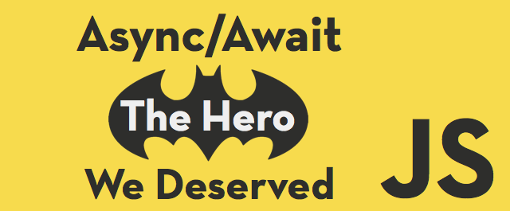
Async/Await:
The Hero JavaScript Deserved

Slide 57
Async/Await
Writing asynchronous code is hard. When it comes to JavaScript we rely heavily on callback functions to accomplish asynchronous tasks which can be far from intuitive.
Synchronous code is generally easier to understand and write because everything executes in the order in which it is written.
UTOPIA
asynchronous code that lets us work with blocking operations but is also easier to read and write
Notes:
1. This cognitive overhead creates a barrier to entry for newcomers to programming and the language and even causes frequent heartburn for those of us who have been using the language a while.
2. Return statements are widely used and pretty intuitive in other languages but unfortunately we’re unable to use them as much as we’d like in JavaScript because they don’t work well with JavaScript’s asynchronous nature.

Slide 58
Async/await
It works similarly to generators, suspending execution in your context until the promise settles. If the awaited expression isn’t a promise, its casted into a promise.
an Async function always returns a Promise. That promise is rejected in the case of uncaught exceptions, and it’s otherwise resolved to the return value of the async function.
function getRandomPonyFooArticle() { … }
async function read () {
var html = await getRandomPonyFooArticle();
var md = hget(html, {
markdown: true,
root: 'main',
ignore: '.at-subscribe,.mm-comments,.de-sidebar'
});
var txt = marked(md, {
renderer: new Term()
});
console.log(txt);
}
read();

Slide 59
Async/await
var request = require('request');
function getQuote() {
var quote;
return new Promise(function(resolve, reject) {
request('http://ron-swanson-quotes.herokuapp.com/v2/quotes', function(error, response, body) {
quote = body;
resolve(quote);
});
});
}
async function main() {
var quote = await getQuote();
console.log(quote);
}
main();
console.log('Ron once said,');
Changing the Full-Width Photo:
Ideally new photo is 10” wide x 5” high (this will fill the entire slide, minus bar)
Double click on photo
Right click on photo
Select “Change Picture” from menu
./node_modules/.bin/babel-node app.js
// Ron once said,
// {"quote":"Breakfast food can serve many purposes."}

Slide 60
Until ES7 arrives…
You can use async functions and other ES6/7 features today using the babel transpiler. Also, you can use ES6 generators to create something akin to async functions.
In
async function foo() {
await bar();
}
Out
var _asyncToGenerator = function (fn) {
...
};
var foo = _asyncToGenerator(function* () {
yield bar();
});
Changing the Full-Width Photo:
Ideally new photo is 10” wide x 5” high (this will fill the entire slide, minus bar)
Double click on photo
Right click on photo
Select “Change Picture” from menu

Slide 61
Resources
Event loop – based on: https://www.youtube.com/watch?v=8aGhZQkoFbQ
process.nextTick vs setImmediate vs setTimeout: https://poshworks.wordpress.com/2014/12/26/process-nexttick-vs-setimmediate-vs-settimeout/
The event-loop timers and nextTick: https://github.com/nodejs/node/blob/master/doc/topics/the-event-loop-timers-and-nexttick.md
How promise APIs would look like in core: https://github.com/nodejs/promises/issues/16
We have a problem with promises: https://pouchdb.com/2015/05/18/we-have-a-problem-with-promises.html
ES6 generators in depth: http://www.2ality.com/2015/03/es6-generators.html
Changing the Full-Width Photo:
Ideally new photo is 10” wide x 5” high (this will fill the entire slide, minus bar)
Double click on photo
Right click on photo
Select “Change Picture” from menu

Slide 62
End!

