Slide 1
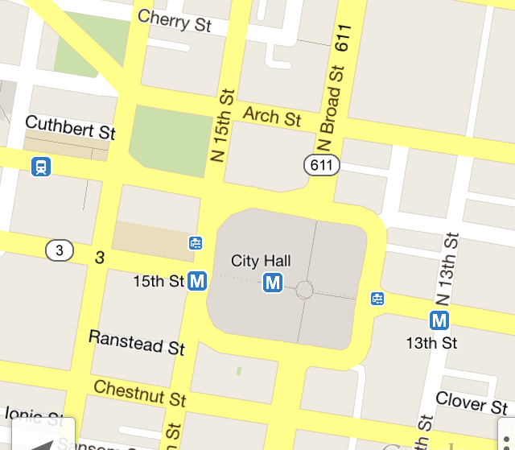
Restrooms
Closest restrooms
1
Memorial Stadium | 0.3 mi
GO
2
Memorial Stadium | 0.3 mi
GO
3
Memorial Stadium | 0.3 mi
GO
4
Memorial Stadium | 0.3 mi
GO
5
Memorial Stadium | 0.3 mi
GO

Slide 2

Restrooms
Closest restrooms
1
Memorial Stadium | 0.3 mi
GO
Bathroom on 3rd floor
Exist: Comments (31):
Disabled stall:
Overall Rating:
Number of sinks: 3
Number of flushing units: 8
“I’m bursting with joy. I can finally doo the doo”
“how did someone ever manage to make an app about toilets”
See more
2
Memorial Stadium | 0.3 mi
GO

Slide 3
Water Fountains
Closest water fountains
1
Memorial Stadium | 0.3 mi
GO
2
Memorial Stadium | 0.3 mi
GO
3
Memorial Stadium | 0.3 mi
GO
4
Memorial Stadium | 0.3 mi
GO
5
Memorial Stadium | 0.3 mi
GO

Slide 4
