Slide 1
UtiLocator? FindA?

Slide 2
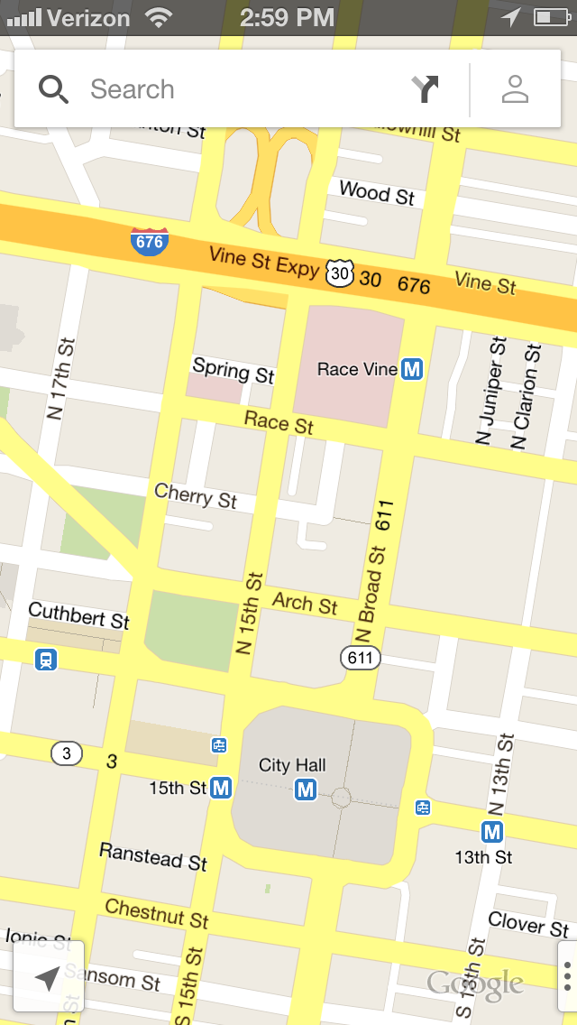
Restrooms
New

Slide 3
Restrooms
Add restroom
Name
YES
NO
Does it exist?
Disabled stall?
Number of sinks: ______________________
Number of flushing units: _______________
Overall rating:
YES
NO
Comments

Slide 4
Restrooms
Closest restrooms
1
Memorial Stadium | 0.3 mi
GO
2
Memorial Stadium | 0.3 mi
GO
3
Memorial Stadium | 0.3 mi
GO
4
Memorial Stadium | 0.3 mi
GO
5
Memorial Stadium | 0.3 mi
GO

Slide 5

Restrooms
Closest restrooms
1
Memorial Stadium | 0.3 mi
GO
Bathroom on 3rd floor
Exists: Comments (31):
Disabled stall:
Overall Rating:
Number of sinks: 3
Number of flushing units: 8
“I’m bursting with joy. I can finally doo the doo”
“how did someone ever manage to make an app about toilets”
See more
Memorial Stadium | 0.3 mi
GO

Slide 6
Water Fountains
Closest water fountains
1
Memorial Stadium | 0.3 mi
GO
2
Memorial Stadium | 0.3 mi
GO
3
Memorial Stadium | 0.3 mi
GO
4
Memorial Stadium | 0.3 mi
GO
5
Memorial Stadium | 0.3 mi
GO

Slide 7
