Slide 1
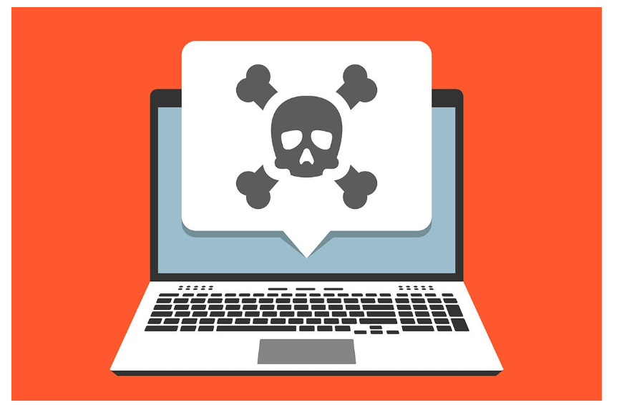
I. Malware

Slide 2
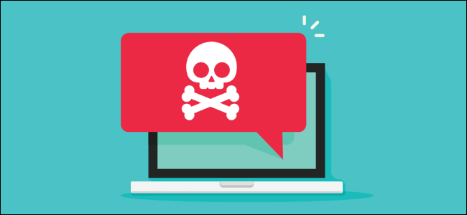
Viruses :
from showing a distracting note to removing files from a hard drive or causing a computer to crash multiple times, as well as Northstar Secure

Slide 3
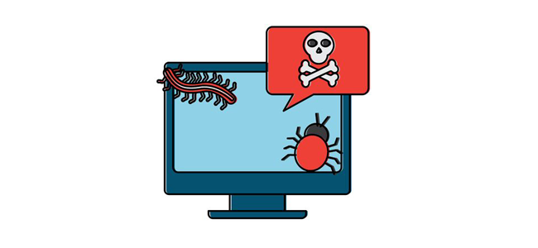
Worms:
Ability to manually copy archive files without being inserted. These often use the Internet to spread, causing serious harm to a general network

Slide 4
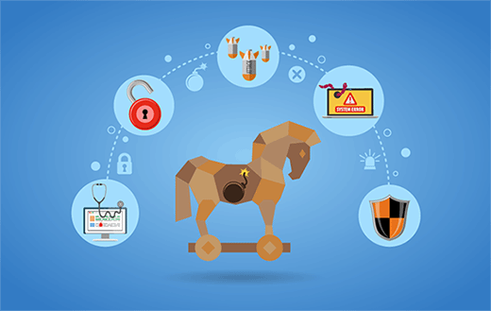
Trojan:
No self-replicating, no implantation in a file like a virus, instead installed into the system by pretending to be a valid and harmless software then allowing hackers to remotely control the computer.

Slide 5
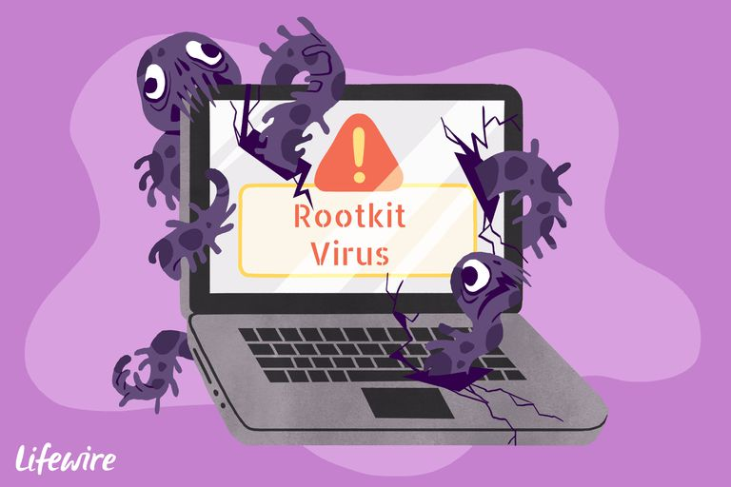
Rootkit :
Rootkit is a series of software tools used to conceal
actions or other software typs

Slide 6
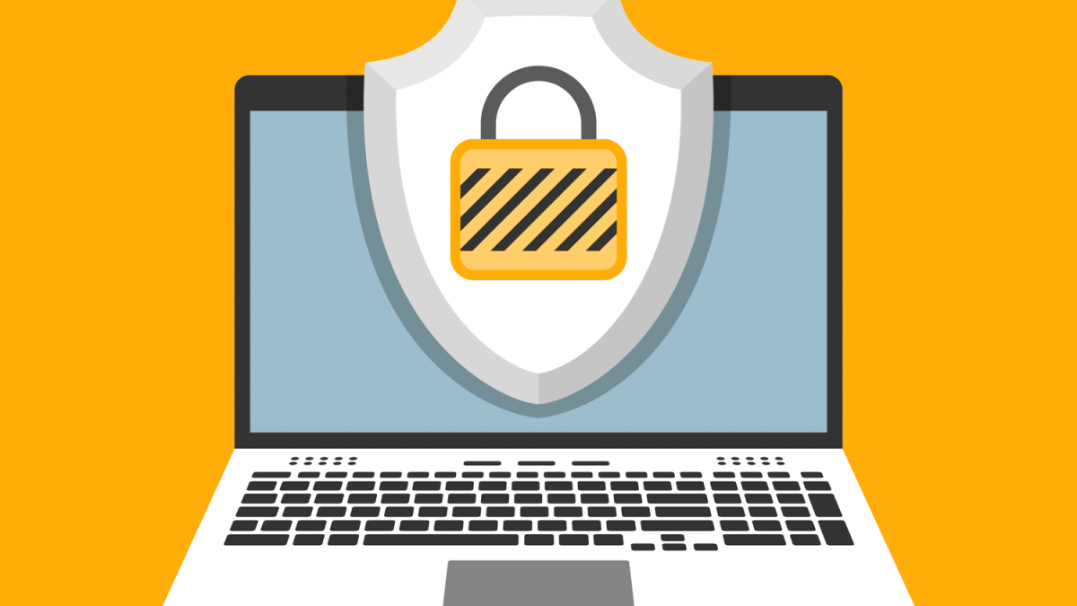
Spyware:
Spyware is software that attempts to collect, sometimes without their permission, information about a person or company and send that information to another party without the user's consent.

Slide 7
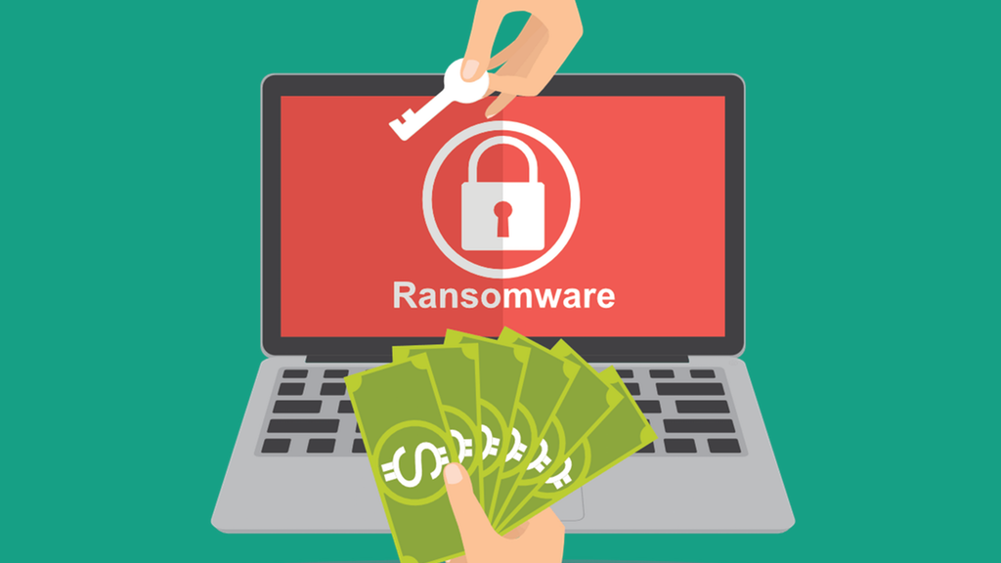
Ransomware
Ransomware is a type of ransomware Virology crypto that attempts to publish a victim's data or permanently block access to it unless the ransom is paid.

Slide 8
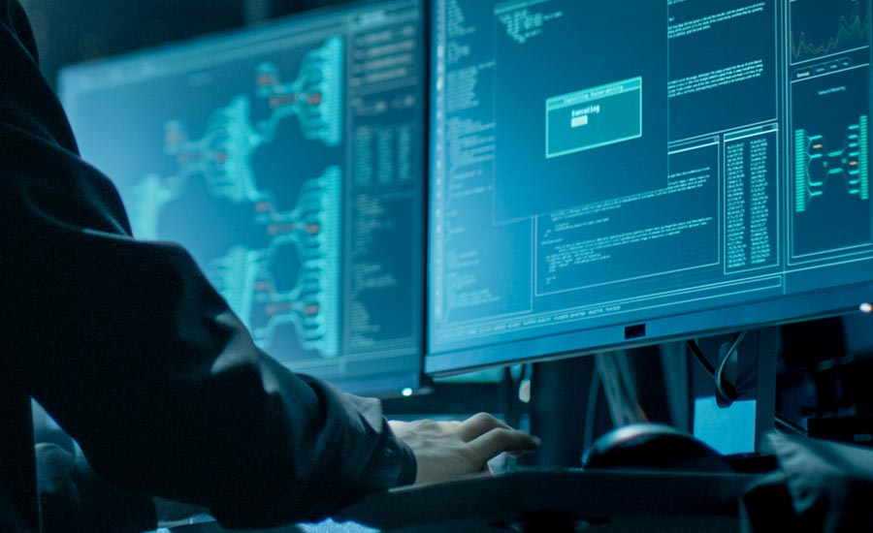
Application Attacks
The web application provides a mechanism for communication between the client and the web server. On the server, web pages are created and viewed by users on the client side. Data is transmitted via HTTP protocol as an HTML page between the client and the server. some examples like: SQL, XML, Cross-site scripting.

Slide 9
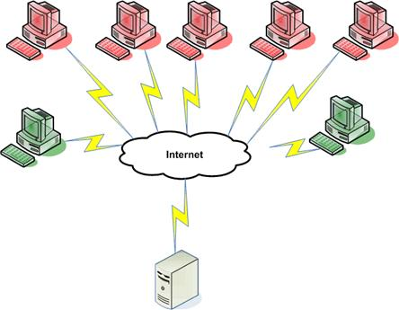
Networking-Based Attacks
Networkbased attacks are other risks than those being attacked initiated and managed by computers or systems.

Slide 10
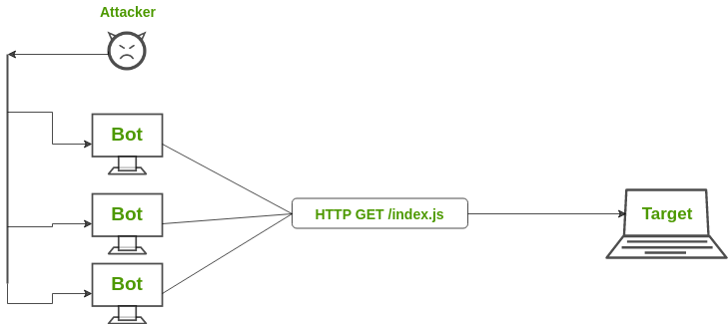
Denial of Service (DoS) AND Interception
DoS is a technical attack in the public to not allow valid access to the server. This attack technique often happens in class and application.

Slide 11
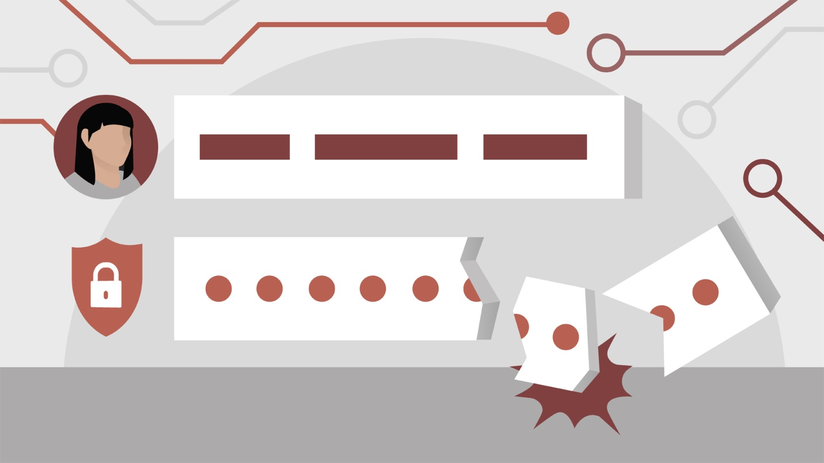
Poisoning AND Attacks on Access Rights
Using a flaw in applications to control information that consumers will often be prevented from accessing.

Slide 12
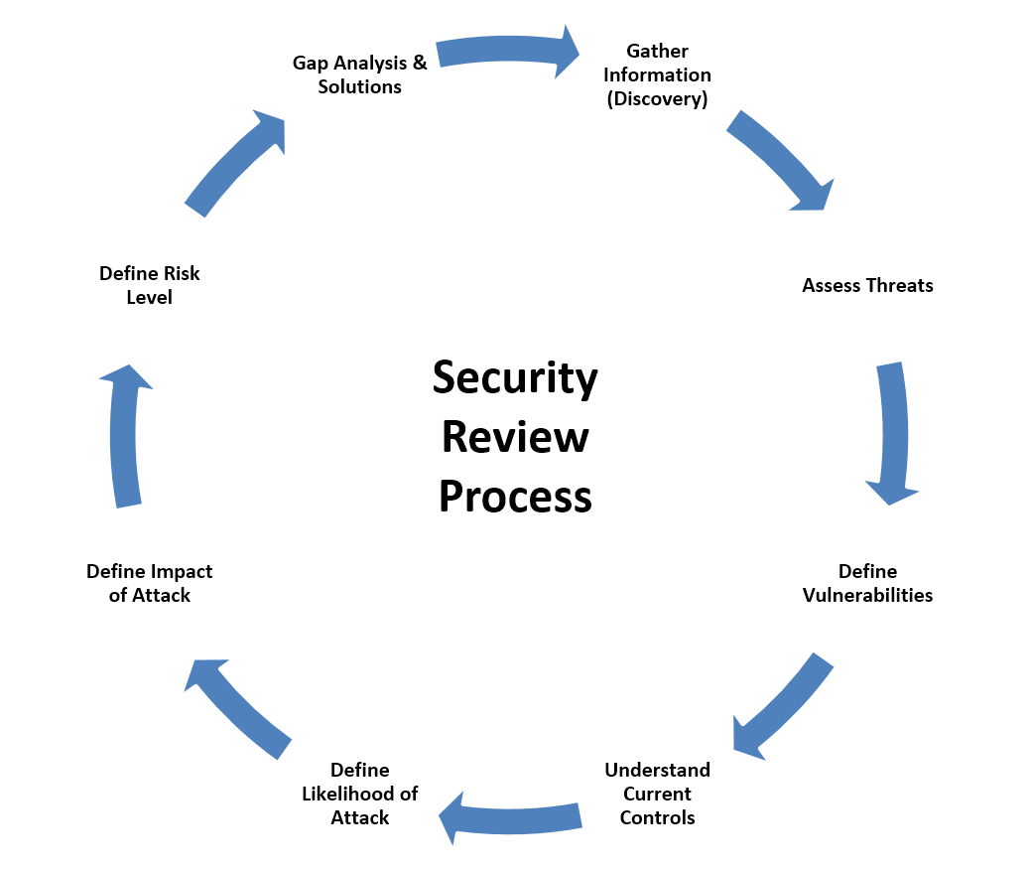
Assess network security risks
The cybersecurity risk assessment for data can be done by NorthStar dedicated cybersecurity personnel or by consulting cybersecurity experts.

Slide 13
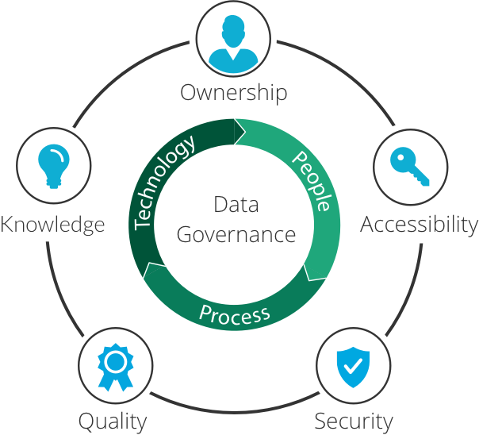
DATASECURITY governance
Security risks for enterprise data are frequent. Therefore, security measures cannot be implemented for a short period of time, requiring regular and continuous implementation. If possible, every business should have a dedicated leader or individual, with its knowledge of data security and confidentiality responsible for monitoring the implementation of security measures, processes. to ensure data security

Slide 14
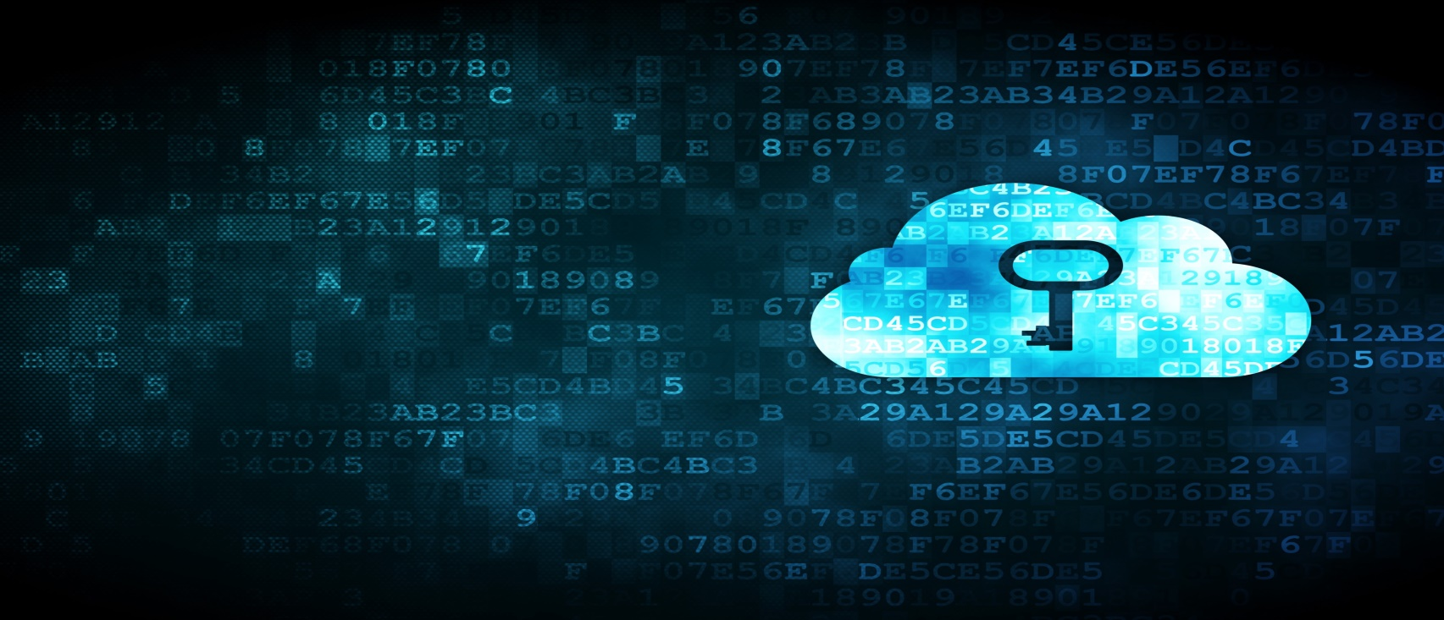
Configure the system securely AND Control access
All components of the system (including software and hardware) are configured to meet security policy requirements as well as effective measures to help ensure data safety. These standards may be passwords, accounts, Services or system configuration policies

Slide 15
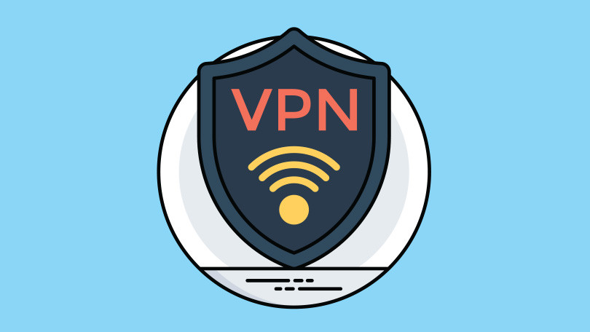
The potential impact on security when configuring the wrong third-party VPN policy
VPNS is also known as virtual private network, which allows users to set up a virtual private network with other networks on the Internet. VPNs can be used to access sites that restrict geolocation access, protecting your browsing activity from "prying" on public Wi-Fi networks by setting up virtual private networks for friend. Some organizations or people at home can use a variety of methods to protect their devices, many of which are common practices, such as data encryption, firewalls, etc. Access people can use is to set up a VPNS (Virtual Private Network). VPNS is used to facilitate secure data sharing, normally when sending data, packets will have to bypass public domain to be transmitted successfully.

Slide 16
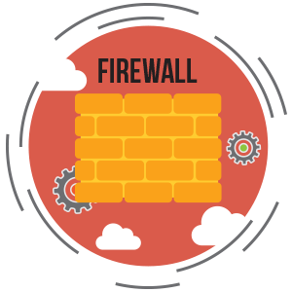
The potential impact on security when configuring the wrong third-party firewall policy.
A firewall is a computer network term that implements a technology that is integrated into the network to prevent unauthorized access to protect internal information sources as well as restrict access for certain access rights. Unwanted systems for individuals, officials, businesses, government agencies firewalls as a hardware device or both software work together and operate in the intranet environment to implement Fence Block 1 to prevent contact prohibited by policy. VPNs can keep data secure as they are transmitted between networks, but it's not the only factor that can protect data on the go, it's a common knowledge of what's being done. , They are protecting the device against malicious data entry into the system.

Slide 17
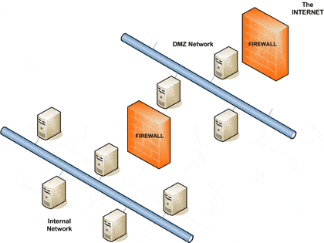
DMZ
The DMZ is a neutral network area between the intranet and the Internet, containing information that allows users from the Internet to retrieve and accept the risk of Internet attacks.

Slide 18
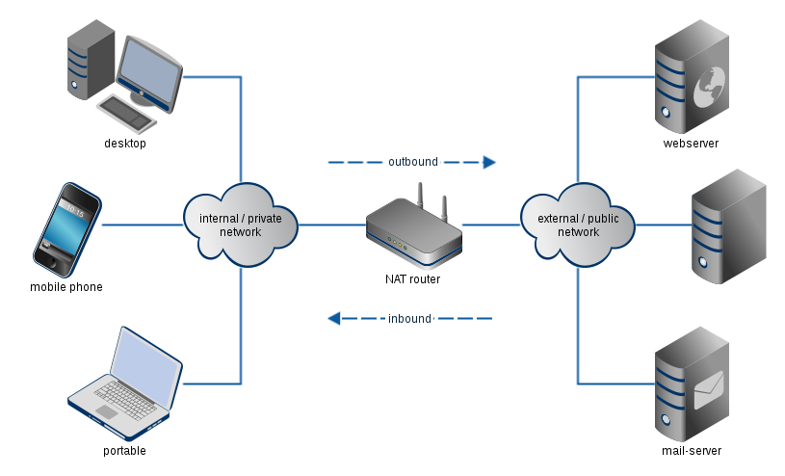
NAT
(Network address translation) is a method that facilitates conversion from one IP address to another. Typically, NAT is often used on networks that use local addresses, allowing access to public networks (the Internet).

Slide 19
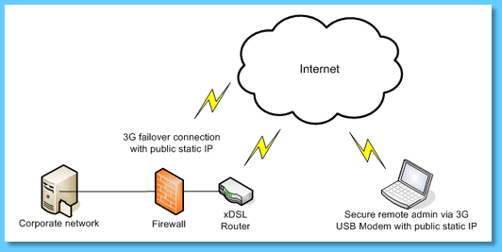
Static IP
Static IP là một địa chỉ IP cố định được dành riêng cho một người hoặc nhóm người dùng mà thiết bị kết nối Internet của họ luôn được đặt địa chỉ IP.

