Slide 1
Real time evolution group
Harada Yuki
Noda Masashi
Tani Mizuki
Uemoto Mitsuharu

Slide 2
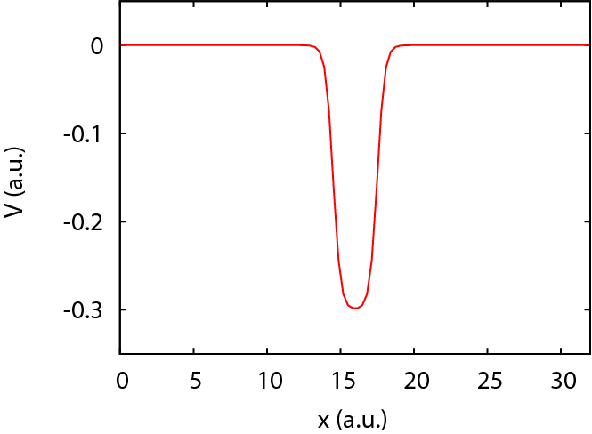

Target system : electron in 1D potential
Simulation box in real space
Single electron dynamics
$$H_{x}=\frac{1}{2}{\left(\frac{∂_{x}}{i}\right)}^{2}+V\left(x\right)+a\left(t\right)\frac{∂_{x}}{i}$$
$$i∂_{t}ψ\left(x,t\right)=H_{x}ψ\left(x,t\right)$$
$$H_{x}ψ\left(x,0\right)=εψ\left(x,0\right)$$

Slide 3

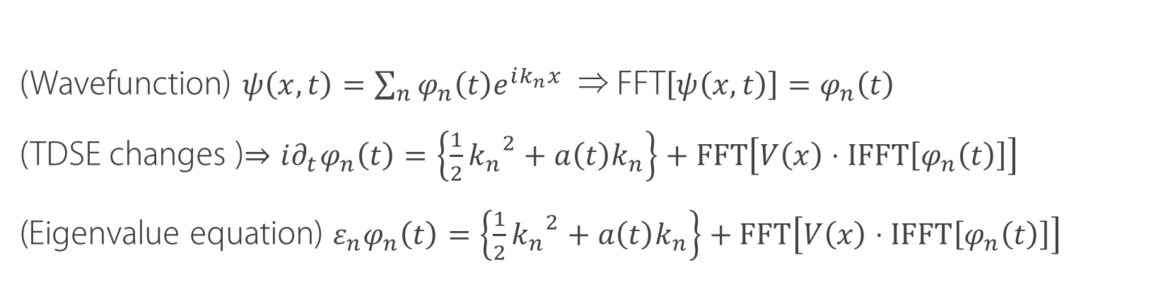
Solving the SE
Transformation into fourier space
(Wavefunction) $ψ\left(x,t\right)=\sum_{n}{φ_{n}\left(t\right)e^{ik_{n}x}}$ ⇒ FFT$\left[ψ\left(x,t\right)\right]=φ_{n}\left(t\right)$
(TDSE changes )$⇒i∂_{t}φ_{n}\left(t\right)=\left\{\frac{1}{2}{k_{n}}^{2}+a\left(t\right)k_{n}\right\}+FFT\left[V\left(x\right)⋅IFFT\left[φ_{n}\left(t\right)\right]\right]$
(Eigenvalue equation) $ε_{n}φ_{n}\left(t\right)=\left\{\frac{1}{2}{k_{n}}^{2}+a\left(t\right)k_{n}\right\}+FFT\left[V\left(x\right)⋅IFFT\left[φ_{n}\left(t\right)\right]\right]$
Real time evolution
$$φ_{n}\left(t\right)=e^{−iHt}φ_{n}\left(0\right)$$
$$φ_{n}\left(t+∆t\right)=e^{−iH∆t}φ_{n}\left(t\right)$$

Slide 4
Matrix representation

Slide 5
Directory structure
https://github.com/mn2007/iccms-te.git
├── readme_command_memo_01.txt
├── readme_command_memo_02.txt
├── readme_command_memo_02B.txt
├── EIGEN_EK.F90
├── EIGEN_LAPACK.F90
├── GS.F90
├── HPHI.F90
├── MAIN.F90
├── README.md
├── RT.F90
├── SETV.F90
└── Makefile
  EIGEN_EK.F90, EIGEN_LAPACK.F90
    固有値計算用サブルーチン(Eigenkernel使用・LAPACK使用)
  HPSI.F90
    ハミルトニアン計算サブルーチン
  GS.F90
    初期状態（基底状態）計算用サブルーチン
  RT.F90
    時間発展サブルーチン
  SETV.F90
    ポテンシャル関数系設定ルーチン
  MAIN.F90
    メインルーチン

Slide 6
results

Slide 7
おわり

Slide 8
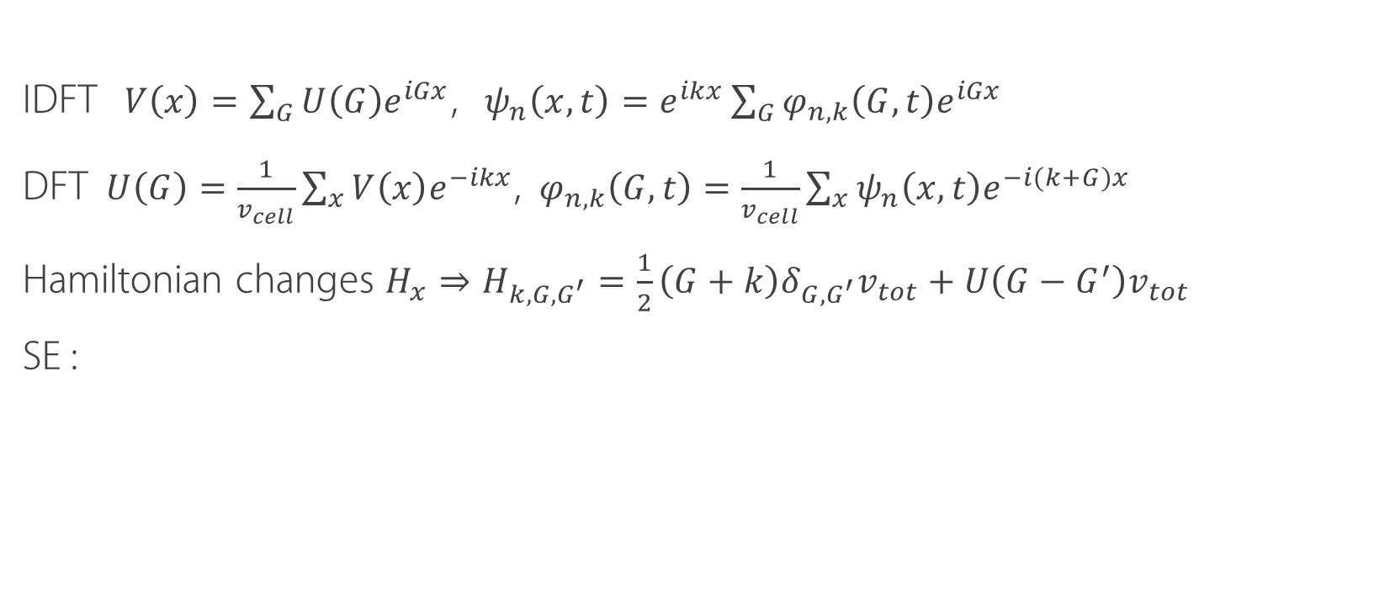
algorithm
Solve the TDSE in reciprocal lattice space
IDFT $V\left(x\right)=\sum_{G}{U\left(G\right)e^{iGx}}$, $ψ_{n}\left(x,t\right)=e^{ikx}\sum_{G}{φ_{n,k}\left(G,t\right)e^{iGx}}$
DFT $U\left(G\right)=\frac{1}{v_{cell}}\sum_{x}{V\left(x\right)e^{−ikx}}$, $φ_{n,k}\left(G,t\right)=\frac{1}{v_{cell}}\sum_{x}{ψ_{n}\left(x,t\right)e^{−i(k+G)x}}$
Hamiltonian changes $H_{x}⇒H_{k,G,G^{′}}=\frac{1}{2}\left(G+k\right)δ_{G,G^{′}}v_{tot}+U\left(G−G^{′}\right)v_{tot}$
SE :

Slide 9
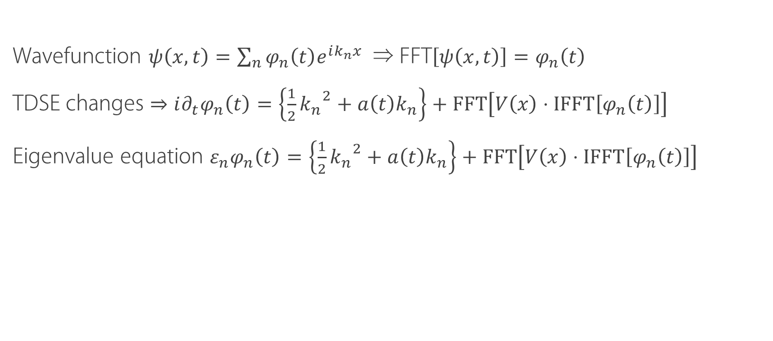
Solving the SE
Transformation into fourier space
Wavefunction $ψ\left(x,t\right)=\sum_{n}{φ_{n}\left(t\right)e^{ik_{n}x}}$ ⇒ FFT$\left[ψ\left(x,t\right)\right]=φ_{n}\left(t\right)$
TDSE changes $⇒i∂_{t}φ_{n}\left(t\right)=\left\{\frac{1}{2}{k_{n}}^{2}+a\left(t\right)k_{n}\right\}+FFT\left[V\left(x\right)⋅IFFT\left[φ_{n}\left(t\right)\right]\right]$
Eigenvalue equation $ε_{n}φ_{n}\left(t\right)=\left\{\frac{1}{2}{k_{n}}^{2}+a\left(t\right)k_{n}\right\}+FFT\left[V\left(x\right)⋅IFFT\left[φ_{n}\left(t\right)\right]\right]$

