Slide 1

AWP Agentic Workflow Platform
Architecture Study
Mohamad NABAA
20 Janvier 2026
Notes:
Bonjour à tout et à tous !
Je m'appelle Mohamad Nabaa.
J'ai 15 ans d'expérience dans le domaine technologique, dont 8 ans comme architecte de solutions et 4 ans dans le domaine de l'IA générique.
Dans le cadre de ce processus de recrutement, vous m'avez demandé de préparer une présentation architecturale pour un client du secteur du luxe.
La présentation couvrira :

Slide 2
Sommaire
Index
01
02
03
Introduction
Logical Architecture
Physical Architecture
04
05
06
RAG Strategies
Advantages
TCO & Roadmap
07
Conclusion

Slide 3

Introduction
Use Case
LUXE Sector client with 25000 internal users, are using a static chatbot that provides information but lack the capability to perform autonomous operational actions.
Vision
Transform from Static Chatbot to Sovereign Agentic Platform
Objective
Create a Sovereign Agentic-powered "Virtual Team" that executes complex tasks while keeping the human in the loop for actions.
Notes:
Cas d’usage : Un client du secteur du luxe a 25 000 utilisateurs internes qui utilisent un chatbot statique sur leur intranet.
Un client du secteur du luxe compte 25 000 utilisateurs internes qui utilisent un chatbot statique sur leur intranet.
L'objectif est de développer une plateforme agentique pour renforcer les compétences de vos collaborateurs.

Slide 4
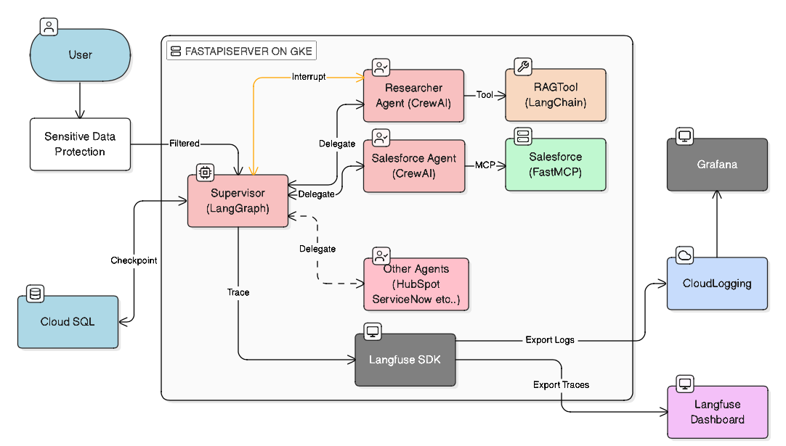
Logical Architecture
Logical Architecture (The "Virtual Team")
Stateful Multi-Agent Orchestration with End-to-End Observability
Notes:
Pour cette plateforme agentique :
Nous avons choisi le modèle Superviseur/Agent pour garantir une gouvernance centralisée.
Un superviseur (LangGraph) orchestre des agents spécialisés (CrewAI)
capables d'exécuter des actions complexes via leurs outils connectés.
Chaque décision prise par l'IA est tracée et remontée par Langfuse vers Cloud Logging pour garantir une transparence et une observabilité totales.

Slide 5
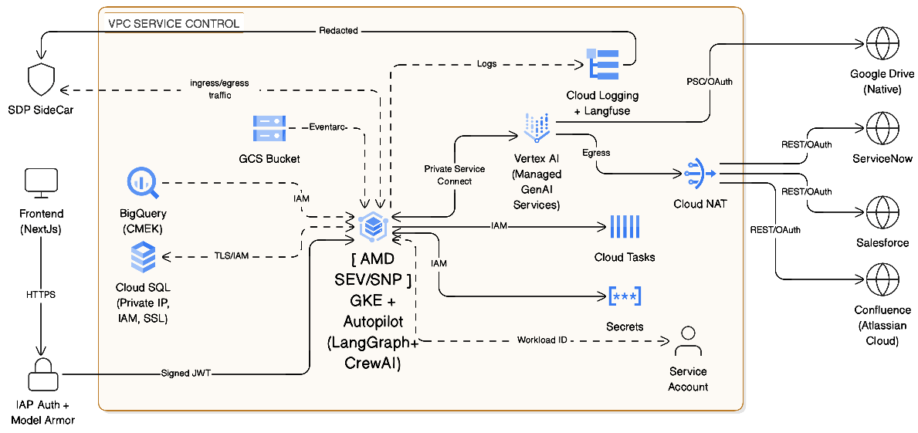
Physical Architecture
Physical Architecture
Zero-Trust Serverless Enclave for Enterprise GenAI (europe-west-9)
Notes:
Pour l’architecture physique souveraine et Zero-Trust :
Nous avons choisi un design serverless pour notre orchestrateur avec Confidential GKE Autopilot (incluant le chiffrement de lamémoire au niveau matériel (AMD SEV-SNP).
Côté réseau, nous intégrons :
VPC Service Control (région europe-west-9).
Une Sovereign Access Gate avec IAP Auth + Access Approval.
Cloud NAT pour la gestion de l'EGRESS.
================================================================================================================================================================================
Zero-Trust Hardware-Enforced Enclave (europe-west-9)
Infrastructure Breakdown:
Orchestrator (The Brain): Confidential GKE Autopilot running LangGraph. Hardware-level memory encryption (AMD SEV-SNP) ensures the supervisor's reasoning logic is invisible to the provider.
Vertex AI Endpoints. BUT can change to Models deployed on N2D/C3 machine types with the "Confidential Computing" toggle enabled to eliminate the "RAM Gap" during processing
Sovereign Access Gate: IAP Auth + Access Approval. Dual-layer security requiring explicit user identity verification and time-bound client approval before any administrative provider access.
Networking: VPC Service Control (europe-west-9) perimeter encompassing all components to prevent data exfiltration to unauthorized external IPs.

Slide 6
Architecture
Architecture
Asynchronous Python native stack
Here's a breakdown of our technical architecture:
Stack
Observability
Langfuse Monitoring traces every graph node state transition, exports logs to Cloud Logging and Grafana or (Cloud Trace) for production monitoring.
LangGraph for graph orchestration, LangChain for native tools
CrewAI for agent implementation
FastAPI for the async server runtime
Governance
FastMCP for MCP server/client services
Sensitive Data Protection sidecar: (GCP managed service) for PII redaction at ingress and industry standard guard rails
Terraform: Infrastructure as Code
Model Armor: Intent Validation, blocking malicious "jailbreak" commands or prompt injections before they reach the LLM orchestrator.
Interrupt-based approval flow for high-risk or agent flagged actions (Human-in-Loop validated via IAP identity).

Slide 7



RAG Strategies
Multi-Modal Agentic RAG
Autonomous Multi-Source Intelligence: Orchestrating Hybrid Retrieval with Self-Correcting Logic and Enterprise-Grade Governance
Pattern A: Adaptive Semantic Search
(Unstructured)
Pattern B: Verified Analytical Query (Structured)
Pattern C: Hybrid Agentic Orchestrator (Cross-Source)
Vector Engine: Vertex AI RAG Engine using text-embedding-005 for high-dimensional accuracy.
Chunking Strategy: Layout-Aware & Semantic Chunking to preserve document hierarchy.
Reranking: Cross-Encoder Rerankernode to score the most relevant 3-5 passages, reducing "lost in the middle" hallucinations.
Engine: LangChain Semantic Text-to-SQL feeding into BigQuery.
Governance: Mandatory Dry Run Validation via a Read-Only Service Account to ensure zero data-leakage.
Few-Shot examples: Uses a vector store of "Golden Query-SQL" pairs to guide the agent in generating high-accuracy queries for complex luxury inventory metrics.
Logic: LangGraph Supervisor decomposes complex multi-source requests (e.g., "Compare sales trends against last month's policy update").
Self-Correction Loop: If the initial retrieval is irrelevant, a Query Transformation node automatically rewrites the prompt and triggers a second search attempt.
Notes:
Le Mémoire Externe de notre client a:
Unstructured Data: Confluence+Drive + RAG Ephemeral
Structured Data: BigQuery

Slide 8
Comparative Analysis
Advantages
Advantage
Agentic Platform Capability
Operational Efficiency
Agents offload L1/L2 support and operational cost
Reduced MTTR
Automated workflows vs manual processes
Control
100% EU Data Residency with Zero-Trust security in a serverless enclave.
Sovereignty
Full ownership of the "AI Brain," specialized logic, and system connectors.
Scalability
Horizontal, demand-driven scaling with usage-dependent serverless costing.
Notes:
Économies : Réduction drastique des frais de support (L1/L2).
Vitesse : Automatisation des workflows vs processus manuels.
Contrôle : Souveraineté UE vs Opacité des modèles standards.
Flexibilité : Paiement à l'usage (Serverless) vs Coûts fixes.

Slide 9
Planification
TCO & Roadmap
Build Phase
CapEx: Estimated Cost: €480K->€660K
3-6 months, Requires 6-7 FTE Squad:
  1 Cloud Architect
  1 UX/Product Lead
  2 Senior AI Engineer
  1 Frontend Dev
  1 Data Engineer
  1 DevSecOps / Security Architect
Run Phase
OpEx: Infrastructure €8,000 - €10,000 / month in pilot phase
GCP Infrastructure + LLM Tokens for ~1k users
Operational Team
Requires 2.5 FTE -> (Platform Engineer + FinOps/Security Analyst ) + 0.5 FTE to maintain connectors and governance

Slide 10



Conclusion
Agentic Workflow Platform
Total replacement of a static chatbot.
Activates autonomous agents with a human in the loop while preserving observability and governance. Scalable on demand and secure.
Budget
Cost Offset
Development budget replaces recurring 1 year for most of L1/L2 support cost.
Value
Ownership
We own the "Brain" and the "Connectors" (no Black Box SaaS).
Notes:
En résumé : ont remplace un coût récurrent par un actif stratégique sécurisé, souverain et performant

Slide 11
Merci
Q/A

Slide 12
Annex

Slide 13
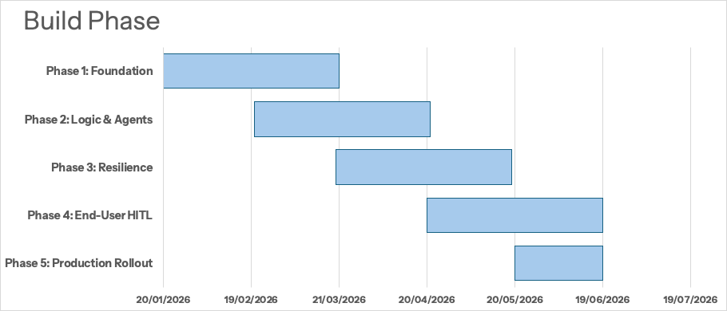

Slide 14
Zero Trust
Phase | Timeline | Key Activities | Technical Focus
Foundation | Month 1-2 | Setup VPC Service Controls & Confidential GKE Cluster. | Security: Establishing the Zero-Trust serverless enclave in europe-west-9
Logic & Agents | Month 2-3 | Develop the LangGraph Supervisor and specialized CrewAI agents (IT, Ops, Analyst). | Orchestration: Implementing stateful multi-agent flows with FastAPI and LangGraph.
Resilience (Queue) | Month 3-4 | Implement Cloud Tasks for long-running (3–5 min) actions and Transient RAG processing. | Connects the Confidential GKE orchestrator to asynchronous background services for higher reliability
End-User HITL | Month 4-5 | Integrating the "Interrupt" UI to facilitate Human-in-the-Loop (HITL) approvals for high-risk actions. | Governance: Using IAP identity to validate high-risk actions before execution
Run Phase | Month 6+ | Production rollout to 25k users with 100% EU residency. | Scalability: Managed by horizontal, demand-driven serverless scaling via Confidential GKE Autopilot.

Slide 15
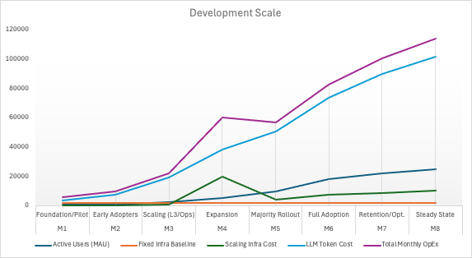
Service Category | Estimated Cost | Core Purpose & Governance
Confidential Compute | €800 | Management fee for GKE Autopilot and the minimum "warm" pods for the LangGraph Supervisor. Includes the premium for RAM Encryption.
Knowledge Search Index | €600 | Continuous hosting of the Vertex AI Search vector store to ensure RAG data (Confluence/Drive) is instantly available.
Stateful Data Tier | €250 | Cloud SQL (HA) instance for stateful multi-agent checkpointing, ensuring conversation continuity.
Security & Perimeter | €250 | Fixed costs for VPC Service Controls, IAP Authentication, Cloud NAT, and Secret Manager.
Networking & LB | €470 | Global External HTTP(S) LB with US-based Anycast IP and cross-region data transfer .
TOTAL BASELINE | €2370 | Minimum "Sovereign Tax" for a Zero-Trust Enclave.
Run Phase Scaling
Month | Phase | Active Users (MAU) | Fixed Infra Baseline | Scaling Infra Cost | LLM Token Cost | Total Monthly OpEx
M1 | Foundation/Pilot | 500 | €2 370,00 | €200 | €3 850,00 | €6 420,00
M2 | Early Adopters | 1000 | €2 370,00 | €400 | €7 700,00 | €10 470,00
M3 | Scaling (L3/Ops) | 2500 | €2 370,00 | €1 000,00 | €19 250,00 | €22 620,00
M4 | Expansion | 5000 | €2 370,00 | €20 000,00 | €38 500,00 | €60 870,00
M5 | Majority Rollout | 10000 | €2 370,00 | €4 050,00 | €51 000,00 | €57 420,00
M6 | Full Adoption | 18000 | €2 370,00 | €7 250,00 | €73 500,00 | €83 120,00
M7 | Retention/Opt. | 22000 | €2 370,00 | €8 900,00 | €89 800,00 | €101 070,00
M8 | Steady State | 25000 | €2 370,00 | €10 100,00 | €102 000,00 | €114 470,00

Slide 16
Operational Maturity (Day 2)
Capability | Implementation | Value
Observability | Distributed Tracing (Langfuse/opentelemtery) | User flagged response (hallucination) is traced back to the specific retrieved document or agent decision.
QA & Testing | "Golden Dataset" Regression + Continuous Benchmarking | CI/CD pipeline runs 100+ standard questions to ensure new code doesn't degrade answer quality.
Resilience | Circuit Breakers | Graceful degradation if a tool (e.g., ServiceNow) is slow or down.
Notes:
Continuous Benchmarking (To catch prompt drift/LLM updates)
Observability: Si un utilisateur "flague" une réponse (hallucination), on peut remonter instantanément au document source ou à la décision précise de l'agent.
QA & Testing: On fait tourner plus de 100 tests de non-régression à chaque mise à jour du code via la CI/CD pour garantir que la qualité des réponses ne dégrade pas.
Résilience:En cas de lenteur ou de panne d'un outil externe (ex: ServiceNow), le système bascule en "mode dégradé" proprement au lieu de planter.

Slide 17
Compute & Application Hosting
  Cloud Run (Services & Workers): ~€600 - €800 / month
  Cloud Run (Jobs - Connectors): ~€30 - €60 / month
Data & Storage
  Cloud SQL (PostgreSQL HA): ~€250 - €400 / month
  Vertex AI Search (Vector Store): ~€600 - €1,000 / month
  Cloud Storage (GCS): ~€50 - €100 / month
  Memorystore (Redis) - Optional: ~€40 - €150 / month
AI & Intelligence
  Vertex AI (Gemini Models): ~€200 - €500 / month
  Security & Networking (The "Enterprise" Premium)
  Cloud Armor + Load Balancer: ~€40 - €100 / month
  Cloud NAT: ~€50 / month
  Secret Manager & KMS: ~€50 - €80 / month
Observability & Operations
  Cloud Logging & Monitoring: ~€100 - €200 / month
  Dataplex (Data Quality): ~€100 - €200 / month
Notes:
Vertex AI Search ($2.50 / 1k queries):
If 1,000 users ask 5 questions a day, and your "Researcher Agent" decides to perform 3 searches per question to "refine results,”
$1,000 \text{ users} \times 5 \text{ Qs} \times 3 \text{ searches} \times 20 \text{ days} = 300,000 \text{ queries/mo} = $750
Critical Risk: If a bug causes the agent to loop 10 times instead of 3, this cost triples overnight.
Solution: Hard-limit the number of tool calls per turn in your LangGraph definition.

Slide 18
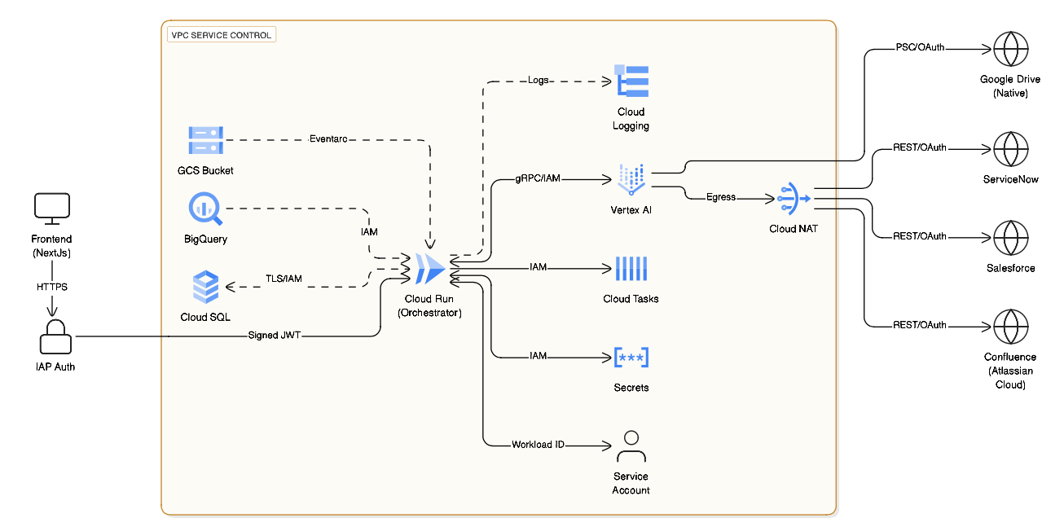
Physical Architecture
Physical Architecture
Contractual Trust Serverless Enclave for Enterprise GenAI (europe-west-9)
Notes:
Le cœur du système est isolé au sein d'un périmètre VPC Service Controls sur GCP, garantissant que les données ne quittent jamais cet environnement sécurisé.
Identité et Accès : l'authentification est gérée par IAP (Identity-Aware Proxy), assurant la propagation de l'identité de l'utilisateur.
Souveraineté des Données : les données sont localisées en Europe (EU Residency).
Connectivité Maîtrisée : tous les flux passent par un Cloud NAT avec une adresse IP fixe autorisée (whitelisted), sécurisant les échanges via REST/OAuth.
Scalabilité Serverless : l'utilisation de Cloud Run permet une mise à l'échelle automatique selon l'usage, optimisant les coûts tout en supportant une charge allant jusqu'à 25 000 utilisateurs.

Slide 19
Analyse Comparative
Advantages(Contractual)
Advantage
Static Chatbot (Current)
Agentic Platform Capability
Architectural Solution
Operational Efficiency
High L1/L2 support costs (€1M+ annually) for 25k users.
Agents offload L1/L2 support and operational actions and their recurrent cost.
Supervisor (LangGraph) & CrewAI Agents
Reduced MTTR
Response and resolution times are bottlenecked by human intervention.
Faster response times with minimal human intervention through automated workflows.
Supervisor (LangGraph) & CrewAI Agents
Data Sovereignty
Reliance on "Black Box" SaaS with vague GDPR and data residency controls.
100% EU Data Residency with Zero-Trust security in a serverless enclave.
VPC Service Control(europe-west-9)
System Ownership
Renting a platform where the reasoning logic is a vendor secret.
Full ownership of the "AI Brain," specialized logic, and system connectors.
FastAPI Native Stack& FastMCP Connectors
Security & Privacy
Limited ability to filter or redact sensitive data before LLM processing.
Integrated PII redaction and identity propagation for secure operations.
Cloud SDP & IAP Authentication
Scalable TCO
Inflexible scaling; costs don't align perfectly with actual usage.
Horizontal, demand-driven scaling with usage-dependent serverless costing.
Cloud Run & Serverless Scaling

Slide 20
Contractual Trust
Phase | Timeline | Key Activities | Technical Focus
Foundation | Month 1-2 | Setup GCP Landing Zone, VPC Service Controls, and IAP Auth) | Security: Establishing the Zero-Trust serverless enclave in europe-west-9
Logic & Agents | Month 2-3 | Develop the LangGraph Supervisor and specialized CrewAI agents (IT, Ops, Analyst). | Orchestration: Implementing stateful multi-agent flows with FastAPI and LangGraph.
Resilience (Queue) | Month 3-4 | Implement Cloud Tasks for long-running (3–5 min) actions and Transient RAG processing. | Connects the Cloud Run orchestrator to asynchronous background services for higher reliability
End-User HITL | Month 4-5 | Integrating the "Interrupt" UI to facilitate Human-in-the-Loop (HITL) approvals for high-risk actions. | Governance: Using IAP identity to validate high-risk actions before execution
Run Phase | Month 6+ | Production rollout to 25k users with 100% EU residency. | Scalability: Managed by horizontal, demand-driven serverless scaling via Cloud Run.

Slide 21
RAG Strategies
Multiple sources of KB seamlessly integrated in the pipeline
Corporate Knowledge (Confluence, Drive)
Structured Business Data (BigQuery)
Transient Uploads
Presigned URL Upload
Vertex AI Agent Builder
Semantic Text-to-SQL (Langchain Tool) exposed to agent
Vertex AI Layout-Aware Chunking
Secure with Private Service Connect
text-embedding-004
text-embedding-004
Vertex AI RAG Engine configured for Semantic Chunking
Vector Search on preingested (worker based) structured schema embeddings
DRY RUN with authorized functions with Read-Only via Service Account

Slide 22
Service Heavy vs Asset Heavy
Composant GCP | Équivalent Kubernetes Natif / Souverain | Fonction Clé
VPC Service Control | Cilium + Network Policies | Isolation logique et segmentation L7.
IAP + Access Approval | Keycloak + OAuth2 Proxy + Teleport | Authentification forte et accès conditionnel.
Cloud NAT | Cilium / Istio Egress Gateway | Contrôle et traçabilité des flux sortants.
GKE Autopilot | RKE2 ou Talos Linux | Orchestration durcie et immuable.
Confidential GKE (SEV) | Confidential Containers (CoCo) | Chiffrement de la RAM au niveau matériel.
Notes:
Same CapEx but whatever you offload from LLM tokens will be paid for the team+ renovation and retention over the long run.
You will ending up chasing the latest in tech and although no vendor lockin, but latest tech and offering will always come in late.
Unless you have a team of DS continuously adapting tto the latest and innovating on your data/needs. Then you will be replacing the L1/L2 on the service line with your own Datacenter heavy

