Slide 1
AUTOMATED GUIDED VEHICLE
AUTONOMOUS MOBILE ROBOT
BY ALSAIAARI MOHAMMED NASSER 1734429

Slide 2

01.
02.
03.
INTRODUCTION
HISTORY
APPLICATION
04.
MAIN COMPONENT
05.
CONCLUSION

Slide 3
01.
INTRODUCTION

Slide 4
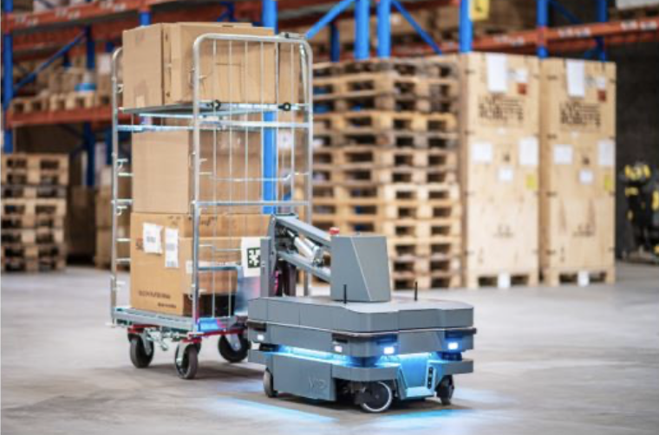
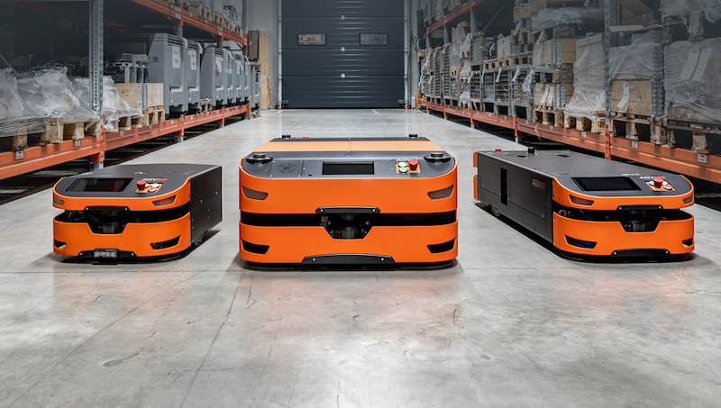
INTRODUCTION
WHAT IS AMR & AGV ?
Autonomous Mobile Robots (AMRs):
● Do tasks without direct human supervision or control.
● Use sensors and onboard computers to navigate and make decisions
● Are more flexible in terms of navigation capabilities
Automated Guided Vehicles (AGVs):
● Follow a predetermined path or route using guidance technology.
● Are typically used in industrial environments to move materials, products, or equipment.
● Are ideal for repetitive or predictable tasks within a controlled environment.

Slide 5
02.
HISTORY

Slide 6
HISTORY
AGV
AGV technology has existed since the 1950s. They were developed by Arthur Barrett, whose business, Barrett Electronics, produced the "Guide-O-Matic" driverless car in 1954. Early AGVs often pulled carts and were designed after railways. The "Stop & Drop" AGV, which could autonomously handle and unload pallets, appeared in the 1970s. The development of AGVs has spent a lot of time since the 1980s enhancing its fuel and navigational systems.
AMR
AMRs had their beginnings with William Grey Walter. Between the late 1940s and the beginning of the 1950s, he created the first AMR. It was intended to be a tool for medical research laboratories from the beginning. The AMR performed this function by detecting its surroundings using light, touch, and sound sensors and making judgements depending on the information it gathered.
AMRs weren't effectively used in commerce until the "HelpMate" robot was developed in the early 1990s. Hospital staff members employed this AMR to help with tasks like distributing meal trays, delivering mail, and transferring lab findings.

Slide 7
03.
Application of
AGV/AMR

Slide 8
Application
AGVs:
Material handling
Transportation
Assembly line feeding and uploading
Order picking and replenishment
Moving parts and components in production lines.
Moving equipment, supplies and medical waste.
AMRs:
Material handling and transportation
Logistics and e-commerce
operations
Inspection and maintenance tasks
Medication and supply delivery
Patient transportation and disinfection

Slide 9
04.
MAIN COMPONENT

Slide 10
MAIN COMPONENT
1. Frame & Design
2. Propulsion
System
3. Navigation &
Control System
4. Data
Collection
5. Data
Transmission
6. Power
Management

Slide 11
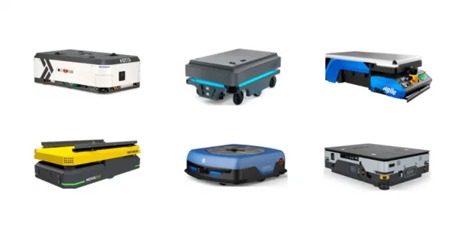
Frame & Design for AGV
typically have a low-to-the-ground, flat, rectangular frame with wheels or casters attached to the bottom.
The frame is made to fit the cargo being transported, which might be a pallet, a container, or something else entirely.
Depending on the usage and specifications of the vehicles, different materials are utilised for the frames.
For the frame, materials including aluminium, steel, carbon fibre, and plastic are frequently utilised.

Slide 12
Frame & Design for AMR
AMRs can manoeuvre in constrained spaces and in more challenging terrain thanks to their more adaptable and compact design.
AMRs come in a range of sizes and forms depending on the location and purpose.
Some of the designs are cylinder-shaped or box-like with legs, wheels, or tracks that enable them to manoeuvre around obstructions.
The AMR's frame is made of a variety of materials, not just aluminium, steel, carbon fibre, and plastic, depending on the vehicle's role.

Slide 13
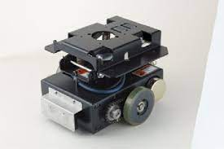
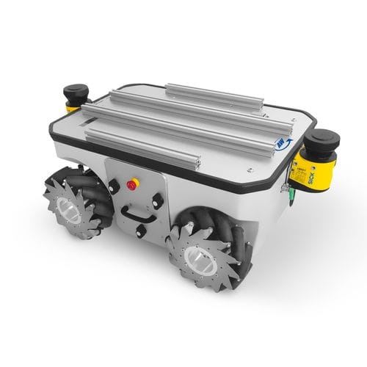
Propulsion System for AGV
Differential Drive:
AGVs use 2 drive wheels, which are controlled independently using motors.
By varying the speed and direction of each wheel, it can move in any direction.
Omni-Differential Drive:
Use multi-directional wheels that enable the AGV to move in any direction, without needing to turn around.
Allows the AGV to rotate around its axis while moving forward, backward or sideways.

Slide 14
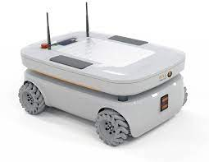
Propulsion System for AMR
Wheel-Based Propulsion:
Electric motors power the wheels that move the robots.
The wheels may be unidirectional, allowing the robot to turn by moving its wheels in the opposite direction, or they may be omnidirectional, allowing the robot to travel in any direction.
Hybrid Propulsion:
Electric motors power the rails on which the robot travels.
well-suited for outdoor settings and tough terrain when a robot must explore uneven terrain.

Slide 15
Navigation & Control System for AGV
Laser Guidance:
uses lasers to direct the movement of the AGV.
A laser beam from an AGV-mounted laser scanner bounces off reflectors installed on the building walls, mapping the surroundings.
Sensors:
used to determine the location, orientation, and surroundings of the AGV.
sensors based on magnetism, optics, lasers, or vision.
Safety System:
used to maintain safety and prevent accidents.
includes collision prevention, obstacle sensors, and emergency stop buttons.
Communication System
enables data communication between the AGV and other equipment.
Use Ethernet, CAN bus, or Wi-Fi connectivity, which can be connected or wireless.
Inertial Navigation:
AGV having sensors that track its rotation, speed, and acceleration.
Vision-Based:
AGV navigation is done using cameras and computer vision.
The camera takes pictures of the environment, which are then edited to produce a map of the area.

Slide 16
Navigation & Control System for AMR
Magnetic Guidance:
To direct AMR, a magnetic tape is laid down on the facility's floor. AMR has magnetic sensors that can pick up the magnetic field produced by the tape.
Sensors:
used to determine the location, orientation, and surroundings of the AMR.
Sonar, ultrasonic sensors, cameras, or lidar.
Safety System:
used to maintain safety and prevent accidents.
includes collision prevention, obstacle sensors, and emergency stop buttons.
Communication System
Use Ethernet, CAN bus, or Wi-Fi connectivity, which can be connected or wireless.
Inertial Navigation:
AMR has sensors that track its rotation, speed, and acceleration.
Vision-Based:
navigates AMR using cameras and computer vision.
The camera takes pictures of the environment, which are then edited to produce a map of the area.

Slide 17
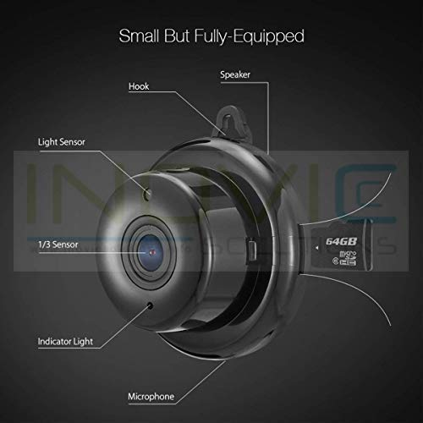
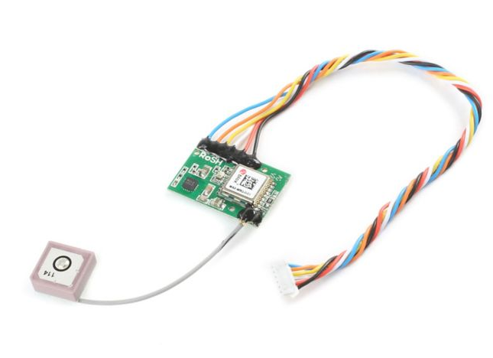
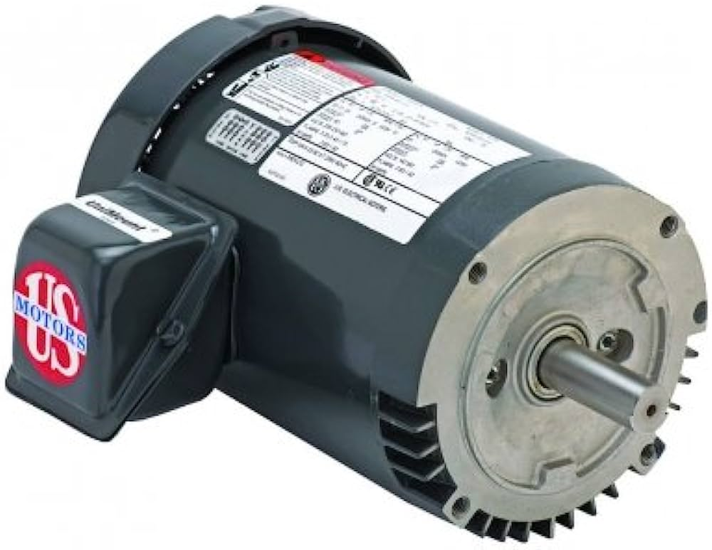
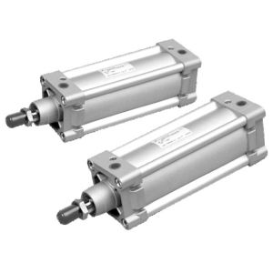
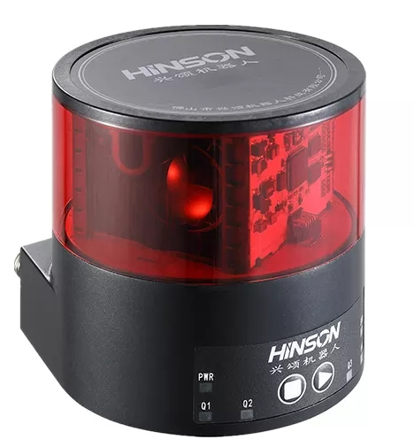
Data Collection
Sensors:
Camera
Sonar/ Ultrasonic Sensor
Infrared Sensor
GPS
Lidar
Encoders
Actuators:
Electric Motors
Pneumatic Cylinders
Gripper or arms
Conveyor Belts
Vacuum Suction Cups

Slide 18
Data Transmission
Wired Communication:
AGVs may be connected via cables to their control system or other equipment.
Wireless Communication:
When transferring data between a robot and its control system or other devices, AMR and AGV frequently employ wireless communication protocols like Wi-Fi, Bluetooth, or ZigBee.
Ethernet Communication:
AGVs and other automation devices are frequently utilized to connect to the manufacturing network.
offers a quick and dependable connection that enables real-time data transfer and command.
CAN Bus Communication:
a communication protocol that is frequently used in industrial and automotive applications.
used in an AGV or AMR to link sensors, actuators, and other devices.

Slide 19
Power Management
Battery System:
The robot is powered by systems of rechargeable batteries.
These batteries come in a variety of sizes, from modestly sized low-voltage batteries to huge high-voltage battery packs.
Energy Recovery System:
By absorbing and recycling energy, you can help AMRs and AGVs run longer.
For instance, regenerative braking might utilise the energy released during acceleration to replenish the battery.
Charging System:
To keep AGV or AMR operating, the battery needs to be charged often.
To maximize charging, utilize basic charging connections or more sophisticated charging stations that include sensor and communication protocols.
Power Distribution System:
Distribute energy from the battery system to the different AGV or AMR motors, sensors, and other parts.
For safe and effective functioning, they include voltage regulators, fuses, and circuit breakers..

Slide 20
05.
CONCLUSION

Slide 21
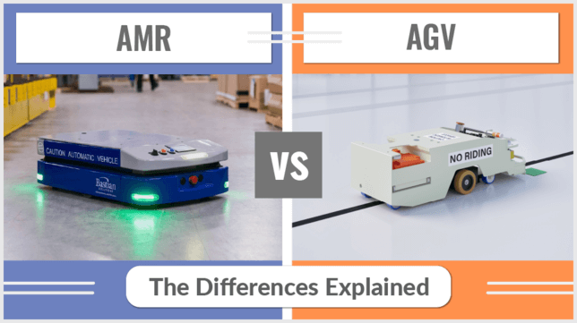
CONCLUSION
To summarize, AMRs and AGVs are robotic systems utilized in many sectors to increase productivity and security. AMRs are autonomous robots that navigate utilizing a variety of technologies, in contrast to AGVs, which follow a predefined course using sensors. They boost productivity in a variety of applications while decreasing manual labor and enhancing safety. Although it will cost a lot to execute them, it may be profitable. Companies are increasingly using AGVs and AMRs in Malaysia and other nations as they look to streamline operations and maintain competitiveness.

Slide 22
THANKS
Please keep this slide for attribution

