Slide 1
Forecasting Product Demand
Name: Moaz Nabeel
SPRINGBOARD
CAPSTONE-2

Slide 2
Problem Statement
The client for the data is a production planning facility and forecasting for the anonymous product is necessary for production, planning and control.
The problem will be solved using traditional time forecasting techniques such as Holt's Linear Method, Holt’s Winter Method, ARIMA and SARIMA as well as deep learning techniques such as LSTM network and ConvLSTM.

Slide 3
Dataset Description
The dataset used in this project is provided by Southern Illinois University Edwardsville and shows the product demand for five years.
The data is a univariate time series in nature.
The dataset did not need a lot of cleaning or wrangling.
Reading in the dates had to be parsed using the pandas.read_csv command. The dataset did not have any missing values or dates.

Slide 4
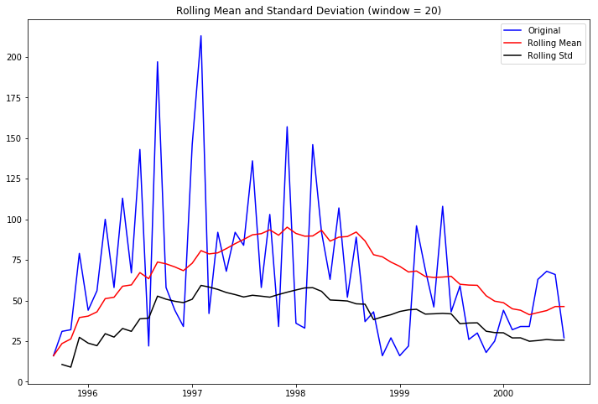
Data Story
The trend of demand for the product is shown in the figure along with the rolling means and standard deviations.

Slide 5

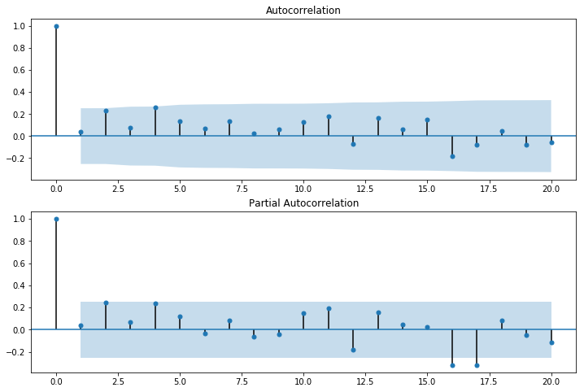
Exploratory Data Analysis
For time series data it is highly recommended to see the ACF and PACF plots to check if there is autocorrelation in the data.
In time series data it is recommended to check if the data is stationary or not. To check for stationarity, Dickey-Fuller test was done and the output of the p-value was below 0.05 and that proved that the data is stationary.

Slide 6
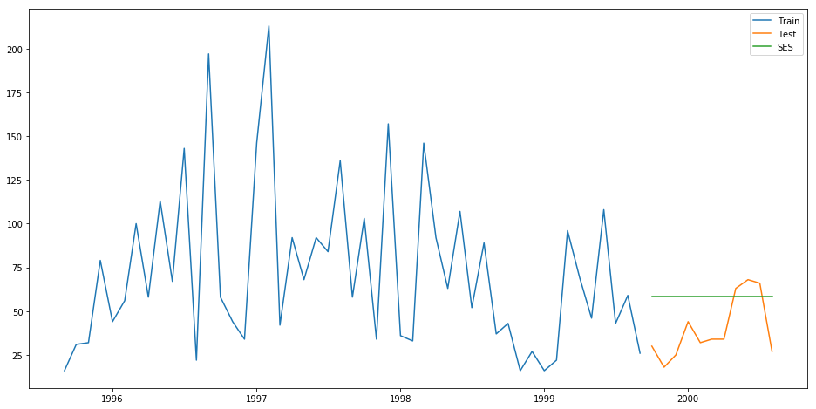
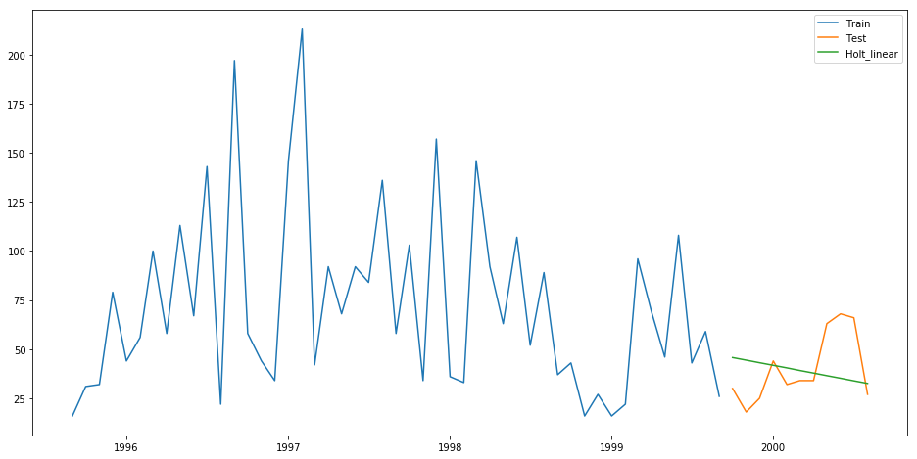
Traditional Forecasting
Simple Exponential Smoothing
The root mean squared error was 24.8.
Holt’s Linear Trend
The root mean squared error was 19.6.

Slide 7
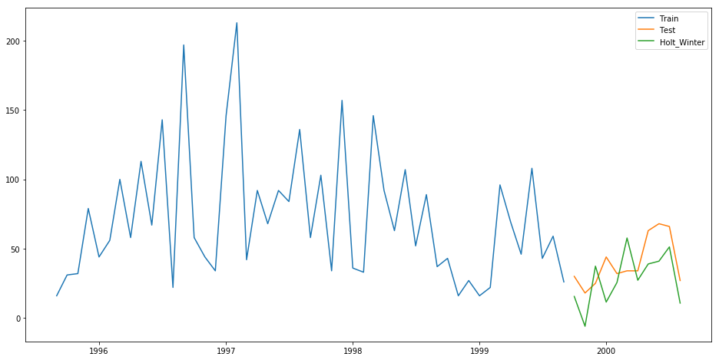
Traditional Forecasting (cont.)
Holt’s Winter Method
The root mean squared error was 20.09.

Slide 8
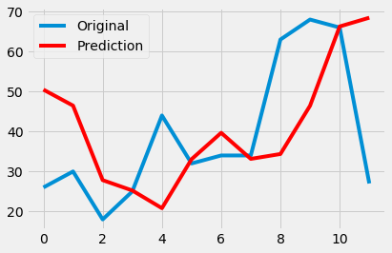
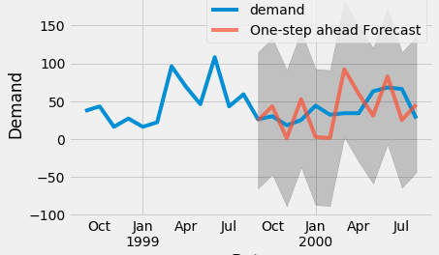
Traditional Forecasting (cont.)
ARIMA
The root mean squared error was 19.45.
SARIMA
The test set error was 30.56

Slide 9
Deep Learning
Results from LSTM
LSTM: 26.900 RMSE (+/- 0.438)
The model developed for the data set used had 8 layers, first was the input layer, and from second layer to seventh layer, hidden layers were added with ‘relu’ activation function.
The optimizer used in the output layer was ‘adam’, which is an industry standard.
Validation of the forecast with respect to the actual data was done three times.

Slide 10
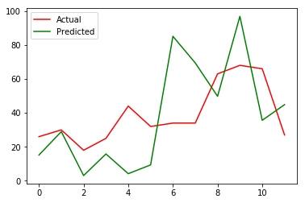
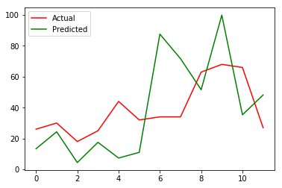
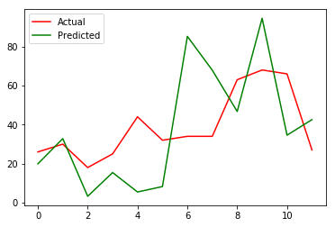
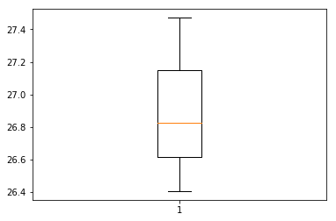
Deep Learning ( cont.)
Results from LSTM (cont.)

Slide 11
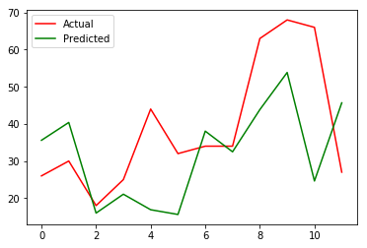
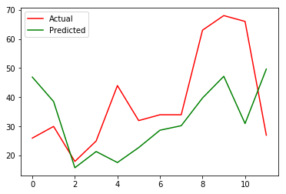
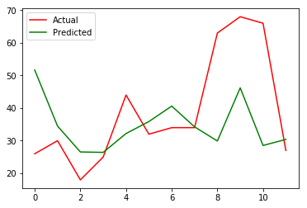
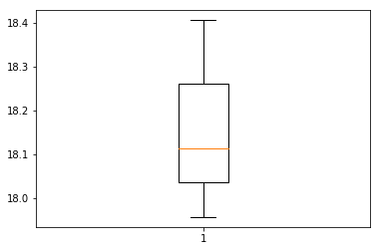
Deep Learning ( cont.)
ConvLSTM/CNN-LSTM
ConvLSTM is combination of CNNs and LSTMs where the LSTM units read input data using the convolutional process of a CNN.
Results of ConvLSTM
CNN-LSTM: 18.159 RMSE (+/- 0.186)

Slide 12
Comparison Table
MODEL/ ALGORITHM | RMSE
Simple Exponential Smoothing (SES) | 24.81
Holt's Linear Trend (HLT) | 19.61
Holt’s Winter Method | 20.09
ARIMA | 19.45
SARIMA | 30.56
LSTM | 26.9
CNN-LSTM | 18.16

Slide 13
Conclusion
Overall, with univariate time series data traditional techniques performed quite well.
However, convolution long-short term neural networks were able to perform the best out of the models and algorithms used.
But if we look at forecasting for univariate time series data ARIMA did quite well and for a lot less computational power.
In conclusion, deep learning technique such as Conv-LSTM is quite useful for time series forecasting and can handle multivariate time series better than traditional techniques.

