Slide 1
Introduction to Exceptions in Java

Slide 2
Runtime Errors
What are syntax errors?
What are runtime errors?
Java differentiates between runtime errors and exceptions
  Exceptions can be handled in some way
    Example: division by zero
  Errors are unrecoverable situations
    Example: running out of memory

Slide 3
Exceptions
Exception : an abnormal or erroneous situation at runtime
Examples:
    Division by zero
    Array index out of bounds
    Illegal input number format
    Following a null reference

Slide 4
Exceptions
These erroneous situations throw an exception
Exceptions can be thrown by the runtime environment or by the program itself

Slide 5
Throwing Exceptions
You have seen a situation where a program throws an exception
Example in ArrayStack.java:
public T pop() throws EmptyCollectionException
{
if (isEmpty())
throw new EmptyCollectionException(“Stack”);
…
  }

Slide 6
Java Exceptions
In Java, an exception is an object
There are predefined exception classes in the Java API
  Exception
    Its subclass RuntimeException
      Its subclass NullPointerException
  etc.

Slide 7
Java Exceptions
Examples of Java predefined exception classes (types):
  IllegalArgumentException
  ArrayIndexOutOfBoundsException
  IOException
  NullPointerException

Slide 8
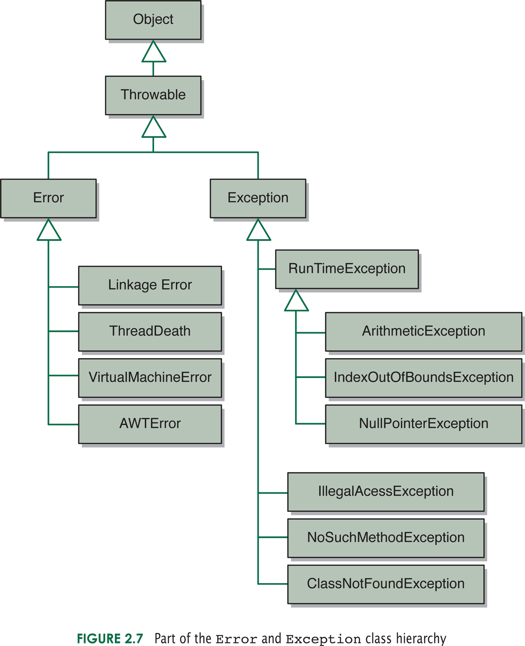
Some Java Error and Exception Classes

Slide 9
Java Exceptions
We can throw an exception object of one of these predefined types, or we can define our own exception classes
How? We can extend Exception or one of its subclasses

Slide 10
Example from ArrayStack
public class EmptyCollectionException extends
RuntimeException
{
/**
* Sets up this exception with an appropriate message.
* @param collection String representing name of collection
*/
public EmptyCollectionException (String collection)
{
super (“The ” + collection + “ is empty.”);
}
}

Slide 11
Uncaught Exceptions
If an exception is not handled at all by the program, a standard error message is printed by the Java runtime system and the program is terminated
Example:
java.lang.ArrayIndexOutOfBoundsException: 5
at ExceptionExample1.main(ExceptionExample1.java:17)
Exception in thread "main"
Notes:
gives name of exception, class and method, filename and line number where the exception occurred
see ExceptionExample1.java.

Slide 12
Catching Exceptions
To handle an exception in your program:
  A method, or the runtime environment, that detected an error during execution throws an exception
  The code that deals with the exception is said to catch or handle it

Slide 13
How to Catch an Exception
Syntax of try-catch statement :
  try
  { // try block: statements(s) that might cause an exception to
  // be thrown
  }
  catch ( possible-exception-type e)
  { // catch clause: statements to handle the problem,
  // referring to the exception object e
  }

Slide 14
Catching Exceptions: Example
public static void main (String[] args) throws Exception {
BufferedReader keyboard = new BufferedReader
(new InputStreamReader(System.in), 1);
System.out.print("Enter an integer:");
String userTyped = keyboard.readLine();
//continued

Slide 15
Catching Exceptions: Example
try {
int value = Integer.parseInt(userTyped);
}
catch (NumberFormatException e)
{
System.out.println("Hey, " + e.getMessage() +
" is not an integer!");
}
}

Slide 16
Catching Exceptions
How try-catch works:
  When the try-catch statement is executed, the statements in the try block are executed
  If no exception is thrown:
    Processing continues with the statement following the try-catch statement
  If an exception is thrown:
    Control is immediately passed to the first catch clause whose specified exception corresponds to the class of the exception that was thrown

Slide 17
Catching Exceptions:Example
Example: try to create a file (in a non-existent directory)
String filename = "/nosuchdir/myfilename“ ;
try
{
new File(filename).createNewFile() ;
}
catch (IOException e)
{
System.out.println("Unable to create" + filename + ":" +
e.getMessage()) ;
}
// execution continues here
* code from Java Developers Almanac

Slide 18
Catching Exceptions: Example
Here is the output :
Unable to create /nosuchdir/myfilename: The system cannot find the path specified

Slide 19
Catching Exceptions
If an exception is not caught and handled where it occurs:
  Control is immediately returned to the method that invoked the method that produced the exception
  If that method does not handle the exception (via a try statement with an appropriate catch clause) then control returns to the method that called it
This process is called propagating the exception

Slide 20
Catching Exceptions
Exception propagation continues until
  The exception is caught and handled
  Or until it is propagated out of the main method, resulting in the termination of the program

Slide 21
A Try-Catch-Finally Example
The try-catch-finally syntax:
try { code }
catch(exception1) {statements}
catch(exception2) {statements}
catch(exception3|exception4){statements}
…
finally {statements}

Slide 22
try block
You can put each line of code that might throw an exception within its own try block and provide separate exception handlers for each or you can put all the writeList code within a single try block and associate multiple handlers with it (as in the example below).

Slide 23
Try Example
As an example [see http://docs.oracle.com/javase/tutorial/essential/exceptions/try.html],
consider exception handling for a writeList method using a ListOfNumbers class. We enclose the exception-throwing statements of the writeList method within a try block.
private List<Integer> list;
private static final int SIZE = 10;
PrintWriter out = null;

Slide 24
try example continued
try { System.out.println("Entered try statement");
out = new PrintWriter(new FileWriter("OutFile.txt"));
for (int i = 0; i < SIZE; i++) {
out.println("Value at: " + i + " = " + list.get(i)); } }
If an exception occurs within the try block, that exception is handled by an exception
handler associated with it. To associate an exception handler with a try block, you must put a catch block after it.

Slide 25
Catch Block
The following are two exception handlers for the writeList method: one for the two checked exceptions that can be thrown within the try statement:
catch(FileNotFoundException e) {
System.err.println("FileNotFoundException:
e.getMessage());
// Ask for new filename
throw new SampleException(e); }

Slide 26
Catch Block
catch(IOException e) {
System.err.println("Caught IOException: " + e.getMessage()); }
Both handlers print error messages. The first handler throws a user-defined exception.
You might want to do this if you want your program to handle an exception in this
situation in a specific way. Exception handlers can do more than just print error
messages or halt the program.

Slide 27
Catch Blocks
They can do error recovery, prompt the user to make a decision, or propagate the error up to a higher-level handler using chained exceptions.
Note that a single catch block can handle more than one type of exception. This feature can reduce code duplication and lessen the temptation to catch an overly broad exception. In the catch clause, specify the types of exceptions that the block can handle and separate each exception type with a vertical bar (|).

Slide 28
Finally Block
The finally block always executes when the try block exits. This ensures that the finally block is executed even if an unexpected exception occurs. But finally is useful for more than just exception handling — it allows the programmer to avoid having cleanup code accidentally bypassed by a return, continue, or break.
Putting cleanup code in a finally block is always a good practice, even when no
exceptions are anticipated.

Slide 29
Finally Block
The try block of the writeList method that we have been using opens a PrintWriter. The program should close that stream before
exiting the writeList method. writeList's try
block can exit in one of the following ways:
The new FileWriter statement fails and throws an IOException.
An FileNotFoundException is thrown
The list.get(i) statement fails and throws an ArrayIndexOutOfBoundsException
Everything succeeds and the try block exits normally.

Slide 30
Finally Block
The runtime system always executes the statements within the finally block, so it's the perfect place to perform cleanup.
The following finally block for the writeList method cleans up and then closes the PrintWriter.
Finally {
if (out != null) {
System.out.println("Closing PrintWriter");
out.close(); }
else { System.out.println("PrintWriter already closed"); } }

