Slide 1

: Agri-TECH :
( A Crop And Fertilizer Prediction Model)
Designed by-
Bhawana (21718)
Krishan Kant Singh Gautam (21725)
Kunal Asthana (21727)
Mohd Hesham Ashraf Ansari (21732)

Slide 2

A Presentation ON
AGRI-TECH
For partial fulfillment of award of
Master of Computer Applications session (2021-23)
KAMLA NEHRU INSTITUTE OF TECHNOLOGY, SULTANPUR
Submitted To :-
Prof. Nilesh Chandra & Prof. Kriti Chaurasia

Slide 3
introduction
India is an agriculture country and Most agriculture crops have been badly affected by the effect of global climate change in india.in terms of output over the past 20 years.
It will allow policy makers and farmers to take effective marketing and storage steps to predict the crop and fertiliser earlier in their harvest.
However as the condition change day by day very rapidly, farmers are forced to cultivate more and more crops. Being this as the current situation, many of them don’t have enough knowledge about losses that might incur and are not completely aware of the benefits they get while farming them.
This project will allow farmers to capture the yield of their crops before cultivation in the fields of agriculture and predicting the appropriate fertilizer thus helps them make the necessary decision.

Slide 4
AIM OF THE PROJECT
The project aims by comparing various supervised learning algorithm like decision tree, naïve bayes model, support vector machine, logistic regression and random forest algorithm on the dataset containing11(maize,sugarcane,cotton,tabacco,paddy,barley,wheat,millets,oilseeds,pulses and groundnuts) category of crops and 7 types of fertilizer named (Urea, DAP, 14-35-14, 28-28, 20-20, 17-17-17and 10-26-26). The model will predict the best fertilizer as per the crop predicted.
This model focus on the given points-
Improving Agriculture- We are going to help the farmers by suggesting the best suitable crops and fertilizer on the basis of soil nature, weather, region and rainfall.
Improving Lives- Healthy crops will leads to healthy lives.
Cultivating Crops To Make Farmers Increase Profit- This model will suggest the most yielding crops that will result in a better profit for farmers.

Slide 5
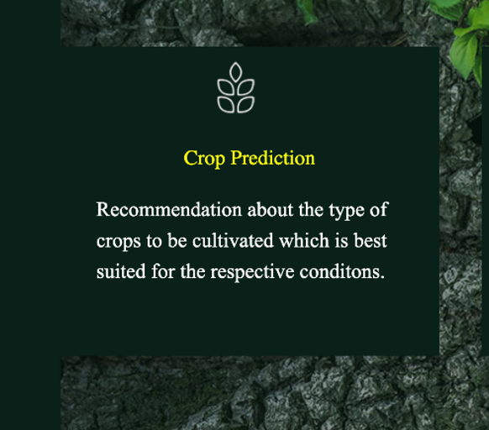
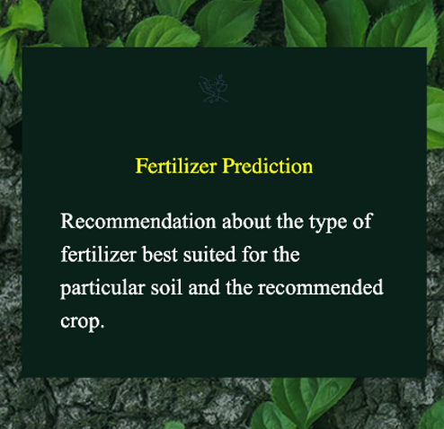
SERVICES
This model basically provides two types of services-
Crop Prediction
Fertilizer Prediction

Slide 6
HOW CROP PREDICTION WORKS?
Crop prediction is done with the help of Random Forest algorithm on the basis of its attribute, region and the climate change measured by weather API.
Those attribute are listed below-
Measurement of Nitrogen(N)
Measurement of Potassium(K)
Measurement of Phosphorus(P)
PH value
Rainfall
Region

Slide 7
HOW FERTILIZER PREDICTION WORKS?
The process of fertilizer prediction also uses the Random forest algorithm which makes the prediction on the basis of its listed attributed(if the input dataset is in form of string then is uses the column transformer algorithm to convert into integer value)
Those attribute are –
Measurement of Nitrogen(N)
Measurement of Potassium(K)
Measurement of Phosphorus(P)
Measurement of Moisture
Type of crop wants to grow
Type of soil

Slide 8
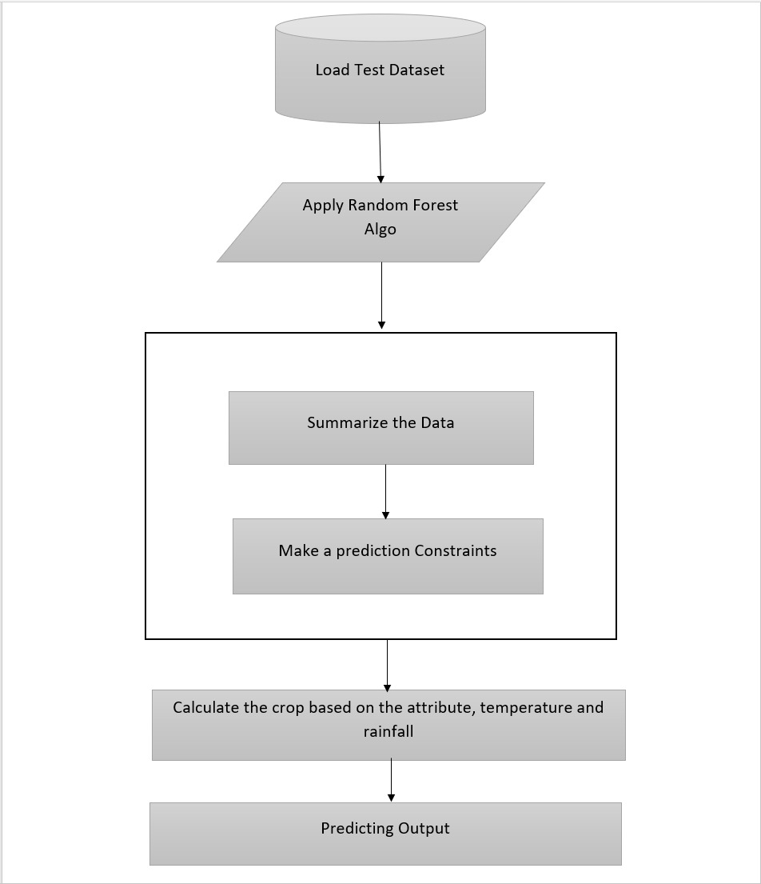
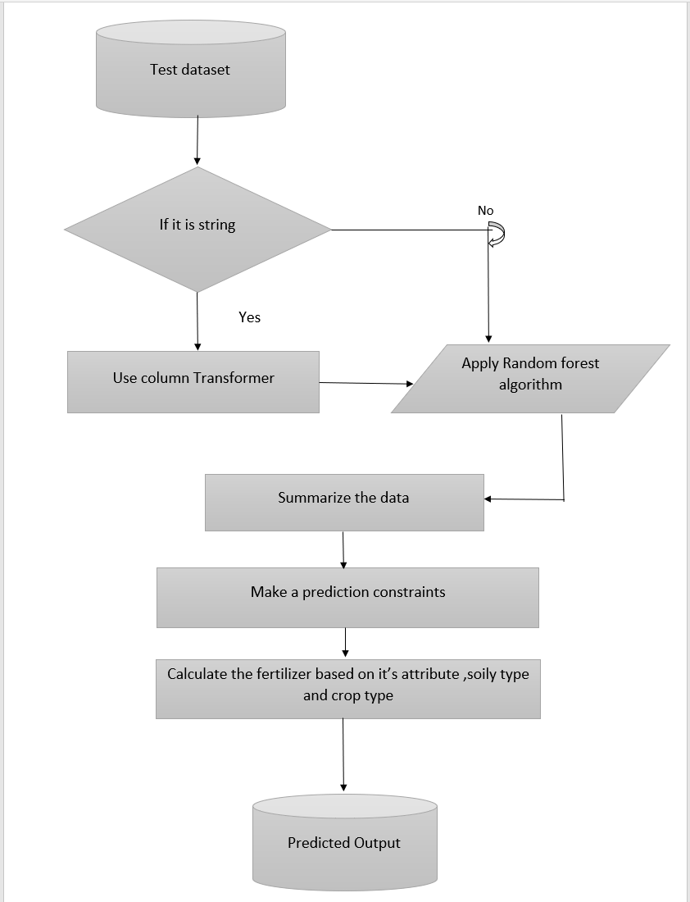
Flow chart
For crop prediction
For fertilizer prediction

Slide 9
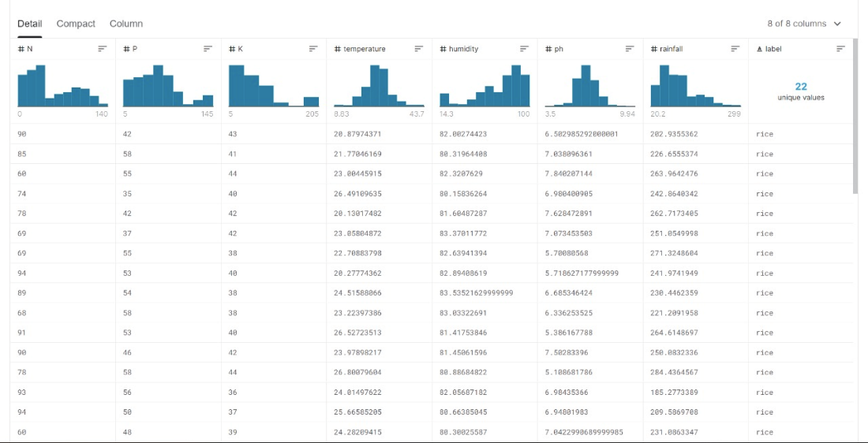
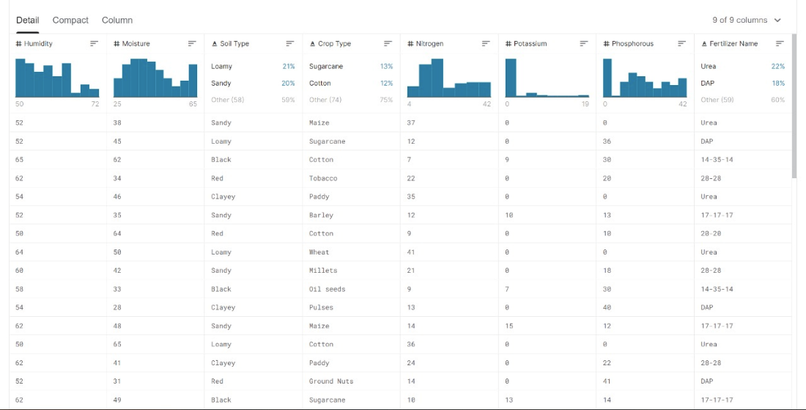
Sample of pre-defined datasets
The model used some pre-defined datasets for predicting the crop recommendation and fertilizer recommendation
Here are some sample of pre-defined datasets given below-
(Few Datasets for crop prediction)
(Few datasets for fertilizer prediction)

Slide 10
tested MODELs
In this project the pre defined datasets are tested with the help of different types of modelling technique to get the higher accuracy, in the end we chose the model that provided the highest accuracy rate. Those used modelling technique are given below-
Accuracy measured by Decision tree
Accuracy measured by Naïve bayes model
Accuracy measured by Support vector machine
Accuracy measured by Random forest algorithm
Accuracy measured by Logistic regression

Slide 11
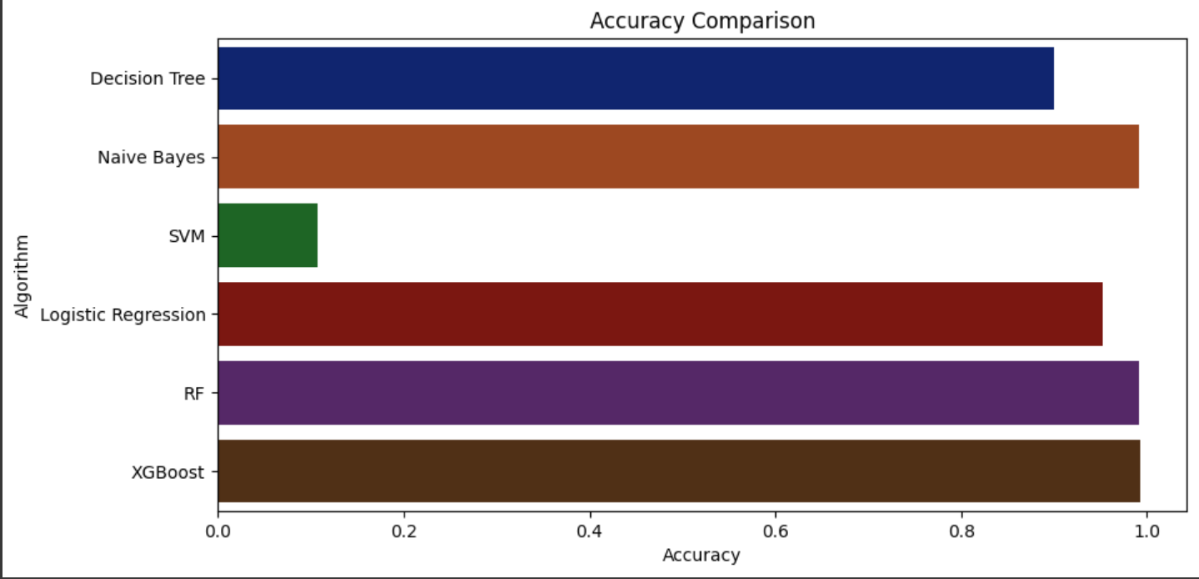
REASON FOR CHOOSING RFM
It is a process that operates among multiple decision tree to get the optimum result by choosing the majority among them as the rest value .Points for choosing RFM -
Quick Prediction
Higher Accuracy as shown In the accuracy comparison chart

Slide 12
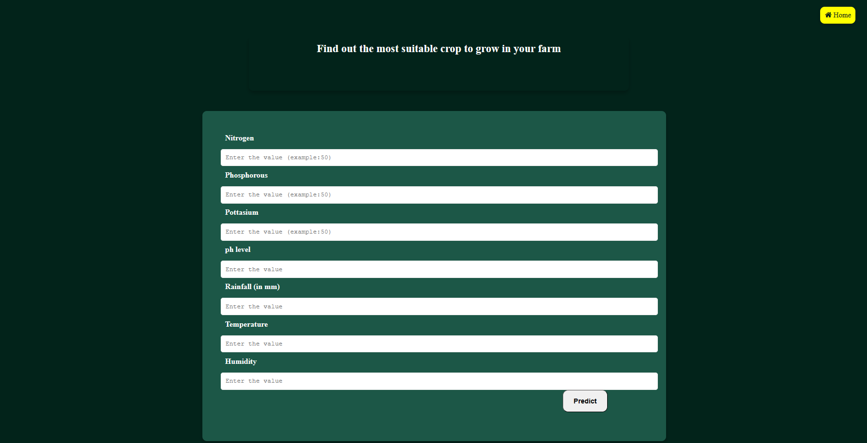
Input & output
Here are the user interface for crop prediction given below -

Slide 13
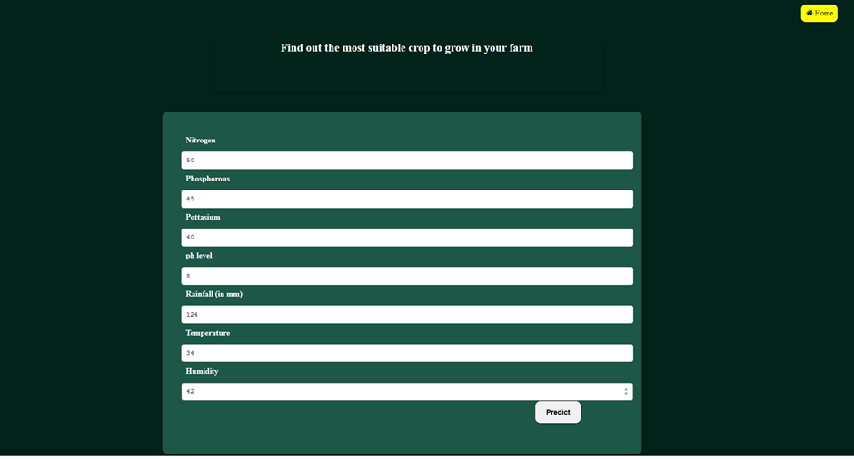
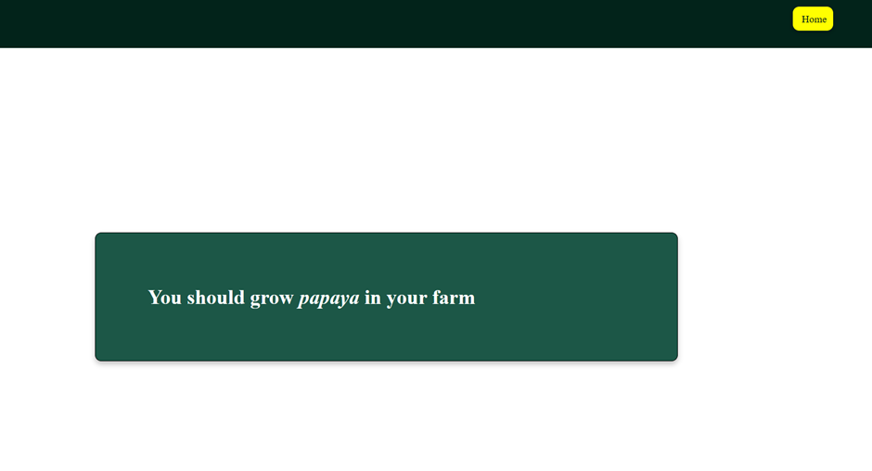
- Input Dataset For Crop Prediction
Predicted Crop As Output -

Slide 14
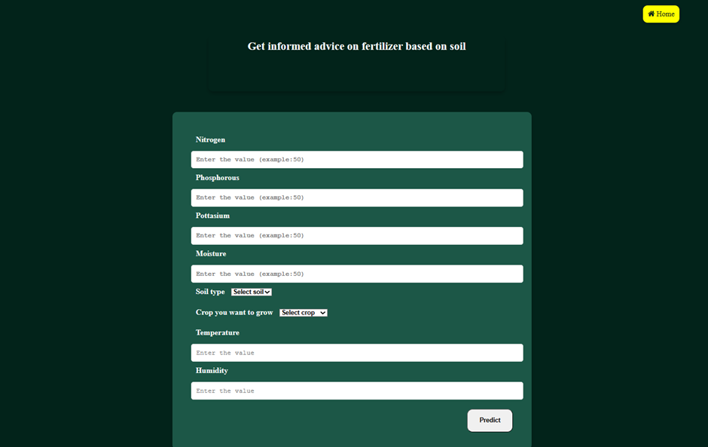
Here are the user interface for fertilizer prediction to inserting the value of its attribute

Slide 15
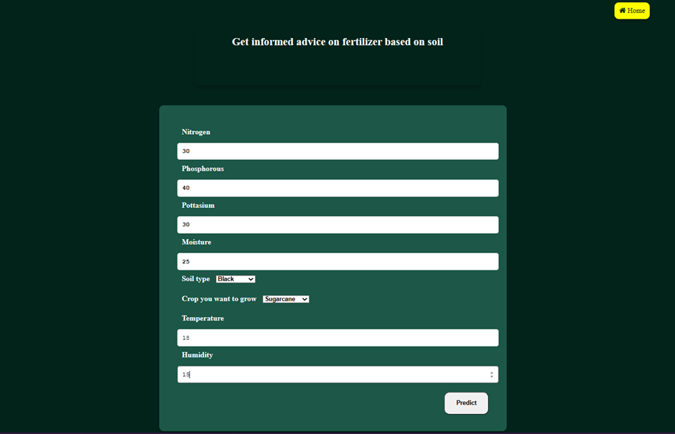
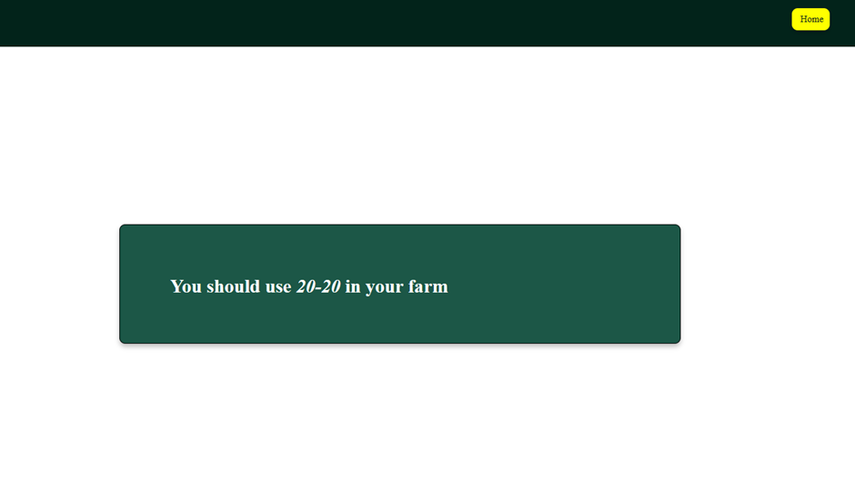
-Input Dataset For Fertilizer Prediction
Predicted Fertilizer As Output-

Slide 16
FUTURE scope
Language Translator -
Building this particular project in the different different regional language so that it would be more comfortable for the farmers
In future we will train a deep convolutional neural network to identify several crops species and every possible disease
Crop Disease Prediction -

Slide 17
conclusion
Based on the input parameter the present model provides demonstration of the potential use of machine learning technique in predicting the crop yield and fertilizer

Slide 18


