Slide 1
Analyze Big Data with Hadoop
By
Team-03

Slide 2
What is Big Data?
Big Data is a term for collection of data sets so large and complex that it becomes difficult to process using traditional data processing applications.
Systems/Enterprises generate huge amounts of data in Terabytes or even in Petabytes.
IBM defines Big Data in terms of 3 V’s- Volume, velocity and variety.

Slide 3
Hadoop-A Solution to Big Data problems
Hadoop is an open source, Java-based programming framework that supports the processing and storage of extremely large data sets in a distributed computing environment.
Designed to answer the question: “How to process big data with reasonable cost and time?”

Slide 4
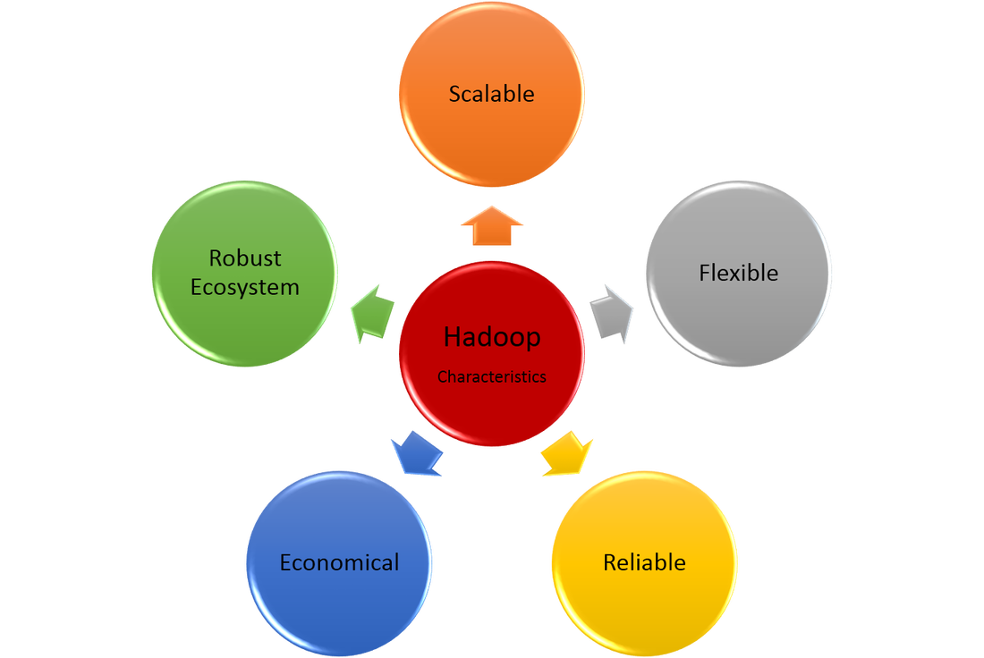
Hadoop Characteristics

Slide 5
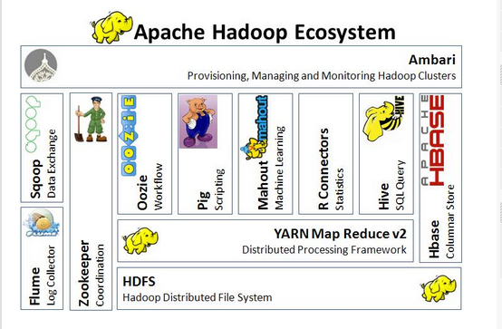

Slide 6
Hadoop Core Components
Hadoop is a system for large scale data-processing.
It has two main components:
HDFS – Hadoop Distributed File System (Storage)
MapReduce (Processing)

Slide 7
Hadoop Distributed File System
HDFS is built to support applications with large data sets, including individual files that reach into the terabytes.
It uses a master/slave architecture, with each cluster consisting of a single NameNode that manages file system operations and supporting DataNodes that manage data storage on individual compute nodes.

Slide 8
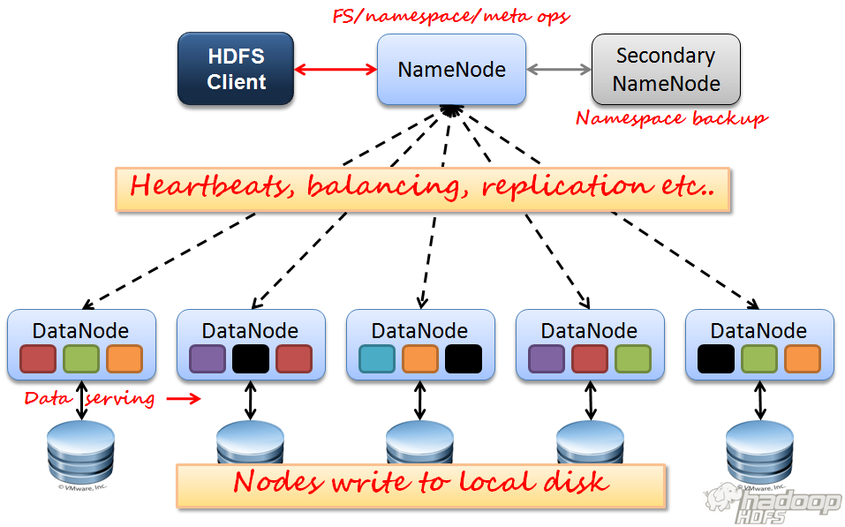

Slide 9
Hive
Apache Hive is a data warehouse infrastructure built on top of Hadoop for providing data summarization, query, and analysis.
Hive gives an SQL-like interface to query data stored in various databases and file systems that integrate with Hadoop.
Hive provides the necessary SQL abstraction to integrate SQL-like Queries (HiveQL) into the underlying Java API without the need to implement queries in the low-level Java API.

Slide 10
Hive External table
External table stores files on the HDFS server but tables are not linked to the source file completely.
If you delete an external table the file still remains on the HDFS server.
The file and the table link is there but read only.
Meta data is maintained on master node and deleting an external table from HIVE, only deletes the metadata not the data/file.

Slide 11
Hive partition
Hive is a good tool for performing queries on large datasets, especially datasets that require full table scans. But quite often there are instances where users need to filter the data on specific column values.
Partitions are essentially horizontal slices of data which allow larger sets of data to be separated into more manageable chunks. In Hive, partitioning is supported for both managed and external tables.

Slide 12
Bucketing in Hive
Partitioning in hive offers a way of seggregating hive table data into multiple files/directories.
But it gives only when there are limited number of partitions and equal sized partitions.
To overcome problem of over-partitioning , hive provides bucketing concept, another technique for decomposing table data sets into more manageable parts.
Bucketing concept based on (hashing function on bucketing column) mod by (total numb of buckets).

Slide 13
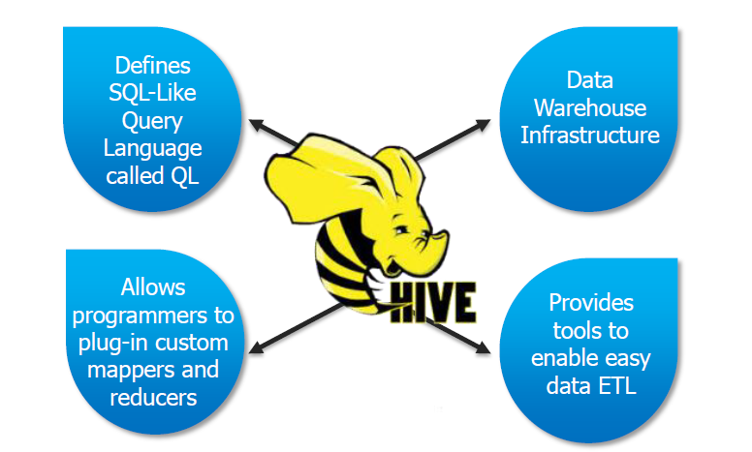
In Simple terms..

Slide 14
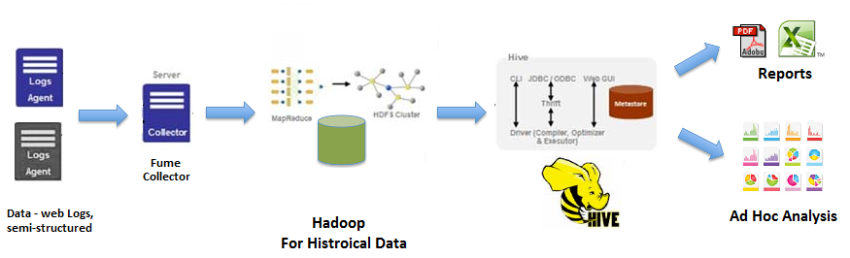
Solution using Hive and Hadoop tech
Knowing the limitations of traditional systems, AgencyX opted to invest in new Big Data technology that uses Hive. The application is designed in such a way that it uses Flume to collect data and send it to HDFS storage.
Hive performs in the role as the analyzer – scripts and ad hoc queries are run on top of this dataset to produce reports

Slide 15
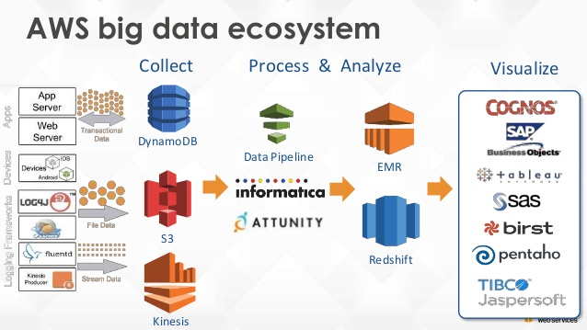
AWS Ecosystem

Slide 16
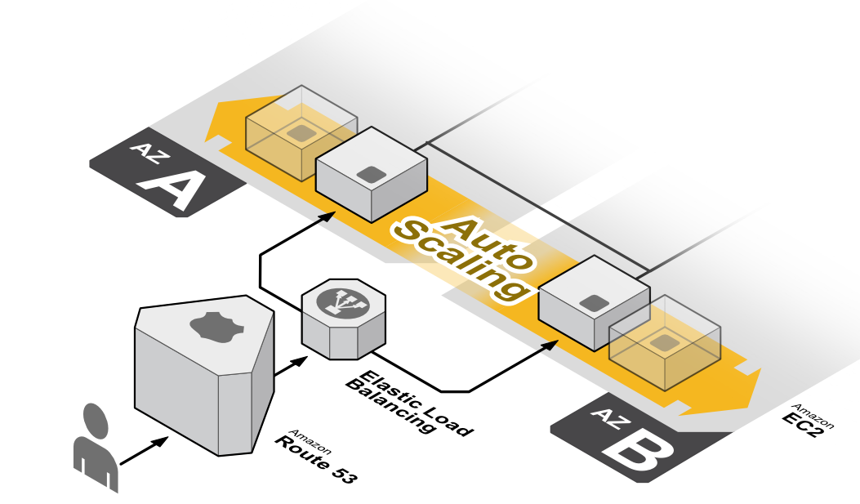
Auto-Scaling in aws
Auto Scaling helps you maintain application availability and allows you to scale your Amazon EC2 capacity up or down automatically according to conditions you define.
Auto Scaling can also automatically increase the number of Amazon EC2 instances during demand spikes to maintain performance and decrease capacity during lulls to reduce costs.

Slide 17

Analyzing Big Data with Hadoop
In our project, we use AWS services to analyze big data with hadoop.
We create a hadoop cluster, and run a hive script on it to process the log data.
Amazon EMR provides a managed Hadoop framework that makes it easy, fast, and cost-effective to process vast amounts of data across dynamically scalable Amazon EC2 instances.

Slide 18
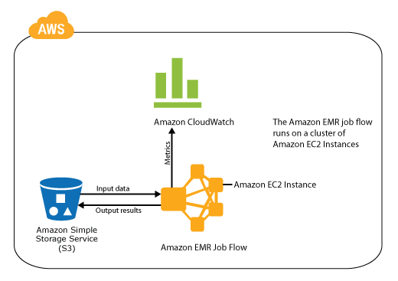
Elastic map reduce job flow

Slide 19
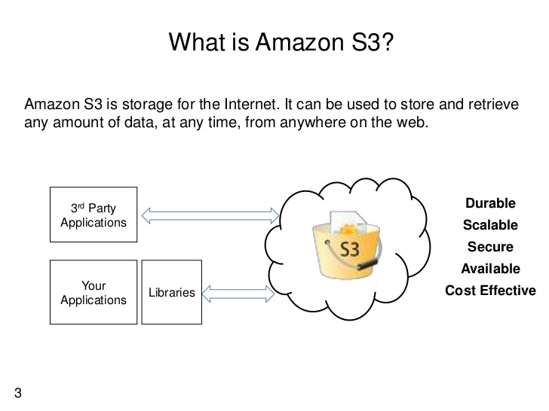

Slide 20
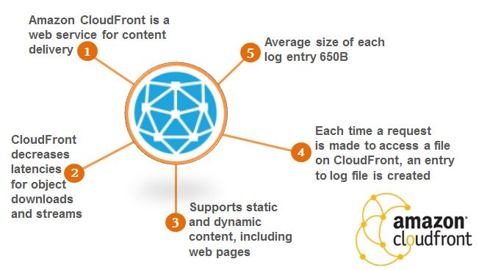
Amazon CloudFRont

Slide 21
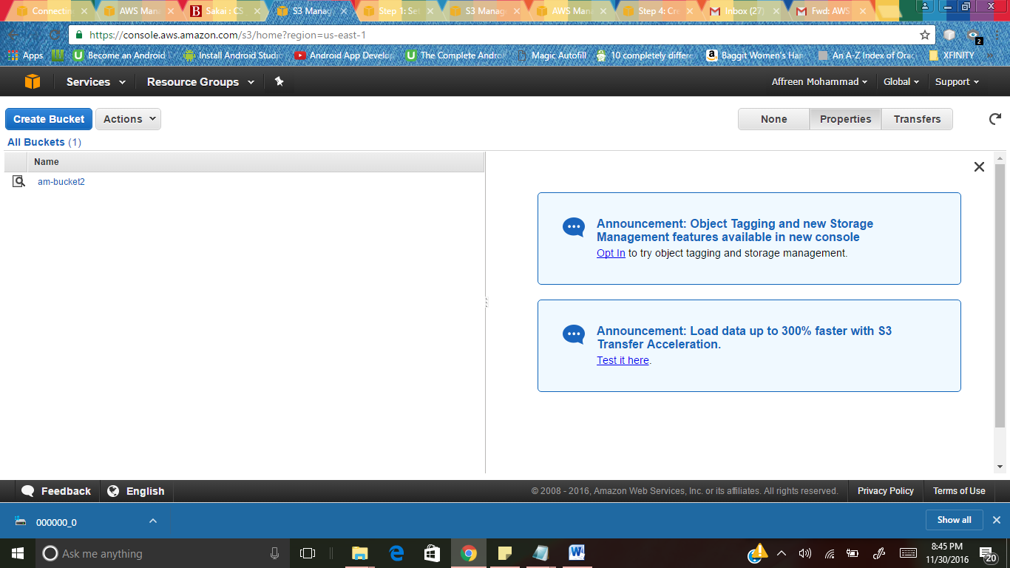
Project Details
Here, We created a S3 bucket named “am-bucket2”.

Slide 22
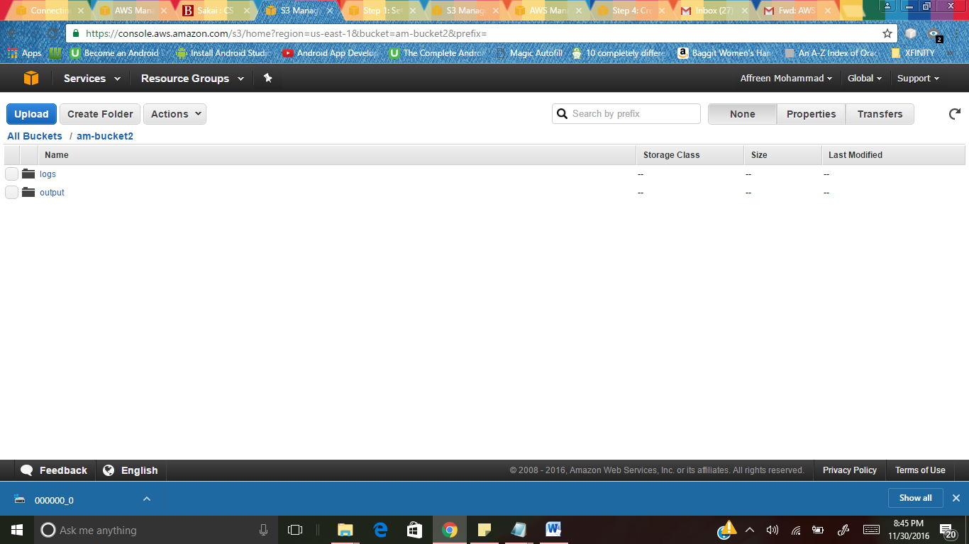
Inside, the bucket, create two folders called “logs” and “output” to store the output.

Slide 23
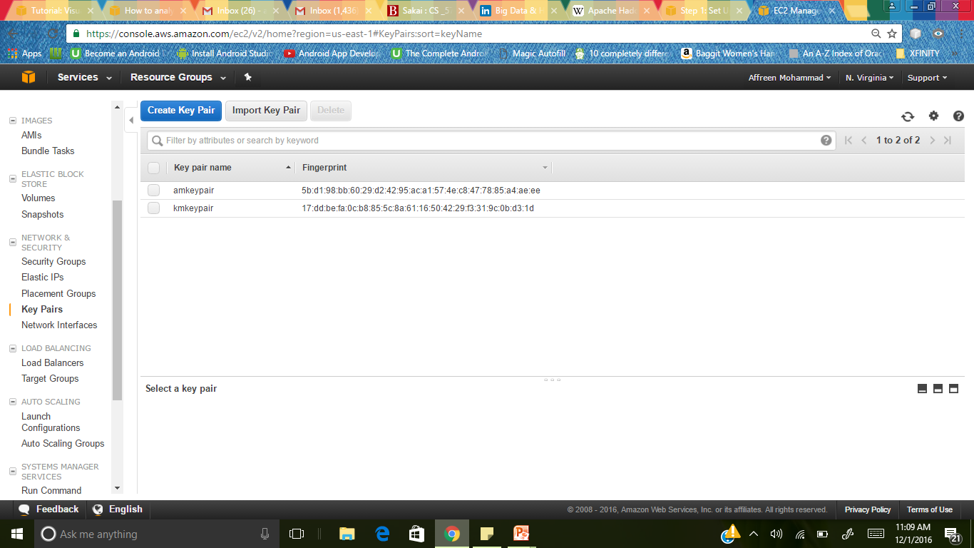
We need to create a keypair to connect. We created a keypair called “amkeypair” in amazon EC2.

Slide 24
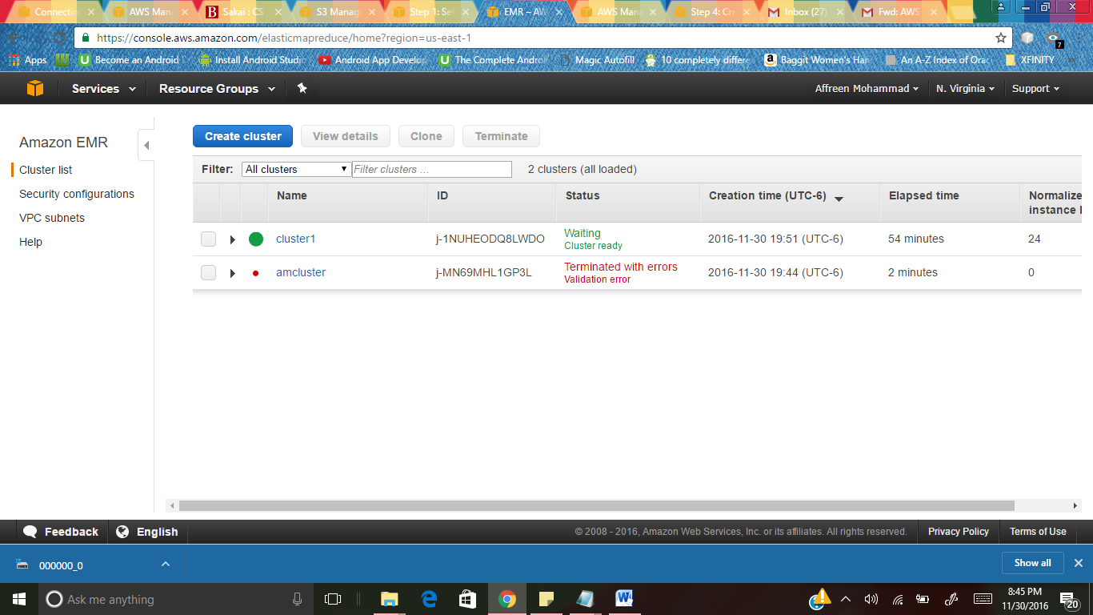
In EMR, we created a cluster named “cluster1” and launch the cluster.

Slide 25
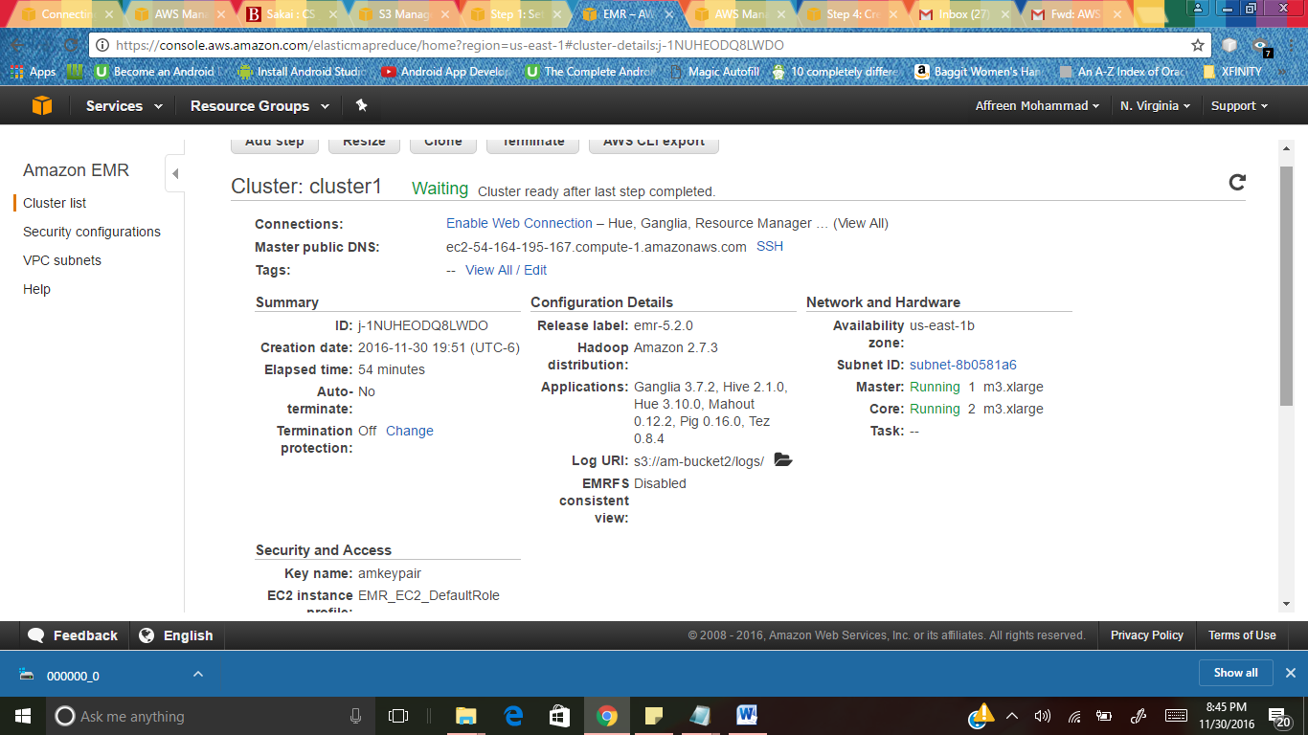
In the cluster creation, we specify the details like S3 folder logs, and our keypair and then launch the cluster.

Slide 26
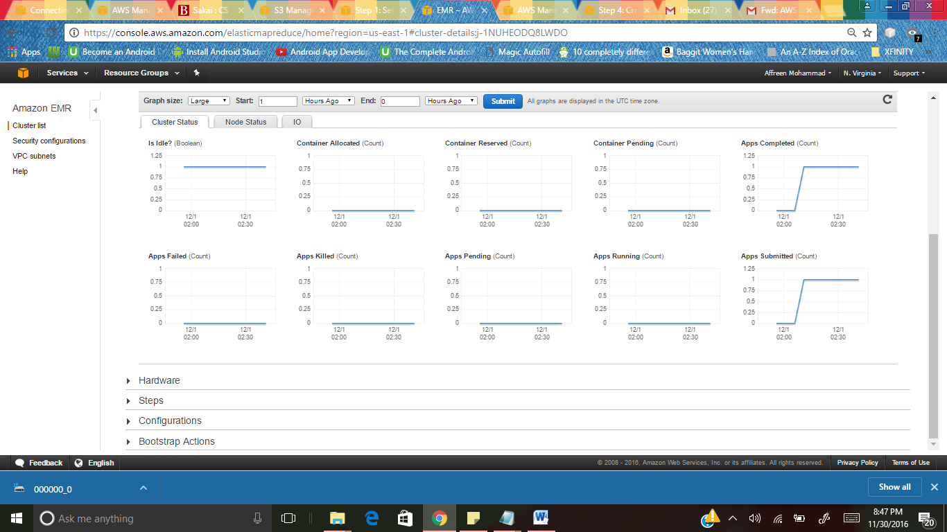
Monitoring the cluster

Slide 27
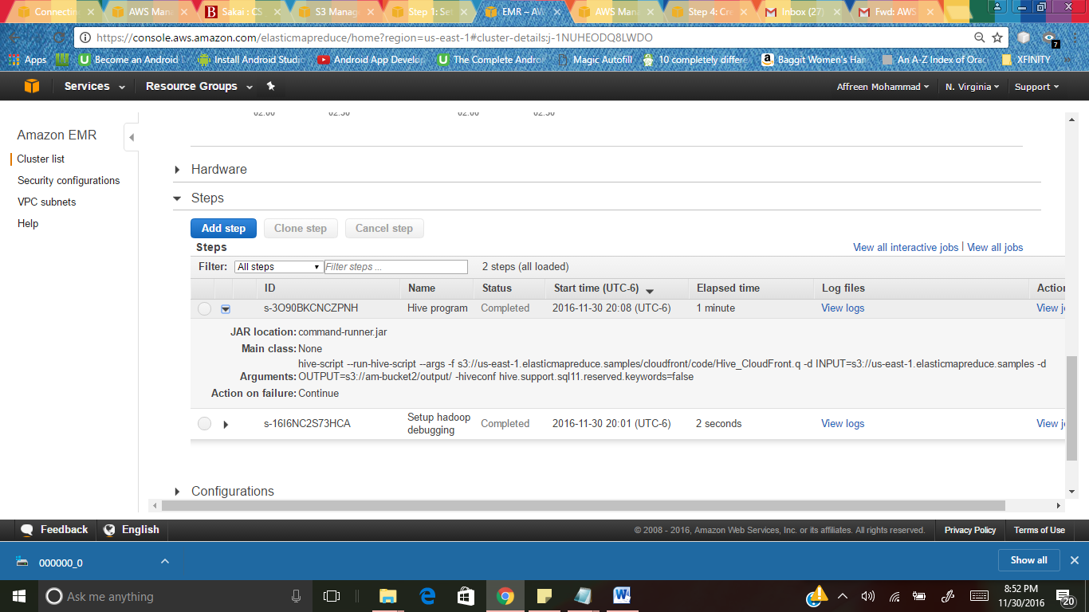
We submit hive script in the cluster by adding a step.

Slide 28

To view the output, we go to S3 Bucket created, and open output folder. There will be output folder named os_requests

Slide 29
Hive Script
The hive script does the following:
Creates a Hive table named cloudfront_logs.
Reads the CloudFront log files from Amazon S3 using EMRFS and parses the CloudFront log files using the regular expression serializer/deserializer (RegEx SerDe).
Writes the parsed results to the Hive table cloudfront_logs.
Submits a HiveQL query against the data to retrieve the total requests per operating system for a given time frame.
Writes the query results to your Amazon S3 output bucket.
Hive query looks like,
SELECT os, COUNT(*) count FROM cloudfront_logs WHERE date BETWEEN '2016-10-05' AND '2016-11-05' GROUP BY os;

Slide 30

Os_request contains an output text document “000000_0”.

Slide 31
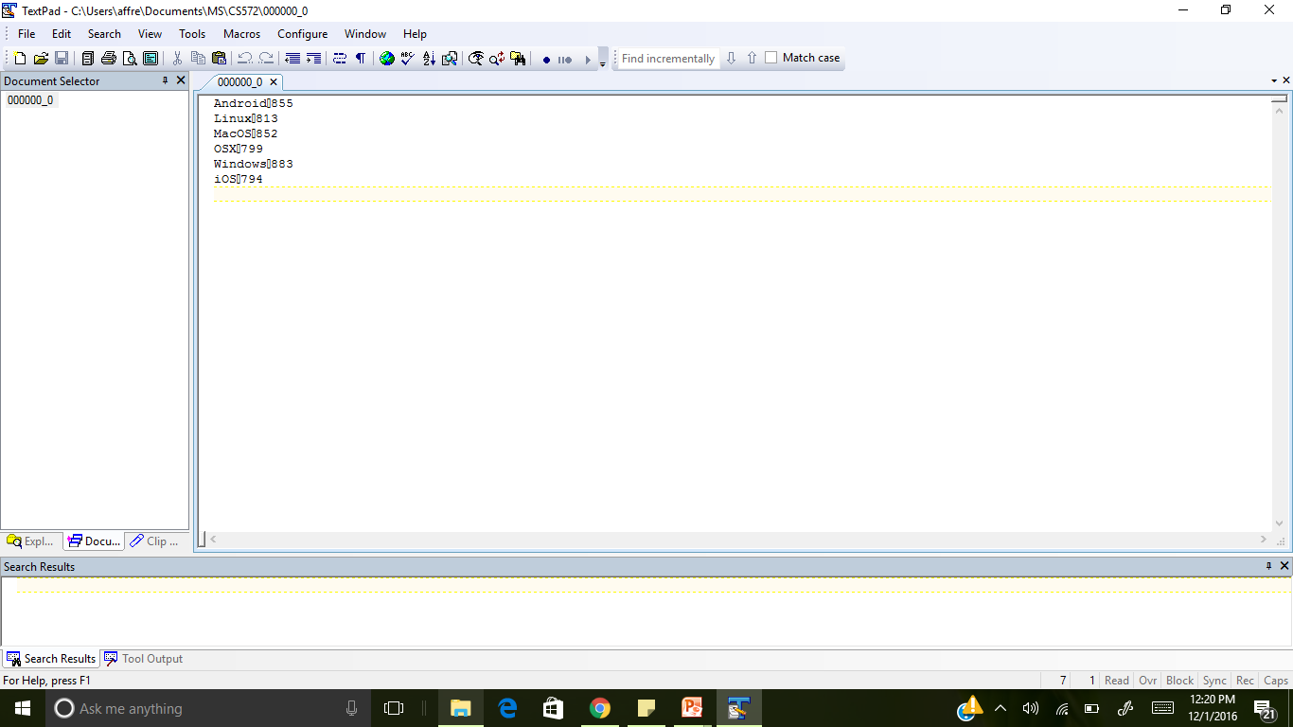
Contents of output file
Android855
Linux813
MacOS852
OSX799
Windows883
iOS794

Slide 32
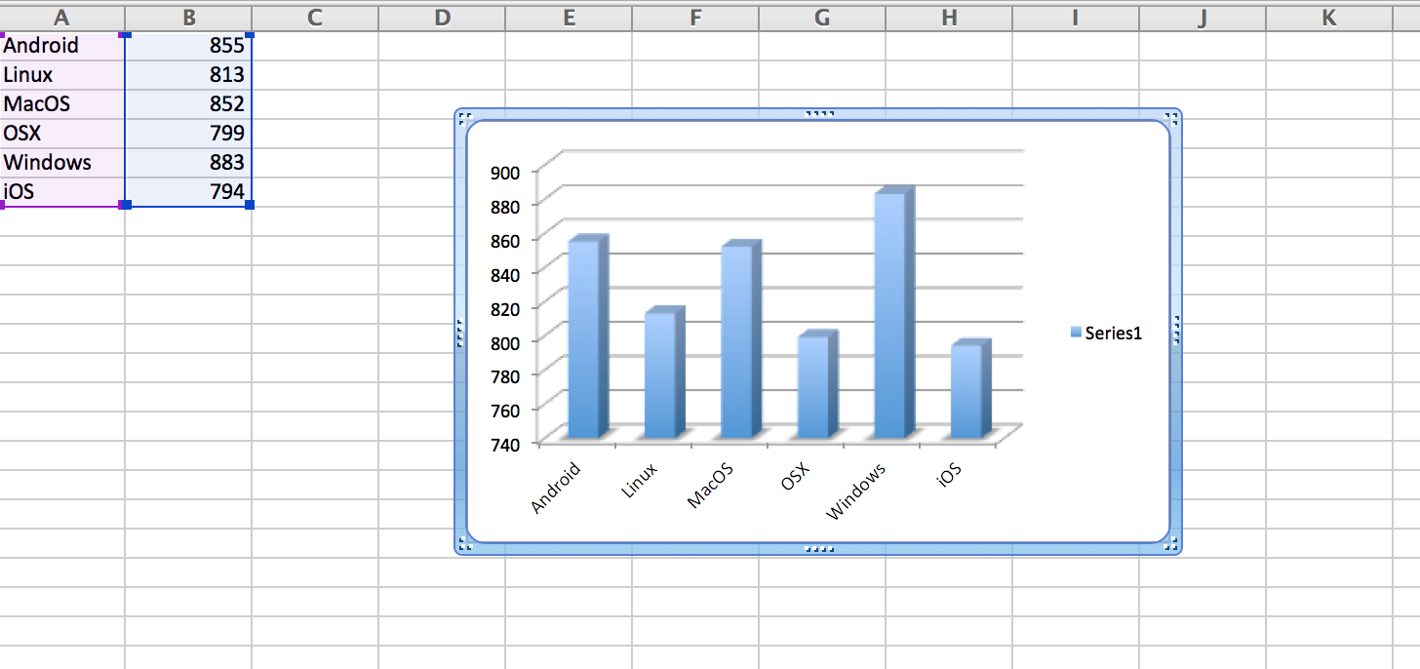
Visualization

Slide 33


