Slide 1
From AI Chatbots
to AI as Architecture
Chatbot
Service
Architecture
A hands-on comparison: chatbot vs service vs architecture
Same use case: Student Assignment Assistant
AI as interface
AI as feature
AI as system design
We started by talking to AI.
Then we added AI into products.
Now we are designing products around AI.
AI-native development workshop framing

Slide 2
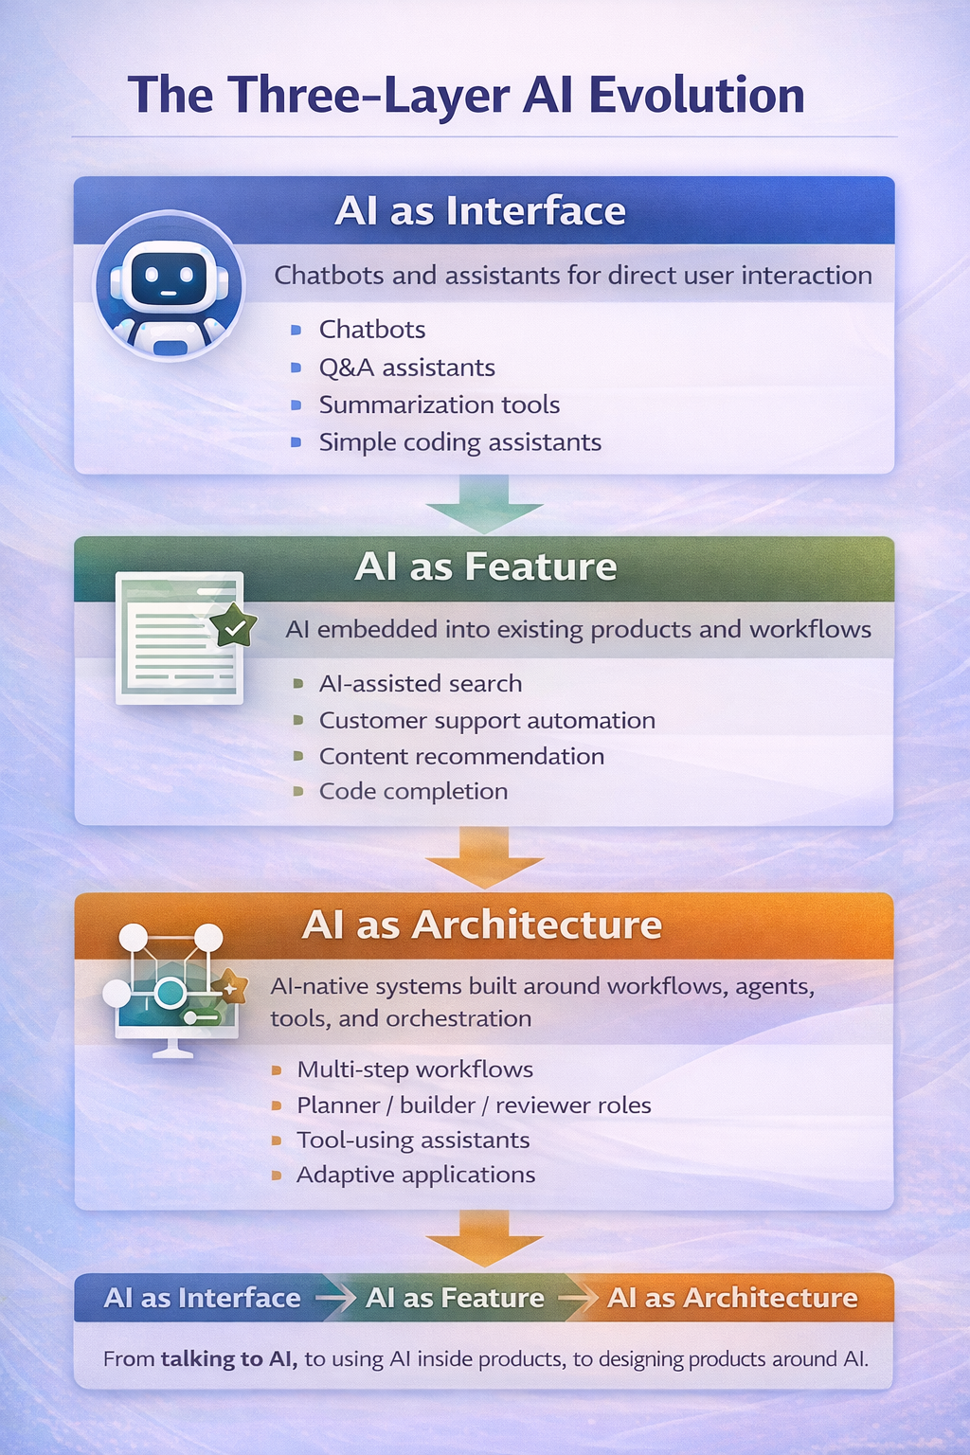
The Three-Layer AI Evolution
A simple way to explain the transition from chatbot to AI-native development
1. AI as Interface
Users talk to AI directly
• Chatbots, Q&A, summarization
• Main value: fast guidance and interaction
2. AI as Feature
AI is embedded into an existing product
• Generate, search, recommend, assist
• Main value: improve a workflow or screen
3. AI as Architecture
AI shapes the system design from the start
• Workflows, agents, tools, orchestration
• Main value: adaptive, intent-driven software
AI-native development workshop framing

Slide 3
Hands-on Example: Same Task, Three AI Roles
Use case: “Build a Python program that reads sensor CSV data, computes average/std, and plots the result.”
AI as Chatbot
AI as Service
AI as Architecture
AI is the interface
AI is a feature
AI is the system design
• Student asks one prompt directly
• Model returns explanation + sample code
• Good for ideation and quick help
• Student uses an existing app or portal
• App calls an LLM for one specific feature
• Good for enhancement inside a product
• Planner extracts requirements
• Builder generates starter code
• Reviewer checks gaps and improvements
Typical flow
Typical flow
Typical flow
Prompt → Response
App logic → AI call → Output
Request → Planner → Builder → Reviewer
The use case stays the same. What changes is the role AI plays in the system.
AI-native development workshop framing

Slide 4
We are entering the phase of
AI as Architecture
From single prompts to workflows
The next stage of AI is not just using AI in products,
but building products around AI.
From one assistant to specialized roles
From outputs to tools and orchestration
From static logic to adaptive systems
Interface → Feature → Architecture
Closing message

