Slide 1
AI-Native Development
in Practice
Workshop architecture preview
Planner
Builder
Building a simple agentic application with open tools and local models
Task → steps
Plan → code
1-hour online workshop
Use-case driven
No paid subscription required
What participants will build
A local AI lab assistant for short technical assignments
A workflow with Planner, Builder, and Reviewer roles
A small Python app that runs with Ollama on student laptops
Ollama
Reviewer
Local model
Code → gaps
Python • Streamlit/CLI • GitHub
Open tools, fully reproducible
Electrical and Computer Engineering students
Workshop package / English slide set

Slide 2
Workshop at a glance
Format
Audience
Cost model
Online, hands-on, use-case driven
Built around one simple but complete example
ECE students with basic programming knowledge
Introductory to intermediate level
Open tools + local open models
No paid subscription required
Core promise
Students will not just hear about AI-native development. They will see a small AI-native system, run it locally, and understand how prompts, workflows, agents, tools, and context fit together in practice.
Success looks like this
“I understand what AI-native development means.”
“I know the difference between a prompt, a workflow, and an agent.”
“I can run a small local prototype myself.”
1-hour online workshop package
Open tools • local models • no paid subscription

Slide 3
Workshop flow
AGENDA
1
2
3
4
5
Welcome
Concepts
Use case
Hands-on
Wrap-up
0–5 min
5–15 min
15–20 min
20–50 min
50–60 min
Why AI-native development matters and what participants will build
Prompt vs workflow vs agent; tools, context, and orchestration
AI lab assistant architecture and role definitions
Run the app, inspect Planner / Builder / Reviewer outputs, test locally
What makes this AI-native and how to extend it after the session
One example, end to end: students see the complete lifecycle instead of isolated prompts.
1-hour online workshop package
Open tools • local models • no paid subscription

Slide 4
The use case: AI Lab Assistant
Student input
Understand the task
Requirement extraction from the assignment text
1
“Build a Python program that reads sensor measurements from a CSV file, computes the average and standard deviation, and generates a simple plot.”
2
Create a plan
Ordered implementation steps and assumptions
3
Generate starter code
First-draft code and project structure
4
Review the output
Check coverage, gaps, and edge cases
A compact example that is technical, familiar, and easy to run locally.
5
Suggest next steps
Concrete improvements students can implement next
1-hour online workshop package
Open tools • local models • no paid subscription

Slide 5
From prompt to workflow to agent
Prompt
Workflow
Agentic pattern
A single instruction to the model.
Useful for one-shot tasks, but limited when the task has multiple stages.
A predefined sequence of steps.
Best default choice when the application needs structure and predictability.
Role-based components within a workflow.
Useful when different reasoning styles or tool access improve the result.
Key message: not everything needs an agent. Start with a workflow, then add roles only where they create real value.
Planner
Builder
Reviewer
Breaks the task into requirements and steps
Produces starter code and a first draft
Checks coverage, risks, and improvements
1-hour online workshop package
Open tools • local models • no paid subscription

Slide 6
Workshop architecture
Planner
Requirements + steps
User
Coordinator
Reviewer
Output
Provides the assignment or short technical task
Runs the workflow and passes outputs across roles
Coverage + improvements
Plan, code, review, next steps
Builder
Starter code
Local execution stack: Python + Streamlit/CLI + Ollama + one local open model (for example Llama 3).
1-hour online workshop package
Open tools • local models • no paid subscription

Slide 7
Open stack and local setup
Tools used in the workshop
Why local models
Minimum participant setup
• Python
• Streamlit or CLI
• GitHub repository
• Ollama
• One tested local model
• No paid subscription
• Full reproducibility after the workshop
• Students can experiment on their own laptops
• Clearer focus on architecture, not vendor lock-in
• Python 3.10+
• Git
• VS Code or another editor
• Ollama installed locally
• Repo cloned before the session if possible
Suggested commands
ollama pull llama3
python -m venv .venv
pip install -r requirements.txt
streamlit run app.py
This can also be run as a CLI fallback if some student laptops struggle with a UI setup.
1-hour online workshop package
Open tools • local models • no paid subscription

Slide 8
What participants take away
Understanding
What AI-native development means in practice
Conceptual clarity
The difference between prompts, workflows, and agents
Hands-on artifact
A small local app with Planner, Builder, and Reviewer roles
Deployment confidence
A reproducible stack based on open tools and local models
Next steps
Clear directions for adding retrieval, testing, memory, or APIs later
Recommended close: position the session as “a practical introduction to AI-native development through a small but complete role-based application built with open tools and local models.”
1-hour online workshop package
Open tools • local models • no paid subscription

Slide 9
From Chatbots to AI as Architecture
Why this matters
A simple evolution story for AI-native development
AI is moving from an interface layer to a systems design concern
Workflows, tools, context, and roles now matter as much as model choice
This is the foundation of AI-native development
Interface
Feature
Architecture
We started by talking to AI.
Then we started adding AI into products.
Now we are learning how to build products around AI.
AI as Architecture

Slide 10
The Three-Layer AI Evolution
A practical way to frame how AI changes software
AI as Interface
AI as Feature
AI as Architecture
Chatbots and assistants
Prompt -> response interaction
Useful for Q&A, summarization, guidance
Embedded into existing products
AI-assisted search, support, coding
Application remains mostly traditional
Workflows, agents, tools, context
Coordinator + specialized roles
Applications designed around AI
AI helps users interact with information
AI helps products perform useful tasks
AI shapes how the whole system is built
AI as Architecture

Slide 11
The Research Framing: Weights -> Context -> Harness
Based on arXiv:2604.08224 (April 2026)
Weights
->
Context
->
Harness
Capability expected to live inside the model
More capability shifted into prompting and retrieved context
Capability externalized into memory, skills, protocols, and orchestration
We are moving from intelligence in the model to intelligence in the system around the model.
AI as Architecture | Research framing

Slide 12
Why “AI as Architecture” Matters
What changes when AI becomes part of the system design
Design shifts
Operating shifts
From single prompts to multi-step workflows
From one assistant to specialized roles such as planner, builder, reviewer
From isolated outputs to tools, memory, and governed execution
System quality depends on orchestration, not only on model quality
Competitive advantage shifts toward reusable skills and infrastructure
AI-native development becomes a software architecture problem
AI is no longer only an interface or a feature. It becomes a core design principle.
AI as Architecture

Slide 13
One Use Case, Three Modes
Student Assignment Assistant: same task, different role for AI
Mode
Interaction
System behavior
Meaning
AI as Chatbot
Student asks directly
One answer with code or explanation
AI is the interface
AI as Service
App calls an LLM feature
Generate starter code inside a portal
AI is a feature
AI as Architecture
Workflow coordinates roles
Planner -> Builder -> Reviewer
AI is the system logic
The use case stays the same. What changes is how much of the system is designed around AI.
AI as Architecture

Slide 14
AI as Architecture
Takeaways
Interface -> Feature -> Architecture
Weights -> Context -> Harness
AI-native development is a systems discipline
The future is not just software with AI inside it.
It is software designed around AI from the start.
Research anchor: Zhou et al., arXiv:2604.08224 (2026)
Closing slide

Slide 15
From AI Chatbots
to AI as Architecture
Chatbot
Service
Architecture
A hands-on comparison: chatbot vs service vs architecture
Same use case: Student Assignment Assistant
AI as interface
AI as feature
AI as system design
We started by talking to AI.
Then we added AI into products.
Now we are designing products around AI.
AI-native development workshop framing

Slide 16
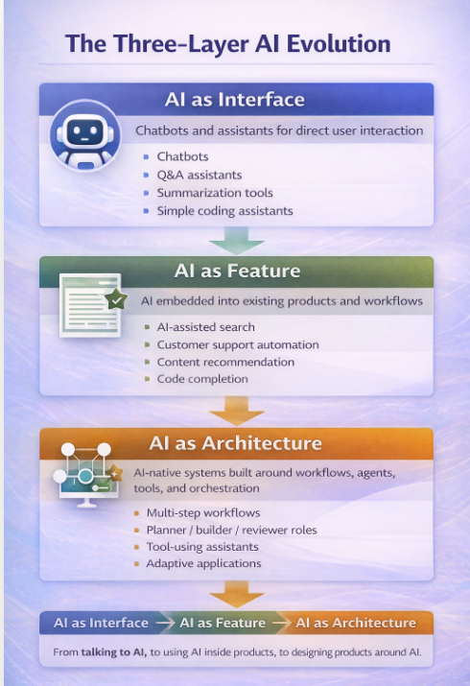
The Three-Layer AI Evolution
A simple way to explain the transition from chatbot to AI-native development
1. AI as Interface
Users talk to AI directly
• Chatbots, Q&A, summarization
• Main value: fast guidance and interaction
2. AI as Feature
AI is embedded into an existing product
• Generate, search, recommend, assist
• Main value: improve a workflow or screen
3. AI as Architecture
AI shapes the system design from the start
• Workflows, agents, tools, orchestration
• Main value: adaptive, intent-driven software
AI-native development workshop framing

Slide 17
Hands-on Example: Same Task, Three AI Roles
Use case: “Build a Python program that reads sensor CSV data, computes average/std, and plots the result.”
AI as Chatbot
AI as Service
AI as Architecture
AI is the interface
AI is a feature
AI is the system design
• Student asks one prompt directly
• Model returns explanation + sample code
• Good for ideation and quick help
• Student uses an existing app or portal
• App calls an LLM for one specific feature
• Good for enhancement inside a product
• Planner extracts requirements
• Builder generates starter code
• Reviewer checks gaps and improvements
Typical flow
Typical flow
Typical flow
Prompt → Response
App logic → AI call → Output
Request → Planner → Builder → Reviewer
The use case stays the same. What changes is the role AI plays in the system.
AI-native development workshop framing

Slide 18
We are entering the phase of
AI as Architecture
From single prompts to workflows
The next stage of AI is not just using AI in products,
but building products around AI.
From one assistant to specialized roles
From outputs to tools and orchestration
From static logic to adaptive systems
Interface → Feature → Architecture
Closing message

