Slide 1

Fake News
Marc Anthony Nares

Slide 2
About our project
Fake News on the Internet
Web Extension in Google Chrome

Slide 3
Purpose & Description
To main purpose of this project is to give awareness
to online users
To prevent from being tricked by fake news

Slide 4

Objectives
The objectives of this study are: 1. To create a system that determine whether a link leads to a fake news article or not. 2. To create a web extension that can identify whether a link clicked by a user leads to a fake news article or not

Slide 5
Scope and Limitations
Web Extension on Google Chrome
Sources from Kaggle.com / Opensources

Slide 6
Assumptions, Constraints, and Risks

Slide 7
Assumptions
The project team assumed that the web application to be developed is needed by the online users
The project team assumed that the could achieve its goals and meet the online users expectations.
Constraints
The project may not finish on time
Risks
The project may be extended and can ruin the time schedule
With the project being extended the budget of the project may be change

Slide 8
Managerial Process Plan

Slide 9
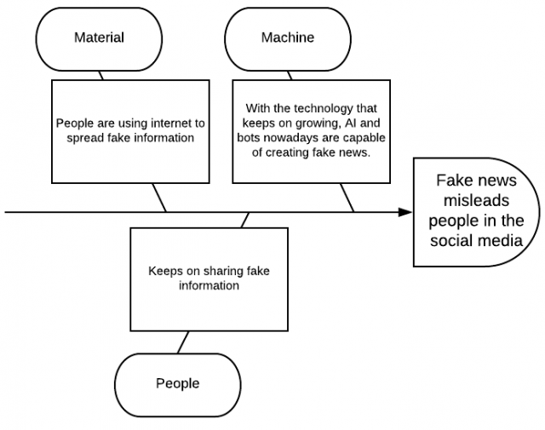
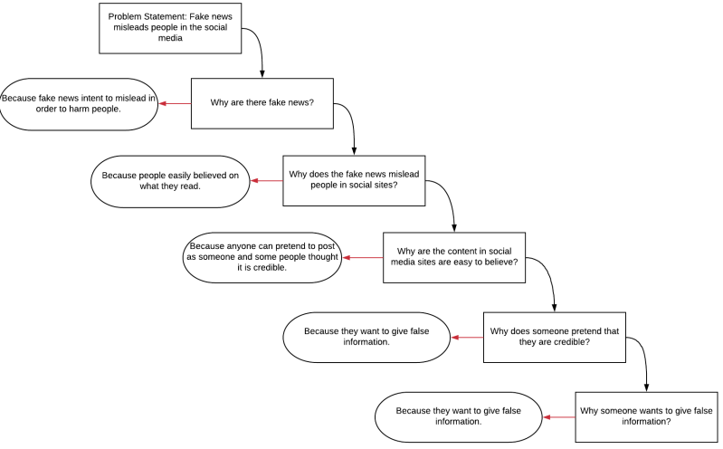
Managerial Process Plan
Fish Bone
5 Whys

Slide 10
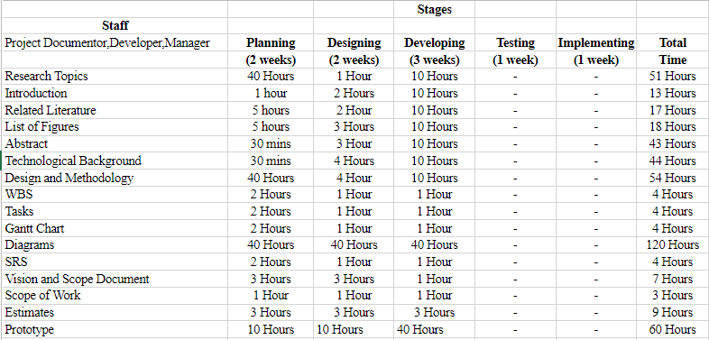
Managerial Process Plan
Estimates

Slide 11
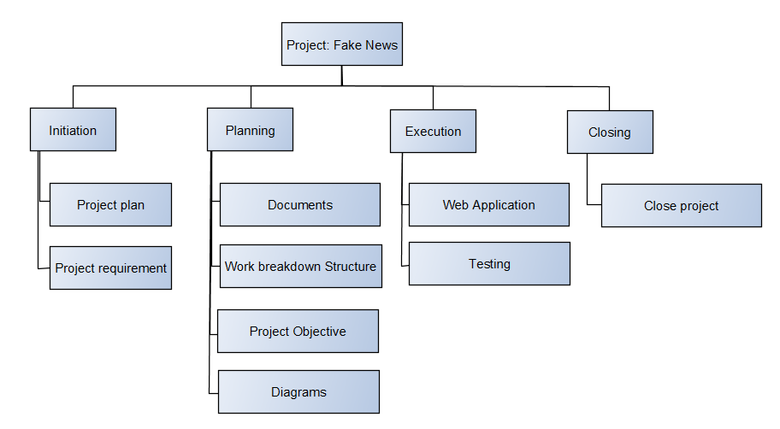
Managerial Process Plan
Work Breakdown Structure

Slide 12
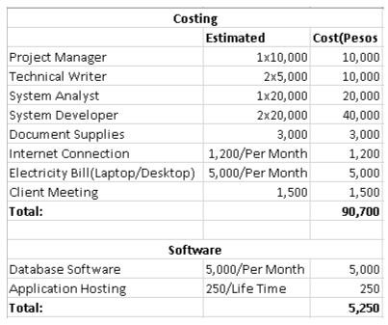
Managerial Process Plan
Costing

Slide 13
Quality Management Plan

Slide 14
Quality Management Plan
The quality management plan of identifying fake news will focus on the process and procedures for ensuring quality of the identifying fake news in terms of monitoring during the testing process
The purpose of this plan to:
Ensure high quality out the project
- To assure the quality of the extension there will be numerous types of testing that will be done by software testers

Slide 15
Human Resource
Management Plan

Slide 16
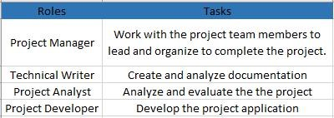
Human Resource Management Plan
The human resource management plan allow the researchers, project manager and members to classify and understand the roles and responsibilities of each project team member.
This will guarantee the value and effectiveness of assigning task or activities to each team member in order to complete the project requirements and deliverables
Roles and Task

Slide 17
Conclusion and Recommendations

Slide 18
Conclusion and Recommendations
Fake news can be lessened or better yet eliminated, since people keep falling prey for such posts; it needs to be stopped. If this program could be implemented, there will definitely be a big change in how news would be spread, since users will no longer fall for faulty news articles and posts. This extension will also help users from falling to a phishing sites.
To help increase the accuracy of the extension, the researchers recommend adding more features for classifying data and to work not only in chrome but also on other browsers

Slide 19
Web Extension

Slide 20
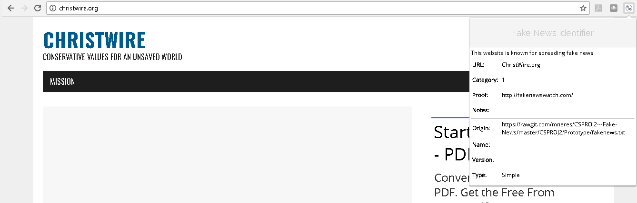
Web Extension

Slide 21
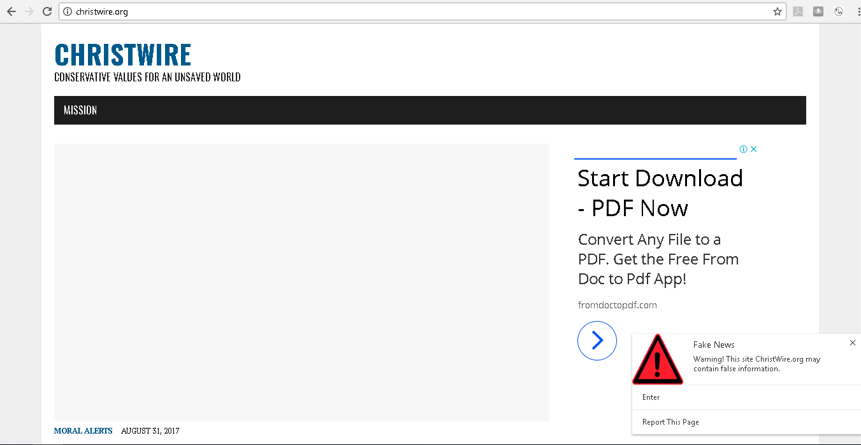
Web Extension

Slide 22
Thank you

