Slide 1


DASH-R-COME Applied Project 2 (CSPROJ)
Hurley Evangelista | Emmanuel Devera|
Alyssa Anne Fernandez | Miguel Matawaran

Slide 2
Objectives
To expand the scope of Barangay Magallanes
To provide evidence or supporting details

Slide 3
Scope and Limitations
Barangay Magallanes.
Target users : motorists, bystanders, constituents and android device users.
An internet connection or mobile data.
Firebase
Barangay Magallanes employee.
the user can use dashboard camera and transfer with its Bluetooth feature (the two devices must have a Bluetooth capability)
android’s file system such as, Gallery
the ‘take a snap’ feature
Only limited in generating incident report
Notes:
Responding part of Barangay Magallanes and the desired leading agency are NOT part of SCOPE

Slide 4
Application’s Features
Login system feature to authenticate the user and to avoid fake reporters.
A video cutter feature to reduce the file size and data that will be consumed.
Take a snap feature that allows user to send only a picture of an event.
DashCamBlue feature that allows user to transfer the video footage of the incident from the dashboard camera to the android device

Slide 5
Software Requirements
Android Studio –
Firebase Database
Firebase Authentication
Firebase Cloud

Slide 6
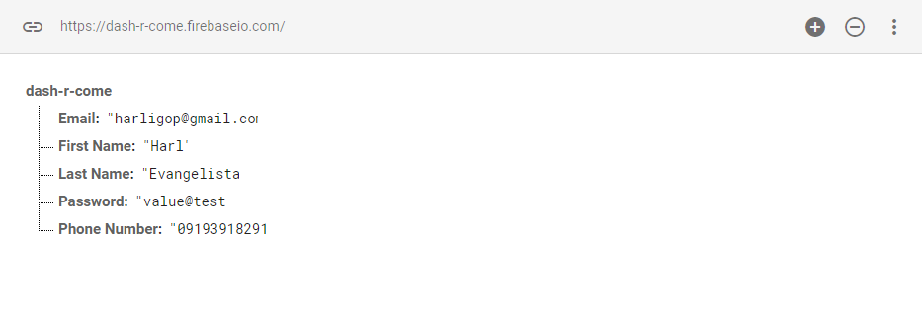
User ID String (UID / Database)

Slide 7
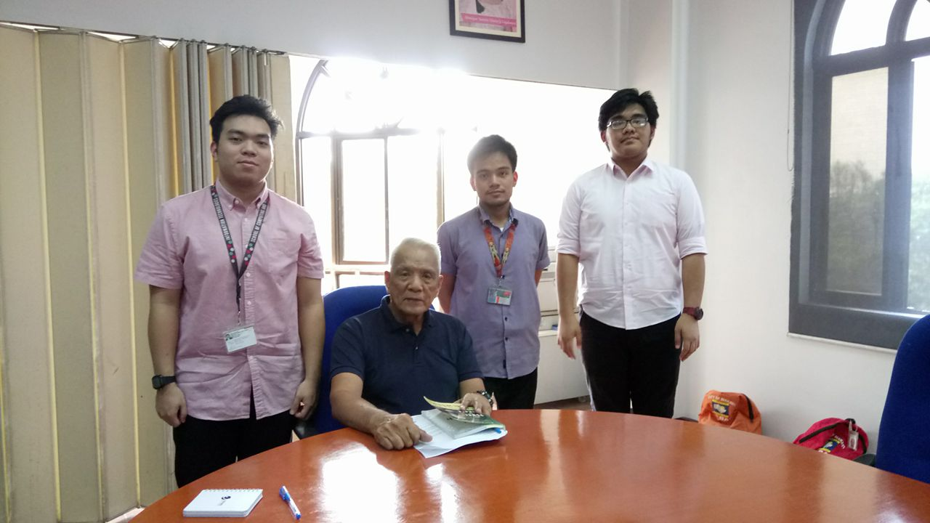
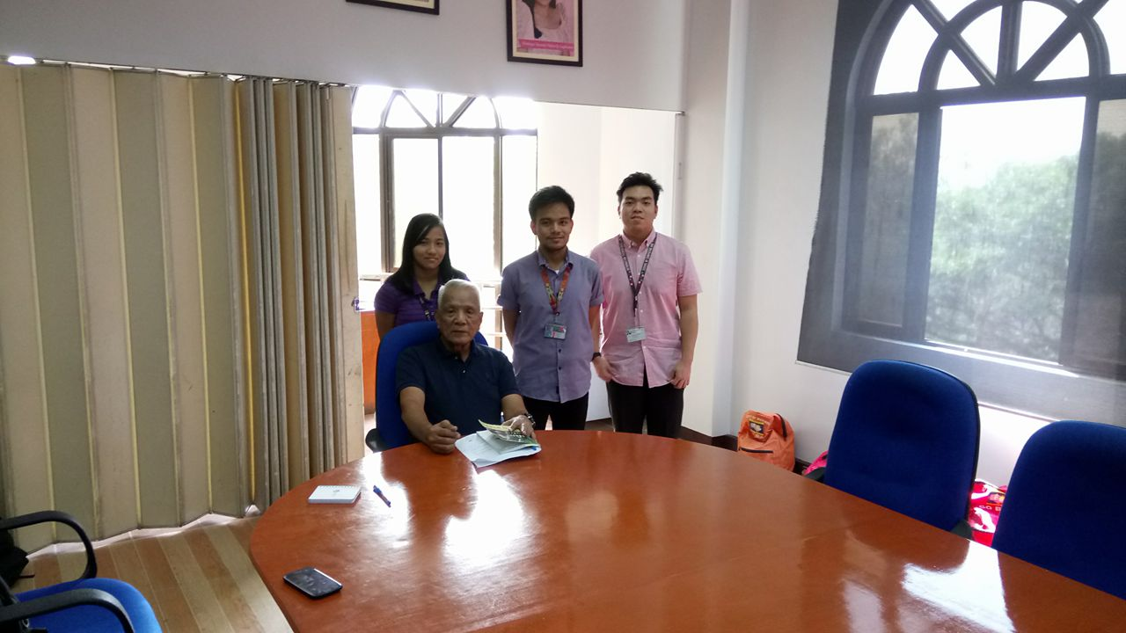
T H A N K Y O U

