Slide 1
Identifying fake news on Social Media Websites

Slide 2
About Our Project

Slide 3
About Our Project
Create a system that identifies fake news
Chrome extension

Slide 4
What is fake new?

Slide 5
What is fake news?
Article full of misinformation
Misleads People
Harms the community

Slide 6
Purpose and Description

Slide 7
Purpose and Description
Give awareness to online users
No government agency that monitors fake news
Provide security against phishing sites
Provide solution against fake news
Implemented through Extension

Slide 8
Objectives

Slide 9
Objectives
To create a system that determine whether a link leads to a fake news article or not
To create a web extension that can identify whether a link clicked by a user leads to a fake news article or not

Slide 10
Design and Methodology

Slide 11
1.
Gathering of Data

Slide 12
Gathering of Data
Kaggle.com is a data science website.
Opensources.com provide a continuously updated database of information sources
The DNS-BH project(malwaredomains) creates and maintains a listing of domains that are known to be used to propagate malware and spyware
Manual download

Slide 13
2.
Analyzing the Link

Slide 14
Analyzing the Link
The extension will only run when a link is clicked
the system will compare the news link article from the list of fake news links
If the link is not in the list, the system will extract the TLD (Top Level Domain) from the URL then the extracted TLD will be compared to our list of malicious and shady domains.

Slide 15
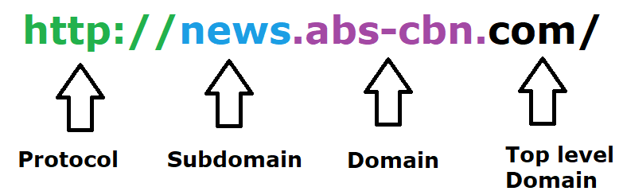
Well-known top-level domains are edu, gov, org and com.

Slide 16

In this example the system would flag this website as “shady” since zip is the TLD and it is in the list of top shady site
*Shady – Sources that has malicious domain

Slide 17
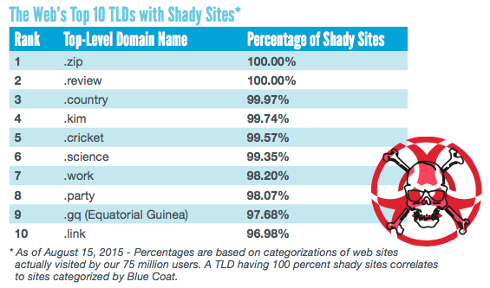

Slide 18
3.
Updating

Slide 19
Updating the link
The extension is automatically updated without user intervention
Googles Developer Dashboard
The developers will update the data of fake new list and malicious domains every month.

Slide 20
4.
Reporting System

Slide 21
Reporting System
The developers will be using indexedDB for the client-side storage.
MySQL for the main server
The data from the clients will be synced to MySQL
it will be analyzed by the developers by getting the average percentage.
Once the tag reaches 80% of the total reports the developers will flag it as a fake website and it will show the user the reason why it is flagged as fake (Fake News, Clickbait, Caution, Bias).
The developers would also use a captcha system to avoid bots and spammers.

Slide 22
Reporting System
Fake News- Sources that entirely fabricate information, disseminate deceptive content, or grossly distort actual news reports
Clickbait- Sources that provide generally credible content, but use exaggerated, misleading, or questionable headlines, social media descriptions, and/or images.
Caution - Sources that may be reliable but whose contents require further verification.
Bias - Sources that come from a particular point of view and may rely on propaganda, decontextualized information, and opinions distorted as facts.
Shady – Sources that has malicious domain

Slide 23
5.
Diagrams

Slide 24
Conclusion and Recommendation
Fake news can be lessened or better yet eliminated, since people keep falling prey for such posts; it needs to be stopped.
If this program could be implemented, there will definitely be a big change in how news would be spread, since users will no longer fall for faulty news articles and posts.
To help increase the accuracy of the extension, the researchers recommend adding more features for classifying data and to work not only in chrome but also on other browsers
If this program could be implemented, there will definitely be a big change in how news would be spread, since users will no longer fall for faulty news articles and posts.

Slide 25

Our Logo
Place your screenshot here

Slide 26
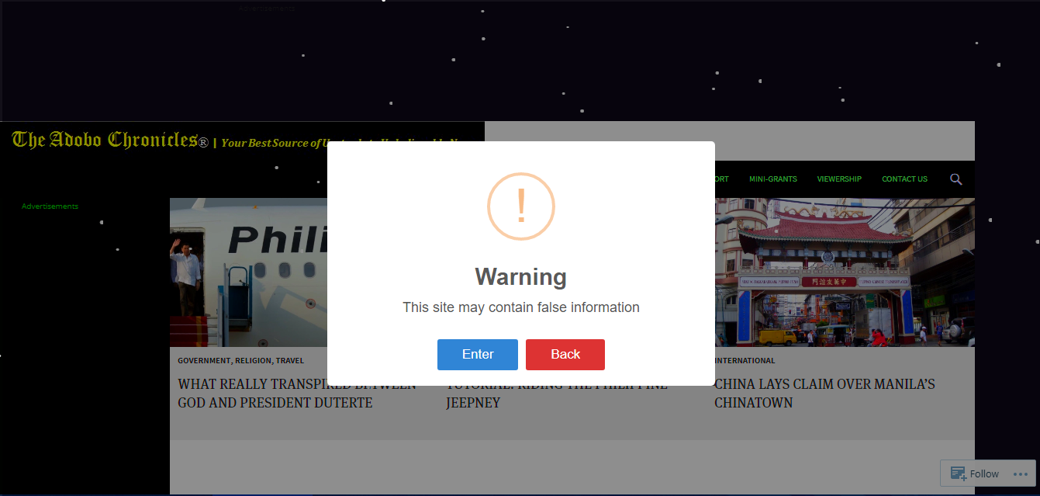
Warning Alert
Place your screenshot here

Slide 27
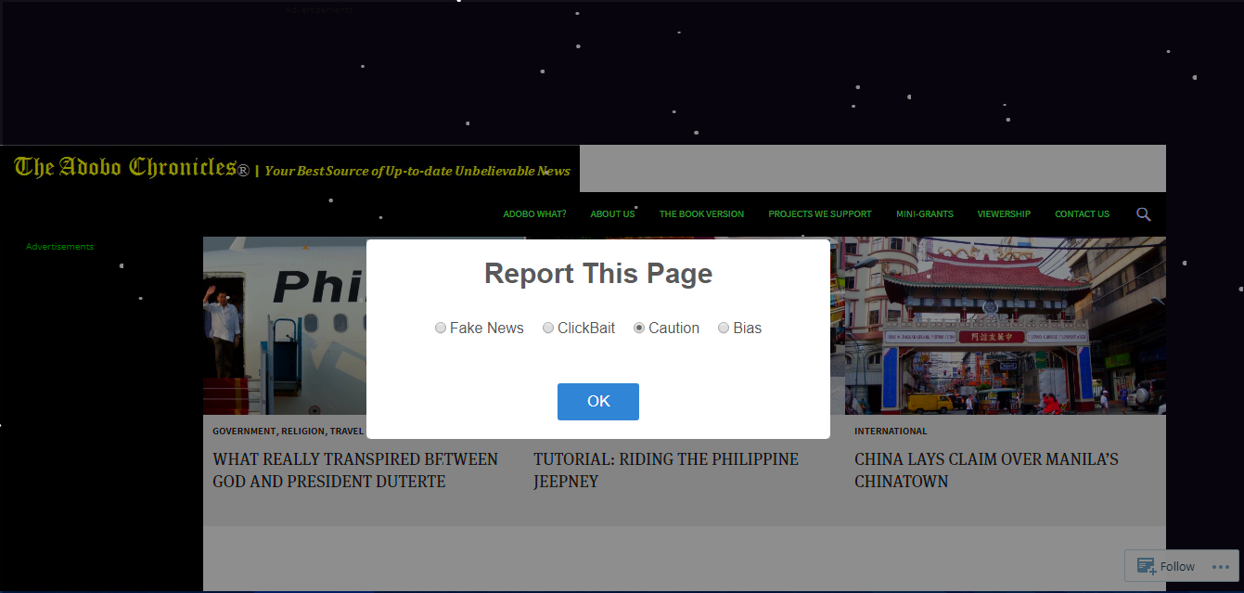
Reporting

Slide 28
😉
Thank You!

