Slide 1
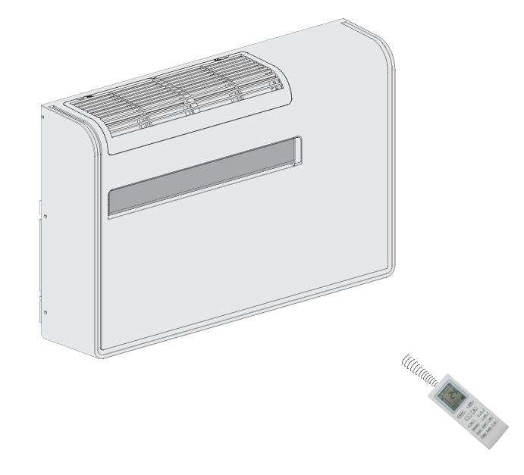
FUTURDATA THESIS
Disassembly Guide
APOLLO air conditioner without outdoor
unit
PPTX export • 8 action group(s) • depth: DepthMode.FULL • schema 1.1
Nominal weight Unknown
APOLLO air conditioner without outdoor unit
1 / 17

Slide 2
PROJECT OVERVIEW
Export scope and model summary
PRODUCT ID
ACTION GROUPS
BOM COMPONENTS
VALIDATION ISSUES
2047097084112
8
36
1
PRODUCT DATA
EXPORT BEHAVIOUR
Name: APOLLO air conditioner without outdoor unit
Weight: Unknown
Material: Unknown
Color: Unknown
Depth mode: DepthMode.FULL
• Parent operation and atomic actions stay grouped.
• Output components and remaining assembly are shown.
• Text and images remain editable in PowerPoint.
• Unknown branch sources are never guessed.
• Source JSON is opened read-only and never modified.
APOLLO air conditioner without outdoor unit
2 / 17

Slide 3
VALIDATION
Model warnings and errors
Each issue is localized to the corresponding JSON element when possible.
SEVERITY.INFO · mass_balance
Mass balance not verifiable: the product has no weight; 36 component(s) have no weight.
Location: node_ids=[2046878681424, 2046878813072, 2046879025104, 2046881540432, 2046884269648, 2046884534608, 2046884535248, 2046884538128, 2046884539984, 2046884543568, 2046965450000, 2046970672464, 2046970926288, 2046970926352, 2046970934672, 2046970956496, 2046970964240, 2046970967312, 2046971235792, 2046971240912, 2046971245712, 2046971246032,
2046971246160, 2046971246544, 2046996494224, 2047096392144, 2047097640976, 2047097833744, 2047097836624, 2047097837520, 2047097838352, 2047097842000, 2047097842064, 2047097842576, 2047098194384, 2047098205904]
APOLLO air conditioner without outdoor unit
3 / 17

Slide 4
PREPARATION
Tools and safety notices
Aggregated from step-level and atomic-action metadata.
TOOLS REQUIRED
SAFETY NOTICES
• Screwdriver
• No safety notices are specified in this model.
APOLLO air conditioner without outdoor unit
4 / 17

Slide 5
BILL OF MATERIALS
Recovered components — page 1 of 4
ID | Component | Weight | Material | Color | Quality | Destination
2046878 681424 | Back panel / rear back plate | Unknown | Unknown | Unknown | — | —
2046879 025104 | Side/front-shell screws (6) | Unknown | Unknown | Unknown | — | —
2046970 926288 | Guide-plate screws (3) | Unknown | Unknown | Unknown | — | —
2046970 964240 | Electronic control box cover | Unknown | Unknown | Unknown | — | —
2047097 838352 | Electronic-control-box-cover screws (2) | Unknown | Unknown | Unknown | — | —
2047097 842576 | Front housing / front shell assembly | Unknown | Unknown | Unknown | — | —
2046970 926352 | Appliance box | Unknown | Unknown | Unknown | — | —
2046881 540432 | Appliance-box screws (2) | Unknown | Unknown | Unknown | — | —
2047097 837520 | Main control PCB | Unknown | Unknown | Unknown | — | —
APOLLO air conditioner without outdoor unit
5 / 17

Slide 6
BILL OF MATERIALS
Recovered components — page 2 of 4
ID | Component | Weight | Material | Color | Quality | Destination
2047097 842064 | PCB radiator | Unknown | Unknown | Unknown | — | —
2047097 842000 | Heat dissipation fan | Unknown | Unknown | Unknown | — | —
2046971 240912 | Heat-dissipation-fan-bracket screws (2) | Unknown | Unknown | Unknown | — | —
2046965 450000 | Reactor | Unknown | Unknown | Unknown | — | —
2047097 640976 | Motor press plate | Unknown | Unknown | Unknown | — | —
2046971 246032 | Evaporator / air-duct assembly | Unknown | Unknown | Unknown | — | —
2046971 246160 | Inner machine base assembly | Unknown | Unknown | Unknown | — | —
2046971 246544 | Front wind baffle (1) | Unknown | Unknown | Unknown | — | —
2046996 494224 | Middle support cross plate (2) | Unknown | Unknown | Unknown | — | —
APOLLO air conditioner without outdoor unit
6 / 17

Slide 7
BILL OF MATERIALS
Recovered components — page 3 of 4
ID | Component | Weight | Material | Color | Quality | Destination
2047096 392144 | Middle partition | Unknown | Unknown | Unknown | — | —
2046884 539984 | Side plates | Unknown | Unknown | Unknown | — | —
2046970 934672 | Volute assembly | Unknown | Unknown | Unknown | — | —
2046884 543568 | Volute outside screws (4) | Unknown | Unknown | Unknown | — | —
2046884 534608 | Motor-shaft nut | Unknown | Unknown | Unknown | — | —
2046970 956496 | Exhaust air wheel | Unknown | Unknown | Unknown | — | —
2046884 535248 | Exhaust motor | Unknown | Unknown | Unknown | — | —
2046884 538128 | Motor fixing screws (4) | Unknown | Unknown | Unknown | — | —
2047098 194384 | Bottom condenser-side end-plate screws (3) | Unknown | Unknown | Unknown | — | —
APOLLO air conditioner without outdoor unit
7 / 17

Slide 8
BILL OF MATERIALS
Recovered components — page 4 of 4
ID | Component | Weight | Material | Color | Quality | Destination
2046970 967312 | Compressor ground-foot nuts (3) | Unknown | Unknown | Unknown | — | —
2046971 235792 | Compressor ground-foot gaskets | Unknown | Unknown | Unknown | — | —
2046971 245712 | Refrigeration system: compressor + condenser + evaporator | Unknown | Unknown | Unknown | — | —
2047098 205904 | Chassis assembly | Unknown | Unknown | Unknown | — | —
2047097 836624 | Magnetic ring switch | Unknown | Unknown | Unknown | — | —
2047097 833744 | Magnetic-ring-switch screws (2) | Unknown | Unknown | Unknown | — | —
2046878 813072 | Water heater | Unknown | Unknown | Unknown | — | —
2046884 269648 | Water-heater screws (2) | Unknown | Unknown | Unknown | — | —
2046970 672464 | APOLLO unit after documented disassembly procedures | Unknown | Unknown | Unknown | — | —
APOLLO air conditioner without outdoor unit
8 / 17

Slide 9
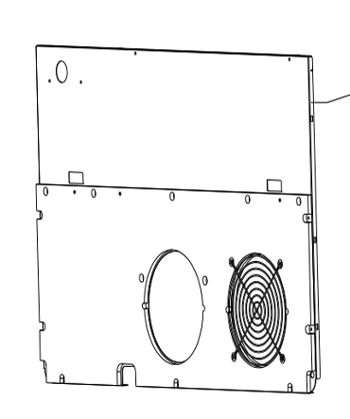
ACTION GROUP 1
Remove back panel
Atomic actions are grouped under their parent disassembly operation.
Source: APOLLO air conditioner without outdoor unit (Unknown)
explicit source
ATOMIC ACTIONS
1
Remove a total of 6 screws on the left and right sides of the front shell
with a screwdriver, and remove the screws fixing the back plate.
2
Pull the back plate outward by hand until the upper and lower clamps between the front shell
and back plate are detached. Pay attention to the clasps at the front-housing/back-plate joint.
Action 1
RESULT
• Back panel / rear back plate (Unknown)
• Side/front-shell screws (6) (Unknown)
CONTINUES AS
• Unit without back panel (Unknown)
APOLLO air conditioner without outdoor unit
9 / 17

Slide 10
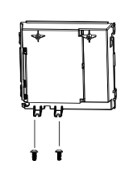
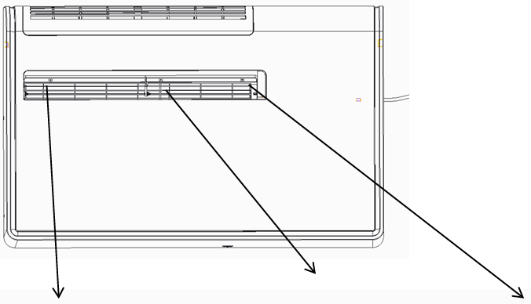
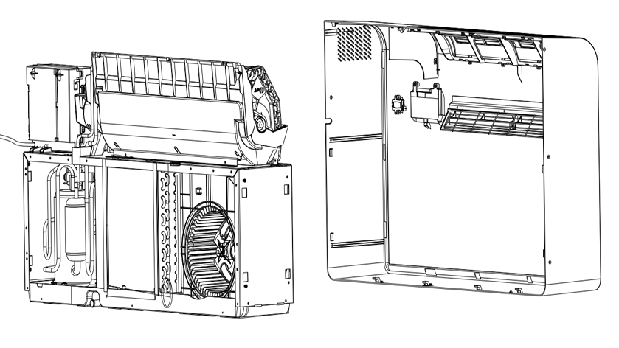
ACTION GROUP 2
Remove front housing assemblies
Atomic actions are grouped under their parent disassembly operation.
Source: Unit without back panel (Unknown)
explicit source
ATOMIC ACTIONS
1
Swing the guide plate to the horizontal position and remove the 3
screws behind the guide plate.
2
Remove the 2 screws fixing the electronic control box cover, remove the cover, and
pull out the connected terminal for subsequent disassembly and maintenance.
3
Slightly lift the base, pull the front shell outward, verify that the left/right sheet-metal joint clips and
bottom/base joint clips are detached, then move the front shell horizontally out while loosening the
connection line.
Action 1
Action 2
Action 3
RESULT
• Guide-plate screws (3) (Unknown)
• Electronic control box cover (Unknown)
• Electronic-control-box-cover screws (2) (Unknown)
• Front housing / front shell assembly (Unknown)
CONTINUES AS
• Unit without front housing (Unknown)
APOLLO air conditioner without outdoor unit
10 / 17

Slide 11
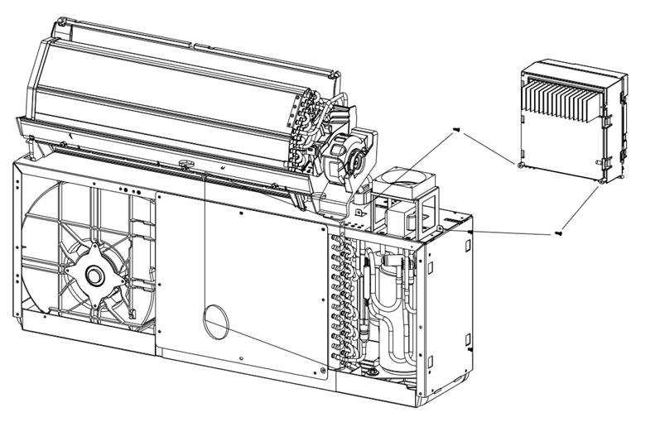
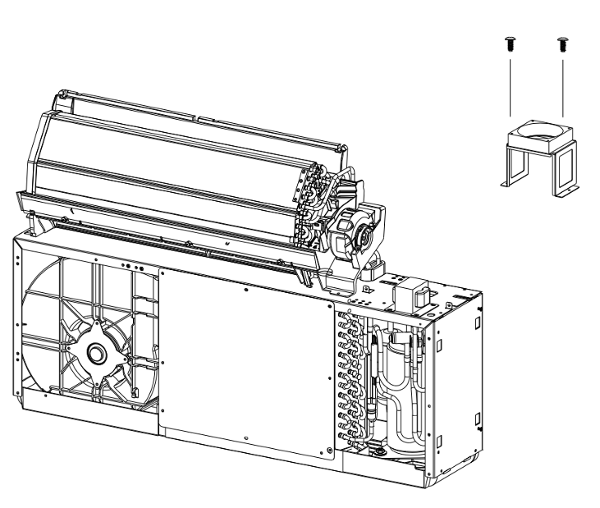
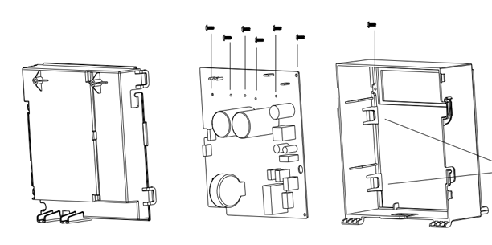
ACTION GROUP 3
Dismantle electronic control components
Atomic actions are grouped under their parent disassembly operation.
Source: Unit without front housing (Unknown)
explicit source
ATOMIC ACTIONS
1
Remove the 2 screws fixing the appliance box and remove the
appliance box.
2
Remove the screws fixing the main control PCB and remove the main
control PCB.
3
Remove the screws fixing the PCB radiator to the electronic control box
and remove the PCB radiator.
Action 1
Action 2
Action 3
4
Remove the 2 screws on the heat dissipation fan bracket and remove
the heat dissipation fan.
RESULT
Remove the screws fixing the reactor and remove the reactor.
• Appliance box (Unknown)
• Appliance-box screws (2) (Unknown)
• Main control PCB (Unknown)
• PCB radiator (Unknown)
• Heat dissipation fan (Unknown)
• Heat-dissipation-fan-bracket screws (2) (Unknown)
• Reactor (Unknown)
5
CONTINUES AS
• Unit with electronic control components removed
(Unknown)
APOLLO air conditioner without outdoor unit
11 / 17

Slide 12
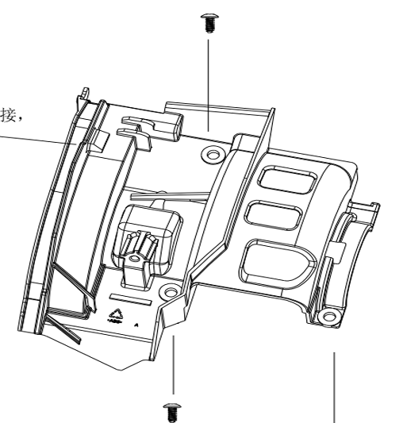
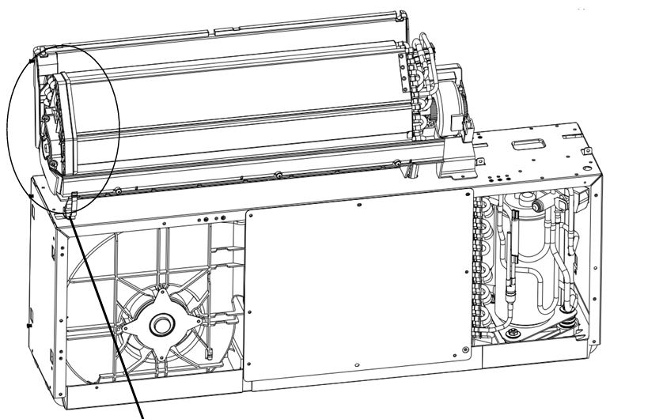
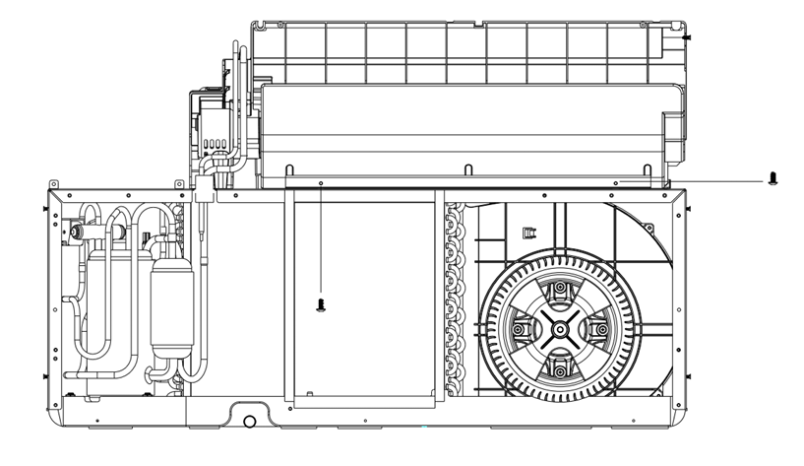
ACTION GROUP 4
Remove evaporator duct / inner-machine assembly
Atomic actions are grouped under their parent disassembly operation.
Source: Unit with electronic control components removed (Unknown)
explicit source
ATOMIC ACTIONS
1
Remove the screws fixing the motor press plate and remove the motor
press plate.
2
Remove the screws fixing the evaporator to the air duct assembly, as
illustrated on pages 9-10.
3
Release the illustrated end/side fasteners associated with the
evaporator/air-duct assembly.
Action 1
Action 2
Action 3
4
Lift the evaporator assembly and tilt/move the inner machine base
assembly out.
RESULT
• Motor press plate (Unknown)
• Evaporator / air-duct assembly (Unknown)
• Inner machine base assembly (Unknown)
CONTINUES AS
• Separated evaporator and inner-machine assemblies
(Unknown)
APOLLO air conditioner without outdoor unit
12 / 17

Slide 13
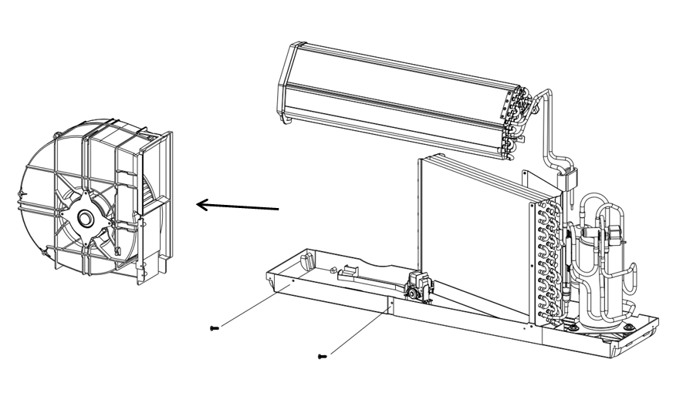
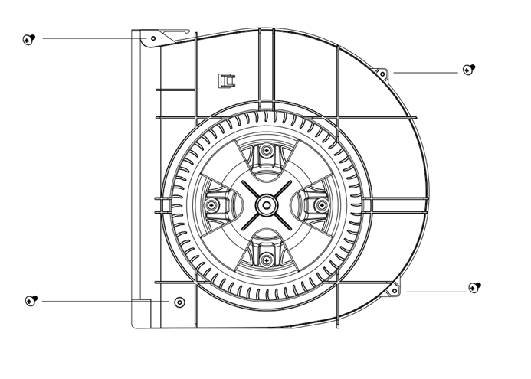
ACTION GROUP 5
Dismantle inner-machine components
Atomic actions are grouped under their parent disassembly operation.
Source: Separated evaporator and inner-machine assemblies (Unknown)
explicit source
ATOMIC ACTIONS
1
Remove the screws connecting the front wind baffle (1) to the
inner-machine assembly.
2
Remove the screws connecting the middle support cross plate (2) to
the middle support side plate.
3
Lift the evaporator assembly and horizontally move the middle partition
out.
Action 1
Action 2
4
Remove the screws attached to the base and the side plates, and
remove the side plates.
RESULT
• Front wind baffle (1) (Unknown)
• Middle support cross plate (2) (Unknown)
• Middle partition (Unknown)
• Side plates (Unknown)
CONTINUES AS
• Inner-machine base with listed panels removed
(Unknown)
APOLLO air conditioner without outdoor unit
13 / 17

Slide 14
ACTION GROUP 6
Dismantle exhaust duct assembly
Atomic actions are grouped under their parent disassembly operation.
Source: Inner-machine base with listed panels removed (Unknown)
explicit source
ATOMIC ACTIONS
RESULT
1
Remove the screws fixing the volute assembly and remove the volute
assembly.
• Volute assembly (Unknown)
• Volute outside screws (4) (Unknown)
• Motor-shaft nut (Unknown)
• Exhaust air wheel (Unknown)
• Exhaust motor (Unknown)
• Motor fixing screws (4) (Unknown)
2
Remove the 4 screws on the outside of the volute.
3
Loosen and remove the nut fixed on the motor shaft, then pull the
exhaust air wheel outward with both hands.
CONTINUES AS
Remove the 4 screws fixing the motor on the other side and remove the
motor.
• Unit with exhaust duct components dismantled
(Unknown)
4
TOOLS
Screwdriver
APOLLO air conditioner without outdoor unit
14 / 17

Slide 15
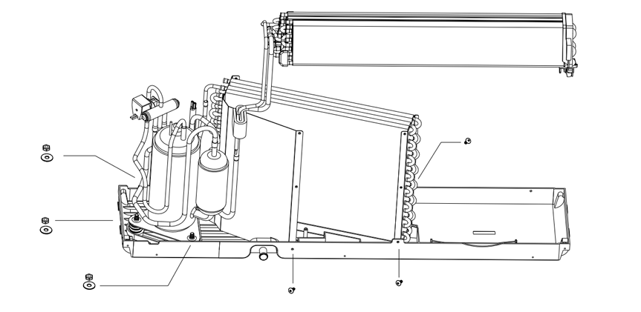
ACTION GROUP 7
Dismantle two-body system components
Atomic actions are grouped under their parent disassembly operation.
Source: Unit with exhaust duct components dismantled (Unknown)
explicit source
ATOMIC ACTIONS
1
Remove the 3 screws connecting the bottom condenser-side end plate
to the base.
2
Remove the 3 nuts from the compressor ground feet, including the nuts
and gaskets.
3
Lift the refrigeration system composed of compressor, condenser and evaporator so it detaches from
the chassis assembly. Arrange the two system components carefully; do not break the protection line.
Action 2
RESULT
• Bottom condenser-side end-plate screws (3) (Unknown)
• Compressor ground-foot nuts (3) (Unknown)
• Compressor ground-foot gaskets (Unknown)
• Refrigeration system: compressor + condenser + evaporator (Unknown)
• Chassis assembly (Unknown)
CONTINUES AS
• Chassis separated from refrigeration system
(Unknown)
APOLLO air conditioner without outdoor unit
15 / 17

Slide 16
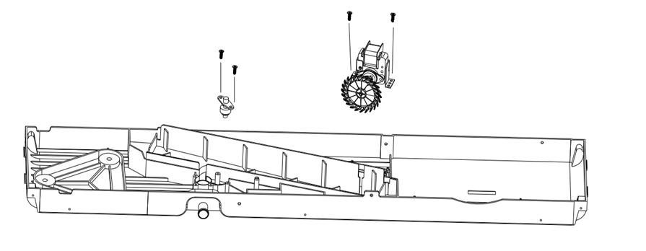
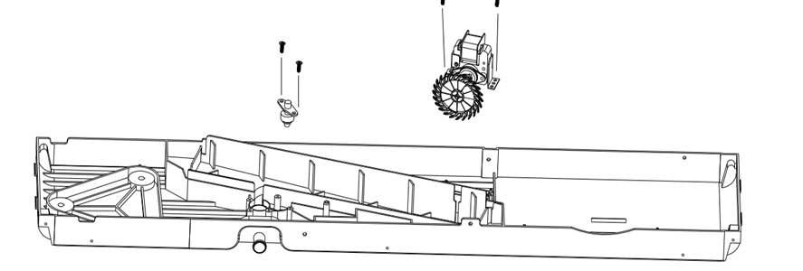
ACTION GROUP 8
Remove magnetic ring switch and water heater
Atomic actions are grouped under their parent disassembly operation.
Source: Chassis separated from refrigeration system (Unknown)
explicit source
ATOMIC ACTIONS
1
Remove the 2 screws fixing the magnetic ring switch and remove the
switch as illustrated.
2
Remove the 2 screws fixing the water heater and remove the heater as
illustrated.
Action 1
Action 2
RESULT
• Magnetic ring switch (Unknown)
• Magnetic-ring-switch screws (2) (Unknown)
• Water heater (Unknown)
• Water-heater screws (2) (Unknown)
• APOLLO unit after documented disassembly procedures (Unknown)
CONTINUES AS
End of this branch
APOLLO air conditioner without outdoor unit
16 / 17

Slide 17
EXPORT COMPLETE
8 action groups prepared
The PowerPoint remains fully editable: text, tables, images and component information
can be revised after export.
APOLLO air conditioner without outdoor unit
APOLLO air conditioner without outdoor unit
17 / 17

