Slide 1
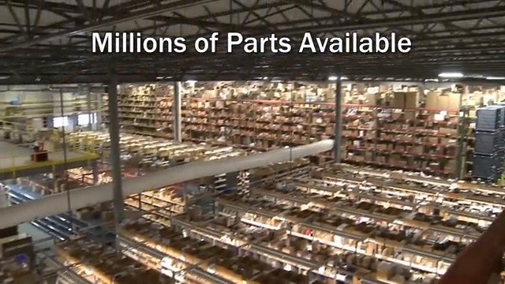
FUTURDATA THESIS
Disassembly Guide
Washing machine
PPTX export • 48 action group(s) • depth: DepthMode.FULL • schema 1.1
Nominal weight Unknown
Washing machine
1 / 59

Slide 2
PROJECT OVERVIEW
Export scope and model summary
PRODUCT ID
ACTION GROUPS
BOM COMPONENTS
VALIDATION ISSUES
2046967624720
48
48
1
PRODUCT DATA
EXPORT BEHAVIOUR
Name: Washing machine
Weight: Unknown
Material: Unknown
Color: Unknown
Depth mode: DepthMode.FULL
• Parent operation and atomic actions stay grouped.
• Output components and remaining assembly are shown.
• Text and images remain editable in PowerPoint.
• Unknown branch sources are never guessed.
• Source JSON is opened read-only and never modified.
Washing machine
2 / 59

Slide 3
VALIDATION
Model warnings and errors
Each issue is localized to the corresponding JSON element when possible.
SEVERITY.INFO · mass_balance
Mass balance not verifiable: the product has no weight; 48 component(s) have no weight.
Location: node_ids=[2046885871760, 2046885872080, 2046885872400, 2046885872720, 2046885873040, 2046885873360, 2046885873616, 2046885873872, 2046885874192, 2046885874512, 2046885874832, 2046885875152, 2046885875472, 2046885875792, 2046885876112, 2046885876432, 2046885876752, 2046885877072, 2046885883920, 2046967613904, 2046967614096, 2046967614544,
2046967614864, 2046967614992, 2046967616720, 2046967617168, 2046967617360, 2046967617616, 2046967619024, 2046967619216, 2046967619344, 2046967620176, 2046967620944, 2046967621008, 2046967621456, 2046967622032, 2046967622096, 2046967622736, 2046967623120, 2046967623248, 2046967623376, 2046967623952, 2046967624080, 2046967624528, 2046967624976,
2046967625872, 2046967626192, 2046967627472]
Washing machine
3 / 59

Slide 4
PREPARATION
Tools and safety notices
Aggregated from step-level and atomic-action metadata.
TOOLS REQUIRED
SAFETY NOTICES
• No tools are specified in this model.
• No safety notices are specified in this model.
Washing machine
4 / 59

Slide 5
BILL OF MATERIALS
Recovered components — page 1 of 6
ID | Component | Weight | Material | Color | Quality | Destination
2046967 617168 | Back plate | Unknown | Unknown | Unknown | — | —
2046967 627472 | Black cord | Unknown | Unknown | Unknown | — | —
2046967 617360 | Valve | Unknown | Unknown | Unknown | — | —
2046967 622096 | Water supply hose | Unknown | Unknown | Unknown | — | —
2046967 626192 | A part of the washing machine | Unknown | Unknown | Unknown | — | —
2046967 620176 | Upper agitator | Unknown | Unknown | Unknown | — | —
2046967 613904 | White plastic component | Unknown | Unknown | Unknown | — | —
2046967 623120 | A screw on the lid of the bucket | Unknown | Unknown | Unknown | — | —
2046967 614544 | Screw | Unknown | Unknown | Unknown | — | —
Washing machine
5 / 59

Slide 6
BILL OF MATERIALS
Recovered components — page 2 of 6
ID | Component | Weight | Material | Color | Quality | Destination
2046967 623376 | 4 Phillips screws on the back plate | Unknown | Unknown | Unknown | — | —
2046967 624976 | Control panel | Unknown | Unknown | Unknown | — | —
2046967 614992 | Control knobs | Unknown | Unknown | Unknown | — | —
2046967 622032 | A component from the case | Unknown | Unknown | Unknown | — | —
2046967 619216 | Lid switch | Unknown | Unknown | Unknown | — | —
2046967 616720 | A screw from a white plastic component | Unknown | Unknown | Unknown | — | —
2046967 623952 | Metal clip | Unknown | Unknown | Unknown | — | —
2046967 614864 | Rear panel | Unknown | Unknown | Unknown | — | —
2046967 622736 | Back plate screws | Unknown | Unknown | Unknown | — | —
Washing machine
6 / 59

Slide 7
BILL OF MATERIALS
Recovered components — page 3 of 6
ID | Component | Weight | Material | Color | Quality | Destination
2046967 621456 | Lid switch mounting screws | Unknown | Unknown | Unknown | — | —
2046967 614096 | A screw on the appliance | Unknown | Unknown | Unknown | — | —
2046967 617616 | 4 Phillips screws on the back plate | Unknown | Unknown | Unknown | — | —
2046967 621008 | 4 Phillips screws on the back plate | Unknown | Unknown | Unknown | — | —
2046967 623248 | A refrigerator component labeled 'SPILL' | Unknown | Unknown | Unknown | — | —
2046967 619344 | Tabs securing the tub ring | Unknown | Unknown | Unknown | — | —
2046967 619024 | 4 Phillips screws on the back plate | Unknown | Unknown | Unknown | — | —
2046967 620944 | White plastic component | Unknown | Unknown | Unknown | — | —
2046967 625872 | Tub nut | Unknown | Unknown | Unknown | — | —
Washing machine
7 / 59

Slide 8
BILL OF MATERIALS
Recovered components — page 4 of 6
ID | Component | Weight | Material | Color | Quality | Destination
2046967 624528 | Metal component | Unknown | Unknown | Unknown | — | —
2046967 624080 | Drive block | Unknown | Unknown | Unknown | — | —
2046885 883920 | Drain pump | Unknown | Unknown | Unknown | — | —
2046885 871760 | 4 Phillips screws on the back plate | Unknown | Unknown | Unknown | — | —
2046885 872080 | Motor | Unknown | Unknown | Unknown | — | —
2046885 872400 | Wire retainer from the transmission | Unknown | Unknown | Unknown | — | —
2046885 872720 | Wire retainer | Unknown | Unknown | Unknown | — | —
2046885 873040 | Transmission | Unknown | Unknown | Unknown | — | —
2046885 873360 | 4 Phillips screws on the back plate | Unknown | Unknown | Unknown | — | —
Washing machine
8 / 59

Slide 9
BILL OF MATERIALS
Recovered components — page 5 of 6
ID | Component | Weight | Material | Color | Quality | Destination
2046885 873616 | Wire retainer | Unknown | Unknown | Unknown | — | —
2046885 873872 | Motor | Unknown | Unknown | Unknown | — | —
2046885 874192 | Motor or engine part | Unknown | Unknown | Unknown | — | —
2046885 874512 | White plastic component | Unknown | Unknown | Unknown | — | —
2046885 874832 | 4 Phillips screws on the back plate | Unknown | Unknown | Unknown | — | —
2046885 875152 | Drum cover | Unknown | Unknown | Unknown | — | —
2046885 875472 | A screw on the bottom of the machine | Unknown | Unknown | Unknown | — | —
2046885 875792 | 4 Phillips screws on the back plate | Unknown | Unknown | Unknown | — | —
2046885 876112 | A part from the white surface | Unknown | Unknown | Unknown | — | —
Washing machine
9 / 59

Slide 10
BILL OF MATERIALS
Recovered components — page 6 of 6
ID | Component | Weight | Material | Color | Quality | Destination
2046885 876432 | Lid switch | Unknown | Unknown | Unknown | — | —
2046885 876752 | Control panel | Unknown | Unknown | Unknown | — | —
2046885 877072 | Hoses and connections | Unknown | Unknown | Unknown | — | —
Washing machine
10 / 59

Slide 11
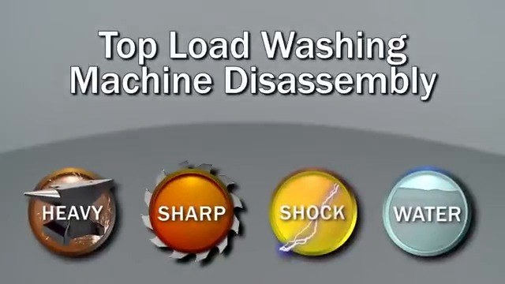
ACTION GROUP 1
Remove back plate using Phillips screwdriver (Phillips screws on the back plate)
Atomic actions are grouped under their parent disassembly operation.
Source: Washing machine (Unknown)
explicit source
ATOMIC ACTIONS
1
Remove back plate using Phillips screwdriver (Phillips screws on the
back plate)
Back plate
Washing machine (remaining after step 1)
RESULT
• Back plate (Unknown)
CONTINUES AS
• Washing machine (remaining after step 1) (Unknown)
Washing machine
11 / 59

Slide 12
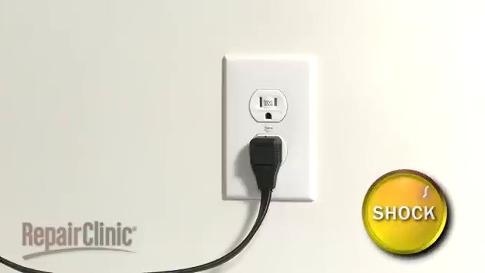
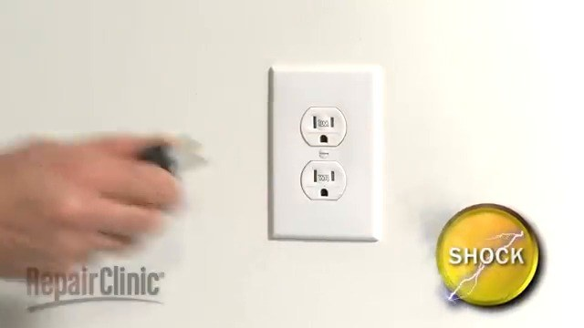
ACTION GROUP 2
Disconnect black cord
Atomic actions are grouped under their parent disassembly operation.
Source: Washing machine (remaining after step 1) (Unknown)
explicit source
ATOMIC ACTIONS
1
Disconnect black cord
Black cord
Washing machine (remaining after step 2)
RESULT
• Black cord (Unknown)
CONTINUES AS
• Washing machine (remaining after step 2) (Unknown)
Washing machine
12 / 59

Slide 13
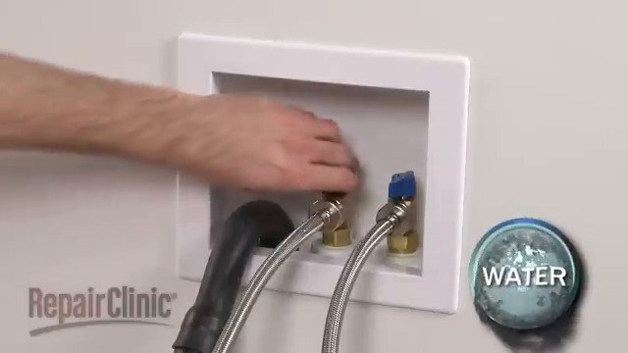
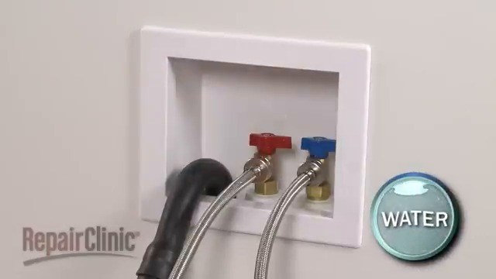
ACTION GROUP 3
Remove valve using pliers (valve screws)
Atomic actions are grouped under their parent disassembly operation.
Source: Washing machine (remaining after step 2) (Unknown)
explicit source
ATOMIC ACTIONS
1
Remove valve using pliers (valve screws)
Valve
Washing machine (remaining after step 3)
RESULT
• Valve (Unknown)
CONTINUES AS
• Washing machine (remaining after step 3) (Unknown)
Washing machine
13 / 59

Slide 14
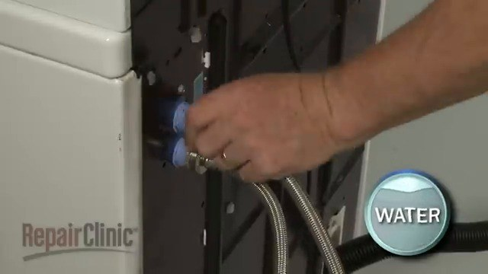
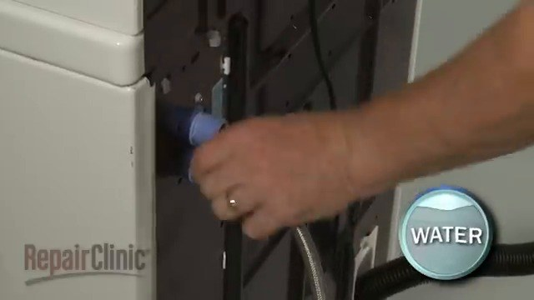
ACTION GROUP 4
Disconnect water supply hose using plastic wrench
Atomic actions are grouped under their parent disassembly operation.
Source: Washing machine (remaining after step 3) (Unknown)
explicit source
ATOMIC ACTIONS
1
Disconnect water supply hose using plastic wrench
Water supply hose
Washing machine (remaining after step 4)
RESULT
• Water supply hose (Unknown)
CONTINUES AS
• Washing machine (remaining after step 4) (Unknown)
Washing machine
14 / 59

Slide 15
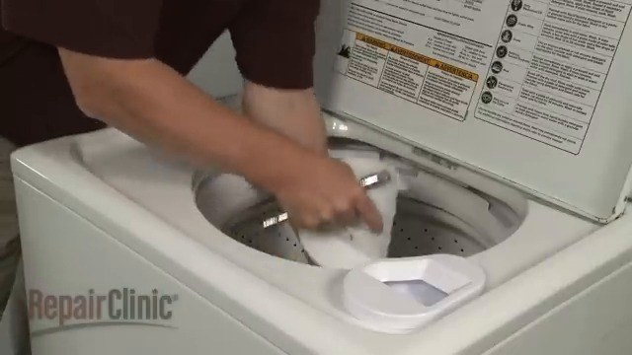
ACTION GROUP 5
Remove a part of the washing machine using a tool
Atomic actions are grouped under their parent disassembly operation.
Source: Washing machine (remaining after step 4) (Unknown)
explicit source
ATOMIC ACTIONS
1
Remove a part of the washing machine using a tool
A part of the washing machine
RESULT
• A part of the washing machine (Unknown)
CONTINUES AS
• Washing machine (remaining after step 5) (Unknown)
Washing machine
15 / 59

Slide 16
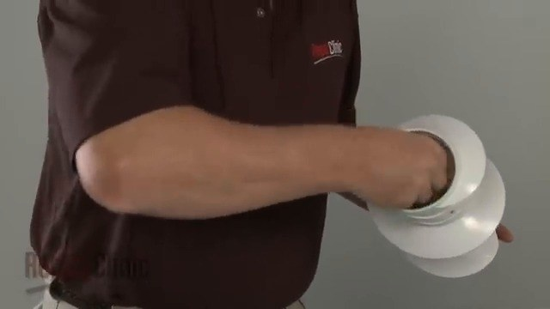
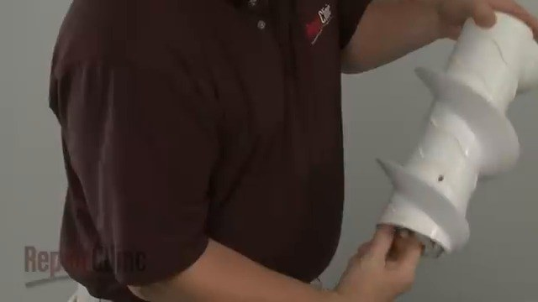
ACTION GROUP 6
Lift upper agitator using small flathead
Atomic actions are grouped under their parent disassembly operation.
Source: Washing machine (remaining after step 5) (Unknown)
explicit source
ATOMIC ACTIONS
1
Lift upper agitator using small flathead
Upper agitator
Washing machine (remaining after step 6)
RESULT
• Upper agitator (Unknown)
CONTINUES AS
• Washing machine (remaining after step 6) (Unknown)
Washing machine
16 / 59

Slide 17
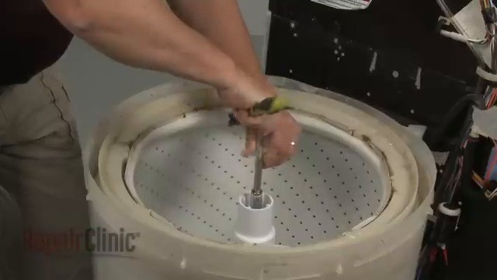
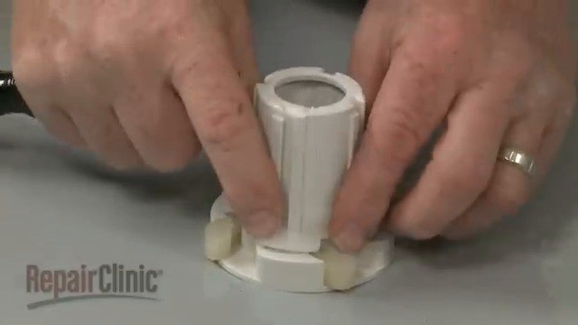
ACTION GROUP 7
Remove white plastic component with a transparent section using hands (ring on the person's finger)
Atomic actions are grouped under their parent disassembly operation.
Source: Washing machine (remaining after step 6) (Unknown)
explicit source
ATOMIC ACTIONS
1
Remove white plastic component with a transparent section using
hands (ring on the person's finger)
White plastic component
Washing machine (remaining after step 7)
RESULT
• White plastic component (Unknown)
CONTINUES AS
• Washing machine (remaining after step 7) (Unknown)
Washing machine
17 / 59

Slide 18
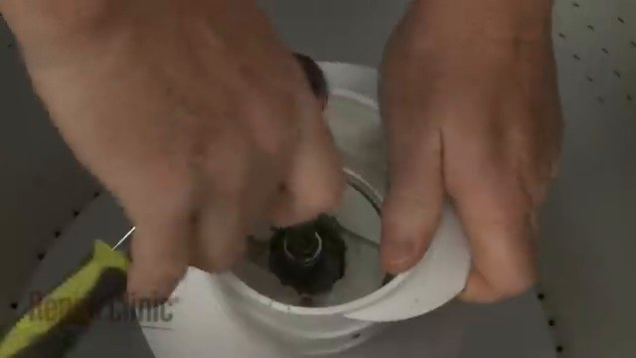
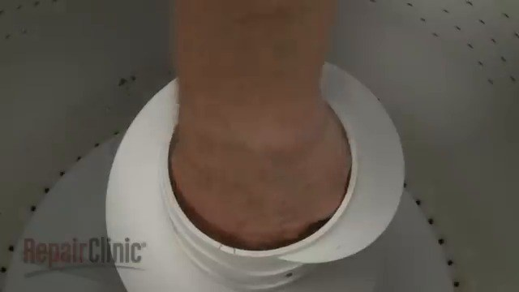
ACTION GROUP 8
Remove a screw on the lid of the bucket using a screwdriver (a screw on the lid of the bucket)
Atomic actions are grouped under their parent disassembly operation.
Source: Washing machine (remaining after step 7) (Unknown)
explicit source
ATOMIC ACTIONS
1
Remove a screw on the lid of the bucket using a screwdriver (a screw
on the lid of the bucket)
A screw on the lid of the bucket
Washing machine (remaining after step 8)
RESULT
• A screw on the lid of the bucket (Unknown)
CONTINUES AS
• Washing machine (remaining after step 8) (Unknown)
Washing machine
18 / 59

Slide 19
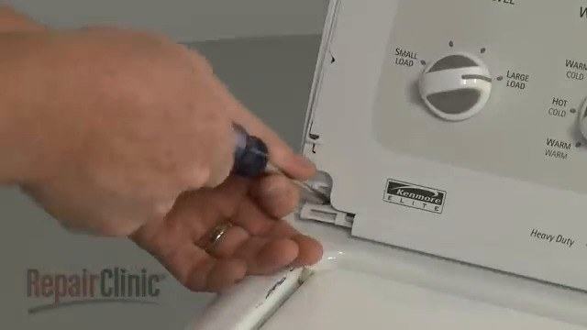
ACTION GROUP 9
Remove screw using screwdriver (4 Phillips screws on the back plate)
Atomic actions are grouped under their parent disassembly operation.
Source: Washing machine (remaining after step 8) (Unknown)
explicit source
ATOMIC ACTIONS
1
Remove screw using screwdriver (4 Phillips screws on the back plate)
Screw
RESULT
• Screw (Unknown)
CONTINUES AS
• Washing machine (remaining after step 9) (Unknown)
Washing machine
19 / 59

Slide 20
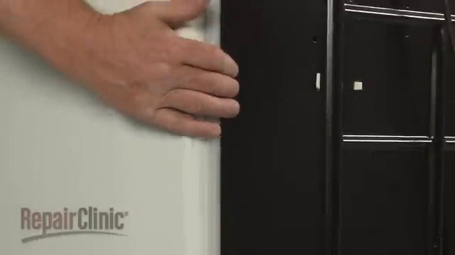
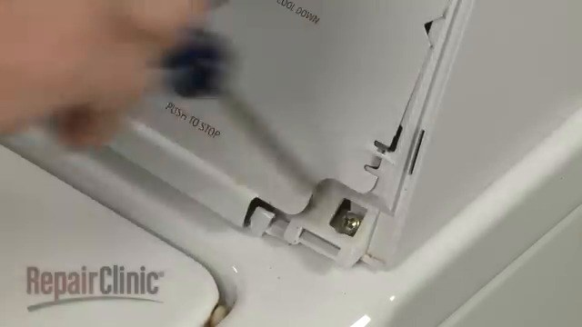
ACTION GROUP 10
Unscrew 4 Phillips screws on the back plate using screwdriver (4 Phillips screws on the back plate)
Atomic actions are grouped under their parent disassembly operation.
Source: Washing machine (remaining after step 9) (Unknown)
explicit source
ATOMIC ACTIONS
1
Unscrew 4 Phillips screws on the back plate using screwdriver (4
Phillips screws on the back plate)
4 Phillips screws on the back plate
Washing machine (remaining after step 10)
RESULT
• 4 Phillips screws on the back plate (Unknown)
CONTINUES AS
• Washing machine (remaining after step 10) (Unknown)
Washing machine
20 / 59

Slide 21
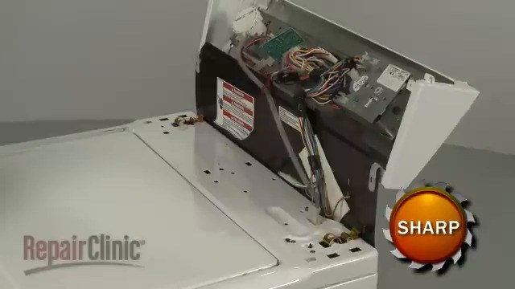
ACTION GROUP 11
Lift control panel
Atomic actions are grouped under their parent disassembly operation.
Source: Washing machine (remaining after step 10) (Unknown)
explicit source
ATOMIC ACTIONS
1
Lift control panel
Control panel
RESULT
• Control panel (Unknown)
CONTINUES AS
• Washing machine (remaining after step 11) (Unknown)
Washing machine
21 / 59

Slide 22
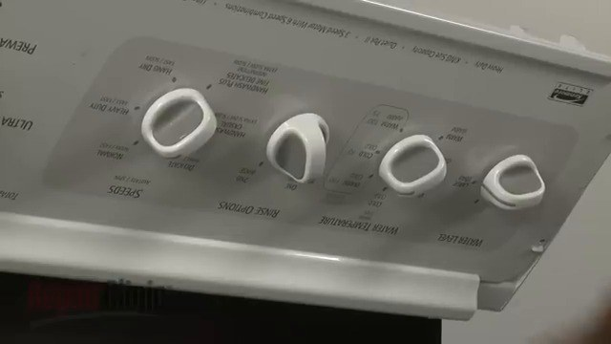
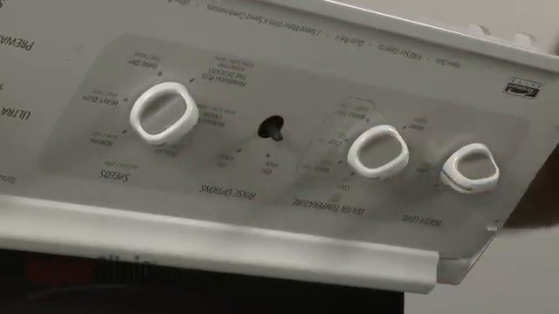
ACTION GROUP 12
Remove control knobs using small flathead
Atomic actions are grouped under their parent disassembly operation.
Source: Washing machine (remaining after step 11) (Unknown)
explicit source
ATOMIC ACTIONS
1
Remove control knobs using small flathead
Control knobs
Washing machine (remaining after step 12)
RESULT
• Control knobs (Unknown)
CONTINUES AS
• Washing machine (remaining after step 12) (Unknown)
Washing machine
22 / 59

Slide 23
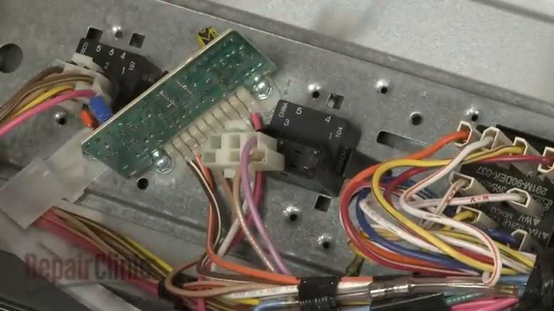
ACTION GROUP 13
Remove a component from the case using small flathead
Atomic actions are grouped under their parent disassembly operation.
Source: Washing machine (remaining after step 12) (Unknown)
explicit source
ATOMIC ACTIONS
1
Remove a component from the case using small flathead
A component from the case
RESULT
• A component from the case (Unknown)
CONTINUES AS
• Washing machine (remaining after step 13) (Unknown)
Washing machine
23 / 59

Slide 24
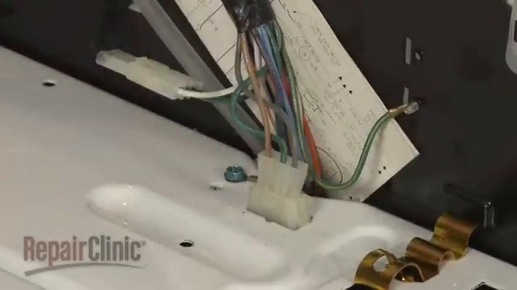
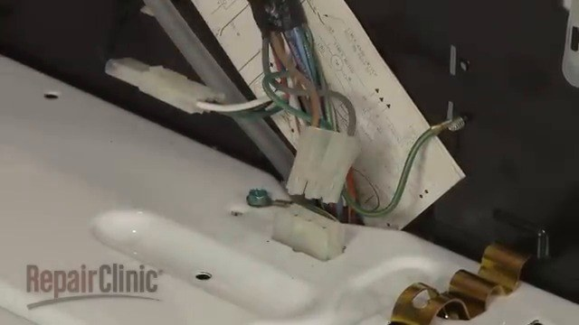
ACTION GROUP 14
Disconnect lid switch wire connector using null
Atomic actions are grouped under their parent disassembly operation.
Source: Washing machine (remaining after step 13) (Unknown)
explicit source
ATOMIC ACTIONS
1
Disconnect lid switch wire connector using null
Lid switch
Washing machine (remaining after step 14)
RESULT
• Lid switch (Unknown)
CONTINUES AS
• Washing machine (remaining after step 14) (Unknown)
Washing machine
24 / 59

Slide 25
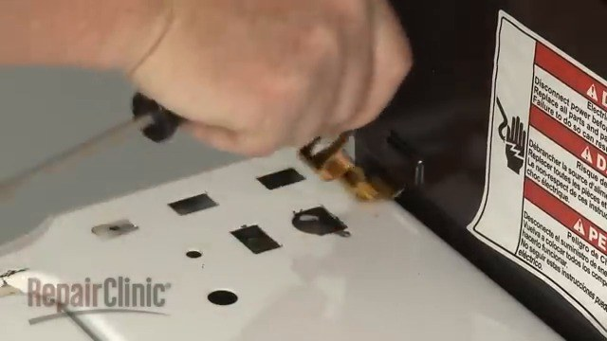
ACTION GROUP 15
Remove a screw from a white plastic component using a screwdriver (a screw)
Atomic actions are grouped under their parent disassembly operation.
Source: Washing machine (remaining after step 14) (Unknown)
explicit source
ATOMIC ACTIONS
1
Remove a screw from a white plastic component using a screwdriver (a
screw)
A screw from a white plastic component
RESULT
• A screw from a white plastic component (Unknown)
CONTINUES AS
• Washing machine (remaining after step 15) (Unknown)
Washing machine
25 / 59

Slide 26
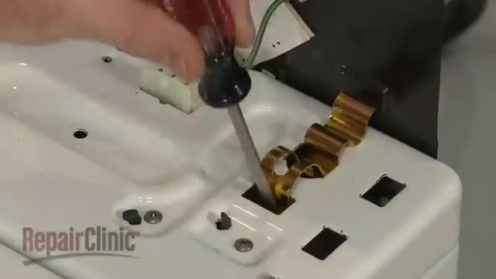
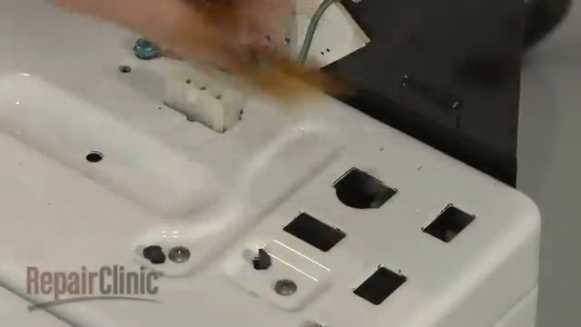
ACTION GROUP 16
Remove metal clip using screwdriver (4 Phillips screws on the back plate)
Atomic actions are grouped under their parent disassembly operation.
Source: Washing machine (remaining after step 15) (Unknown)
explicit source
ATOMIC ACTIONS
1
Remove metal clip using screwdriver (4 Phillips screws on the back
plate)
Metal clip
Washing machine (remaining after step 16)
RESULT
• Metal clip (Unknown)
CONTINUES AS
• Washing machine (remaining after step 16) (Unknown)
Washing machine
26 / 59

Slide 27
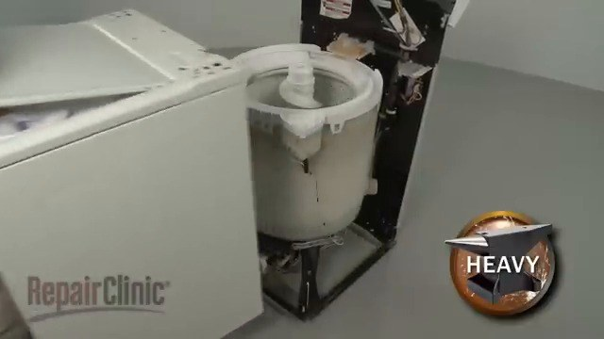
ACTION GROUP 17
Slide rear panel
Atomic actions are grouped under their parent disassembly operation.
Source: Washing machine (remaining after step 16) (Unknown)
explicit source
ATOMIC ACTIONS
1
Slide rear panel
Rear panel
RESULT
• Rear panel (Unknown)
CONTINUES AS
• Washing machine (remaining after step 17) (Unknown)
Washing machine
27 / 59

Slide 28
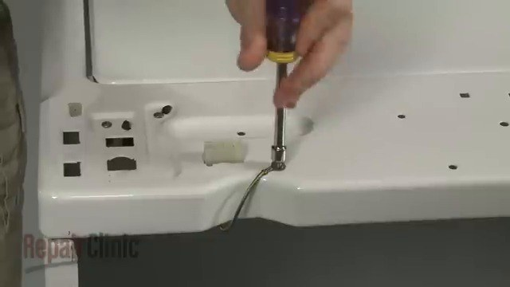
ACTION GROUP 18
Unscrew back plate screws using screwdriver (4 Phillips screws on the back plate)
Atomic actions are grouped under their parent disassembly operation.
Source: Washing machine (remaining after step 17) (Unknown)
explicit source
ATOMIC ACTIONS
1
Unscrew back plate screws using screwdriver (4 Phillips screws on the
back plate)
Back plate screws
RESULT
• Back plate screws (Unknown)
CONTINUES AS
• Washing machine (remaining after step 18) (Unknown)
Washing machine
28 / 59

Slide 29
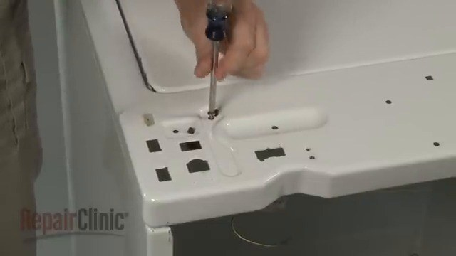
ACTION GROUP 19
Unscrew lid switch mounting screws using screwdriver (4 Phillips screws on the back plate)
Atomic actions are grouped under their parent disassembly operation.
Source: Washing machine (remaining after step 18) (Unknown)
explicit source
ATOMIC ACTIONS
1
Unscrew lid switch mounting screws using screwdriver (4 Phillips
screws on the back plate)
Lid switch mounting screws
RESULT
• Lid switch mounting screws (Unknown)
CONTINUES AS
• Washing machine (remaining after step 19) (Unknown)
Washing machine
29 / 59

Slide 30
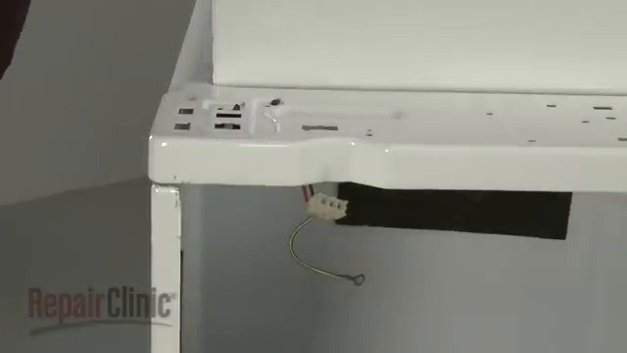
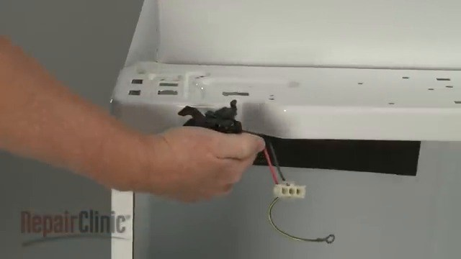
ACTION GROUP 20
Remove a screw on the appliance using a screwdriver (a screw on the appliance)
Atomic actions are grouped under their parent disassembly operation.
Source: Washing machine (remaining after step 19) (Unknown)
explicit source
ATOMIC ACTIONS
1
Remove a screw on the appliance using a screwdriver (a screw on the
appliance)
A screw on the appliance
Washing machine (remaining after step 20)
RESULT
• A screw on the appliance (Unknown)
CONTINUES AS
• Washing machine (remaining after step 20) (Unknown)
Washing machine
30 / 59

Slide 31
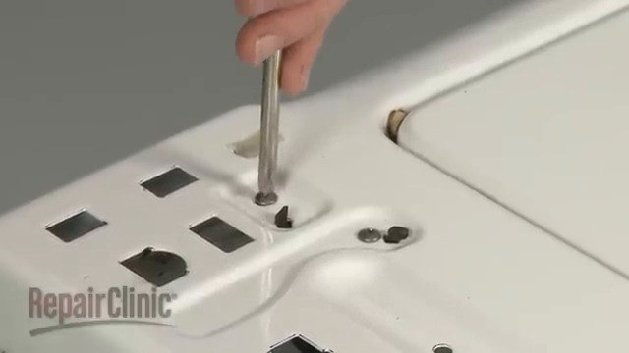
ACTION GROUP 21
Remove screws on the back plate using screwdriver (4 Phillips screws on the back plate)
Atomic actions are grouped under their parent disassembly operation.
Source: Washing machine (remaining after step 20) (Unknown)
explicit source
ATOMIC ACTIONS
1
Remove screws on the back plate using screwdriver (4 Phillips screws
on the back plate)
4 Phillips screws on the back plate
Washing machine (remaining after step 21)
RESULT
• 4 Phillips screws on the back plate (Unknown)
CONTINUES AS
• Washing machine (remaining after step 21) (Unknown)
Washing machine
31 / 59

Slide 32
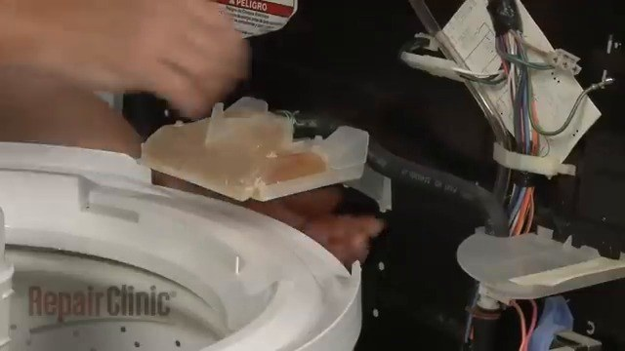
ACTION GROUP 22
Unscrew 4 Phillips screws on the back plate using a screwdriver (4 Phillips screws on the back plate)
Atomic actions are grouped under their parent disassembly operation.
Source: Washing machine (remaining after step 21) (Unknown)
explicit source
ATOMIC ACTIONS
1
Unscrew 4 Phillips screws on the back plate using a screwdriver (4
Phillips screws on the back plate)
4 Phillips screws on the back plate
Washing machine (remaining after step 22)
RESULT
• 4 Phillips screws on the back plate (Unknown)
CONTINUES AS
• Washing machine (remaining after step 22) (Unknown)
Washing machine
32 / 59

Slide 33
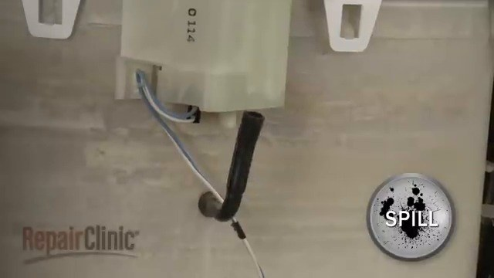
ACTION GROUP 23
Remove a refrigerator component labeled 'SPILL'
Atomic actions are grouped under their parent disassembly operation.
Source: Washing machine (remaining after step 22) (Unknown)
explicit source
ATOMIC ACTIONS
1
Remove a refrigerator component labeled 'SPILL'
A refrigerator component labeled 'SPILL'
RESULT
• A refrigerator component labeled 'SPILL' (Unknown)
CONTINUES AS
• Washing machine (remaining after step 23) (Unknown)
Washing machine
33 / 59

Slide 34
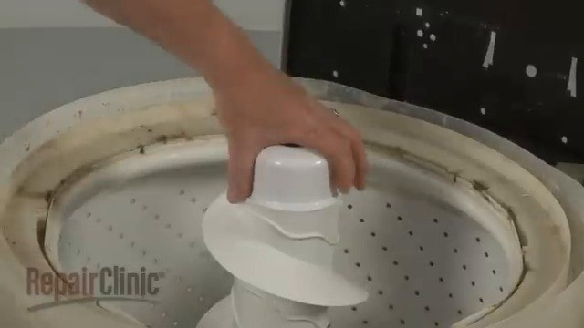
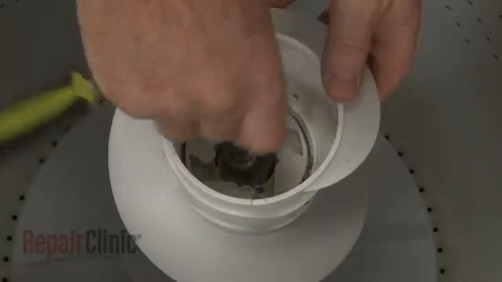
ACTION GROUP 24
Remove tabs securing the tub ring
Atomic actions are grouped under their parent disassembly operation.
Source: Washing machine (remaining after step 23) (Unknown)
explicit source
ATOMIC ACTIONS
1
Remove tabs securing the tub ring
Tabs securing the tub ring
Washing machine (remaining after step 24)
RESULT
• Tabs securing the tub ring (Unknown)
CONTINUES AS
• Washing machine (remaining after step 24) (Unknown)
Washing machine
34 / 59

Slide 35
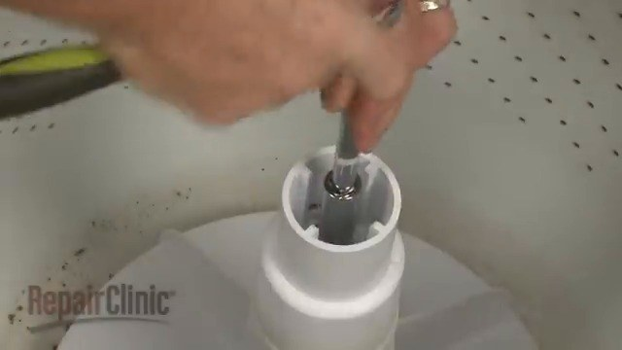
ACTION GROUP 25
Unscrew 4 Phillips screws on the back plate using tool (4 Phillips screws on the back plate)
Atomic actions are grouped under their parent disassembly operation.
Source: Washing machine (remaining after step 24) (Unknown)
explicit source
ATOMIC ACTIONS
1
Unscrew 4 Phillips screws on the back plate using tool (4 Phillips
screws on the back plate)
4 Phillips screws on the back plate
Washing machine (remaining after step 25)
RESULT
• 4 Phillips screws on the back plate (Unknown)
CONTINUES AS
• Washing machine (remaining after step 25) (Unknown)
Washing machine
35 / 59

Slide 36
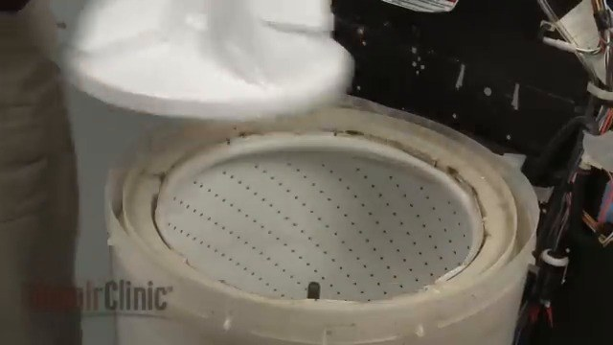
ACTION GROUP 26
Remove a white component using a screwdriver (a screw on the white component)
Atomic actions are grouped under their parent disassembly operation.
Source: Washing machine (remaining after step 25) (Unknown)
explicit source
ATOMIC ACTIONS
1
Remove a white component using a screwdriver (a screw on the white
component)
White plastic component
Washing machine (remaining after step 26)
RESULT
• White plastic component (Unknown)
CONTINUES AS
• Washing machine (remaining after step 26) (Unknown)
Washing machine
36 / 59

Slide 37
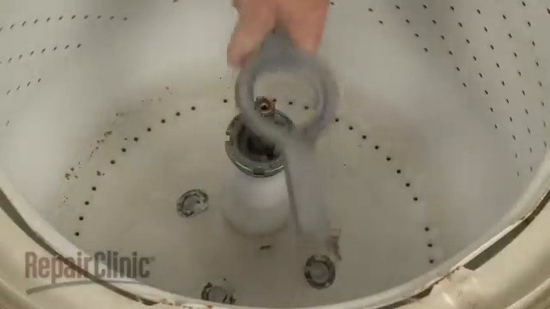
ACTION GROUP 27
Unscrew tub nut using spanner wrench and hammer (a screw on the metal ring)
Atomic actions are grouped under their parent disassembly operation.
Source: Washing machine (remaining after step 26) (Unknown)
explicit source
ATOMIC ACTIONS
1
Unscrew tub nut using spanner wrench and hammer (a screw on the
metal ring)
Tub nut
RESULT
• Tub nut (Unknown)
CONTINUES AS
• Washing machine (remaining after step 27) (Unknown)
Washing machine
37 / 59

Slide 38
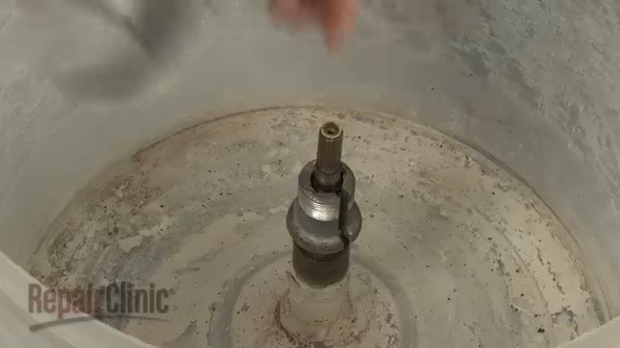
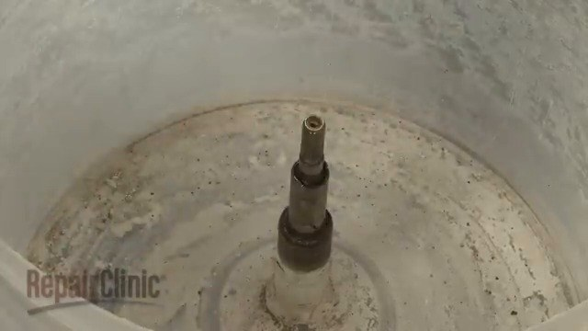
ACTION GROUP 28
Remove metal component
Atomic actions are grouped under their parent disassembly operation.
Source: Washing machine (remaining after step 27) (Unknown)
explicit source
ATOMIC ACTIONS
1
Remove metal component
Metal component
Washing machine (remaining after step 28)
RESULT
• Metal component (Unknown)
CONTINUES AS
• Washing machine (remaining after step 28) (Unknown)
Washing machine
38 / 59

Slide 39
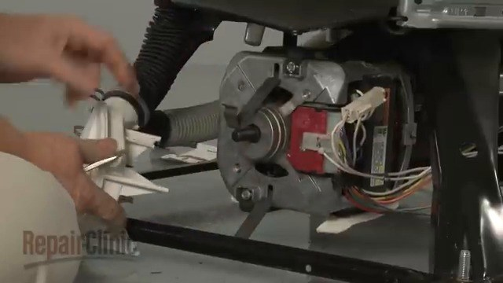
ACTION GROUP 29
Remove drive block
Atomic actions are grouped under their parent disassembly operation.
Source: Washing machine (remaining after step 28) (Unknown)
explicit source
ATOMIC ACTIONS
1
Remove drive block
Drive block
RESULT
• Drive block (Unknown)
CONTINUES AS
• Washing machine (remaining after step 29) (Unknown)
Washing machine
39 / 59

Slide 40
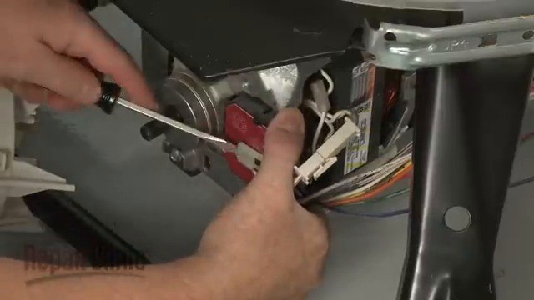
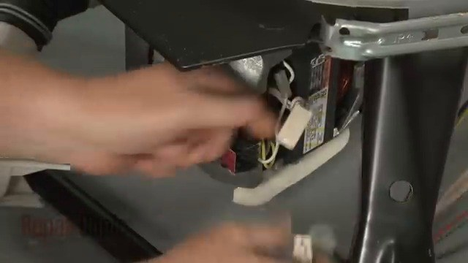
ACTION GROUP 30
Remove drain pump
Atomic actions are grouped under their parent disassembly operation.
Source: Washing machine (remaining after step 29) (Unknown)
explicit source
ATOMIC ACTIONS
1
Remove drain pump
Drain pump
Washing machine (remaining after step 30)
RESULT
• Drain pump (Unknown)
CONTINUES AS
• Washing machine (remaining after step 30) (Unknown)
Washing machine
40 / 59

Slide 41
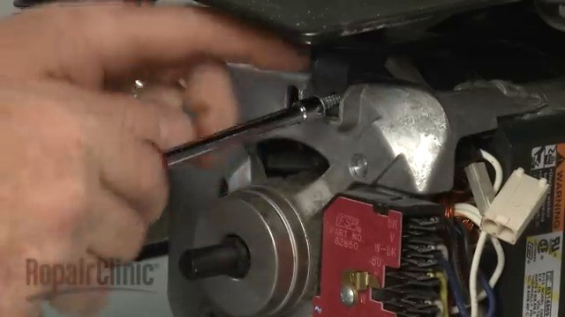
ACTION GROUP 31
Unscrew 4 Phillips screws on the back plate using screwdriver (4 Phillips screws on the back plate)
Atomic actions are grouped under their parent disassembly operation.
Source: Washing machine (remaining after step 30) (Unknown)
explicit source
ATOMIC ACTIONS
1
Unscrew 4 Phillips screws on the back plate using screwdriver (4
Phillips screws on the back plate)
4 Phillips screws on the back plate
Washing machine (remaining after step 31)
RESULT
• 4 Phillips screws on the back plate (Unknown)
CONTINUES AS
• Washing machine (remaining after step 31) (Unknown)
Washing machine
41 / 59

Slide 42
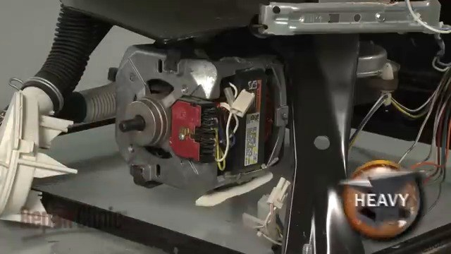
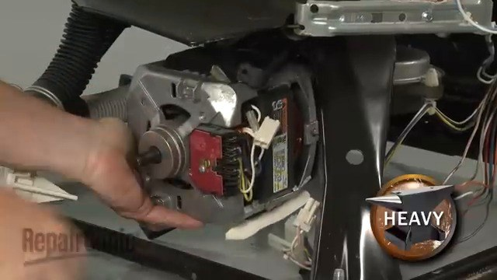
ACTION GROUP 32
Remove motor using quarter inch socket or nut driver (4 Phillips screws on the back plate)
Atomic actions are grouped under their parent disassembly operation.
Source: Washing machine (remaining after step 31) (Unknown)
explicit source
ATOMIC ACTIONS
1
Remove motor using quarter inch socket or nut driver (4 Phillips screws
on the back plate)
Motor
Washing machine (remaining after step 32)
RESULT
• Motor (Unknown)
CONTINUES AS
• Washing machine (remaining after step 32) (Unknown)
Washing machine
42 / 59

Slide 43
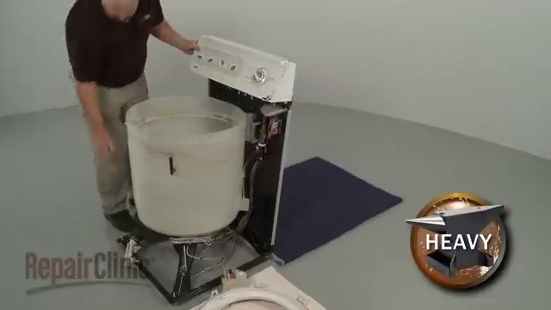
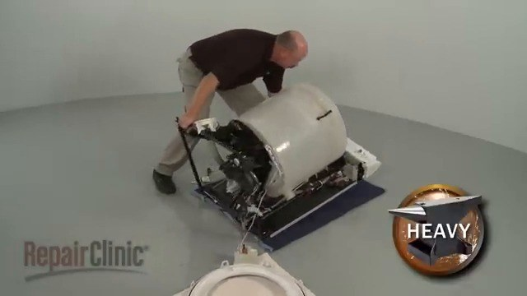
ACTION GROUP 33
Detach wire retainer from the transmission
Atomic actions are grouped under their parent disassembly operation.
Source: Washing machine (remaining after step 32) (Unknown)
explicit source
ATOMIC ACTIONS
1
Detach wire retainer from the transmission
Wire retainer from the transmission
Washing machine (remaining after step 33)
RESULT
• Wire retainer from the transmission (Unknown)
CONTINUES AS
• Washing machine (remaining after step 33) (Unknown)
Washing machine
43 / 59

Slide 44


ACTION GROUP 34
Detach wire retainer using null
Atomic actions are grouped under their parent disassembly operation.
Source: Washing machine (remaining after step 33) (Unknown)
explicit source
ATOMIC ACTIONS
1
Detach wire retainer using null
Wire retainer
Washing machine (remaining after step 34)
RESULT
• Wire retainer (Unknown)
CONTINUES AS
• Washing machine (remaining after step 34) (Unknown)
Washing machine
44 / 59

Slide 45


ACTION GROUP 35
Slide transmission
Atomic actions are grouped under their parent disassembly operation.
Source: Washing machine (remaining after step 34) (Unknown)
explicit source
ATOMIC ACTIONS
1
Slide transmission
Transmission
Washing machine (remaining after step 35)
RESULT
• Transmission (Unknown)
CONTINUES AS
• Washing machine (remaining after step 35) (Unknown)
Washing machine
45 / 59

Slide 46

ACTION GROUP 36
Unscrew 4 Phillips screws on the back plate using wrench (4 Phillips screws on the back plate)
Atomic actions are grouped under their parent disassembly operation.
Source: Washing machine (remaining after step 35) (Unknown)
explicit source
ATOMIC ACTIONS
1
Unscrew 4 Phillips screws on the back plate using wrench (4 Phillips
screws on the back plate)
4 Phillips screws on the back plate
Washing machine (remaining after step 36)
RESULT
• 4 Phillips screws on the back plate (Unknown)
CONTINUES AS
• Washing machine (remaining after step 36) (Unknown)
Washing machine
46 / 59

Slide 47

ACTION GROUP 37
Detach wire retainer using null
Atomic actions are grouped under their parent disassembly operation.
Source: Washing machine (remaining after step 36) (Unknown)
explicit source
ATOMIC ACTIONS
1
Detach wire retainer using null
Wire retainer
Washing machine (remaining after step 37)
RESULT
• Wire retainer (Unknown)
CONTINUES AS
• Washing machine (remaining after step 37) (Unknown)
Washing machine
47 / 59

Slide 48

ACTION GROUP 38
Slide motor
Atomic actions are grouped under their parent disassembly operation.
Source: Washing machine (remaining after step 37) (Unknown)
explicit source
ATOMIC ACTIONS
1
Slide motor
Motor
Washing machine (remaining after step 38)
RESULT
• Motor (Unknown)
CONTINUES AS
• Washing machine (remaining after step 38) (Unknown)
Washing machine
48 / 59

Slide 49

ACTION GROUP 39
Remove motor or engine part using screwdriver (4 Phillips screws on the back plate)
Atomic actions are grouped under their parent disassembly operation.
Source: Washing machine (remaining after step 38) (Unknown)
explicit source
ATOMIC ACTIONS
1
Remove motor or engine part using screwdriver (4 Phillips screws on
the back plate)
Motor or engine part
RESULT
• Motor or engine part (Unknown)
CONTINUES AS
• Washing machine (remaining after step 39) (Unknown)
Washing machine
49 / 59

Slide 50

ACTION GROUP 40
Remove white plastic component from the lid using screwdriver (4 Phillips screws on the back plate)
Atomic actions are grouped under their parent disassembly operation.
Source: Washing machine (remaining after step 39) (Unknown)
explicit source
ATOMIC ACTIONS
1
Remove white plastic component from the lid using screwdriver (4
Phillips screws on the back plate)
White plastic component
Washing machine (remaining after step 40)
RESULT
• White plastic component (Unknown)
CONTINUES AS
• Washing machine (remaining after step 40) (Unknown)
Washing machine
50 / 59

Slide 51

ACTION GROUP 41
Remove 4 Phillips screws on the back plate using green screwdriver (4 Phillips screws on the back plate)
Atomic actions are grouped under their parent disassembly operation.
Source: Washing machine (remaining after step 40) (Unknown)
explicit source
ATOMIC ACTIONS
1
Remove 4 Phillips screws on the back plate using green screwdriver (4
Phillips screws on the back plate)
4 Phillips screws on the back plate
Washing machine (remaining after step 41)
RESULT
• 4 Phillips screws on the back plate (Unknown)
CONTINUES AS
• Washing machine (remaining after step 41) (Unknown)
Washing machine
51 / 59

Slide 52

ACTION GROUP 42
Remove top cover of the drum
Atomic actions are grouped under their parent disassembly operation.
Source: Washing machine (remaining after step 41) (Unknown)
explicit source
ATOMIC ACTIONS
1
Remove top cover of the drum
Drum cover
RESULT
• Drum cover (Unknown)
CONTINUES AS
• Washing machine (remaining after step 42) (Unknown)
Washing machine
52 / 59

Slide 53


ACTION GROUP 43
Unscrew a screw on the bottom of the machine using a screwdriver (a screw on the bottom of the machine)
Atomic actions are grouped under their parent disassembly operation.
Source: Washing machine (remaining after step 42) (Unknown)
explicit source
ATOMIC ACTIONS
1
Unscrew a screw on the bottom of the machine using a screwdriver (a
screw on the bottom of the machine)
A screw on the bottom of the machine
Washing machine (remaining after step 43)
RESULT
• A screw on the bottom of the machine (Unknown)
CONTINUES AS
• Washing machine (remaining after step 43) (Unknown)
Washing machine
53 / 59

Slide 54

ACTION GROUP 44
Remove 4 Phillips screws on the back plate (4 Phillips screws on the back plate)
Atomic actions are grouped under their parent disassembly operation.
Source: Washing machine (remaining after step 43) (Unknown)
explicit source
ATOMIC ACTIONS
1
Remove 4 Phillips screws on the back plate (4 Phillips screws on the
back plate)
4 Phillips screws on the back plate
Washing machine (remaining after step 44)
RESULT
• 4 Phillips screws on the back plate (Unknown)
CONTINUES AS
• Washing machine (remaining after step 44) (Unknown)
Washing machine
54 / 59

Slide 55


ACTION GROUP 45
Remove a part from the white surface using a tool with a metallic clip (a metallic clip)
Atomic actions are grouped under their parent disassembly operation.
Source: Washing machine (remaining after step 44) (Unknown)
explicit source
ATOMIC ACTIONS
1
Remove a part from the white surface using a tool with a metallic clip (a
metallic clip)
A part from the white surface
Washing machine (remaining after step 45)
RESULT
• A part from the white surface (Unknown)
CONTINUES AS
• Washing machine (remaining after step 45) (Unknown)
Washing machine
55 / 59

Slide 56
ACTION GROUP 46
Disconnect lid switch wire connector
Atomic actions are grouped under their parent disassembly operation.
Source: Washing machine (remaining after step 45) (Unknown)
explicit source
ATOMIC ACTIONS
1
Disconnect lid switch wire connector
Lid switch
RESULT
• Lid switch (Unknown)
CONTINUES AS
• Washing machine (remaining after step 46) (Unknown)
Washing machine
56 / 59

Slide 57

ACTION GROUP 47
Detach control panel using wrench (4 Phillips screws on the back plate)
Atomic actions are grouped under their parent disassembly operation.
Source: Washing machine (remaining after step 46) (Unknown)
explicit source
ATOMIC ACTIONS
1
Detach control panel using wrench (4 Phillips screws on the back plate)
Control panel
Washing machine (remaining after step 47)
RESULT
• Control panel (Unknown)
CONTINUES AS
• Washing machine (remaining after step 47) (Unknown)
Washing machine
57 / 59

Slide 58

ACTION GROUP 48
Disconnect hoses and connections using plastic tool (blue plastic cap on the hose connection)
Atomic actions are grouped under their parent disassembly operation.
Source: Washing machine (remaining after step 47) (Unknown)
explicit source
ATOMIC ACTIONS
1
Disconnect hoses and connections using plastic tool (blue plastic cap
on the hose connection)
Hoses and connections
RESULT
• Hoses and connections (Unknown)
CONTINUES AS
End of this branch
Washing machine
58 / 59

Slide 59
EXPORT COMPLETE
48 action groups prepared
The PowerPoint remains fully editable: text, tables, images and component information
can be revised after export.
Washing machine
Washing machine
59 / 59

