Slide 1
FUTURDATA THESIS
Disassembly Guide
Delonghi EC710 Coffee Maker
PRODUCT
IMAGE
PPTX export • 10 action group(s) • depth: DepthMode.FULL • schema 1.1
Nominal weight Unknown
Delonghi EC710 Coffee Maker
1 / 17

Slide 2
PROJECT OVERVIEW
Export scope and model summary
PRODUCT ID
ACTION GROUPS
BOM COMPONENTS
VALIDATION ISSUES
2327528033232
10
12
1
PRODUCT DATA
EXPORT BEHAVIOUR
Name: Delonghi EC710 Coffee Maker
Weight: Unknown
Material: Unknown
Color: Unknown
Depth mode: DepthMode.FULL
• Parent operation and atomic actions stay grouped.
• Output components and remaining assembly are shown.
• Text and images remain editable in PowerPoint.
• Unknown branch sources are never guessed.
• Source JSON is opened read-only and never modified.
Delonghi EC710 Coffee Maker
2 / 17

Slide 3
VALIDATION
Model warnings and errors
Each issue is localized to the corresponding JSON element when possible.
SEVERITY.INFO · mass_balance
Mass balance not verifiable: the product has no weight; 12 component(s) have no weight.
Location: node_ids=[2327510733456, 2327511007952, 2327511009744, 2327511009936, 2327511312016, 2327528047184, 2327528050768, 2327528051088, 2327528052496, 2327528060432, 2327528232144, 2327528232272]
Delonghi EC710 Coffee Maker
3 / 17

Slide 4
PREPARATION
Tools and safety notices
Aggregated from step-level and atomic-action metadata.
TOOLS REQUIRED
SAFETY NOTICES
• No tools are specified in this model.
• No safety notices are specified in this model.
Delonghi EC710 Coffee Maker
4 / 17

Slide 5
BILL OF MATERIALS
Recovered components — page 1 of 2
ID | Component | Weight | Material | Color | Quality | Destination
2327511312016 | Right arm | Unknown | Unknown | 4 | — | —
2327528051088 | Left arm | Unknown | Unknown | 4 | — | —
2327511009936 | Base | Unknown | 1 | 4 | — | —
2327528232272 | Coffee tamper | Unknown | Unknown | Unknown | — | —
2327528232144 | Top | Unknown | Unknown | Unknown | — | —
2327528050768 | Earth wiring | Unknown | Unknown | Unknown | — | —
2327511009744 | Boiler inlet pipe | Unknown | Unknown | Unknown | — | —
2327511007952 | Diffuser | Unknown | Unknown | Unknown | — | —
2327528060432 | Underside casing | Unknown | 1 | 4 | — | —
Delonghi EC710 Coffee Maker
5 / 17

Slide 6
BILL OF MATERIALS
Recovered components — page 2 of 2
ID | Component | Weight | Material | Color | Quality | Destination
2327528047184 | Rest of the coffee machine | Unknown | Unknown | Unknown | — | —
2327528052496 | Boiler underside | Unknown | Unknown | Unknown | — | —
2327510733456 | Spring-loaded flow valve | Unknown | Unknown | Unknown | — | —
Delonghi EC710 Coffee Maker
6 / 17

Slide 7
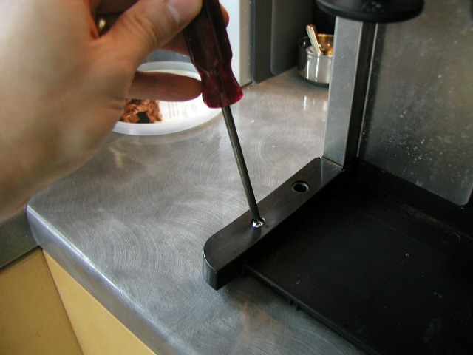
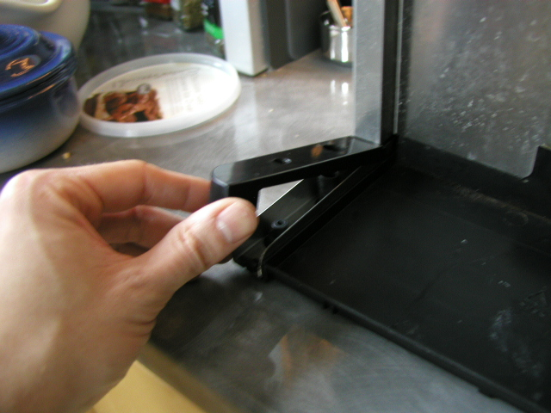
ACTION GROUP 1
Arms Removal
Atomic actions are grouped under their parent disassembly operation.
Source: Delonghi EC710 Coffee Maker (Unknown)
explicit source
ATOMIC ACTIONS
1
Remove screws
2
Lift arms
3
Remove arms
Action 1
Action 2
RESULT
• Right arm (Unknown)
• Left arm (Unknown)
CONTINUES AS
• Composite (Unknown)
Color: 4
Delonghi EC710 Coffee Maker
7 / 17

Slide 8
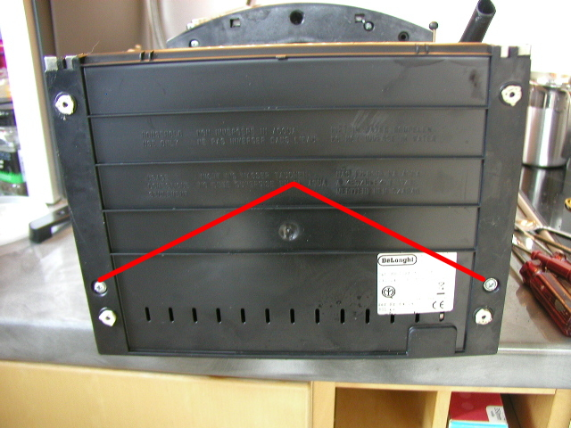
ACTION GROUP 2
Base removal
Atomic actions are grouped under their parent disassembly operation.
Source: Composite (Unknown)
explicit source
ATOMIC ACTIONS
1
Remove screws
2
Pull away base
Action 1
RESULT
• Base (Unknown)
CONTINUES AS
• Composite (Unknown)
Material: 1 · Color: 4
Delonghi EC710 Coffee Maker
8 / 17

Slide 9
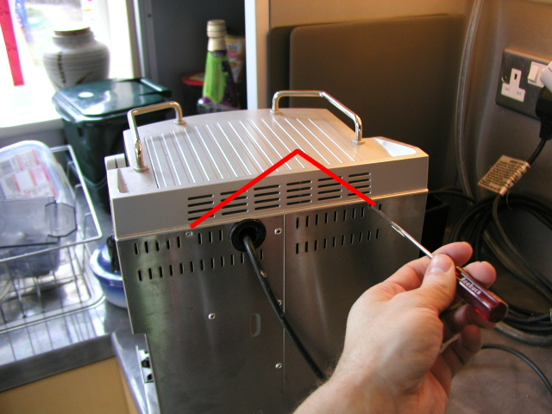
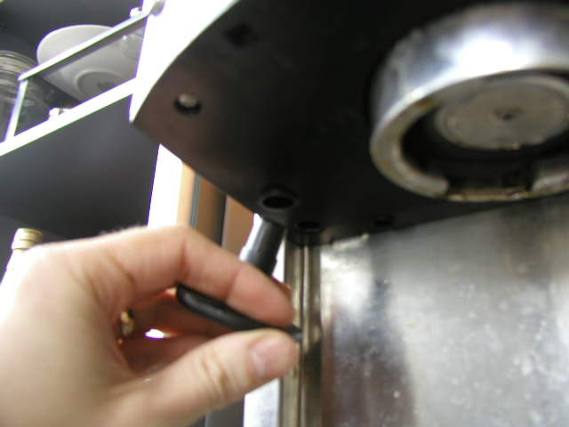
ACTION GROUP 3
Coffee tamper removal
Atomic actions are grouped under their parent disassembly operation.
Source: Composite (Unknown)
explicit source
ATOMIC ACTIONS
1
Remove top-rear screws
2
Pull and twist tamper
Action 1
Action 2
RESULT
• Coffee tamper (Unknown)
CONTINUES AS
• Composite (Unknown)
Delonghi EC710 Coffee Maker
9 / 17

Slide 10
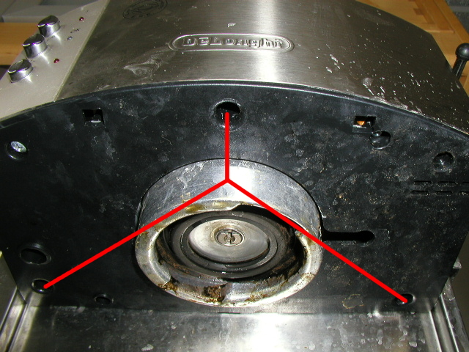
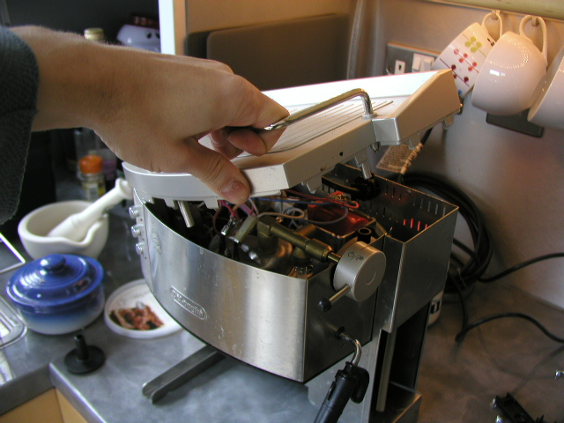
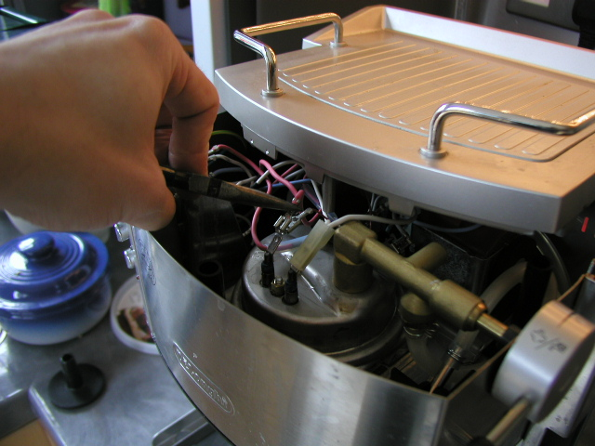
ACTION GROUP 4
Top removal
Atomic actions are grouped under their parent disassembly operation.
Source: Composite (Unknown)
explicit source
ATOMIC ACTIONS
1
Remove anti-tamper screws
2
Lift away top
3
Disconnect hotplate/ boiler heater connection
Action 1
Action 2
Action 3
RESULT
• Top (Unknown)
CONTINUES AS
• Composite (Unknown)
Delonghi EC710 Coffee Maker
10 / 17

Slide 11
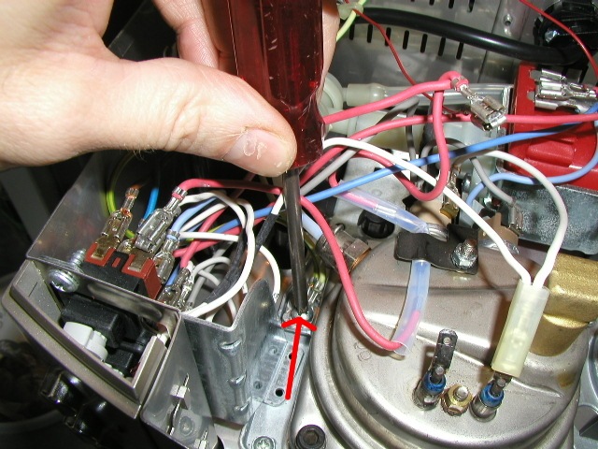
ACTION GROUP 5
Earth wiring removal
Atomic actions are grouped under their parent disassembly operation.
Source: Composite (Unknown)
explicit source
ATOMIC ACTIONS
1
Unscrew electrical safety earth
2
Move out of the way
Action 1
RESULT
• Earth wiring (Unknown)
CONTINUES AS
• Composite (Unknown)
Delonghi EC710 Coffee Maker
11 / 17

Slide 12
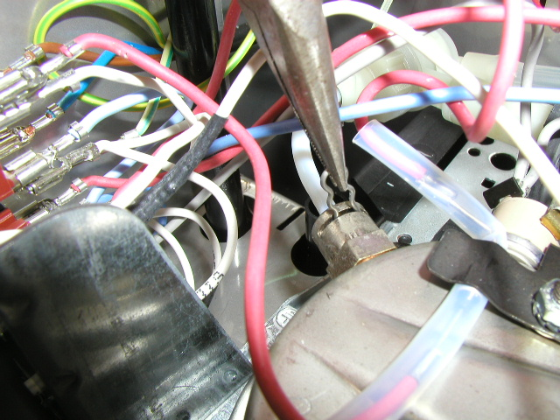
ACTION GROUP 6
Pipe removal
Atomic actions are grouped under their parent disassembly operation.
Source: Composite (Unknown)
explicit source
ATOMIC ACTIONS
1
Pull out the circlip that holds the pipe in place
2
Pull out the pipe
Action 1
RESULT
• Boiler inlet pipe (Unknown)
CONTINUES AS
• Composite (Unknown)
Delonghi EC710 Coffee Maker
12 / 17

Slide 13
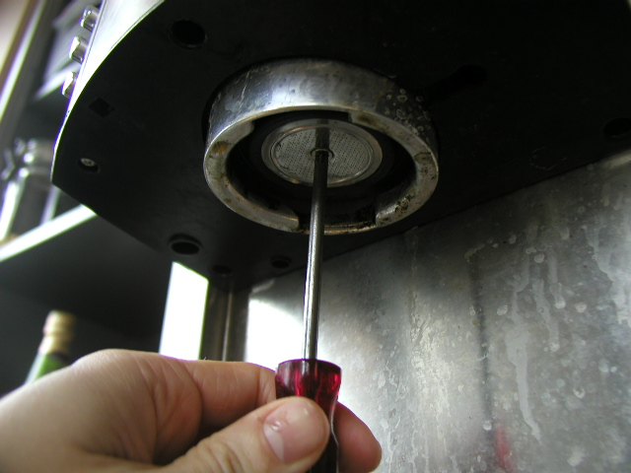
ACTION GROUP 7
Diffuser removal
Atomic actions are grouped under their parent disassembly operation.
Source: Composite (Unknown)
explicit source
ATOMIC ACTIONS
1
Unscrew
2
Remove diffuser
3
Clean diffuser
Action 1
RESULT
• Diffuser (Unknown)
CONTINUES AS
• Composite (Unknown)
Delonghi EC710 Coffee Maker
13 / 17

Slide 14
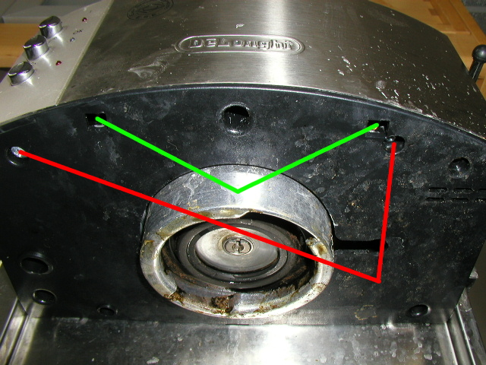
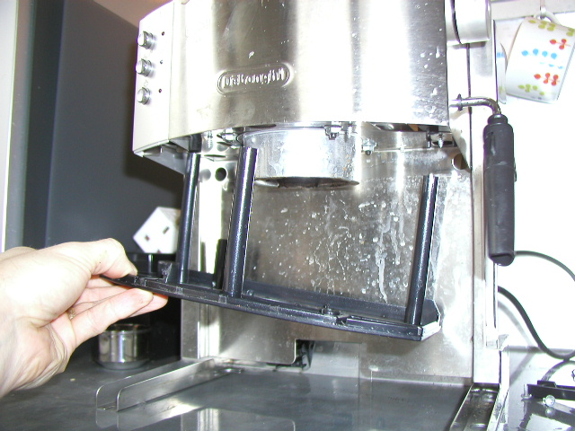
ACTION GROUP 8
Underside casing removal
Atomic actions are grouped under their parent disassembly operation.
Source: Composite (Unknown)
explicit source
ATOMIC ACTIONS
1
Remove screws
2
Push aside tabs
3
Pull away casing
Action 1
Action 3
RESULT
• Underside casing (Unknown)
CONTINUES AS
• Composite (Unknown)
Material: 1 · Color: 4
Delonghi EC710 Coffee Maker
14 / 17

Slide 15
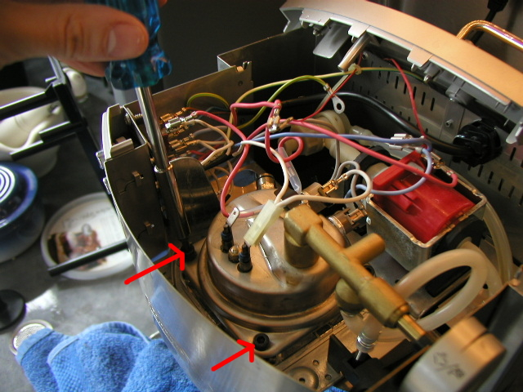
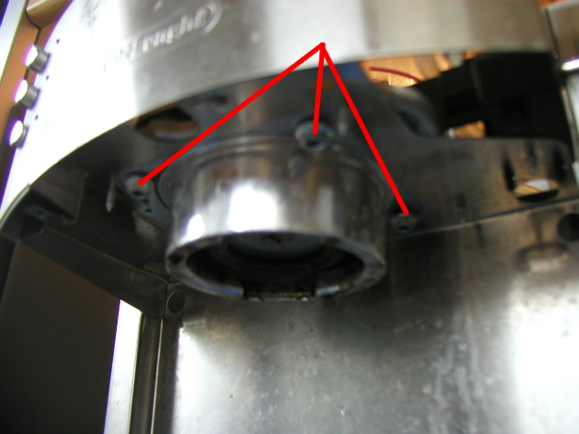
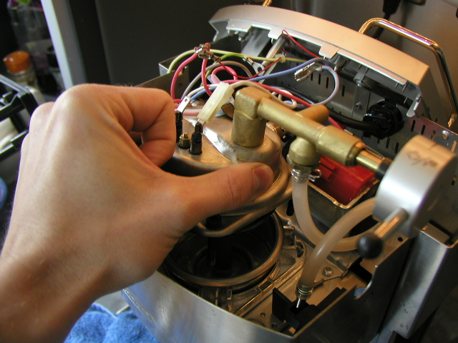
ACTION GROUP 9
Boiler assembly removal
Atomic actions are grouped under their parent disassembly operation.
Source: Composite (Unknown)
explicit source
ATOMIC ACTIONS
1
Place towel underneath
2
Loosen boiler screws
3
Remove nuts from the underside
Action 1
Action 3
Action 4
4
Lift up top boiler assembly
RESULT
Lift up steam outlet
• Rest of the coffee machine (Unknown)
5
6
Lift out lower boiler assembly
CONTINUES AS
• Lower boiler assembly (Unknown)
Delonghi EC710 Coffee Maker
15 / 17

Slide 16
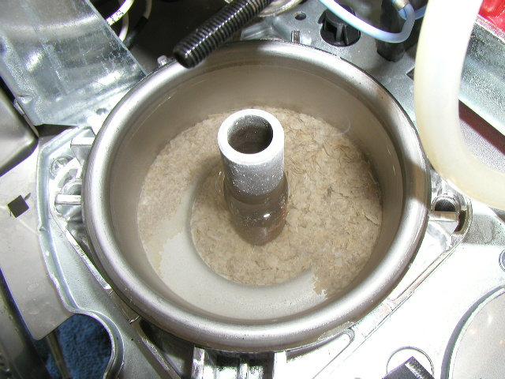
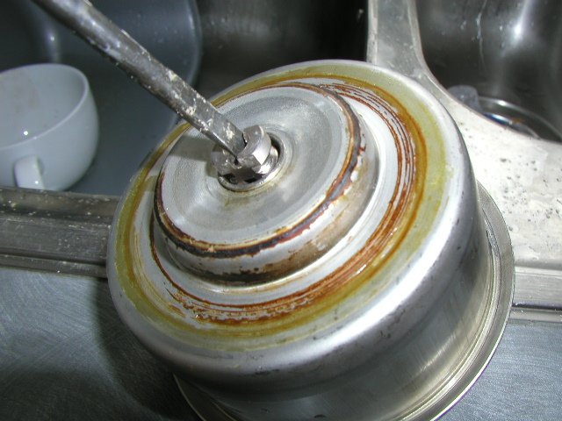
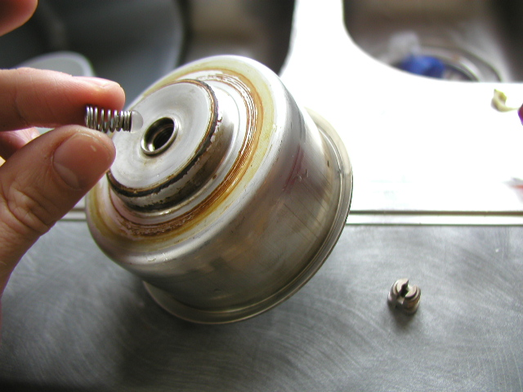
ACTION GROUP 10
Flow valve removal
Atomic actions are grouped under their parent disassembly operation.
Source: Lower boiler assembly (Unknown)
explicit source
ATOMIC ACTIONS
1
Clean lower boiler assembly
2
Turn over lower boiler assembly
3
Unscrew dowel
Action 1
Action 2
Action 4
4
Take out valve
RESULT
Clean valve
• Boiler underside (Unknown)
• Spring-loaded flow valve (Unknown)
5
6
Clean channel
CONTINUES AS
End of this branch
Delonghi EC710 Coffee Maker
16 / 17

Slide 17
EXPORT COMPLETE
10 action groups prepared
The PowerPoint remains fully editable: text, tables, images and component information can be revised after export.
Delonghi EC710 Coffee Maker
Delonghi EC710 Coffee Maker
17 / 17

