Slide 1
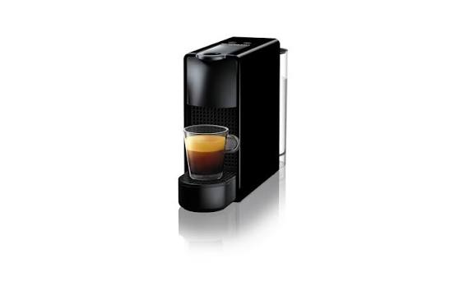
FUTURDATA THESIS
Disassembly Guide
Nespresso Essenza Mini
PPTX export • 4 action group(s) • depth: DepthMode.FULL • schema 1.1
Nominal weight 2300 g
Nespresso Essenza Mini
1 / 11

Slide 2
PROJECT OVERVIEW
Export scope and model summary
PRODUCT ID
ACTION GROUPS
BOM COMPONENTS
VALIDATION ISSUES
1783269333776
4
11
1
PRODUCT DATA
EXPORT BEHAVIOUR
Name: Nespresso Essenza Mini
Weight: 2300 g
Material: 2
Color: 4
Depth mode: DepthMode.FULL
• Parent operation and atomic actions stay grouped.
• Output components and remaining assembly are shown.
• Text and images remain editable in PowerPoint.
• Unknown branch sources are never guessed.
• Source JSON is opened read-only and never modified.
Nespresso Essenza Mini
2 / 11

Slide 3
VALIDATION
Model warnings and errors
Each issue is localized to the corresponding JSON element when possible.
SEVERITY.ERROR · valid_node_types
Nodes [1783269333776] have an unrecognized type and cannot be interpreted in the disassembly grammar.
Location: node_ids=[1783269333776]
Nespresso Essenza Mini
3 / 11

Slide 4
PREPARATION
Tools and safety notices
Aggregated from step-level and atomic-action metadata.
TOOLS REQUIRED
SAFETY NOTICES
• No tools are specified in this model.
• No safety notices are specified in this model.
Nespresso Essenza Mini
4 / 11

Slide 5
BILL OF MATERIALS
Recovered components — page 1 of 2
ID | Component | Weight | Material | Color | Quality | Destination
1783269575440 | Water Tank | 150 g | 9 | Unknown | — | —
1783269578384 | Drip Tray & Grid | 100 g | 1 | Unknown | — | —
1783269576336 | Capsule Bin | 80 g | 1 | Unknown | — | —
1783269576784 | Oval-head Security Screws (x4) | 10 g | 9 | Unknown | — | —
1783269576464 | Side Panels (Left & Right) | 400 g | 1 | Unknown | — | —
1783269577232 | Brewing Chamber (Capsule slot) | 300 g | 1 | Unknown | — | —
1783269577168 | Top Lever / Handle | 150 g | 9 | Unknown | — | —
1783269575504 | Silicone Tubing & Wiring | 230 g | 9 | Unknown | — | —
1783269575376 | Motherboard (PCB) | 80 g | 9 | Unknown | — | —
Nespresso Essenza Mini
5 / 11

Slide 6
BILL OF MATERIALS
Recovered components — page 2 of 2
ID | Component | Weight | Material | Color | Quality | Destination
1783269575632 | Water Pump (19-bar) | 350 g | 4 | Unknown | — | —
1783269575120 | Thermoblock (Heater) | 450 g | 2 | Unknown | — | —
Nespresso Essenza Mini
6 / 11

Slide 7
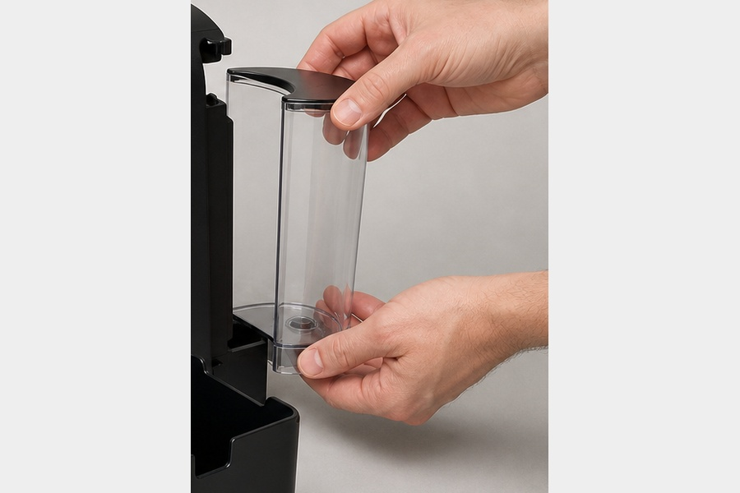
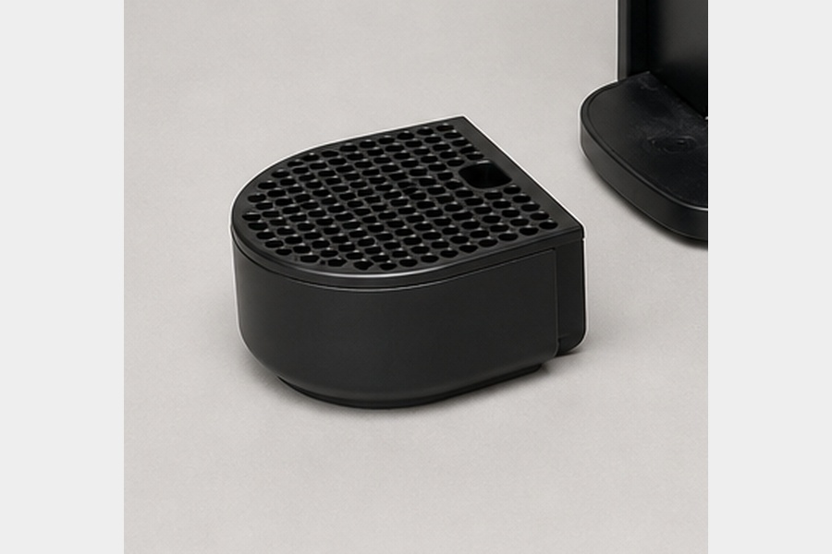
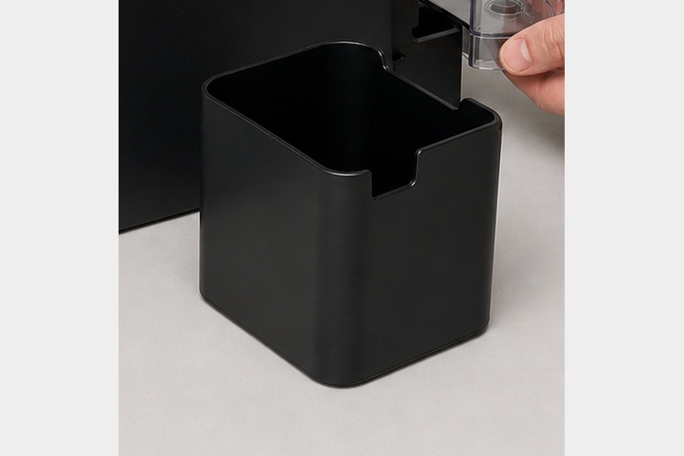
ACTION GROUP 1
Manually detach the drip tray, water tank, and pull out the used capsule bin. No tools required
Atomic actions are grouped under their parent disassembly operation.
Source: Nespresso Essenza Mini (2300 g)
explicit source
ATOMIC ACTIONS
1
Manually detach the drip tray, water tank, and pull out the used capsule bin. No tools required
Water Tank
Drip Tray & Grid
Capsule Bin
RESULT
• Water Tank (150 g)
• Drip Tray & Grid (100 g)
• Capsule Bin (80 g)
CONTINUES AS
• Main Housing (1970 g)
Material: 9
Nespresso Essenza Mini
7 / 11

Slide 8
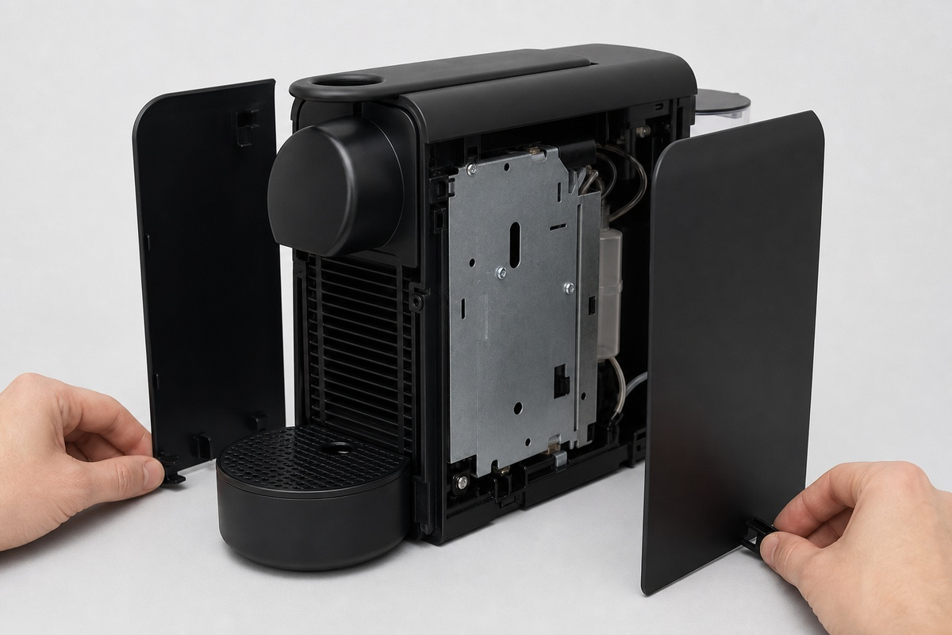
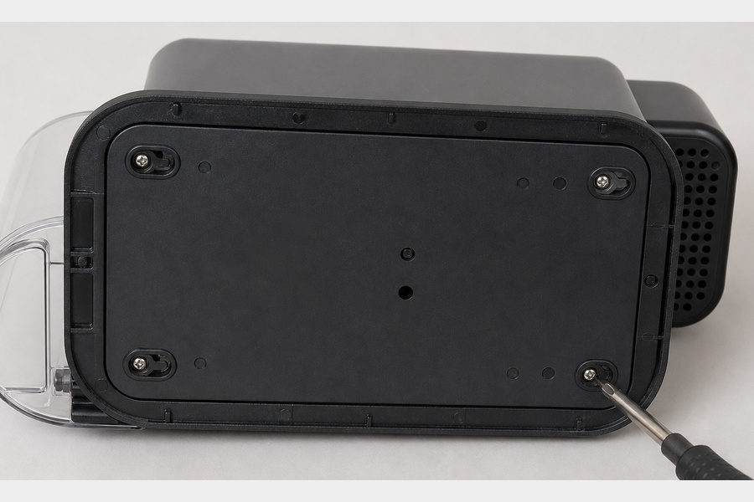
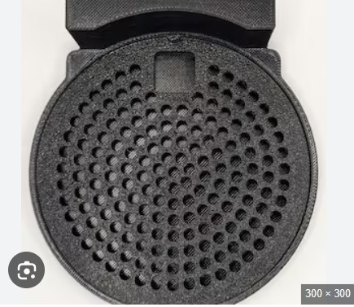
ACTION GROUP 2
Remove the 4 proprietary oval-head screws at the bottom of the machine
Atomic actions are grouped under their parent disassembly operation.
Source: Main Housing (1970 g)
explicit source
ATOMIC ACTIONS
1
Release Bottom Clips
Action 1
Oval-head Security Screws (x4)
Side Panels (Left & Right)
RESULT
• Oval-head Security Screws (x4) (10 g)
• Side Panels (Left & Right) (400 g)
CONTINUES AS
• Internal Chassis (Core) (Unknown)
Material: 9
Nespresso Essenza Mini
8 / 11

Slide 9
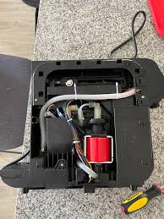
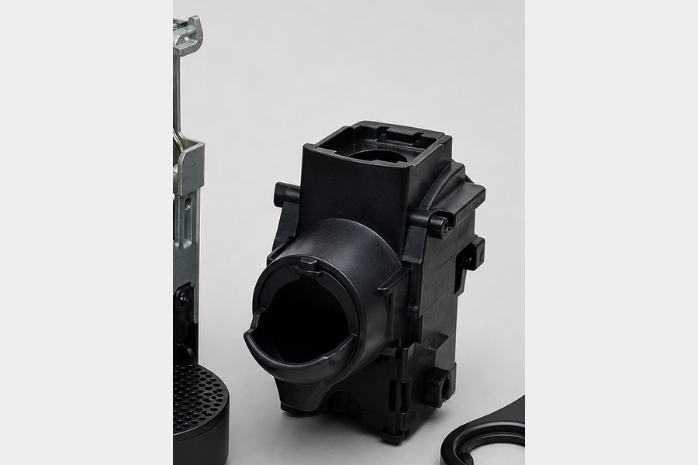
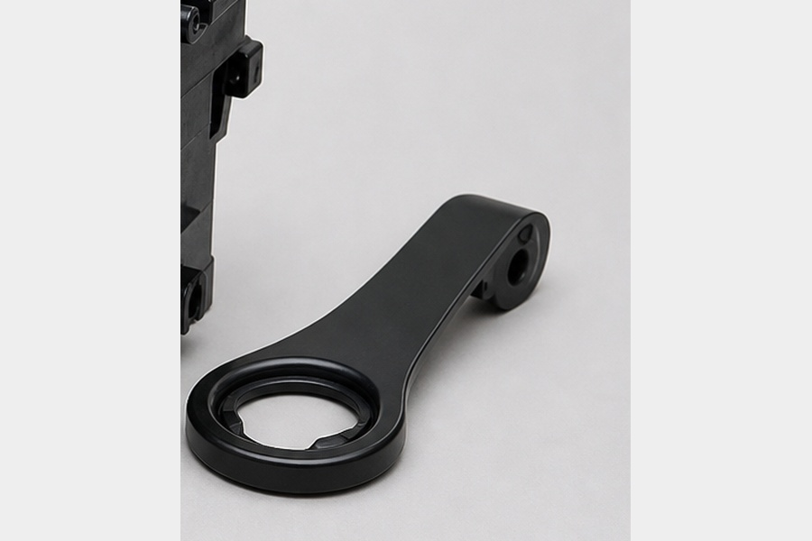
ACTION GROUP 3
Unscrew the top lever mechanism and carefully detach the brewing chamber from the water lines
Atomic actions are grouped under their parent disassembly operation.
Source: Internal Chassis (Core) (Unknown)
explicit source
ATOMIC ACTIONS
1
Unscrew the top lever mechanism and carefully detach the brewing chamber from the water lines
Brewing Chamber (Capsule slot)
Top Lever / Handle
Lower Engine Core
RESULT
• Brewing Chamber (Capsule slot) (300 g)
• Top Lever / Handle (150 g)
CONTINUES AS
• Lower Engine Core (1110 g)
Material: 1
Nespresso Essenza Mini
9 / 11

Slide 10
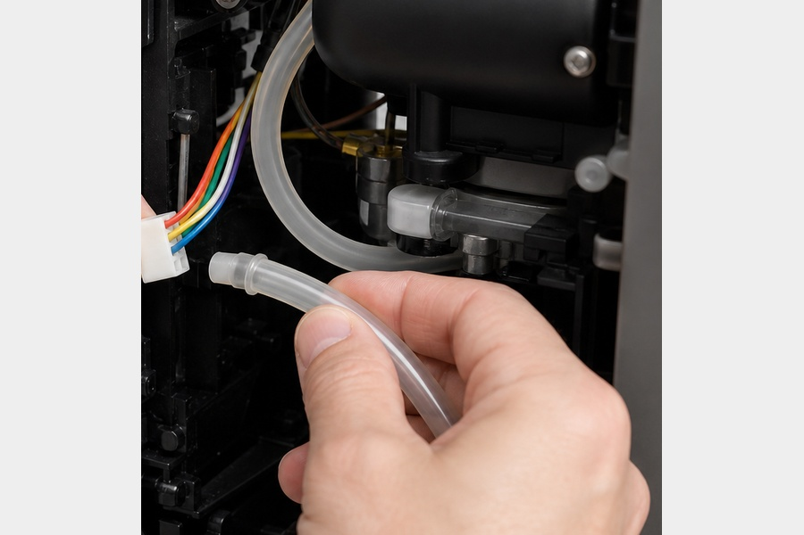
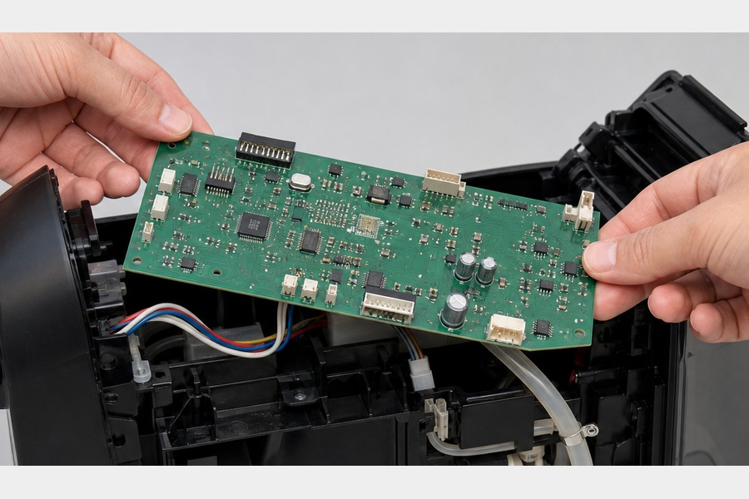
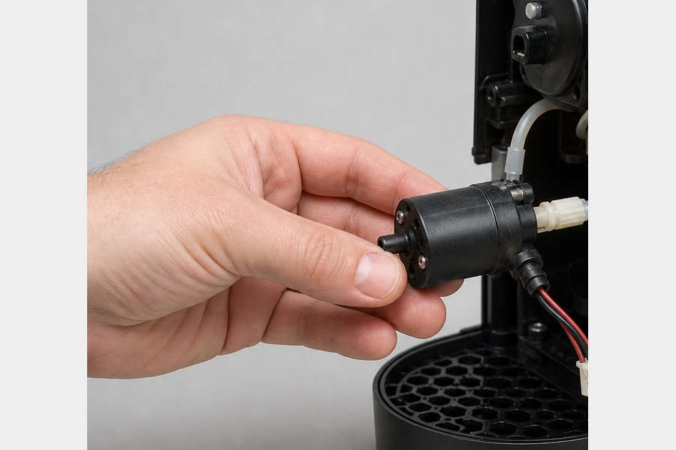
ACTION GROUP 4
Unplug the wiring harness from the motherboard, pull out the water pump, and detach the thermoblock heater
Atomic actions are grouped under their parent disassembly operation.
Source: Lower Engine Core (1110 g)
explicit source
ATOMIC ACTIONS
1
Unplug the wiring harness from the motherboard, pull out the water pump, and detach the thermoblock heater
Silicone Tubing & Wiring
Motherboard (PCB)
Water Pump (19-bar)
RESULT
• Silicone Tubing & Wiring (230 g)
• Motherboard (PCB) (80 g)
• Water Pump (19-bar) (350 g)
CONTINUES AS
End of this branch
Material: 9
Nespresso Essenza Mini
10 / 11

Slide 11
EXPORT COMPLETE
4 action groups prepared
The PowerPoint remains fully editable: text, tables, images and component information can be revised after export.
Nespresso Essenza Mini
Nespresso Essenza Mini
11 / 11

