Slide 1
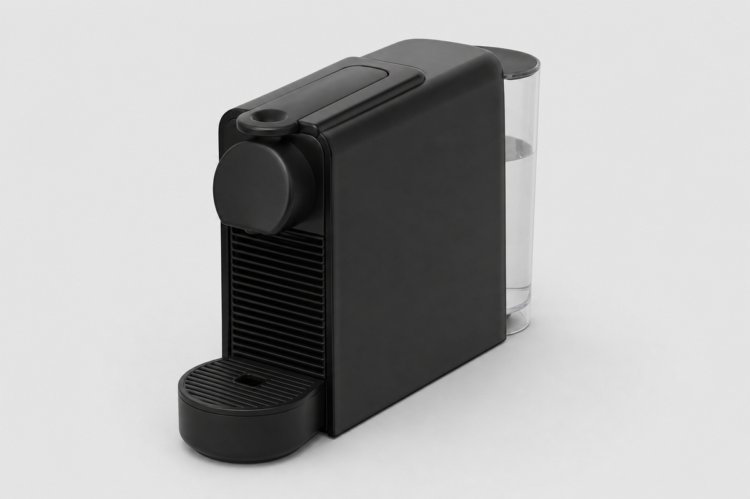
FUTURDATA THESIS
Disassembly Guide
Nespresso Essenza Mini
PPTX export • 9 action group(s) • depth: full • schema 1.0
Nominal weight 2300 g
Nespresso Essenza Mini
1 / 21

Slide 2
PROJECT OVERVIEW
Export scope and model summary
PRODUCT ID
ACTION GROUPS
BOM COMPONENTS
VALIDATION ISSUES
1
9
17
35
PRODUCT DATA
EXPORT BEHAVIOUR
Name: Nespresso Essenza Mini
Weight: 2300 g
Material: 2
Color: 4
Depth mode: full
• Parent operation and atomic actions stay grouped.
• Output components and remaining assembly are shown.
• Text and images remain editable in PowerPoint.
• Unknown branch sources are never guessed.
• Source JSON is opened read-only and never modified.
Nespresso Essenza Mini
2 / 21

Slide 3
VALIDATION
Model warnings and errors — 1
Each issue is localized to the corresponding JSON element when possible.
WARNING · images
Image file not found: images/machine_root.jpg
Location: product.image
WARNING · images
Image file not found: images/action_remove_external.jpg
Location: steps[0].actions[0].image
WARNING · images
Image file not found: images/water_tank.jpg
Location: steps[0].outputs[0].image
WARNING · images
Image file not found: images/drip_tray.jpg
Location: steps[0].outputs[1].image
WARNING · images
Image file not found: images/capsule_bin.jpg
Location: steps[0].outputs[2].image
WARNING · images
Image file not found: images/main_housing.jpg
Location: steps[0].continues_as.image
Nespresso Essenza Mini
3 / 21

Slide 4
VALIDATION
Model warnings and errors — 2
Each issue is localized to the corresponding JSON element when possible.
WARNING · images
Image file not found: images/action_unscrew_casing.jpg
Location: steps[1].actions[0].image
WARNING · images
Image file not found: images/oval_screws.jpg
Location: steps[1].outputs[0].image
WARNING · images
Image file not found: images/housing_unfastened.jpg
Location: steps[1].continues_as.image
WARNING · images
Image file not found: images/diamond_release_clips.jpg
Location: steps[2].actions[0].image
WARNING · images
Image file not found: images/side_panel_left.jpg
Location: steps[2].outputs[0].image
WARNING · images
Image file not found: images/side_panel_right.jpg
Location: steps[2].outputs[1].image
Nespresso Essenza Mini
4 / 21

Slide 5
VALIDATION
Model warnings and errors — 3
Each issue is localized to the corresponding JSON element when possible.
WARNING · images
Image file not found: images/internal_chassis.jpg
Location: steps[2].continues_as.image
WARNING · images
Image file not found: images/action_disconnect_brewing.jpg
Location: steps[3].actions[0].image
WARNING · images
Image file not found: images/brewing_chamber.jpg
Location: steps[3].outputs[0].image
WARNING · images
Image file not found: images/top_lever.jpg
Location: steps[3].outputs[1].image
WARNING · images
Image file not found: images/chassis_without_brewing.jpg
Location: steps[3].continues_as.image
WARNING · images
Image file not found: images/action_disconnect_wiring.jpg
Location: steps[4].actions[0].image
Nespresso Essenza Mini
5 / 21

Slide 6
VALIDATION
Model warnings and errors — 4
Each issue is localized to the corresponding JSON element when possible.
WARNING · images
Image file not found: images/wiring_harness.jpg
Location: steps[4].outputs[0].image
WARNING · images
Image file not found: images/silicone_tubing.jpg
Location: steps[4].outputs[1].image
WARNING · images
Image file not found: images/core_without_wiring.jpg
Location: steps[4].continues_as.image
WARNING · images
Image file not found: images/action_remove_pcb.jpg
Location: steps[5].actions[0].image
WARNING · images
Image file not found: images/motherboard.jpg
Location: steps[5].outputs[0].image
WARNING · images
Image file not found: images/core_without_pcb.jpg
Location: steps[5].continues_as.image
Nespresso Essenza Mini
6 / 21

Slide 7
VALIDATION
Model warnings and errors — 5
Each issue is localized to the corresponding JSON element when possible.
WARNING · images
Image file not found: images/action_remove_pump.jpg
Location: steps[6].actions[0].image
WARNING · images
Image file not found: images/water_pump.jpg
Location: steps[6].outputs[0].image
WARNING · images
Image file not found: images/core_without_pump.jpg
Location: steps[6].continues_as.image
WARNING · images
Image file not found: images/action_remove_thermoblock.jpg
Location: steps[7].actions[0].image
WARNING · images
Image file not found: images/thermoblock.jpg
Location: steps[7].outputs[0].image
WARNING · images
Image file not found: images/core_without_heater.jpg
Location: steps[7].continues_as.image
Nespresso Essenza Mini
7 / 21

Slide 8
VALIDATION
Model warnings and errors — 6
Each issue is localized to the corresponding JSON element when possible.
WARNING · images
Image file not found: images/action_separate_remaining.jpg
Location: steps[8].actions[0].image
WARNING · images
Image file not found: images/final_internal_frame.jpg
Location: steps[8].outputs[0].image
WARNING · images
Image file not found: images/final_power_cable.jpg
Location: steps[8].outputs[1].image
WARNING · images
Image file not found: images/final_power_switch.jpg
Location: steps[8].outputs[2].image
WARNING · images
Image file not found: images/final_small_parts.jpg
Location: steps[8].outputs[3].image
Nespresso Essenza Mini
8 / 21

Slide 9
PREPARATION
Tools and safety notices
Aggregated from step-level and atomic-action metadata.
TOOLS REQUIRED
SAFETY NOTICES
• No tools are specified in this model.
• No safety notices are specified in this model.
Nespresso Essenza Mini
9 / 21

Slide 10
BILL OF MATERIALS
Recovered components — page 1 of 2
ID | Component | Weight | Material | Color | Quality | Destination
4 | Water Tank | 180 g | 1 | Unknown | — | —
5 | Drip Tray & Grid | 100 g | 6 | Unknown | — | —
6 | Capsule Bin (Used Capsule Container) | 110 g | 1 | Unknown | — | —
10 | Oval-head Security Screws (x4) | 10 g | 9 | Unknown | — | —
14 | Side Panel (Left) | 85 g | 1 | Unknown | — | —
15 | Side Panel (Right) | 85 g | 1 | Unknown | — | —
19 | Brewing Chamber (Capsule Slot) | 120 g | 6 | Unknown | — | —
20 | Top Lever / Handle | 45 g | 1 | Unknown | — | —
24 | Wiring Harness | 45 g | 9 | Unknown | — | —
Nespresso Essenza Mini
10 / 21

Slide 11
BILL OF MATERIALS
Recovered components — page 2 of 2
ID | Component | Weight | Material | Color | Quality | Destination
25 | Silicone Tubing | 20 g | 4 | Unknown | — | —
29 | Motherboard (PCB) | 55 g | 9 | Unknown | — | —
33 | Water Pump (19-bar) | 310 g | 6 | Unknown | — | —
37 | Thermoblock Heater | 420 g | 2 | Unknown | — | —
41 | Internal Frame (Plastic + Metal Structure) | 220 g | 6 | Unknown | — | —
42 | Power Cable & Cable Guide | 120 g | 9 | Unknown | — | —
43 | Switch Assembly (Power Switch) | 25 g | 9 | Unknown | — | —
44 | Remaining Plastic Structure & Small Parts | 350 g | 1 | Unknown | — | —
Nespresso Essenza Mini
11 / 21

Slide 12
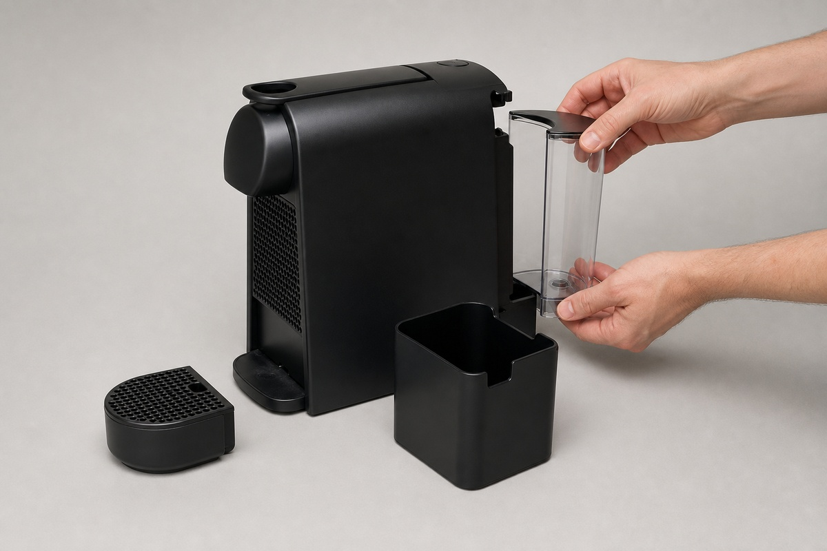
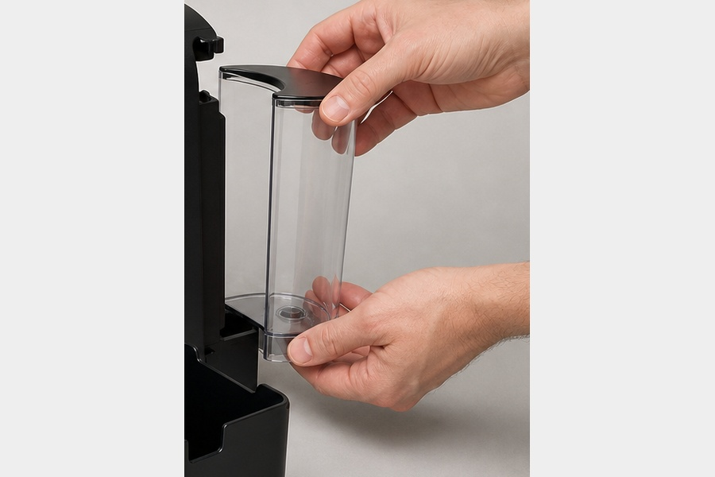
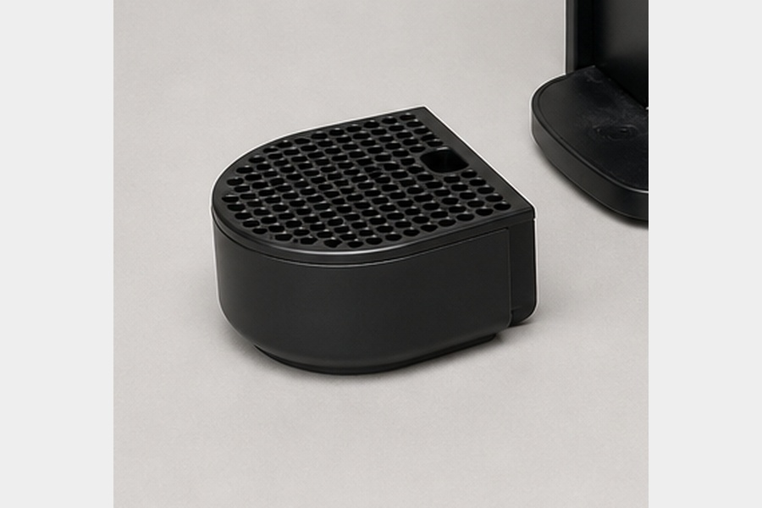
ACTION GROUP 1
Remove external components
Atomic actions are grouped under their parent disassembly operation.
Source: Nespresso Essenza Mini (2300 g)
product root
ATOMIC ACTIONS
1
Manually remove external components (no tools required)
Action 1
Water Tank
Drip Tray & Grid
RESULT
• Water Tank (180 g)
• Drip Tray & Grid (100 g)
• Capsule Bin (Used Capsule Container) (110 g)
CONTINUES AS
Main Housing (Outer Shell) (1910 g)
Material: 1
Nespresso Essenza Mini
12 / 21

Slide 13
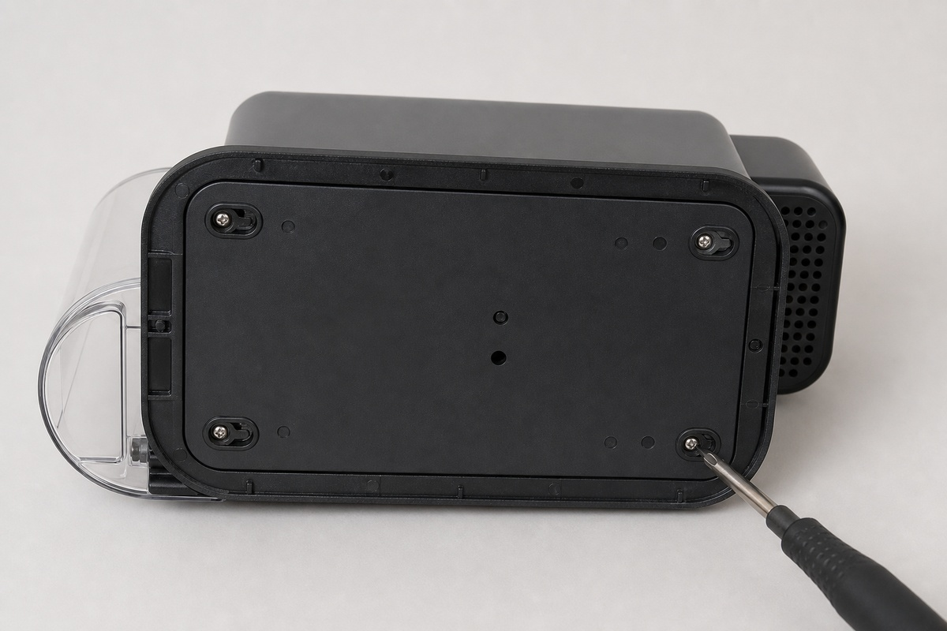
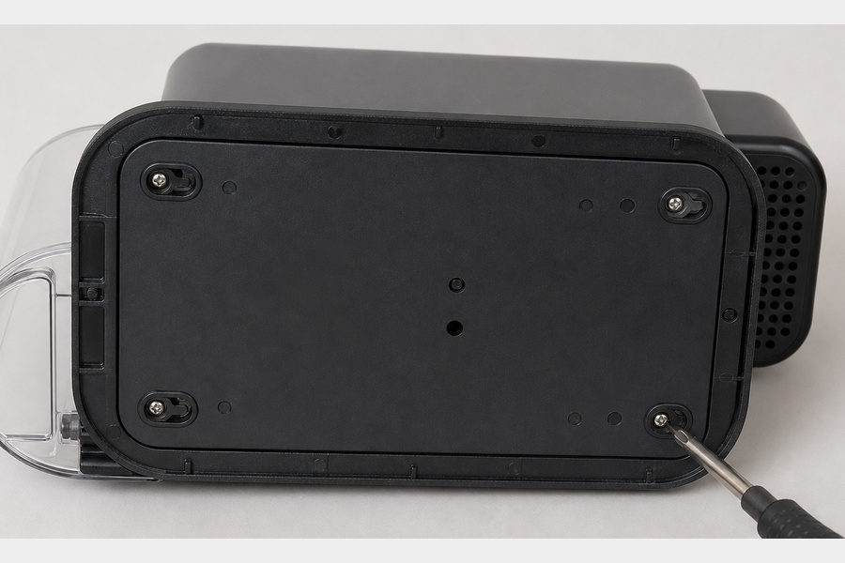
ACTION GROUP 2
Remove bottom screws
Atomic actions are grouped under their parent disassembly operation.
Source: Main Housing (Outer Shell) (1910 g)
previous continuation
ATOMIC ACTIONS
1
Remove the 4 proprietary oval-head security screws at the bottom
Action 1
Oval-head Security Screws (x4)
Housing Unfastened
RESULT
• Oval-head Security Screws (x4) (10 g)
CONTINUES AS
Housing Unfastened (1900 g)
Material: 9
Nespresso Essenza Mini
13 / 21

Slide 14
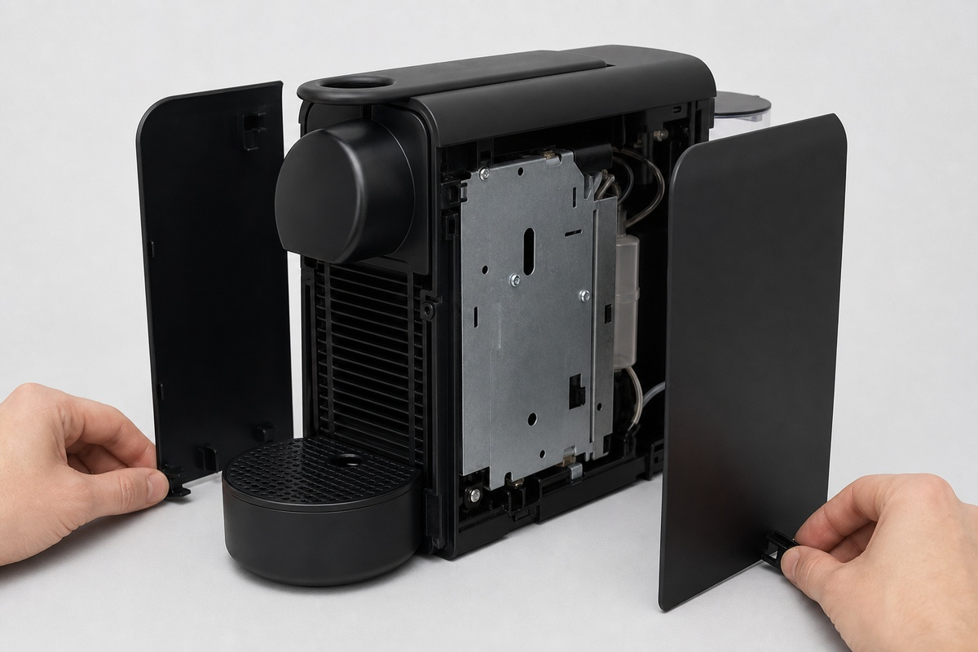
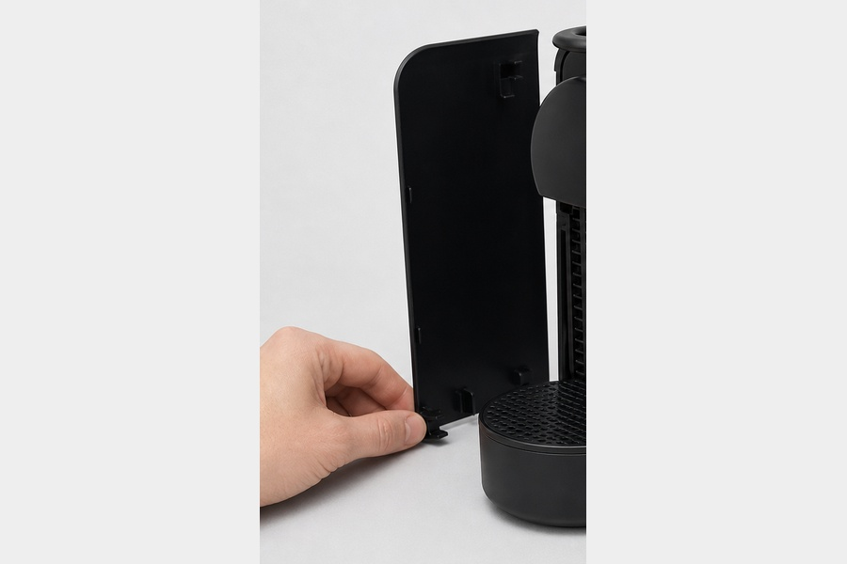
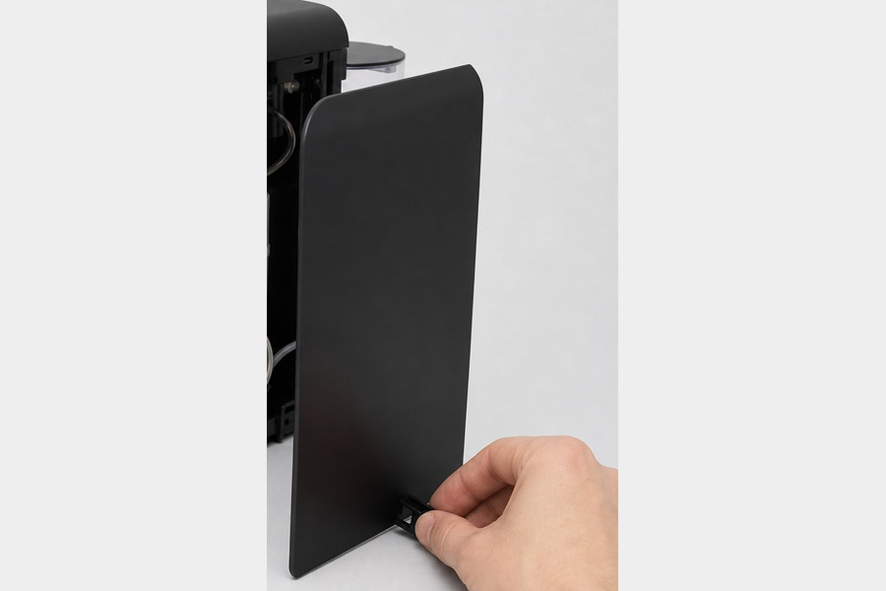
ACTION GROUP 3
Release bottom clips and side panels
Atomic actions are grouped under their parent disassembly operation.
Source: Housing Unfastened (1900 g)
previous continuation
ATOMIC ACTIONS
1
Release bottom clips and separate the side panels
Action 1
Side Panel (Left)
Side Panel (Right)
RESULT
• Side Panel (Left) (85 g)
• Side Panel (Right) (85 g)
CONTINUES AS
Internal Chassis (Core) (1730 g)
Material: 1
Nespresso Essenza Mini
14 / 21

Slide 15
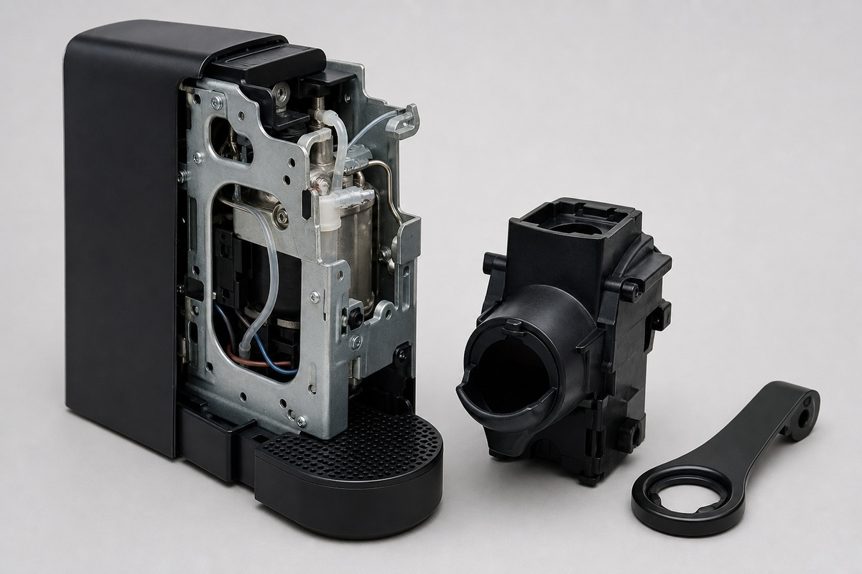
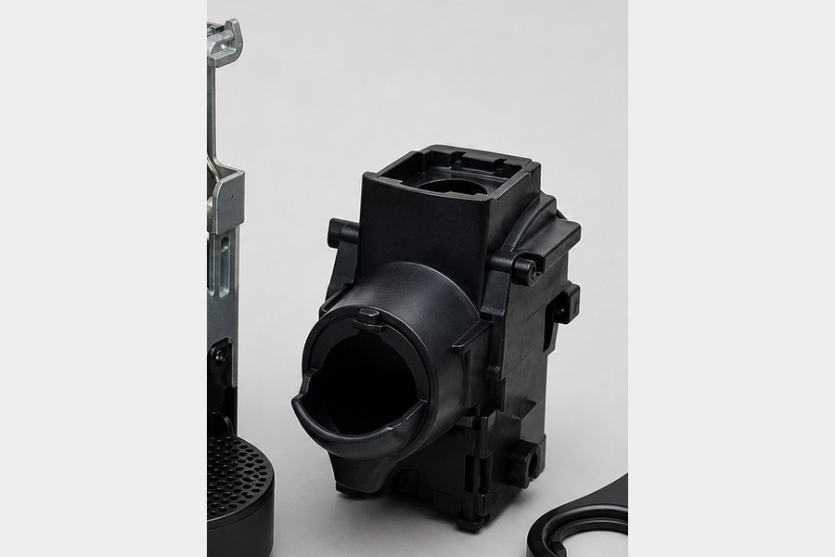
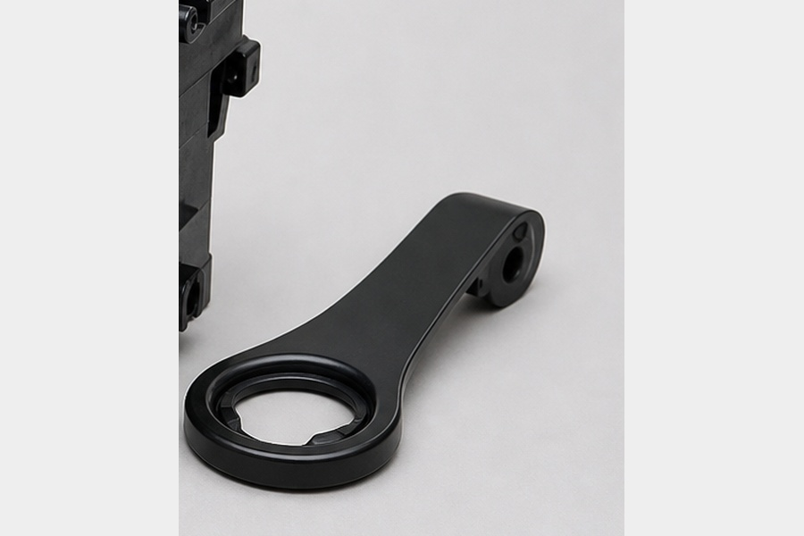
ACTION GROUP 4
Remove brewing assembly
Atomic actions are grouped under their parent disassembly operation.
Source: Internal Chassis (Core) (1730 g)
previous continuation
ATOMIC ACTIONS
1
Remove brewing assembly
Action 1
Brewing Chamber (Capsule Slot)
Top Lever / Handle
RESULT
• Brewing Chamber (Capsule Slot) (120 g)
• Top Lever / Handle (45 g)
CONTINUES AS
Chassis without Brewing Assembly (1565 g)
Material: 6
Nespresso Essenza Mini
15 / 21

Slide 16
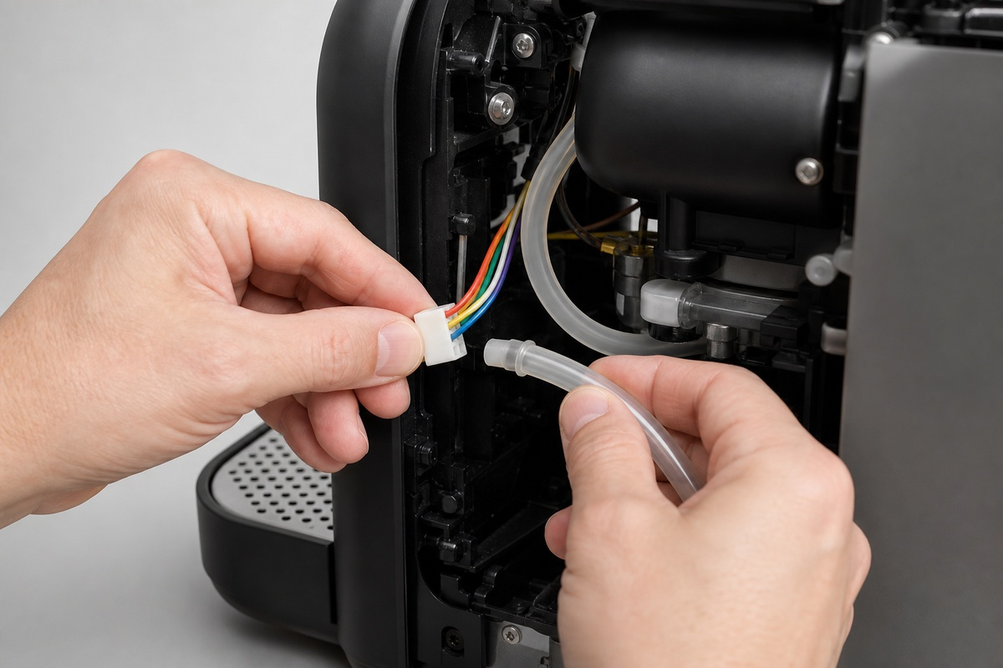
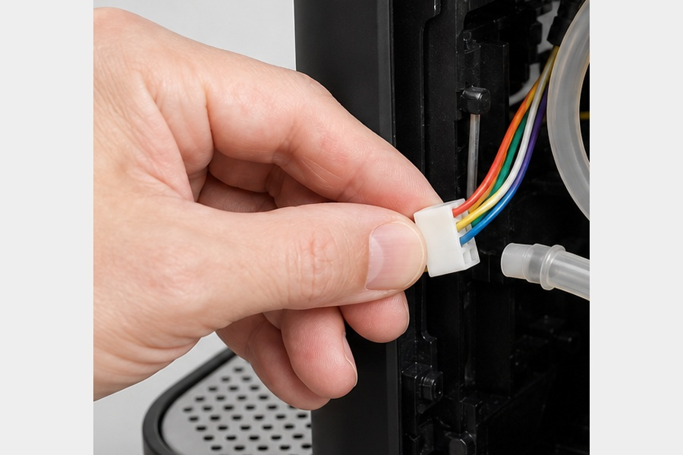
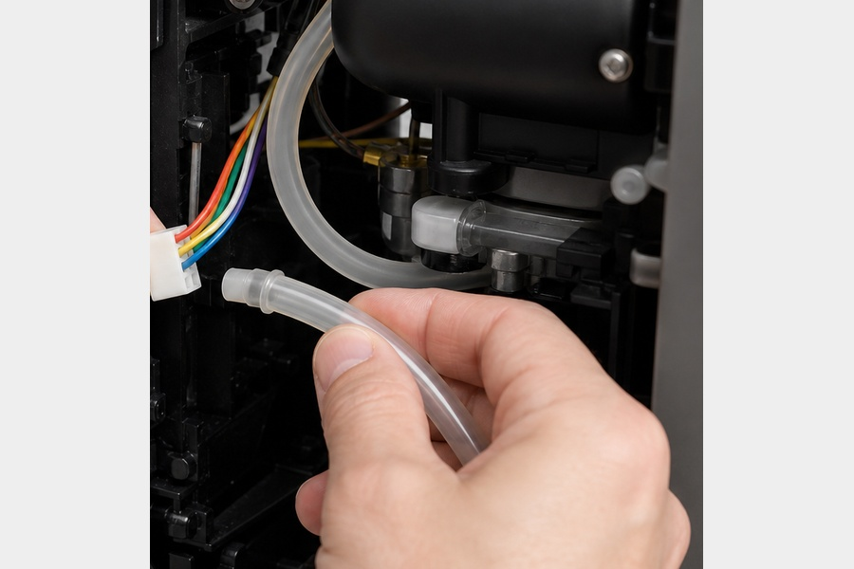
ACTION GROUP 5
Disconnect wiring and tubing
Atomic actions are grouped under their parent disassembly operation.
Source: Chassis without Brewing Assembly (1565 g)
previous continuation
ATOMIC ACTIONS
1
Disconnect wiring harness and silicone tubing
Action 1
Wiring Harness
Silicone Tubing
RESULT
• Wiring Harness (45 g)
• Silicone Tubing (20 g)
CONTINUES AS
Core without Wiring (1500 g)
Material: 9
Nespresso Essenza Mini
16 / 21

Slide 17
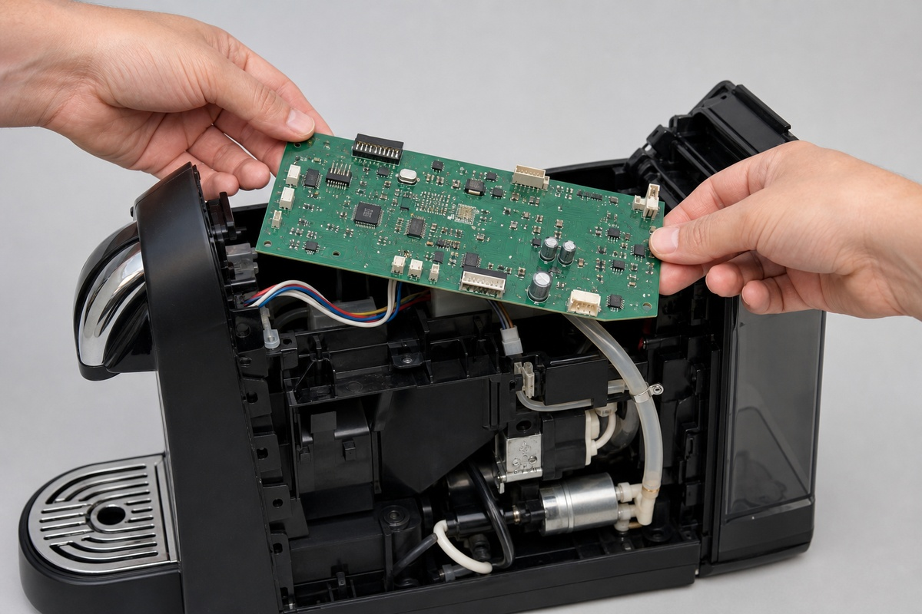
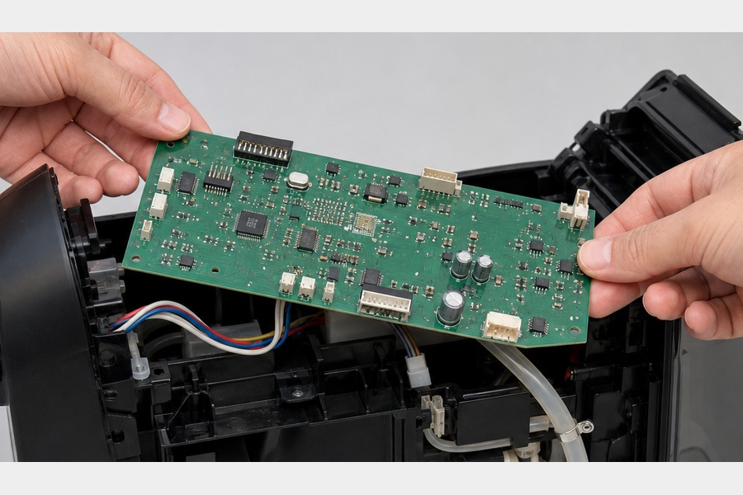
ACTION GROUP 6
Remove control electronics
Atomic actions are grouped under their parent disassembly operation.
Source: Core without Wiring (1500 g)
previous continuation
ATOMIC ACTIONS
1
Remove control electronics (PCB)
Action 1
Motherboard (PCB)
Core without PCB
RESULT
• Motherboard (PCB) (55 g)
CONTINUES AS
Core without PCB (1445 g)
Material: 9
Nespresso Essenza Mini
17 / 21

Slide 18
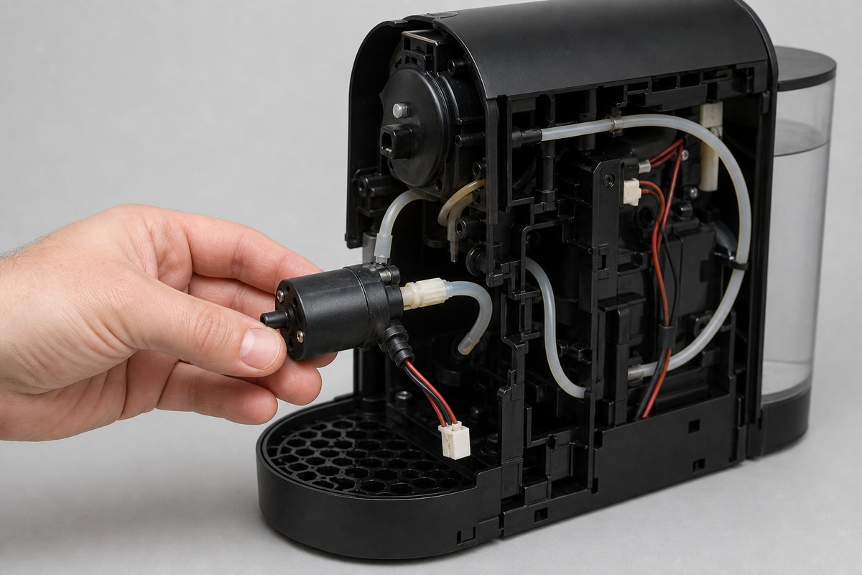
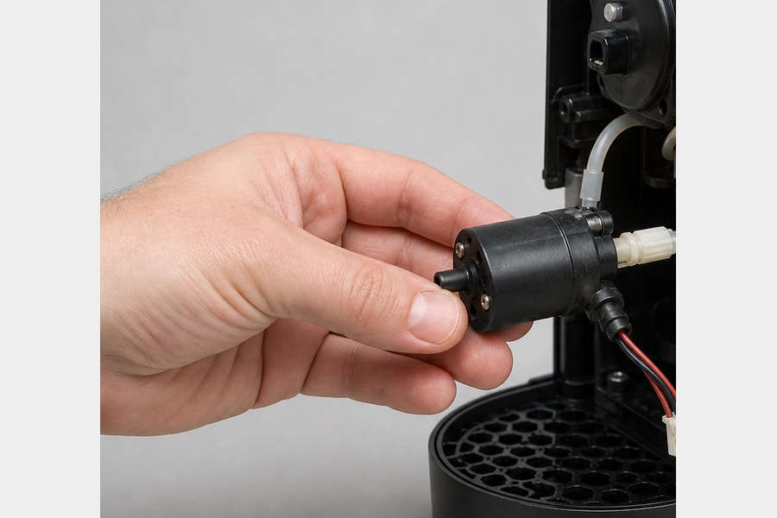
ACTION GROUP 7
Remove water pump
Atomic actions are grouped under their parent disassembly operation.
Source: Core without PCB (1445 g)
previous continuation
ATOMIC ACTIONS
1
Remove water pump
Action 1
Water Pump (19-bar)
Core without Pump
RESULT
• Water Pump (19-bar) (310 g)
CONTINUES AS
Core without Pump (1135 g)
Material: 6
Nespresso Essenza Mini
18 / 21

Slide 19
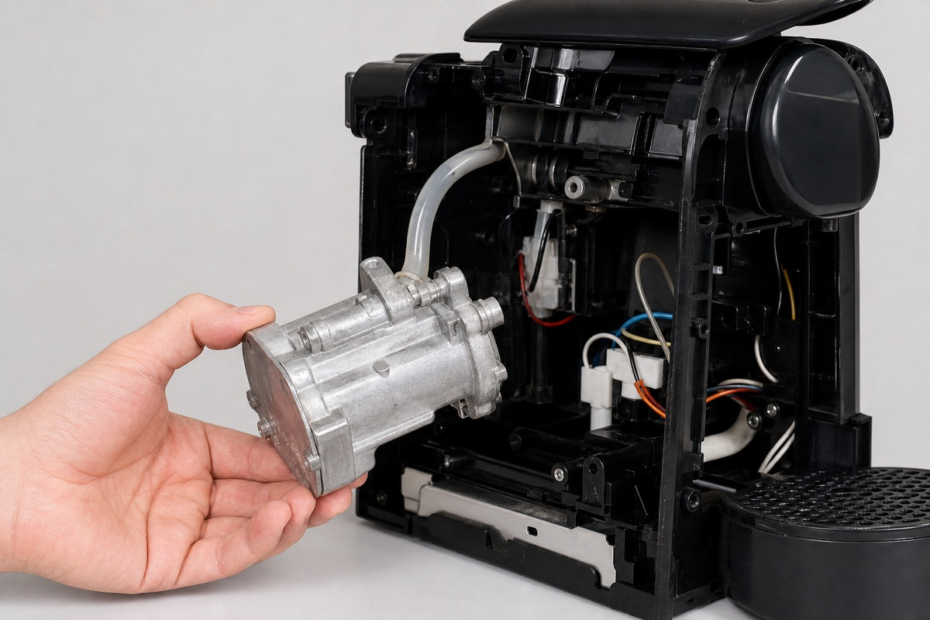
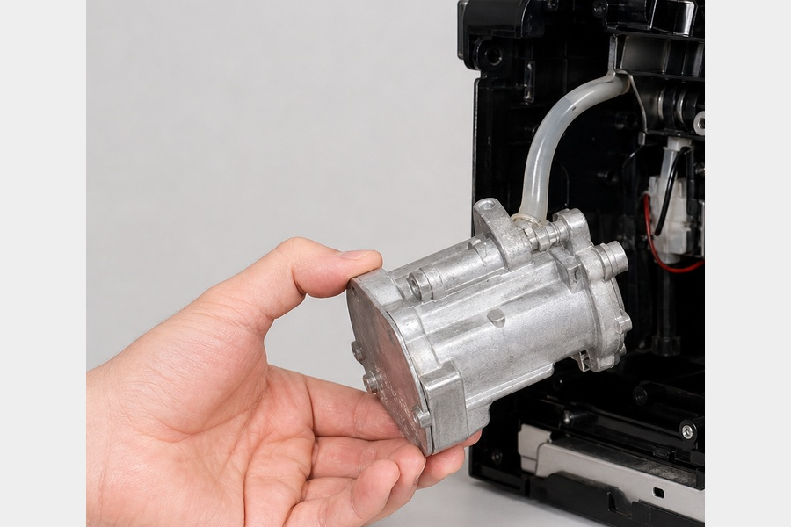
ACTION GROUP 8
Remove heating system
Atomic actions are grouped under their parent disassembly operation.
Source: Core without Pump (1135 g)
previous continuation
ATOMIC ACTIONS
1
Remove heating system (thermoblock heater)
Action 1
Thermoblock Heater
Core without Heater
RESULT
• Thermoblock Heater (420 g)
CONTINUES AS
Core without Heater (715 g)
Material: 2
Nespresso Essenza Mini
19 / 21

Slide 20
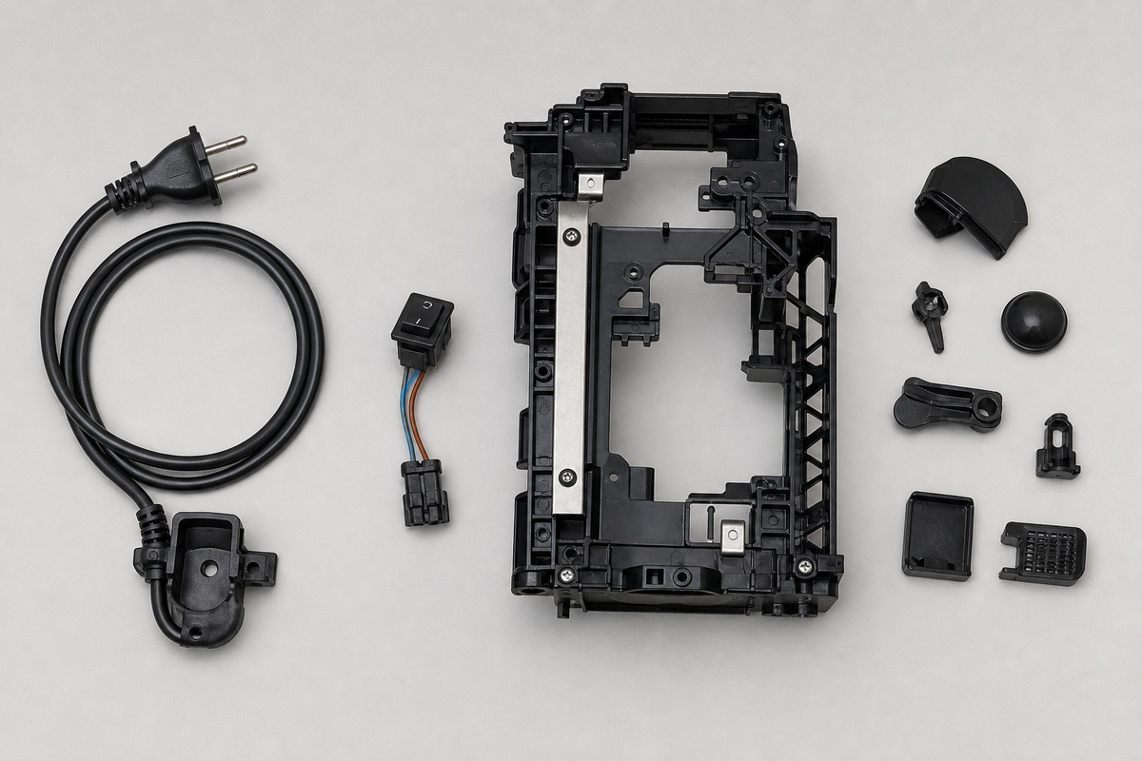
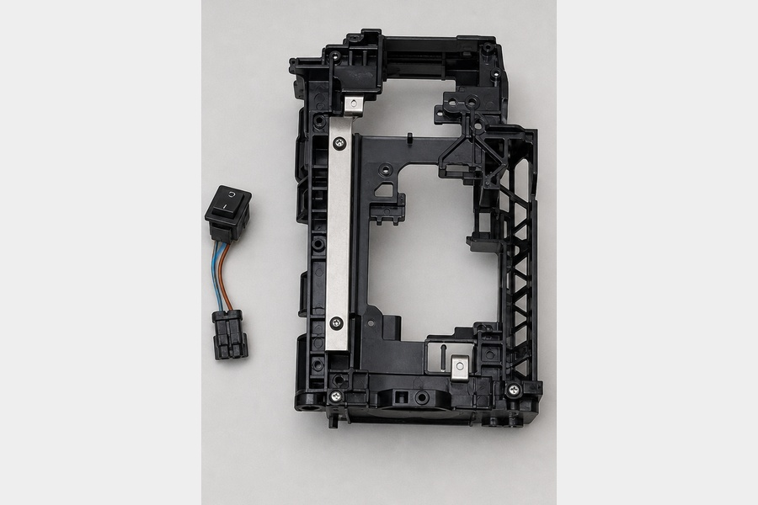
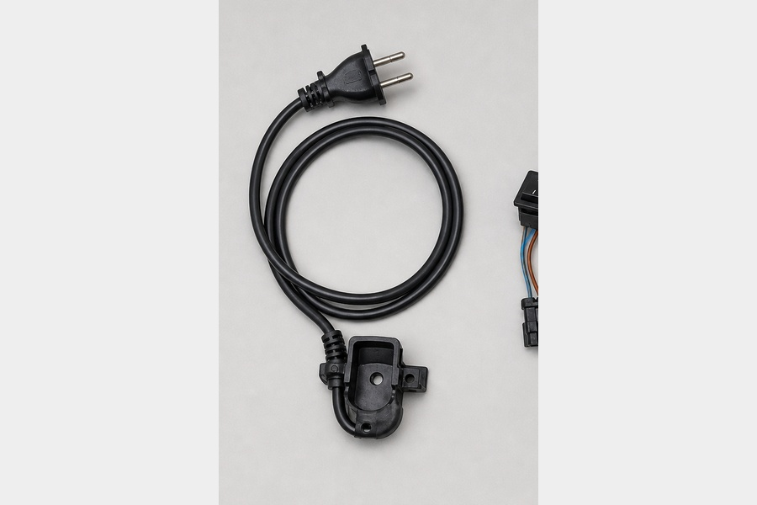
ACTION GROUP 9
Separate remaining structure and small parts
Atomic actions are grouped under their parent disassembly operation.
Source: Core without Heater (715 g)
previous continuation
ATOMIC ACTIONS
1
Separate remaining structure and small parts
Action 1
Internal Frame (Plastic + Metal Structure)
Power Cable & Cable Guide
RESULT
• Internal Frame (Plastic + Metal Structure) (220 g)
• Power Cable & Cable Guide (120 g)
• Switch Assembly (Power Switch) (25 g)
CONTINUES AS
End of this branch
Material: 6
Nespresso Essenza Mini
20 / 21

Slide 21
EXPORT COMPLETE
9 action groups prepared
The PowerPoint remains fully editable: text, tables, images and component information can be revised after export.
Nespresso Essenza Mini
Nespresso Essenza Mini
21 / 21

