Slide 1
UNIGE_SE @ PRELEARN Utility for Automatic Prerequisite Learning from Italian Wikipedia
Alessio Moggio, Andrea Parizzi
DIBRIS - Dipartimento di Informatica, Bioingegneria, Robotica e Ingegneria dei Sistemi
University of Genova, Italy
Notes:
HI, I’m Andrea Parizzi and together with my collegue Alessio Moggio we present u the approach we used to tackle the EVALITA 2020 PRELEARN Task and the tool we developed.

Slide 2
Introduction
In the context of our degree course Software Engineering we got asked to develop a system to partecipate to EVALITA 2020 PRELEARN Task that:
Would be able to get better results than the Baseline
Had a GUI that allowed the user to easily test and tune various parameter of the system
Moggio, Parizzi @ DIBRIS - University of Genoa
Utility for Automatic Prerequisite Learning from Italian Wikipedia
2
Notes:
Descrizione alla Slide: In the context of our ‘Software engineering’ course at University of Genoa we had to develop a tool capable to predict results better than task’ own Baseline on all the configurations proposed by the task.
This tool also had to show a Graphic user interface to easily allow selection and tuning of features and parameters

Slide 3
The Task
Given a pair of distinct concepts (A, B) → predict whether or not concept B is a prerequisite of concept A.
Concepts are single or multi word domain terms corresponding to the title of a page on the Italian Wikipedia
Models.:
a model that acquires information only from raw text
a model that can rely both on raw text and structured information
Scenarios:
train the model(s) on any domain (in-domain setting);
train the model(s) on anything but the domain of the test set (cross-domain setting).
Moggio, Parizzi @ DIBRIS - University of Genoa
Utility for Automatic Prerequisite Learning from Italian Wikipedia
3
Notes:
Ref: https://sites.google.com/view/prelearn20/task
Descrizione primo punto: The shared task consists in classifying prerequisite relations between pairs of concepts distinguishing between prerequisite pairs and non-prerequisite ones.
This can be considered as a binary classification problem between two distinct concepts
What’s a concept? A concept is defined as a single or multiword term belonging to a domain and being the title of a wikipedia page
Esempio Secondo punto: For example, Sottrazione and Matematica are both concepts of the Precalculus domain, but the two concepts are also the titles of two Italian Wikipedia pages. In this scenario, identifying a prerequisite relation can be compared to understanding if the content of a Wikipedia page contains the prior knowledge required to understand the content of another Wikipedia page (i.e. the target page).
The task presented 4 domains which were PreCalculus, Physics, Data Mining, Geometry.
Esempio punto 3.2: Wikipedia hyperlink graph and categories to which a wikipedia page belongs, but also the page organization in sections and paragraphs, etc.
Conclusione slide: we submitted a classification for all the 4 subtasks that arise from models and scenarios combinations

Slide 4
Classifier
The classifier uses a two-dense-layers Neural Network.
The output layer consists of one neuron with sigmoid activation function.
For the specific purposes of this work, we used in every scenario a model exploiting a
20 neurons hidden layer
trained on 15 epochs.
A 4-fold cross validation was used for the in-domain scenario.
Moggio, Parizzi @ DIBRIS - University of Genoa
Utility for Automatic Prerequisite Learning from Italian Wikipedia
4
Notes:
First point: built using Scikit-Learn and Keras libraries (wrapped for Tensorflow) using a ReLU as the activation function for the hidden layer
Third point: this structural parameters of the classifier are customizable by the Graphical interface.
Last point:
For the in-domain scenario, the model was trained using stratified random folds of concept pairs. This preserves the original proportion of domains’ pairs.
For the cross-domain scenario, a “leave one domain out” approach was used instead: training the model on all domains but the one used for test, thus the number of k-fold is constraint to equal the number of domains, thus was a 4-fold Cross validation.

Slide 5
Features
Features used for the raw model:
titleInText
Jaccard Similarity
LDA
LDA Cross Entropy
Features, added to the raw ones, used for the raw and structural model:
extractCategories
extractLinkConnections
totalIncoming/OutgoingLinks
Reference Distance
Moggio, Parizzi @ DIBRIS - University of Genoa
Utility for Automatic Prerequisite Learning from Italian Wikipedia
5
Notes:
Descrizione della slide:
We defined a set of features extracted from the Wikipedia page content and structure that we divided in two categories. The raw featurs exploit only the text of each wikipedia page, while the structural ones checks for the categories and the links.
Depending on the subtask requirements we used a different combination of them to train the model.
Descrizione raw features:
titleInText: cheks if the title of a page is mentioned in the page of another concept.
Jaccard: a word-based metric that measures the similarity between two pages by measuring the ratio of shared words between them.
LDA: the LDA vector calculated over nouns and verbs of a concept text (extracted using a pretrained UDPipe model).
LDA CE: the cross entropy of the LDA vectors.
Descrizione structured features:
extractCategories: the Wikipedia category to which each page belongs.
extractLinkConnections: considering a pairs of pages it checks if one contains the link to other ones.
totalIncoming/OutgoingLinks: it computes how much a concept is linked to/from other concepts.
RefD: a link-based metric that measures the relation between two pages by the links contained in each of them.

Slide 6
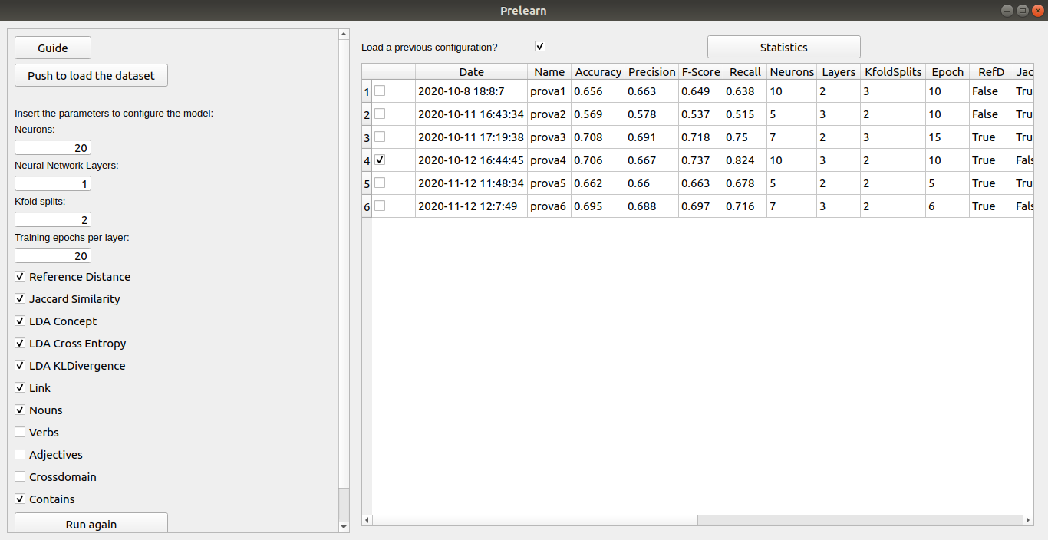
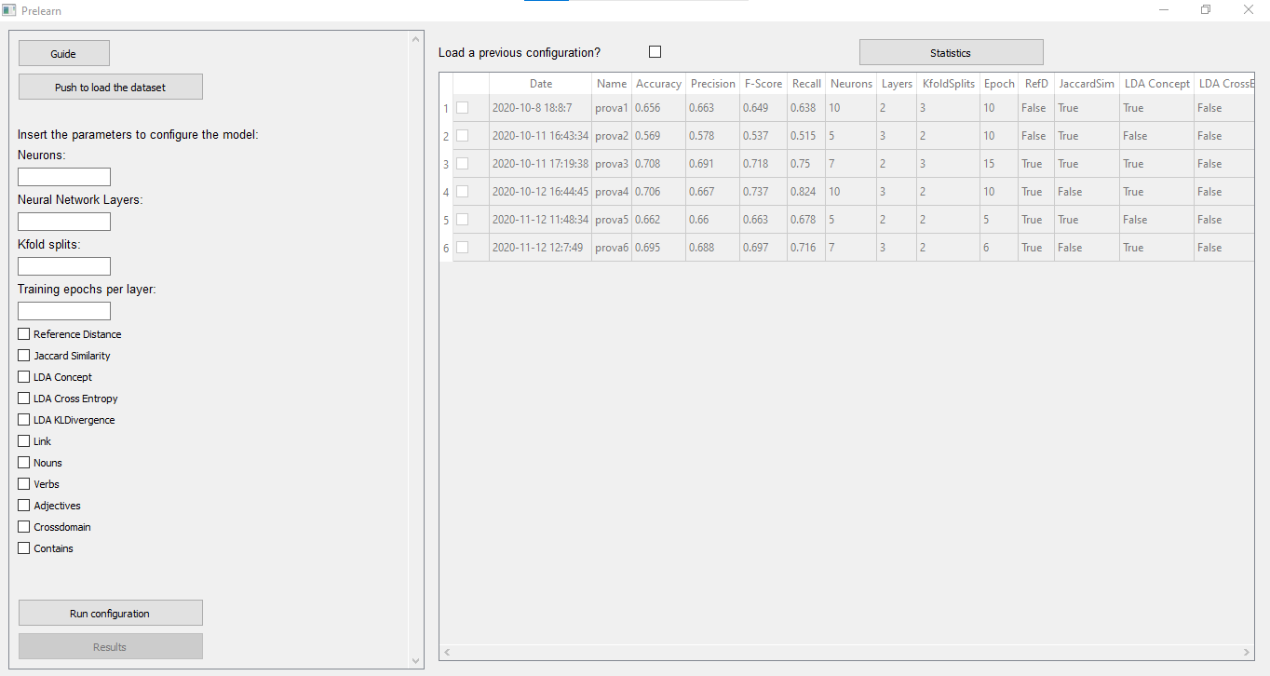
Interface: setup module
Moggio, Parizzi @ DIBRIS - University of Genoa
Utility for Automatic Prerequisite Learning from Italian Wikipedia
6
Notes:
Descrizione della slide:
We developed a User Interface to let the user personalize the neural network and the features.
The setup module contains the form to load the dataset, to insert the values for the configuration of the neural network and a list of features to customize the model. Besides it includes a table in which the user can choose a configuration run and saved before.

Slide 7
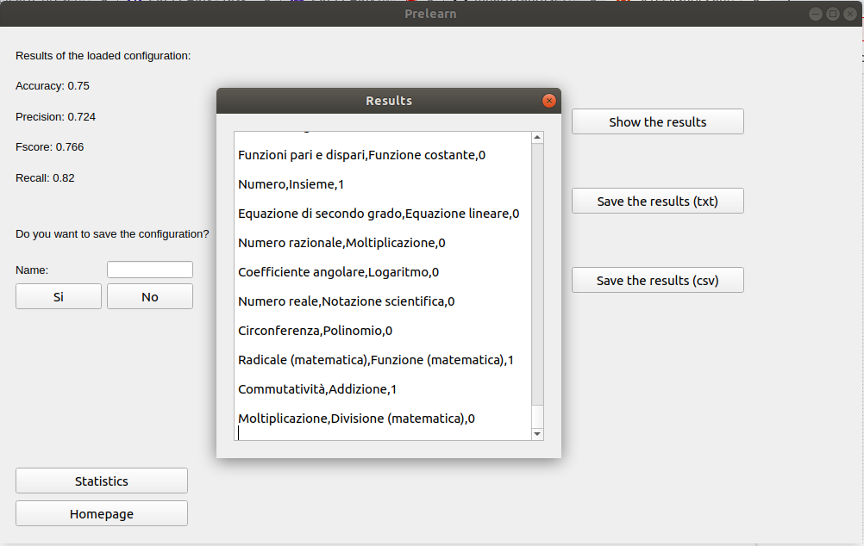
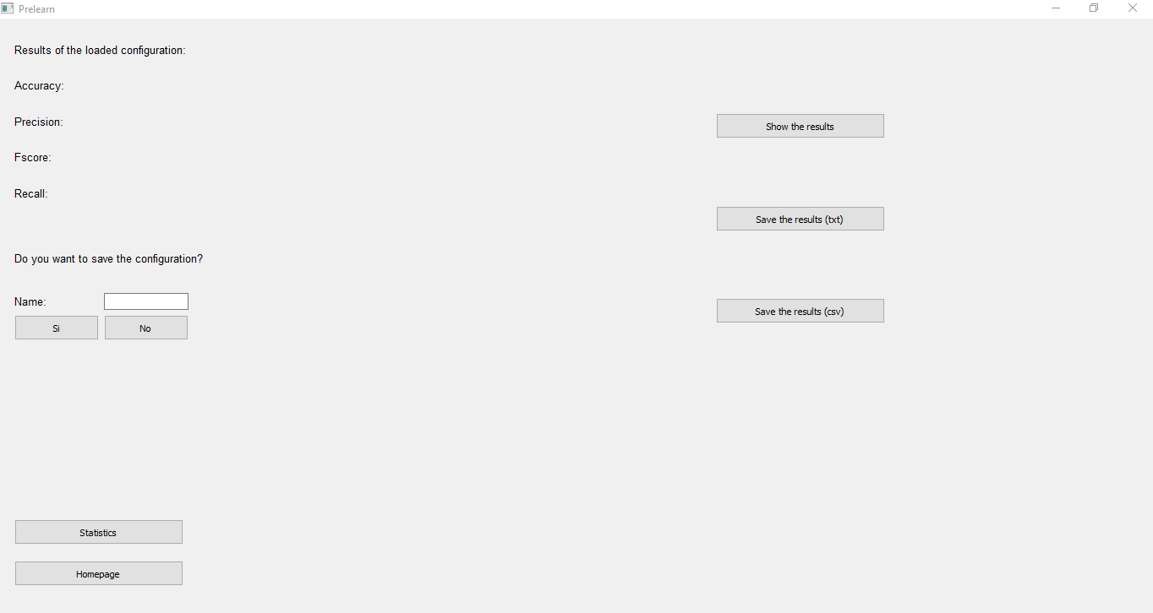
Interface: results module
Moggio, Parizzi @ DIBRIS - University of Genoa
Utility for Automatic Prerequisite Learning from Italian Wikipedia
7
Notes:
Descrizione della slide:
After the computation the results module is enabled. It shows an interface to display the result and the formed pairs and allows to handle them like saving the configuration just executed by the model in the program and externally.

Slide 8
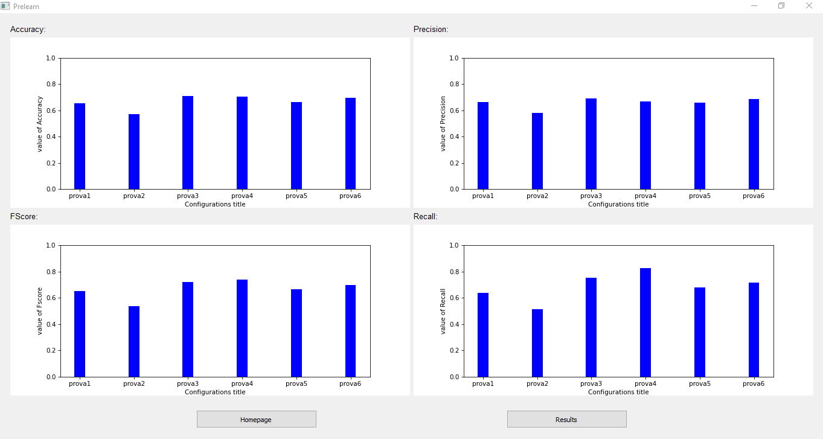
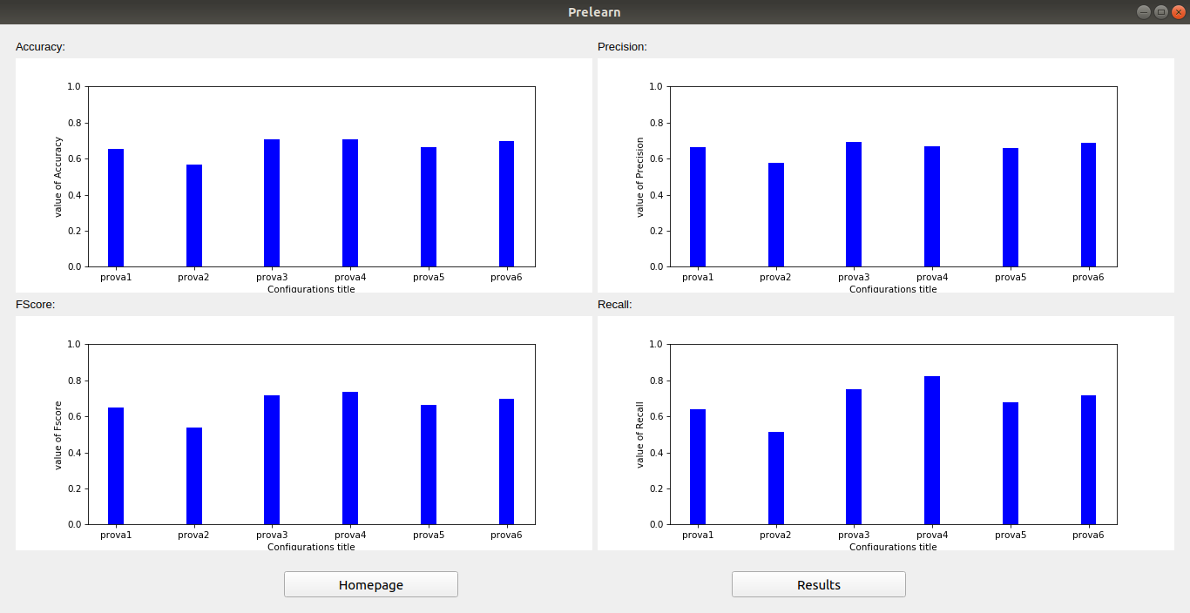
Interface: statistics module
Moggio, Parizzi @ DIBRIS - University of Genoa
Utility for Automatic Prerequisite Learning from Italian Wikipedia
8
Notes:
Descrizione della slide:
The statistics module prints in four bar charts the values of accuracy, precision, F-score and recall of all saved configurations which are the main statistics to compare the run configurations.

Slide 9
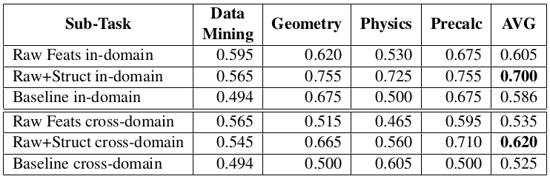
Conclusion
The results obtained by our models are all above baseline considering the average accuracies across all domain.
The future work will be focused on analyzing the impact of each feature in training the model and exploring the inclusion of new features to improve the performance.
Moggio, Parizzi @ DIBRIS - University of Genoa
Utility for Automatic Prerequisite Learning from Italian Wikipedia
9
Notes:
The results obtained by our models are all above baseline considering the average accuracies across all domain.
The obtained results suggest that in a in-domain setting features extracted from raw texts are sufficient to achieve competitive results, while in the cross-domain setting only this set of features is not enough.

Slide 10
Thank you for your attention

