Slide 1
Artificial Intelligence
Constraint Satisfaction Problems
Notes:
Slides and exercises are inspired by Russell & Norvig AI Book, Stanford’s AI course and from Berkeley’s AI course

Slide 2
Constraint satisfaction problems
Factored representation for each state: a set of variables, each of which has a value.
A problem is solved when each variable has a value that satisfies all the constraints on the variable.
The main idea is to eliminate large portions of the search space all at once by identifying variable/value combinations that violate the constraints.

Slide 3
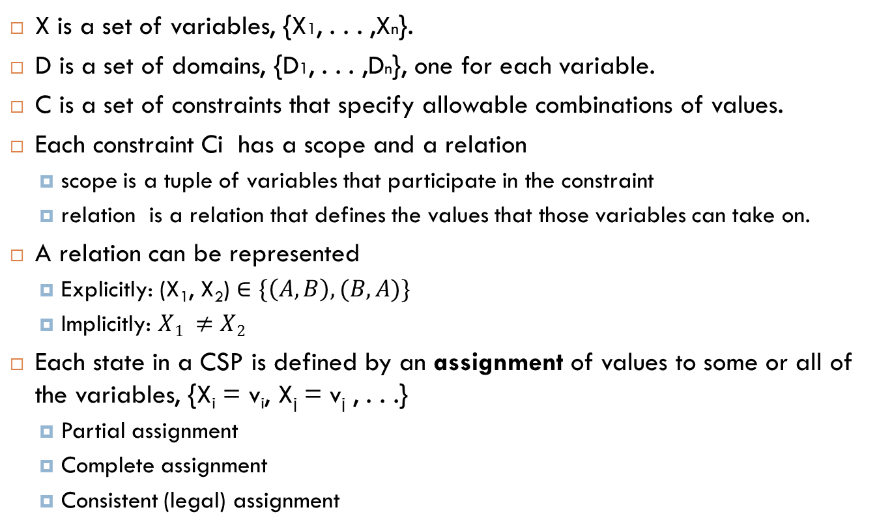
Definition
X is a set of variables, {X1, . . . ,Xn}.
D is a set of domains, {D1, . . . ,Dn}, one for each variable.
C is a set of constraints that specify allowable combinations of values.
Each constraint Ci has a scope and a relation
scope is a tuple of variables that participate in the constraint
relation is a relation that defines the values that those variables can take on.
A relation can be represented
Explicitly: $\text{(}\text{X}\text{1}\text{, }\text{X}\text{2}\text{)}∈\{\left(A,B\right), (B,A)\}$
Implicitly: $X1 ≠X2$
Each state in a CSP is defined by an assignment of values to some or all of the variables, {X_{i} = v_{i}, X_{j} = v_{j} , . . .}
Partial assignment
Complete assignment
Consistent (legal) assignment
Notes:
An assignment that does not violate any constraints is called a consistent or legal assignment.

Slide 4
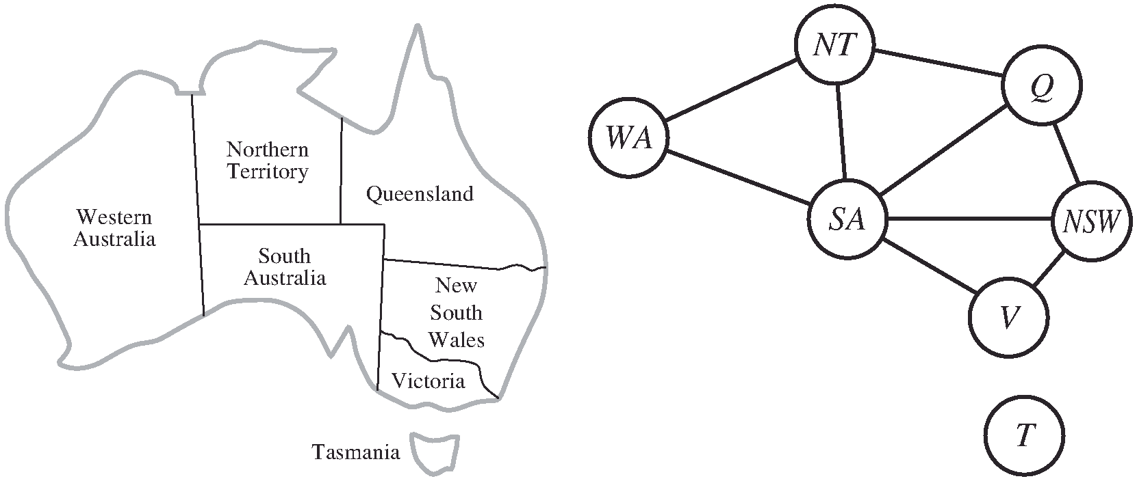
Example: map coloring
X = {WA, NT, Q, NSW, V, SA, T}
D_{i} = {red , green, blue}
C = {SA ≠ WA, SA ≠ NT, SA ≠ Q, SA ≠ NSW, SA ≠ V,
WA ≠ NT, NT ≠ Q, Q ≠ NSW, NSW ≠ V }
How many states? 3⁷, but can be reduced very easily with CSP

Slide 5
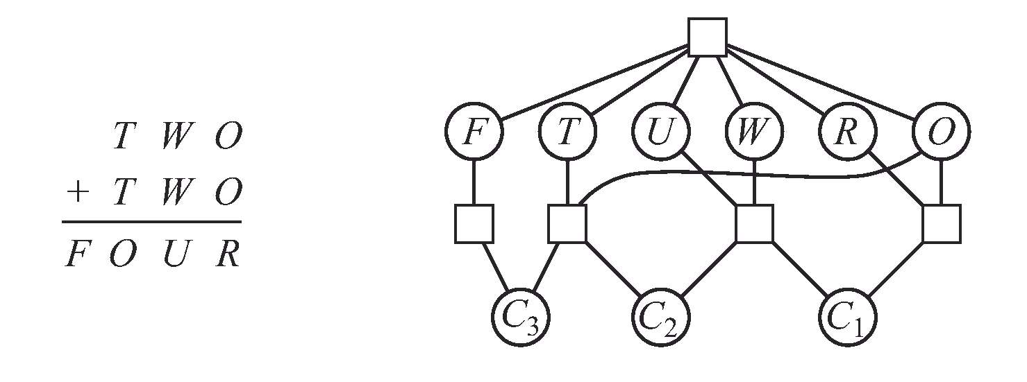
Example: Cryptarithmetic
Global constraint
(alldiff)
Ternary constraint
Domains:
Di = {0, 1, 2, 3, 4, 5, 6, 7, 8, 9}
Constraints:
O + O = R + 10 ・ C1
C1 +W +W = U +10 ・ C2
C2 + T + T = O + 10 ・ C3
C3 = F
We can also have unary constraints and binary constraints
Notes:
One solution; T=2 , O = 4 , R = 8 , W= 3 , F =0 , C1 = C2 = C3 =0

Slide 6
Example: N-queens
Variables: X_{ij}
Domains: {0, 1} : 0 means no queen, 1 means queen
Constraints:
X_{ij} and X_{ik} cannot be both 1 (same i )
X_{ij} and X_{kj} cannot be both 1 (same j)
X_{ij} and X_{i+k, j+k} cannot be both 1 (same diagonal )
Xij and X_{i+k, j-k} cannot be both 1 (same diagonal)
Sum of X_{ij}s= N

Slide 7
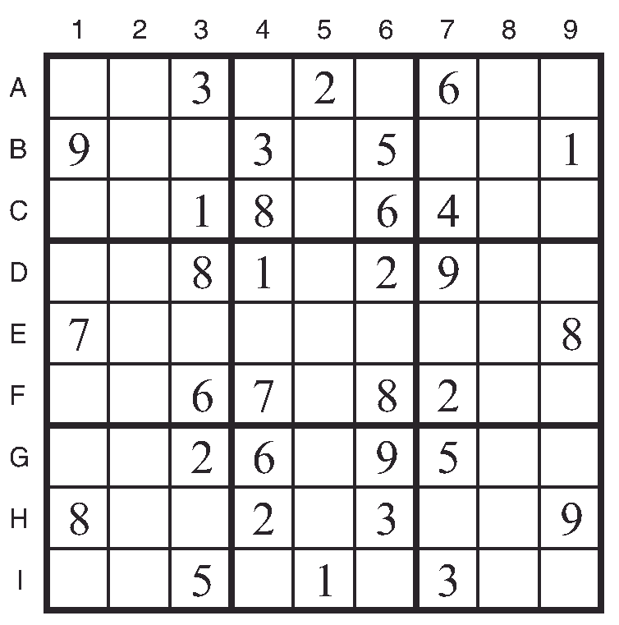
Sudoku
Alldiff
Variables:
Each (open) square
Domains:
{1,2,…,9}
Alldiff
Find E6
Find I6
Find A6
Alldiff
Naked triples example:
Take 3 variables having an alldiff constraint with the following respective domains {1, 8}, {3, 8}, and {1, 3, 8}.
We don’t know which square contains 1, 3, or 8, but we do know that the three numbers must be distributed among the three squares.
Therefore we can remove 1, 3, and 8 from the domains of every other square in the unit.
Notes:
E6 = 4
I6 = 7
A6 = 1

Slide 8
Inference in CSP
Constraint propagation: using the constraints to reduce the number of legal values for a variable, which in turn can reduce the legal values for another variable, and so on.
Node consistency: A single variable (corresponding to a node in the CSP network) is node-consistent if all the values in the variable’s domain satisfy the variable’s unary constraints.
Arc consistency: A variable in a CSP is arc-consistent if every value in its domain satisfies the variable’s binary constraints. More formally, Xi is arc-consistent with respect to another variable Xj if for every value in the current domain Di there is some value in the domain Dj that satisfies the binary constraint on the arc (Xi,Xj).

Slide 9
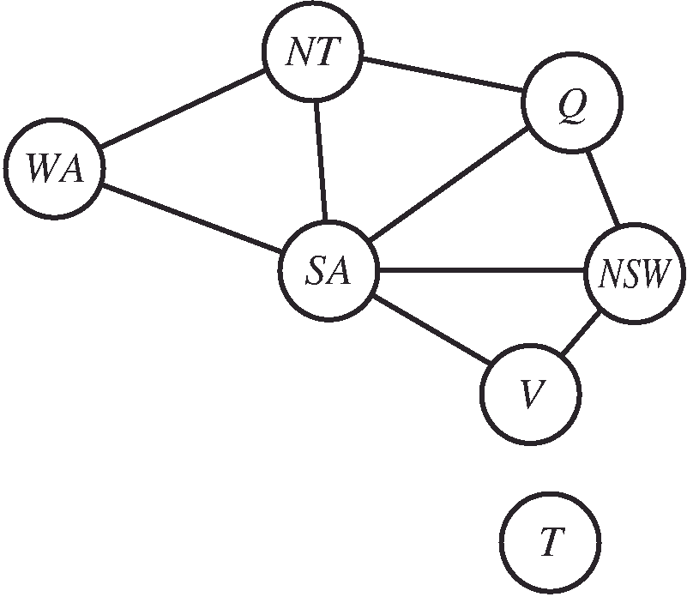
Example constraint propagation

Slide 10
Example arc consistency
Constraint: y = x²
x’s domain = {0, 1, 2, 3, 4, 5, 6, 7, 8, 9 }
y’s domain = {0, 1, 2, 3, 4, 5, 6, 7, 8, 9 }
how to make the arc x→ y consistent ?
Remove 4, 5, 6, 7, 8 and 9 from x’s domain
How to make the arc y→x consistent ?
Remove 2, 3, 5, 6, 7 and 8 from y’s domain
Results:
x’s domain = {0, 1, 2, 3}
y’s domain = {0, 1, 4, 9}

Slide 11
The arc-consistency algorithm AC-3
AC-3 initializes a queue that contains all the arcs in the CSP.
AC-3 then pops off an arbitrary arc (Xi,Xj) from the queue and makes Xi arc-consistent with respect to Xj.
If this leaves Di unchanged, the algorithm just moves on to the next arc. But if this revises Di (makes the domain smaller), then we add to the queue all arcs (Xk,Xi) where Xk is a neighbor of Xi. We need to do that because the change in Di might enable further reductions in the domains of Dk, even if we have previously considered Xk.
If Di is revised down to nothing, then we know the whole CSP has no consistent solution, and AC-3 can immediately return failure.
Otherwise, we keep checking, trying to remove values from the domains of variables until no more arcs are in the queue.
After applying AC-3, either every arc is arc-consistent, or some variable has an empty domain, indicating that the CSP cannot be solved.
Notes:
Don’t worry about the number 3, it is just because the AC-3 was the third variant of the algorithm in the original paper proposing this technique

Slide 12
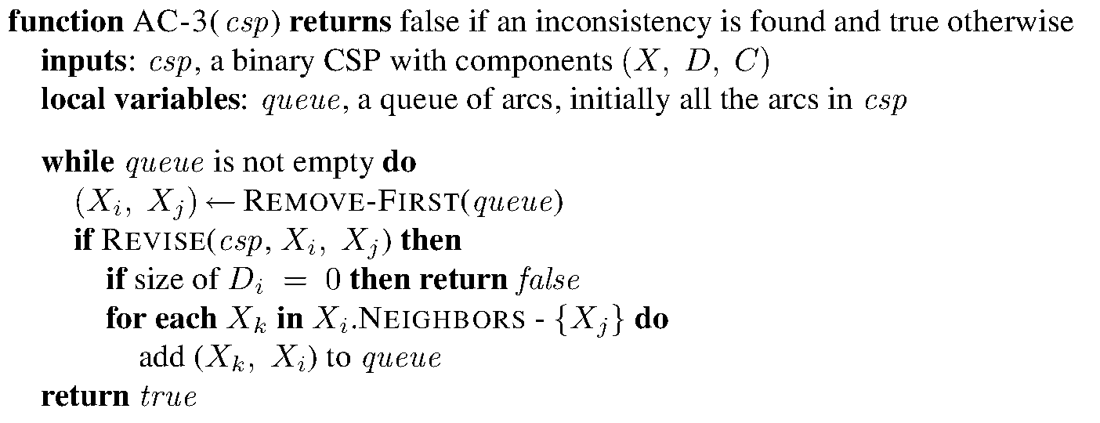
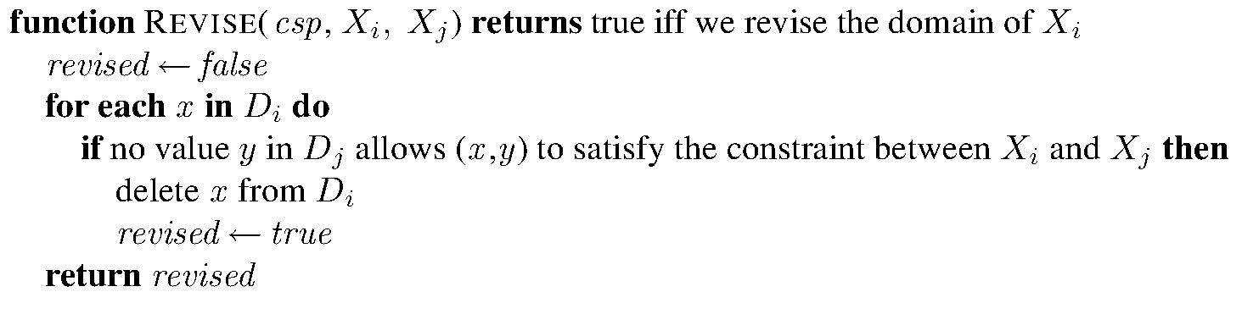
AC3 code

Slide 13
AC3 complexity
Consider a CSP with n variables, each with domain size at most d, and with c binary constraints (arcs).
Each arc (Xk,Xi) can be inserted in the queue only d times because Xi has at most d values to delete.
Checking consistency of an arc can be done in O(d²) time
So we get O(cd³) total worst-case time

Slide 14
Does arc consistency discover all failures?
This is arc consistent, but is there a solution ?
This is arc consistent, but is there a solution ?
Path consistency: A two-variable set {Xi,Xj} is path-consistent with respect to a third variable Xm if, for every assignment {Xi = a, Xj = b} consistent with the constraints on {Xi,Xj}, there is an assignment to Xm that satisfies the constraints on {Xi,Xm} and {Xm,Xj}.
Notes:
The generalization of arc consistency and path consistency is called K-consistency but it is not really practical beyond path consistency.
Strong K-consistency means K-consistent, k-1 consistent, …, path consistent and arc consistent.
If a CSP is strongly k-consistent, it can be solved without any backtracking (the first trial of assigning values to variables will work)

Slide 15
Generalized arc consistency
A variable Xi is generalized arc consistent with respect to an n-ary constraint if for every value v in the domain of Xi there exists a tuple of values that is a member of the constraint, has all its values taken from the domains of the corresponding variables, and has its Xi component equal to v.
Example, 3-ary constraint:
D_{x}=D_{y}=D_{z}={1, 2, 3, 4 }
To satisfy X<Y<Z; we must remove 3 and 4 from D_{x}

Slide 16
Backtracking search
Depth-first search
Choose values for one variable at a time
Backtrack when a variable has no legal values left to assign
Basic backtracking can solve n-queens for n ≈ 25

Slide 17
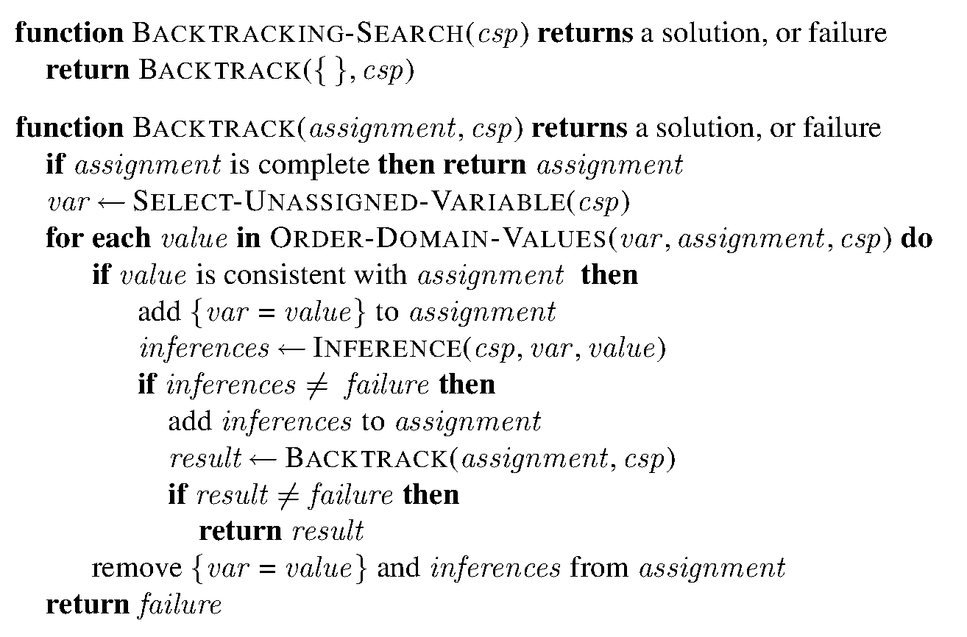
Backtracking code
How to order variables?
CV
How to order values
What type of inference? Forward checking? Arc consistency?
Always backtracking to the previous node, can we do better ?

Slide 18
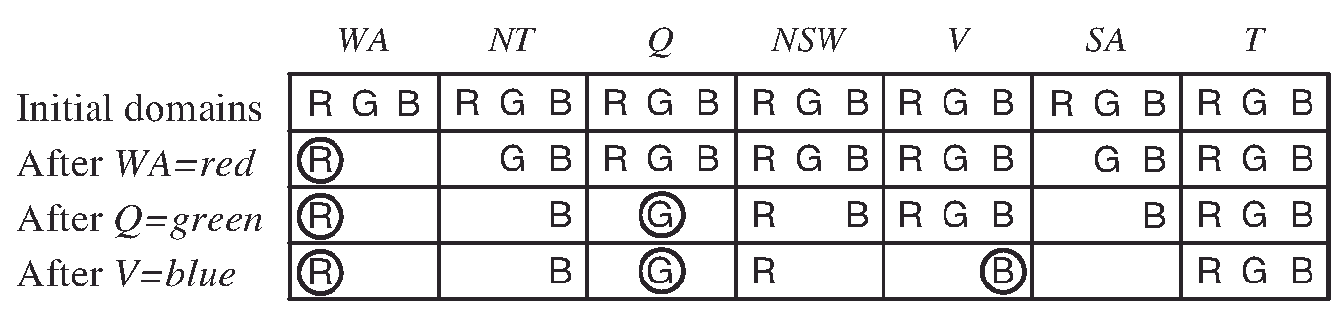
Inference (filtering)
Every time we make a choice of a value for a variable, we have a brand-new opportunity to infer new domain reductions on the neighboring variables.
Forward checking: Whenever a variable X is assigned, the forward-checking process establishes arc consistency for it. (i.e. all Y → X arcs)

Slide 19
Maintaining Arc Consistency
Forward checking does not detect all inconsistencies
MAC (for Maintaining Arc Consistency (MAC)) calls AC-3 after a variable Xi is assigned a value.
But instead of a queue of all arcs in the CSP, we start with only the arcs (Xj,Xi) for all Xj that are unassigned variables that are neighbors of Xi. From there, AC-3 does constraint propagation in the usual way.
If any variable has its domain reduced to the empty set, the call to AC-3 fails and we know to backtrack immediately.
Notes:
MAC is strictly more powerful than forward checking because forward checking does the same thing as MAC on the initial arcs in MAC’s queue; but unlike MAC, forward checking does not recursively propagate constraints when changes are made to the domains of variables.

Slide 20
Variable ordering
Minimum-remaining-values (MRV): choose the variable with the fewest “legal” values (i.e. the smallest domain)
The idea is that the MRV variable will probably lead to a failure, so let’s backtrack early
MRV performs better than random ordering with a factor of 1000 (depending on the problem)
Degree heuristic attempts to reduce the branching factor on future choices (can serve as a tie breaker for MRV)
Degree heuristic:
Choose SA first
Notes:
Degree heuristic selects the variable that is involved in the largest number of constraints on other unassigned variables

Slide 21
Value ordering
Least-constraining-value prefers the value that rules out the fewest choices for the neighboring variables in the constraint graph.
Q: Why should variable selection be fail-first, but value selection be fail-last?
A: For a wide variety of problems, a variable ordering that chooses a variable with the minimum number of remaining values helps minimize the number of nodes in the search tree by pruning larger parts of the tree earlier.
A: For value ordering, the trick is that we only need one solution; therefore it makes sense to look for the most likely values first.
Example:
Which value you would choose for Q?
If you choose Blue, you rule out all possibilities for SA → bad choice
LCV suggests choosing Red
2
3 ?
1
Combining all these heuristics makes 1000 queens feasible

Slide 22
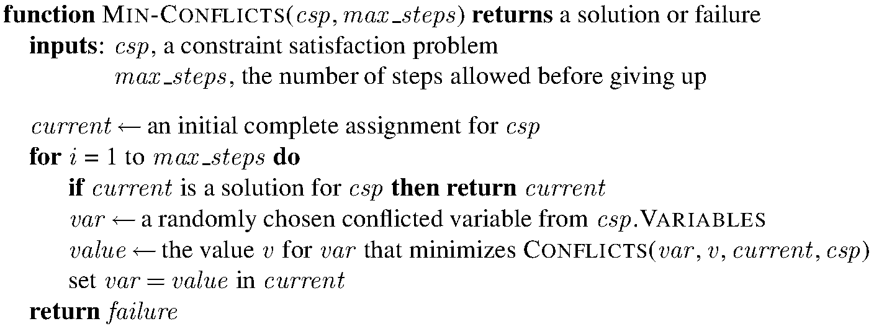
Local search – Min conflict heuristic
Use a complete-state formulation
Change the value of one variable at a time
Select the value that results in the minimum number of conflicts with other variables

Slide 23
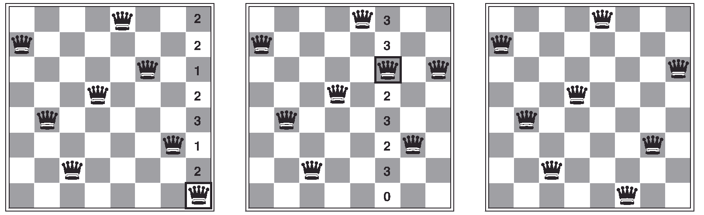
Min-conflict heuristic example
A two-step solution using min-conflicts for an 8-queens problem
Min-conflicts is surprisingly effective for many CSPs. Amazingly, It solves even the million-queens problem in an average of 50 steps.

Slide 24
Structure of CSPs
Independent sub-problems:
CSP with domain size d and n variables → O(d^{n})
If the problem can be divided into smaller problems where each sub-problem has c variables → O( (n/c)*d^{c} ) → linear in n
Independent sub-problems are connected components of the constraint graph
Any tree-structured CSP can be solved in time linear in the number of variables
Notes:
Dividing a Boolean CSP with 80 variables into four subproblems reduces
the worst-case solution time from the lifetime of the universe down to less than a second!!

Slide 25
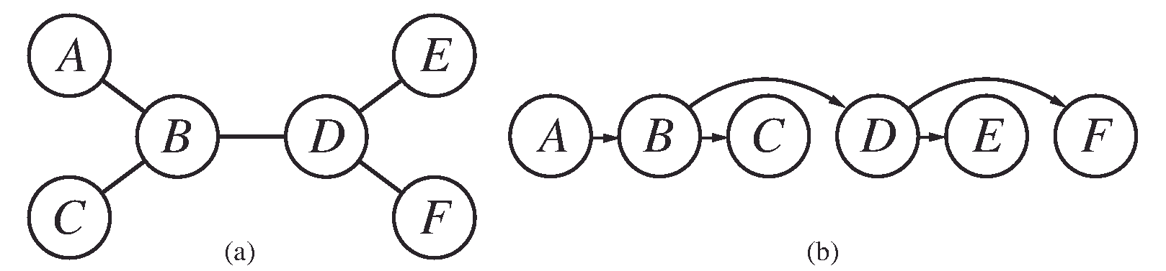
Directed Arc Consistency (DAC)
Topological sort: choose an ordering of the variables such that each variable appears after its parent in the tree
N variables → N-1 arcs → enforcing arc consistency takes O(d²N)
Once we have a directed arc-consistent graph, we can just march down the list of variables and choose any remaining value
We won’t have to backtrack

Slide 26
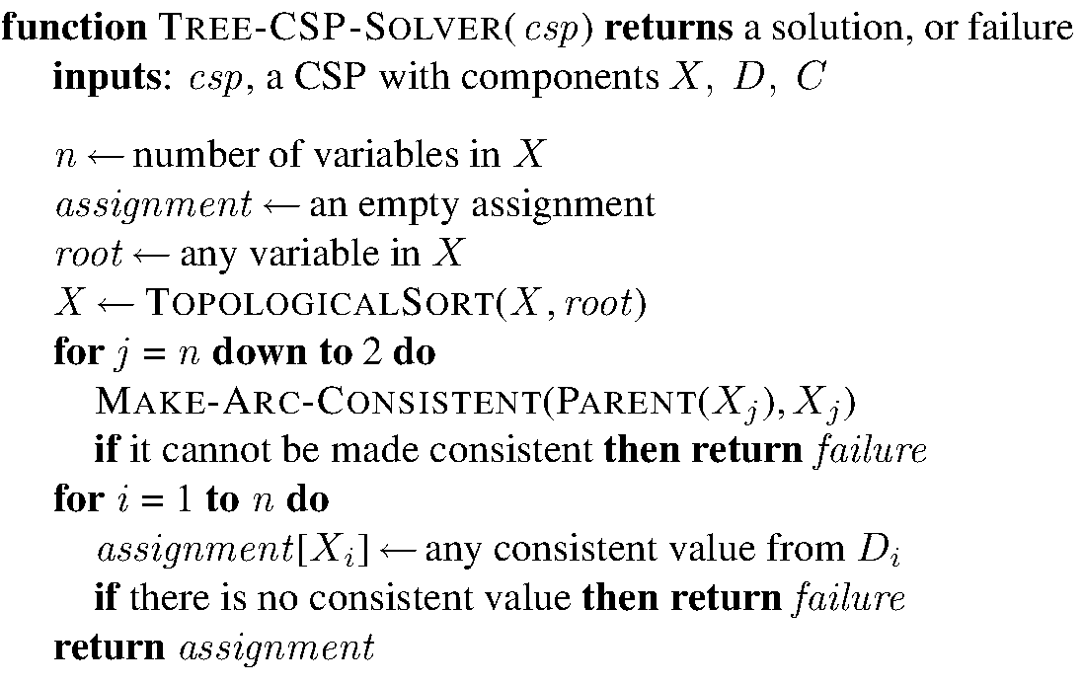
Tree CSP solver

Slide 27
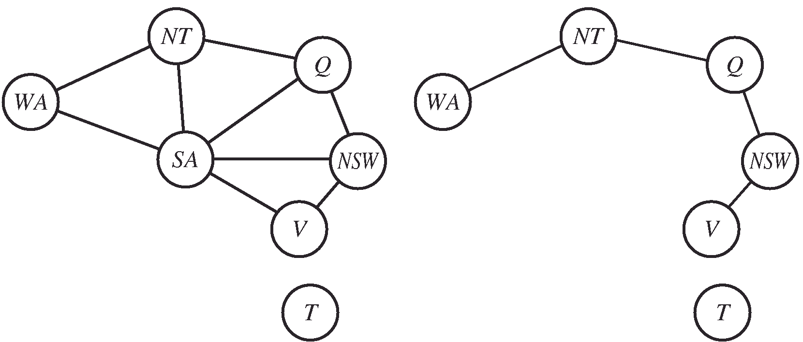
Some graphs can be reduced to trees somehow
Choose value for SA
Delete all inconsistent values from the nodes connected to SA
SA is called a cycle cutset
If the cycle cutset has size c, then the total run time is O(d^{c} (n − c)d²)

Slide 28
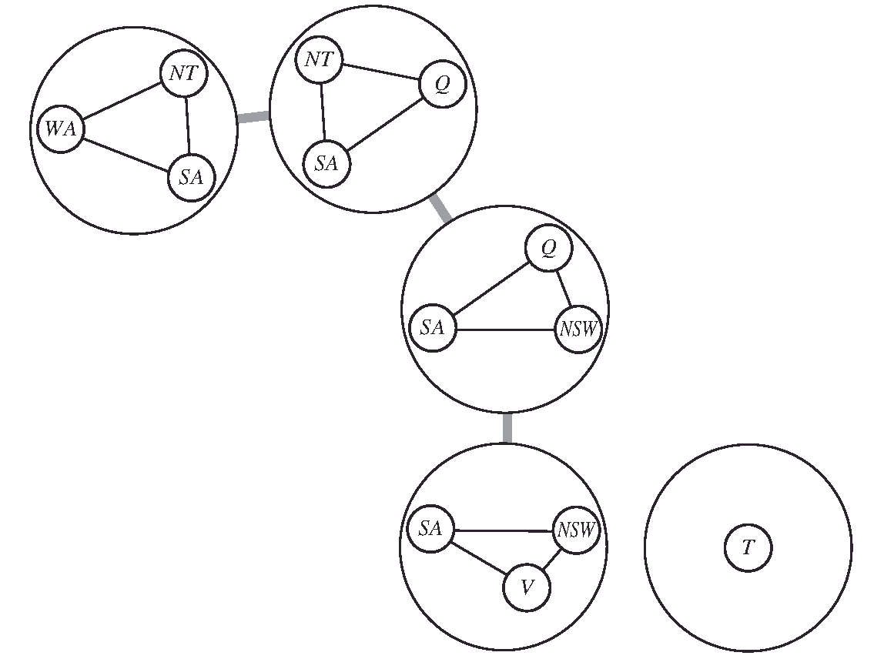
Tree decomposition
If any sub-problem has no solution → the CSP has no solution
This constraint means that NT must have the same value in both sub-problems, same for SA
We solve the constraints connecting the
sub-problems, using the tree CSP solver given earlier
The domain for a mega variable is composed of the possible solutions for its sub-problem

Slide 29
Exercise 1: Course scheduling
You are in charge of scheduling for computer science classes that meet Mondays, Wednesdays and Fridays.
There are 5 classes that meet on these days and 3 professors who will be teaching these classes.
You are constrained by the fact that each professor can only teach one class at a time.
The classes are:
Class 1 - Intro to Programming: meets from 8:00-9:00am
Class 2 - Intro to Artificial Intelligence: meets from 8:30-9:30am
Class 3 - Natural Language Processing: meets from 9:00-10:00am
Class 4 - Computer Vision: meets from 9:00-10:00am
Class 5 - Machine Learning: meets from 10:30-11:30am
The professors are:
Professor A, who is qualified to teach Classes 1, 2, and 5.
Professor B, who is qualified to teach Classes 3, 4, and 5.
Professor C, who is qualified to teach Classes 1, 3, and 4.
Formulate this problem as a CSP problem in which there is one variable per class, stating the domains, and constraints. Constraints should be specified formally and precisely, but may be implicit rather than explicit.

Slide 30
Course scheduling
Draw the constraint graph associated with your CSP
Your CSP should look nearly tree-structured. Briefly explain (one sentence or less) why we might prefer to solve tree-structured CSPs.

Slide 31

Solution
Variables Domains (or unary constraints)
C1 $∈${A, C}
C2 $∈${A}
C3 $∈${B, C}
C4 $∈${B, C}
C5 $∈${A, B}
Binary Constraints
C1 ≠ C2
C2 ≠ C3
C2 ≠ C4
C3 ≠ C4
We can solve nearly tree structured in polynomial time. If a graph is tree structured (i.e. has no loops), then the CSP can be solved in O(nd²) time as compared to general CSPs, where worst-case time is O(d^{n}).
For tree-structured CSPs you can choose an ordering such that every node's parent precedes it in the
ordering. Then after enforcing arc consistency you can greedily assign the nodes in order, starting from
the root, and will find a consistent assignment without backtracking.

Slide 32
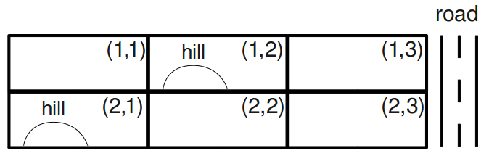
Exercise 2: campus layout
4 variables:
an administration (A),
a bus stop (B),
a classroom (C),
and a dormitory (D).
Constraints:
(B) must be adjacent to the road.
(A) and (C) must both be adjacent to (B).
(C) must be adjacent to (D).
(A) must not be adjacent to the dormitory (D).
(A) must not be on a hill.
(D) must be on a hill or adjacent to the road.
All structures must be in different grid squares.
Which of the constraints are unary constraints?
Select the domains of all variables after unary constraints have been applied?
Notes:
1. Constraints 1, 5, 6 are unary
2. B={(1,3);(2,3)} ; A={(1,1);(2,2);(1,3);(2,3)} ; D={(1,2);(2,1);(1,3);(2,3)}, C = All

Slide 33
Exercise 2: campus layout
Constraints:
(A) and (C) must both be adjacent to (B).
(C) must be adjacent to (D).
(A) must not be adjacent to the dormitory (D).
All structures must be in different grid squares.
B={(1,3);(2,3)} ; A={(1,1);(2,2);(1,3);(2,3)} D={(1,2);(2,1);(1,3);(2,3)}
C = All
3. Enforce arc consistency A->B
Notes:
A={(2,2);(1,3);(2,3)}

Slide 34
Exercise 2: campus layout
B={(1,3);(2,3)} ;
A={(2,2);(1,3);(2,3)} D={(1,2);(2,1);(1,3);(2,3)}
C = All
Enforcing consistency for A → C, A → D, B → A, B → C, B → D, and C → A do not change the domains of any variables. After enforcing these arcs, the next is C → B.
4. Enforce arc consistency C → B.
Constraints:
(A) and (C) must both be adjacent to (B).
(C) must be adjacent to (D).
(A) must not be adjacent to the dormitory (D).
All structures must be in different grid squares.
Notes:
C={(1,2);(2,2);(1,3);(2,3)}

Slide 35
Exercise 2: campus layout
B={(1,3);(2,3)} ;
A={(2,2);(1,3);(2,3)} D={(1,2);(2,1);(1,3);(2,3)}
C={(1,2);(2,2);(1,3);(2,3)}
5. What arcs got added to the queue while enforcing C → B? Remember that the queue contained C → D, D → A, D → B, and D → C prior to enforcing C → B.
Constraints:
(A) and (C) must both be adjacent to (B).
(C) must be adjacent to (D).
(A) must not be adjacent to the dormitory (D).
All structures must be in different grid squares.
Notes:
A->C

Slide 36
Exercise 2: campus layout
B={(1,3);(2,3)} ;
A={(2,2);(1,3);(2,3)} D={(1,2);(2,1);(1,3); (2,3) }
C={(1,2);(2,2);(1,3);(2,3)}
6. Continuing from the previous parts, select the domains of all variables after enforcing arc consistency until the queue is empty. Remember that the queue currently contains C → D, D → A, D → B, D → C, B → C and A → C.
Constraints:
(A) and (C) must both be adjacent to (B).
(C) must be adjacent to (D).
(A) must not be adjacent to the dormitory (D).
All structures must be in different grid squares.
Notes:
C->D: nothing change
D->A: remove (2,3) from D’s domain (A must not be adjacent to D) ; re-add arcs A->D; B->D and C->D but nothing change
D->B: nothing
D->C: nothing
B->C: nothing
A->C: nothing

Slide 37
Exercise 2: campus layout
B={(1,3);(2,3)} ;
A={(2,2);(1,3);(2,3)}
D={(1,2);(2,1);(1,3) }
C={(1,2);(2,2);(1,3);(2,3)}
7. If arc consistency had resulted in all domains having a single value left, we would have already found a solution. Similarly, if it had found that any domain had no values left, we would have already found that no solution exists. Unfortunately, this is not the case in our example (as you should have found in the previous part). To solve the problem, we need to start searching. Use the MRV (minimum remaining values) heuristic to choose which variable gets assigned next (breaking any ties alphabetically).
Which variable gets assigned next?
Notes:
B

Slide 38
Exercise 2: campus layout
Constraints:
(A) and (C) must both be adjacent to (B).
(C) must be adjacent to (D).
(A) must not be adjacent to the dormitory (D).
All structures must be in different grid squares.
B={(1,3);(2,3)} ;
A={(2,2);(1,3);(2,3)}
D={(1,2);(2,1);(1,3) }
C={(1,2);(2,2);(1,3);(2,3)}
8. Which value of B has the largest number of values remaining (and therefore is the least constraining value)? Use arc consistency.
Notes:
If we choose B=(1,3).
Enforce A->B : A=(2,3) / 2 values removed
Enforce C->B: / 2 values removed
Enforce D->B: nothing; …
If we choose B=(2,3), one value will be removed from A … => B=(2,3) is LCV

Slide 39
Exercise 2: campus layout –Solution
A
D
C
B
Constraints:
(A) and (C) must both be adjacent to (B).
(C) must be adjacent to (D).
(A) must not be adjacent to the dormitory (D).
All structures must be in different grid squares.
B=(2,3)
A={(2,2);(1,3);(2,3)}
D={(1,2);(2,1);(1,3) }
C={(1,2);(2,2);(1,3);(2,3)}
9. Enforce arc consistency and return the result of the backtracking algorithm
Notes:
A->B => A={(2,2);(1,3)}
C->B =>C ={(2,2);(1,3)}
D->A=> D={(2,1);(1,3) }
C->D =>C=(2,2)
A->C => A=(1,3)
D->A => D=(2,1)

Slide 40
Ex 3
Select all of the following statements about CSPs that are true.
Even when using arc consistency, backtracking might be needed to solve a CSP.
Even when using forward checking, backtracking might be needed to solve a CSP.
None of the above
Notes:
1 and 2

Slide 41
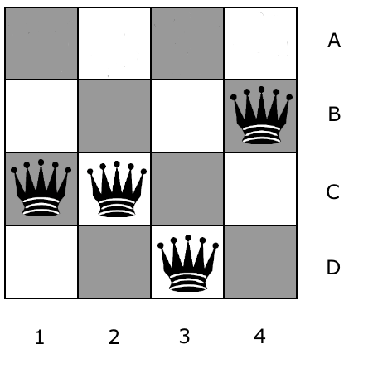
Ex 4: min-conflict
Execute the following min-conflict algorithm:
Choose the leftmost queen in conflict
Change its position as required by min-conflict (topmost for tie break)
Repeat
What are the executed steps and the found solution?
Notes:
1 -> A
2-> A
1 -> C
Done

Slide 42
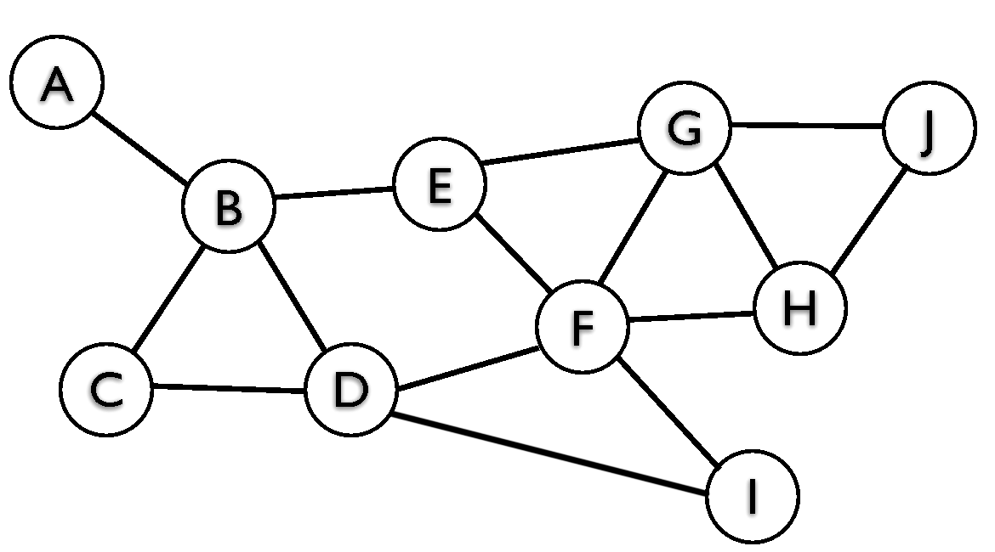
Ex 5: Nearly tree-structured
Select the variables that are in the smallest cutset of this graph. Note: in general, this is a computationally difficult problem. We have not seen an algorithm to compute the minimum cutset in lecture, but for a small graph you should be able to do it by hand (with some effort)
Notes:
D and G

Slide 43
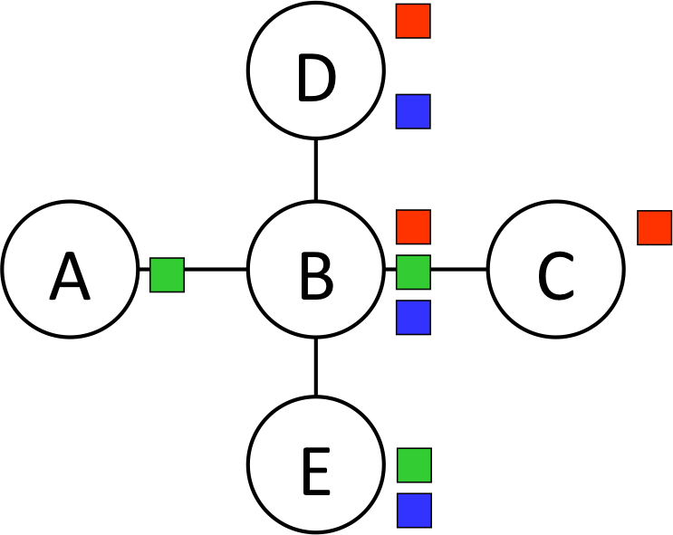
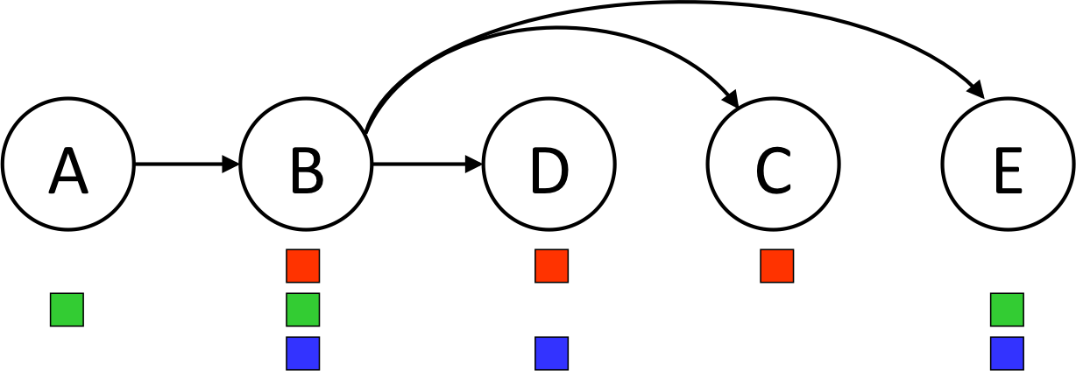
Ex 6: SOLVING TREE-STRUCTURED CSPS
Step 1: Remove Backward
In this step we start with the right-most node (E), enforce arc-consistency for its parent (B), then do the same for the second-to-right-most node (C) and its parent (B), and so on. Execute this process, and then mark the remaining values for each variable.
Notes:
B: B/G
A: G
C: R
D: R/B
E: G/B

Slide 44
Ex 6: SOLVING TREE-STRUCTURED CSPS
Step 2: Assign Forward
Now that all domains have been pruned, we can find the solution in a single forward pass (i.e. no need for backtracking). This is done by starting at the left-most node (A), picking any value remaining in its domain, then going to the next variable (B), picking any value in its domain that is consistent with its parent, and continue left to right, always picking a value consistent with its parent’s assignment.
Break ties by picking red over green, and then green over blue.
What is the solution found by running the algorithm?
Notes:
B: B
A: G
C: R
D: R
E: G

Slide 45
Ex 7
Consider the problem of arranging the schedule for an event. There are three time slots: 1, 2, and 3. There are three presenters: A, B, and C. The variables for the CSP will then be A, B, and C, each with domain {1, 2, 3}. The following constraints need to be satisfied:
A, B, and C all need to take on different values
A<C
Enforce arcs A→ C ; B→A and C→A
What are the new domains of the variables
Notes:
A = {1,2}
B = {1,2, 3}
C={2,3}

