Slide 1
Artificial Intelligence
D-separation
Notes:
Slides and exercises are inspired by Russell & Norvig AI Book, Stanford’s AI course and from Berkeley’s AI course

Slide 2
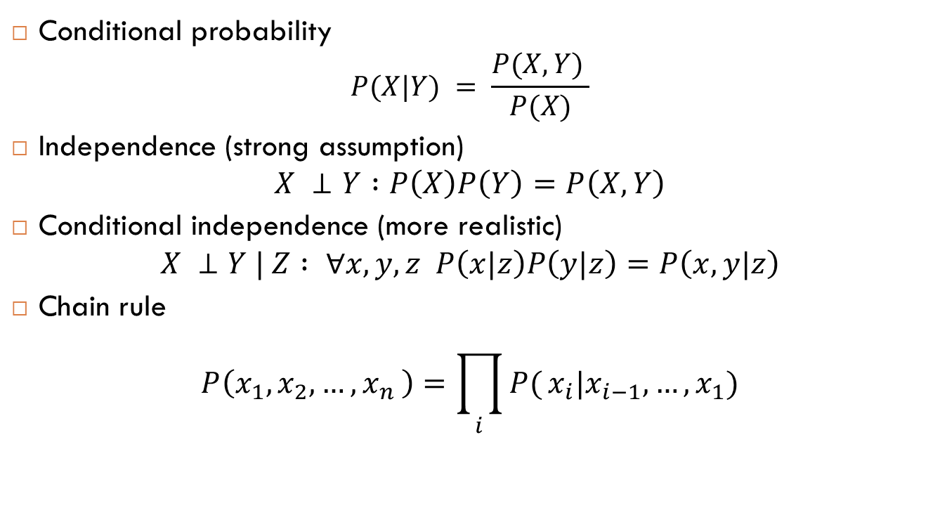
Probability recap
Conditional probability
$$P(X|Y) = \frac{P(X,Y) }{P(X)}$$
Independence (strong assumption)
$$X ⊥Y :P\left(X\right)P\left(Y\right)=P\left(X,Y\right)$$
Conditional independence (more realistic)
$$X ⊥Y | Z : ∀x,y,z P\left(x|z\right)P\left(y|z\right)=P\left(x,y|z\right)$$
Chain rule
$$P\left(x_{1},x_{2},{…,x}_{n}\right)=\prod_{i}{P(}x_{i}|x_{i−1}, …,x_{1})$$

Slide 3
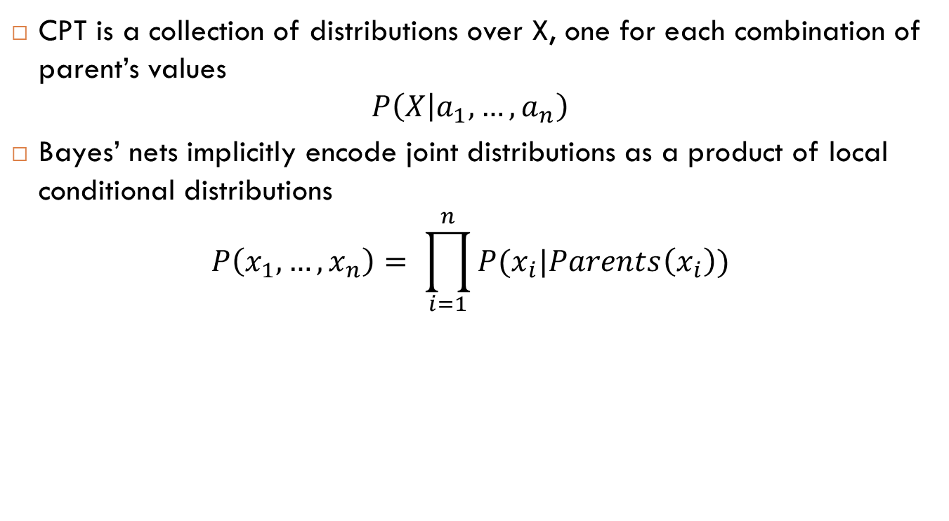
Bayes Nets
CPT is a collection of distributions over X, one for each combination of parent’s values
$$P\left(X | a_{1}, …,a_{n}\right)$$
Bayes’ nets implicitly encode joint distributions as a product of local conditional distributions
$$P\left(x_{1}, …,x_{n}\right)= \prod_{i=1}^{n}{P(x_{i}|Parents\left(x_{i}\right))}$$

Slide 4
Size of Bayes Nets
Size of joint distribution for N Boolean variables: O(2^{N})
Size of a Bayes Net for N Boolean variables where a variable has up to K parents: O(N.2^{K+1})
Both give us the power to compute
Joint distributions
Answer queries (causal and diagnostic)
But BN have huge space savings and is faster for queries
Notes:
We can also say it is O(N.2^{K}), since half the parameters of CPTs can be deducted from the other half: P(+a|+b) = 1- P(-a|+b)

Slide 5


D-separation or reachability
Common cause: Test1 and test2 are conditionally independent knowing C
Causal chain A→C→B: A and B are conditionally independent knowing C
Explaining away: S and R are conditionally dependent knowing W
X
Z
Y
X
Z
Y
X
Z
Y
D-separated
D-separated
D-separated
Notes:
Explaining away is also known as common effect and sometimes simply the (V)

Slide 6
Assumptions
By definition of Bayes nets, we are making the assumption that nodes are conditionally independent of other nodes given their parents
Beyond this, often additional conditional independences assumptions can be deducted
These additional assumptions can be read off the graph using the d-separation properties

Slide 7
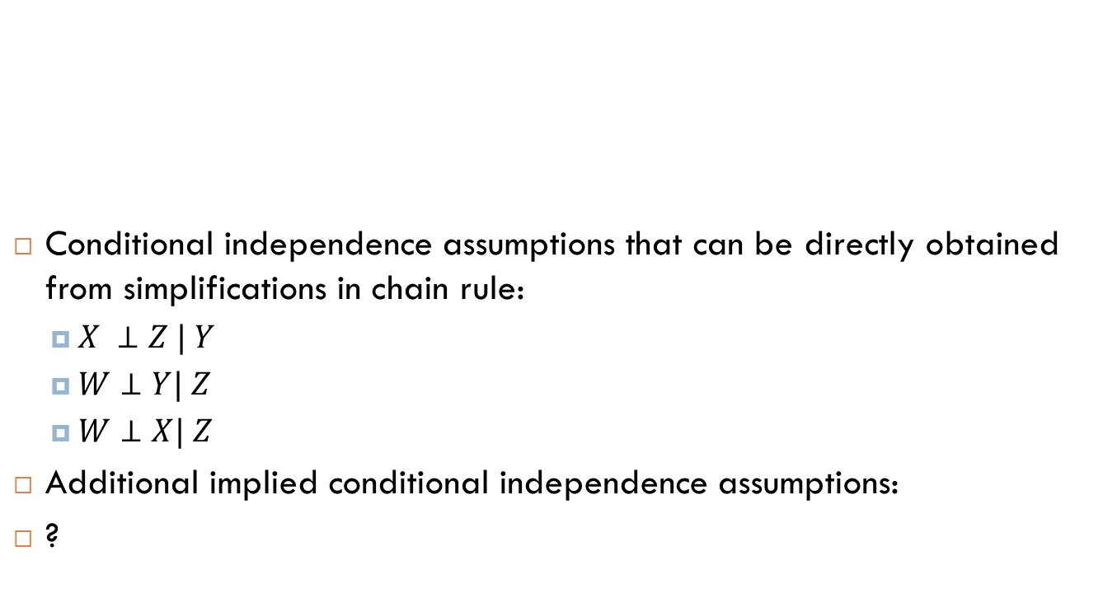
Example
Conditional independence assumptions that can be directly obtained from simplifications in chain rule:
$X ⊥Z | Y$
$W⊥Y| Z$
$W⊥X| Z$
Additional implied conditional independence assumptions:
?
X
Y
Z
W

Slide 8
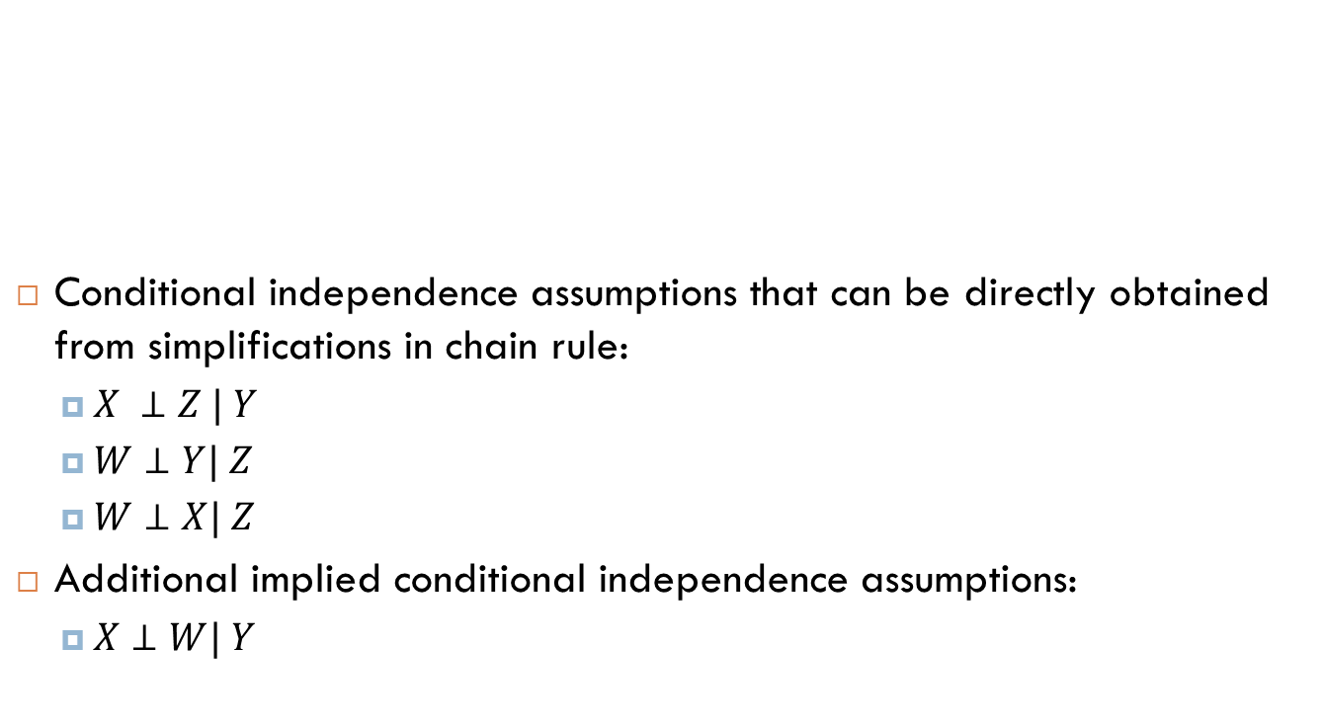
Example
Conditional independence assumptions that can be directly obtained from simplifications in chain rule:
$X ⊥Z | Y$
$W⊥Y| Z$
$W⊥X| Z$
Additional implied conditional independence assumptions:
$X⊥W| Y$
X
Y
Z
W

Slide 9
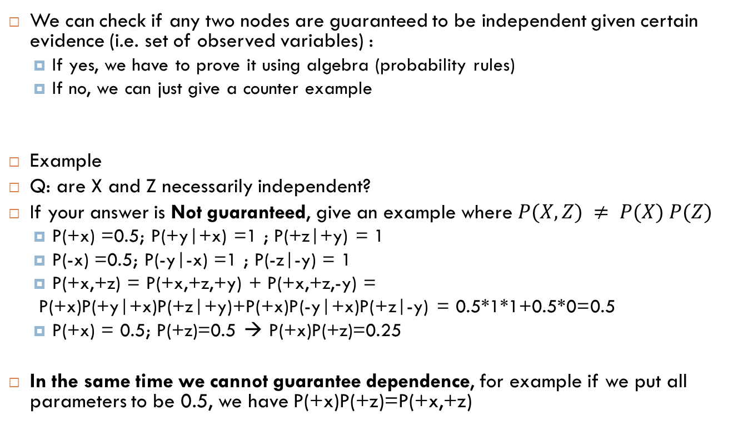
Independence in BN
We can check if any two nodes are guaranteed to be independent given certain evidence (i.e. set of observed variables) :
If yes, we have to prove it using algebra (probability rules)
If no, we can just give a counter example
Example
Q: are X and Z necessarily independent?
If your answer is Not guaranteed, give an example where $P(X,Z) ≠ P(X) P(Z)$
P(+x) =0.5; P(+y|+x) =1 ; P(+z|+y) = 1
P(-x) =0.5; P(-y|-x) =1 ; P(-z|-y) = 1
P(+x,+z) = P(+x,+z,+y) + P(+x,+z,-y) =
P(+x)P(+y|+x)P(+z|+y)+P(+x)P(-y|+x)P(+z|-y) = 0.5*1*1+0.5*0=0.5
P(+x) = 0.5; P(+z)=0.5 → P(+x)P(+z)=0.25
In the same time we cannot guarantee dependence, for example if we put all parameters to be 0.5, we have P(+x)P(+z)=P(+x,+z)
X
Y
Z

Slide 10
D-separation
An algorithm to answer independence queries without doing the tedious algebra
Decompose complex cases into paths and paths into triples

Slide 11
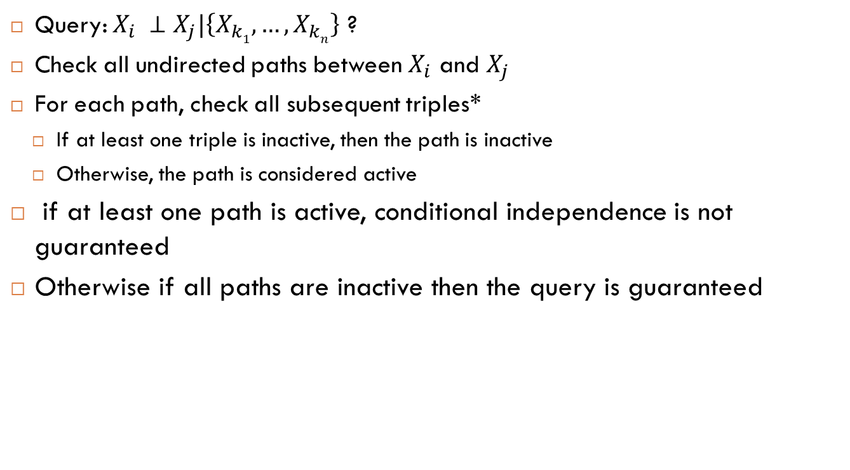
D-separation
Query: $X_{i} ⊥X_{j}|\left\{X_{k1}, …,X_{kn}\right\}$ ?
Check all undirected paths between $X_{i}$ and $X_{j}$
For each path, check all subsequent triples*
If at least one triple is inactive, then the path is inactive
Otherwise, the path is considered active
if at least one path is active, conditional independence is not guaranteed
Otherwise if all paths are inactive then the query is guaranteed
Notes:
*(each node different than the soure and the destination of the path must be tried as a middle of a triple)

Slide 12

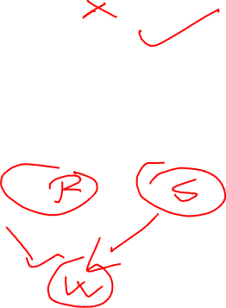
D-separation exercise
$C⊥A ?$
$C⊥A | B ?$
$C⊥D ?$
$C⊥D | A ?$
$E⊥C | D ?$
A
B
D
C
E

Slide 13

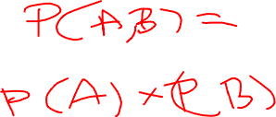
D-separation exercise
$C⊥A$Not guaranteed
$C⊥A | B ?$ Yes
$C⊥D ?$ Not guaranteed
$C⊥D | A ?$ Yes
$E⊥C | D ?$ Yes
A
B
D
C
E

Slide 14


D-separation exercise
$A⊥E ?$
$A⊥E|B ?$
$A⊥E|C ?$
$A⊥B?$
$A⊥B|C?$
A
B
C
D
E

Slide 15

D-separation exercise
$A⊥E ?$ Not guaranteed
$A⊥E|B ?$ Not guaranteed
$A⊥E|C ?$ Yes
$A⊥B?$ Yes
$A⊥B|C?$ Not guaranteed
A
B
C
D
E

Slide 16

D-separation exercise
$F⊥A ?$
$F⊥A|D ?$
$F⊥A|G ?$
$F⊥A|H?$
A
C
F
B
E
H
D
G

Slide 17

D-separation exercise
$F⊥A ?$ Yes
$F⊥A|D ?$ Not guaranteed
$F⊥A|G ?$ Not guaranteed
$F⊥A|H?$ Yes
A
C
F
B
E
H
D
G

Slide 18
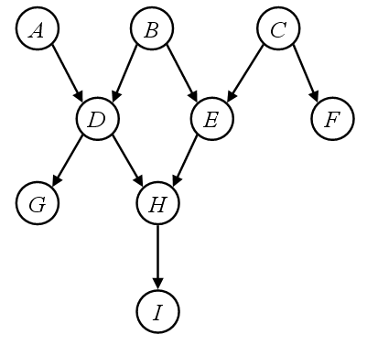
Markov Blanket
Pearl* has proved that a node is d-separated by its parents, its children and the parents of its children from the remaining nodes of the graph.
Notes:
https://en.wikipedia.org/wiki/Judea_Pearl

Slide 19
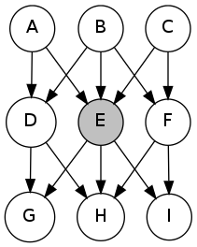
I independent of G given E?
Notes:
No

Slide 20
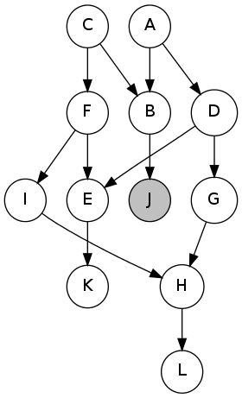
I is independent of D given J?
Notes:
No

Slide 21
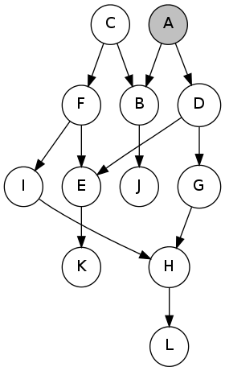
K is independent of H given A?
Notes:
No

Slide 22
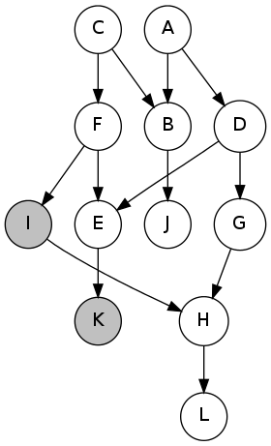
D is independent of H given I,K?
Notes:
No

Slide 23
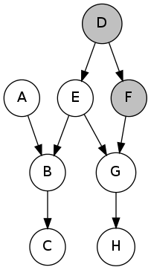
B is independent of H given F,D?
Notes:
No

Slide 24
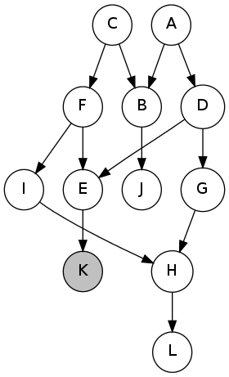
E is independent of A given K?
Notes:
No

