Slide 1
102-1 Under-Graduate Project Case Study: Single-path Delay Feedback FFT
Speaker: Darcy Tsai
Advisor: Prof. An-Yeu Wu
Date: 2013/10/31

Slide 2
Outline
Introduction of Fast Fourier Transform (FFT)
DFT/IDFT & FFT/IFFT
Flow Graph of FFT Algorithm
Hardware Implementation
Radix-n FFT Algorithm
System Design Flow
Floating Point Modeling
Fixed Point Modeling
Simulation

Slide 3
DFT/IDFT
Definition of Discrete Fourier Transform (DFT) and Inverse DFT (IDFT)
x[n]
Time domain
sequence
DFT
X[k]
Frequency domain
spectrum
IDFT
Twiddle factor :

Slide 4
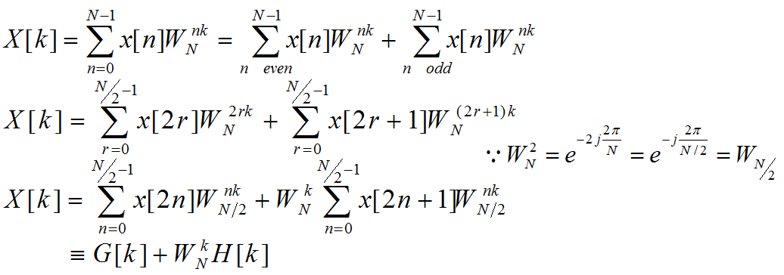
FFT/IFFT
Fast Fourier Transform (FFT) is based on the concept of “Divide-and-Conquer”
The complexity of DFT: N²
The complexity of FFT: Nlog₂N
Decimation-in-Time (DIT) FFT Algorithm —

Slide 5
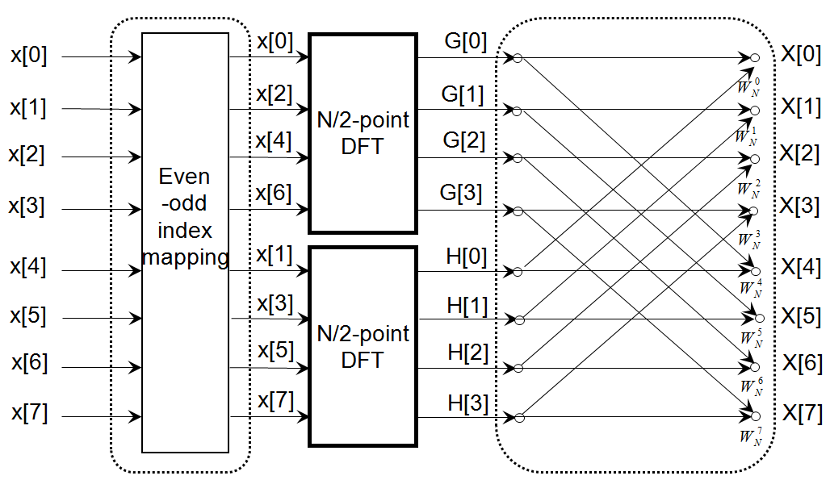
Flow Graph of DIT FFT Algorithm
Pre-processing
Post-processing

Slide 6
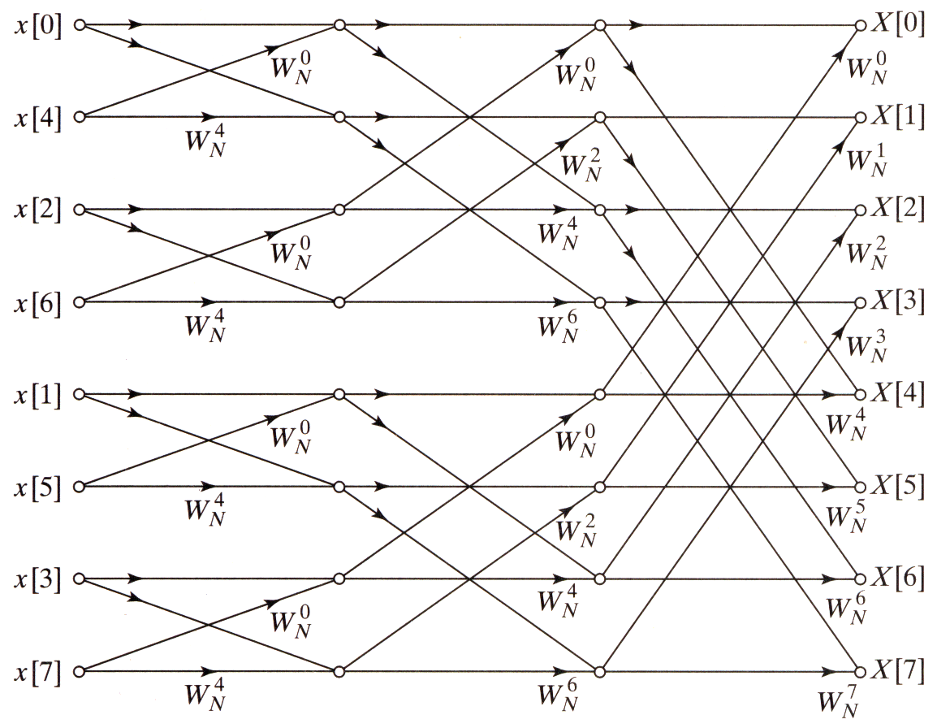
Flow Graph of DIT FFT Algorithm
Computation: Nlog₂N
N
N
N
log₂N stages

Slide 7
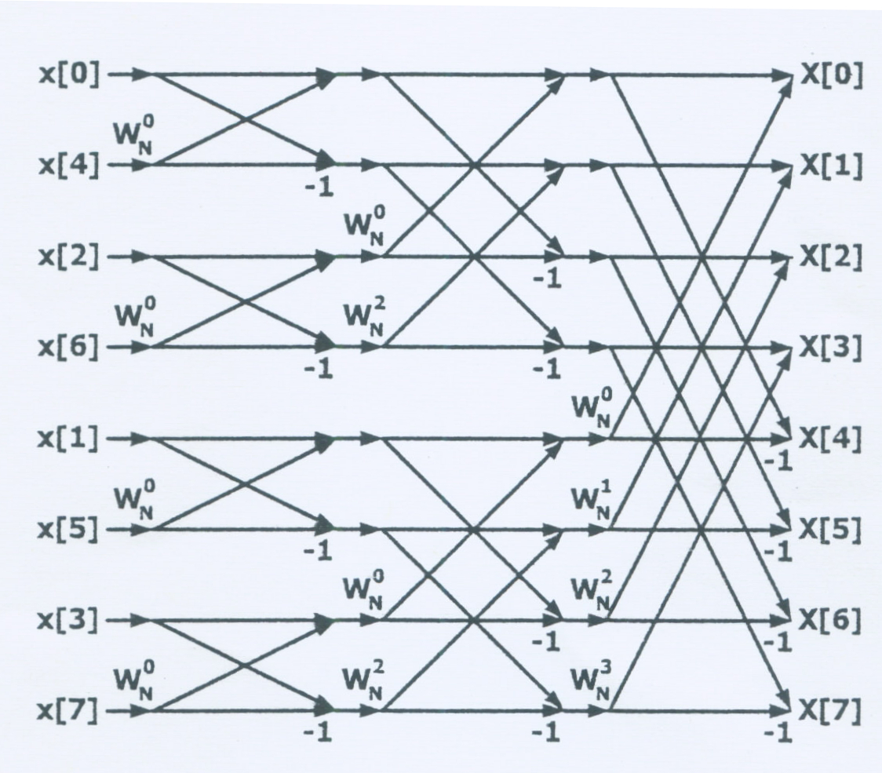
Flow Graph of DIT FFT Algorithm
DFT-4
DFT-2
Bit-reverse order
Normal order
000
100
010
110
001
101
011
111
000
001
010
011
100
101
110
111
[1]

Slide 8
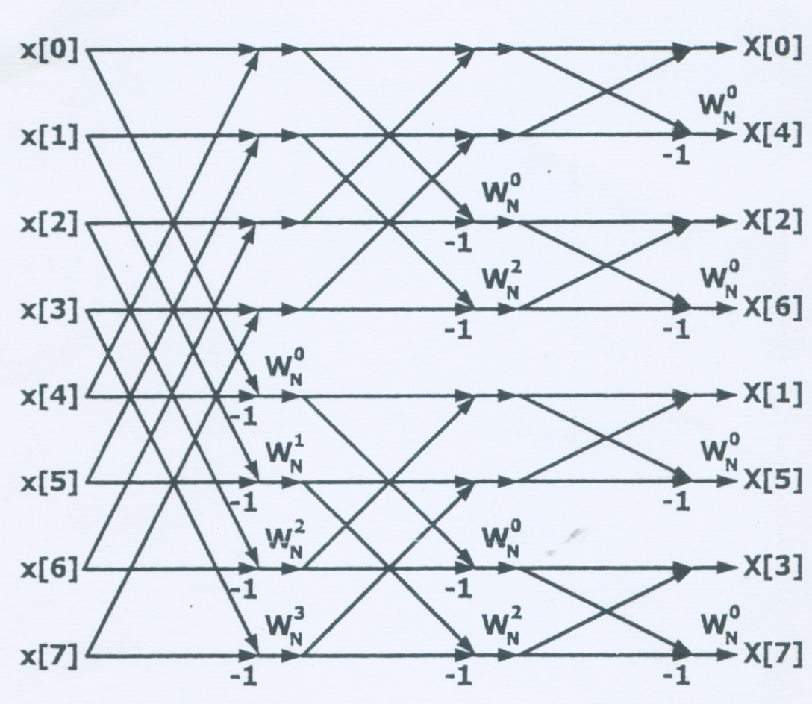
Flow Graph of DIF FFT Algorithm
DFT-2
DFT-4
Normal order
Bit-reverse order
000
001
010
011
100
101
110
111
000
100
010
110
001
101
011
111
[1]

Slide 9
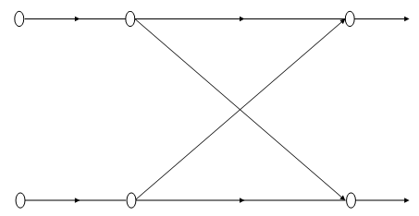
Hardware Implementation
Fully Spread
Reuse of Single Butterfly
Slow ← ———— Speed ———— → Fast
Small ← ———— Area ———— → Large
Complex ← ———— Control ———— → Simple

Slide 10
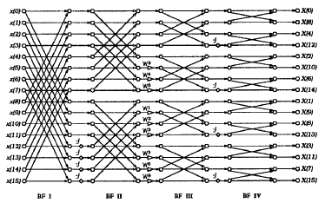
Hardware Implementation
[2]

Slide 11
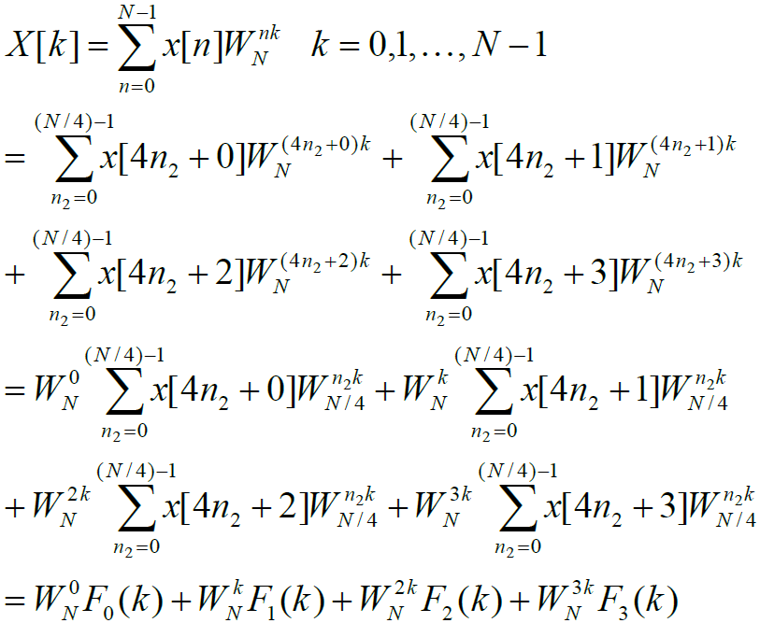
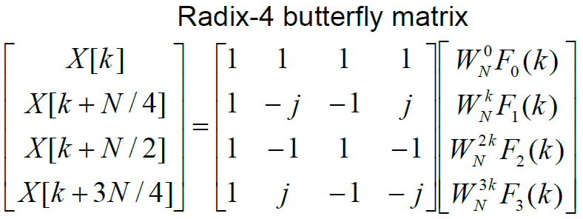
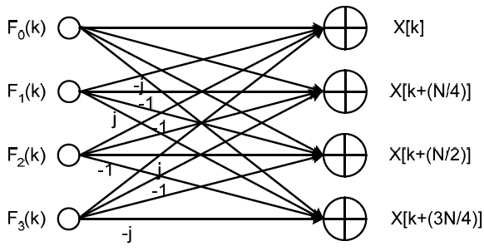
Radix-4 FFT Algorithm
Radix-4: decimation into 4 groups

Slide 12
Radix-2 Single-path Delay Feedback for N=16
Radix-4 Single-path Delay Feedback for N=256
[2]

Slide 13
Radix-n FFT Algorithm
For Radix-n FFT, the complexity is Nlog_{n}N
Larger N —
Less complex multiplier
Less stages
More complex butterfly structure
Designing at algorithm level outperforms others
Pipeline, Parallel, Retiming, Folding/Unfolding

Slide 14
Relationship of Radix-4 & Radix-2²
BF4
BF2i
BF2ii
[2]

Slide 15
Radix-2² Single-path Delay Feedback for N=256
s
t
s
t
s
t
s
t
BF2i
BF2ii
Xr(n)
0
Zr(n+N/2)
Xr(n)
0
Zr(n+N/2)
1
1
Xi(n)
0
Zi(n+N/2)
Xi(n)
0
Zi(n+N/2)
1
1
±
Xr(n+N/2)
-
1
Zr(n)
Xr(n+N/2)
0
-
1
Zr(n)
0
1
0
Xi(n+N/2)
-
1
Zi(n)
Xi(n+N/2)
1
1
Zi(n)
0
0
±
0
s
[2]
s
t

Slide 16
System Design Flow
Physical Model
MATLAB
Floating Point Model
Fixed Point Model
Optimize
Simulation
MATLAB
Verilog
Verification

Slide 17
Floating Point Model
Implemented with MATLAB / C code
Translate physical structure to high level language
Keep original signal flow intact

Slide 18
Floating Point Model
Butterfly(16)
Butterfly(8)
Butterfly(4)
Butterfly(2)
-j
-j
-j
-j
-j
-j
-j
-j

Slide 19
Fixed Point Model
Simulate truncation due to limited word-length
Dynamic range of input is critical
Ex: Only 3-bit of fractional part
1.422₍₁₀₎ → 1.422₍₁₀₎ (floating point)
1.422₍₁₀₎ → 1.011011₍₂₎ = 1 + 2⁻²+ 2⁻³ = 1.375
Input signal are truncated to limited precision
Apply truncation where arithmetic is applied after the multiplier module
Twiddle factors are also truncated before introduced to multiplier
Fixed Point Model of FFT

Slide 20
Fixed Point Model of FFT
-j
-j
-j
-j
-j
-j
-j
-j

Slide 21
Simulation
Parameterize the word-lengths of input
Integer word-length
Fractional word-length
Twiddle factor word-length
Insert randomly generated floating point input
Compare with floating point result from MATLAB (SQNR computing)

Slide 22
Calculation of SQNR
SQNR: Signal-to-Quantization-Noise Ratio

Slide 23
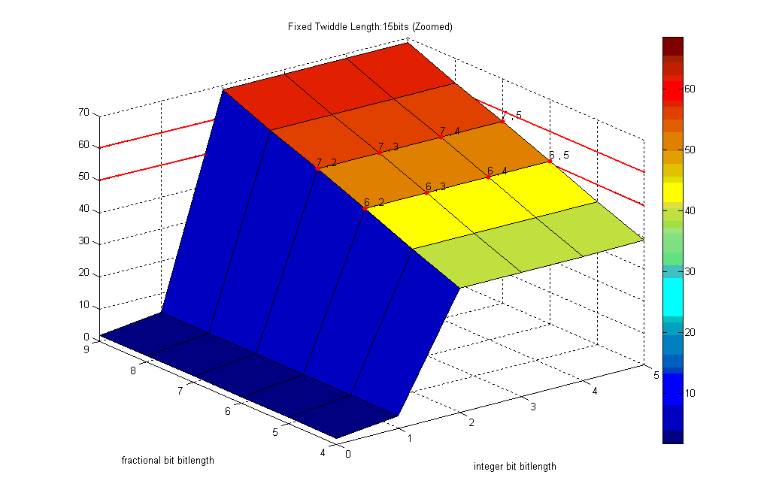
Optimal set: 2+6 = 8
Integer 2 bits
Fractional 6 bits
Notes:
Fixed twiddle

Slide 24
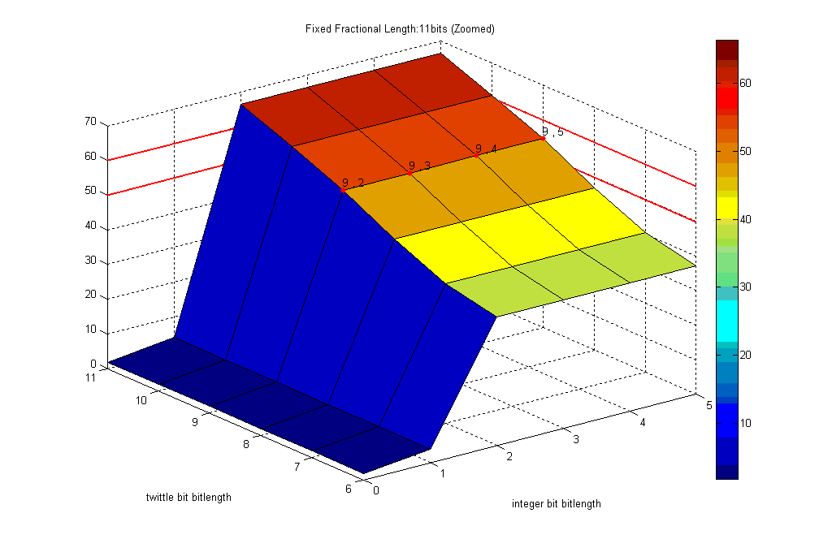
Optimal set: 9+2 = 11
Integer 2 bits
Twiddle 9 bits
Notes:
Fix Fractional

Slide 25
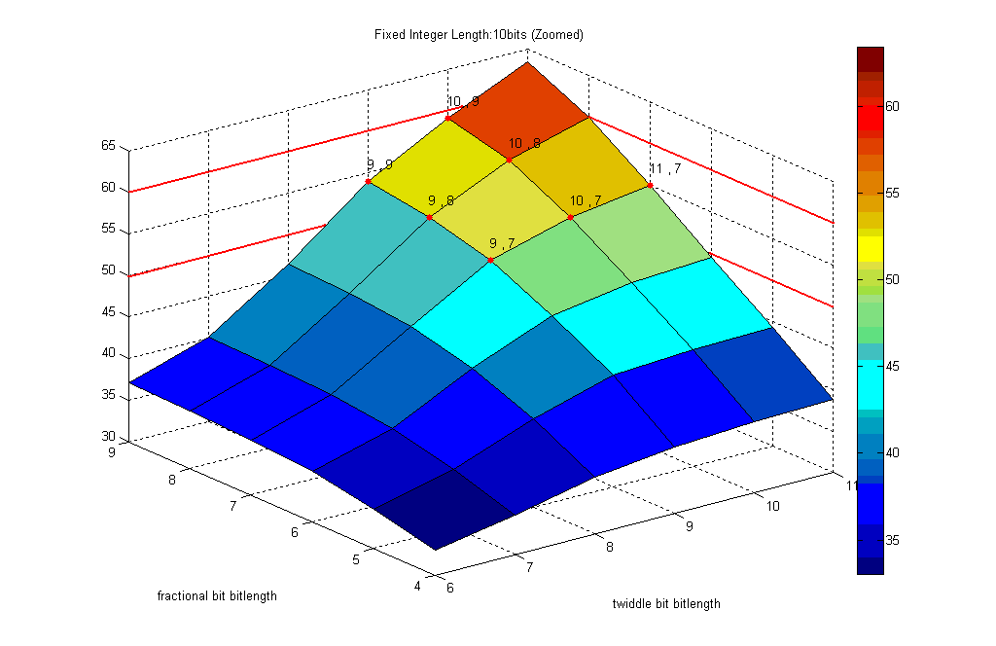
Optimal set: 9+7 = 15
Twiddle 9 bits
Fractional 7 bits
Notes:
Fix Integer

Slide 26
Verification
Word-lengths chosen:
Integer 2 bits
Fractional 7 bits
Twiddle 9 bits
Run multiple random tests (10⁵ times) to ensure we have desired results
Adjust bit lengths to ensure the SQNR ≧ 50 if necessary

Slide 27
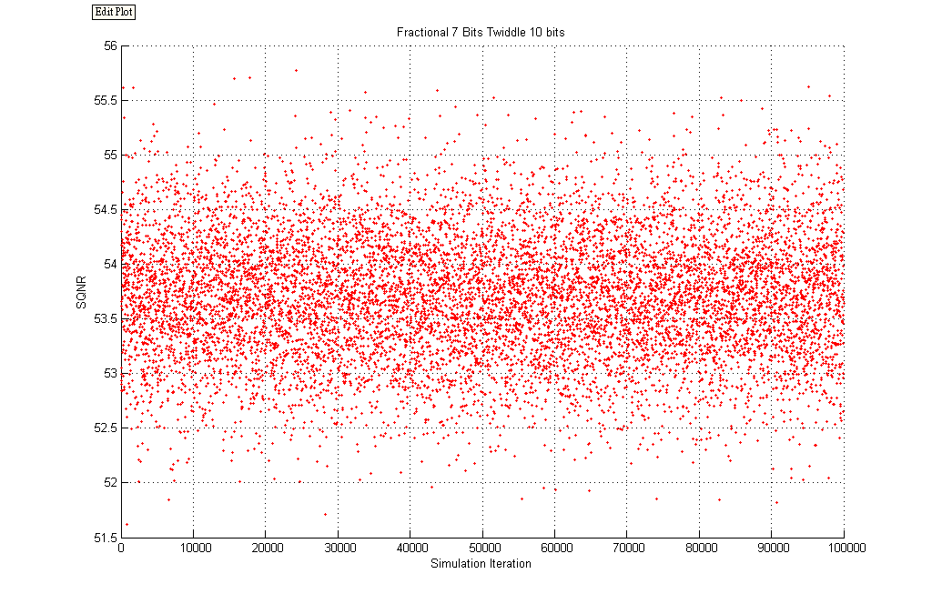
Fractional 7 bits, Twiddle 9+1 bits

Slide 28
References
[1] Alan V.Oppenheim, Ronald W. Schafer, “Discrete-time signal processing” 2nd edition.
[2] E.H. Wold and A.M. Despain. “Pipelined and parallel-pipelined FFT processors for VLSI implementation.,” IEEE Trans. Comput., May 1984
[3] Shousheng He and Torkelson, M., “A new approach to pipeline FFT processor,” Proceedings of IPPS '96, 15-19 April 1996, pp766 –770.

