Slide 1
Single Delay Feedback Pipelined FFT Architecture

Slide 2
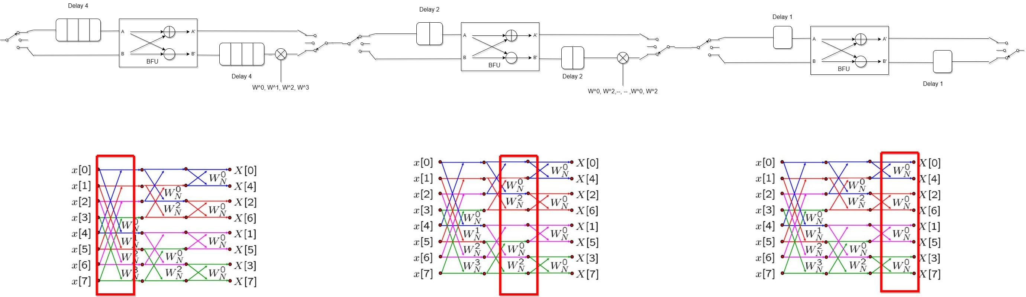
SDF Pipelined FFT Architecture
(Radix 2) (DIF)

Slide 3
SDF Pipelined FFT Architecture
IN
B
C
OUT
IN
0 | 1 | 2 | 3 | 4 | 5 | 6 | 7
B
0 | 1 | 2 | 3 | 4 | 5 | 6 | 7
C
0 | 1 | 2 | 3 | 4 | 5 | 6 | 7
OUT
0 | 1 | 2 | 3 | 4 | 5 | 6 | 7

Slide 4
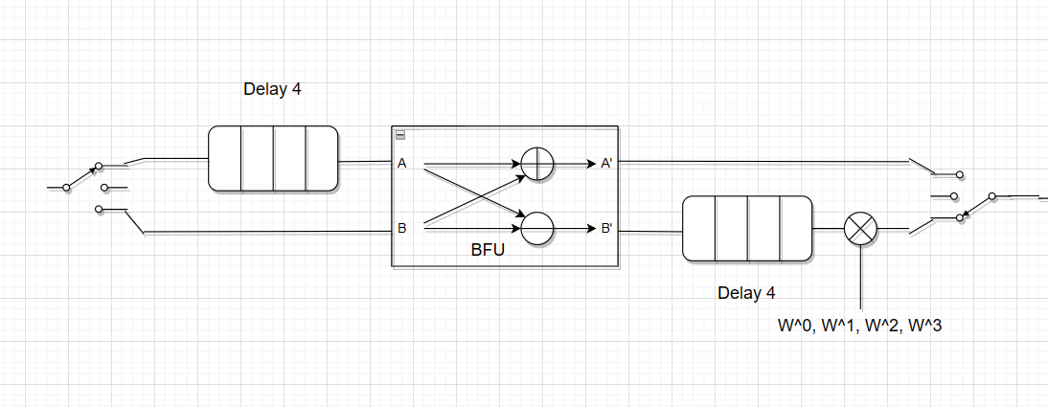
SDF Pipelined FFT Architecture

Slide 5
SDF Pipelined FFT Architecture
X0

Slide 6
SDF Pipelined FFT Architecture
X1X0

Slide 7
SDF Pipelined FFT Architecture
X2X1X0

Slide 8
SDF Pipelined FFT Architecture
X3X2X1X0

Slide 9
SDF Pipelined FFT Architecture
X X3X2X1 X0
X4

Slide 10
SDF Pipelined FFT Architecture
X X X3X2 X1
X0
X4
X5

Slide 11
SDF Pipelined FFT Architecture
X X X X3 X2
X1
X5 X4
X6

Slide 12
SDF Pipelined FFT Architecture
X X X X X3
X2
X6 X5X4
X7

Slide 13
SDF Pipelined FFT Architecture
X X X X X
X3
X7 X6X5X4
X

Slide 14
SDF Pipelined FFT Architecture
X X X X X
X
X X7X6X5X4
X

Slide 15
SDF Pipelined FFT Architecture
X X X X X
X
X X X7X6X5X4
X

Slide 16
SDF Pipelined FFT Architecture
X X X X X
X
X X X X7X6X5 X4
X

Slide 17
SDF Pipelined FFT Architecture
X X X X X
X
X X X X X7X6 X5
X

Slide 18
SDF Pipelined FFT Architecture
X X X X X
X
X X X X X X7 X6
X

Slide 19
SDF Pipelined FFT Architecture
X X X X X
X
X X X X X X7
X

Slide 20
Notes about FFT design

Slide 21
DIT vs DIF
No key difference in terms of HW implementation.
However, DIT is more popular for memory based FFTs and DIF is more popular in pipelined FFT cores.
DIT requires bit reversal at input and the twiddle factor multiplication is performed before BFU addition and subtraction.
DIF requires bit reversal at output and the twiddle factor multiplication is performed after BFU addition and subtraction.

Slide 22
Fixed-point
simply an integer where the decimal point location is in programmer’s mind only.
Q(8,7) (or) Q7
010111001.1101100
0x5cec (or) 23,788 (integer representation)
in fixed representation = 23788 / 2⁷ = 185.84375
sb₇b₆b₅b₄b₃b₂b₁b₀b₋₁b₋₂b₋₃b₋₄ b₋₅b₋₆b₋₇

Slide 23
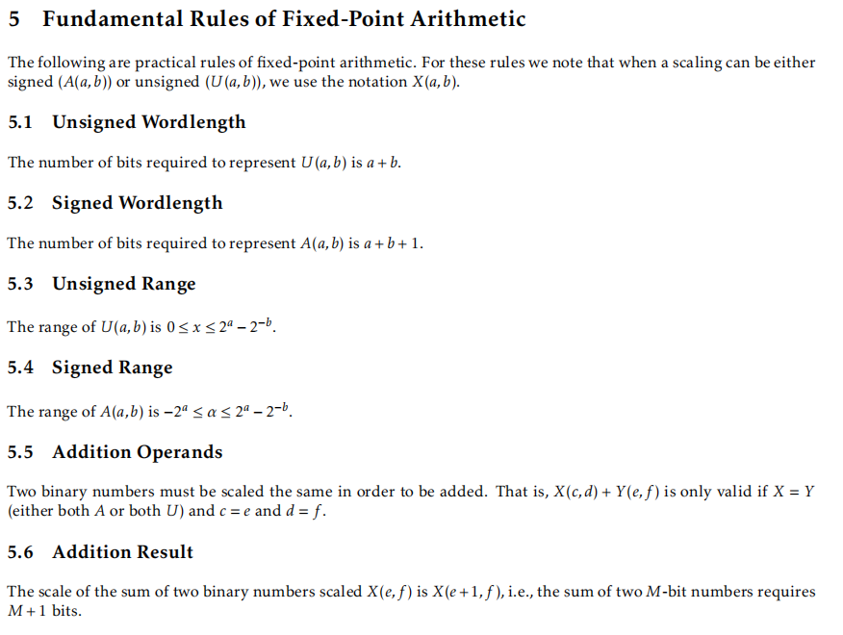
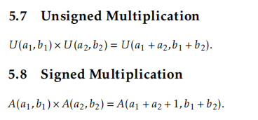
Fixed-point arithmetic rules

Slide 24
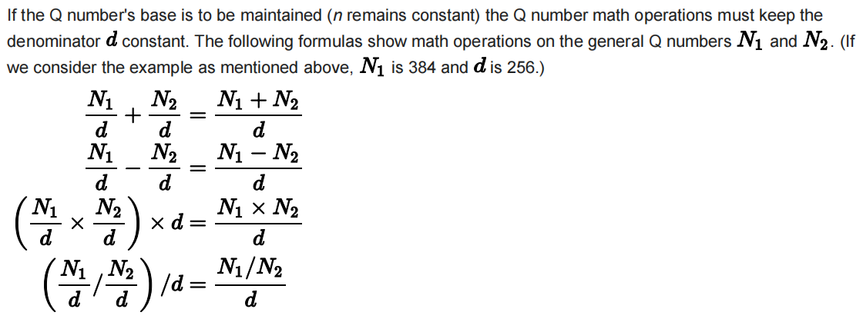
Fixed-point arithmetic rules
do whatever operation you want. however, to keep the decimal point location fixed the base should be “d”
from here: after addition or subtraction no worries about the place of decimal point.
Q8 + Q8 = Q8
but if you do multiplication: -
Q8 x Q8 = Q16
the decimal point location is shifted to the left by N points where N is the number of bits on the right side of the decimal point, in this example its 8
therefore, to take the correct result we have to right shift the result 8 bits to the right to have it in the form Q8
watch out for underflow (precesion loss) !!!

Slide 25
Overflow
suppose we have 2 fixed point numbers stored in 16-b registers of the form Q7 or Q(8,7) with values: -
0x7fff, 0x7fff
suppose the result will be stored in 16-b reg also
then,
0x7fff + 0x7fff = 0b1111 1111 1111 1110 (OR) 0xfffe
255.9921875 + 255.9921875 = should be 511.984375
but interpreted as -0.015628

Slide 26
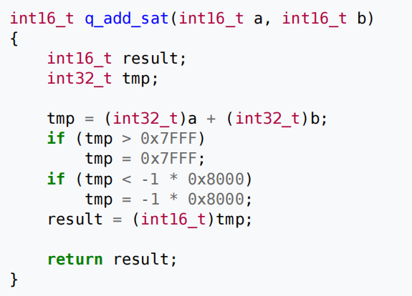
Avoiding overflow
#1 saturation logic: -
limit the 16-b register either to maximum positive value (0x7fff) or maximum negative value (0x8000)

Slide 27
Avoiding overflow
#2 adding guard bits: -
despite using 16-bit registers for input values we limit the input values (implicitly) to say for example 12-bits therefore, there are 4 guard bits used only for sign extention
maximum positive in this case: 0x07ff
maximum negative: 0xf800
0x07ff + 0x07ff = 0x0ffe
15.9921875 + 15.9921875 = 31.984375 (for Q7)

Slide 28
Minimum number of twiddle factors required for storage
twiddle factors with k=0 to k=N/4 are the only ones calculated.
the remaining twiddle factors are generated by simply playing with the signs of both the real and imaginary parts.

Slide 29
Calculating twiddle factors on the fly
by simply using LUT for both sine and cosine twiddle factors can be calculated cominationaly on the fly with acceptable percesion.

Slide 30
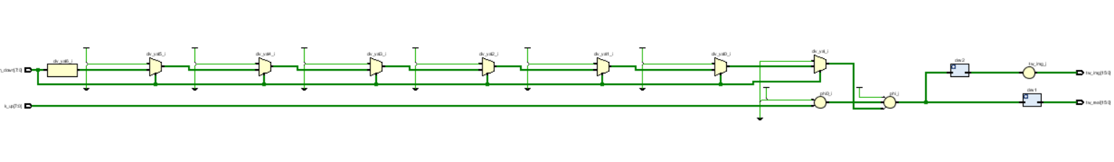
Calculating twiddle factors on the fly
using sine and cosine LUT with only 64 entries of 8-bits we were able to generated twiddle factors with only 76 FPGA elements and no DSP blocks.

Slide 31

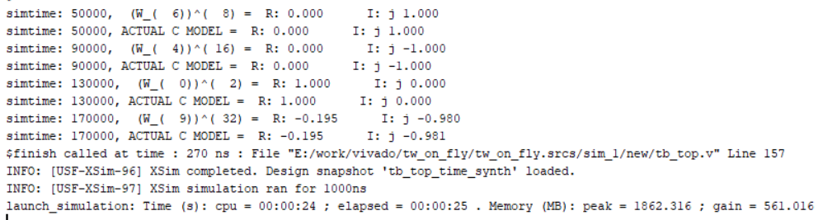
Calculating twiddle factors on the fly

Slide 32
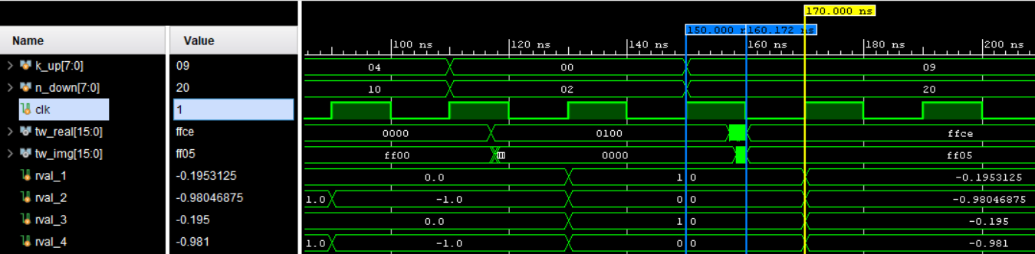
Calculating twiddle factors on the fly

Slide 33
comparison between pipelined and memory based FFT architectures
----- | pipelined (sdf r-2) | memory based (r-2)
No. mult | log2 (N - 2) | 1
No. adds | 2 log2 (N) | 1
Throughput/ number of computation cycles | at steady state ≈ 1 sample per cycle | N/2 log2 (N + 2)

Slide 34
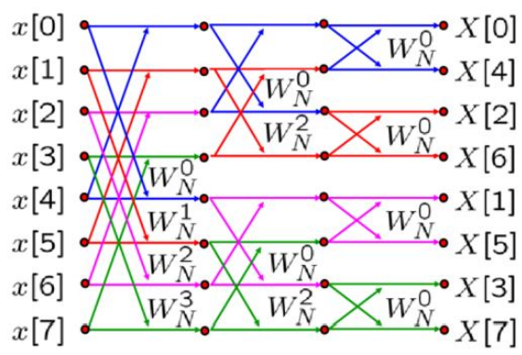
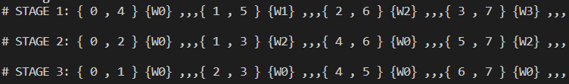
8-point radix-2 DIF FFT
butterfly diagram
BFU indices
each color represents an independent butterfly operation.
notice how the indices in each stage are not repeated which means that no other BFU in each stage deals with other BFU input samples.
from here we can say that computations can be done in place (the same input memory can be used for output)

