Slide 1

Predicting the rating of an Airbnb based on the amenities provided
Presented by:
Bhuvana Gudipudi
Lakshmi Naga Sameera Sunkara
Navya Sree Madagoni

Slide 2

Review Questions?
How does the average price of listings vary between different room types and property types in each market?
What is the average number of reviews per listing in each market?
How accurately can we predict the star rating of a listing based on its features such as room type, property type, price and market?

Slide 3
Business Understanding
The dataset contains information about Airbnb listings such as listing ID, date of review, reviewer name, comments, room type, property type, market, price, star rating. This data can provide valuable insights for various stakeholders involved in the Airbnb ecosystem, hosts, guests.
The objective is to build a model which will help the property owners or managers to assess how well their properties are performing using variables like pricing, location(market), kind of property, type of room. This can be determined using different machine learning techniques and can analyze which best suits the requirements.

Slide 4
Data Understanding
Airbnb has the following attributes:
listing_id: string
date: Date or datetime
reviewer_name: String
comments: String
room_type: Categorical (string).
property_type: Categorical (string).
market: Categorical (string).
price: Numeric (integer or float).
Star_rating_scale5: Numeric
RevHasHostName: Binary
RevRefsByPronoun: Binary

Slide 5
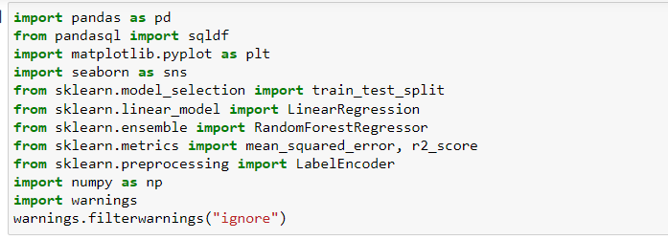
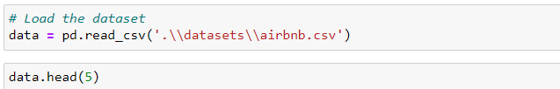
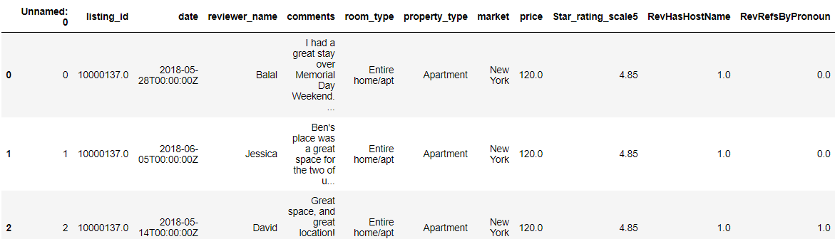
Methodology
Importing libraries and loading data:

Slide 6
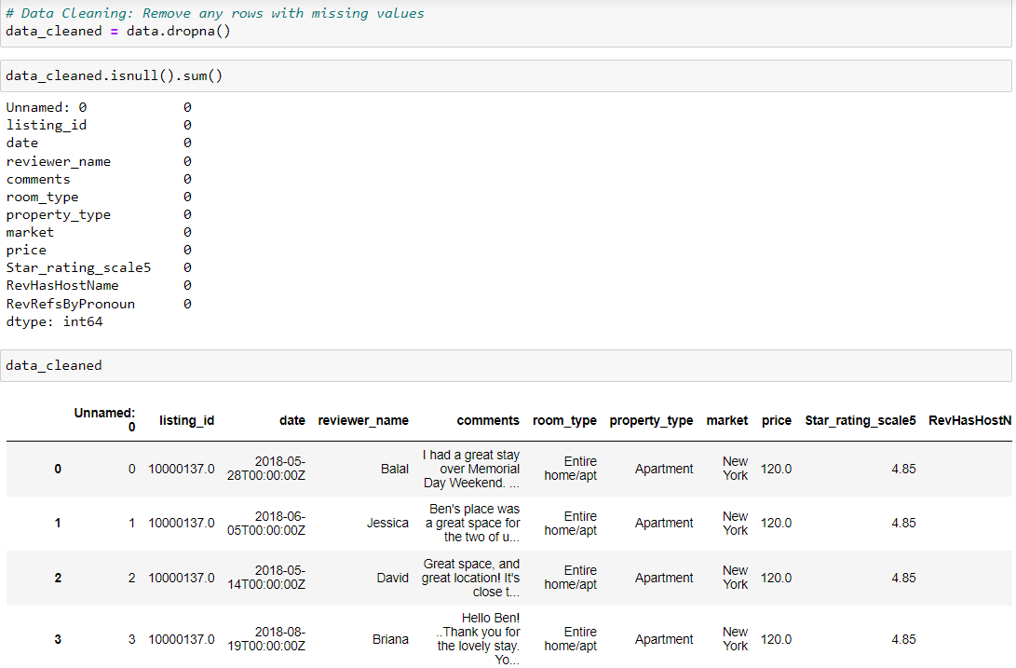
Checking Null values and cleaning data:

Slide 7
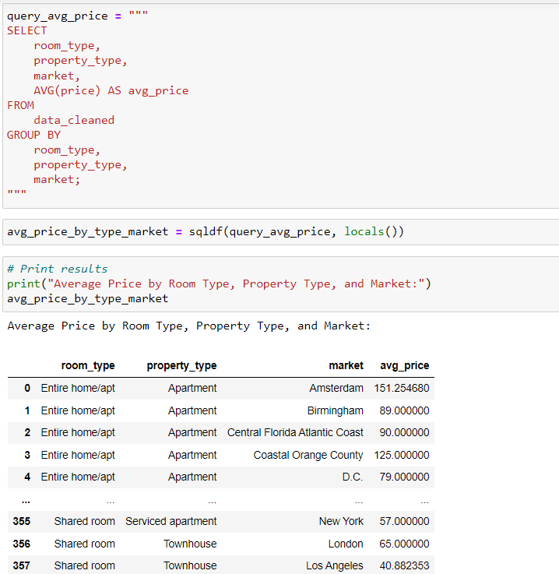
R1: Calculate average price for each combination of room type, property type, and market

Slide 8
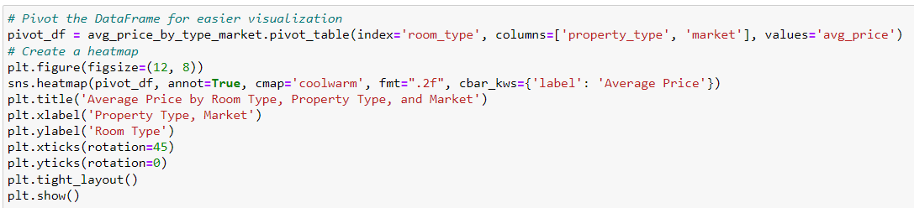
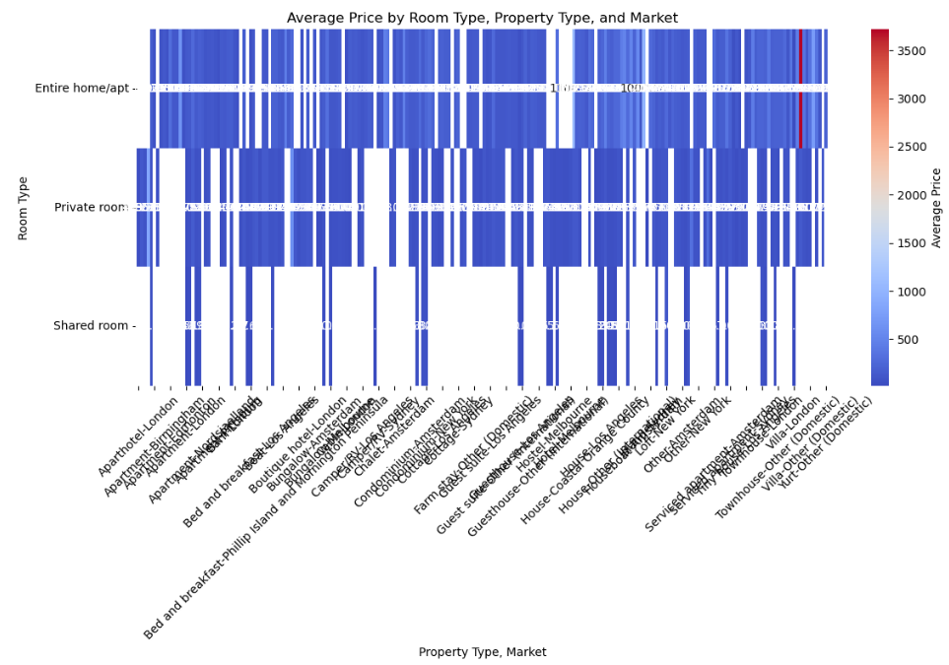
Pivoting data and creating heatmap for easier visualization

Slide 9
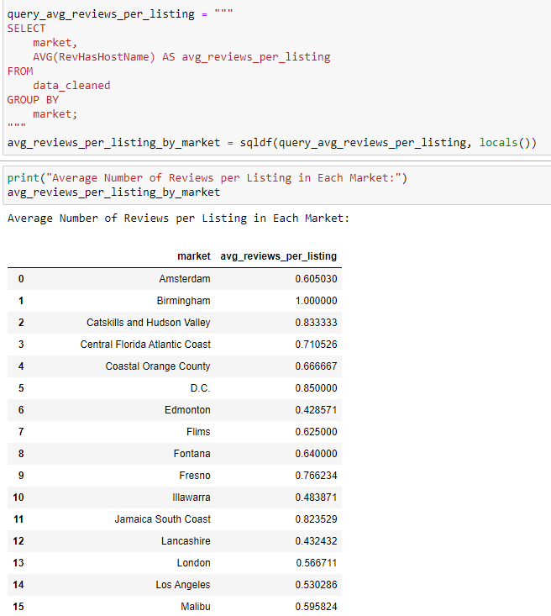
R2: Average number of reviews per listing in each market

Slide 10
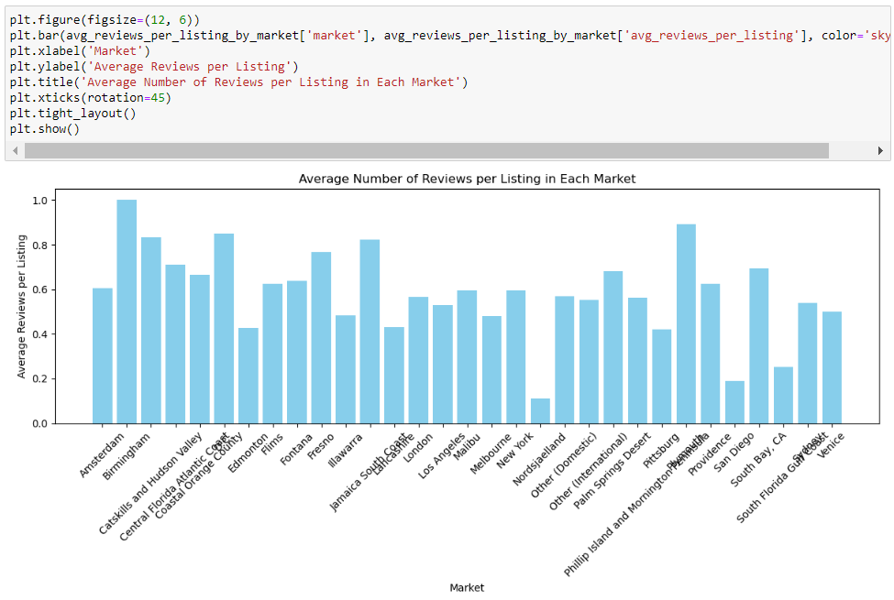
Visualization

Slide 11
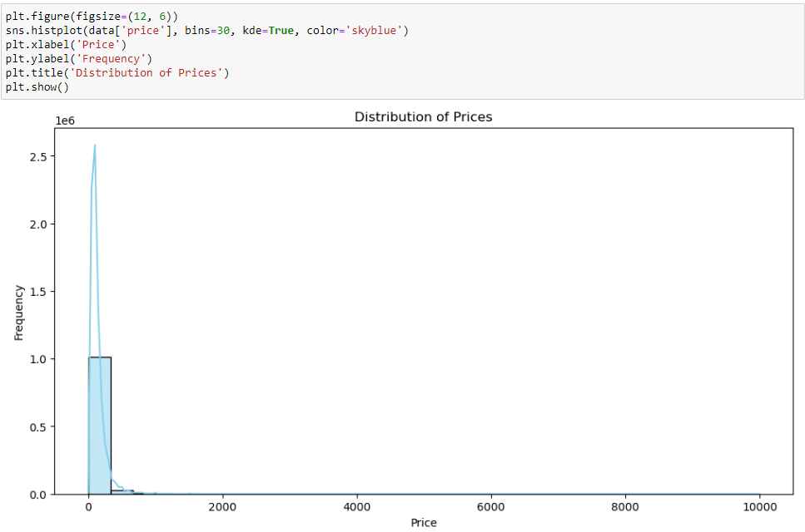
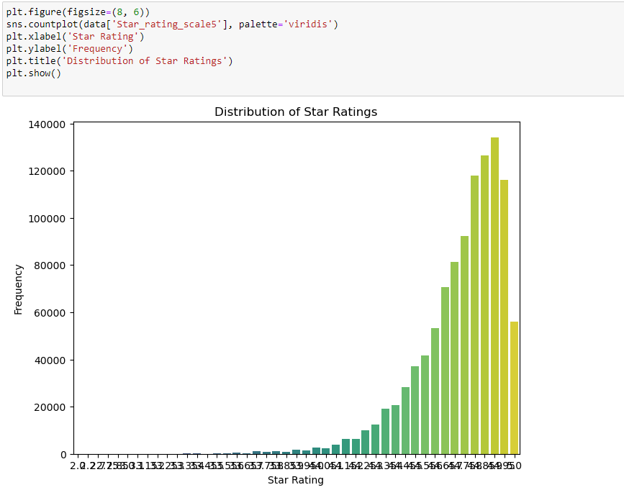
Distribution of prices
Distribution of star rating

Slide 12
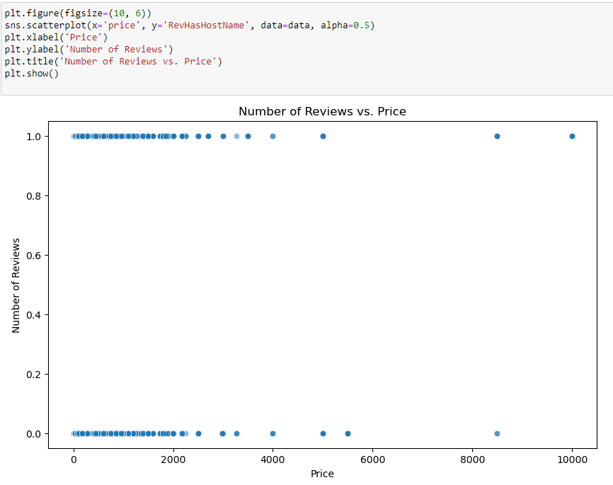
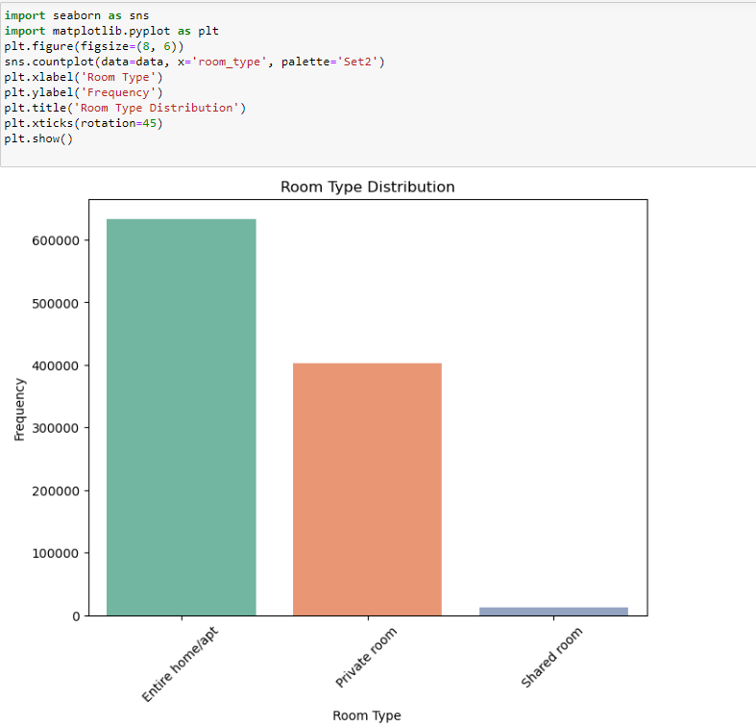
Number of reviews vs price
Room type distribution

Slide 13
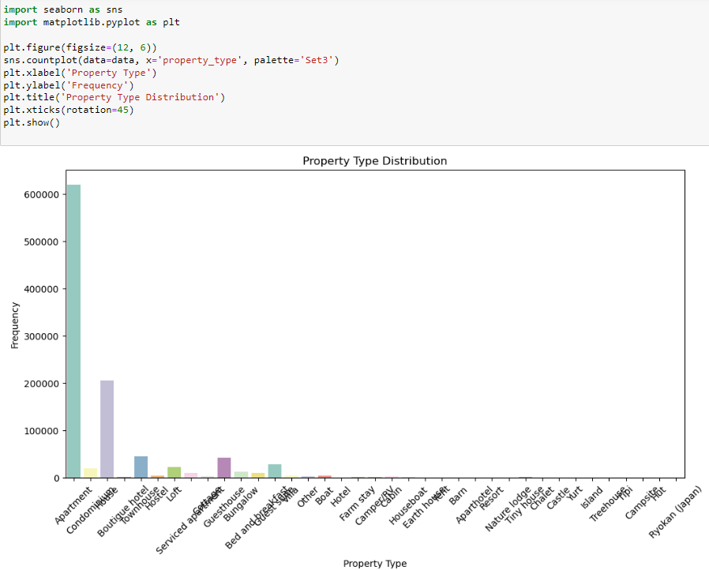
Property type distribution

Slide 14
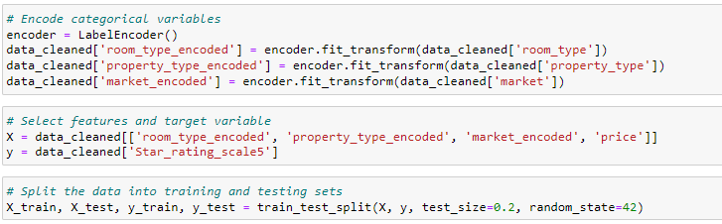
R3: Analyzing using different methods
Data Preparation: Data is split into training data and test data with 80:20 ratio

Slide 15
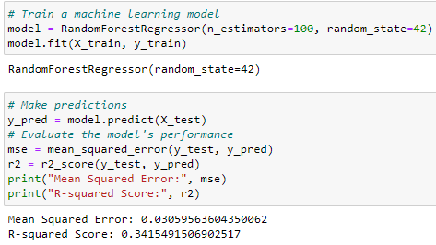
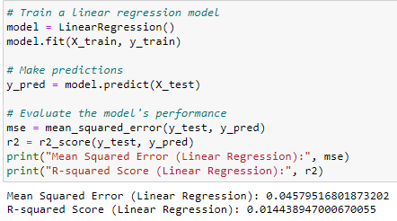
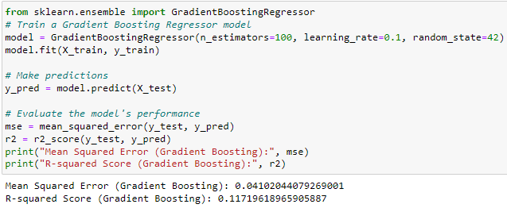
Random forest Regressor
Linear Regression
Gradient Boosting Regression

