Slide 1
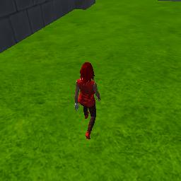

Downsampling
Upsampling
160 x 160 x 32 , Bilinear UpSampling, concatenated,
2 x separable convolutions
softmax
80 x 80 x 32, relu, batch nrom
80 x 80 x 64 , Bilinear UpSampling, concatenated, 2 x separable convolutions
40 x 40 x 64, relu, batch norm
40 x 40 x 64, Bilinear UpSampling, concatenated, 2 x separable convolutions
20 x 20 x 64, relu, batch norm
20 x 20 x 128
convolution

