Slide 1

Healthcare Data Classification
Final Project Presentation
CSCN8010-24W

Slide 2

Problem Statement
Develop a machine learning model that predicts the category of medical test results—Normal, Abnormal, or Inconclusive—based on the features provided in a synthetic healthcare dataset, which includes patient demographics, medical conditions, admission details, and other relevant healthcare data.
The objective is to enhance predictive accuracy to aid healthcare practitioners in anticipating patient outcomes and to provide a practical learning tool for data science enthusiasts in the healthcare field.

Slide 3
Data Overview
Data Source: Healthcare Dataset
Data Volume: 10000 Observations
Key features :
Age
Gender
Blood Type
Medical Conditions
Doctor
Insurance Provider

Slide 4
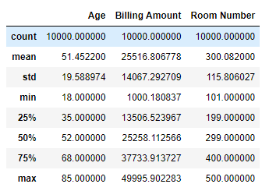
Data Overview

Slide 5
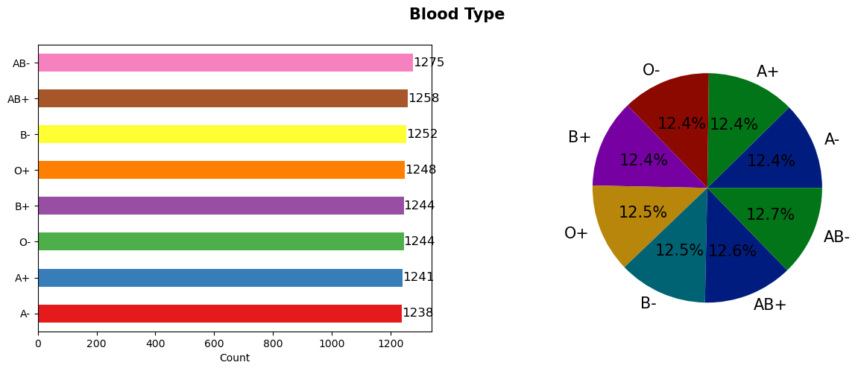
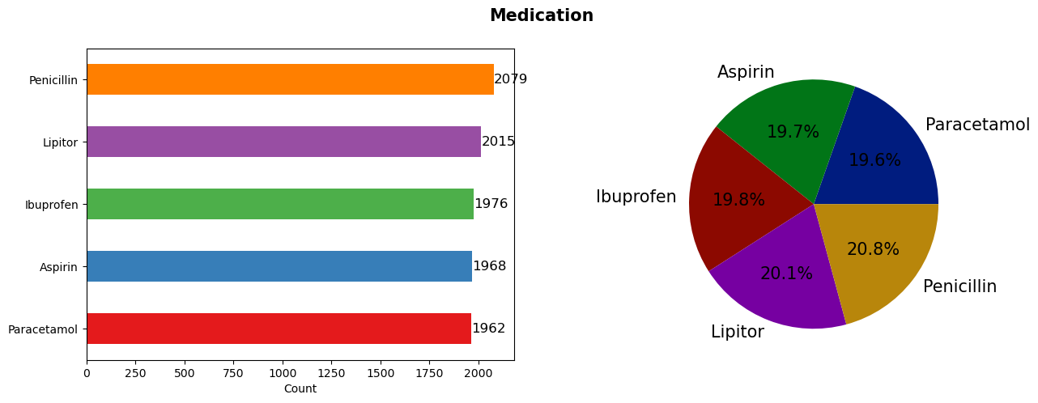
EDA
Pie chart and Distribution of Blood Type.
Pie chart and Distribution of medication.

Slide 6
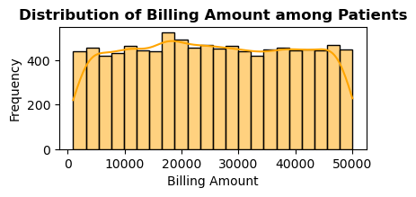
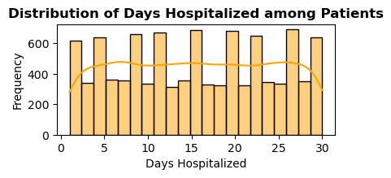
EDA
The distribution of Billing amount with respect to Patients.
The distribution of Days Hospitalized with respect to Patients.

Slide 7
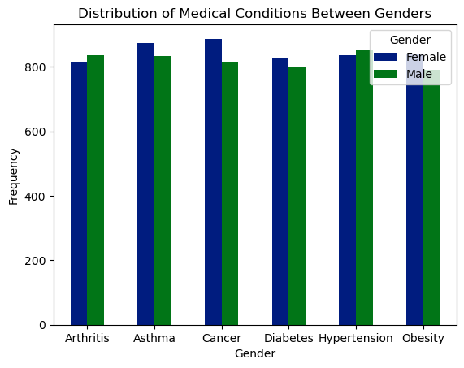
EDA
Female have higher share in majority of the medical conditions. Cancer is leading medical condition among female whereas Hypertension is leading cause among male.

Slide 8
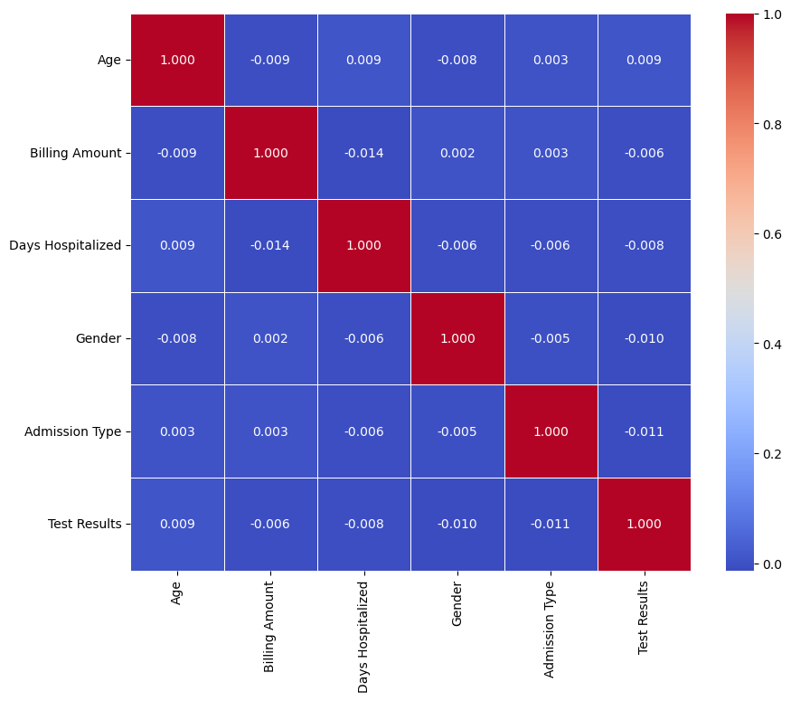
EDA
Billing amount has negative correlation with test results and days hospitalized. Billing amount has a positive correlation with admission type and gender.
Except for billing amount attribute, gender has a negative correlation with all other attributes.
Admission type and test results have a negative correlation.

Slide 9
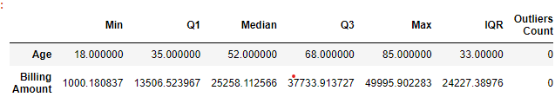
Outliers:

Slide 10

Target (Test Results):

Slide 11
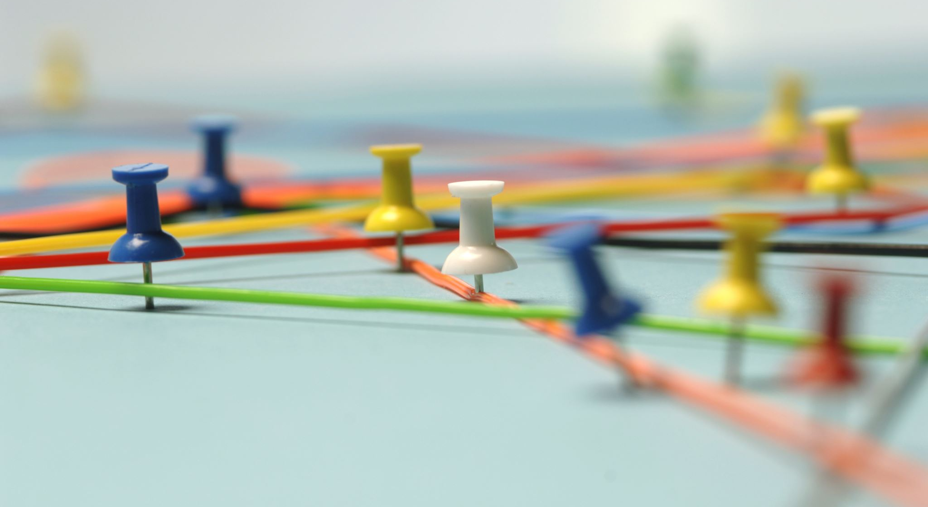
Model Selection

Slide 12

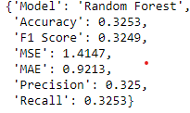
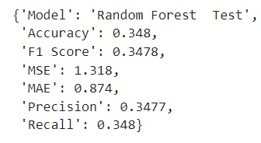
Random Forest
A robust ensemble technique that can handle unbalanced data and is less likely to overfit. Good for handling different types of data without scaling.
On training data:
On test data:

Slide 13
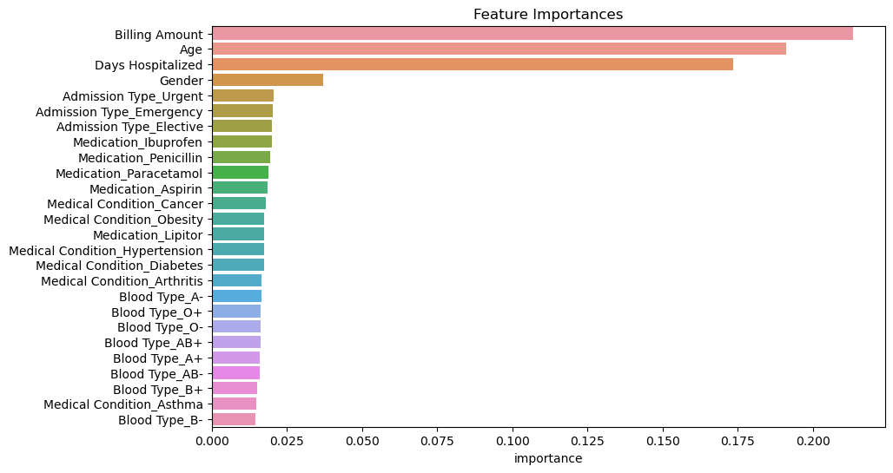
Random Forest

Slide 14
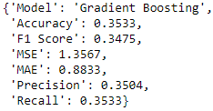
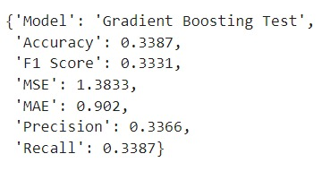
Gradient Boosting Classifier
On Training Data:
Strong predictive power by combining weak models sequentially to reduce error.
Effective in handling different types of features and may provide high accuracy for complex patterns in data.
On Test Data:

Slide 15
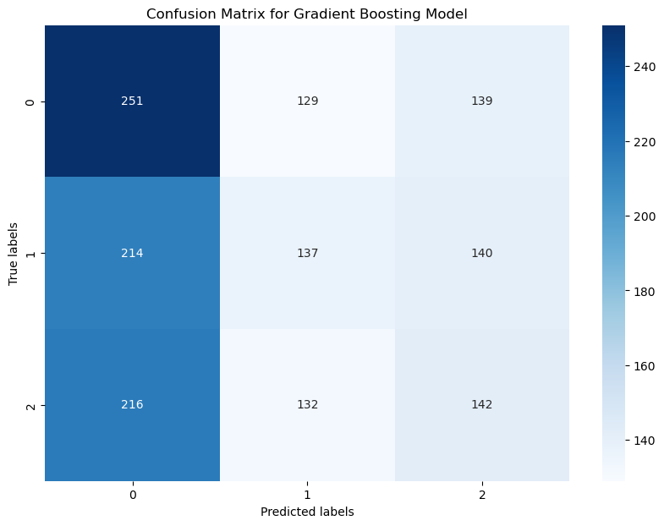
Gradient Boosting Classifier

Slide 16

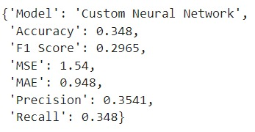
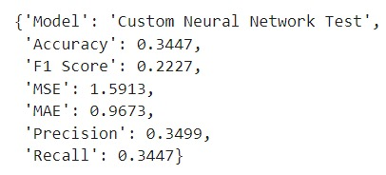
Custom Neural Network
Our custom neural network consists of an input layer with a dimension matching the feature space of the training data.
Two hidden layers with 64 neurons each use ReLU (Rectified Linear Unit) for activation.
The model is trained for 60 epochs, With a batch size of 32.
On Training Data:
On Test Data:

Slide 17
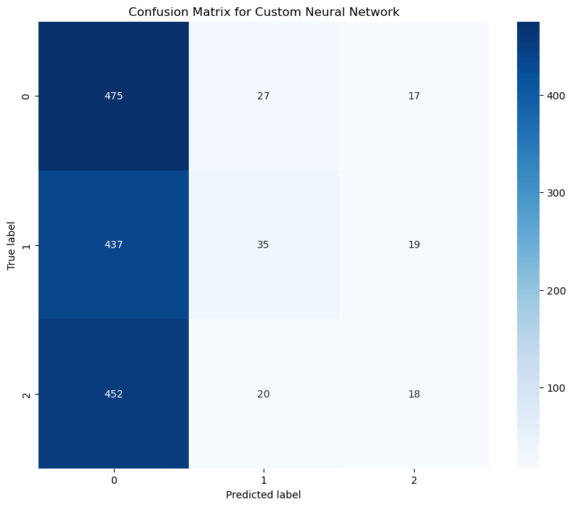
Custom Neural Network

Slide 18
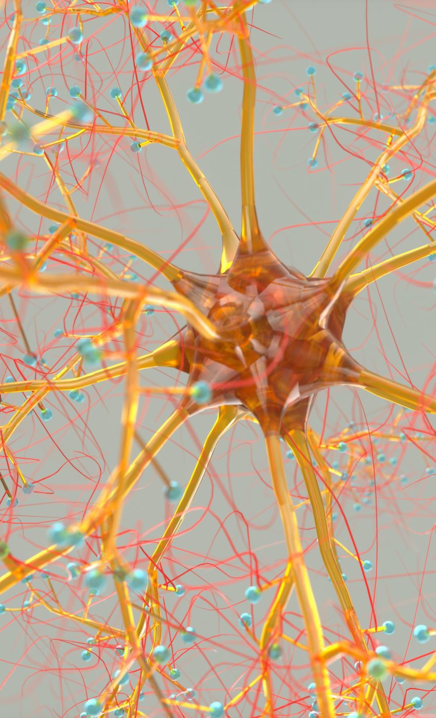
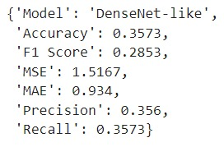
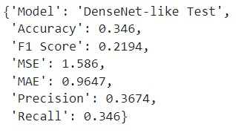
DenseNet Like Neural Network:
A DenseNet, or Densely Connected Convolutional Network, is a type of neural network that is specifically designed to solve problems in how information flows through the network.
On Training Data:
On Test Data:

Slide 19
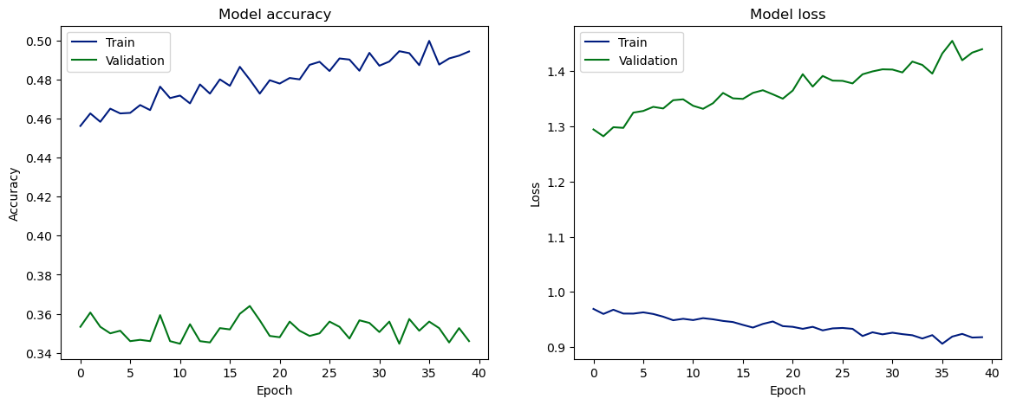
DenseNet Like Neural Network:

Slide 20
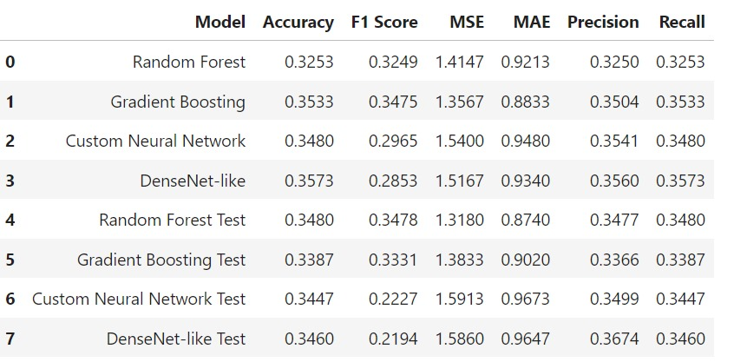
Comparison:

Slide 21

Insights:

Slide 22

References:
Dataset: Healthcare Dataset
Denselike Neural Network
Gradient Boosting Alogorithm
Random Forest Classifier
GitHub Page:

Slide 23

Thank You

