Slide 1
CHAPTER 1 POWERPOINT
INTRODUCTION

Slide 2
WHAT IS MODELING?
Creating a simplified version of reality
  Maps
Working with this version to understand or control some aspect of the world
Chapter 1
Copyright © 2013 John Wiley & Sons, Inc.

Slide 3
TYPES OF MODELS
Mental
Visual
Physical
Mathematical
  Algebra
  Calculus
  Spreadsheets
Chapter 1
Copyright © 2013 John Wiley & Sons, Inc.

Slide 4
WHY STUDY MODELING?
Models generate insight which leads to better decisions.
Modeling improves thinking skills:
  Break problems down into components
  Make assumptions explicit
Modeling improves quantitative skills:
  Ballpark estimation, number sense, sensitivity analysis
Modeling is widely used by business analysts:
  Finance, marketing, operations
Chapter 1
Copyright © 2013 John Wiley & Sons, Inc.

Slide 5
MODELS IN BUSINESS: TYPES
One time decision models (usually built by the decision maker)
  Will be the primary focus in this text
Decision support models
Embedded models
  A computer makes the decision without the user being explicitly aware
Models used in business education
Chapter 1
Copyright © 2013 John Wiley & Sons, Inc.

Slide 6
BENEFITS OF BUSINESS MODELS
Modeling allows us to make inexpensive errors.
Allows exploration of the impossible
Improves business intuition
Provides timely information
Reduces costs
Chapter 1
Copyright © 2013 John Wiley & Sons, Inc.

Slide 7
ROLE OF SPREADSHEETS
Principal vehicle for modeling in business
Mathematics at an accessible level
  Versus calculus, algebra
Correspond nicely to accounting statements
“The Swiss Army knife of business analysis”
Chapter 1
Copyright © 2013 John Wiley & Sons, Inc.

Slide 8
SPREADSHEETS:
“THE SWISS ARMY KNIFE OF BUSINESS ANALYSIS”
Prior to the 1980s, modeling was performed only by specialists using demanding software on expensive hardware.
  Spreadsheets changed all this in the 1990s
The “second best” way to do many kinds of analysis
  Many specialized decision tools exist (e.g., simulation software, optimization software, etc.).
The best way to do most modeling
  An effective modeler should know its limitations and when to call in specialists.
Chapter 1
Copyright © 2013 John Wiley & Sons, Inc.

Slide 9
RISKS OF SPREADSHEET USE
Spreadsheets contain internal errors, and more errors are introduced as these spreadsheets are used and modified.
A sampling of errors with serious ramifications:
  Sorting a spreadsheet improperly
  Careless naming of spreadsheet files
  Copy-and-paste error in a spreadsheet
  Erroneous numerical input in a spreadsheet
  Numbers entered as text in a spreadsheet
  Shifting a spreadsheet so the wrong numbers appear in the wrong columns
  Incorrect references in a spreadsheet formula
Chapter 1
Copyright © 2013 John Wiley & Sons, Inc.

Slide 10
WHY ARE ERRORS SO COMMON?
Traditional computer programming is carried out largely by trained professionals.
It uses elaborate and formalized development methods.
Very few corporations (and even fewer individuals) employ even the most basic design and inspection procedures.
Chapter 1
Copyright © 2013 John Wiley & Sons, Inc.

Slide 11
CHALLENGES FOR SPREADSHEET USERS
End-user spreadsheets frequently have bugs.
End-users are overconfident about the quality of their spreadsheets.
Development process is inefficient
Most productive methods for generating insights not employed
Chapter 1
Copyright © 2013 John Wiley & Sons, Inc.

Slide 12
END USER INEFFICIENCIES
Lack of planning causes extensive rework
No prototyping; too much complexity too soon
Users rarely spend time debugging
Users rarely seek review
Do not use Excel’s best tools for clearest insights (even advanced users)
Chapter 1
Copyright © 2013 John Wiley & Sons, Inc.

Slide 13
BASIC KNOWLEDGE FOR SPREADSHEET MODELING
Basic algebra
  e.g., quadratic, exponential, logarithmic functions
Simple logic
  e.g., IF statements or MAX functions
Basic probability
  e.g., distributions and sampling
Basic familiarity with Excel
  e.g., entering and formatting text, using functions
Chapter 1
Copyright © 2013 John Wiley & Sons, Inc.

Slide 14
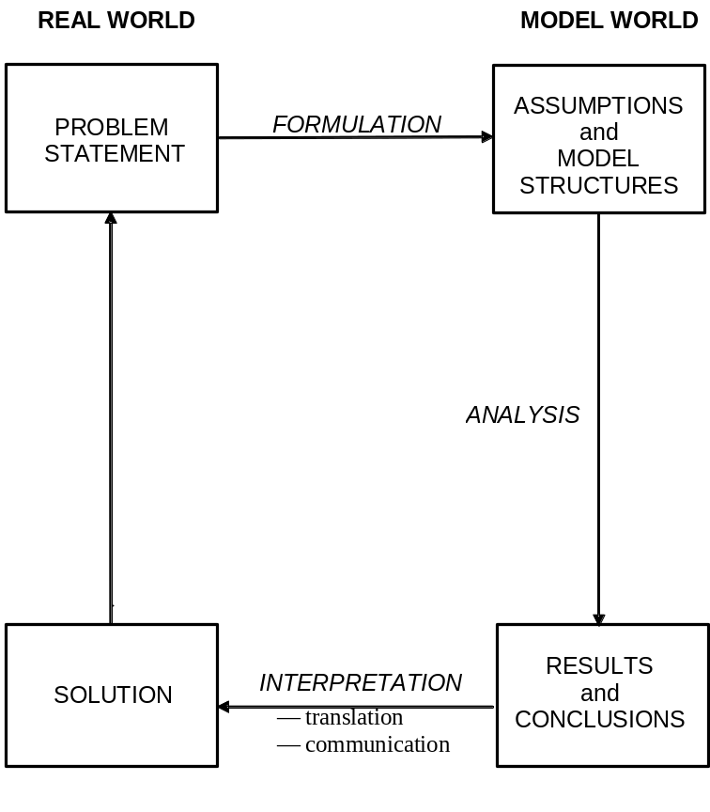
THE REAL WORLD AND THE MODEL WORLD
Chapter 1
Copyright © 2013 John Wiley & Sons, Inc.

Slide 15
MODEL FORMULATION
Decisions
  Possible choices or actions to take
Outcomes
  Consequences of the decisions
Structure
  Logic that links elements of the model together
Data
  Numerical assumptions in model
Chapter 1
Copyright © 2013 John Wiley & Sons, Inc.

Slide 16
FIVE ASPECTS OF MODELING ACTIVITY
Problem context
  Situation from which modeler’s problem arises
Model structure
  Building the model
Model realization
  Fitting model to available data and calculating results
Model assessment
  Evaluating model’s correctness, feasibility, and acceptability
Model implementation
  Working with client to derive value from the model
Chapter 1
Copyright © 2013 John Wiley & Sons, Inc.

Slide 17
HABITS OF EXPERT MODELERS
Experts:
  Frequently switched among the five aspects of modeling
  Spent 60% of activity time on model structure with frequent switches between model structure and model assessment.
  Used model structure as the organizing principle around which the related activities were arrayed
Conclusion: Craft skills are as essential as technical skills in effective modeling.
Chapter 1
Copyright © 2013 John Wiley & Sons, Inc.

Slide 18
RANKING OF MODELING SKILLS
Creativity, sensitivity to client needs, persistence
Communication, teamwork skills, etc.
Technical expertise
Knowledge of the industry or problem-type
Above ranking confirms the importance of craft skills alongside technical skills in modeling.
Chapter 1
Copyright © 2013 John Wiley & Sons, Inc.

Slide 19
BEHAVIORS THAT LIMIT MODELING EFFECTIVENESS
Over-reliance on given numerical data
Taking shortcuts to an answer
Insufficient use of abstract variables and relationships
Ineffective self-regulation
Overuse of brainstorming relative to structured problem solving
Chapter 1
Copyright © 2013 John Wiley & Sons, Inc.

Slide 20
ORGANIZATION OF TEXT
Spreadsheet engineering
  How to design build, test and perform analysis with a spreadsheet model
Modeling craft
  Effective abstraction, model debugging, and translating models into managerial insights
Data analysis
  Exploring datasets and basic techniques for classification, prediction
Management science
  Optimization
  Simulation
Chapter 1
Copyright © 2013 John Wiley & Sons, Inc.

Slide 21
SUMMARY OF TEXT PHILOSOPHY
Modeling is a necessary skill for every business analyst.
Spreadsheets are the modeling platform of choice.
Basic spreadsheet modeling skills are an essential foundation.
End-user modeling is cost-effective.
Craft skills are essential to the effective modeler.
Analysts can learn the required modeling skills.
Management science/statistics are important advanced tools.
Chapter 1
Copyright © 2013 John Wiley & Sons, Inc.

Slide 22
COPYRIGHT © 2013 JOHN WILEY & SONS, INC.
All rights reserved. Reproduction or translation of this work beyond that permitted in section 117 of the 1976 United States Copyright Act without express permission of the copyright owner is unlawful. Request for further information should be addressed to the Permissions Department, John Wiley & Sons, Inc. The purchaser may make back-up copies for his/her own use only and not for distribution or resale. The Publisher assumes no responsibility for errors, omissions, or damages caused by the use of these programs or from the use of the information herein.

