Slide 1
CHAPTER 2 POWERPOINT
MODELING IN A PROBLEM-SOLVING FRAMEWORK

Slide 2
MODELERS’ ROLES IN THE PROBLEM-SOLVING PROCESS
End user
  Identifies problems, develops model, uses model, and implements results
  Often the modeler
Team member
  Communication skills critical
  Whole team must understand model and assumptions
Independent consultant
  Model is for a client
  Model must be consistent with client’s goals
Chapter 2
Copyright © 2013 John Wiley & Sons, Inc.

Slide 3
KEY TERMS: “PROBLEM” VERSUS A “MESS”
A problem is a well-defined situation that is capable of resolution.
A mess is a morass of unsettling symptoms, causes, data, pressures, shortfalls, opportunities, etc.
Identifying a problem in the mess is the first step in the creative problem solving process.
Chapter 2
Copyright © 2013 John Wiley & Sons, Inc.

Slide 4
PROBLEM STATEMENTS
A statement in the form “In what ways might…?”
  Focuses on defining the problem to be solved
  Example: “In what ways might we increase revenues to keep pace with costs?”
Solutions will differ based on the problem statement, so:
  Pay close attention to the problem definition.
  Take any problem definition as tentative.
  Prepare to alter the definition if evidence suggests a different statement would be more effective.
Chapter 2
Copyright © 2013 John Wiley & Sons, Inc.

Slide 5
CHARACTERISTICS OF WELL-STRUCTURED PROBLEMS
The objectives of the analysis are clear.
The assumptions that must be made are obvious.
All the necessary data are readily available.
The logical structure behind the analysis is well understood.
Example: Algebra problems are typically well- structured problems.
Chapter 2
Copyright © 2013 John Wiley & Sons, Inc.

Slide 6
ILL-STRUCTURED PROBLEMS
Objectives, assumptions, data, and structure of the problem are all unclear.
Examples:
  Should the Red Cross institute a policy of paying for blood donations?
  Should Boeing’s next major commercial airliner be a small supersonic jet or a slower jumbo jet?
  Should an advertiser spend more money on the creative aspects of an ad campaign or on the delivery of the ad?
  How much should a mid-career executive save out of current income toward retirement?
Require exploration more than solutions.
Chapter 2
Copyright © 2013 John Wiley & Sons, Inc.

Slide 7
EXPLORATION
With an inquiring mind and a spirit of discovery, exploration involves:
  formulating hypotheses
  making assumptions
  building simple models
  deriving tentative conclusions
It often reveals aspects of the problem that are not obvious at first glance.
Chapter 2
Copyright © 2013 John Wiley & Sons, Inc.

Slide 8
DIVERGENT AND CONVERGENT THINKING
Divergent thinking
  Thinking in different directions
  Searching for a variety of answers to questions that may have many right answers
  Brainstorming
Convergent thinking
  Directed toward achieving a goal or single solution
  Involves trying to find the one best answer
  Emphasis shifts from idea generation to evaluation
Decision makers need to be clear as to which they use at a given time, and balance the two.
Chapter 2
Copyright © 2013 John Wiley & Sons, Inc.

Slide 9
THE SIX-STAGE PROBLEM-SOLVING PROCESS
1. Exploring the mess
  Divergent phase
    Search the mess for problems and opportunities.
  Convergent phase
    Accept a challenge and undertake systematic efforts to respond to it.
2. Searching for information
  Divergent phase
    Gather data, impressions, feelings, observations; examine the situation from many different viewpoints.
  Convergent phase
    Identify the most important information.
3. Identifying a problem
  Divergent phase
    Generate many different potential problem statements.
  Convergent phase
    Choose a working problem statement.
Chapter 2
Copyright © 2013 John Wiley & Sons, Inc.

Slide 10
THE SIX-STAGE PROBLEM-SOLVING PROCESS (CONT’D)
4. Searching for solutions
  Divergent phase
    Develop many different alternatives and possibilities for solutions.
  Convergent phase
    Select one or a few ideas that seem most promising.
5. Evaluating solutions
  Divergent phase
    Formulate criteria for reviewing and evaluating ideas.
  Convergent phase
    Select the most important criteria; use them to evaluate, strengthen, and refine ideas.
6. Implementing a solution
  Divergent phase
    Consider possible sources of assistance and resistance to proposed solution. Identify implementation steps and required resources.
  Convergent phase
    Prepare the most promising solution for implementation.
Chapter 2
Copyright © 2013 John Wiley & Sons, Inc.

Slide 11
EXAMPLE: INVIVO DIAGNOSTICS
A $300M pharmaceutical company built on the strength of a single product that accounts for over 75% of revenues.
In 18 months, the patent for this product will expire.
The CEO wants to explore ways to plug the expected $100-$200M revenue gap as revenues from this product decline.
Chapter 2
Copyright © 2013 John Wiley & Sons, Inc.

Slide 12
1. EXPLORING THE MESS
What problems or opportunities do we face?
Where is there a gap between the current situation and the desired one?
What are the stated and unstated goals?
This stage is complete when we have:
  A description of the situation
  Identified (not gathered) key facts and data
Chapter 2
Copyright © 2013 John Wiley & Sons, Inc.

Slide 13
2. SEARCHING FOR INFORMATION
What are the symptoms and causes?
What measures of effectiveness seem appropriate?
What actions are available?
This stage is complete when we have:
  Found and organized relevant data
  Made initial hypotheses about problem causes and solutions
Chapter 2
Copyright © 2013 John Wiley & Sons, Inc.

Slide 14
3. IDENTIFYING A PROBLEM
Which is the most important problem?
Is this problem like others we have dealt with?
What are the consequences of a broad versus narrow problem statement?
This stage is complete when we have produced a working problem statement.
Chapter 2
Copyright © 2013 John Wiley & Sons, Inc.

Slide 15
4. SEARCHING FOR SOLUTIONS
What decisions are open to us?
What solutions have been tried in similar situations?
How are the various candidate solutions linked to outcomes of interest?
This stage is complete when we have produced a list of potential solutions.
  Perhaps also a list of advantages and disadvantages
Chapter 2
Copyright © 2013 John Wiley & Sons, Inc.

Slide 16
5. EVALUATING SOLUTIONS
How does this solution impact each of the criteria?
What factors within our control could improve the outcomes?
What factors outside our control could alter the outcomes?
This stage is complete when we have produced a recommended course of action along with justification.
Chapter 2
Copyright © 2013 John Wiley & Sons, Inc.

Slide 17
6. IMPLEMENTING A SOLUTION
What are the barriers to successful implementation?
Where will there be support and motivation, or resistance and conflict?
Are the resources available for successful implementation?
This stage is complete when we have produced an implementation plan and begun execution.
Chapter 2
Copyright © 2013 John Wiley & Sons, Inc.

Slide 18
MENTAL MODELS (INFORMAL MODELING)
Help us to relate cause and effect
  But often in a simplified, incomplete way
Help us determine what is feasible
  But may be limited by personal experiences
Are influenced by our preferences for certain outcomes
Are useful but can be limiting
Problem solvers construct quick, informal mental models at many different points in the process.
Chapter 2
Copyright © 2013 John Wiley & Sons, Inc.

Slide 19
FORMAL MODELS
Provide the same kind of information as mental models
  Link causes to effects, aid in evaluating solutions
Require a set of potential solutions and criteria to compare solutions to be identified
More costly and time consuming to build than mental models
Make assumptions, logic, and preferences explicit and open to debate
Chapter 2
Copyright © 2013 John Wiley & Sons, Inc.

Slide 20
INFLUENCE CHARTS
A simple diagram to show outputs and how they are calculated from inputs
Tool of choice for complex, unstructured problems
Identifies main elements of a model
Delineates the boundaries of a model
Recommended for early stages of any problem formulation task
Flexible, support frequent revision
Chapter 2
Copyright © 2013 John Wiley & Sons, Inc.

Slide 21
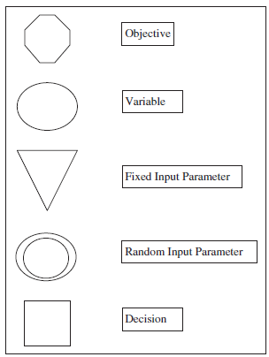
BUILDING AN INFLUENCE CHART
Built from right to left
Conventions on types of variables
  Outputs – hexagons
  Decisions – boxes
  Inputs – triangles
  Other variables – circles
  Random variables – double circles
  See Figure 2.3
Figure 2.3
Chapter 2
Copyright © 2013 John Wiley & Sons, Inc.

Slide 22
INFLUENCE CHART PRINCIPLES
Start with outcome measure
Decompose outcome measure into independent variables that directly determine it
Repeat decomposition for each variable in turn
Identify input data and decisions as they arise
Ensure each variable appears only once
Highlight special types of elements with consistent symbols
Chapter 2
Copyright © 2013 John Wiley & Sons, Inc.

Slide 23
EXAMPLE 1: A PRICING DECISION
“Determine the price we should set for our product so as to generate the highest possible profit this coming year.”
See Figures 2.2a – 2.2f
Chapter 2
Copyright © 2013 John Wiley & Sons, Inc.

Slide 24
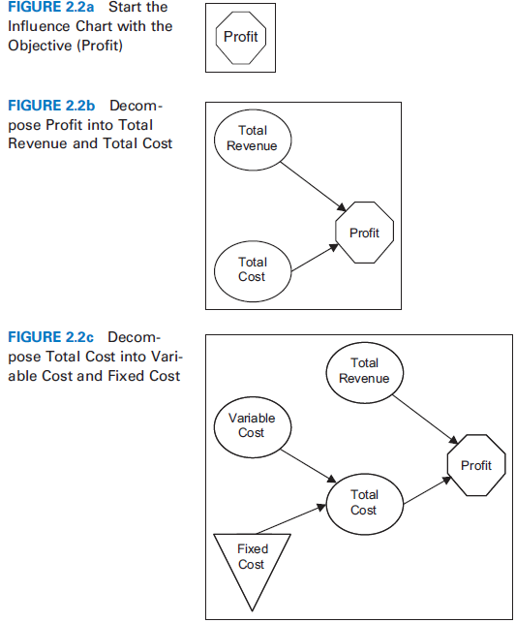
EXAMPLE 1: A PRICING DECISION
Chapter 2
Copyright © 2013 John Wiley & Sons, Inc.

Slide 25
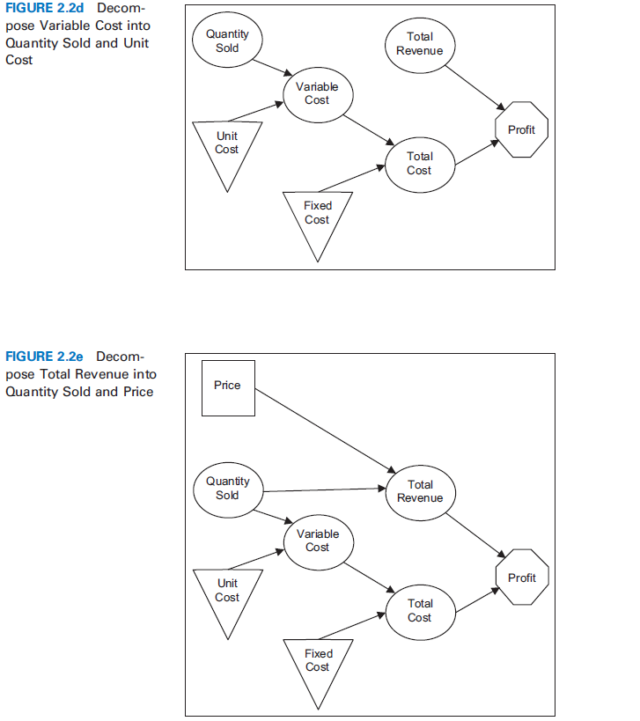
EXAMPLE 1: A PRICING DECISION
Chapter 2
Copyright © 2013 John Wiley & Sons, Inc.

Slide 26
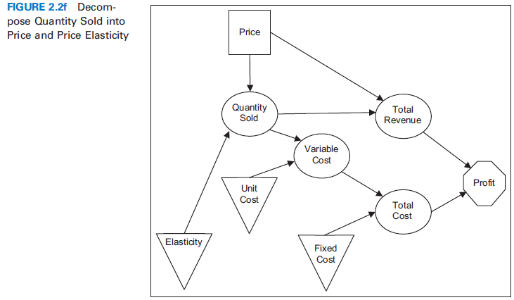
EXAMPLE 1: A PRICING DECISION
Chapter 2
Copyright © 2013 John Wiley & Sons, Inc.

Slide 27
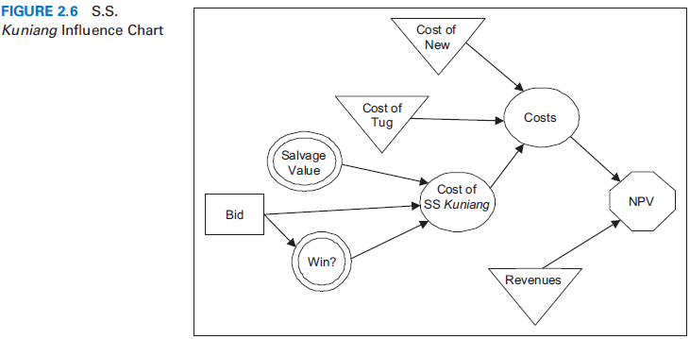
EXAMPLE 2: THE SS KUNIANG¹
In the early 1980s, New England Electric System (NEES) was deciding how much to bid for the salvage rights to a grounded ship, the SS Kuniang. If the bid were successful, the ship could be repaired and outfitted to haul coal for the company’s power-generation stations. But the value of doing so depended on the outcome of a U.S. Coast Guard judgment about the salvage value of the ship.
See Figure 2.6
¹D. E. Bell, “Bidding for the S.S. Kuniang,” Interfaces 14 (1984): 17–23.
Chapter 2
Copyright © 2013 John Wiley & Sons, Inc.

Slide 28
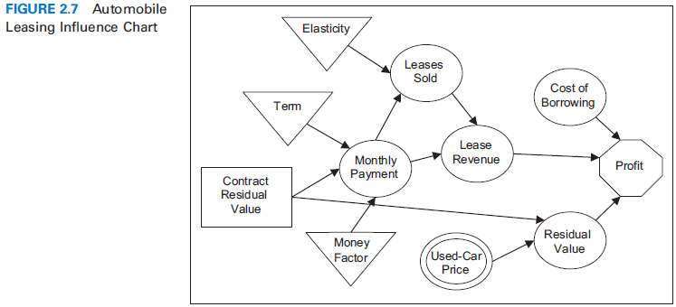
EXAMPLE 3: AUTOMOBILE LEASING
The primary challenge for companies offering a closed-end lease is to select the residual value of the vehicle.
See Figure 2.7
Chapter 2
Copyright © 2013 John Wiley & Sons, Inc.

Slide 29
INFLUENCE CHARTS WRAP-UP
The goal is to develop a problem structure—not to solve the problem.
There is no one correct chart.
Charts ignore all available numerical data.
Charts rely on modeling assumptions that should be recorded as made.
Chapter 2
Copyright © 2013 John Wiley & Sons, Inc.

Slide 30
CRAFT SKILLS FOR MODELING
Successful modelers draw on both technical and craft skills
Technical skills
  Lead to a single correct answer
  Require no creativity, learned quickly
  Example: Calculating present values
Craft skills
  Do not lead to a single answer
  Example: Designing a prototype
Chapter 2
Copyright © 2013 John Wiley & Sons, Inc.

Slide 31
CHARACTERISTICS OF CRAFT SKILLS
Do not lead to a single answer
Require creativity
Harder to define and teach
Develop slowly over time
Involve modeling heuristics
Chapter 2
Copyright © 2013 John Wiley & Sons, Inc.

Slide 32
MODELING HEURISTICS
Simplify the problem
Break the problem into modules
Build a prototype and refine it
Sketch graphs of key relationships
Identify parameters and perform sensitivity analysis
Separate the creation of ideas from their evaluation
Work backward from the desired answer
Focus on model structure, not data collection
Chapter 2
Copyright © 2013 John Wiley & Sons, Inc.

Slide 33
SIMPLIFY THE PROBLEM
“Model simple, think complicated”
Simplification
  The essence of modeling
  Increases transparency - aids with buy-in
  Requires a focus on key connections and central trade-offs
  Involves making assumptions
Chapter 2
Copyright © 2013 John Wiley & Sons, Inc.

Slide 34
BREAK THE PROBLEM INTO MODULES
Keep components as independent as possible.
Each component is simpler to deal with than the whole.
Development of components provides structure to the modeling process.
Chapter 2
Copyright © 2013 John Wiley & Sons, Inc.

Slide 35
BUILD A PROTOTYPE AND REFINE IT
A prototype is a working model.
It should:
  Take data and inputs from the user
  Produce key outputs in response
A prototype:
  Will be refined later
  Is, by definition, simple
Chapter 2
Copyright © 2013 John Wiley & Sons, Inc.

Slide 36
CHARACTERISTICS OF A COMPLETED PROTOTYPE
The problem is decomposed into modules.
We have built a simple model for each module.
The modules work together to produce results.
We have provided a tentative answer to the client’s major questions.
Chapter 2
Copyright © 2013 John Wiley & Sons, Inc.

Slide 37
PROTOTYPES
Keep the entire problem in the mind of the modeler
Provide a roadmap for future work
Support sensitivity analysis
  Where would my model benefit most from additional work?
Chapter 2
Copyright © 2013 John Wiley & Sons, Inc.

Slide 38
SKETCH GRAPHS OF KEY RELATIONSHIPS
Graphs express relationships visually
  Not mathematically or verbally
Allows for looking at a problem from different viewpoints
Externalizes the analysis
  Moves it from the mind to an external artifact (the graph)
Chapter 2
Copyright © 2013 John Wiley & Sons, Inc.

Slide 39
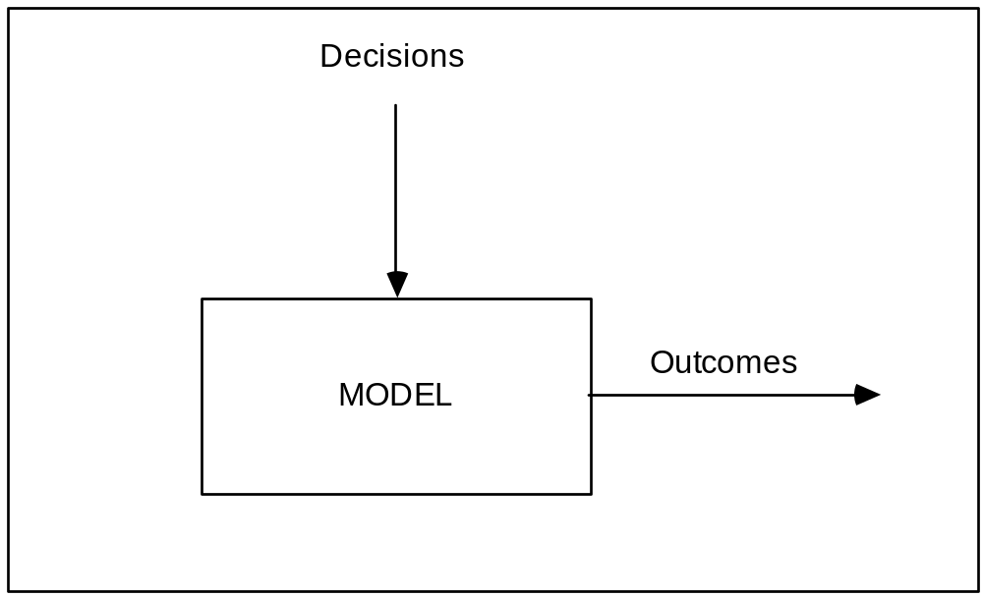
VISUALIZATION OF THE MODELING PROCESS
Chapter 2
Copyright © 2013 John Wiley & Sons, Inc.

Slide 40
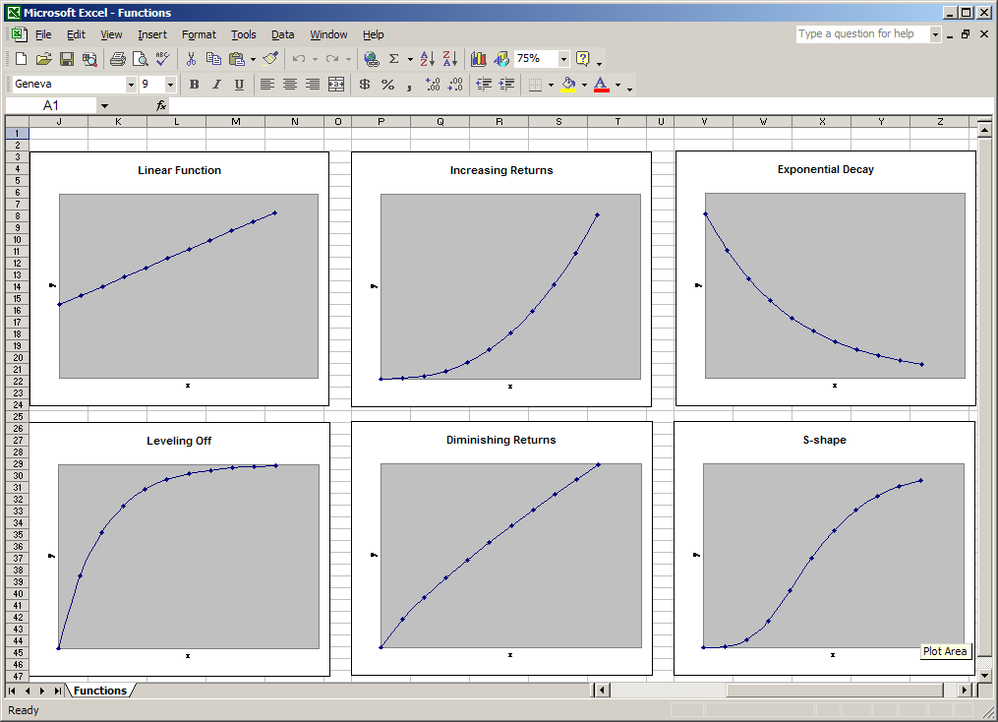
USEFUL FUNCTIONS FOR MODELING
Chapter 2
Copyright © 2013 John Wiley & Sons, Inc.

Slide 41
IDENTIFY PARAMETERS AND PERFORM SENSITIVITY ANALYSIS
Price1 and Price2 below represent a family of relations.
  Price1 = a – b*(Quantity)
  Price2 = a*(Quantity)^{b} (b<1)
a and b are the parameters of these models.
Sensitivity analysis
  Determines plausible ranges for the parameters
  Tests the impact of parameter values on model outputs
Parameterization builds links between our rational knowledge and our intuition.
Chapter 2
Copyright © 2013 John Wiley & Sons, Inc.

Slide 42
SEPARATE THE CREATION OF IDEAS FROM THEIR EVALUATION
Many modelers prefer judging ideas over generating them.
To “quiet the critical voice”:
  Separate periods of divergent and convergent thinking.
  Initiate a brainstorming session; remind participants not to criticize ideas of others.
  Realize that mistakes and blind alleys are part of the modeling process.
Chapter 2
Copyright © 2013 John Wiley & Sons, Inc.

Slide 43
WORK BACKWARD FROM THE DESIRED ANSWER
Start with the form the answer will take.
Work backward to select model and analysis to generate the chosen result.
The “PowerPoint heuristic”
  What should be on one summary slide that contains the essential message (e.g., a number, a table, a chart)?
Chapter 2
Copyright © 2013 John Wiley & Sons, Inc.

Slide 44
FOCUS ON MODEL STRUCTURE, NOT ON DATA COLLECTION
Novice modelers spend a high proportion of time on data.
Expert modelers spend most of their time on model structure.
Chapter 2
Copyright © 2013 John Wiley & Sons, Inc.

Slide 45
MISTAKEN BELIEFS OF NOVICE MODELERS
The available data is the information needed in the modeling process.
Obtaining data moves the process forward.
More data improves the quality of the final recommendations.
Chapter 2
Copyright © 2013 John Wiley & Sons, Inc.

Slide 46
COMMON SOURCES OF BIASES AND ERRORS IN EMPIRICAL DATA
Sampling error
Differences in purpose
Masking
Inappropriateness
Definitional differences
Chapter 2
Copyright © 2013 John Wiley & Sons, Inc.

Slide 47
EXPERT MODELERS’ ATTITUDES TOWARDS DATA
Treat data skeptically
Realize that even good data may not be relevant for the model
Realize that data collection can be distracting and limiting
Build the model structure first and then use data to refine it
Chapter 2
Copyright © 2013 John Wiley & Sons, Inc.

Slide 48
SUMMARY
Effective modeling takes place within a larger problem solving process.
Problem-solving process:
  Exploring the mess
  Searching for information
  Defining the problem
  Searching for solutions
  Evaluating solutions
  Implementing the solution
Chapter 2
Copyright © 2013 John Wiley & Sons, Inc.

Slide 49
SUMMARY (CONT’D)
Mental modeling is an essential tool in problem solving.
Formal models provide the same kind of benefits as mental models.
Influence charts offer the modeler a bridge between an ill-structured problem and a formal model.
Chapter 2
Copyright © 2013 John Wiley & Sons, Inc.

Slide 50
SUMMARY (CONT’D)
Modeling heuristics are rules of thumb that help in the design and use of models.
  Simplify the problem.
  Break the problem into modules.
  Build a prototype and refine it.
  Sketch graphs of key relationships.
  Identify parameters and perform sensitivity analysis.
  Separate the creation of ideas from their evaluation.
  Work backward from the desired answer.
  Focus on model structure, not on data collection.
Chapter 2
Copyright © 2013 John Wiley & Sons, Inc.

Slide 51
COPYRIGHT © 2013 JOHN WILEY & SONS, INC.
All rights reserved. Reproduction or translation of this work beyond that permitted in section 117 of the 1976 United States Copyright Act without express permission of the copyright owner is unlawful. Request for further information should be addressed to the Permissions Department, John Wiley & Sons, Inc. The purchaser may make back-up copies for his/her own use only and not for distribution or resale. The Publisher assumes no responsibility for errors, omissions, or damages caused by the use of these programs or from the use of the information herein.

