Slide 1
CHAPTER 3 POWERPOINT
SPREADSHEET ENGINEERING
Notes:
Power Point Slides Revised By: Dann Anthony Maurno, nSight, Inc.

Slide 2
SPREADSHEET ENGINEERING
Spreadsheet engineering is akin to structural and civil engineering.
  Builders use blueprints or plans.
  Without plans, structures will fail to be effective.
Advanced planning in any sort of design can speed up implementation.
Spreadsheets are no different from other arenas of design.
  Engineering and advanced planning aid effectiveness, and reduce rework and costs.
Chapter 3
Copyright © 2013 John Wiley & Sons, Inc.

Slide 3
SPREADSHEET DESIGN
An efficient process minimizes time spent.
An effective process yields results that meet users’ requirements.
Good design helps analysts spend the majority of their effort improving decisions, rather than building and fixing models.
Chapter 3
Copyright © 2013 John Wiley & Sons, Inc.

Slide 4
THE PHASES OF SPREADSHEET MODELING
Spreadsheet modeling is a creative process.
Still, every spreadsheet passes through three predictable stages:
  Designing
  Building
  Testing
Chapter 3
Copyright © 2013 John Wiley & Sons, Inc.

Slide 5
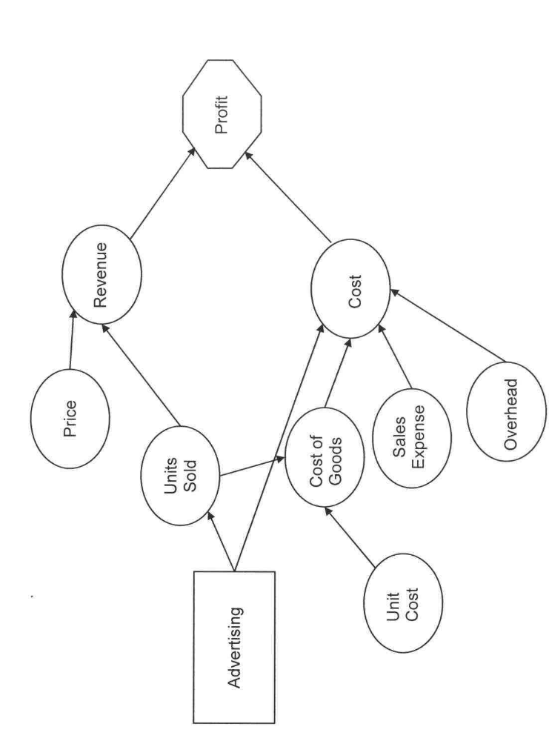
EXAMPLE: INFLUENCE CHART
Chapter 3
Copyright © 2013 John Wiley & Sons, Inc.

Slide 6
DESIGNING A SPREADSHEET
Plan: Sketch the Spreadsheet
Organize the Spreadsheet into Modules
Start Small
Isolate Input Parameters
Design for Use
Keep it Simple
Design for Communication
Document Important Data and Formulas
Chapter 3
Copyright © 2013 John Wiley & Sons, Inc.

Slide 7
PLAN: SKETCH THE SPREADSHEET
“Measure twice, cut once.”
Decreases time spent correcting mistakes.
Turn computer off and think before beginning.
Begin with a sketch:
  Physical layout of major elements
  Rough indication of calculation flow
Anticipate model’s ultimate uses.
Chapter 3
Copyright © 2013 John Wiley & Sons, Inc.

Slide 8
ORGANIZE THE SPREADSHEET INTO MODULES
Group like items and separate unlike items.
Separate:
  Data
  Decision variables
  Outcome measures
  Detailed calculations
Influence diagrams aid with this design.
Consider the flow of information.
  Which information needs to pass from one group to another?
Chapter 3
Copyright © 2013 John Wiley & Sons, Inc.

Slide 9
START SMALL
Sketch a full design but do not build all at once.
Isolate one module, then build and test that module.
  Start with one customer, one month, before building a customer base or year.
Local mistakes are much easier to detect than when they are part of the global model.
Chapter 3
Copyright © 2013 John Wiley & Sons, Inc.

Slide 10
ISOLATE INPUT PARAMETERS
Place parameters in a single location away from calculations.
  So they are easy to identify, change.
  Formulas should only contain cell references, not numerical values.
Assists in:
  Identifying parameters
  Sensitivity analysis
  Documenting assumptions behind parameters
Chapter 3
Copyright © 2013 John Wiley & Sons, Inc.

Slide 11
DESIGN FOR USE
Anticipate who will use the spreadsheet.
  What type of questions will be asked?
Make it easy to change common parameters.
Make it easy to find key outputs.
  Group in one place
Place outputs near inputs.
  Thus, details of model do not interfere with analysis
Chapter 3
Copyright © 2013 John Wiley & Sons, Inc.

Slide 12
KEEP IT SIMPLE
Complex spreadsheets:
  Require more time and effort to build
  Are much more difficult to debug
Keep formulas short.
  Decompose complex calculations into intermediate steps.
Chapter 3
Copyright © 2013 John Wiley & Sons, Inc.

Slide 13
DESIGN FOR COMMUNICATION
Spreadsheets’ lives are often longer than expected.
Use visual cues that reinforce the model’s logic.
  Use informative labels
  Use blank spaces
  Use outlines, color, bold fonts, as appropriate
Split windows can aid in viewing.
Chapter 3
Copyright © 2013 John Wiley & Sons, Inc.

Slide 14
DOCUMENT IMPORTANT
DATA AND FORMULAS
Record source for important parameters.
Explain important formulas.
Use Cell Comments to describe cell contents.
Consider a separate module to list assumptions.
Chapter 3
Copyright © 2013 John Wiley & Sons, Inc.

Slide 15
DOCUMENT IMPORTANT DATA/FORMULAS:
USE CELL COMMENTS
Insert Cell Comment – Review►Comments►New Comment
Different Display options (Advanced ► Display ► For cells with comments, show):
  Comments and indicators
  Indicators only, and comments on hover
  No comments or indicators – neither comment nor indicator visible
Chapter 3
Copyright © 2013 John Wiley & Sons, Inc.

Slide 16
WORKBOOK DESIGN
Use separate sheets to group similar kinds of information.
  Each worksheet has a well-defined purpose, in natural order, with a descriptive name.
Design workbooks for ease of navigation and use.
  Revealing names, hyperlinks, buttons.
Design a workbook as a decision-support system.
  Protect workbooks from unwanted changes.
Chapter 3
Copyright © 2013 John Wiley & Sons, Inc.

Slide 17
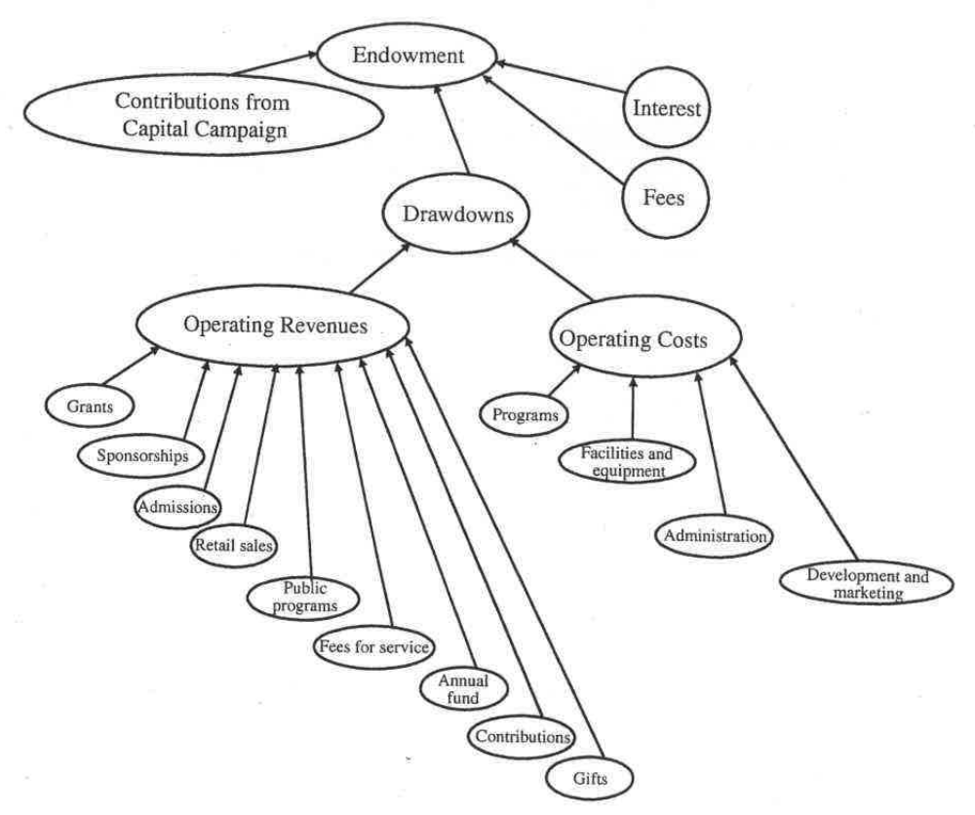
EXAMPLE: NORTHERN MUSEUM CAPITAL CAMPAIGN
Chapter 3
Copyright © 2013 John Wiley & Sons, Inc.

Slide 18
USE SEPARATE WORKSHEETS TO GROUP SIMILAR KINDS OF INFORMATION
Workbooks should be designed to make a model easy to understand and use.
Individual worksheets should each have a well-defined purpose and be given descriptive names.
Worksheets should appear in a natural order.
Assumptions, calculations and results should be placed on separate worksheets whenever possible; this allows users to view assumptions and results without being distracted by the details of the calculations.
Chapter 3
Copyright © 2013 John Wiley & Sons, Inc.

Slide 19
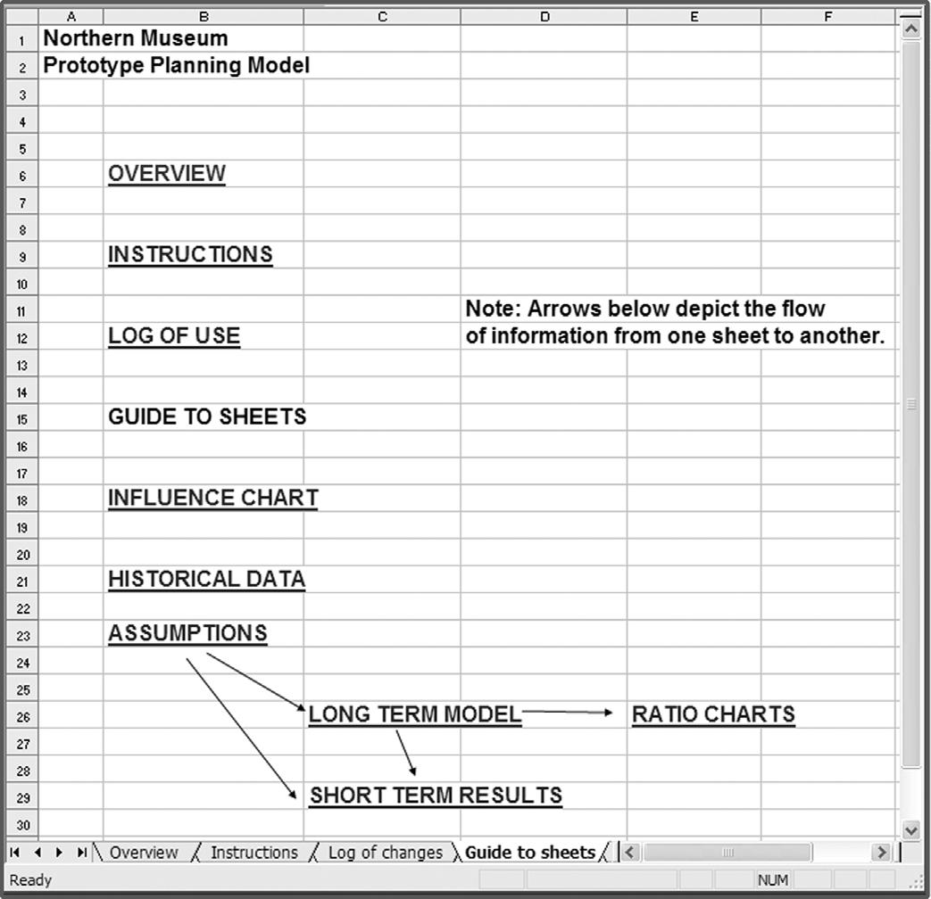
GUIDE TO SHEETS
Chapter 3
Copyright © 2013 John Wiley & Sons, Inc.

Slide 20
DESIGN WORKBOOKS FOR
EASE OF NAVIGATION AND USE
Structured workbooks facilitate understanding by user.
  Any form of structural help is beneficial.
Use revealing names for individual sheets.
  Double-click on the name tab at bottom of spreadsheet to edit name.
Use hyperlinks to corresponding worksheets.
  Insert►Links►Hyperlink
Use buttons.
  Developer►Controls►Insert
Chapter 3
Copyright © 2013 John Wiley & Sons, Inc.

Slide 21
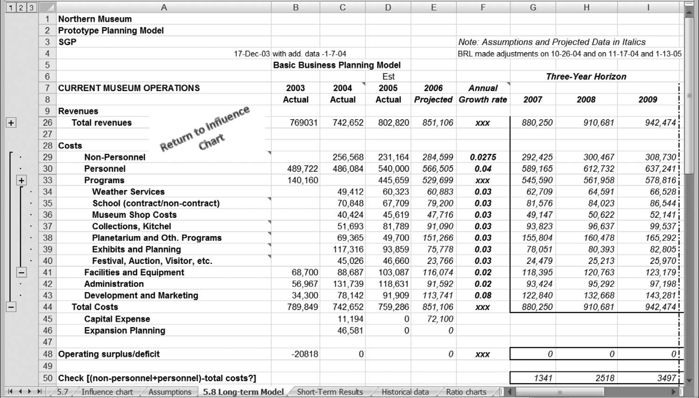
NAVIGATION & EASE OF USE: OUTLINING
Chapter 3
Copyright © 2013 John Wiley & Sons, Inc.

Slide 22
DESIGN A WORKBOOK AS A
DECISION SUPPORT SYSTEM
Decision support system: An integrated information system that provides data, analytics, and reporting capabilities over an extended period of time to multiple users.
Effective decision support systems present information in the manner most useful to decision makers.
  Graphs versus tables of numbers
Chapter 3
Copyright © 2013 John Wiley & Sons, Inc.

Slide 23
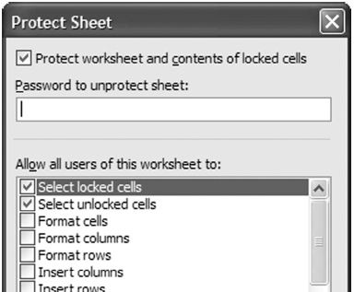
PROTECT CONTENT AGAINST UNWANTED CHANGES
Lock cells not to be changed.
Use worksheet protection.
Use data validation.
Chapter 3
Copyright © 2013 John Wiley & Sons, Inc.

Slide 24
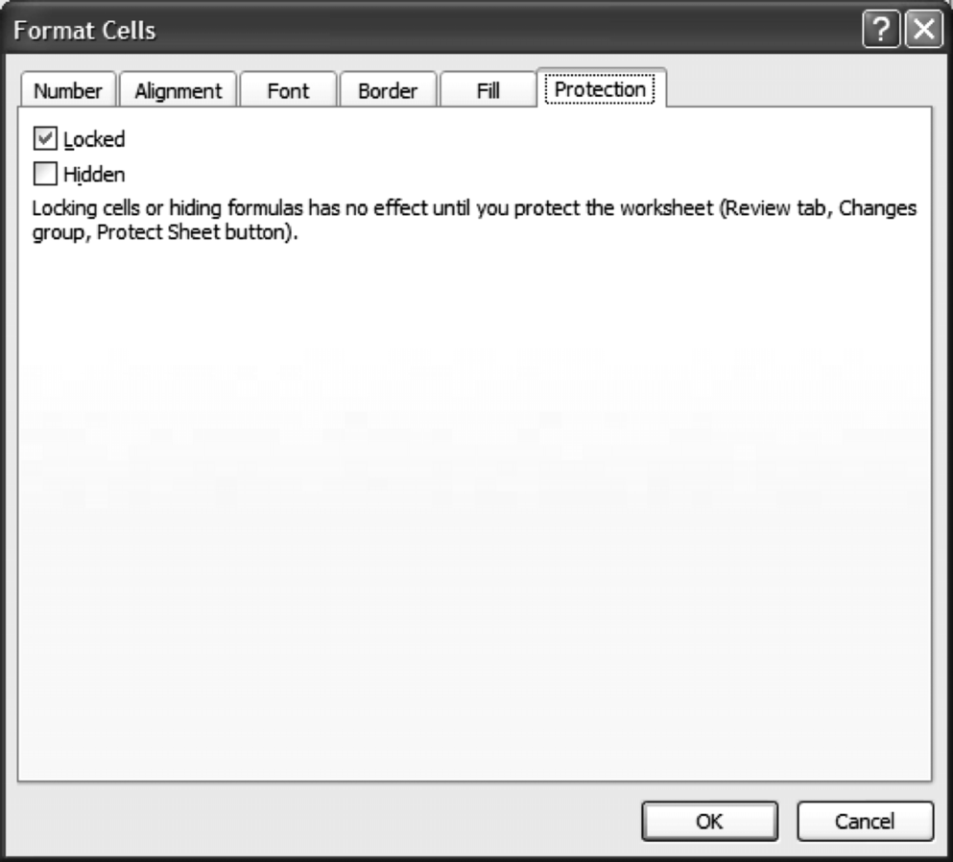
LOCKING CELLS
To lock all cells:
  Select entire worksheet
  Select Home►Font, choose
  the Protection tab, and
  check the box for Locked
To unlock variable cells:
  Select desired cells
  Select Home►Font and
  choose Protection tab, but
  uncheck the box for Locked
Chapter 3
Copyright © 2013 John Wiley & Sons, Inc.
Notes:
Important to emphasize this, else, home/font command does not work.

Slide 25
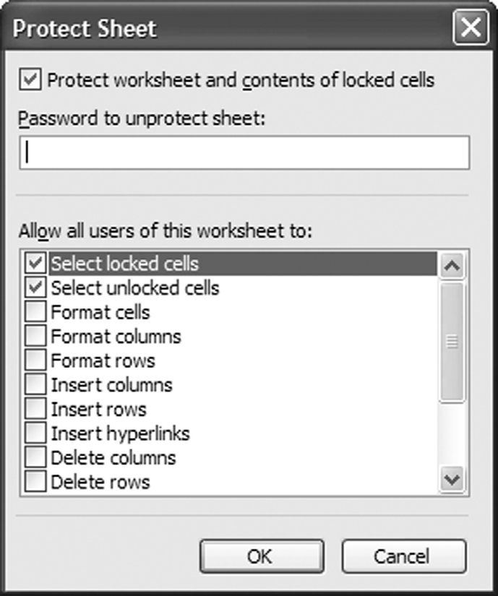
PROTECTING WORKSHEETS
Review►Changes►Protect Sheet
At top of Protect Sheet window
check box for Protect worksheet
If check only Select Unlocked Cells
  User will be able to only select and
  modify unlocked cells.
If check Select Locked and Unlocked
Cells
  User will be able to select any cell
  but only modify unlocked cells.
Chapter 3
Copyright © 2013 John Wiley & Sons, Inc.

Slide 26
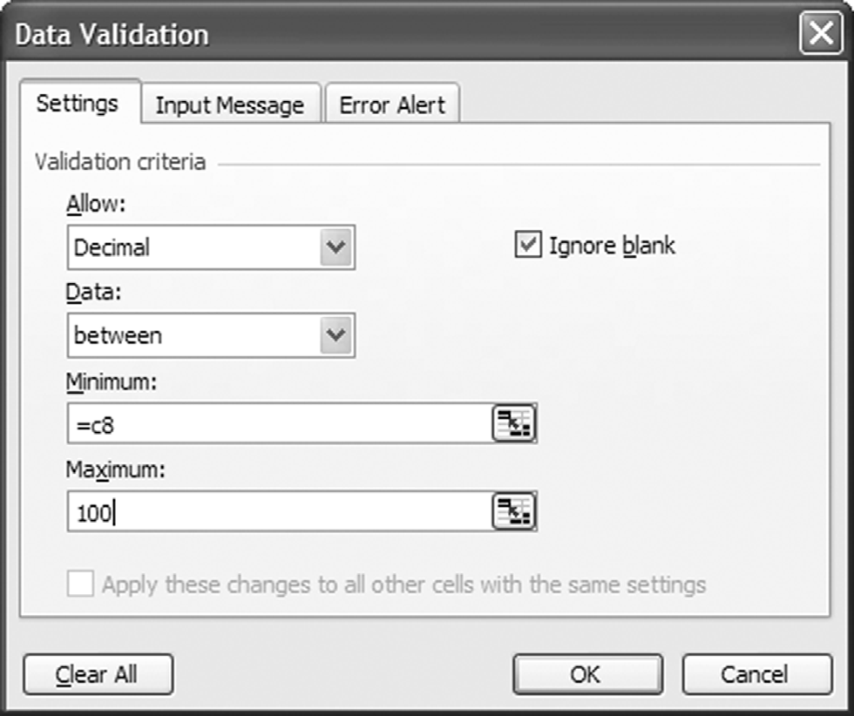
DATA VALIDATION
Controls input values
Highlight cells then click
Data►Data Tools ►Data
Validation
Three tabs:
  Settings: Restrict inputs
  (e.g., range of cell values)
  Input Message: Create
  message when cursor on cell
  Error Alert: Alert for
  invalid entry
Chapter 3
Copyright © 2013 John Wiley & Sons, Inc.

Slide 27
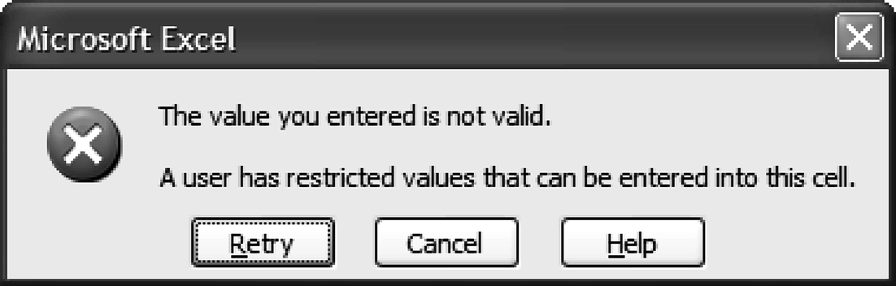
DATA VALIDATION: ERROR ALERT
Chapter 3
Copyright © 2013 John Wiley & Sons, Inc.

Slide 28
BUILDING A WORKBOOK
The second stage in creating a useful spreadsheet model, in eight steps:
  Follow a Plan
  Build One Worksheet or Module at a Time
  Predict the Outcome of Each Formula
  Copy and Paste Formulas Carefully
  Use Relative and Absolute Addressing to Simplify Copying
  Use the Function Wizard to Ensure Correct Syntax
  Use Range Names to Make Formulas Easy to Read
  Choose Input Data to Make Errors Stand Out
Chapter 3
Copyright © 2013 John Wiley & Sons, Inc.

Slide 29
COPYING AND PASTING FORMULAS
Copy-and-Paste commands (rather than retyping) reduce the potential for typographical errors.
Careless copying can also be a source of bugs.
  e.g., wrong range copied
Chapter 3
Copyright © 2013 John Wiley & Sons, Inc.

Slide 30
RELATIVE AND ABSOLUTE ADDRESSING
Necessary for efficient copying
An address such as B7 is relative.
  In cell A6, B7 represents one row down and one column to the right.
  If copied, new formula will refer to new cell that is one row down and one column to the right.
An address such as $B$6 is absolute.
  Cell will not change if formula is copied.
  Use for parameter values.
Chapter 3
Copyright © 2013 John Wiley & Sons, Inc.

Slide 31
FUNCTION WIZARD
The button f_{x} (on formula bar or Formulas ribbon) brings up the function wizard.
Contains a complete list of all Excel functions
Selecting a function will bring up a window showing needed inputs.
Function value will be shown in window automatically
Chapter 3
Copyright © 2013 John Wiley & Sons, Inc.

Slide 32
RANGE NAMES
Any cell or range of cells may be named.
Name or cell reference may be used in formulas.
  Names easier to debug and use
Require extra work to enter and maintain
Select Formulas►Defined Names►Define Name to assign a name.
Pull-down window at top left of spreadsheet.
  Shows all named cells for workbook
  Can be used to enter individual cell names
Chapter 3
Copyright © 2013 John Wiley & Sons, Inc.

Slide 33
TESTING A WORKBOOK
Even a carefully designed and built spreadsheet may contain errors.
  Check that numerical results look plausible.
  Check that formulas are correct.
  Test that model performance is plausible.
Chapter 3
Copyright © 2013 John Wiley & Sons, Inc.

Slide 34
CHECK THAT NUMERICAL RESULTS LOOK PLAUSIBLE
Make rough estimates.
Check with a calculator.
Test extreme cases.
Chapter 3
Copyright © 2013 John Wiley & Sons, Inc.

Slide 35
CHECK THAT FORMULAS ARE CORRECT
Check visually.
Display individual cell references.
Display all formulas.
Use the Excel Auditing Tools.
Use Excel Error Checking.
Use error traps.
Use auditing software.
Chapter 3
Copyright © 2013 John Wiley & Sons, Inc.

Slide 36
CHECK FORMULAS VISUALLY
Visually check formulas in each cell.
Most effective when range names used
Tends to be tedious
Chapter 3
Copyright © 2013 John Wiley & Sons, Inc.

Slide 37
DISPLAY INDIVIDUAL CELL REFERENCES
Press F2 or double-click on cell of interest.
Reveals formula with color-coded cell references
Stronger visual clues than manual checking
Chapter 3
Copyright © 2013 John Wiley & Sons, Inc.

Slide 38
DISPLAY ALL FORMULAS
Hold down Control key and press Tilde key [Control + ~].
All spreadsheet formulas are displayed
Makes for easier scanning
Aids in detecting deviations from patterns
Reverse by repeating Control + ~
Chapter 3
Copyright © 2013 John Wiley & Sons, Inc.

Slide 39
USING THE EXCEL AUDITING TOOLS
Identifies predecessors (used to calculate cells) and dependents of cells
Select Formulas►Formula Auditing to identify the cells used to calculate a given cell.
Trace Precedents
  Draws colored arrows to predecessors
Trace Dependents
  Draws colored arrows to successors
Chapter 3
Copyright © 2013 John Wiley & Sons, Inc.

Slide 40
EXCEL ERROR CHECKING
Spreadsheet equivalent of grammar checking
Managed from the Formulas tab of the Excel Options menu.
Available in Excel 2002 and later versions.
Cells with possible errors are flagged with a colored triangle.
Chapter 3
Copyright © 2013 John Wiley & Sons, Inc.

Slide 41
ERRORS CHECKED UNDER AUTOMATIC ERROR CHECKING
Cells containing formulas that result in an error
Inconsistent calculated column formula in tables
Cells containing years represented as 2 digits
Numbers Formatted as text or preceded by an apostrophe
Formulas inconsistent with other formulas in the region
Formulas which omit cells in a region
Unlocked cells containing formulas
Formulas referring to empty cells
Data entered in a table is invalid
Chapter 3
Copyright © 2013 John Wiley & Sons, Inc.

Slide 42
USE ERROR TRAPS
Error traps = formulas added to a spreadsheet that warn the user of potential errors
Can check for errors in input data or in formulas
Improve a workbook’s safety.
Important that results of error checks be clearly visible to the user
  For example, an overall error trap that checks if any one of individual traps is true, then returns a warning
Chapter 3
Copyright © 2013 John Wiley & Sons, Inc.

Slide 43
USE AUDITING SOFTWARE
A number of Excel add-ins are available for auditing spreadsheets.
Add-ins typically provide a set of tools for detecting errors, displaying model structure graphically
One such tool = Spreadsheet Professional (www.spreadsheetinnovations.com)
Chapter 3
Copyright © 2013 John Wiley & Sons, Inc.

Slide 44
TEST THAT MODEL PERFORMANCE IS PLAUSIBLE
Model should react in a plausible manner to a range of inputs
User should be content with trends in output based on varying inputs
Sensitivity testing an important tool to test plausibility
Chapter 3
Copyright © 2013 John Wiley & Sons, Inc.

Slide 45
SUMMARY
Spreadsheets deserve careful engineering.
  Most spreadsheets contain errors.
  Users are over confident about their models.
Rules for spreadsheet modeling:
  Designing a spreadsheet
  Designing a workbook
  Building a workbook
  Testing a workbook
Chapter 3
Copyright © 2013 John Wiley & Sons, Inc.

Slide 46
COPYRIGHT © 2013 JOHN WILEY & SONS, INC.
All rights reserved. Reproduction or translation of this work beyond that permitted in section 117 of the 1976 United States Copyright Act without express permission of the copyright owner is unlawful. Request for further information should be addressed to the Permissions Department, John Wiley & Sons, Inc. The purchaser may make back-up copies for his/her own use only and not for distribution or resale. The Publisher assumes no responsibility for errors, omissions, or damages caused by the use of these programs or from the use of the information herein.
Notes:
Updated copyright to 2013, added © symbol, and retained times new roman font.

