Slide 1
CHAPTER 4 POWERPOINT
SPREADSHEET ANALYSIS

Slide 2
FIVE CATEGORIES OF SPREADSHEET ANALYSIS
Base-case analysis
What-if analysis
Breakeven analysis
Optimization analysis
Risk analysis
A detailed analysis may involve all types.
Chapter 4
Copyright © 2013 John Wiley & Sons, Inc.

Slide 3
BASE CASE ANALYSIS
Base case serves as a point of comparison:
  Current policy or common practice
  Most likely scenario, best or worst case scenarios
Answers questions such as:
  If we follow last year’s plan, how much profit should we expect next year?
  How many items do we expect to sell next week?
Chapter 4
Copyright © 2013 John Wiley & Sons, Inc.

Slide 4
WHAT-IF ANALYSIS
Analyzes how key outputs change with changes in one or more of the inputs
May vary a parameter, a decision variable, or the model structure
Related to sensitivity analysis
  But, sensitivity analysis explores effects upon optimal outcomes.
Also part of debugging process
  If output is unexpected we have uncovered either a bug or a useful insight.
Chapter 4
Copyright © 2013 John Wiley & Sons, Inc.

Slide 5
WHAT IF: VARYING A PARAMETER
Asking what if given information were different
Tests numerical assumptions of model
Example: How much will profit change if our product costs turn out to be 10% higher or lower than we have assumed?
Chapter 4
Copyright © 2013 John Wiley & Sons, Inc.

Slide 6
WHAT IF: VARYING A DECISION
Explores outcomes we can influence (by varying inputs we can control)
Leads us to better decisions
Example: How much will profit change if we spend an extra $1000 on advertising in the first quarter?
Chapter 4
Copyright © 2013 John Wiley & Sons, Inc.

Slide 7
WHAT IF: VARYING THE MODEL STRUCTURE
Tests key structural assumptions in model
More complex than changes to parameters or decision variables
Example: How does profit change if we change our linear model of price and demand to a non-linear one?
Chapter 4
Copyright © 2013 John Wiley & Sons, Inc.

Slide 8
BENCHMARKING
Record base case to compare to results of what-if analysis
Base case can be recorded by:
  Home►Clipboard►Copy
  Home►Clipboard►Paste►Paste Special with Values Option selected
Chapter 4
Copyright © 2013 John Wiley & Sons, Inc.

Slide 9
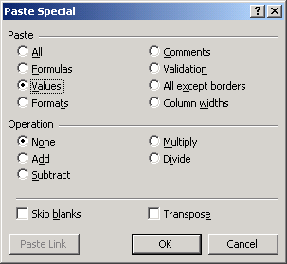
THE PASTE SPECIAL WINDOW
Chapter 4
Copyright © 2013 John Wiley & Sons, Inc.

Slide 10
SCENARIOS
Sets of parameter values often go together.
A scenario is a set of parameter values that are internally consistent.
Adding scenarios
  Data►Data Tools►What-if Analysis►Scenario Manager
  Enter the first scenario by clicking on the Add button
  Enter the information required in the Add Scenario window
Chapter 4
Copyright © 2013 John Wiley & Sons, Inc.

Slide 11
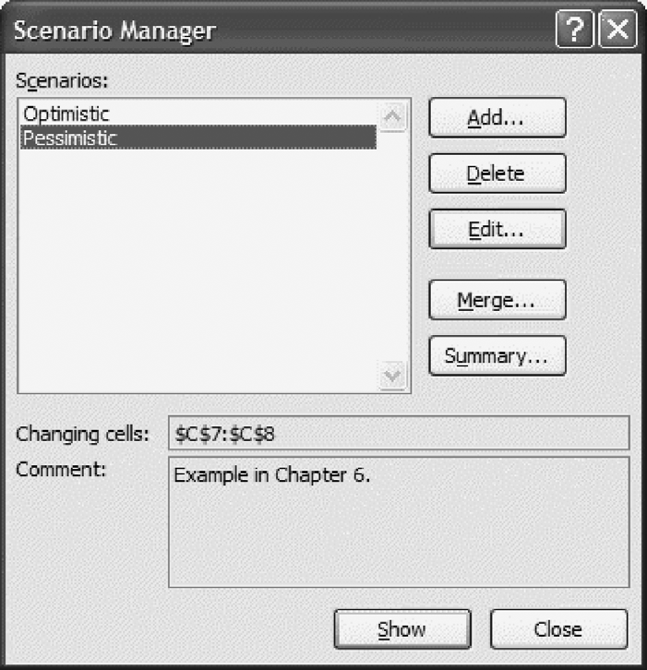
THE SCENARIO MANAGER WINDOW
Chapter 4
Copyright © 2013 John Wiley & Sons, Inc.

Slide 12
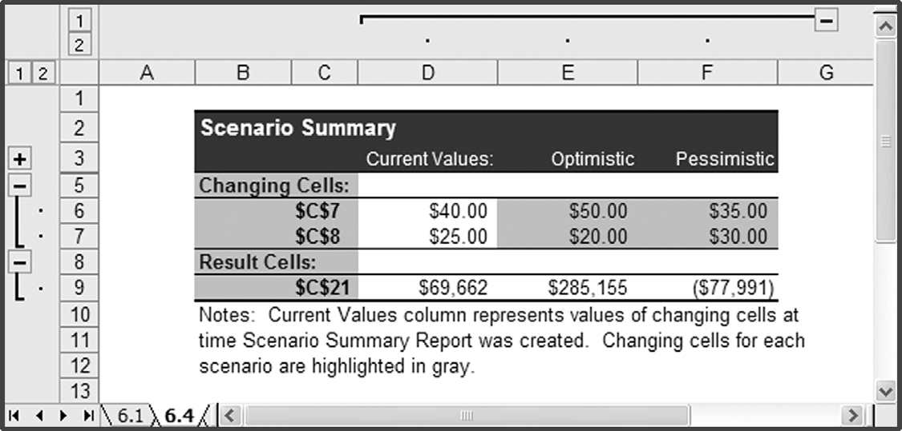
THE SUMMARY PRODUCED BY THE SCENARIO MANAGER
Chapter 4
Copyright © 2013 John Wiley & Sons, Inc.

Slide 13
CHOOSE FUNCTION
Used when scenarios involve a large number of parameters to switch from one set of parameters to another.
Selects a value from a range based on an index number.
  Index number is the number of the scenario and the range contains the inputs for a given parameter.
Chapter 4
Copyright © 2013 John Wiley & Sons, Inc.

Slide 14
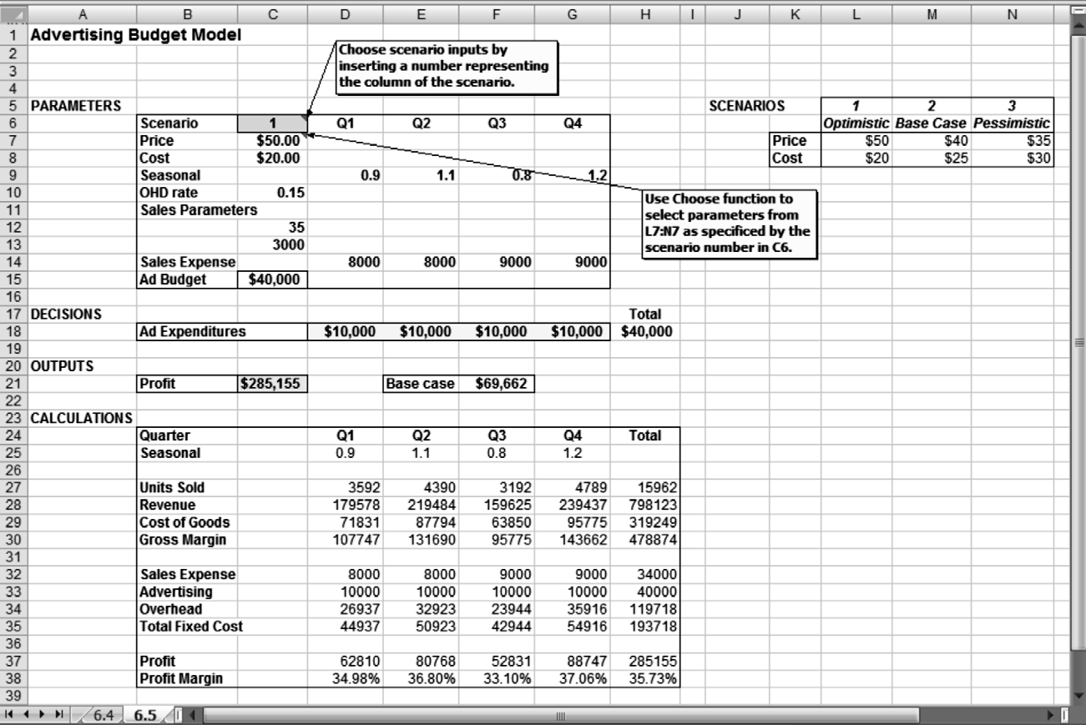
USE OF CHOOSE FUNCTION TO IMPLEMENT SCENARIOS
Chapter 4
Copyright © 2013 John Wiley & Sons, Inc.

Slide 15
PARAMETRIC SENSITIVITY
Tabulates output based over a range of inputs
  Versus just one (e.g., what-if analysis)
Found in Analytic Solver Platform add-in
Steps:
  For a single numerical result: Analytic Solver Platform►Analysis► Sensitivity – opens Function Arguments window
  For a table or graph plotting, e.g., profit as a function of unit cost: Analytic Solver Platform► Analysis► Sensitivity ► Parameter Analysis – opens Sensitivity Report window
Chapter 4
Copyright © 2013 John Wiley & Sons, Inc.

Slide 16
TORNADO CHARTS
Shows sensitivity to several inputs (versus one or two in parametric sensitivity)
Reveals which inputs have major vs. minor impacts
Chapter 4
Copyright © 2013 John Wiley & Sons, Inc.

Slide 17
LIMITATIONS OF TORNADO CHARTS
Potential pitfalls in assuming every parameter varies by the same percentage of the base case
Sensitivity implied can be misleading if output related to input in a nonlinear fashion
In general, we must be cautious about drawing conclusions about the sensitivity of a model outside the range of the parameters tested in a tornado chart.
Chapter 4
Copyright © 2013 John Wiley & Sons, Inc.

Slide 18
BREAKEVEN ANALYSIS
Analyzes where a particular point of interest occurs
Answers questions such as:
  How high does our market share need to be before we turn a profit?
  How high would the discount rate have to be in order for this project to have a NPV of zero?
Excel Goal Seek useful for breakeven analysis
  Data► Data Tools►What-if Analysis►Goal Seek
Chapter 4
Copyright © 2013 John Wiley & Sons, Inc.

Slide 19
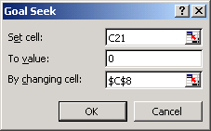
GOAL SEEK
Used for a single output and a single input
Output cell address
Target level sought
Input to vary
Chapter 4
Copyright © 2013 John Wiley & Sons, Inc.

Slide 20
OPTIMIZATION ANALYSIS
Finds set of decision variables that achieves best possible value of an output
Answers questions such as:
  How should we allocate our budget to maximize profit?
  How much inventory should we stock of each type of product, given constraints on shelf size and budget?
Analytic Solver Platform provides a variety of tools.
Chapter 4
Copyright © 2013 John Wiley & Sons, Inc.

Slide 21
SIMULATION AND RISK ANALYSIS
Analyzes the effect of uncertainty on the output
Analytic Solver Platform (which includes Monte Carlo simulation capability) is an important tool
Answers questions such as:
  What is the expected NPV after 25 years given that my return in each year is uncertain?
  What is the probability that the NPV after 25 years is greater than $1,000,000, given that my return in each year is uncertain?
  What is the distribution of NPV after 25 years given that my return in each year is uncertain?
Chapter 4
Copyright © 2013 John Wiley & Sons, Inc.

Slide 22
SUMMARY
Base-case analysis
What-if analysis
  Benchmarking
  Scenarios
  Parametric sensitivity tools
  Tornado charts
Breakeven analysis
  Goal Seek tool
Optimization analysis
Simulation and risk analysis
Chapter 4
Copyright © 2013 John Wiley & Sons, Inc.

Slide 23
COPYRIGHT © 2013 JOHN WILEY & SONS, INC.
All rights reserved. Reproduction or translation of this work beyond that permitted in section 117 of the 1976 United States Copyright Act without express permission of the copyright owner is unlawful. Request for further information should be addressed to the Permissions Department, John Wiley & Sons, Inc. The purchaser may make back-up copies for his/her own use only and not for distribution or resale. The Publisher assumes no responsibility for errors, omissions, or damages caused by the use of these programs or from the use of the information herein.

