Slide 1
CHAPTER 5 POWERPOINT
DATA EXPLORATION AND VISUALIZATION

Slide 2
INTRODUCTION
Business analysts must know how to use data to derive business insights and improve decisions.
Analysts may use data to describe situations (e.g., profit over the last year), predict situations (e.g., profit over the next year), or prescribe actions the organization must take to achieve its goals.
Several basic skills are required to understand a data set, explore individual variables (or groups of them) for insights, and to prepare data for more complex analysis.
Remain skeptical of data: datasets are only as good as their collection methods (e.g., may have been collected with biases), and may or may not be relevant to the problem at hand.
Chapter 5
Copyright © 2013 John Wiley & Sons, Inc.

Slide 3
DATABASE STRUCTURE
Spreadsheet databases are two-dimensional files (versus more complex relational databases).
Consist of:
  Rows = records (sometimes, “cases” or “instances”)
  Columns = or fields (sometimes “variables,” “descriptors,” “predictors”
Most databases contain a data dictionary that documents fields in detail.
Chapter 5
Copyright © 2013 John Wiley & Sons, Inc.

Slide 4
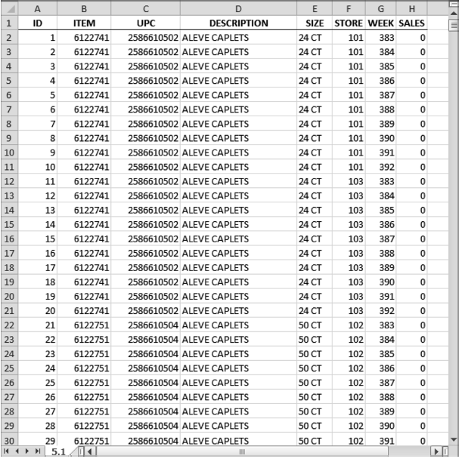
DATABASE STRUCTURE, EXAMPLE
The data dictionary for this sample:
Field Name | Description
ID | Record number
ITEM | Item number
UPC | Uniform Product Code
DESCRIPTION | Description
SIZE | Items per container
STORE | Store number
WEEK | Week number
SALES | Sales volume in cases
Chapter 5
Copyright © 2013 John Wiley & Sons, Inc.

Slide 5
DATABASE STRUCTURE, EXAMPLE
We might use this database to answer the questions:
  What were the market shares of the various brands?
  What were the weekly sales volumes at the various stores?
Chapter 5
Copyright © 2013 John Wiley & Sons, Inc.

Slide 6
TYPES OF DATA
An infinite variety of data, but just a few common types:
  Categorical data, which includes nominal and ordinal data
  Numerical data, which includes interval and ratio data
Chapter 5
Copyright © 2013 John Wiley & Sons, Inc.

Slide 7
TYPES OF DATA: CATEGORICAL VARIABLES
Nominal data, which simply names the category of record.
  Example: A GENDER field, with only two variables (male and female)
  Example: The DESCRIPTION field in previous slides, with numerous variables (e.g., ADVIL, TYLENOL X/STRGTH LIQ).
Ordinal data, also identifies category of record but with a natural order to the values.
  Example: High, Medium and Low
  Example: Numerical rankings, where 5 = most preferred, 1 = least preferred
Chapter 5
Copyright © 2013 John Wiley & Sons, Inc.

Slide 8
TYPES OF DATA: NUMERICAL DATA
Interval data, which conveys a sense of the difference between values.
  Example: The Fahrenheit scale.
Ratio data, based on a scale with a meaningful zero point.
  Example: Monetary units, ages.
Chapter 5
Copyright © 2013 John Wiley & Sons, Inc.

Slide 9
DATA EXPLORATION
Databases are highly structured for storage but do not automatically reveal patterns and insights.
We explore databases in a five-step process:
  Understand the data
  Organize and subset the database
  Examine individual variables and their distributions
  Calculate summary measures for individual variables
  Examine relationships among variables
Chapter 5
Copyright © 2013 John Wiley & Sons, Inc.

Slide 10
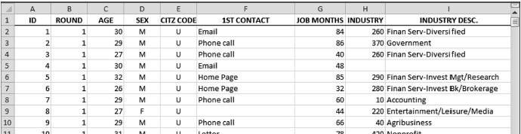
UNDERSTAND THE DATA
Be skeptical of data, and ask:
  How are fields defined?
  What types of data are represented?
  What units are the data in?
Example: Job applicants database
  SEX and AGE are unambiguous, but, does CITZ CODE (with U for US, N for non-US) represent country of birth? Or citizenship? Where the applicant currently lives? Know how the variable was coded.
Chapter 5
Copyright © 2013 John Wiley & Sons, Inc.

Slide 11
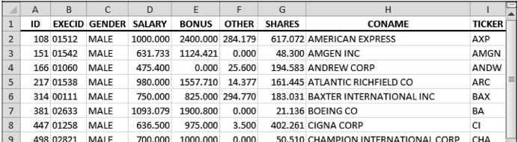
ORGANIZE AND SUBSET THE DATABASE
Two essential tools: Sort and Filter
  On the Home ribbon in the Editing group and the Data Ribbon in the Sort and Filter group
Question: In the Executives database below, do any duplicate records (EXECID) appear?
Chapter 5
Copyright © 2013 John Wiley & Sons, Inc.

Slide 12
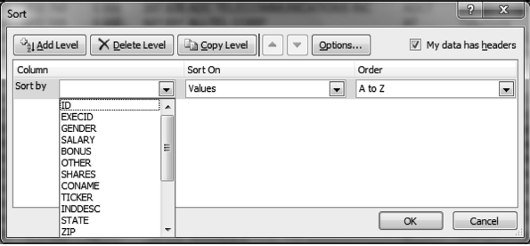
ORGANIZE AND SUBSET THE DATABASE (CONT’D)
Home►Editing►Sort & Filter►Custom Sort opens the Sort window
  We sort by the EXECID column, sort on Values, and in order of A to Z, and click OK.
  We can then scan for duplicate numbers (which appear above one another)
Chapter 5
Copyright © 2013 John Wiley & Sons, Inc.

Slide 13
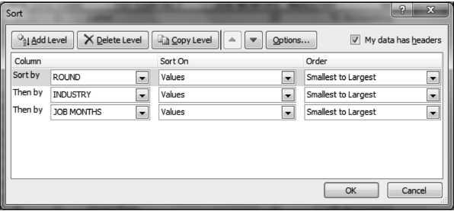
ORGANIZE AND SUBSET THE DATABASE (CONT’D)
We can sort by more than one criterion using Add Level, for example:
  ROUND then INDUSTRY then JOB MONTHS
  But, ties on the first criterion will be broken by the second, and the second by the third.
Chapter 5
Copyright © 2013 John Wiley & Sons, Inc.

Slide 14
ORGANIZE AND SUBSET THE DATABASE: FILTERING
Filtering allows us to probe a large database and extract what interests us.
Example: In Applicants database, what are the characteristics of applicants from nonprofit organizations?
Home►Editing►Sort & Filter►Filter. Click on Industry Description, and uncheck Select All, then check Nonprofit.
Does not delete other records, only hides them
Chapter 5
Copyright © 2013 John Wiley & Sons, Inc.

Slide 15
EXAMINE INDIVIDUAL VARIABLES AND THEIR DISTRIBUTION
For numerical variables, we typically want to know the range of records from lowest to highest, and areas where most outcomes lie.
Example: In Applicants database, what are typical values for JOB MONTHS and what is the range from lowest to highest?
A common way to summarize a set of numerical values is the histogram, although Excel provides eight choices.
Chapter 5
Copyright © 2013 John Wiley & Sons, Inc.

Slide 16
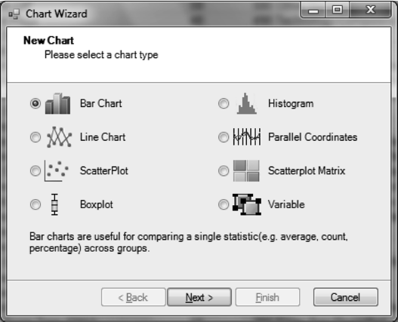
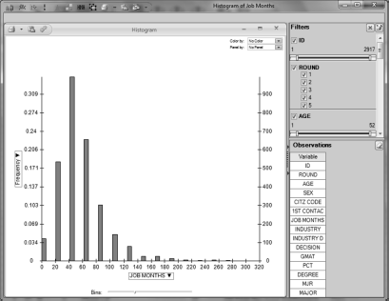
EXAMINE INDIVIDUAL VARIABLES AND THEIR DISTRIBUTION (CONT’D)
In XLMiner add-in, choose Explore►Chart Wizard, and the screen at top right appears.
In subsequent windows choose Frequency for Y axis, JOB MONTHS for X axis, and the histogram at bottom right appears.
Chapter 5
Copyright © 2013 John Wiley & Sons, Inc.

Slide 17
CALCULATE SUMMARY MEASURES FOR INDIVIDUAL VARIABLES (CONT’D)
Excel provides numerous functions useful for investigating individual variables.
Some can summarize the values of numerical variables; others can be used to identify or count specific variables, both numerical and categorical.
Example: What is the average age in the Applicants database?
Chapter 5
Copyright © 2013 John Wiley & Sons, Inc.

Slide 18
CALCULATE SUMMARY MEASURES FOR INDIVIDUAL VARIABLES
The most common summary measure of a numerical value is average or mean.
Calculate using the AVERAGE function in Excel, for example:
AVERAGE (C2:C2918) = 28.97
Other useful summary measures are median, minimum, maximum.
Chapter 5
Copyright © 2013 John Wiley & Sons, Inc.

Slide 19
EXAMINE RELATIONSHIPS AMONG VARIABLES
In many cases relationships among variables are more important in analysis than the properties of one variable.
Graphical methods can track relationships.
Example: How long have older applicants held their current jobs?
Chapter 5
Copyright © 2013 John Wiley & Sons, Inc.

Slide 20
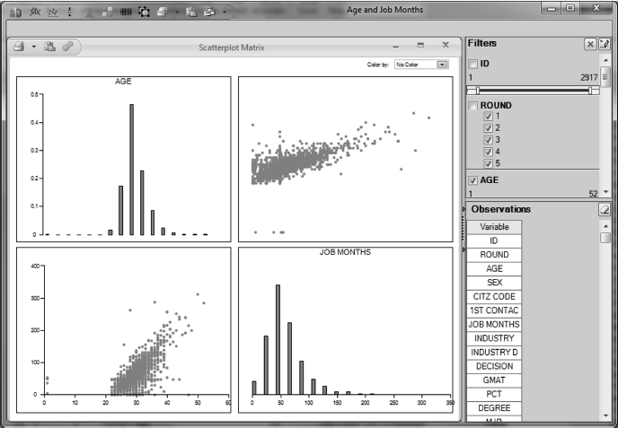
EXAMINE RELATIONSHIPS AMONG VARIABLES (CONT’D)
Use XLMiner to create a scatterplot between AGE and JOB MONTHS in the Applicants database.
Select Explore►Chart Wizard►Scatterplot Matrix.
Select variables AGE and JOB MONTHS, then click Finish for results at right.
Chapter 5
Copyright © 2013 John Wiley & Sons, Inc.

Slide 21
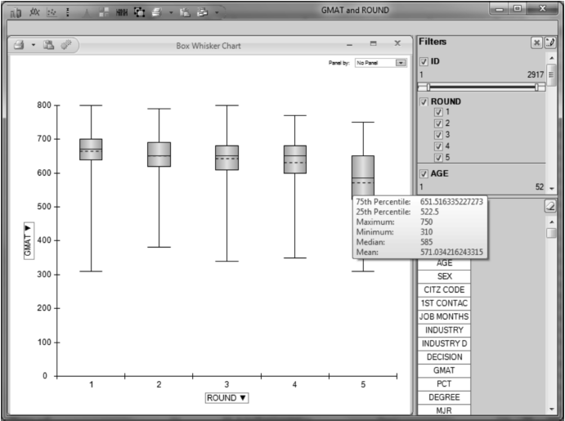
EXAMINE RELATIONSHIPS AMONG VARIABLES (CONT’D)
Relationships may be more complex, based on numerous variables.
  Example: How does the distribution of GMAT scores of applicants compare across the five application rounds?
This asks us to compare five distributions, each with considerable information.
Boxplot option in XLMiner can generate a chart summarizing numerous statistics (e.g., mean, median).
Select Explore►Chart Wizard►Boxplot select variables GMAT and ROUND, click Finish.
Chapter 5
Copyright © 2013 John Wiley & Sons, Inc.

Slide 22
SUMMARY
The ability to use data intelligently is a vital skill for business analysts.
Analysts tend to perform most of their analysis in Excel.
Understanding the data is the most important step, before undertaking any analysis.
Careful preparation of raw data is often required before data mining can succeed.
  Missing values may have to be removed or replaced with average values.
  Numerical variables may need to be converted to categorical values (or vice versa).
  Normalization of data may be required.
Chapter 5
Copyright © 2013 John Wiley & Sons, Inc.

Slide 23
COPYRIGHT © 2013 JOHN WILEY & SONS, INC.
All rights reserved. Reproduction or translation of this work beyond that permitted in section 117 of the 1976 United States Copyright Act without express permission of the copyright owner is unlawful. Request for further information should be addressed to the Permissions Department, John Wiley & Sons, Inc. The purchaser may make back-up copies for his/her own use only and not for distribution or resale. The Publisher assumes no responsibility for errors, omissions, or damages caused by the use of these programs or from the use of the information herein.

