Slide 1
CHAPTER 6 POWERPOINT
CLASSIFICATION AND PREDICTION METHODS

Slide 2
INTRODUCTION
Analysts engage in three types of tasks: 1) descriptive, 2) predictive and 3) prescriptive.
Predictive methods include:
  Classification, to predict which class an individual record will occupy (e.g., will a particular customer buy?)
  Prediction, to predict a numerical outcome for an individual record (e.g., how much will that customer spend?)
Now that data is plentiful, data mining enables more accurate prediction.
Chapter 6
Copyright © 2013 John Wiley & Sons, Inc.

Slide 3
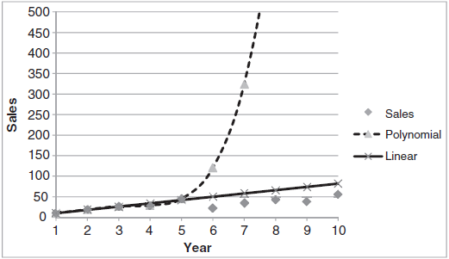
THE PROBLEM OF OVER-FITTING
Data includes both patterns (stable, underlying relationships) and noise (transient, random effects).
Noise has no predictive value; so a model is over-fit when it incorporates noise.
The figure below right shows results from two predictive models—polynomial and linear—applied to the same data set.
The polynomial model predicts sales almost 50 times the actual value, where the linear model is far more realistic (and accurate).
Be skeptical of data and skeptical of results.
Chapter 6
Copyright © 2013 John Wiley & Sons, Inc.

Slide 4
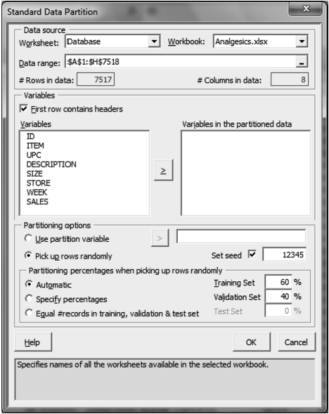
PARTITIONING THE DATABASE
Partitioning overcomes over-fitting; involves developing a model on one portion of data, testing it on another
  Training partition is used to develop the model
  Validation partition used to assess how well the model works on new data
XLMiner provides several partitioning utilities
  Data Mining►Partition►Standard Partition
Chapter 6
Copyright © 2013 John Wiley & Sons, Inc.

Slide 5
PERFORMANCE MEASURES
The ultimate goal of data analysis is to predict the future.
To classify new instances (e.g., whether a registered voter will vote)
  We measure predictive accuracy by instances correctly classified
For numerical predictions (e.g., number of votes received by the winner in each state)
  Accuracy measured by differences between predicted and actual outcomes
Chapter 6
Copyright © 2013 John Wiley & Sons, Inc.

Slide 6
SIX WIDELY-USED CLASSIFICATION/PREDICTION METHODS
k-Nearest Neighbor
Naïve Bayes
Classification and Prediction Trees
Multiple Linear Regression
Logistic Regression
Neural Networks
Chapter 6
Copyright © 2013 John Wiley & Sons, Inc.

Slide 7
GENERAL CAVEAT
No one model is perfect, universally applicable
Data mining analysts will typically build several competing models (e.g., multiple linear regression, k-Nearest Neighbor, Prediction Trees and Neural Networks) and implement the one that proves most effective.
Chapter 6
Copyright © 2013 John Wiley & Sons, Inc.

Slide 8
THE K-NEAREST NEIGHBOR METHOD
Bases classification of a new case on records most similar to the new case
  E.g., by Pandora’s Music Genome Project to identify songs that appeal to a user
Answers three major questions:
  How to define similarity between records?
  How many neighboring records to use?
  What classification or prediction rule to use?
Chapter 6
Copyright © 2013 John Wiley & Sons, Inc.

Slide 9
STRENGTHS AND WEAKNESSES OF THE K-NEAREST NEIGHBOR ALGORITHM
Strengths:
  Simplicity. Requires no assumptions as to the form of the model, few assumptions about parameters.
  Only one parameter estimated (k)
  Performs well where there is a large training database, or many combinations of predictor variables
Weaknesses:
  Provides no information on which predictors are most effective in making a good classification
  Long computational times; number of records required increases faster than linearly
Chapter 6
Copyright © 2013 John Wiley & Sons, Inc.

Slide 10
THE NAÏVE BAYES METHOD
Similar to k-Nearest Neighborhood but, restricted to situations in which all predictor variables are categorical
Example: Spam filtering, based on categorical values Word Appeared and Word did not Appear.
Chapter 6
Copyright © 2013 John Wiley & Sons, Inc.

Slide 11
STRENGTHS AND WEAKNESSES OF THE NAÏVE BAYES ALGORITHM
Strengths:
  Remarkably simple, but often gives classification accuracy as good as or better than more sophisticated algorithms
  Requires no assumptions other than class-conditional independence
Weaknesses:
  Requires large number of records for good results
  Estimates a probability of zero for new cases with a predictor value missing from the training database
  Suitable only for classification, not for estimating class probabilities
Chapter 6
Copyright © 2013 John Wiley & Sons, Inc.

Slide 12
CLASSIFICATION AND PREDICTION TREES
Based on the observation that there are subsets of records in a database that contain mostly 1s or 0s
Identify the subsets, and we can classify a new record based on majority outcome in the subset it most resembles
Example: Predict purchasing behavior of individuals for whom we know three variables, being age, income and education
Chapter 6
Copyright © 2013 John Wiley & Sons, Inc.

Slide 13
CLASSIFICATION AND PREDICTION TREES (CONT’D)
First describe the approach for classification (with numerical predictors) then how to use predictor variables for classification, as follows:
  Pick a predictor variable.
  Sort its values from low to high.
  Define a set of split points as midpoints between each pair of values.
  For each split point, divide records into above/below split.
  Evaluate homogeneity of records in each subset (extent to which records are mostly 1s or 0s)
  Repeat for all split points for this variable
  Choose split point that gives most homogeneous subsets
  Repeat for all variables
  Split on the variable with highest homogeneity
  Repeat for each subset of records
Chapter 6
Copyright © 2013 John Wiley & Sons, Inc.

Slide 14
STRENGTHS AND WEAKNESSES OF CLASSIFICATION AND PREDICTION TREES
Strengths:
  Easy to understand and explain
  Transparent results, can be interpreted as explicit If-Then rules
  Based on few assumptions, works well even with missing data and outliers
Weaknesses:
  Accurate results require very large databases
  Allows partitioning of only individual variables, not pairs or groups
  Specific to XLMiner: only binary categorical variables allowed.
Chapter 6
Copyright © 2013 John Wiley & Sons, Inc.

Slide 15
MULTIPLE LINEAR REGRESSION
One of the most widely-used tools from classical statistics
Used widely in natural and social sciences, more often for explanatory than predictive modeling
  To determine if specific variables influence outcome variable
Answers questions like:
  Do the data support the claim that women are paid less than men in comparable jobs?
  Is there evidence that price discounts and rebates lead to higher long-term sales?
  Do data support the idea that firms that outsource manufacturing overseas have higher profits?
Chapter 6
Copyright © 2013 John Wiley & Sons, Inc.

Slide 16
STRENGTHS AND WEAKNESSES OF MULTIPLE LINEAR REGRESSION
Strengths:
  Well-known and well-accepted model for prediction
  Easy to implement and interpret
  Inferential statistics (p-values and R²) are available
Weaknesses:
  Possible for regression model to exhibit high R² but low predictive accuracy
Chapter 6
Copyright © 2013 John Wiley & Sons, Inc.

Slide 17
LOGISTIC REGRESSION
A statistical approach to classification of categorical outcome variables
Similar to multiple linear regression, but can be used when the outcome has more than two values
Uses data to produce a probability that a given case will fall into one of two classes (e.g., flights that leave on time/delayed, companies that will/will not default on bonds, employees who will/will not be promoted)
Chapter 6
Copyright © 2013 John Wiley & Sons, Inc.

Slide 18
STRENGTHS AND WEAKNESSES OF LOGISTIC REGRESSION
Strengths:
  Well-known, widely used, especially in marketing
  Easy to implement and fairly straightforward
Weaknesses:
  A facility with concept of odds often necessary
  If a large number of predictor values, then often necessary to reduce them to most important through pre-processing, inferential statistics, best subset selection
Chapter 6
Copyright © 2013 John Wiley & Sons, Inc.

Slide 19
NEURAL NETWORKS
An outgrowth of research within artificial intelligence into how the brain works
Used for classification and prediction
Applied to extremely wide variety of areas (e.g., from financial applications to controlling robots)
In finance:
  To predict bankruptcy of firms
  To trade on currency, stock or bond markets
  To predict credit card fraud
Complex and difficult to understand but high predictive accuracy
Chapter 6
Copyright © 2013 John Wiley & Sons, Inc.

Slide 20
STRENGTHS AND WEAKNESSES OF NEURAL NETWORKS
Strengths:
  Highly successful in many applications (thought unsuccessful in many more)
  Very flexible because the fundamental structure (the number of hidden layers and nodes) is chosen by the user
  Capture complex relationships between inputs and outputs
Weaknesses:
  Difficult to interpret, thus hard to justify
  Limited insight into underlying relationships
  Requires modeler to carefully pre-process predictor variables, experiment with different sets of predictors
Chapter 6
Copyright © 2013 John Wiley & Sons, Inc.

Slide 21
SUMMARY
Classification methods apply when the task is to predict which class an individual record may occupy (e.g., whether a customer will buy a certain product).
Prediction methods apply when the task is to predict a numerical outcome (e.g., how much a customer will buy).
It is quite common for analysts to construct models using competing of the six methods, then select the most effective.
Chapter 6
Copyright © 2013 John Wiley & Sons, Inc.

Slide 22
COPYRIGHT © 2013 JOHN WILEY & SONS, INC.
All rights reserved. Reproduction or translation of this work beyond that permitted in section 117 of the 1976 United States Copyright Act without express permission of the copyright owner is unlawful. Request for further information should be addressed to the Permissions Department, John Wiley & Sons, Inc. The purchaser may make back-up copies for his/her own use only and not for distribution or resale. The Publisher assumes no responsibility for errors, omissions, or damages caused by the use of these programs or from the use of the information herein.

