Slide 1
CHAPTER 7 POWERPOINT
TIME SERIES FORECASTING

Slide 2
INTRODUCTION
Regression analysis useful in short-term forecasting, but flawed
A better approach: base the forecast of a variable on its own history
  Avoids need to specify a causal relationship and to predict the values of explanatory variables
Our focus in this chapter is on time series methods for forecasting.
Chapter 7
Copyright © 2013 John Wiley & Sons, Inc.

Slide 3
FORECASTING WITH TIME-SERIES MODELS
Two important features:
  Uses historical data for the phenomenon we wish to forecast.
  We seek a routine calculation to apply to a large number of cases and that may be automated, without relying on qualitative information about the underlying phenomena.
Short-term forecasts are often used in situations that involve forecasting many different variables at frequent intervals.
Chapter 7
Copyright © 2013 John Wiley & Sons, Inc.

Slide 4
AN HYPOTHESIZED MODEL
The major components of such a model are usually the following:
  A base level
  A trend
  Cyclic fluctuations
Chapter 7
Copyright © 2013 John Wiley & Sons, Inc.

Slide 5
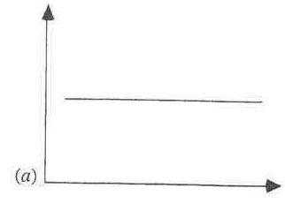
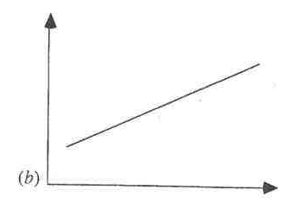
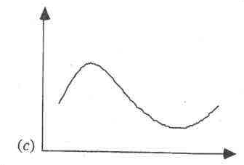
THREE COMPONENTS OF TIME SERIES BEHAVIOR
Chapter 7
Copyright © 2013 John Wiley & Sons, Inc.

Slide 6
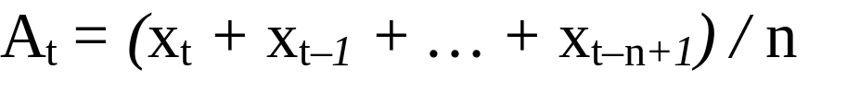
THE MOVING-AVERAGE MODEL
The n-period moving average builds a forecast by averaging the observations in the most recent n periods:
where x_{t} represents the observation made in period t, and A_{t} denotes the moving average calculated after making the observation in period t.
Chapter 7
Copyright © 2013 John Wiley & Sons, Inc.

Slide 7
CONVENTION
We adopt the following convention for the steps in forecasting:
  Make the observation in period t
  Carry out the necessary calculations
  Use the calculations to forecast period (t + 1)
Chapter 7
Copyright © 2013 John Wiley & Sons, Inc.

Slide 8
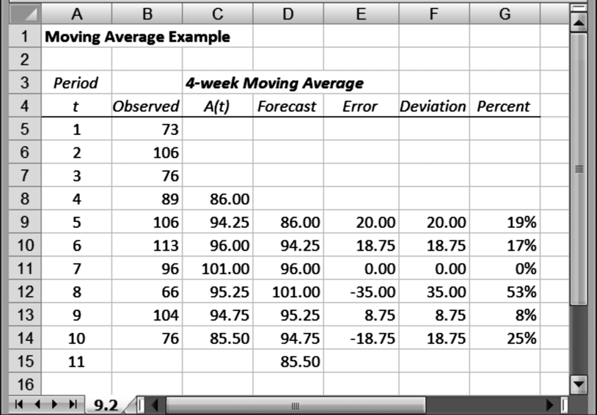
WORKSHEET FOR CALCULATING MOVING AVERAGES
Chapter 7
Copyright © 2013 John Wiley & Sons, Inc.

Slide 9
WHAT NUMBER OF PERIODS TO INCLUDE IN MOVING AVERAGE?
There is no definitive answer, but there is a trade-off to consider.
Suppose the mean of the underlying process remains stable:
If we include very few data points, then the moving average exhibits more variability than if we include a larger number of data points. In that sense, we get more stability from including more points.
Suppose there is an unanticipated change in the mean of the underlying process:
If we include very few data points, our moving average will tend to track the changed process more closely than if we include a larger number of data points. In that case, we get more responsiveness from including fewer points.
Chapter 7
Copyright © 2013 John Wiley & Sons, Inc.

Slide 10
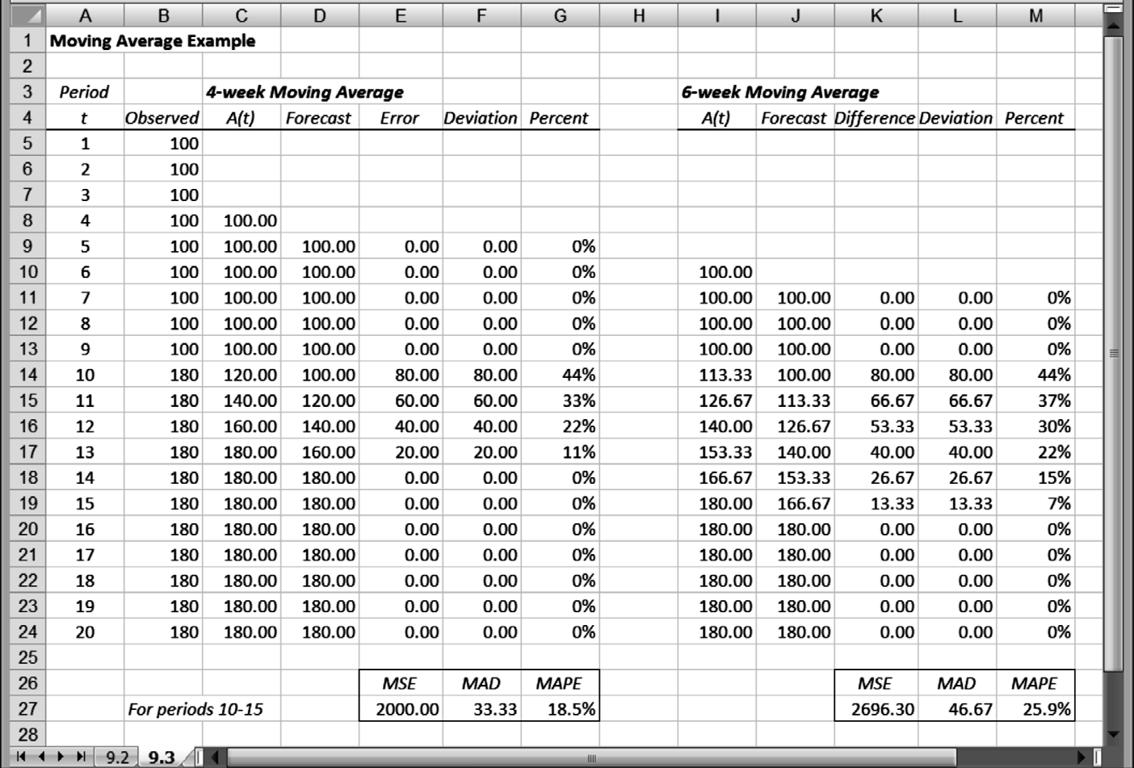
MOVING-AVERAGE CALCULATIONS IN A STYLIZED EXAMPLE
Chapter 7
Copyright © 2013 John Wiley & Sons, Inc.

Slide 11
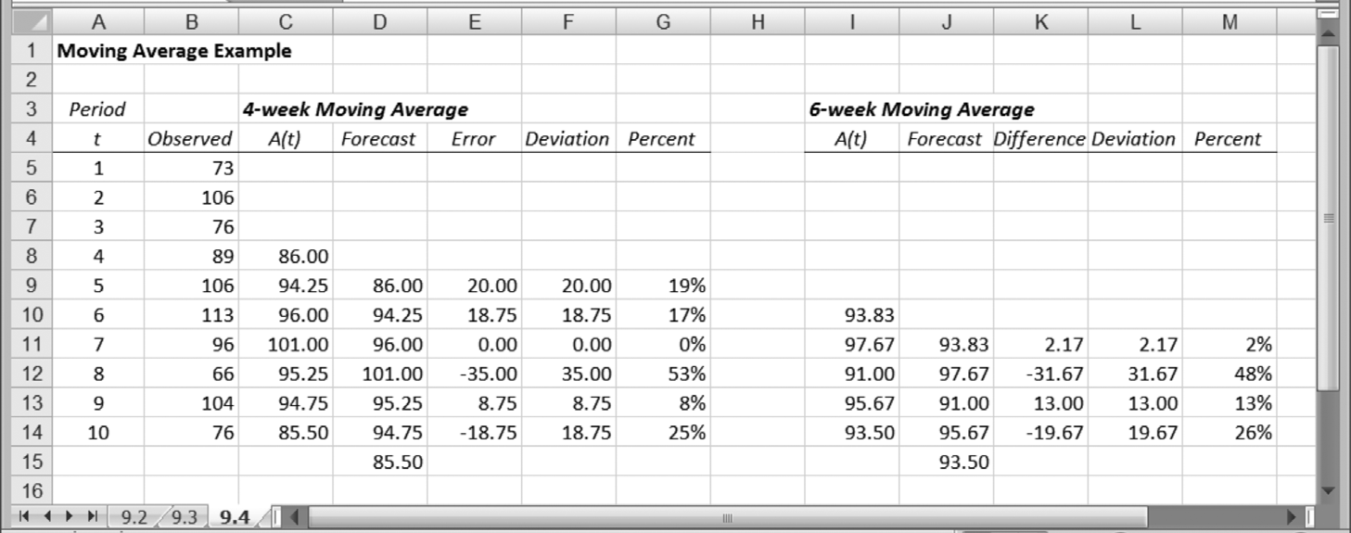
COMPARISON OF 4-WEEK AND 6-WEEK MOVING AVERAGES
Chapter 7
Copyright © 2013 John Wiley & Sons, Inc.

Slide 12
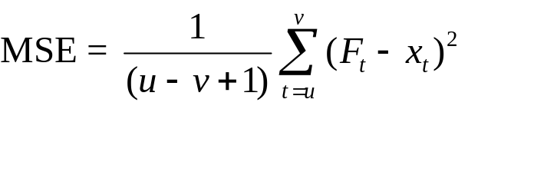
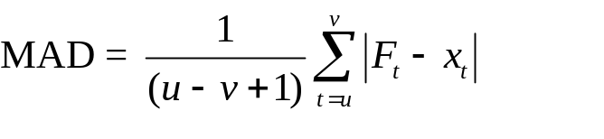
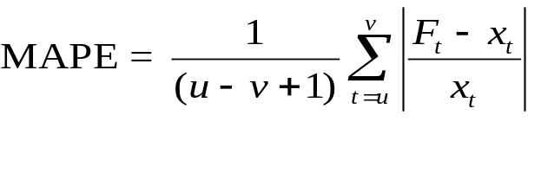
MEASURES OF FORECAST ACCURACY
MSE: the Mean Squared Error between forecast and actual
MAD: the Mean Absolute Deviation between forecast and actual
MAPE: the Mean Absolute Percent Error between forecast and actual
Chapter 7
Copyright © 2013 John Wiley & Sons, Inc.

Slide 13
COMPARISON OF MEASURES OF FORECAST ACCURACY
The MAD calculation and the MAPE calculation are similar: one is absolute, the other is relative.
MAPE is usually reserved for comparisons in which the magnitudes of two cases are different.
Chapter 7
Copyright © 2013 John Wiley & Sons, Inc.

Slide 14
EXCEL TIP: MOVING AVERAGE CALCULATIONS
Excel’s Data Analysis tool (Data►Analysis►Data Analysis►Moving Average) contains an option for calculating moving averages.
Excel assumes that the data appear in a single column, and the tool provides an option of recognizing a title for this column, if it is included in the data range.
Other options include a graphical display of the actual and forecast data and a calculation of the standard error after each forecast.
Chapter 7
Copyright © 2013 John Wiley & Sons, Inc.

Slide 15

THE EXPONENTIAL SMOOTHING MODEL
Exponential smoothing weighs recent observations more than older ones.
Where α (the smoothing constant) is some number between zero and one.
S_{t} is the smoothed value of the observations (our “best guess” as to the value of the mean)
Our forecasting procedure sets the forecast F_{t+1} = S_{t}.
Chapter 7
Copyright © 2013 John Wiley & Sons, Inc.

Slide 16
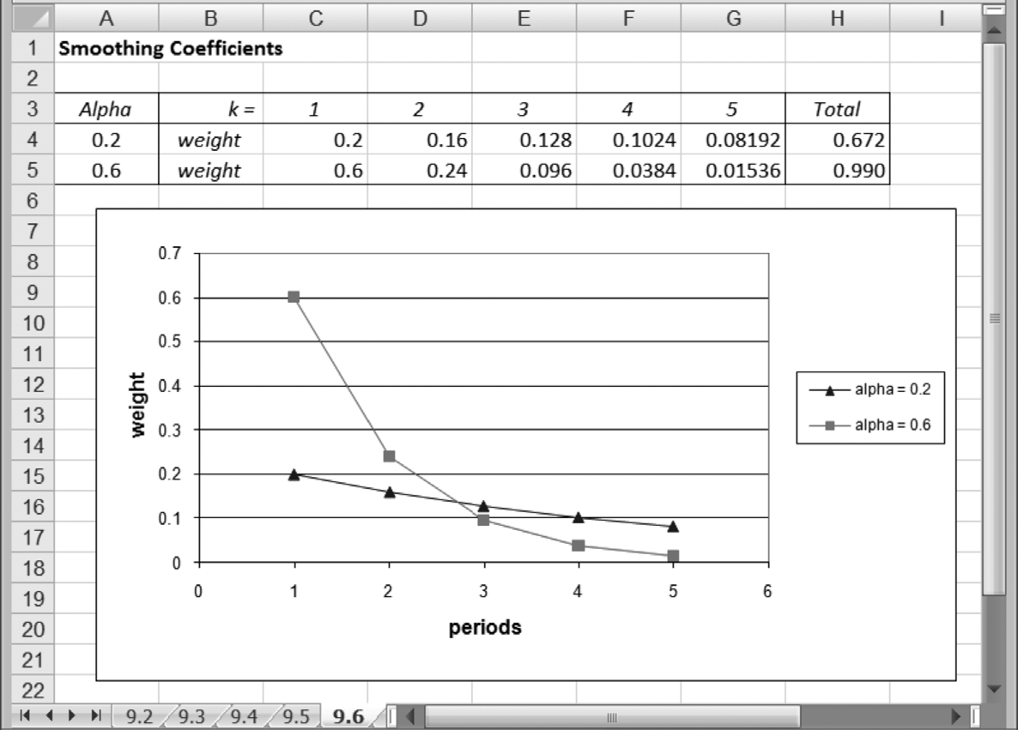
COMPARISON OF WEIGHTS PLACED ON K-YEAR-OLD DATA
Chapter 7
Copyright © 2013 John Wiley & Sons, Inc.

Slide 17
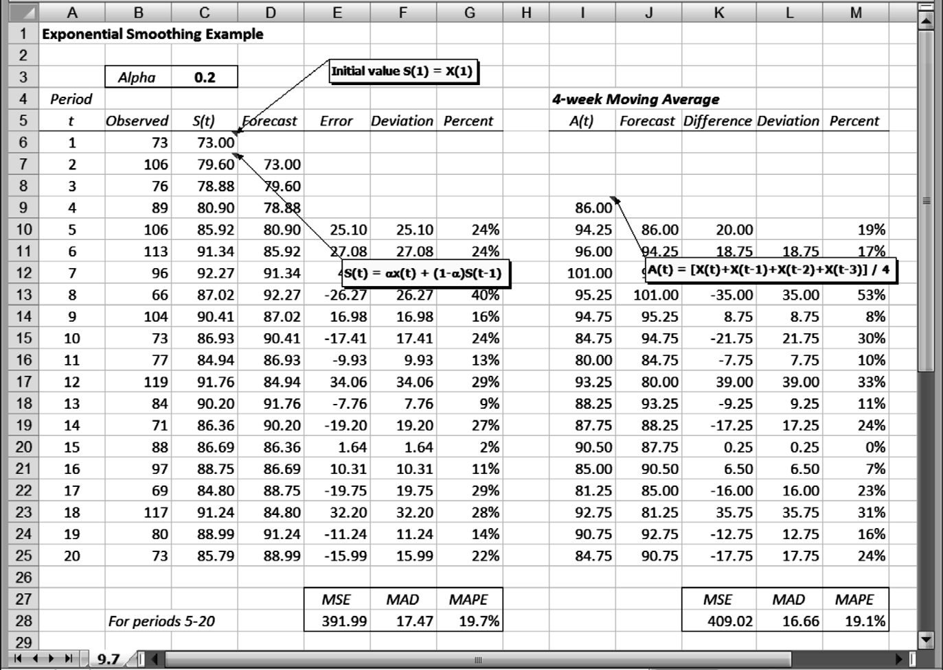
WORKSHEET FOR EXPONENTIAL SMOOTHING CALCULATIONS
Chapter 7
Copyright © 2013 John Wiley & Sons, Inc.

Slide 18
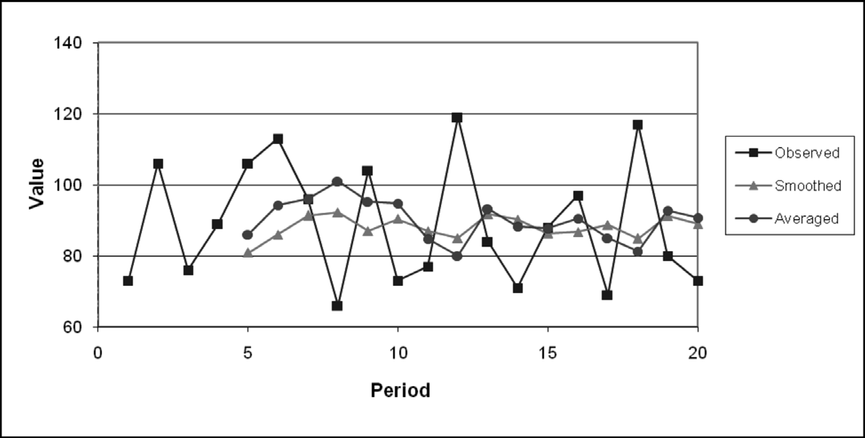
COMPARISON OF SMOOTHED AND AVERAGED FORECASTS
Chapter 7
Copyright © 2013 John Wiley & Sons, Inc.

Slide 19
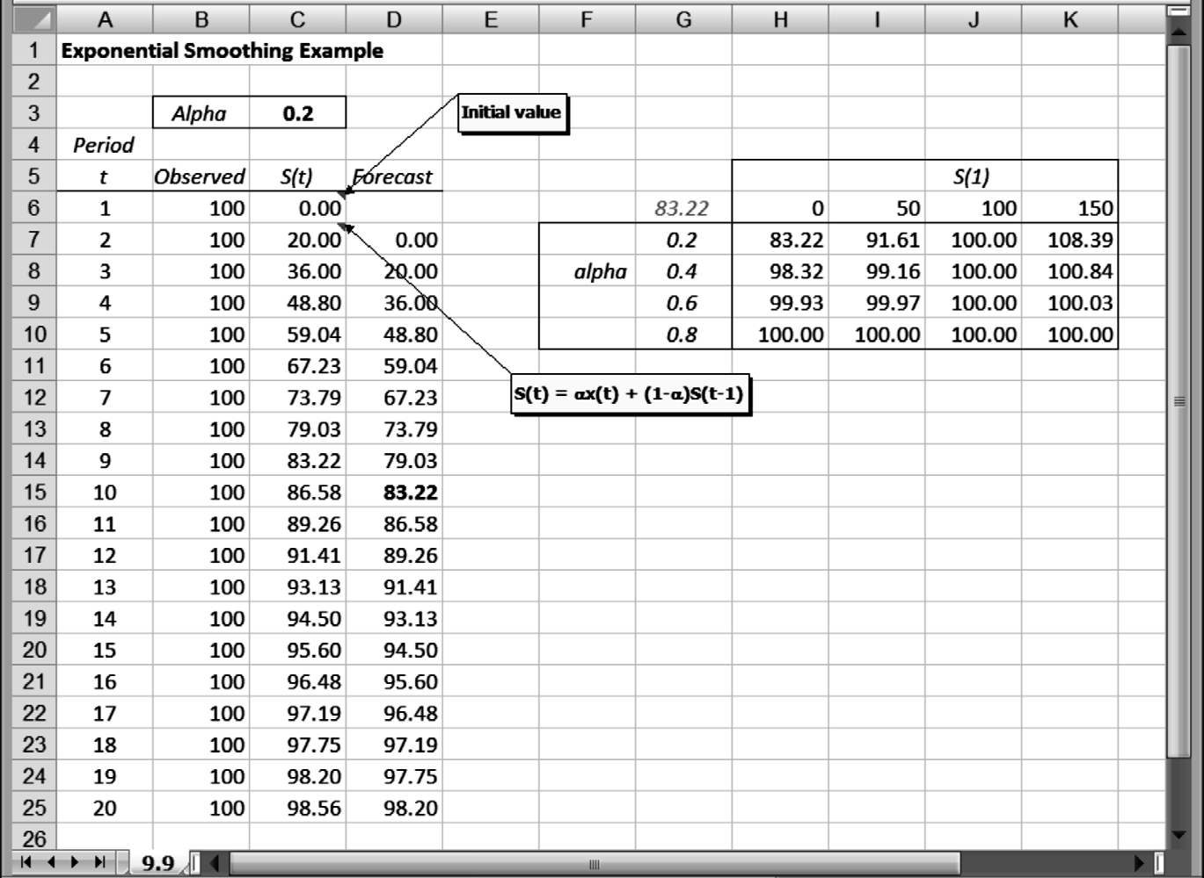
EXPONENTIAL SMOOTHING CALCULATIONS IN A STYLIZED EXAMPLE
Chapter 7
Copyright © 2013 John Wiley & Sons, Inc.

Slide 20
EXCEL TIP: IMPLEMENTING EXPONENTIAL SMOOTHING
Excel’s Data Analysis tool contains an option for calculating forecasts using exponential smoothing.
The Exponential Smoothing module resembles the Moving Average module, but instead of asking for the number of periods, it asks for the damping factor, which is the complement of the smoothing factor, or (1 – α).
Options exist for chart output and for a calculation of the standard error.
Chapter 7
Copyright © 2013 John Wiley & Sons, Inc.

Slide 21
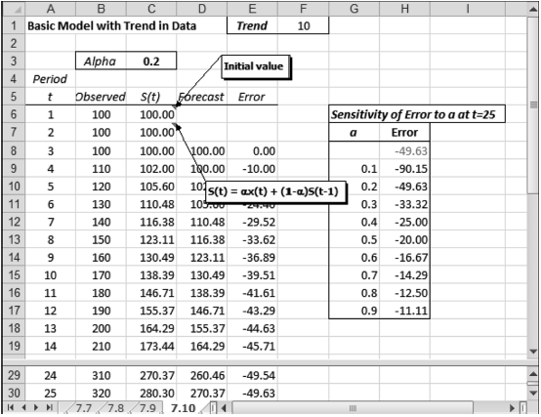
TREND MODEL CALCULATIONS WITH A TREND IN THE DATA
Chapter 7
Copyright © 2013 John Wiley & Sons, Inc.

Slide 22
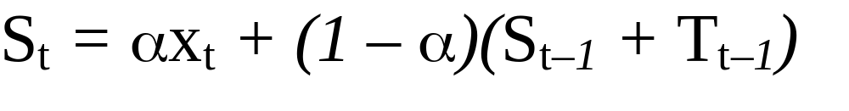
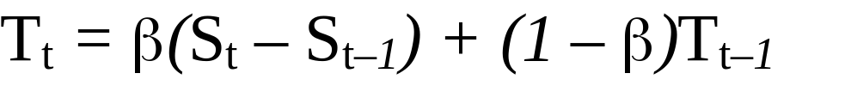
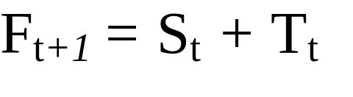
HOLT’S METHOD
This more flexible procedure uses two smoothing constants, as shown in the following formulas:
Chapter 7
Copyright © 2013 John Wiley & Sons, Inc.

Slide 23
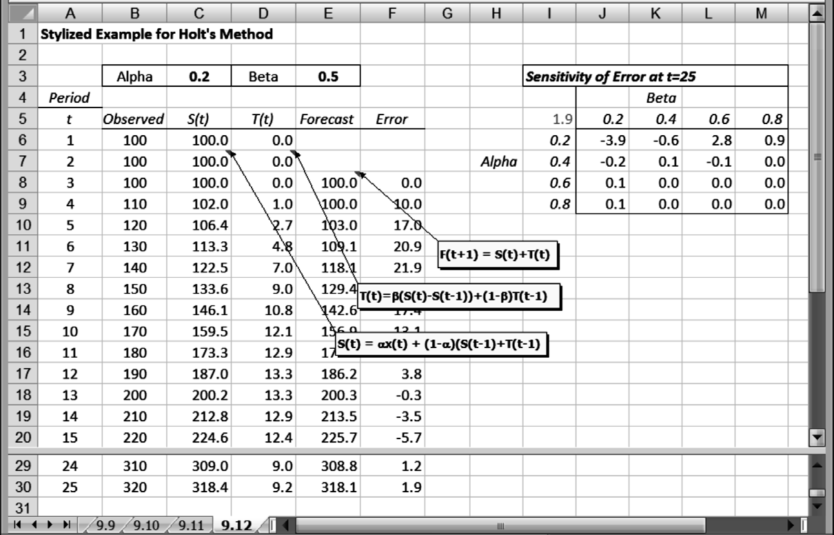
HOLT'S METHOD WITH A TREND IN THE DATA
Chapter 7
Copyright © 2013 John Wiley & Sons, Inc.

Slide 24
EXPONENTIAL SMOOTHING
WITH TREND AND CYCLICAL FACTORS
We can take the exponential smoothing model further and include a cyclical (or seasonal) factor.
For a cyclical effect, there are two types of models: an additive model and a multiplicative model.
See text for formulas.
Chapter 7
Copyright © 2013 John Wiley & Sons, Inc.

Slide 25
SUMMARY
Moving averages and exponential smoothing are widely used for routine short-term forecasting.
By making projections from past data, these methods assume that the future will resemble the past.
However, the exponential smoothing procedure is sophisticated enough to permit representations of a linear trend and a cyclical factor in its calculations.
Exponential smoothing procedures are adaptive.
Chapter 7
Copyright © 2013 John Wiley & Sons, Inc.

Slide 26
SUMMARY
Implementing an exponential smoothing procedure requires that initial values be specified and a smoothing factor be chosen.
The smoothing factor should be chosen to trade off stability and responsiveness in an appropriate manner.
Although Excel contains a Data Analysis tool for calculating moving-average forecasts and exponentially-smoothed forecasts, the tool does not accommodate the most powerful version of exponential smoothing, which includes trend and cyclical components.
Chapter 7
Copyright © 2013 John Wiley & Sons, Inc.

Slide 27
COPYRIGHT © 2013 JOHN WILEY & SONS, INC.
All rights reserved. Reproduction or translation of this work beyond that permitted in section 117 of the 1976 United States Copyright Act without express permission of the copyright owner is unlawful. Request for further information should be addressed to the Permissions Department, John Wiley & Sons, Inc. The purchaser may make back-up copies for his/her own use only and not for distribution or resale. The Publisher assumes no responsibility for errors, omissions, or damages caused by the use of these programs or from the use of the information herein.

