Slide 1
CHAPTER 8 POWERPOINT
NONLINEAR OPTIMIZATION

Slide 2
OPTIMIZATION
Find the best set of decisions for a particular measure of performance
Includes:
  The goal of finding the best set
  The algorithms (procedures) to accomplish this goal
Chapter 8
Copyright © 2013 John Wiley & Sons, Inc.

Slide 3
EXCEL OPTIMIZATION SOFTWARE
Solver
  Standard with Excel
Analytic Solver Platform
  Comes with text – install off text CD
  More advanced than standard solver
  Is preferred tool throughout text
Chapter 8
Copyright © 2013 John Wiley & Sons, Inc.

Slide 4
DECISION VARIABLES
Levers used to improve performance
Want to find the best values for the variables
Finding these best values can be challenging
  Need Solver’s sophisticated software
  Still relatively easy to construct models beyond Solver’s capabilities
Chapter 8
Copyright © 2013 John Wiley & Sons, Inc.

Slide 5
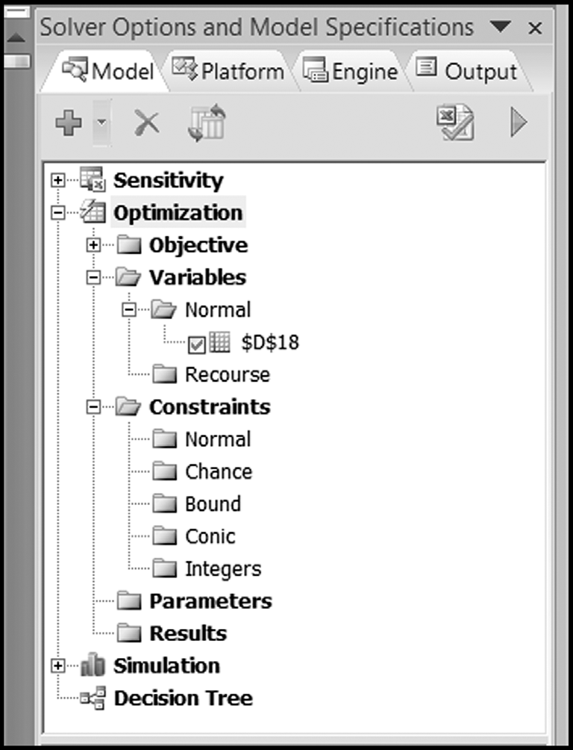
SOLVER WINDOW
Chapter 8
Copyright © 2013 John Wiley & Sons, Inc.

Slide 6
FORMULATION
Decision variables
  What must be decided? Be explicit with units
Objective function
  What measure compares decision variables?
  Use only one measure (as a “yardstick”) – put in target cell
Constraints
  What restrictions limit our choice of decision variables?
Chapter 8
Copyright © 2013 John Wiley & Sons, Inc.

Slide 7
CONSTRAINTS
Left-hand-side (LHS)
  Usually a function
Right-hand-side (RHS)
  Usually a number (i.e., a parameter)
Three types of constraints
  LHS <= RHS (less-than [LT] constraint)
  LHS >= RHS (Greater than [GT] constraint)
  LHS = RHS (Equality [EQ] constraint)
Chapter 8
Copyright © 2013 John Wiley & Sons, Inc.

Slide 8
TYPES OF CONSTRAINTS
LT constraints (LHS<RHS)
  Capacities or ceilings
GT constraints (LHS>RHS)
  Commitments or thresholds
EQ constraints (LHS=RHS)
  Material balance
  Define related variables consistently
Chapter 8
Copyright © 2013 John Wiley & Sons, Inc.

Slide 9
LAYOUT
Standard model template is advisable
Enhances ability to communicate
  Provides common language
  Reinforces understanding how models shaped
Improves ability to spot modeling errors
Enables “scaling up” more easily
Chapter 8
Copyright © 2013 John Wiley & Sons, Inc.

Slide 10
LAYOUT
Organize worksheet in modules
  Decision variables, objective function, constraints
Place decision variables in single row (or column)
Use color or border highlighting
Place objective in single highlighted cell
Arrange constraints for visual comparison of LHS and RHS
Chapter 8
Copyright © 2013 John Wiley & Sons, Inc.

Slide 11
SOLVER TIP: RANGES FOR DECISION VARIABLES
Arrange worksheet with all decision variables in adjacent cells
  Enables a single reference to their range
  Makes data entry efficient
  Reduces clutter in Solver interface
  Makes task pane description easier to interpret
Chapter 8
Copyright © 2013 John Wiley & Sons, Inc.

Slide 12
INTERPRETING RESULTS
Optimal values of decision variables
  Best course of action for the model
Optimal value of objective function
  Best level of performance possible
Constraint outcomes
  Constraint is tight or binding if LHS=RHS in LT or GT constraint
  Throughout optimization, generally only some constraints are binding
Chapter 8
Copyright © 2013 John Wiley & Sons, Inc.

Slide 13
INTERPRETING RESULTS: OPTIMIZATION SOLUTION
Tactical information
  Plan for decision variables
Strategic information
  What factors could lead to better levels of performance?
  Binding constraints are economic factors that restrict the value of the objective.
Chapter 8
Copyright © 2013 John Wiley & Sons, Inc.

Slide 14
MODEL CLASSIFICATION AND THE NONLINEAR SOLVER
Linear optimization or linear programming
  Objective and all constraints are linear functions of the decision variables
Nonlinear optimization or nonlinear programming
  Either objective or a constraint (or both) are nonlinear functions of the decision variables
Techniques for solving linear models are more powerful
  Use wherever possible
Chapter 8
Copyright © 2013 John Wiley & Sons, Inc.

Slide 15
“HILL CLIMBING”
Technique used by Solver for nonlinear optimization
Called LSGRG (Large-Scale Generalized Reduced Gradient) algorithm
Hill climbing in a fog
  Try to follow steepest path going up
  After each step, or group of steps, again find steepest path and follow it
  Stop if no path leads up
Chapter 8
Copyright © 2013 John Wiley & Sons, Inc.

Slide 16
LOCAL AND GLOBAL OPTIMUM
The highest peak is the global optimum.
  What we want to find
Any peak higher than all points around it is a local optimum.
  What the LSGRG algorithm locates
  Except in special circumstances, there is no way to guarantee that a local optimum is the global optimum.
  If multiple local optima, then which is found depends on starting point for decision variables – may want to run Solver starting from multiple points
Chapter 8
Copyright © 2013 John Wiley & Sons, Inc.

Slide 17
PROGRAMMING EXAMPLES
Facility location
Revenue maximization
  Maximize revenue in the presence of a demand curve
Curve fitting
  Fit a function to observed data points
Economic Order Quantity
  Trade-off ordering and carrying costs for inventory
Chapter 8
Copyright © 2013 John Wiley & Sons, Inc.

Slide 18
SOLVER TIP: SOLUTIONS FROM THE LSGRG ALGORITHM
When the GRG algorithm concludes with the convergence message, “Solver has converged to the current solution, all constraints are satisfied”, the algorithm should be rerun from the stopping point.
This message may then reappear, in which case Solver should be rerun once more.
Eventually, the algorithm should conclude with the optimality message, “Solver found a solution, all constraints and optimality conditions are satisfied”, which signifies that it has found a local optimum.
To help determine whether the local optimum is also a global optimum, Solver should be restarted at a different set of decision variables and rerun.
If several widely differing starting solutions lead to the same local optimum, that is some evidence that the local optimum is likely to be a global optimum, but in general there is no way to know for sure.
Chapter 8
Copyright © 2013 John Wiley & Sons, Inc.

Slide 19
SOLVER TIP: AVOID DISCONTINUOUS FUNCTIONS
A number of functions familiar to experienced Excel programmers should be avoided when using the nonlinear solver.
These include:
  Logical functions (e.g., IF or AND)
  Mathematical functions (e.g., ROUND or CEILING)
  Lookup and reference functions (e.g., CHOOSE or VLOOKUP)
  Statistical functions (e.g., RANK or COUNT).
In general, avoid using any function that changes discontinuously.
Chapter 8
Copyright © 2013 John Wiley & Sons, Inc.

Slide 20
SENSITIVITY ANALYSIS FOR NONLINEAR PROGRAMS
Tests our initial assumptions to see what impact they have on our conclusions.
Analysis of one or two variables can lead to optimal values of those variables.
  E.g., using the Parametric Sensitivity tool.
Solver tool for larger numbers of variables and constraints
Chapter 8
Copyright © 2013 John Wiley & Sons, Inc.

Slide 21
SOLVER TIP: WHAT KIND OF SENSITIVITY ANALYSIS?
Easy to confuse parametric sensitivity with optimization sensitivity, which answer different questions:
  Optimization sensitivity determines how the optimal solution changes with a change in parameter.
  Parametric sensitivity answers how specific outputs change with parameters.
The Solver tool can answer questions about how specific outputs change with a change in one or two parameters.
Chapter 8
Copyright © 2013 John Wiley & Sons, Inc.

Slide 22
THE PORTFOLIO OPTIMIZATION MODEL
The performance of a portfolio of stocks is measured in terms of return and risk.
When we create a portfolio of stocks, our goals are usually to maximize the mean return and to minimize the risk.
Both goals cannot be met simultaneously, but we can use optimization to explore the trade-offs involved.
Chapter 8
Copyright © 2013 John Wiley & Sons, Inc.

Slide 23
*EXCEL MINI-LESSON: THE COVAR FUNCTION
The COVAR function in Excel calculates the covariance between two equal-sized sets of numbers representing observations of two variables.
The covariance measures the extent to which one variable tends to rise or fall with increases and decreases in the other variable.
  If the two variables rise and fall in unison, their covariance is large and positive.
  If the two variables move in opposite directions, then their covariance is negative.
  If the two variables move independently, then their covariance is close to zero.
Chapter 8
Copyright © 2013 John Wiley & Sons, Inc.

Slide 24
SUMMARY
Optimization: Answers “What values of the decision variables lead to the best possible value of the objective?”
Excel Solver: Collection of optimization procedures
  Nonlinear Solver is Solver’s default choice
Steps: 1) formulating, 2) solving, and 3) interpreting optimization problems.
Chapter 8
Copyright © 2013 John Wiley & Sons, Inc.

Slide 25
SUMMARY
These guidelines for model builders are the craft skills typically exhibited by experts:
  Follow a standard form whenever possible.
  Enter cell references in the Solver windows; keep numerical values in cells.
  Try out some feasible (and infeasible) possibilities as a way of debugging the model and exploring the problem.
  Test intuition and suggest hypotheses before running Solver.
Chapter 8
Copyright © 2013 John Wiley & Sons, Inc.

Slide 26
COPYRIGHT © 2013 JOHN WILEY & SONS, INC.
All rights reserved. Reproduction or translation of this work beyond that permitted in section 117 of the 1976 United States Copyright Act without express permission of the copyright owner is unlawful. Request for further information should be addressed to the Permissions Department, John Wiley & Sons, Inc. The purchaser may make back-up copies for his/her own use only and not for distribution or resale. The Publisher assumes no responsibility for errors, omissions, or damages caused by the use of these programs or from the use of the information herein.
10 - <number>

